Slide 1

Agency Updates on LSI & ARD – USGS
Steve Labahn, USGS
LSI-VC-12
8 September 2022

Slide 2
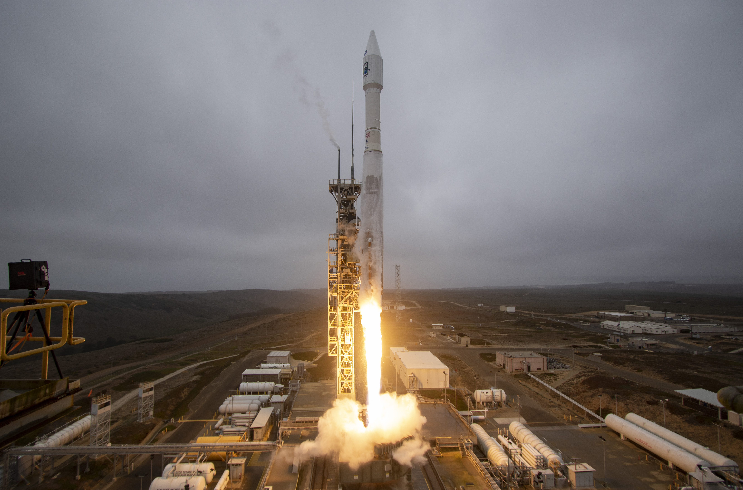
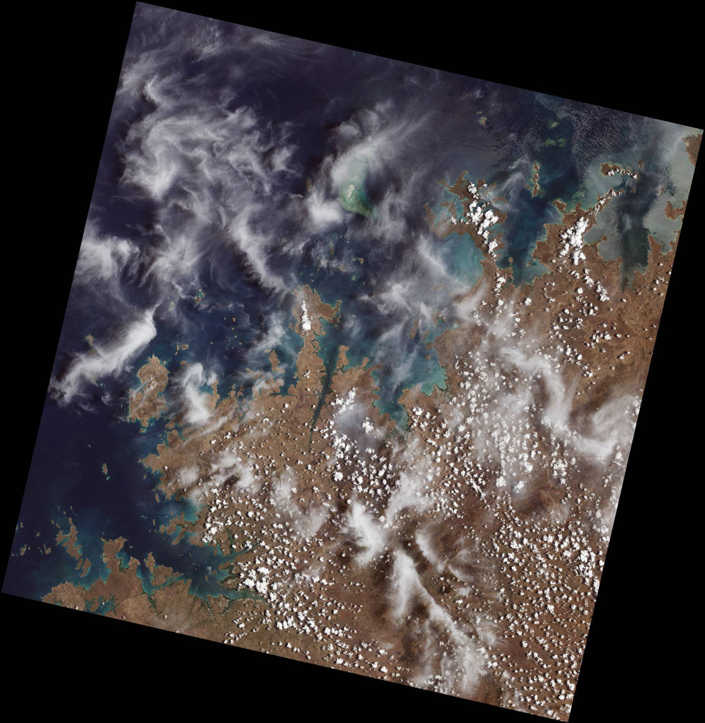
Landsat 9 Launch
Launched from Vandenberg SFB on 27 September 2021
Landsat 9 “First Light” image of an area along the northwest coast of Australia

Slide 3
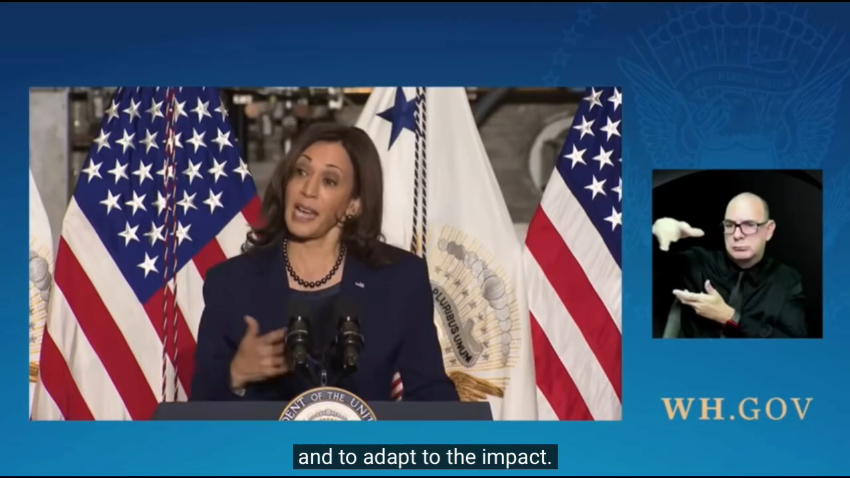
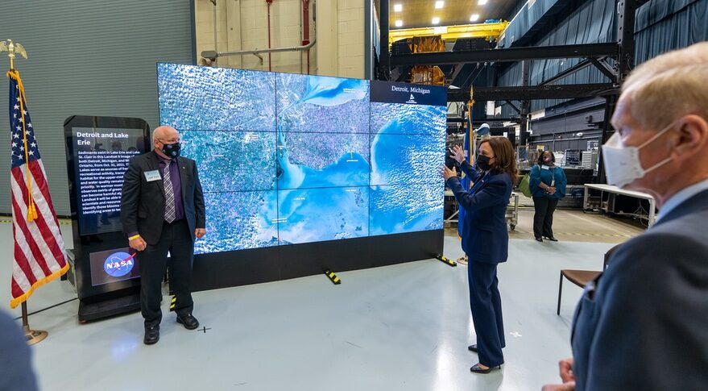
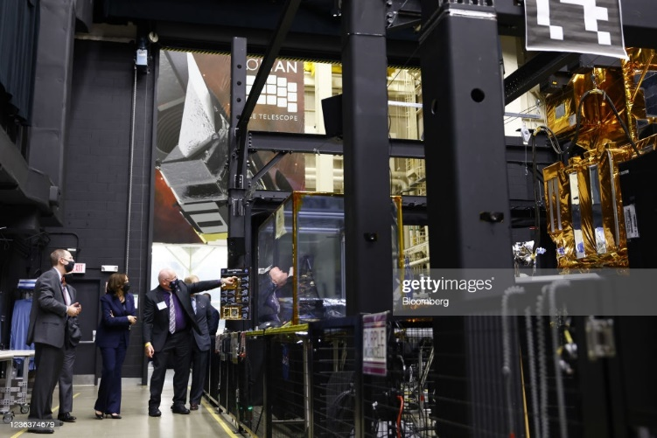
Vice President Harris Visits NASA GSFC
5 November 2021
NASA Goddard Director Andruczyk discussing first Landsat 9 images with VP Harris (view of SE Michigan, NW Ohio, W Lake Erie, and S Lake St Clair)
VP Harris with USGS Director Applegate Viewing OSAM-1 demonstration with Landsat 7 mockup

Slide 4


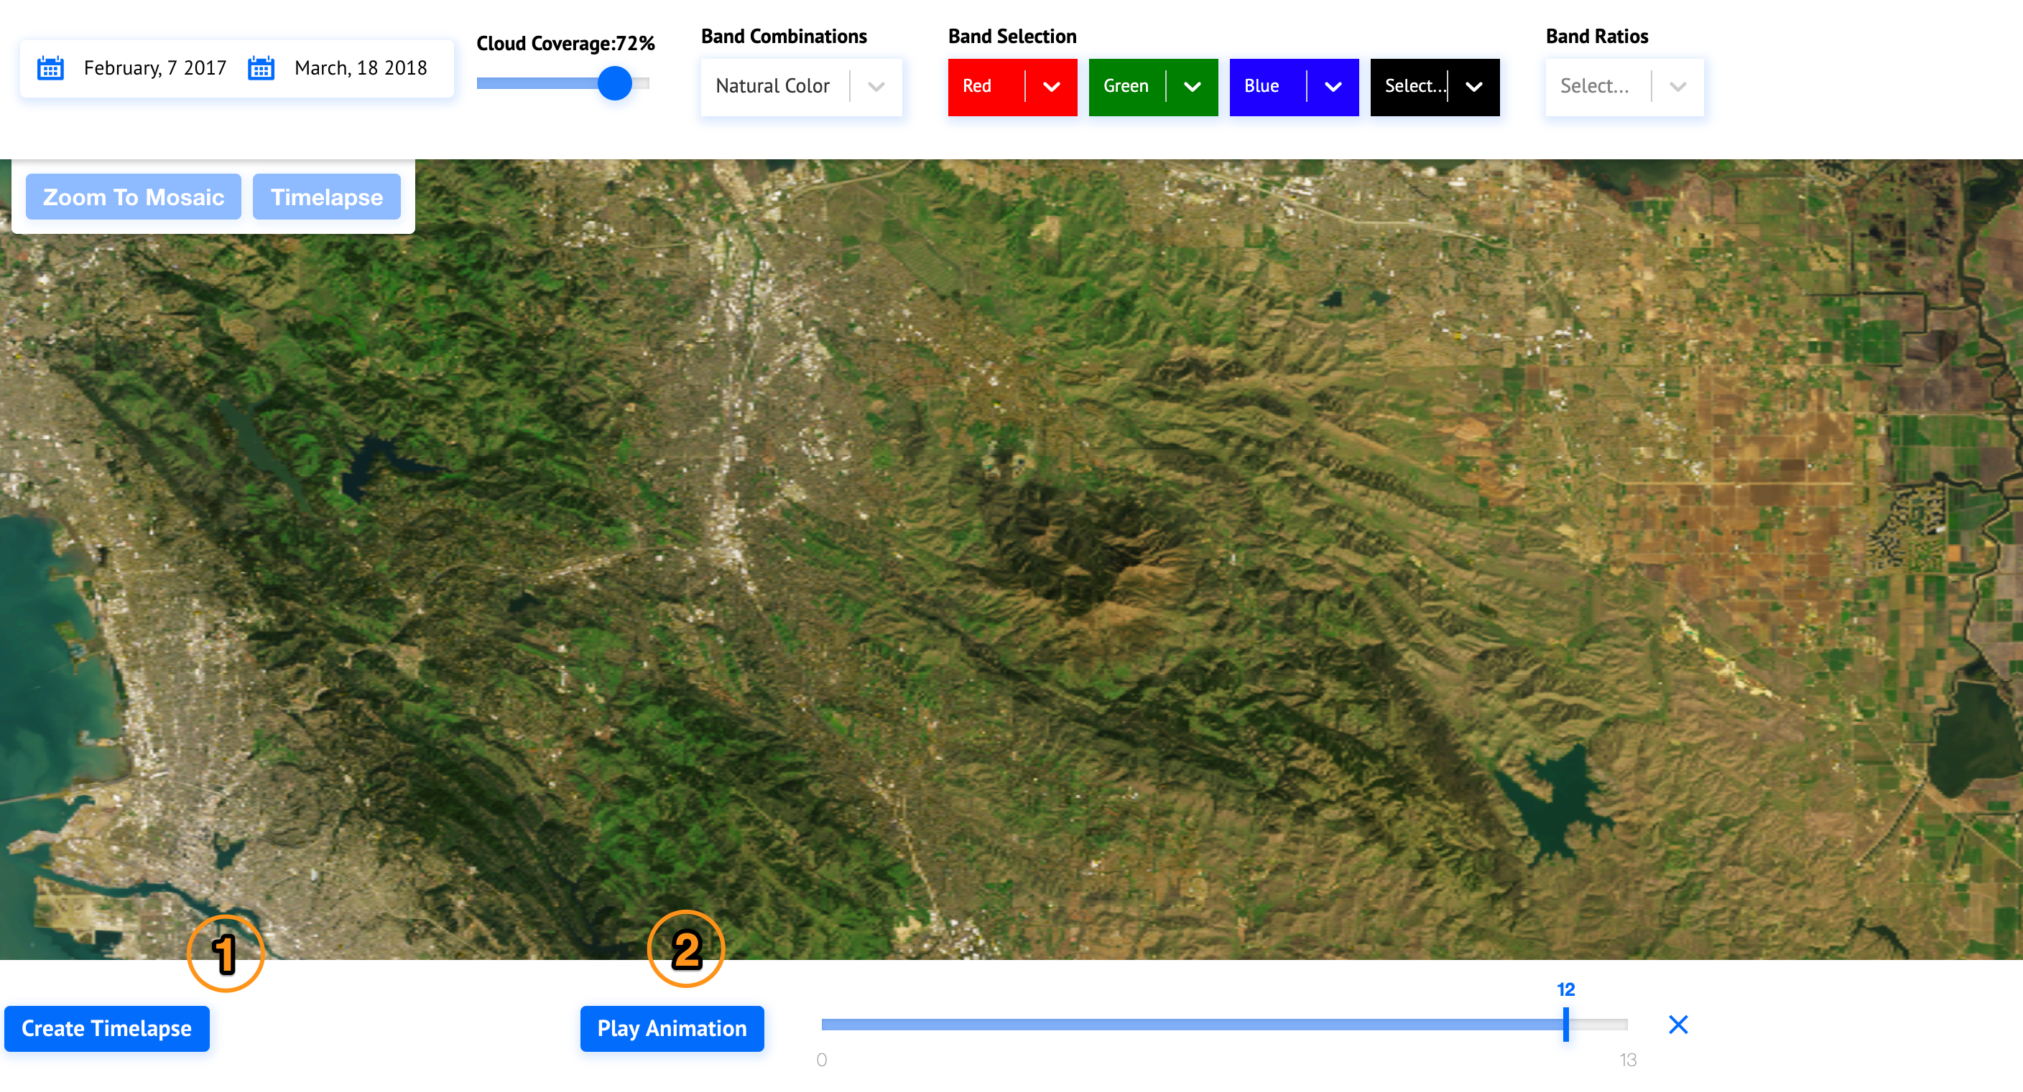

Landsat Collection 2
Released in the Commercial Cloud – May 2021
Improved radiometry, geometry, metadata, and access
New tools for search and discovery
CEOS-ARD/CARD4L-Compliant
Continued growth in Landsat data access via more efficient processes
Cloud Optimized
Geotiff

Slide 5

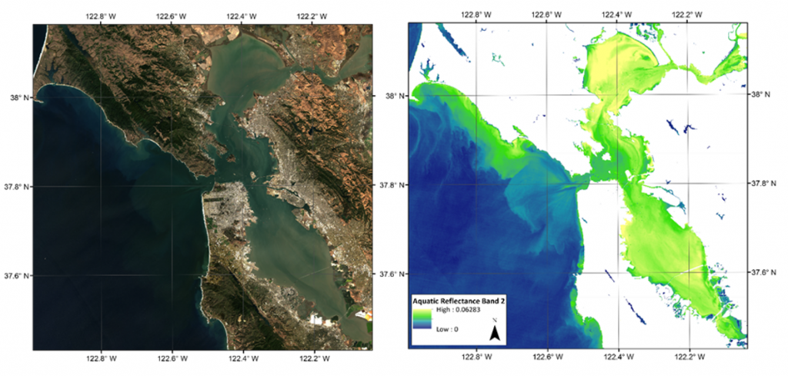
Aquatic Reflectance (AR) PFS
Aquatic Reflectance (AR) PFS finalized
Applicable to inland water bodies and nearshore coastal regions
Preliminary self-assessment of USGS Provisional AR product has been completed
  Several enhancements still required to become Threshold-level CEOS-ARD/CARD4L-compliant
USGS Provisional AR Products
  On 9 May 2022, USGS announced release of Landsat 8-9 Collection 2 Level-2 Provisional Aquatic Reflectance products
  On-demand product requests can be submitted using the EROS Science Processing Architecture (ESPA) interface
  Please contact USGS EROS Customer Services with any questions or comments about these products

Slide 6
Landsat Collection 3 Preparations
Analyzing unmet CEOS-ARD/CARD4L PFS Target-level requirements
Surface Reflectance
  1.1 Traceability
  1.2 Metadata Machine Readability
  2.9 Terrain Shadow Mask
  2.11 Solar and Viewing Geometry
  2.12 Terrain Illumination Correction
  3.1 Measurement (SI Traceable)
  3.2 Measurement Uncertainty
Surface Temperature
  1.1 Traceability
  1.2 Metadata Machine Readability
  1.17 Overall Data Quality
  2.8 Solar and Viewing Geometry
  3.1 Measurement (SI Traceable)

Slide 7


Pecora-22
23-28 October 2022
Denver, Colorado USA
  Flagship land-imaging satellite applications conference; longstanding USGS-NASA partnership
  Highlights Landsat’s 50th anniversary
  Features Landsat 9, Landsat Next, and the many innovative developments in government and commercial land-imaging programs
  Inviting DOI Secretary Haaland and NASA Administrator Nelson for Plenary & Evening Celebration on 26 October
  Monday workshop on the Future of International Collaboration
  Website: pecora22.org
Notes:
​

