Slide 1
Update on Analysis Ready Data activities
German Aerospace Center
Earth Observation Center
Dr. Jonas Eberle
German Remote Sensing Data Center
Department “Information Technology”
Dr. Martin Bachmann
German Remote Sensing Data Center
Department “Land Surface Dynamics”

Slide 2

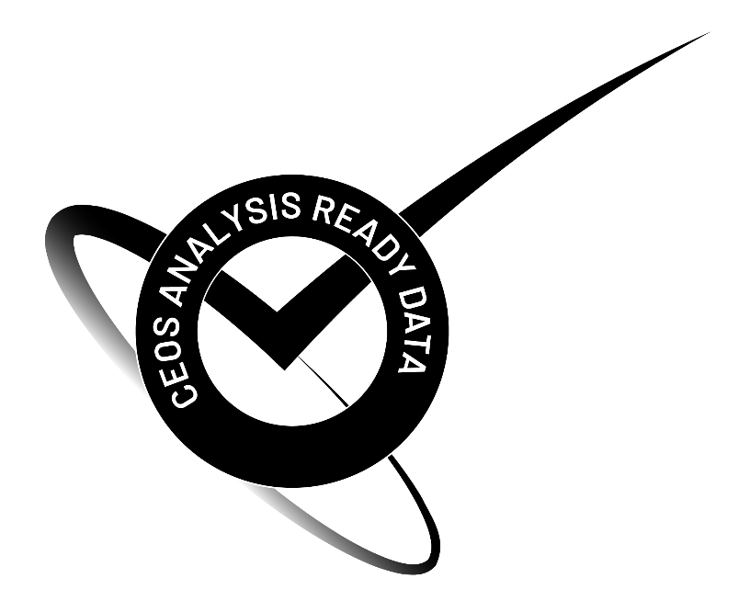
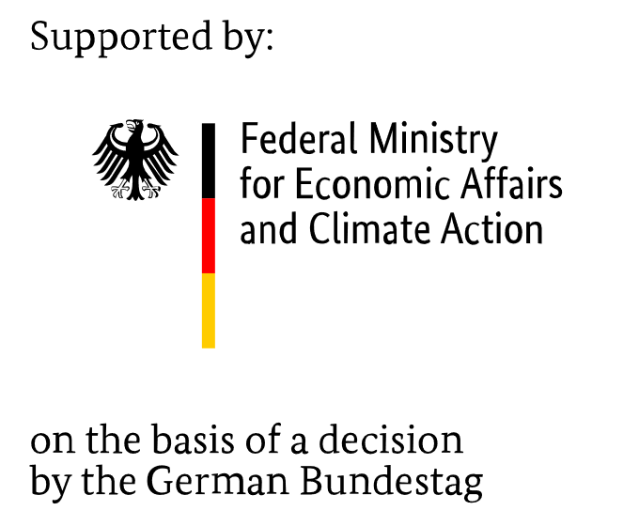
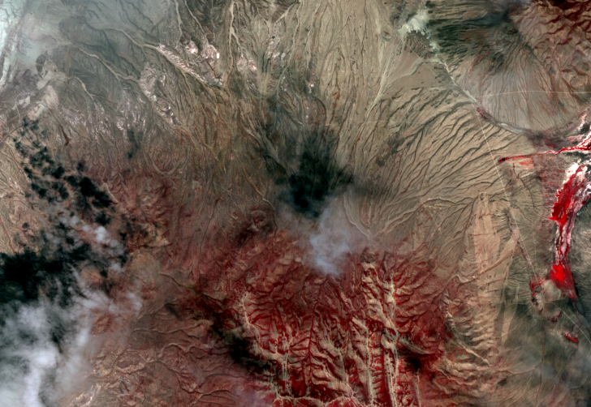
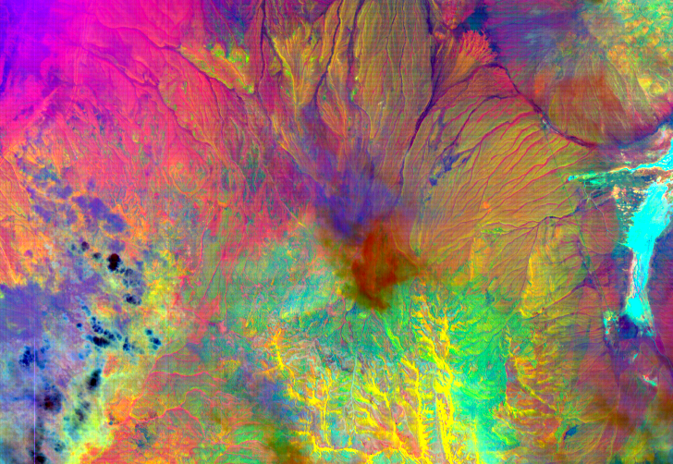
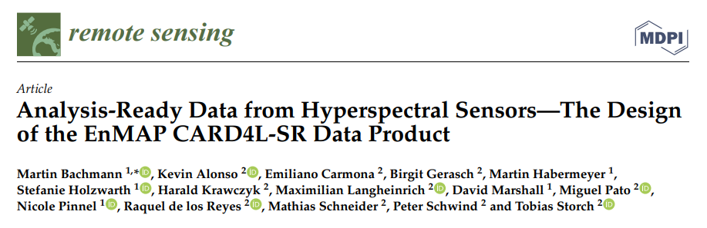
The CEOS CARD4L Conform EnMAP L2A “Land” Product
EnMAP L2A „land“ product is CARD4L conform @ threshold
  => current CARD4L PFS v5.0 is suitable also for hyperspectral products,
  DLR contributions to possible future extension reg. hyperspectral PFS ongoing
EnMAP L2A „water“ product currently in self-assessment (Aquatic Reflectance PFS)
DESIS (hyperspec. mission on ISS by DLR/Teledyne Brown): L2A product in CARD4L assessment
Mission status:
  EnMAP: in commissioning phase, open to public in Q4 ’22 (tbc.), see www.enmap.org
  DESIS: operational
and related contributions to:
12th EARSeL Workshop on Imaging Spectroscopy https://elib.dlr.de/187190/
ESA Living Planet Symposium https://elib.dlr.de/186873/
EnMAP scene Nevada (NE of Railroad Valley, 8.6.’22)
Left: CIR Right: SWIR Principal Components 7,6,5
Source: DLR

Slide 3

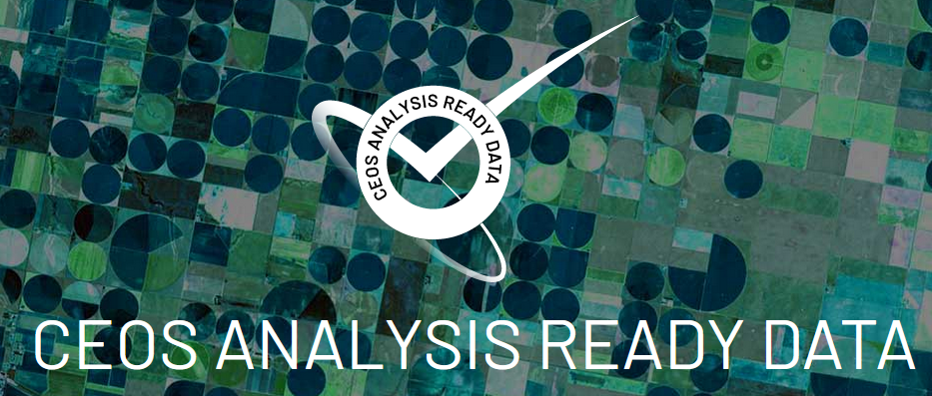
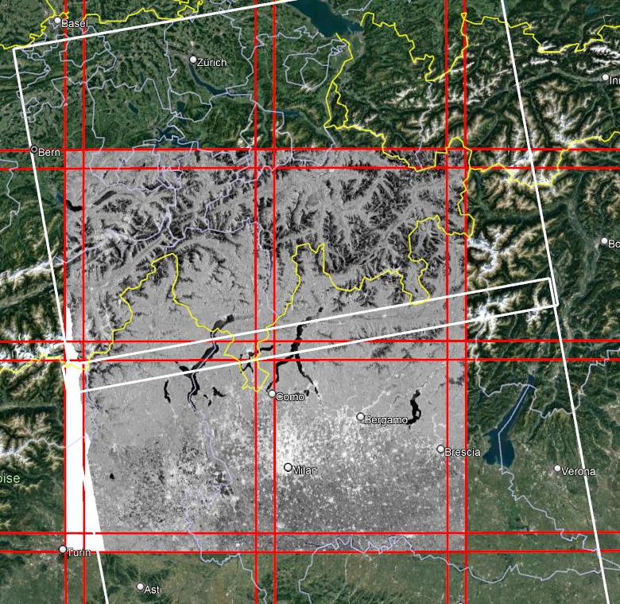
Sentinel-1 ARD Normalized Radar Backscatter (NRB)
Joint DLR and ESA Sentinel-1 NRB product
Developed at DLR (terrabyte) and ESA (COPA)
Definition of SAR ARD products and processing steps
Regular exchange between DLR and ESA
Sentinel-1 ARD Workshop together with NASA (ASF, JPL)
Product specification
Based on CEOS CARD4L NRB guidelines
Based on specification from ESA COPA study
Input data: Sentinel-1 SLC and Copernicus DEM
Gridding: Same tiling system as Sentinel-2 (MGRS)
Cloud-Optimized: GeoTIFF, VRT, XML, and STAC
https://sentinels.copernicus.eu/web/sentinel/sentinel-1-ard-normalised-radar-backscatter-nrb-product

Slide 4
Sentinel-1 ARD Normalized Radar Backscatter (NRB)
Processing software
Multi-SAR processor developed at DLR (based on C/C++)
  Pre-processing system for all SAR data from level 1 to level 2
  Supports data from ERS-1/2, Envisat ASAR, RADARSAT-1/2, ALOS PALSAR-1/2, TSX, and Sentinel-1
  Adjustments and extensions for Sentinel-1 ARD processing
NRB Post-processing based on S1_NRB Python package (developed within ESA COPA study)
Timeline
Finalize product specification and processor development 12/2022
Test processing and validation of product 11/2022 – 03/2023
Historical data processing after successful product validation
Forward data processing after successful product validation

Slide 5
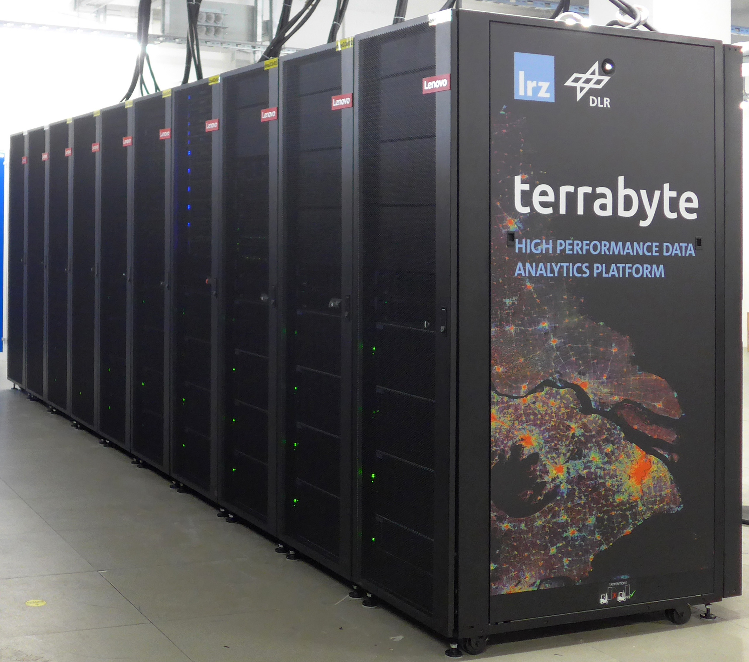
Sentinel-1 ARD Normalized Radar Backscatter (NRB)
High Performance Data Analytics Platform terrabyte
Cloud/HPC-based data processing environment with 36 Petabyte online storage (linked with 100 PB DLR archive)
Data processing:
  Global up-to-date processing to ARD
  User-specific systematic and custom processing
Data storage: Sentinel, Landsat, MODIS, etc.
Data provision: Cloud-optimized data formats, STAC metadata
Exchange with users
Survey on data availabilities, data formats, processing environments
Discussion workshops for Analysis-Ready-Data
  Sentinel-1 Normalized Radar Backscatter
  Sentinel-2 Surface Reflectance

Slide 6
Thank you for your attention!
Dr. Jonas Eberle
Earth Observation Center
Information Technology (DFD-INF)
jonas.eberle@dlr.de
Dr. Martin Bachmann
Earth Observation Center
Land Surface Dynamics (DFD-LAX)
martin.bachmann@dlr.de

