Slide 1
JAXA
JAXA Mission
and CARD4L Product Development Update
Takeo Tadono, JAXA EORC
Ake Rosenqvist, soloEO/JAXA

Slide 2
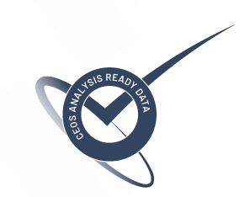
CEOS ARD SAR – ALOS-2 PALSAR-2
JAXA seeking CARD4L NRB v5.5 compliance at THRESHOLD level for SAR data products from ALOS-2 PALSAR-2.
Self-assessment form and sample products submitted to LSI-VC (Matt) and WGCV (Medhavy) on August 27, 2022.
Valid for the three ALOS-2 PALSAR-2 products:
Fine Beam Global Mosaics
ScanSAR scene-based products
ScanSAR tile products
(Product descriptions on following slides)
‹#›

Slide 3
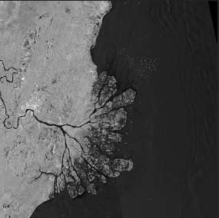
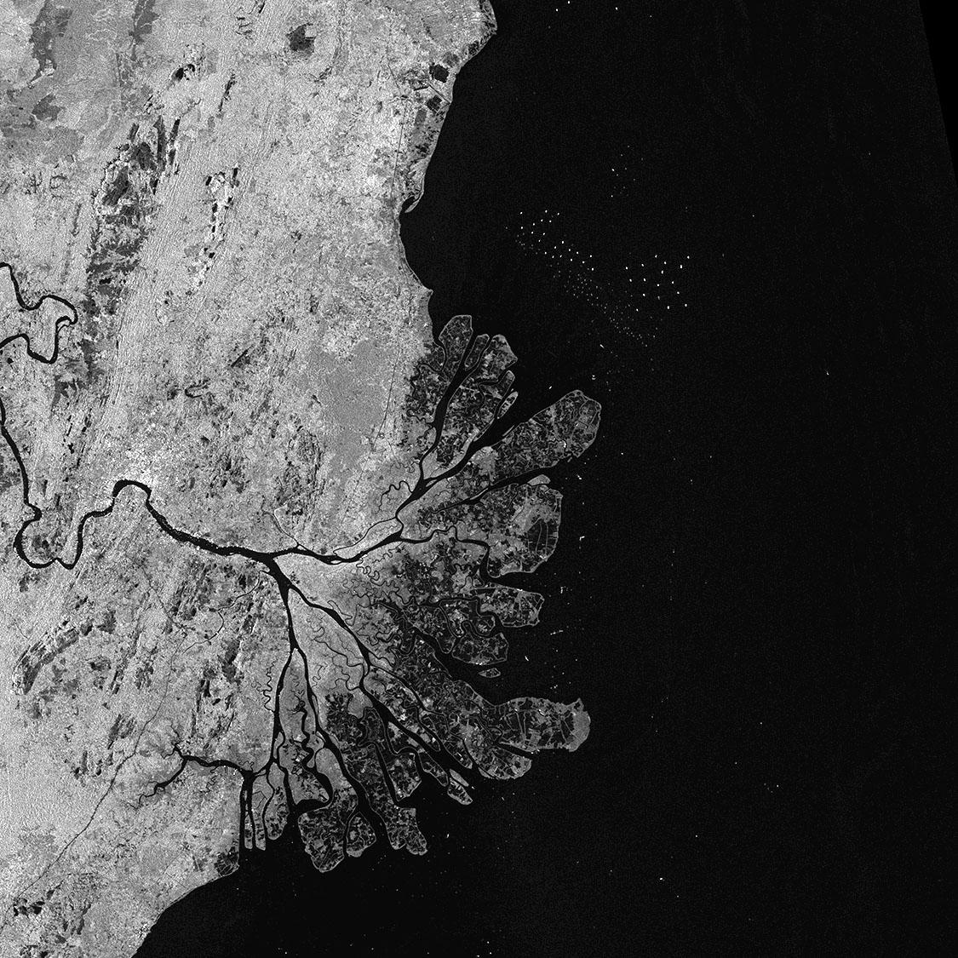
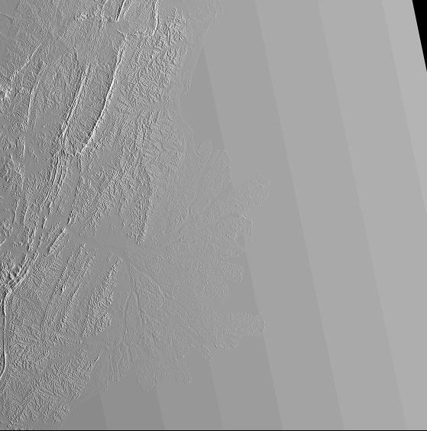
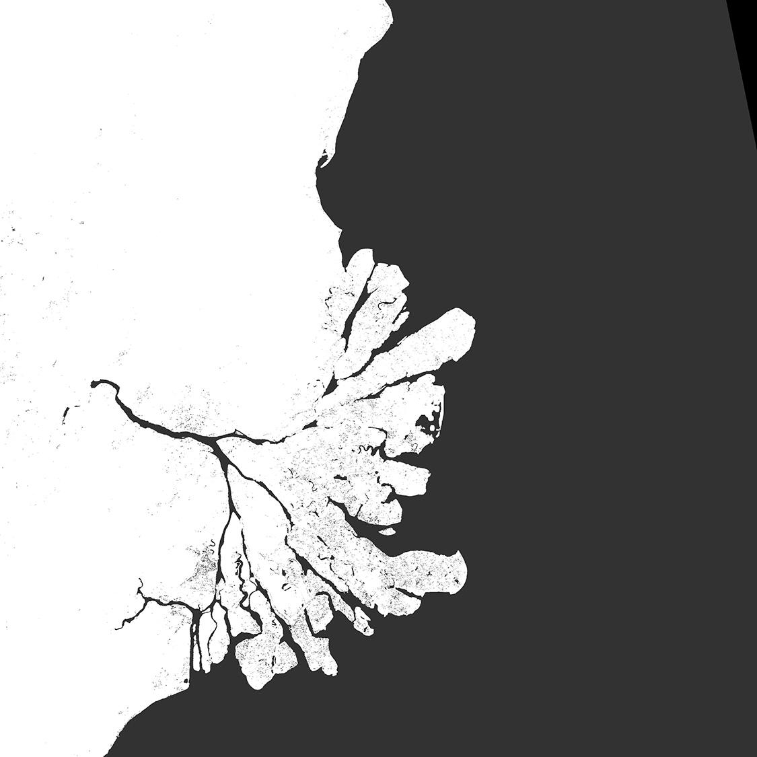
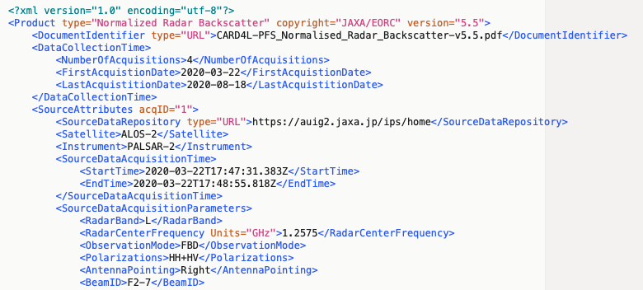
CEOS ARD SAR – ALOS-2 PALSAR-2
ALOS-2 PALSAR-2 Global Mosaics
CARD4L Product contents:
Global mosaic products, Annual 2015 – 2021
25 m pixel spacing
1x1 degree tile products
Available for public download @JAXA EORC www
Radar Measurement data:
Geometric & radiometric Terrain Corrections
Normalised Radar Backscatter as gamma-0, γ⁰
Per-pixel Metadata:
Local Incidence Angle image
Mask image
Acquisition Date image
General metadata:
XML according to CARD4L metadata spec NRB v5.5
γ⁰ Backscatter (HH)
γ⁰ Backscatter (HV)
Local Inc. Angle
Acquisition ID
Data Mask
General Metadata (XML)
‹#›

Slide 4
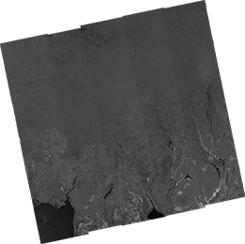
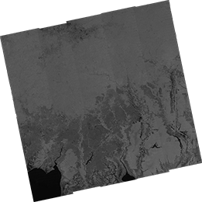
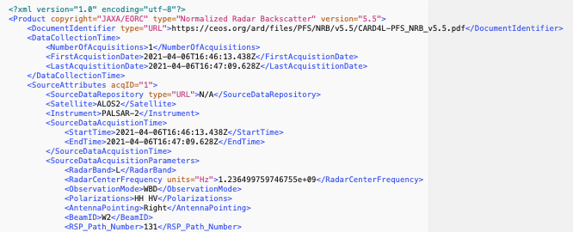
CEOS ARD SAR – ALOS-2 PALSAR-2
ALOS-2 PALSAR-2 ScanSAR NRB
CARD4L Product contents:
Global historical ALOS-2 ScanSAR archive, 2014-present
25m pixel spacing
Scene-based Level 2.2
Public release by GEO Week/CEOS Plenary
On Google EE, VEDAS, and TELLUS for Asia region data; AWS by Digital Earth Africa for Africa region; TBD for South America and the rest of the global areas
Radar Measurement data:
Geometric & radiometric Terrain Corrections
Normalised Radar Backscatter as gamma-0, γ⁰
Per-pixel Metadata:
Local Incidence Angle image
Mask image
General metadata:
XML according to CARD4L metadata spec NRB v5.50
γ⁰ Backscatter (HH)
γ⁰ Backscatter (HV)
Local Inc. Angle
Data Mask
General Metadata (XML)
‹#›

Slide 5
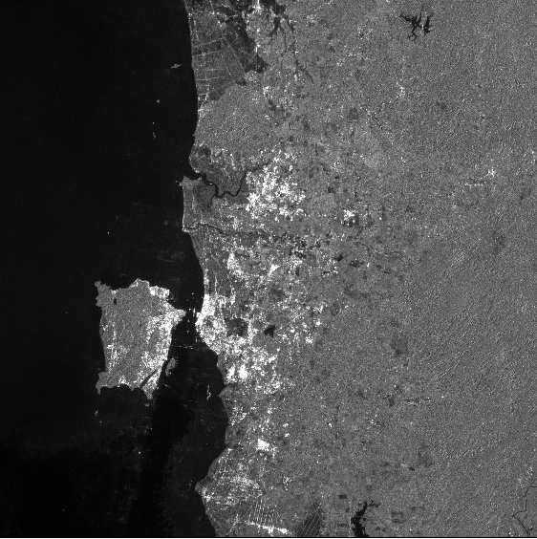
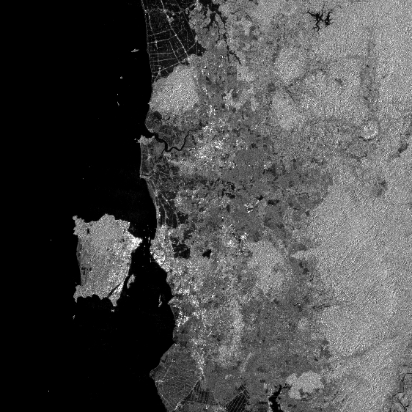
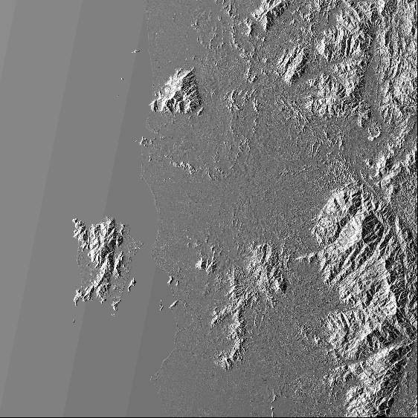
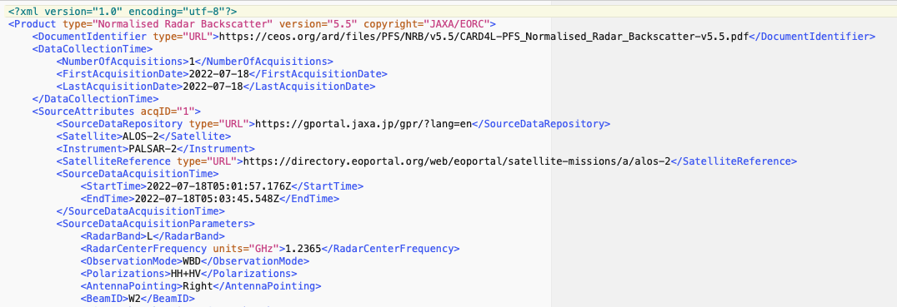
CEOS ARD SAR – ALOS-2 PALSAR-2
ALOS-2 PALSAR-2 ScanSAR NRB – 1°x1° tiles
CARD4L Product contents:
Pan-tropical ALOS-2 ScanSAR (2014-present)
50m pixel spacing
1x1 degree tile products
For (K&C) research program
Radar Measurement data:
Geometric & radiometric Terrain Corrections
Normalised Radar Backscatter as gamma-0, γ⁰
Per-pixel Metadata:
Local Incidence Angle image
Mask image
General metadata:
XML according to CARD4L metadata spec NRB v5.5
γ⁰ Backscatter (HH)
γ⁰ Backscatter (HV)
Local Inc. Angle
Data Mask
General Metadata (XML)
‹#›

Slide 6
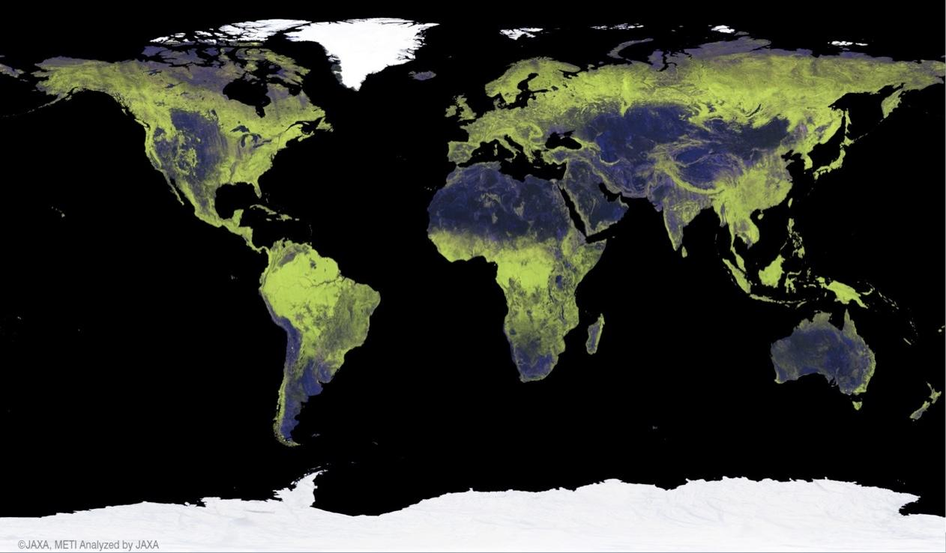
JAXA Annual Global 25 m Mosaics
Global Mosaic revisions
Modifications to the Sigma-SAR processor and EORC mosaicking software undertaken during 2021.
Processing/Re-processing schedule
ALOS-2 PALSAR-2: 2015–2021 [COMPLETED]
2022/Q4: ALOS PALSAR 2007, 2010
2022/Q4: JERS-1 SAR 1993-1998
2023/Q1: ALOS PALSAR 2008, 2009
2023/Q2: ALOS-2 PALSAR-2 2022
New mosaic features:
Improved geometric accuracy
Single-year data only (i.e. no gap-filling from other years in case of missing data)
Cloud Optimized GeoTiff (COG) format
Compliance with CARD4L NRB v5.5
Public download www:
https://www.eorc.jaxa.jp/ALOS/en/dataset/fnf_e.htm
‹#›

Slide 7
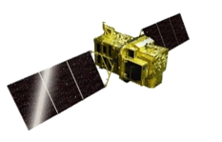
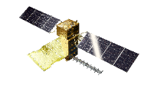
Continuous Observations by ALOS Series Missions
Providing continuous L-band SAR observations since 2014, successor to “DAICHI” (ALOS PALSAR and AVNIR-2) 2006-2011 and JERS-1 (SAR and VNIR) 1992-1998
ALOS-2 PALSAR-2 - operations ongoing
ALOS-3 optical - JFY 2022 as target
ALOS-4 PALSAR-3 - TBC
JFY 2014 | 2015 | 2016 | 2017 | 2018 | 2019 | 2020 | 2021 | 2022 | 2023 | 2024 | 2025 | 2026 | 2027 | 2028 | 2029 | 2030
ALOS-2 (L-band SAR)
Post Operation Review Meeting
Launch
Mission Operation
(5 years)
Post-Operation #1
(2 years)
Post Operation #2
(X years)
ALOS-3 (Optical)
TBC
Development
Mission Operation (7 years)
ALOS-3 Follow-on
(Under discussion)
Feasibility Study
Development
ALOS-4 (L-band SAR)
TBC
Development
Mission Operation (7 years)
ALOS-4 Follow-on
(Under discussion)
Feasibility Study
Development

Slide 8
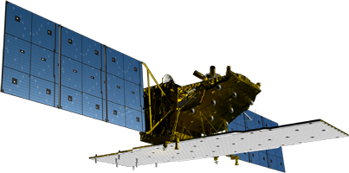
ALOS-2 PALSAR-2
On-board internal calibration is performed every 3 months.
Product quality of key observation modes is evaluated regularly using SAR data over calibration sites.
Launched 2014, ALOS-2 currently in its 2nd Post-operations phase
🡪 PALSAR-2 remains in good condition and performance.
PALSAR-2 calibration summary (using PALSAR-2 acquired 07/2014 – 09/2021)
Items | Results
Geometry (RMSE) | [Stripmap and Spotlight] 5.53 m (L1.1) / 6.73 m (L2.1) [ScanSAR] 60.77 m (L1.1) / 29.33 m (L2.1)
Radiometry | RCS accuracy (1σ) | 0.529 dB (corner reflectors) 0.41 dB (Amazonian forests)
Polarimetry | VV-HH amplitude ratio | 1.003 (σ=0.012)
 | VV-HH phase difference | -0.323 deg (σ=1.436)
 | Cross talk | [HV/HH] -42.858 dB (σ=6.638) [VH/VV] -42.667 dB (σ=5.518)
* https://www.eorc.jaxa.jp/ALOS/a/en/alos-2/a2_calval_e.htm

Slide 9
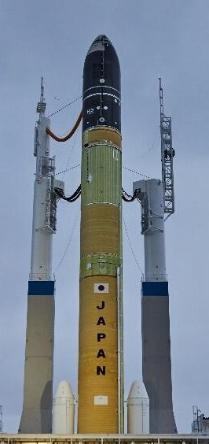
H3 Launch Vehicle
Developed by JAXA and Mitsubishi Heavy Industries
Replacing work horse rockets H-IIA and H-IIB
First test flight of H3 launch vehicle scheduled by end of JFY 2022 (Q1/2023)
Launch site: JAXA Tanegashima Space Center
H3-TF1 to carry ALOS-3 on its maiden flight 🤞❗️
Scheduled to carry ALOS-4 on its second flight (H3-TF2) 🤞🤞❗ Launch date TBA.

Slide 10
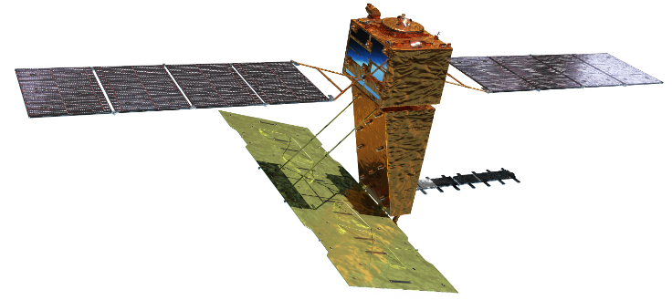
ALOS-4 PALSAR-3
Phase D
Launch | TBA by H3 launch vehicle
Orbit | Same orbit as ALOS-2 Sun-synchronous sub-recurrent orbit Altitude: 628 km Inclination angle: 97.9 degree Local sun time at descending: 12:00 ± 15 min. Revisit time: 14 days (14+11/14 rev/day)
Lifetime | 7 years
Size | X 10.0 m x Y 20.0 m x Z 6.4 m
Satellite Mass | ~2,990 kg
Downlink | 1.8 / 3.6 Gbps (Ka-band)
Mission Instruments | PALSAR-3 (Phased Array type L-band Synthetic Aperture Radar-3) SPAISE3 (SPace based AIS Experiment 3)
Y
X
Z
SPAISE3 (AIS)
PALSAR-3
Ka-band DT antenna
In-orbit configuration
The ALOS-4 launch to follow the H3 launch of ALOS-3.

Slide 11
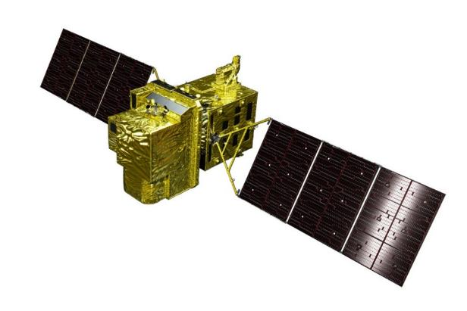
ALOS-3
Items |  | Specifications
Orbit | Type | Sun-synchronous sub-recurrent
 | Altitude | 669 km at the equator
 | Local Sun Time | 10:30 am +/- 15 minutes at the descending node
 | Revisit | 35 days (Sub-cycle 3 days)
Instruments |  | - Wide-swath and high-resolution optical imager (WISH) - Dual-frequencies Infrared sensor (hosted payload)
Ground Sampling Distance (GSD) |  | - Panchromatic band (Pa): 0.8 m - Multispectral band (Mu): 3.2 m (6 bands)
Quantization |  | 11 bit / pixel
Swath width |  | 70 km at nadir
Mission data rate |  | Approx. 4 Gbps (after onboard data compression: 1/4 (Pa) and 1/3 (Mu))
Mission data downlink |  | - Direct Transmission: Ka and X-band - via. the Optical Data Relay Satellite
Mass |  | Approx. 3 tons at launch
Size |  | 5 m×16 m×3.5 m on orbit
Duty |  | 10 (~12) mins / recurrent
Design lifetime |  | Over 7 years
Phase D
Wide-swath and high-resolution optical imager (WISH)
In-orbit configuration

Slide 12
ALOS-3 Standard Products and Target Accuracy
Processing Level | Contents | Specifications Target accuracy
1A | Raw data | [not available to users]
1B1 with RPC | Radiometric system correction | 12 CCD units separated images
1B2 with RPC | Radiometric + Geometric system correction R: Geo-reference G: Geo-coded | Geometric accuracy (1 sigma): 5 m (h) without GCPs; 1.25 m (h), 2.5 m (v) with GCPs Radiometric accuracy (Mu band): +/- 10% (Abs.); +/- 5% (Relative)
1C | Rough ortho rectification using existing DEM/DSM i.e., PRISM DSM (AW3D 5m mesh DSM)
Validation of High-level and Research Products is performed in conjunction with calibration.
Atmospheric correction (ATC): Surface Reflectance to be generated as CARD4L-SR compliant.

Slide 13
JAXA
Thank you

