Slide 1

For All Thailand
GISTDA Update on Land Surface Imaging and Analysis-Ready Data
Open Platform
Spatial Big Data
Sitthisak Moukomla
12th Meeting of the CEOS Virtual Constellation for Land Surface Imaging (LSI-VC)
8-9 September 2022
ESA/ESRIN, Frascati, Italy
1

Slide 2





Pain points
1
3
Too Expensive
Data Quality
2
4
Difficult To Use
No Government Service

Slide 3


Goals
Thailand has a platform for providing geospatial services.
Easy to use, accessible to all Thai people.
High quality information Many types and more positional accuracy than offshore platforms
Expanding the GI business
Solve spatial problems at all levels

Slide 4
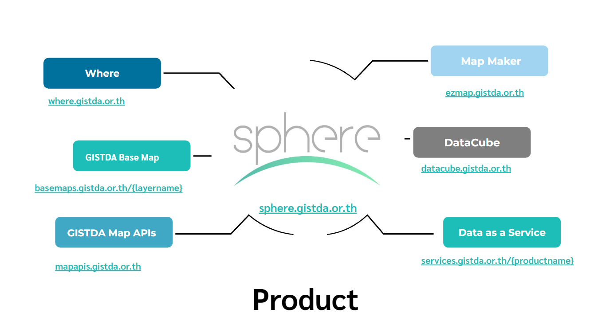

Slide 5









Data Services
More
Other
Search
POI / AOI / Transportation
Suggestion
Static
Custom Marker
  Custom Line
Custom Polygon
Routing
Distance Matrix
Routing Options (Time / Distance)
Embed
Embed with marker
Elevation
SRTM
DEM24m (โครงการ THEOS2)

Slide 6

ARD / DataCube
Rice
Maize
Sugarcane
  Cassava
TOA
SR
Spectral Indices
Agriculture
Thaichote
Temperature
Humidity
Wind Speed
Wind Direction
Rainfall
Fusion with Other Source
Flood
  Fire
Drought
Disaster
Filed Station
Elevation
WorldDEM4Ortho (THEOS2)
JICA
MOST

Slide 7





























ARD & Data Cube Overview
Apply
Data Cube
ARD Tools
RESTFUL APIs
BOA / SR
ingest
Schedule System
: status, datetime
API Management System
ARD Process
TOA
Create & Generate API Key
Keep log request
Service charge system Dashboard API Tutorials
Developer
Radiance
APIs
Web Application (On Main Platform)
Multi Sensor
Transforms
Drag & Drop Model Builder
Code Editor AI/ML Tools
Data Preparation Tools Data Visualization Tools
Students, Researchers, General Public
GeoImages
Multi Satellites
Thaichote, LANDSAT, GEMS Sentinel, MODIS, .. Others
: GISTDA Legacy & THEOS-2
Data Preparation
Thailand Open Data cube White Paper
OGC Service from data cube
Other Data Source
File base & Spatial File (Geo)Spatial Database & Database
Big Data Technology
BOA = Bottom of atmosphere , TOA = Top of atmosphere , SR = Surface reflectance , Pixel_QA = Pixel quality assessment
24
Presented by

Slide 8






FY2023
AI / ML
FY2023
AR For Navigation
FY2024
GIS Exchange
FY2022
Platform
FY2023
Autonomous
Roadmap
FY2024
Infrastructure-as-a-Service (IaaS)
Platform-as-a-Service (PaaS)

