Slide 1
CARD4L Assessments
Medhavy Thankappan
Geoscience Australia
LSI-VC 12
Frascati, 8-9 September 2022

Slide 2
CEOS-ARD Oversight Group
Members
Ferran Gascon (Lead) SIT Chair Team
Andreia Siqueira LSI-VC
Steve Labahn LSI-VC
Peter Strobl LSI-VC
Maycira Costa OCR-VC
Mark Higgins OST-VC
Raj Kumar Sharma OSVW-VC
Chris Kidd P-VC
Matthew Steventon Secretariat
Ed Armstrong SST-VC
Medhavy Thankappan WGCV
Philippe Goryl WGCV
Makoto Natsuisaka WGISS
Jorge Del Rio Vera WGCapD
Identified as a core component of the CEOS-ARD Governance Framework.
Act as a forum for all matters related to CEOS-ARD.
Representatives from the CEOS Virtual Constellations are integral to the effort going forward, as these are the CEOS entities with the technical expertise to recommend, develop and maintain Product Family Specifications.
Provide strong coordination across CEOS and promote CEOS-ARD in a unified way
CEOS-ARD Oversight Group Terms of Reference (Endorsed at SIT-37)
Mailing list: ard-oversight-group@lists.ceos.org

Slide 3
CARD4L Review Process
CARD4L Review Panels are only used for ‘Target’ level submissions (agreed at WGCV-49)
CARD4L peer review guidelines: suggested total of five members on the Review Panel
  One WGCV member
  Three members who are either WGCV members or sub-group members nominated by their Chairs
  Not more than one member from a given sub-group
  Two-year terms for all members
Threshold level CARD4L submissions evaluated through one-on-one interactions between data provider and PoCs for WGCV and LSI-VC
Need a Review Panel to cover the SAR domain (seeking self-nominations)
Landsat CARD4L Review Panel
Sentinel-2 CARD4L Review Panel
Hyperspectral CARD4L Review Panel
Nigel Fox
Valentina Boccia
Darren Ghent
Jeffrey Czapla-Myers
Medhavy Thankappan
Nigel Fox
Cody Anderson
Darren Ghent
Fernando Camacho
Medhavy Thankappan
Nigel Fox
Kurt Thome
Cindy Ong
Hirokuza Yamamoto
Medhavy Thankappan

Slide 4
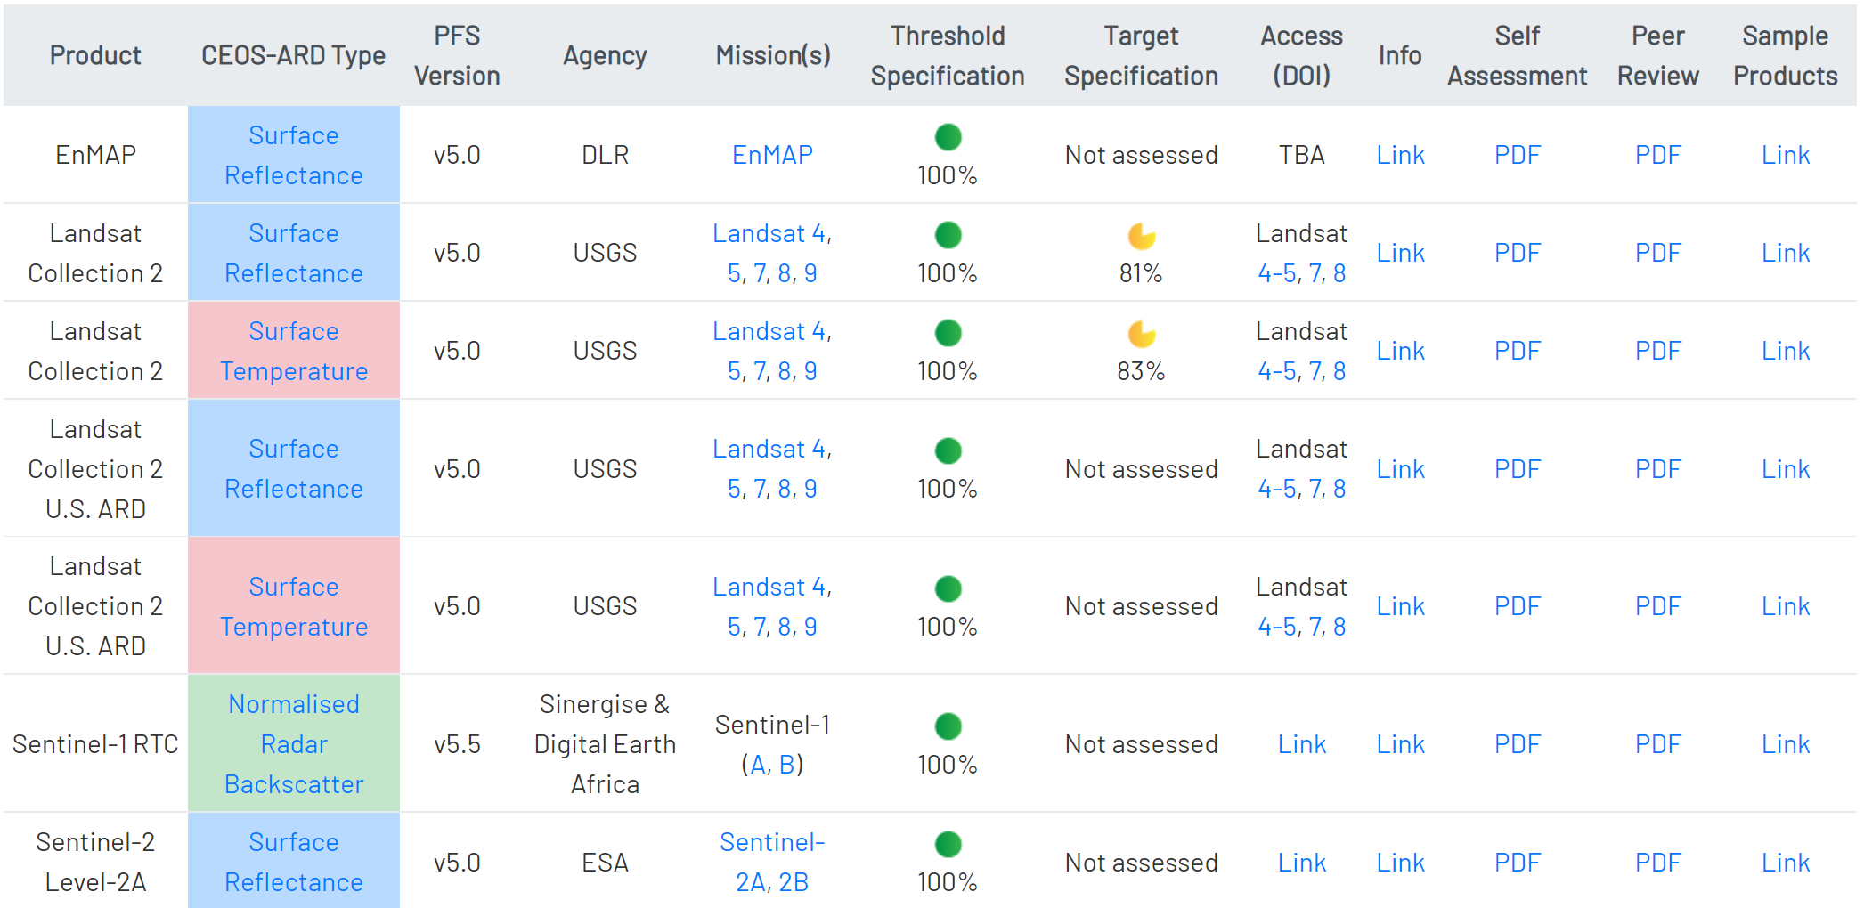

CARD4L Assessments (complete)

Slide 5
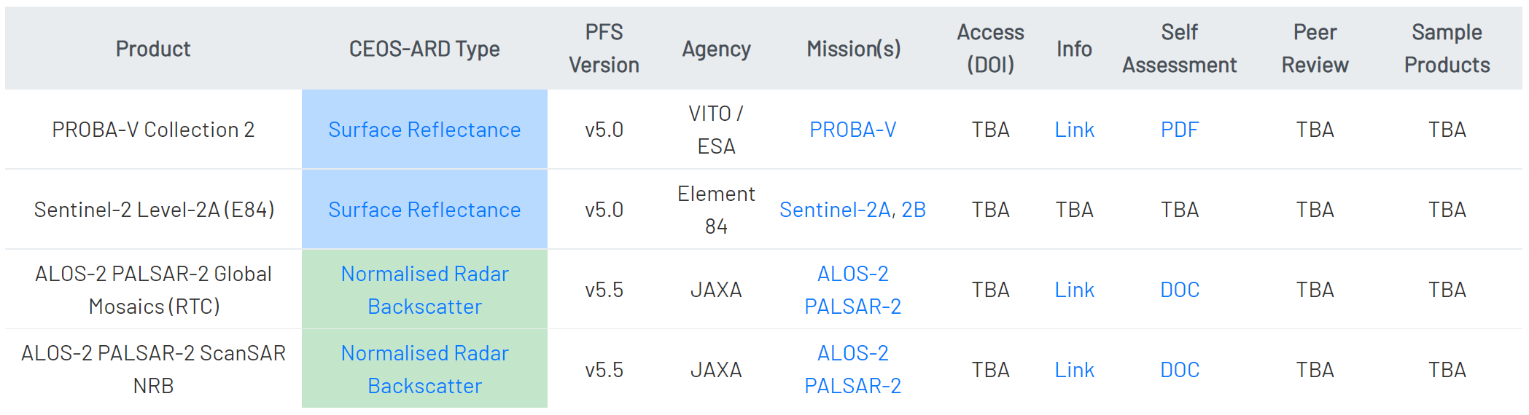
CARD4L Assessments (in progress)
Recently submitted for review
Review pending clarification from data provider

Slide 6
Turnaround and Support
Steady stream of CARD4L submissions coming through now
Expected gains yet to be realised from streamlining CARD4L evaluation process
WGCV PoC - role change at GA, extended leave since June
No redundancy or back-up identified for WGCV PoC
Recruitment for assistance with CARD4L evaluations in progress at GA
Seeking back-up for WGCV PoC at WGCV-51 Plenary next month

Slide 7
Discussion

Slide 8
Thank you
medhavy.thankappan@ga.gov.au

