Slide 1
LSI-VC-12 Welcome

Slide 2
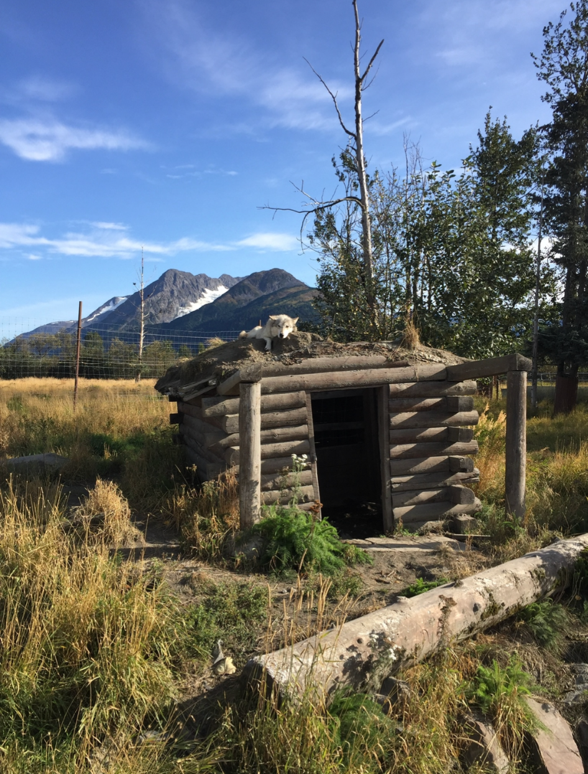
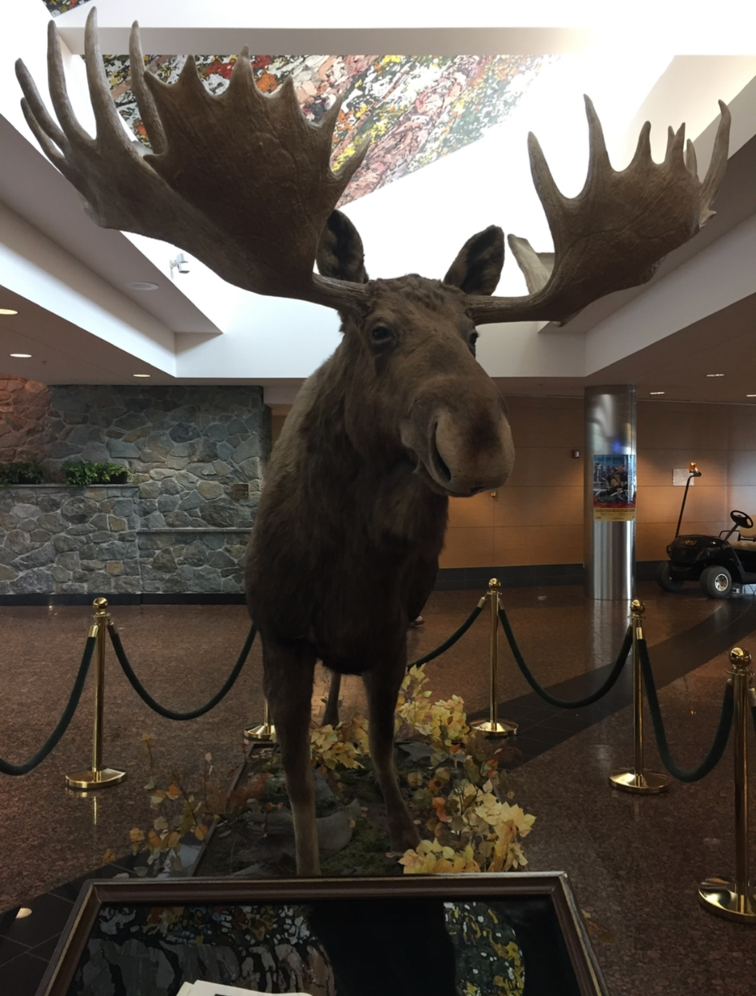
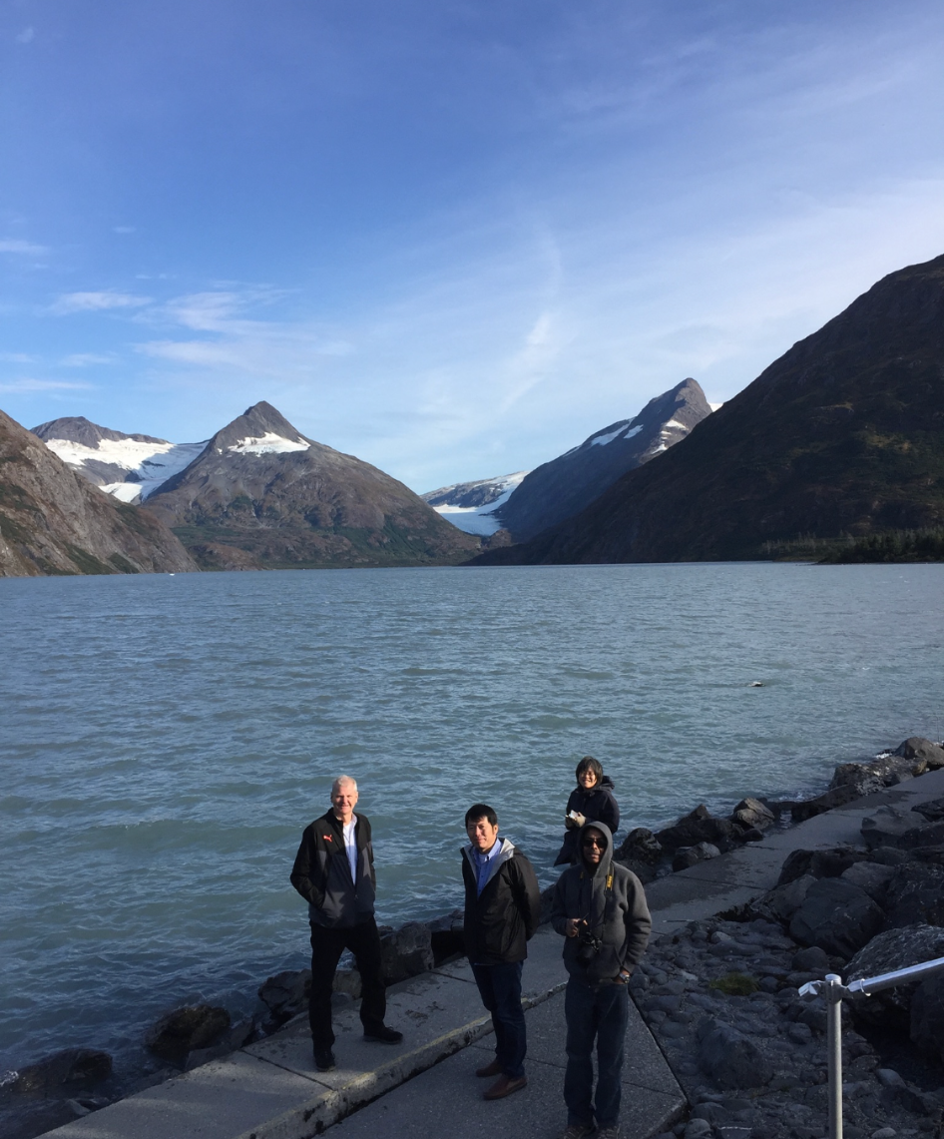
LSI-VC-8: Anchorage, Alaska, USA | September, 2019

Slide 3
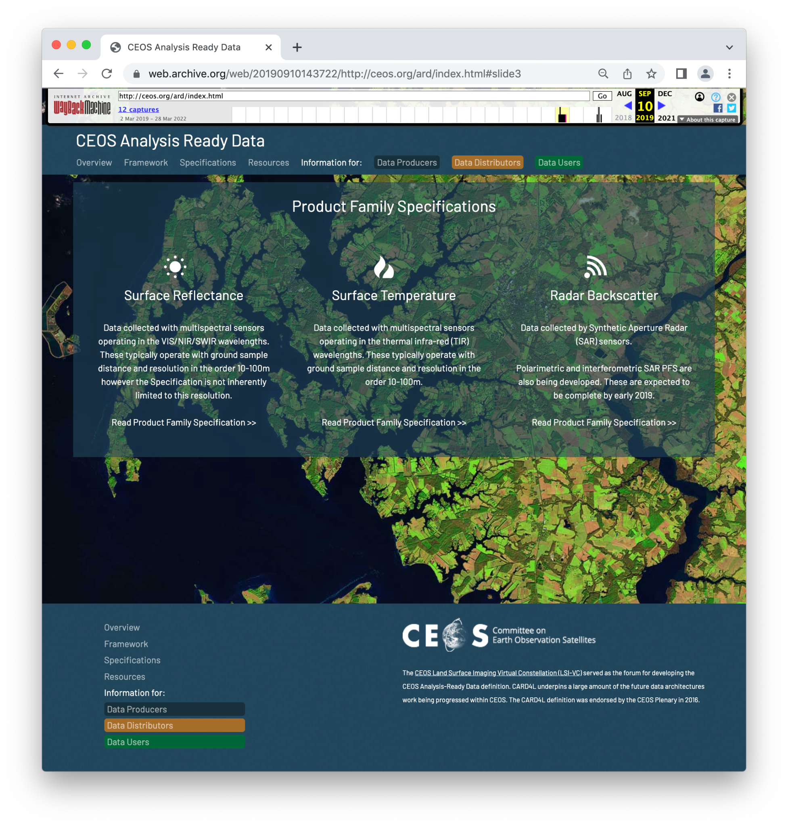
https://web.archive.org/web/20190910143722/http://ceos.org/ard/index.html#slide3

Slide 4
Progress!
No CEOS-ARD Datasets
CEOS-ARD Strategy was in development - now on v2!
Three PFS.
No subgroups.
No CEOS-ARD Governance Framework
No Oversight Group, nor thought of ARD beyond land
Co-Lead changes

Slide 5
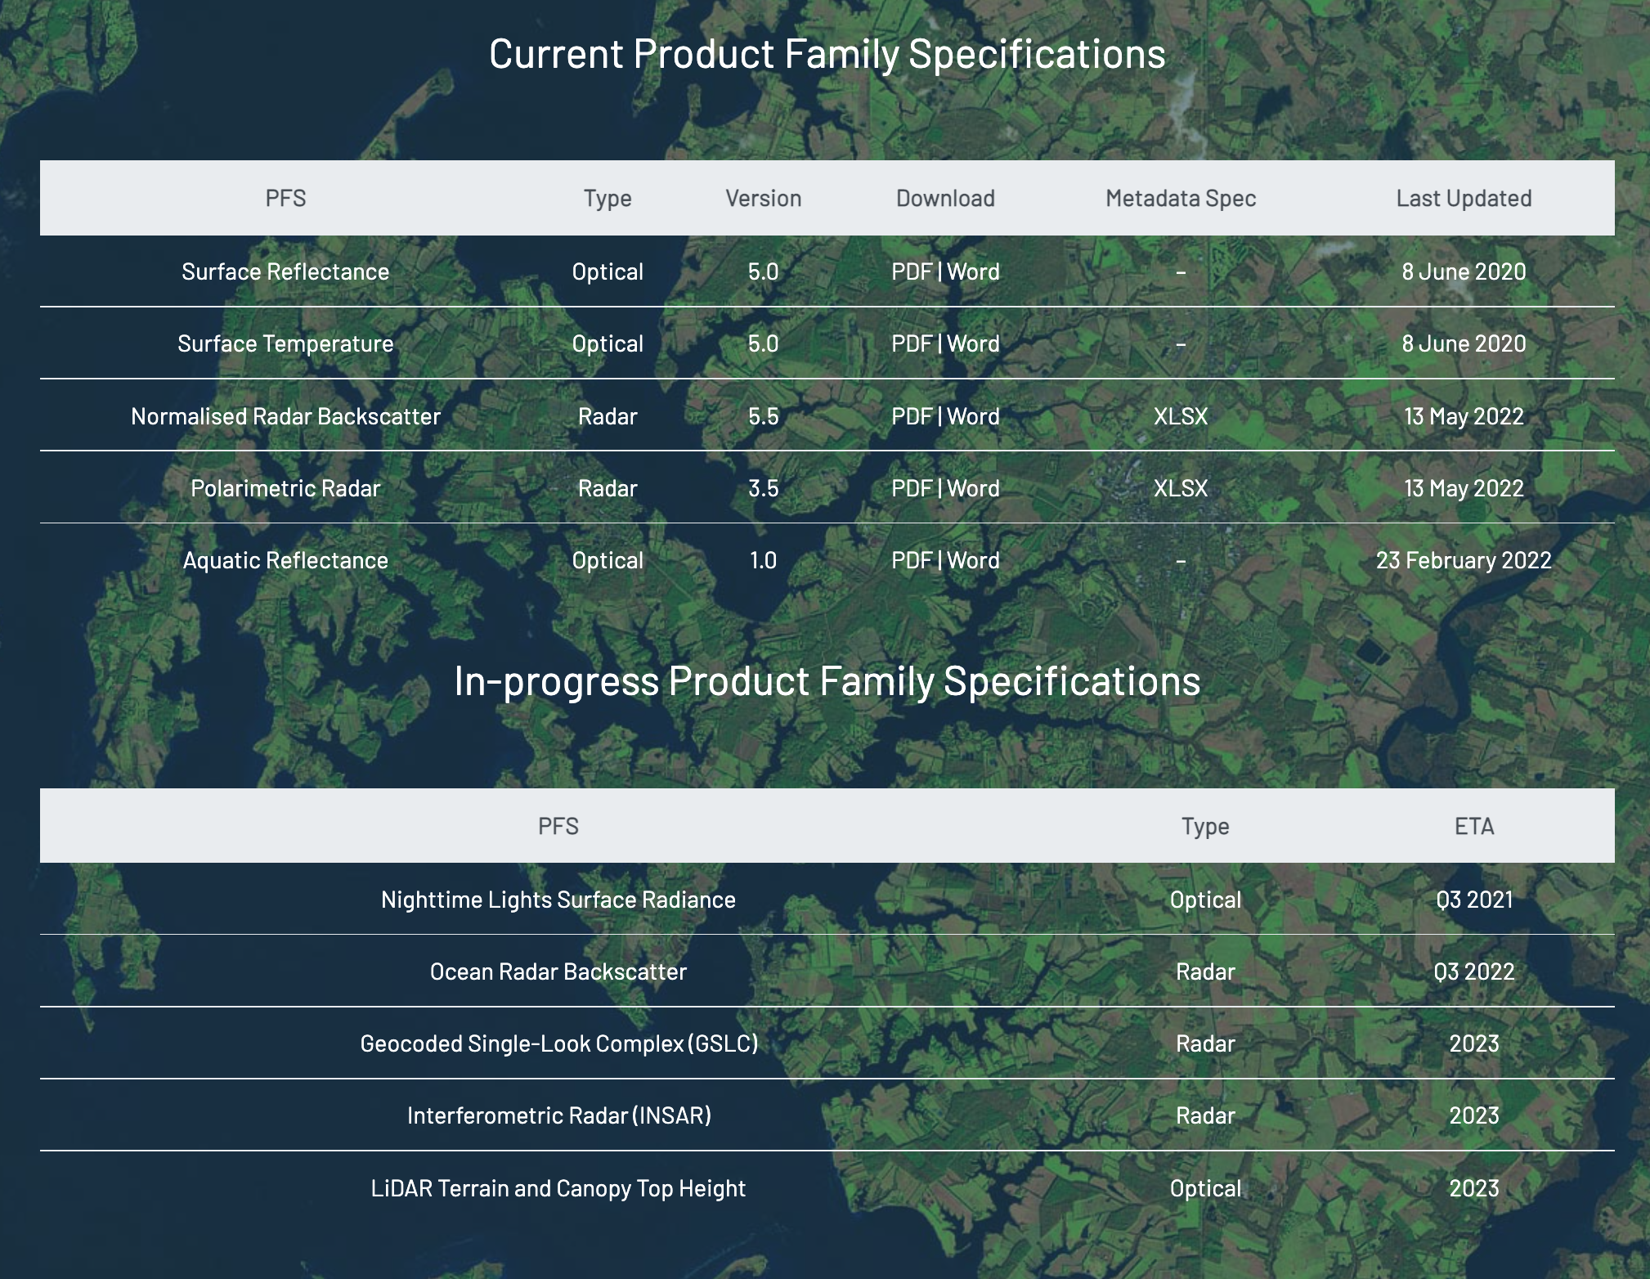

Slide 6
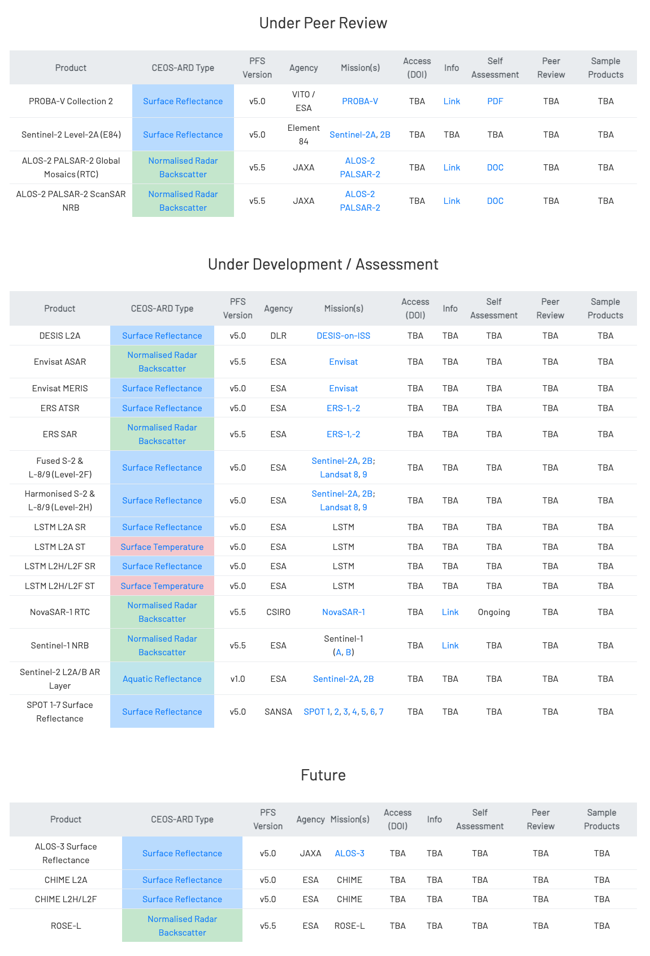
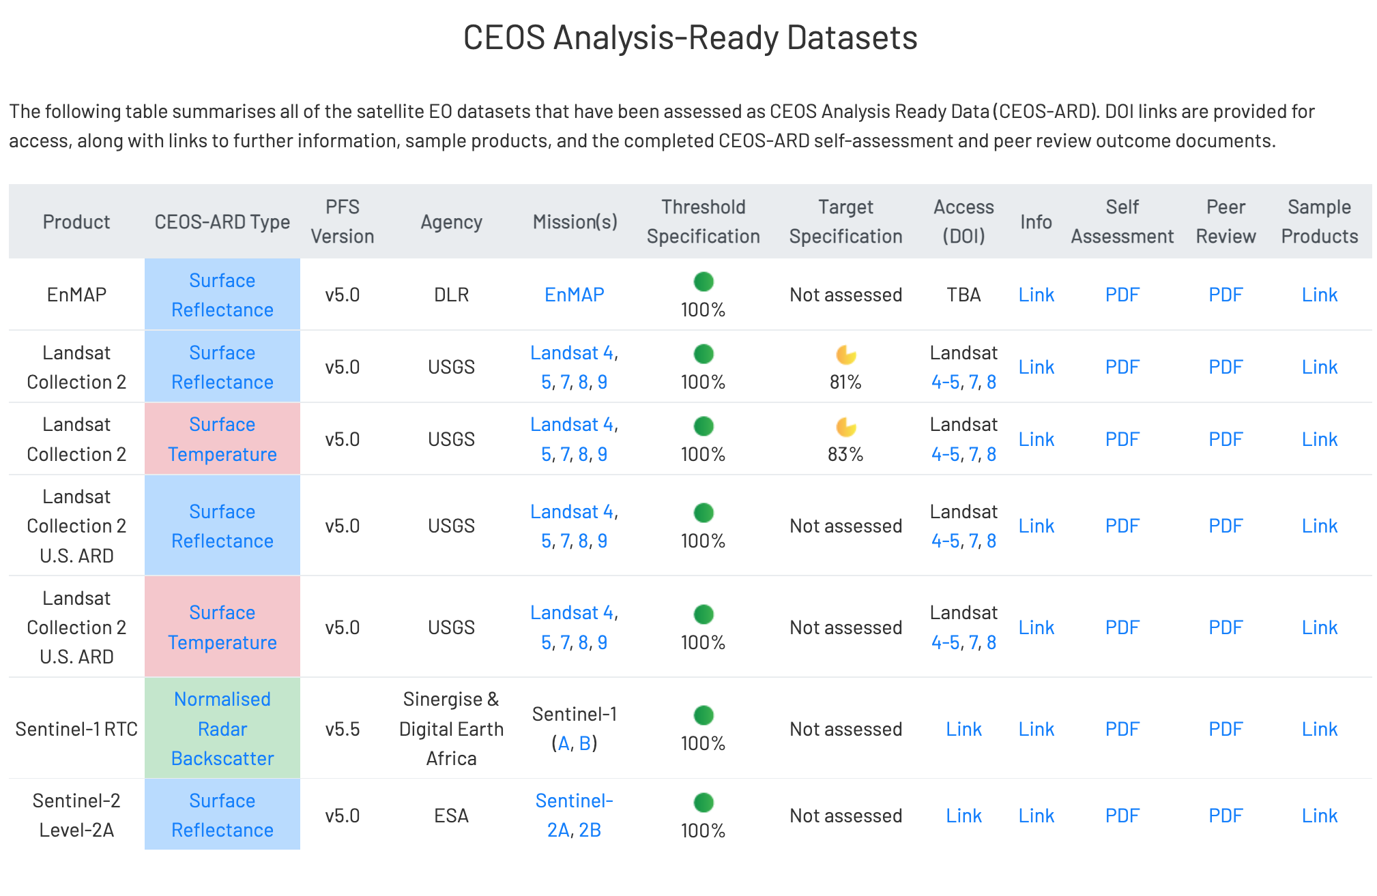

Slide 7
Recall…
Joint session with WGClimate (LST Climate Data Records and continuity)
.
.
.
.

Slide 8
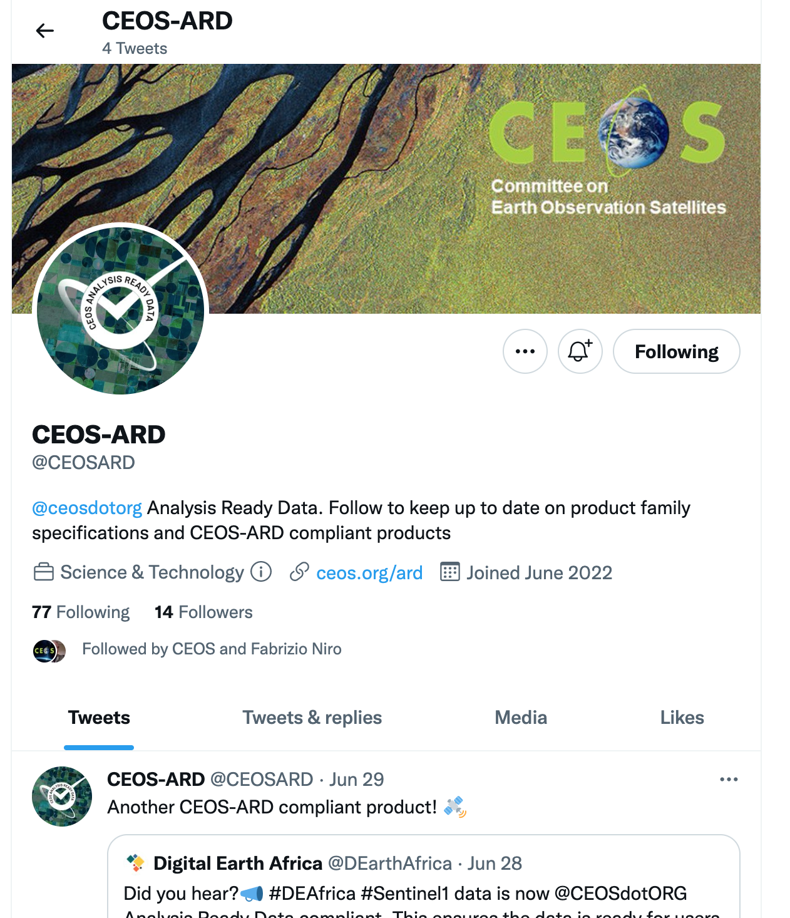

Slide 9
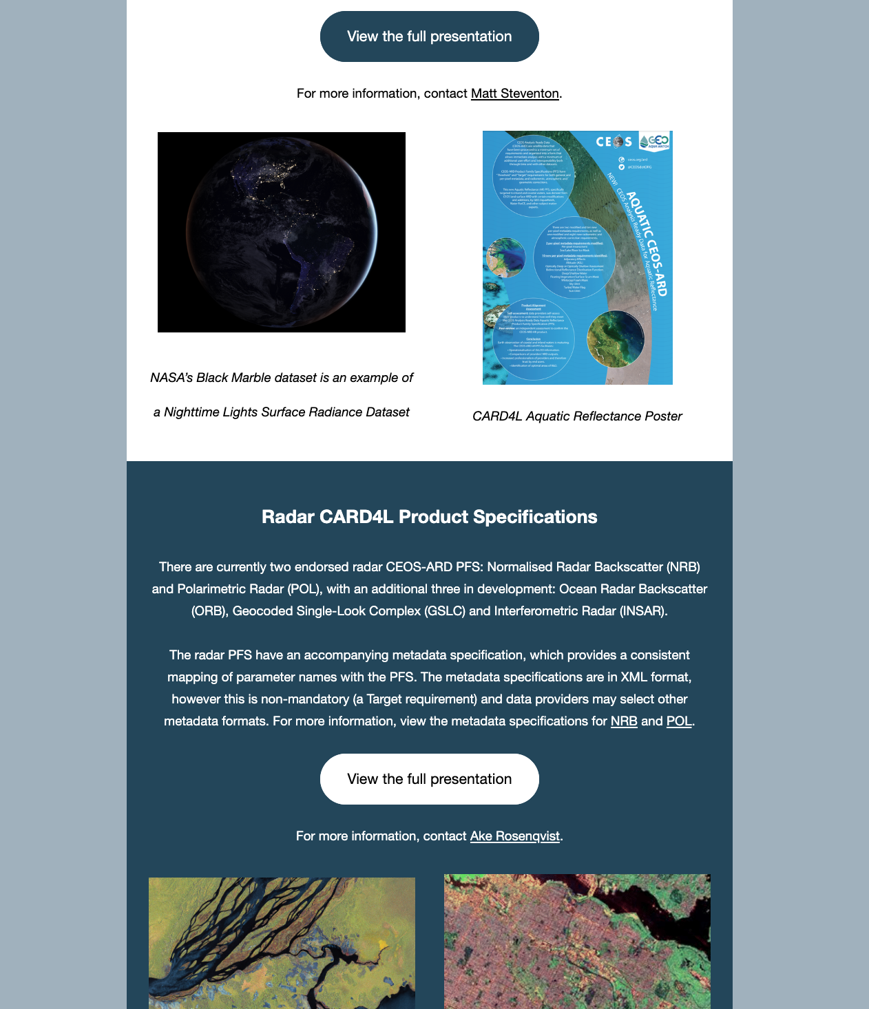
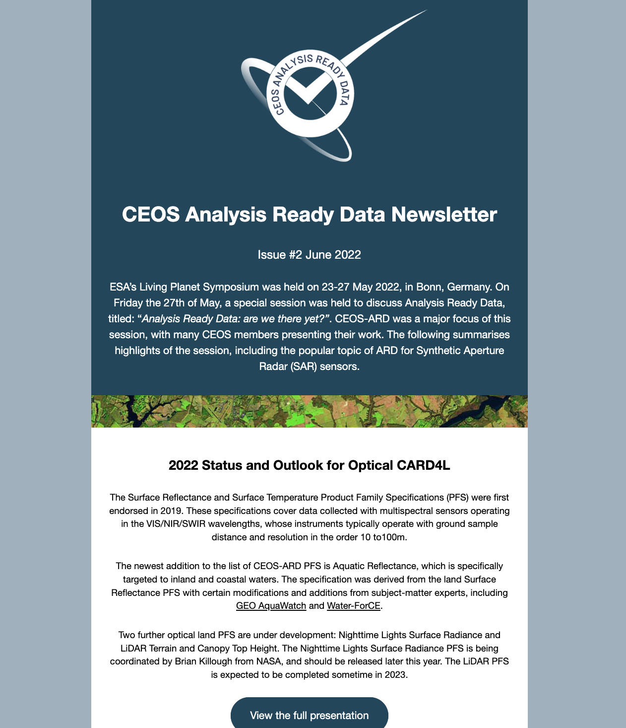
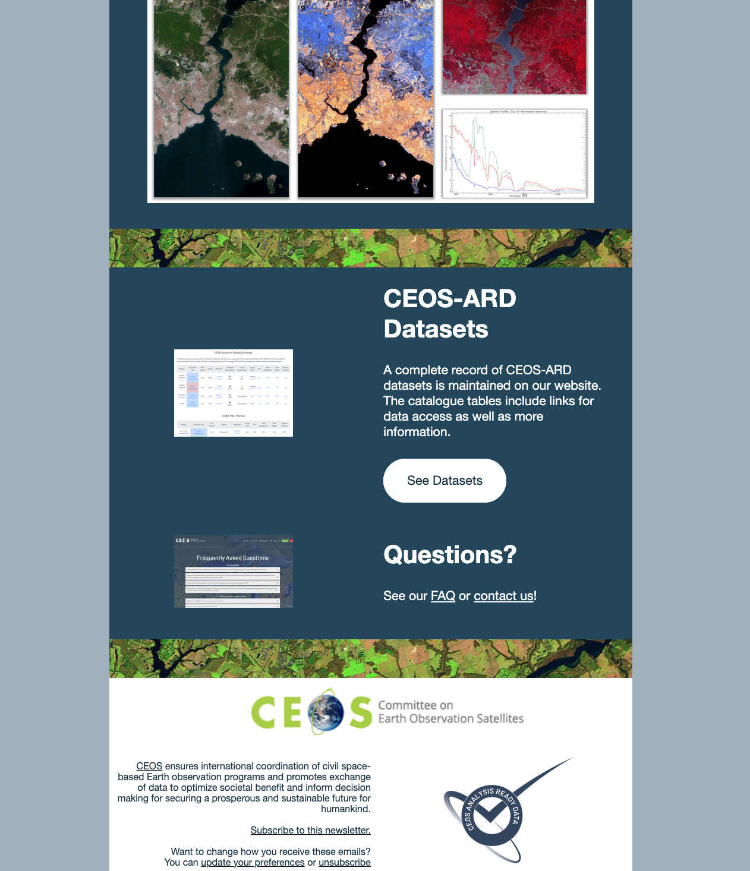
CEOS-ARD Newsletter

