Slide 1
LSI-VC-11 Teleconference #3
Virtual Meeting
19 May 2022

Slide 2
Overview
AFOLU topics
2035 observation scenario
Roadmap: steps and actions needed to meet 2035 observation goals
CEOS actions
National Inventory User Engagement
Reviewing the work plan and CEOS-ARD Strategy alignment of LSI-VC activities
LSI-VC sub-teams
LSI-VC-12 face-to-face planning
Upcoming events
Wrap-up

Slide 3
CEOS AFOLU ROADMAP
May 19, 2022 LSI-VC
Committee on Earth Observation Satellites
Osamu Ochiai (JAXA),
Ben Poulter (NASA) & Frank Martin Seifert (ESA)
Notes:
Osamu to speak < 10 mins

Slide 4
Why is it needed?
The 2015 UNFCCC Paris Agreement came into force on 4th November 2016. Parties have agreed to commit to nationally determined contributions (NDCs), that they intend to achieve regarding their future GHG emissions reductions, to hold global warming well below 2 °C above pre-industrial levels, and aiming to limit it to 1.5 °C.
AFOLU and the Paris Agreement:
National Determined Contributions (NDC) (Art 3, 4)
Conserve and enhance sinks and reservoirs of GHG including forests (Art 5)
Transparency framework and GHG reporting (Art 13)
Global Stocktake (GST) - assessment of collective process (Art 14)

Slide 5
History and Background
GEO Carbon Report developed in June 2010 - Ciais et al. (GCP).
CEOS Strategy for Carbon Observations from Space – written in response to above, completed in March 2014 – Wickland et al.
Systematic Observations and the Paris Agreement (v2.0, GCOS-222, 2018)
Statement of Space Agencies Contributions in Support of the Paris Agreement (2018)
GHG Roadmap - a more focused and policy process driven framework for space agency coordination (draft - 2019)
IPCC Special Report on Climate Change and Land (2019)

Slide 6
GEO Carbon Report – Land Chapter
Increase the density of in-situ network, in particular stations and aircraft atmospheric observation and ocean pCO2 observing systems using Voluntary ships, and eddy covariance terrestrial ecosystem measurement networks.
Develop spatial scaling technique for pCO2 and land flux observations for applications to wider regions, using satellite information.
Undertake a full basin survey of ocean carbon state, together with regular inventories of forest biomass and soil carbon pools.
Improve access to continuous supply of mid-resolution Earth observation satellite data (i.e. LAI, FAPAR, disturbance, land cover change) to monitor areas of forest.
Develop space measurements of vegetation 3-dimensional structure to improve estimates of global terrestrial above-ground biomass and carbon stocks and continue the observational data streams started with JERS-1, ALOS PALSAR and ICESat.
Assemble geospatial information about use of wood and food products and continuously monitored continuously dissolved and particulate carbon, if possible with age information, for related rivers.

Slide 7
IPCC Special Report: Climate Change and Land
Major topics consist of “Land Climate Interaction”, “Land degradation”, “Desertification”, “Food Security”, “Inter-linkage between the topics with GHG fluxes”
Many satellite observation references - both positive and negative
More dialogue with report experts and UNFCCC Secretariat needed to understand the role of Earth observations (satellite and in-situ, etc) in UNFCCC’s Systematic Observations of our planet

Slide 8
CEOS AFOLU Team Participation - under LSI Forest & Biomass team
❖Co-Leads:
Osamu Ochiai, JAXA & GFOI Co-Lead
Frank Martin Seifert, ESA & GFOI Co-Lead
Benjamin Poulter, NASA
Richard Lucas, ESA/CCI
Shaun Quegan, UK & ESA/CCI
Heather Kay, ESA/CCI
Ian Jarvis, GEOGLAM
Stephen Ward, JAXA
Ake Rosenqvist, JAXA
Takeo Tadono, JAXA
Steven Labahn, USGS
Michael Falkowski, NASA
Laura Duncanson, UMD
Christine McMahon-Bognor, NASA
Brian Killough, NASA
Michael Cherlet, JRC
Martin Herold, GFZ Potsdam
Mark Dowell, JRC
Albrecht von Bargen, DLR
Joana Melo, SilvaCarbon
Sylvia Wilson, SilvaCarbon
Sven Gilliams, GEOGLAM
Alessandro Cescatti, JRC
Nancy Harris, WRI
Fred Stole, WRI
Zoltain Szantoi, ESA
Alyssa Whitcraft, GEOGLAM
Kevin Gallo, NOAA

Slide 9
Heritage & 2021 Approach
Assessment of latest AFOLU products that could be readied for COP-26
Engagement of relevant product teams and identification of team leads for our purposes
Coordination with SIT Chair Team and GHG Team on the new CEOS GST Portal – as a unified point of entry to explain and offer our data
Engagement with national inventory users, building on our GFOI experience
Input to SO GST on Mitigation, Adaptation and Means of Implementation.

Slide 10
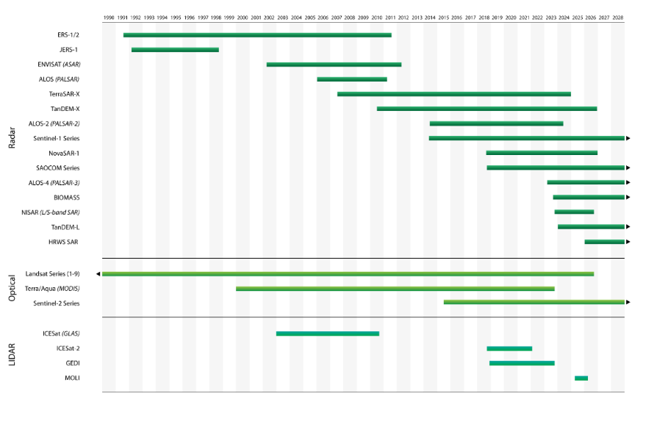
EO satellite sensor types supporting AFOLU information needs

Slide 11
Initial Identification of Existing Datasets
AFOLU Category | Dataset Name | Description | Spatial Resolution | Temporal Coverage
Agriculture | ESA World Cereals. NASA CMS Global Fluxes from Agriculture | Local to global annual cropland extent maps (global for maize and wheat) | 10 m | 2020
Forest (Above Ground Biomass) | CCI Biomass (ESA, with JAXA partnership) | Global above-ground forest biomass maps with associated maps of precision. Derived from L-band and C-band SAR data. | 100 m | 2010, 2017 & 2018 released, 2020 & 2021 planned
 | LiDAR Forest Biomass (NASA/UMD) | Global maps of mean and variance of above-ground forest biomass derived from LiDAR (datasets under development) | 1 km (51.6º N to 51.6º S) | 2019-2022 (release ~2021)
 |  |  | 100m (>N52°)
Forest (Area) | UMD/GLAD Treecover and GFW Datasets | Global maps of forest extent and changes, derived from Landsat data. Maps updated in near real-time. | 30 m | Current
Land Cover | Copernicus Global Land Cover Service (EC), ESA CCI Land Cover | Annual global land cover maps (23 classes) derived from optical coarse resolution sensor data | 100 m - 300 m | 2015 - today, 1992-2015
 | WorldCover (ESA) | Global land cover maps (10 classes) derived from Sentinel-1 and Sentinel-2 | 10 m | 2020 (release mid 2021)
Fire | ESA CCI Fire | Global burned area | 250 m - 300 m | 2001-2019
OLU Wetlands (Mangrove area) | Global Mangrove Watch (JAXA) | Global extent of mangrove forests derived from L-band SAR and optical data. Official UNEP dataset used for SDG 6.6.1 reporting. | 25 m | 1996, 2007-2010, 2015-2018 + annually from 2020
OLU Wetlands (Mangrove biomass) | Mangrove Blue Carbon (NASA) | Global maps of amount and density of carbon stored in mangrove biomass and soil. Total values represent the sum of aboveground carbon, and the soil organic carbon values, attributed to mangrove forests. | 30 m | 2000

Slide 12
CEOS AFOLU Dataset Summary
 | COP-26 (Nov 2021) | GST1 (2021-23) | Beyond (2024+)
Forest - Above Ground Biomass | Individual existing datasets Tool for visualisation of global AGB products developed, with country use case examples and capacity for product assessment | Synthesized, jurisdictional level biomass, emission factors (and prototype biomass change) | Synthesized spatially explicit, annual biomass, emission factors and biomass change
Land Cover & Forest (Area) | - Copernicus annual global land cover - C3S/CCI Land Cover - WorldCover, HILDA+ - Global Forest Watch tree cover loss and forest fluxes | Synthesised map products and estimates of land cover and change at regional, and global levels Global tree cover and forest emissions and removals | Statistically robust activity data estimates (6 IPCC classes) at national and global levels Global annual forest emissions and removals at 30-100 m resolution.
Mangroves & Wetlands | - Global Mangrove Watch cover and change (1996-2020) - Global Mangrove biomass (2000) | - Global mangrove cover and change at 25 m (1996-2022) - Global mangrove biomass at 12 m (2015) | Global annual mangrove emissions and removals at 10-25 m resolution.
Agriculture | Demonstration WorldCereal products for at least 5 countries (Argentina, Spain, France, Ukraine and Tanzania) | Initial WorldCereal map and analytical system. On-going seasonal analysis products | Continual system improvement and production of seasonal state and change products

Slide 13
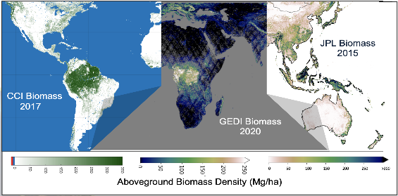
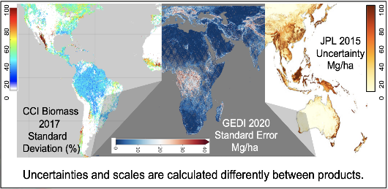
Biomass Product Harmonization Activity for the UNFCCC GST
Intercomparison, validation and harmonization of these products to increase
product improvement and uptake with available reference data.
NASA 2020
GEDI Biomass

Slide 14
Many Upcoming Missions will Provide Data Used to Map Biomass
Product | Data Type | Missions | Years represented | Spatial Resolution | Spatial Domain | Availability
GLOBIOMASS | SAR, lidar | ALOS, ENVISAT, ICESat GLAS | 2010 | 100-m | Global | Available now
GEOCARBON | Fusion of other products | Inputs to other products (lidar, SAR, Optical) | ~2010 | 0.01° | Global | Available now
NASA JPL | Lidar, SAR | GLAS, ALOS-2 | 2015 | 10-km | Global | Available now
CCI Biomass | SAR and Optical | ALOS-2 Sentinel-1 | 2017, 2018 | 100-m | Global | Available now
NASA JPL | Lidar, SAR and optical | GEDI, ALOS-2 | 2020 | 10-km | Global | Available Q4 2021
NCEO Africa | Lidar, SAR, Optical | GEDI, ALOS-2, Landsat | 2007 - 2017 | 100-m | Africa | Available now
CCI Biomass | Lidar, SAR and Optical | ALOS-2, Sentinel-1, GEDI, ICESat-2 | 2020 | 100-m | Global | Available Q4 2021
NASA GEDI mission Product | Lidar | GEDI | 2019-2021 | 1-km | +/- ~51.6° latitude | Available Q4 2021
NASA ICESat-2 boreal product | Lidar | ICESat-2, Landsat | 2019-2021 | 30-m | Boreal (50-75° N) | Available Q4 2021
Past Products
Inputs to Biomass Harmonization Activity

Slide 15
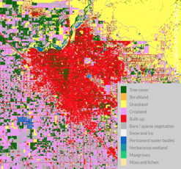
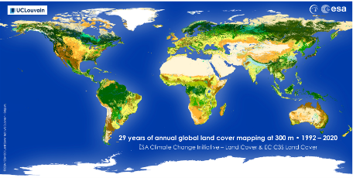
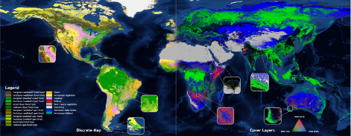
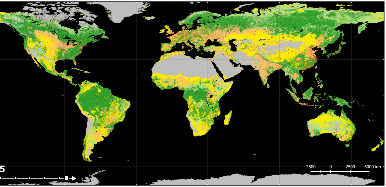
AFOLU Dataset updates - Land Cover
ESA WorldCover
CCI
Copernicus
HILDA+

Slide 16
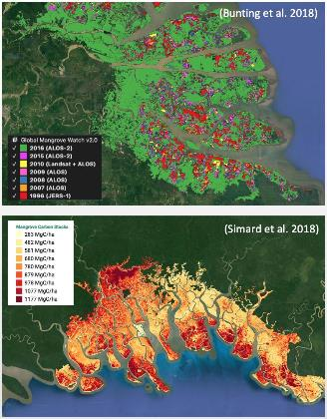
AFOLU Dataset updates – OLU-Wetlands
Mangroves (Forest / OLU-Wetlands)
Activity Data – Global Mangrove Watch (GMW Partnership & JAXA K&C)
Global maps of mangrove area and annual changes at 25 m derived from L-band SAR and optical data. Open access in public domain.
1996–2018 available for COP-26. 2019-2021 for GST1.
Official UNEP SDG 6.6.1 mangrove dataset.
Emission Factors - LCLUC Global Mangrove Mapping (NASA JPL/GSFC)
Global maps of mangrove Height, AGB and Total Biomass at 30 m. Open access in public domain.
Baseline year 2000 derived from SRTM DEM.
New 2015 baseline at 12 m from TanDEM-X DEM available for GST1.

Slide 17
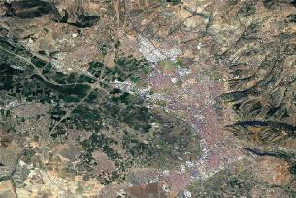
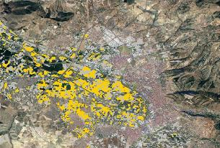
AFOLU Dataset updates – Agriculture
Available for COP26:
All maps for 1 year for 5 countries
Argentina, Spain, France, Ukraine and Tanzania
Spatial resolution: 10 m
Available for Q3 2022:
Global products
Global system to produce the maps

Slide 18
ceos.org/gst
Organised by:
CO₂ & CH₄
Above Ground Biomass
Forests
Mangroves
Agriculture
Land Cover

Slide 19
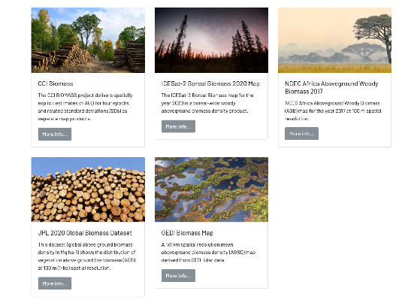
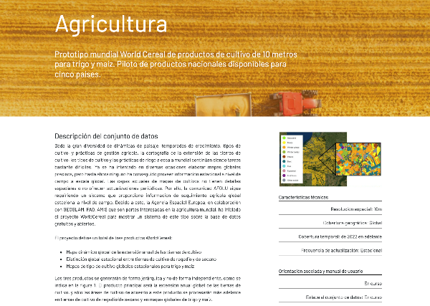
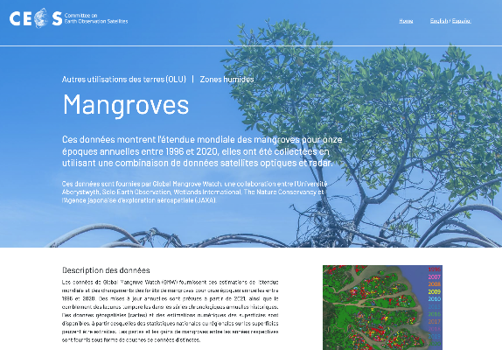
Dataset descriptions
Dataset description
Pointers on usage
Methodology
Uncertainty & Accuracy
Sustainment
Associated Guidance
User Manual
Point of Contact for help
All in English, French and Spanish

Slide 20
National Inventory Test User Group update
Country engagement: Improve understanding and uptake of EO data: AFOLU and Biomass
Two objectives:
i) demonstrations of earth observations uptake
ii) contribution of NFI data for product validation
Update on the CEOS AFOLU engagement with countries
Demonstrate how earth observations and global datasets (land cover and biomass) are used by countries for monitoring and reporting purposes at the COP-26

Slide 21
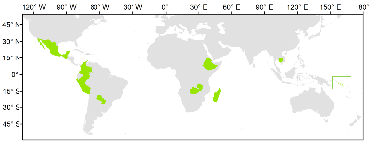
3 Phases activities on National Test
Phase 1: Country selection based on REDD+ compass
evaluation for Land Cover data and availability of Ground-based data (NFI or carbon plots) for biomass
data.
 |  |  | indicators of MRV capacity
Country | Region | Status | FREL | BUR REDD+ Annex | BUR | NIR | NFI
Cambodia | Asia | LDC | 2017; 2021 | 2020 | 2020 | 2020 | No
Colombia | Latin American | n.a. | 2015; 2020 | 2016, 2019 | 2015, 2018 | 2019 | Yes
Ethiopia | Africa | n.a. | 2016 | n.a. | n.a. | n.a. | ?
Guatemala | Latin American | n.a. | n.a. | n.a. | n.a. | n.a. | Yes
Madagascar | Africa | LDC | 2017; 2018 | n.a. | n.a. | n.a. | Yes
Mexico | Latin America | n.a. | 2015; 2020 | n.a. | 2015, 2019 | 2019 | Yes
Paraguay | Latin America | n.a. | 2016 | 2019 | 2015, 2018 | n.a. | Yes
Peru | Latin America | n.a. | 2016; 2021 | n.a. | 2014, 2019 | 2019 | Yes
Solomon Islands | Asia | LDC | 2019 | n.a. | n.a. | n.a. | No
Zambia | Africa | LDC | 2016; 2021 | n.a. | 2020 | n.a. | Yes
Phase 2 :Introduce the initiative to the countries, compile information of global or pantropical datasets that countries are using, and introduce the short list of datasets, test and provide feedback.
Phase 3 :Decision for case studies. Select the countries that will be the best demonstrators on the use of the AFOLU products, biomass estimation, uses and success on the combination of multiple datasets.

Slide 22
2022 Plans

Slide 23
AFOLU Roadmap scope and objectives
Provide a framework for long-term (~15+ years) coordination of CEOS agency observing programmes in support of the needs of society for AFOLU-related information, with a focus on the needs and ambition cycle of the Global Stocktake of the Paris Climate Agreement.
A guiding vision for long term space agency coordination around AFOLU. Characterises the needs, the services and applications required, the products and observing systems that can support.
An effective means for communicating our intentions to society, UNFCCC, national inventory community etc
Addresses basic observation continuity and the necessary agency coordination to achieve it

Slide 24
AFOLU Roadmap Outline
Section 1: Background, Motivation & Objectives
Section 2: CEOS AFOLU activity
Section 3: CEOS GHG and CEOS AFOLU integration (CO₂, CH₄, N₂O)
Section 4: User engagement
Section 5: Beyond CEOS
Section 6: Implementation
Section Leads: Team co-leads (Ben, Osamu, Frank Martin), Stephen Briggs, Martin Herold, Ian Jarvis, Ake Rosenqvist, Richard Lucas, Shaun Quegan, Laura Duncanson, Sylvia Wilson, Stephen Ward - with help from many others…!
Arranging a physical team meeting at SIT TW in Sept
CEOS - GCOS TOPC (Terrestrial Obs) workshop (12 Sep)

Slide 25
Bottom-up AFOLU Inventories
Agriculture, Forestry and Other Land Use (AFOLU) contributes the second largest source of emissions (after fossil fuel use) globally, and the primary source of emissions in many developing nations
In the context of the Global Stocktake (GST),
AFOLU emissions are estimated from the product of an activity index (i.e. number of acres of forest converted to agriculture) and an emission factor (i.e. number of tons of CO₂ released per acre)
Emissions/removals = Activity Index × Emission Factor
Activity Data: Space-based data are a key source of Activity Index data
Emission Factors: Above ground biomass measurements and fire radiative power provide insight into forest emission factors
Only apply to “Managed Land”
If another 10 million hectares burn in Siberia, most of these emissions are not counted because they are not on managed land

Slide 26
Top-down Estimates of GHG Emissions and Removals
Top-down atmospheric measurements provide an integrated estimate of NET emissions and removals by all processes
Not as source specific as the bottom-up inventories required by the UNFCCC
Include sources that are not currently included in those inventories, providing a more complete description of emissions and removals
What fraction of the observed emissions are contributed by:
Fossil fuel combustion?
Agriculture, Forest and other Land Use (AFOLU)?
Changes in the natural biosphere and ocean sources and sinks associated with human activities, extreme events or climate change
Once the assumed fossil fuel sources are accounted for, what fraction of the remaining AFOLU emissions
Are reported by national inventories
Are inferred from existing space-based AFOLU inventories

Slide 27
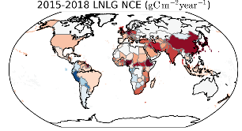
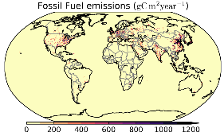
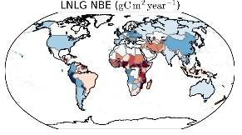
Top-Down Estimates of Carbon Stock Changes
Fossil fuel and cement emissions (FF):
Fossil fuel combustion and cement production releases carbon from the geologic reservoir to the atmosphere.
Net Biosphere exchange (NBE):
Net flux of carbon between the terrestrial biosphere and atmosphere, including biomass burning. Includes both anthropogenic processes (e.g., deforestation, reforestation, farming) and natural processes (e.g., climate-variability-induced carbon fluxes, disturbances, recovery from disturbances).
Terrestrial Net Carbon Exchange (NCE): Net flux of carbon between the surface and atmosphere. For land, NCE can be defined as:
𝑵𝑪𝑬 = 𝑵𝑩𝑬 + 𝑭𝑭
=
+

Slide 28
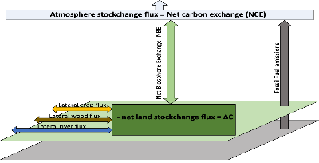
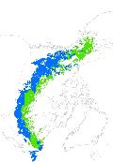
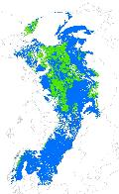
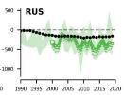
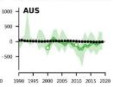
Comparing bottom-up AFOLU and top-down GHG emissions estimates
To compare bottom-up AFOLU inventories with top-down atmospheric GHG estimates, we must
Discriminate Fossil Fuel / Net biospheric Exchange / Ocean contributions to the Net Carbon Exchange (NCE)
Define “Managed Land”
What fraction of the observed emissions are from Managed/Unmanaged land?
Correct for lateral transport of crops, wood products and river carbon, because these contributions do not immediately enter the atmosphere
Byrne et al. (2021)
Dmitry Schepaschenko
Deng et al. (2021)

Slide 29
National Inventory User Engagement
Sylvia Wilson, Joana Melo
USGS SilvaCarbon

Slide 30
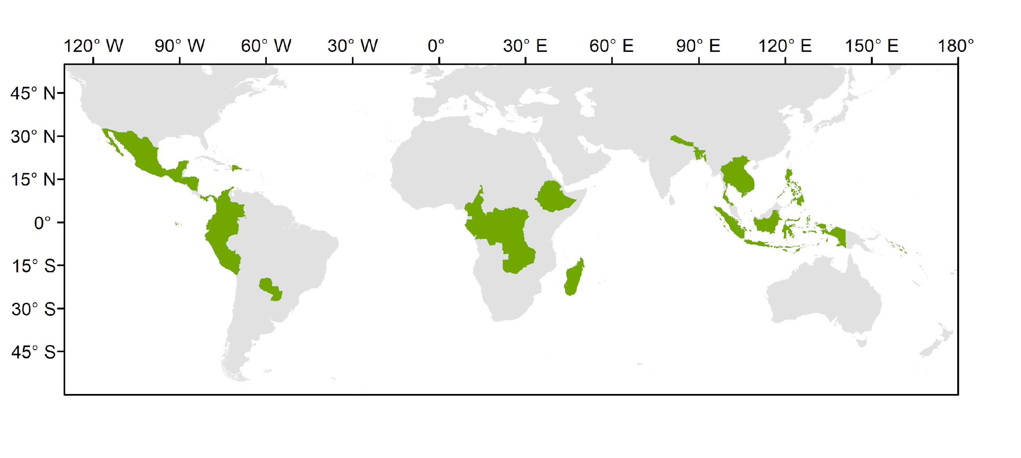
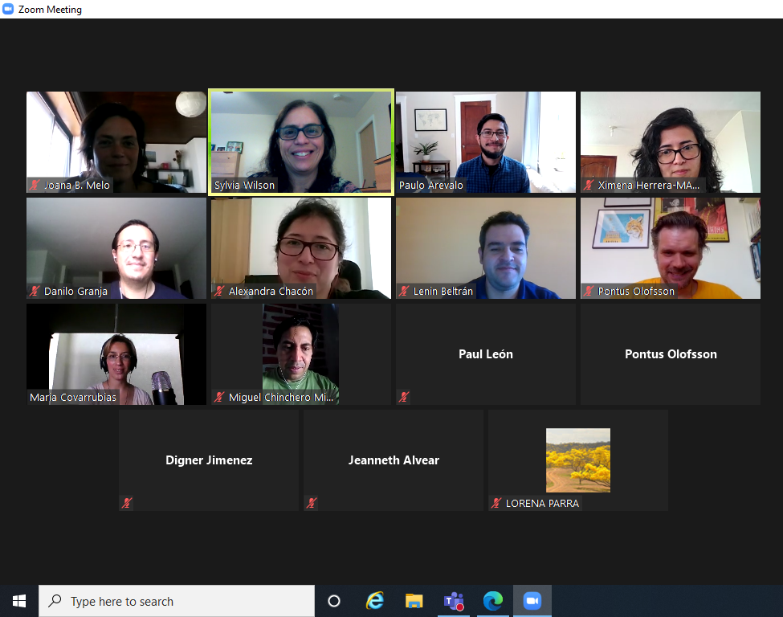
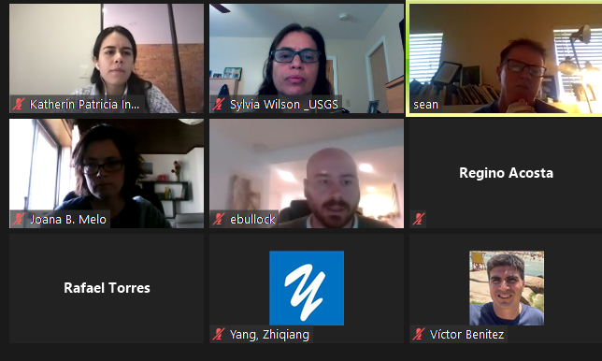
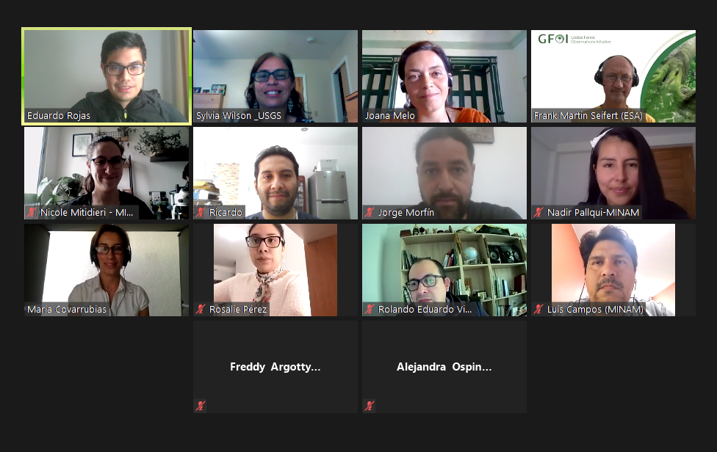
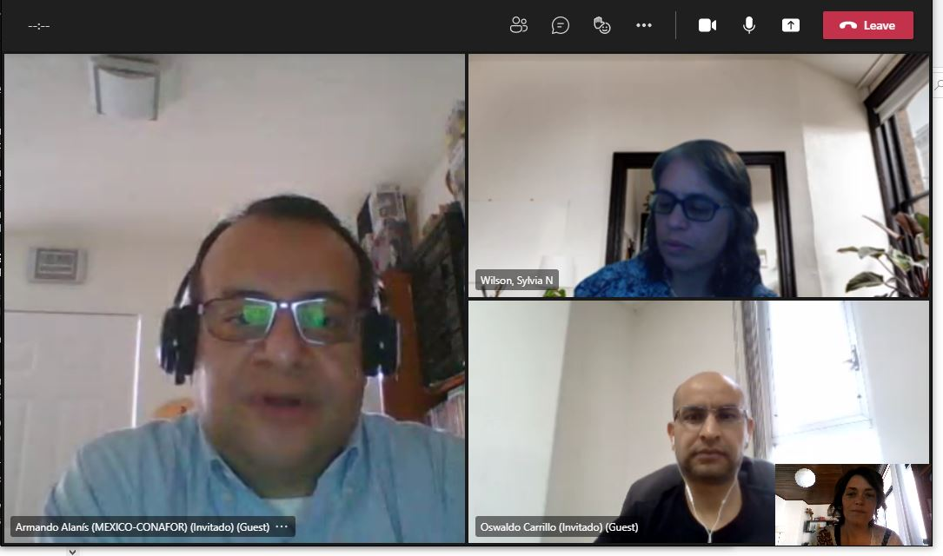
National Inventory User Engagement
Colombia Costa Rica Dominican Republic Ecuador El Salvador Guatemala Honduras Mexico Nicaragua Panama Paraguay Peru
Congo DRC Cameroon Ethiopia Gabon Madagascar Zambia
Bangladesh Cambodia Indonesia Lao PDR Nepal Philippines Solomon Islands Thailand Viet Nam

Slide 31
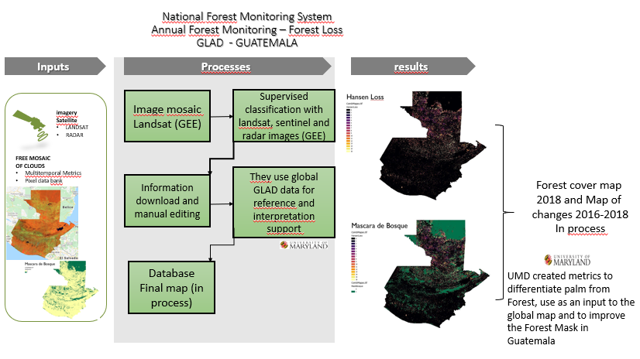
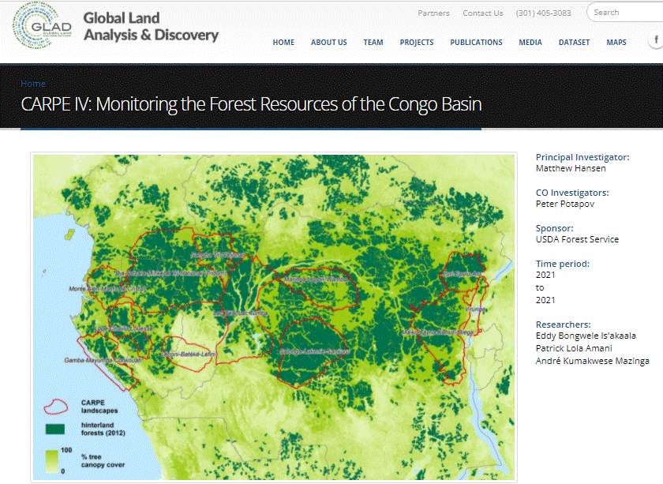
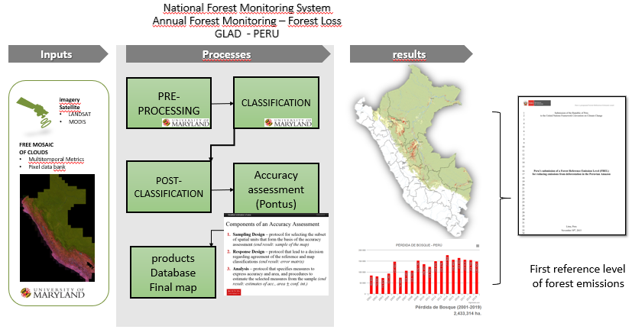
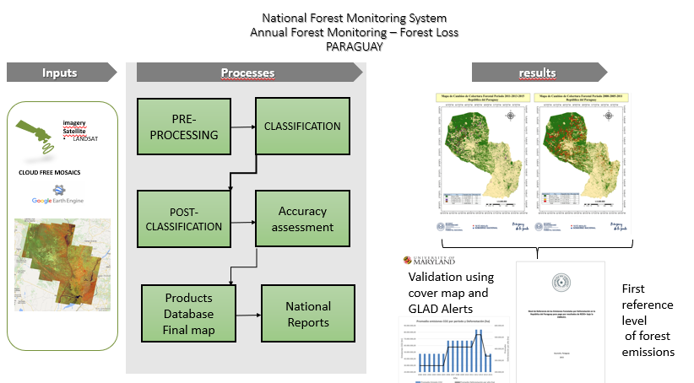

Slide 32
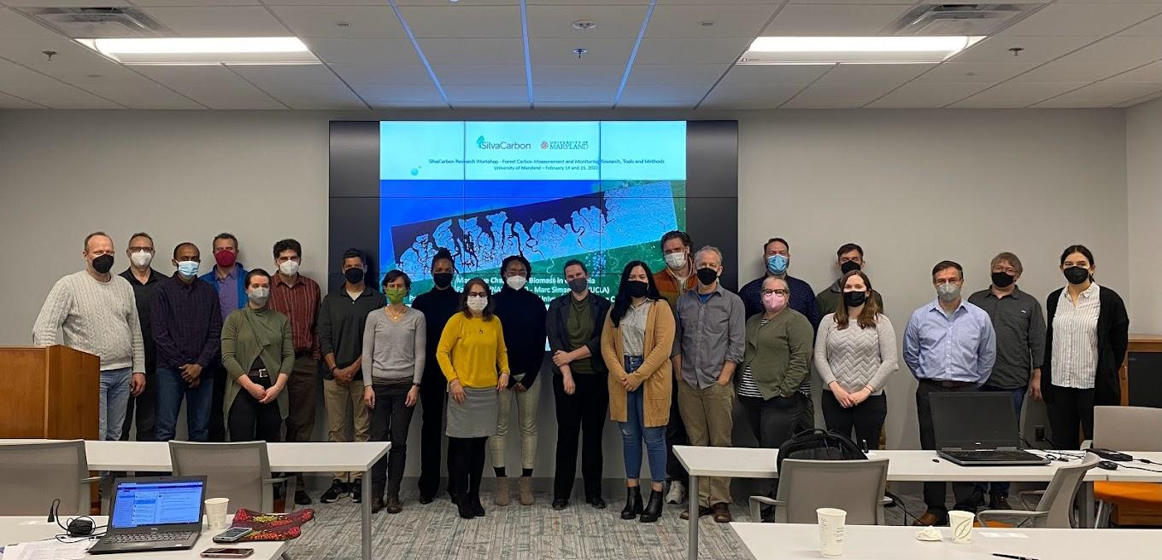
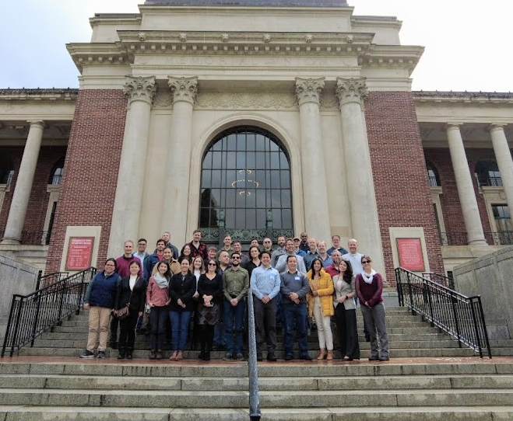
National Inventory User Engagement
Forest Carbon Measurement and Monitoring Research, Tools and Methods Workshop
February 14 -16, 2022 – University of Maryland
Forest Carbon Measurement and Monitoring Research, Tools and Methods Workshop
April 19 -22, 2022 –Oregon State University (OSU)

Slide 33
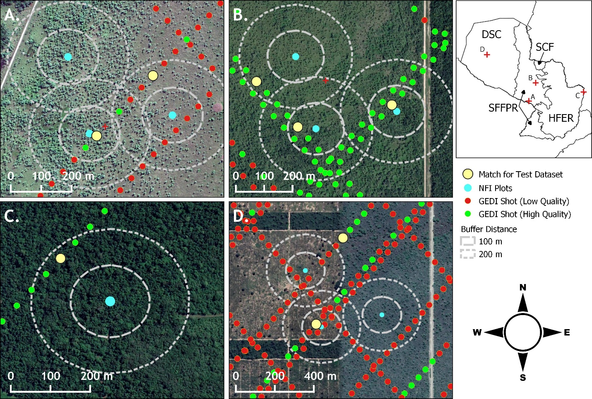
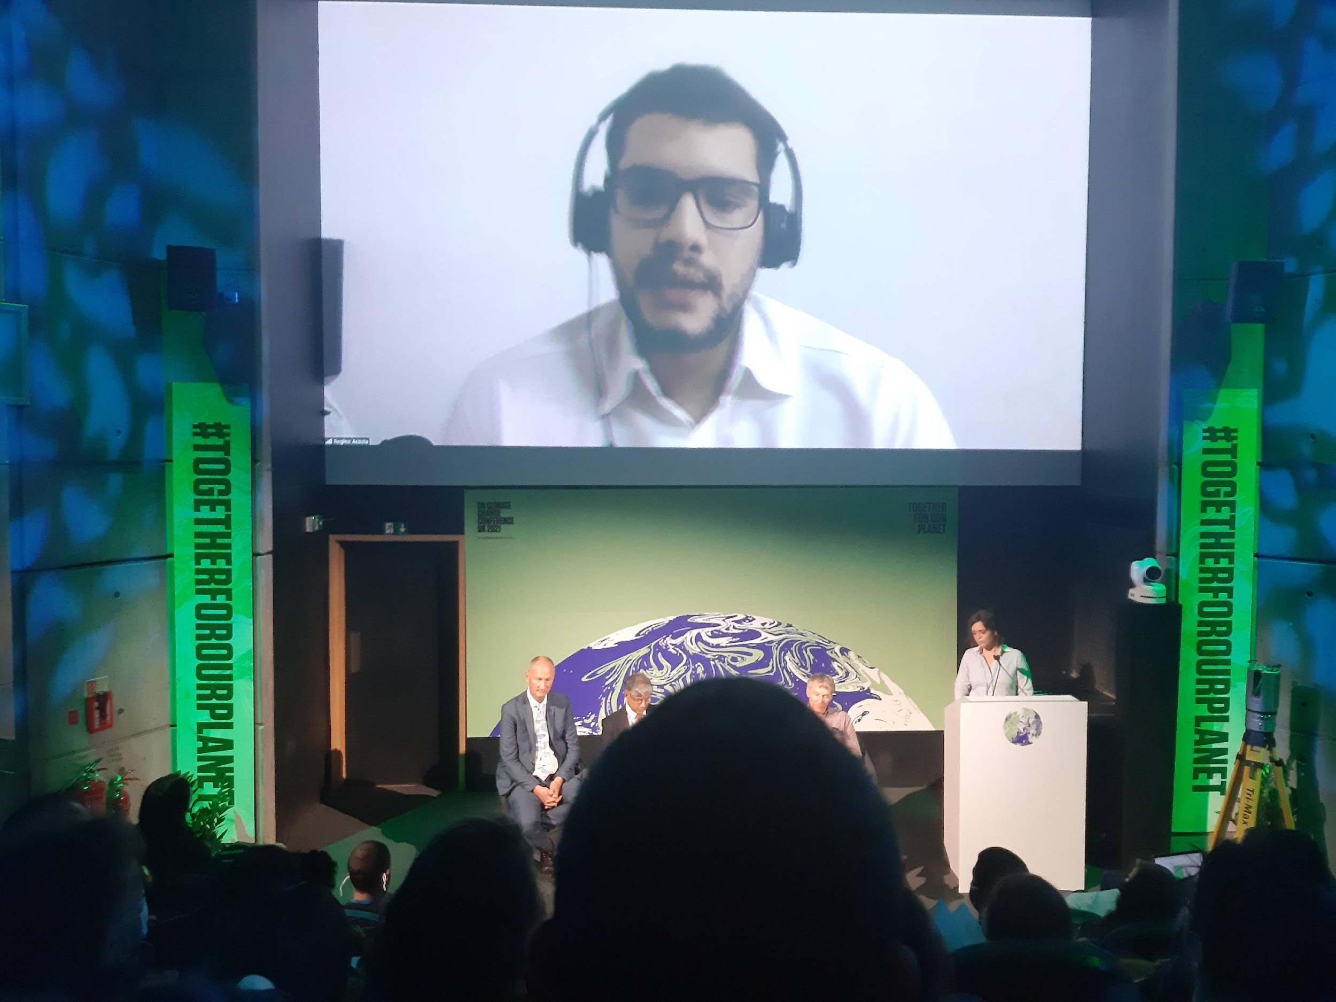
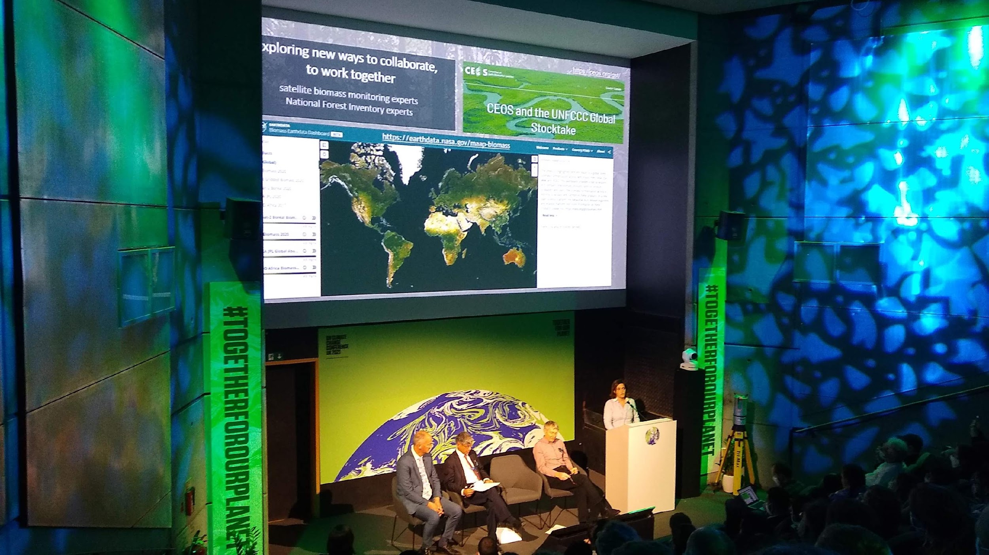
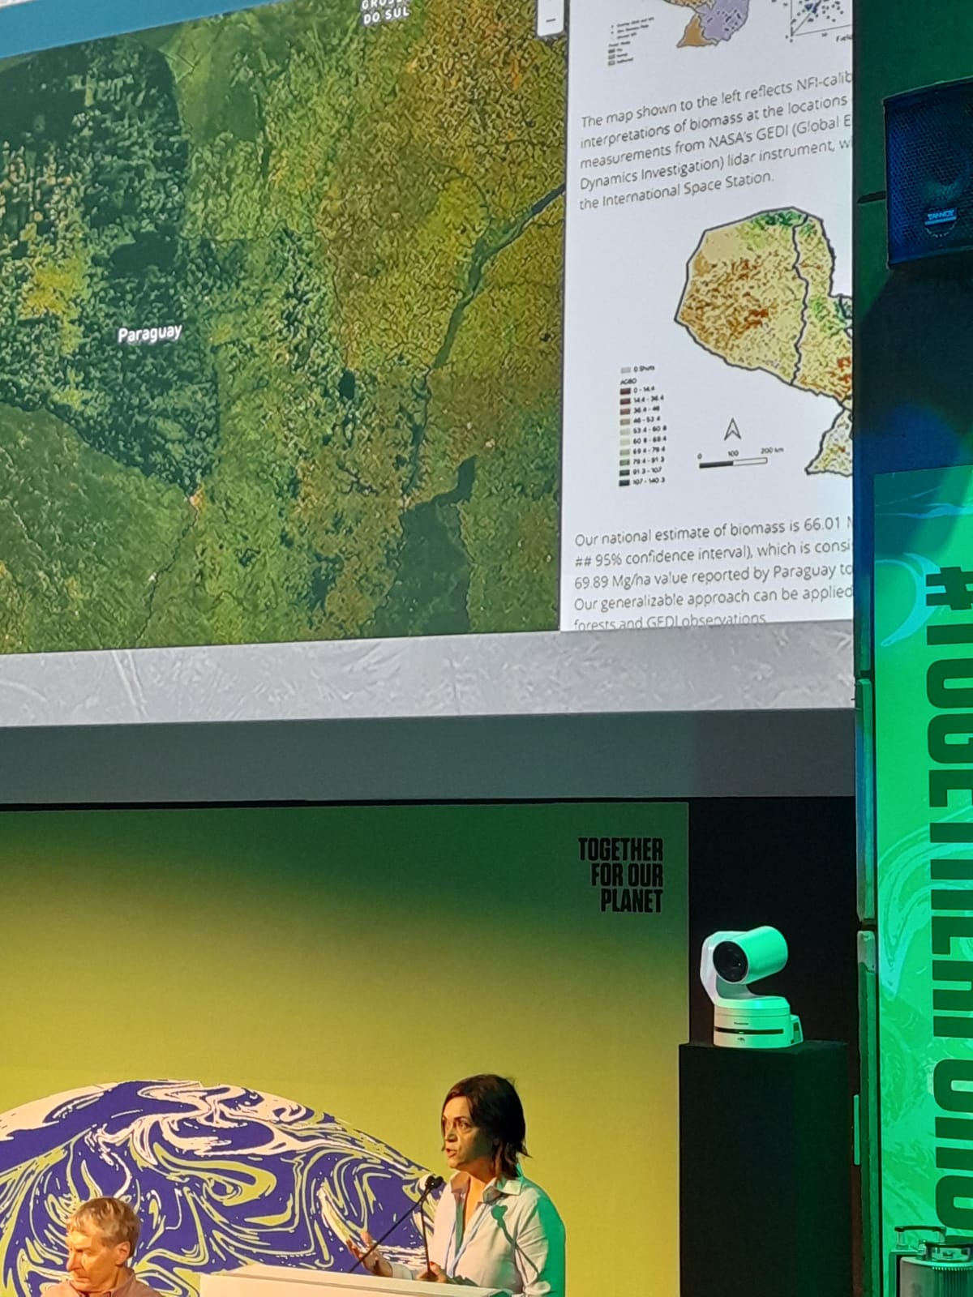
National Inventory User Engagement
Collaboratively develop demonstrations of Earth Observations uptake
Bilateral engagement: CEOS group or agency with a Country
Using GEDI and Landsat to Evaluate and Improve Paraguay’s National Forest Inventory for Estimating Forest Carbon Stocks
COP2 Forests and Carbon from Space Event, 6 Nov, Green Zone

Slide 34
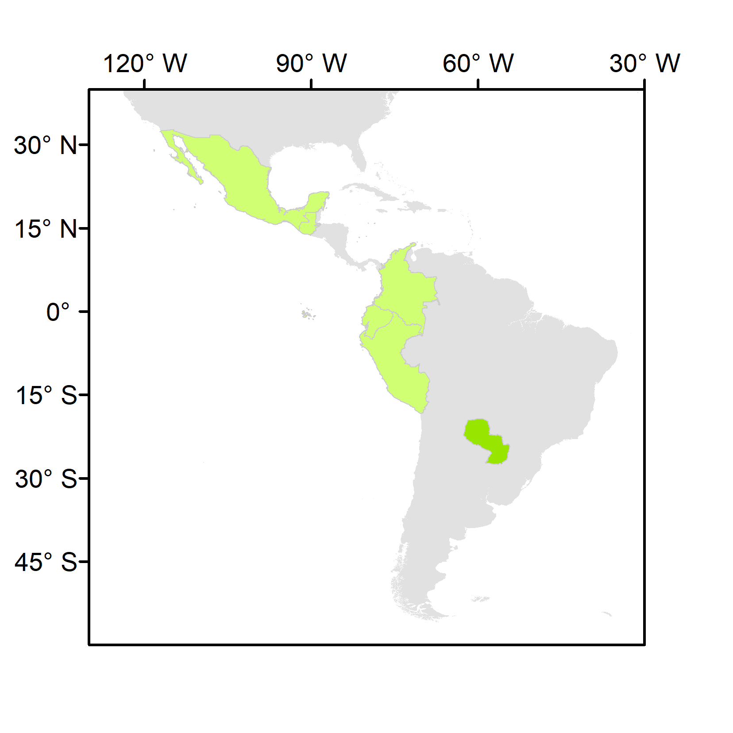
National Inventory User Engagement
Upcoming – June 27 – July 2
1st SilvaCarbon/CEOS Regional Workshop – Biomass measurements
Paraguay, June 2022
National teams to present their NFIs, and the data and methods currently used in reporting and domestic MRV
Comparison of global and regional methodologies calibrated with NFI data, and the ones made purely with defaults or with regional models.
CEOS agencies to present:
the available datasets and methodologies to measure biomass
demonstrations of opportunities for their uptake
a clear plan for sharing of NFI data and collaborating in the calibration/validation of products
Colombia Ecuador Guatemala Mexico Paraguay Peru

Slide 35
In conclusion and moving Ahead….
Regional workshops are schedule for 2022 and 2023. Request of NFI or ground-based data for calibration and validation of pantropical and global biomass
LatinAmerica – Paraguay
Central Africa – Gabon
Pacific Islands – Papua New Guinea
Southeast Asia – Thailand or Vietnam
Include more case studies of Biomass in NASA Biomass Dashboard
Engagement with other partners (FAO in PNG, GIZ in Solomon Islands)
Thanks!
Sylvia Wilson
snwilson@usgs.gov

Slide 36
LSI-VC Organisational Topics

Slide 37
LSI-VC Organisational Topics
Reviewing the work plan and CEOS-ARD Strategy alignment of LSI-VC activities
LSI-VC sub-teams
LSI-VC-12 face-to-face planning
Upcoming events
Slide ‹#›

Slide 38
CEOS Work Plan Tasks
Title | Target Completion Date | Traffic Light Status
CEOS ARD Product Family Specifications (PFS) for land products | 2024 Q4 | Ongoing
CEOS ARD product assessments for land products | 2024 Q4 | Ongoing
Implementation of CEOS ARD Strategy 2021 tasks relevant to LSI-VC | 2024 Q4 | Ongoing - next slides
Mission continuity timelines for land domain CEOS ARD PFS | 2022 Q4 | No progress
Evaluate CARD4L supply, user access, and user experiences via pilot activities (e.g., with Digital Earth Africa, LSI-Forests & Biomass, LSI-GEOGLAM, Mekong Data Cube) | 2022 Q4 | No progress?
Gap Analysis Tools | 2022 Q4 | No progress?
Open-source library for surface reflectance product generation | 2022 Q2 | Unclear status - ESA to update
Water Leaving / Aquatic Reflectance CARD4L PFS | 2022 Q1 | COMPLETE
CEOS–Industry ARD Workshop | 2022 Q4 | Discussed yesterday - SIT Chair New Space priority gives opportunity to revive this task. But need to progress CEOS-side thinking first.

Slide 39
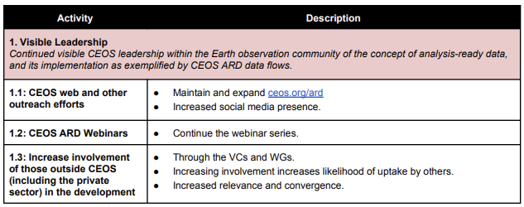
CEOS-ARD Strategy 2021 Tasks
Additional CEOS newsletter contributors?
Action?
Aquatic Reflectance webinar?
On accessibility and utilisation aspects? How do users get and use CEOS-ARD ? With WGISS?
New Space priority

Slide 40
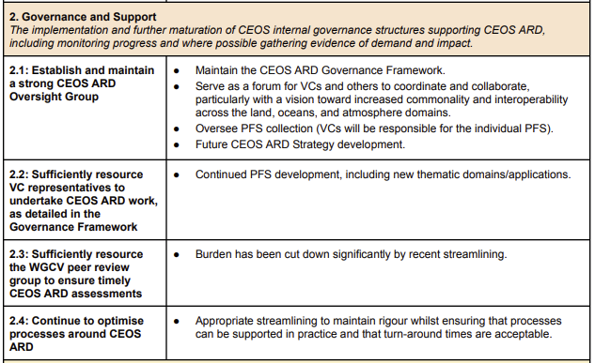
CEOS-ARD Strategy 2021 Tasks
Sufficiently resourced?
Ongoing-discussed on day 1

Slide 41
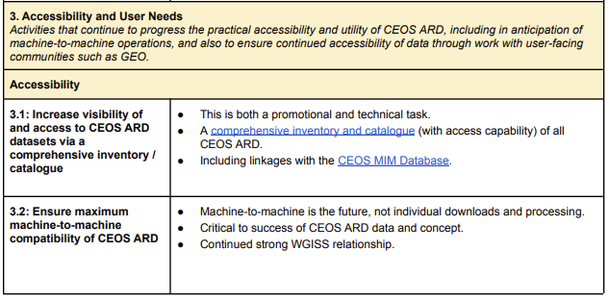
CEOS-ARD Strategy 2021 Tasks
Action recorded Day 2 on this

Slide 42
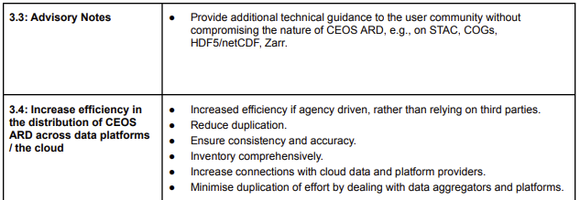
CEOS-ARD Strategy 2021 Tasks
3.2 to 3.4 are really the domain of WGISS
Lacking communication between ARD and WGISS teams?
Action to make a more regular connection to WGISS on these?
Oversight Group role?

Slide 43
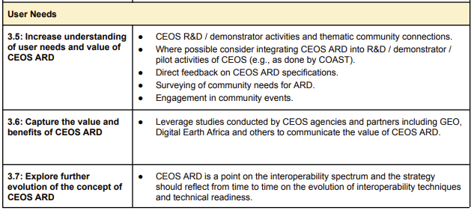
CEOS-ARD Strategy 2021 Tasks
National Inventory work
Digital Earth Africa

Slide 44
LSI-VC Subteams
Idea proposed by Leads to:
Increase engagement of all team members
Progress specific topics:
DGGS
Standards
Assessments
Webinars and outreach
Requirements and gap analysis
User needs and impact?
No additional overhead - just organising people into teams

Slide 45
LSI-VC-12
8-9 September 2022
ESA ESRIN
Week before the CEOS SIT Technical Workshop – also at ESRIN.
Face-to-face but will try to accommodate virtual
Thu 8 | Fri 9 | Sat 10 | Sun 11 | Mon 12 | Tue 13 | Wed 14 | Thu 15
LSI-VC-12 |  | Weekend |  | AFOLU Workshop | SIT TW Side Meetings | SIT TW

Slide 46
Upcoming events
Living Planet
B1.07.1 Analysis Ready Data: are we there yet?
Analysis-Ready Data (ARD) from Hyperspectral Sensors—The Design of the EnMAP L2A Land Product
CEOS-ARD Newsletter content
Pecora 22?

