Slide 1
LSI-VC-11 Teleconference #2
Virtual Meeting
18 May 2022

Slide 2
New Space & Future CEOS:
LSI-VC Role
Day 2
CEOS LSI-VC-11
Virtual Meeting
17-19 May 2022

Slide 3
SIT-37 Preliminary Session
Objectives:
Reflection on the new geometries in the satellite EO sector, including increasing proportion of commercial missions, and CEOS agency arrangements for commercial data buy and partnerships - hearing agency experiences and examples and strategising how public programmes and CEOS must adapt in the decade ahead with this new context. Please refer to the background paper distributed ahead of SIT for further context and objectives.
4.1 Scene-Setting [15 mins]
4.2 Case Studies from CEOS Agencies (NOAA, EC, CNES) [30 mins]
4.3 Discussion on CEOS strategy [15 mins]
A fairly brief & preliminary discussion about trends in the sector and the implications for public EO programmes and for the work of CEOS
Role of public and private EO and the changing dynamic
Trends of relevance to CEOS agencies and CEOS
Possible responses to explore
Slide ‹#›

Slide 4
Context
The share of on-orbit EO satellites belonging to public EO programmes is shrinking rapidly
10 years ago, CEOS agencies launched 14 EO missions during 2012 calendar year (MIM)
5 from China
Some with commercial data aspects
SPOT-6 and Pleaides 1B the only identified commercial sector launches that year
By 2020, more than 50 companies have announced their intention to develop Earth observing missions or constellations, representing roughly 1,800 small satellites, the majority of which are under 50kg
Eg Planet already has ~ 200 active EO satellites in orbit
8 CEOS launches in 2021 (5 from China)
MIM activity shows 80+ commercial EO missions in 2021 (mostly Planet)
These companies raised ~$US 5Bn in each of 2020 and 2021, up from $1Bn in 2019
Slide ‹#›

Slide 5
Context
The space value chain is evolving, with the traditional upstream driven technology push transitioning into a market demand pull.
Space has attracted an important number of actors in the past decades, with New Space and non-space companies entering the different streams of the value chain
Generally EO domain remains geared towards defence and security markets, but an increasing demand from a diversified pool of customers is leading a rapid evolution - with more supply from new entrants, and innovative delivery models for data and analytics to support situational awareness
Cloud computing is bypassing the need for hardware and software ownership, opening up the market to startups and allowing companies to provide ground stations as well as full turnkey solutions as a service (GSaaS concept - allows satellite operators to focus on the core of their business: data)
Machine learning is facilitating the extraction of actionable insights from large amounts of data, automation of repetitive processes, and extending the use of space-based applications to new markets
Slide ‹#›

Slide 6
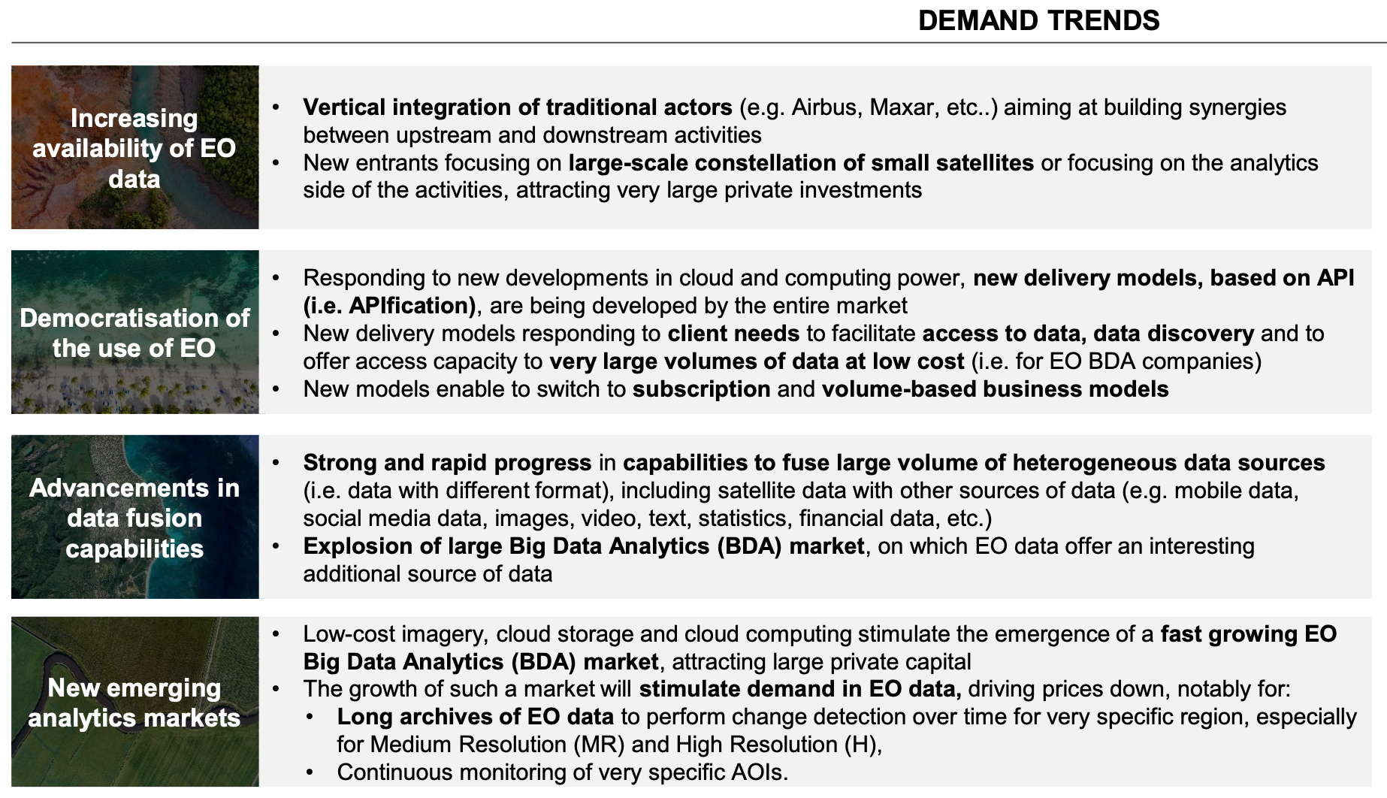
Important trends supporting growth in EO data products & services
Slide ‹#›

Slide 7
Candidate measures in response
SIT Chair Team open to suggestions for future approach and TW Content.
We could consider how New Space missions and data systems, in combination with CEOS agency capabilities, can help the CEOS priority thematic observing strategies: climate (UNFCCC, Paris agreement, GCOS ECVs and the GST), disaster response (Sendai framework), and the SDGs.
Understand how New Space capabilities could address current or projected gaps, or more cost-effectively satisfy selected requirements (eg individual CDRs in support of the ECVs).
Identify the steps necessary to ensure future missions are fit for purpose to meet these requirements. These might include collaboration on data quality standards, calibration and validation, calibration transfer, adoption of common standards for data discovery, mixing and application – including CEOS ARD standards.
Define measures for CEOS to take as part of an engagement strategy to address the opportunities identified and to communicate them to industry and the associated data characteristics that will be needed.
Slide ‹#›

Slide 8
Things we can leverage…
Examples to leverage our long technical heritage:
CEOS has spent decades investing in data standards for interoperability, ARD, catalogues etc. If we anticipate an explosion in diversity of datastreams and sources, including through space agency data buys, is NOW not the time to seek uptake of those standards
For maximum benefit across the whole sector
To allow public EO programmes to be bigger than the sum of their parts
Ensure all our good work is not lost in the noise of a rapidly expanded sector
Likewise we have huge investment by CEOS agencies in legacy infrastructure for cal-val
Supporting easier access and application of the legacy infrastructure for New Space would increase utility and value of the commercial data
Australia and UK discussion of Data Integrity Framework for that purpose
Open Source Toolkit for use of CEOS agency cal-val sites
SITSAT (SI Traceability Satellites) efforts by ESA/UK (TRUTHS), NASA (CLARREO), GA (SCR)
Calibration transfer
DISCUSS!
Slide ‹#›

Slide 9
LSI-VC input and role
Many of the issues and solutions are relevant to LSI-VC scope and expertise
Looking for steer on best approach overall and for next opportunity (TW, half day?)
How can we bring in industry to the conversation? (LSI-VC has history) When?
Interested individuals & agencies encouraged to reach out to SIT Chair Team
DISCUSS!
Slide ‹#›

Slide 10
ARD Standards
Day 2
CEOS LSI-VC-11
Virtual Meeting
17-19 May 2022

Slide 11
ARD Standards
Overwhelming feedback from industry: formal standards are needed for ‘ARD’
Without a standard: difficult to implement CEOS-ARD into operational workflows
Government and commercial sectors will likely not reference documents unless they have gone through an open standard process.
Standards built on the foundation of CEOS-ARD would be helpful
Increase reach of the concepts of CEOS-ARD
Been talked about for a while.
Two avenues explored:
IEEE/GRSS
ISO-OGC
Briefings at both LSI-VC and CEOS-ARD Oversight Group telecons.
Questions are:
Now what?
Does CEOS engage with these groups?
Who would want be a CEOS representative for the long process?
Feeling this (particularly ISO-OGC) will happen with or without CEOS involvement?
Where does this leave CEOS-ARD?
Slide ‹#›

Slide 12
IEEE/GRSS

Slide 13
IEEE Presentation Recap
George Percivall (Vice-Chair, IEEE/GRSS)
CEOS-ARD Oversight Group Meeting March 2022
CEOS has created an excellent baseline of ARD Specifications. IEEE provides a potential process for open standardisation and could provide a platform to bring these CEOS achievements to a broader community.
IEEE North American focus to be considered
Europe: CENELEC

Slide 14
IEEE Presentation Recap
Process:
Project initiation
Mobilisation of the working group (proposed: led by CEOS, alongside experts from GRSS)
Draft and approve the standard
However in the case of ARD, there are existing specifications (CEOS PFS), so this process becomes much quicker.
IEEE then publishes the specification and promotes it through announcements and press releases.
Maintaining the standard is an ongoing process.

Slide 15
IEEE Presentation Recap
Concerns previously raised by LSI-VC:
how would CEOS maintain ‘control’ ?
how do we avoid having the specifications locked behind a paywall?
IEEE charges for most standards, but there are efforts underway to make more standards available more freely.
If CEOS wishes to proceed in this direction, the Oversight Group will need to identify suitable leads for the activity. CEOS will maintain the ‘control’ desired by ensuring strong leadership and representation in the group developing the standard.
Need clarification regarding CEOS-ARD Intellectual Property (IP)
Does the IP of the CEOS-ARD PFS lies with CEOS?
CEOS is not a legal entity
Some form of licence would need to be given to IEEE by whoever holds the IP rights.
Legal vetting of IPR and essential patent checks are a key part of the IEEE process and is one of the benefits of engaging a body like IEEE.

Slide 16
Email - 13/5/2022
The IEEE GRSS Standards Committee remains ready to support CEOS in furthering ARD development.
Here is the presentation we made to the Oversight Group in March.
GRSS standard development draws on this large IEEE community of geoscience and remote sensing expertise:
- Technical Committees, e.g., Image analysis and Data Fusion;
- Conferences, e.g., IGARSS;
- Publications, e.g. Geoscience and Remote Sensing
IEEE Standard Association provides a nimble process that would be tailored to CEOS needs.
Participation from industry, research and governments is the norm in IEEE.

Slide 17
ISO-OGC

Slide 18
ISO-OGC Presentation Recap
The ISO Technical Committee 211 (TC 211) is responsible for setting international standards on geographic information.
OGC, CEOS (through WGISS) and IEEE GRSS are all Class-A external liaison organisations of ISO TC 211.
OGC has signed an MOU with ISO TC 211 to coordinate and cooperate on the development of international standards on geospatial information.
With CEOS support the OGC Disaster Pilot 2022 included an action item to develop a roadmap and initial plan for ARD standardisation.
Initial thoughts are to use CEOS-ARD specifications as the basis, and to build on existing OGC and ISO standards. They will be published as ISO and OGC standards following a joint ISO and OGC development through the usual standards development process.

Slide 19
ISO-OGC Presentation Recap
Multi-part ISO and OGC standard
Part 1: geospatial ARD framework
Parts 2-4: EO ARD for land, ocean and atmosphere.
Part 5: Earth System Model ARD
Part 6: Geospatial ARD service
An ISO TC 211 project team and the OGC ARD SWG will undertake the standard development task (in close collaboration with relevant CEOS committees).
Funding support is needed to support the standard development. This initial phase is funded by USGS.
Process is expected to take 2-3 years and will require a large time commitment.

Slide 20
ISO-OGC Presentation Recap
Will progress regardless?
CEOS participation in the development is desired.
Re-using the work done by CEOS on CEOS-ARD is central to the plan.
Reformatting the content into the usual ISO/OGC standards format (unified modelling language and components).
Need to work closely with CEOS as the original developers of the concept.
The standard will also cover terminology.

Slide 21
ISO-OGC Reactions
Plan to use current CEOS-ARD work as basis
Sounds like this will go ahead regardless of CEOS
With that said they would like CEOS involvement – both through the eventual nomination of CEOS people to work on the standards development team and also they would like to know whether CEOS supports the overall proposal.
Clearly a very long and complicated process (2-3 years)
Development will build off our work but we will continue in parallel on our own CEOS-ARD, which will be more dynamic and flexible than the standards?
Does that create a potential divergence problem?
Will the two have different scope?
Is anyone interested and able to work on the standards team on behalf of CEOS?
Discuss!

Slide 22
Discussion points
Now what?
Does CEOS engage with these groups?
Who would want be a CEOS representative for the long process?
Feeling this (particularly ISO-OGC) will happen with or without CEOS involvement?
Where does this leave CEOS-ARD?
Possible divergence?
CEOS will maintain the ‘control’ desired by ensuring strong leadership and representation in the group developing the standard.
Need clarification regarding CEOS-ARD Intellectual Property (IP)
Does the IP of the CEOS-ARD PFS lies with CEOS?
CEOS is not a legal entity
Funding support?

Slide 23
PFS Updates 2022

Slide 24
SR/ST PFS Annual Review Process
Ongoing
SR/ST Team meeting a few more times to resolve feedback
Participation welcome from all
Target endorsement of update after LSI-VC-11
Open questions for discussion:
Versioning system
How to update already assessed products?
DOI to point to most current PFS?
Discuss

Slide 25
4.1: Geometric Correction and high-res
Sub-pixel accuracy is taken to be less than or equal to 0.5-pixel radial root mean square error (rRMSE) or equivalent in Circular Error Probability (CEP) relative to a defined reference image.
Discussion:
This makes the PFS very difficult to achieve for high res sensors (e.g. KOMPSAT, commercials)
Impact on commercial uptake of CEOS-ARD
Adjustment to wording?
Or tiered requirement? (e.g. >30m resolution, <30m resolution)
Discuss

