Slide 1
LSI-VC-11 Teleconference #1
Virtual Meeting
17 May 2022

Slide 2
Overview
Agency updates: latest plans regarding CEOS-ARD and other LSI related topics
Assessment progress report
PFS updates
NRB/POL metadata update
Status of SAR/Lidar PFS, including the new Ocean Radar Backscatter (ORB)
Tweaks and special conditions for the PFS to accommodate high resolution - discussion
Slide ‹#›

Slide 3
Agency ARD Updates

Slide 4
Agency ARD/LSI Update
Possible topics:
Status of CEOS-ARD product assessments
Any issues - feedback for PFS annual review
Actions underway in agency to increase access to ARD
Cloud initiatives?
New LSI missions that will feature ARD?
Feedback from users on ARD utility?
Connections with industry? New space? Ref: SIT Chair theme
Thoughts on further ARD standardisation?
Any other LSI coordination topics to raise with LSI-VC team?
Requirements analysis, gap filling observations?
Support for AFOLU Roadmap / Global Stocktakes?

Slide 5
Sentinel-1 CARD4L implementation experience
Grega Milcinski, Marko Repse
Sinergise/Sentinel Hub
grega.milcinski@sinergise.com

Slide 6
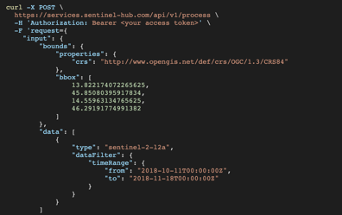
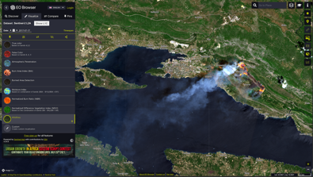
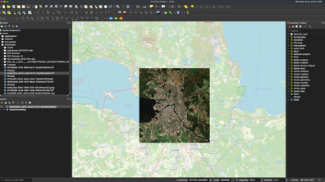
Open Imagery
Programming:
JavaScript, Python, R, etc.
Cloud API
Commercial Imagery
Bring Your Own Data
Web/Mobile Apps
Auxiliary Data: CORINE Land Cover, DEM
Machine Learning
GIS
Notes:
Unified API to access and pre-process various input data sources.

Slide 7
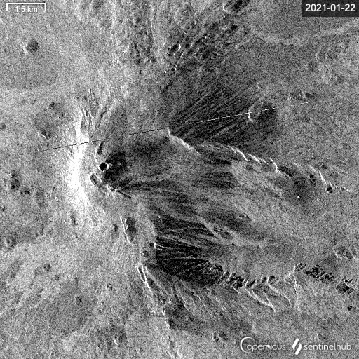
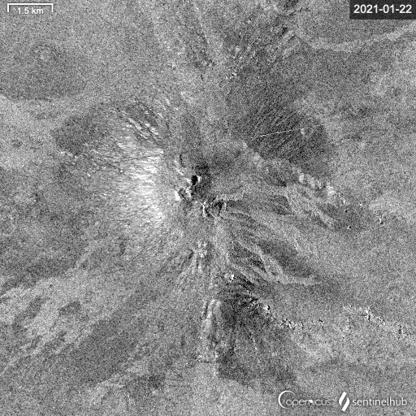
Sentinel-1 CARD4L

Slide 8
Sentinel-1 CARD4L
gamma-0 (optional beta-0, sigma-0)
orthorectified (Copernicus DEM or MapZen DEM)
radiometric terrain correction
(optional) Lee speckle filtering
all relevant meta-data
Full Sentinel-1 archive + fresh data
https://docs.sentinel-hub.com/api/latest/data/sentinel-1-grd/#processing-chain

Slide 9
Sentinel-1 CARD4L – on-demand
Process API
OGC WCS/WMS/WMTS
Batch processing – for pre-processing
(Batch) Statistical API – for time-series

Slide 10
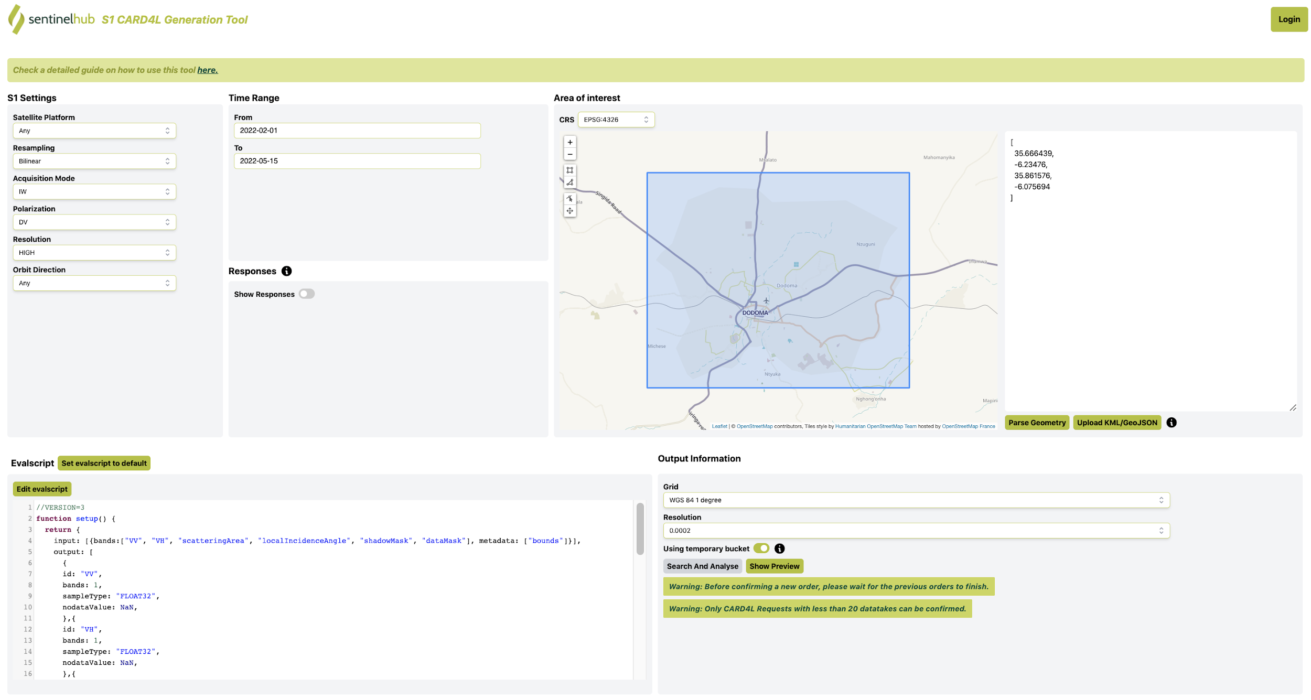

Slide 11
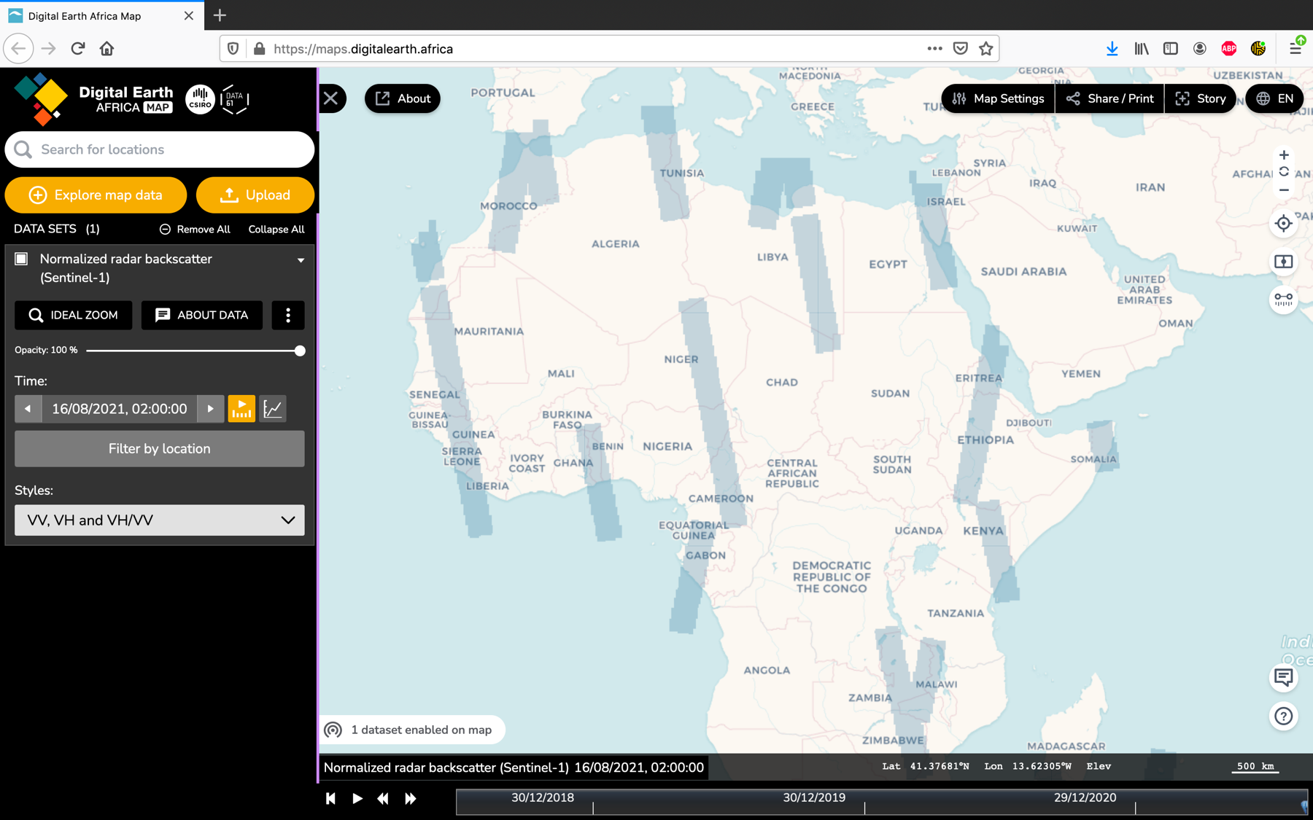

Slide 12
S1 CARD4L uses
DE Africa (+mirror at CreoDIAS)
NASA Open Data Cube
EU CAP Area Monitoring
...

Slide 13
S1 CARD4L implementation
ARD with S1 depends significantly on the use-case
C4L THRESHOLD seems like a good compromise
Amount of data for C4L TARGET excessive
Implementation in parallel with changing requirements is challenging
Peer review is not very clear

Slide 14
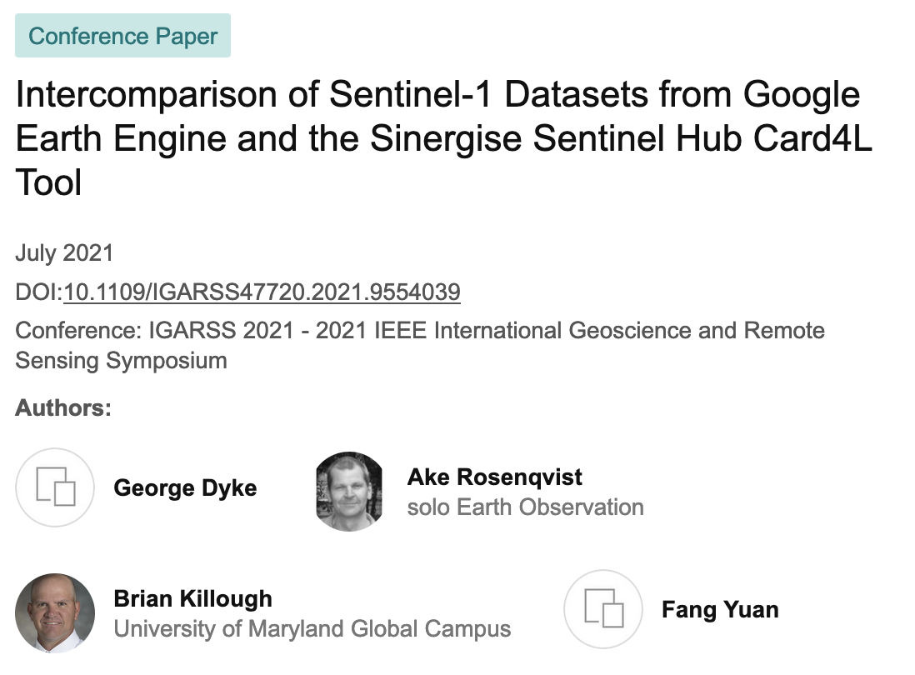
Validation beyond CARD4L
Dyke, George & Rosenqvist, Ake & Killough, Brian & Yuan, Fang. (2021). Intercomparison of Sentinel-1 Datasets from Google Earth Engine and the Sinergise Sentinel Hub Card4L Tool. 1796-1799. 10.1109/IGARSS47720.2021.9554039.

Slide 15
Thoughts
Data validation should be part of peer review as well
People follow examples rather than standards
Add use-case scenarios and implementations

Slide 16
More info
https://sentinel-hub.com/
https://docs.sentinel-hub.com/api/latest/data/sentinel-1-grd
Thanks
Fang Yuan, Ake Rosenqvist

Slide 24
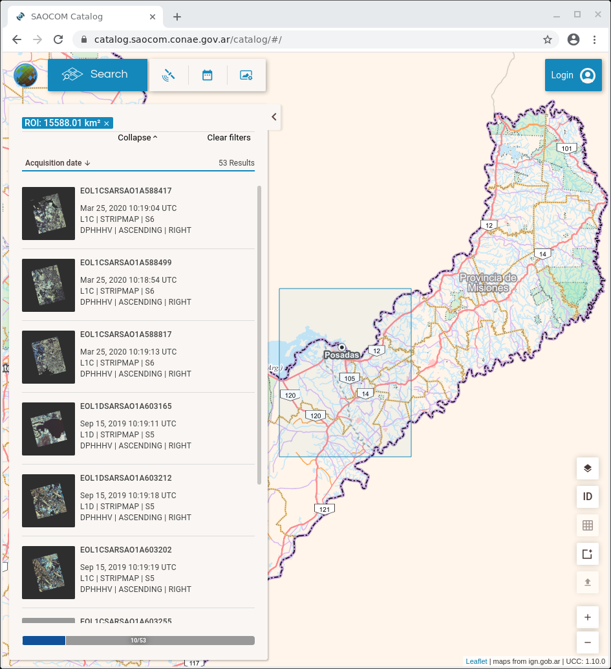
CONAE
SAOCOM Mission
Catalog: Authenticated users
Downloads
New acquisitions
https://catalog.saocom.conae.gov.ar
Polarimetric L-band SAR
SAOCOM 1A (2018)
SAOCOM 1B (2020)
+ Facilities
+ Applications
Notes:
‹#›

Slide 25
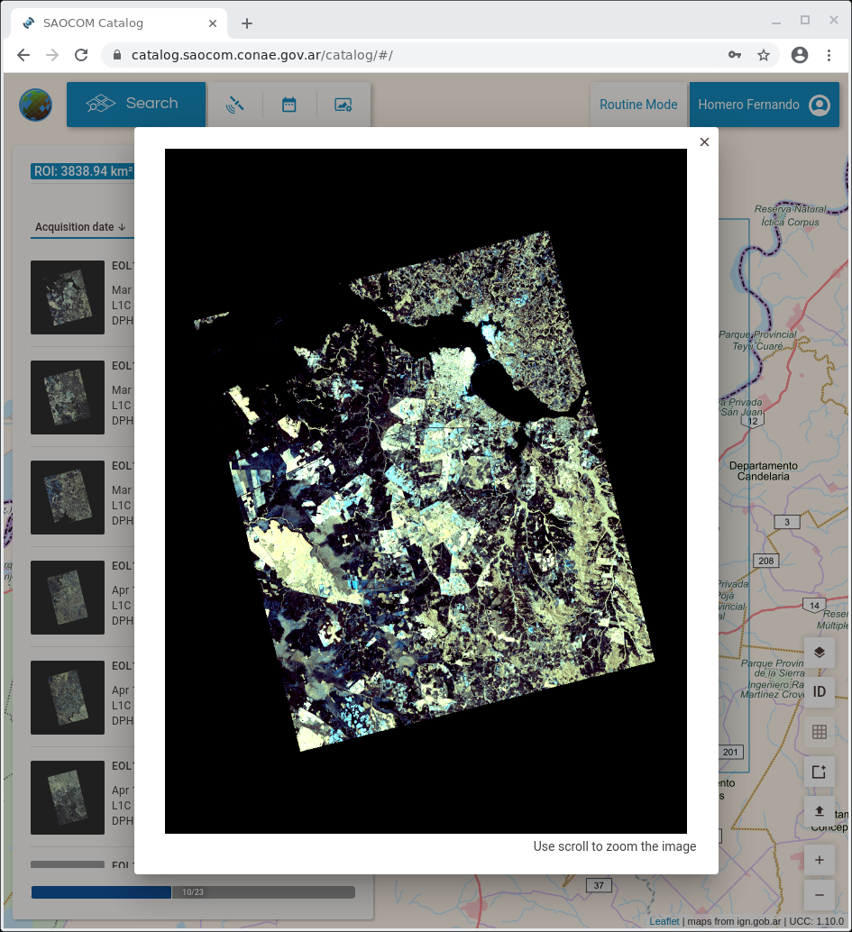
CONAE
SAOCOM Mission
Catalog
Quick-look
Date of acquisition:
March 25th, 2020
Time of acquisition:
7:19 local time.
Acquisition mode:
StripMap Dual Pol (Beam 6).
Orbit:
Ascending
Polarization:
HH – HV
Color combination:
R: HV
V: Mean of 2*HV y HH
A: HH
Notes:
.
‹#›

Slide 26
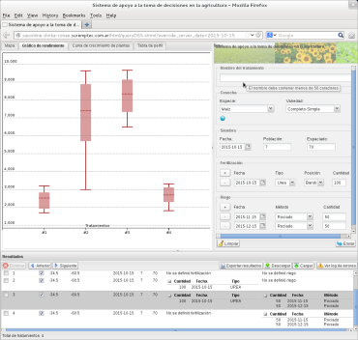
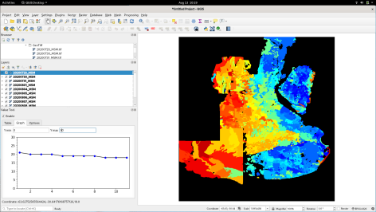
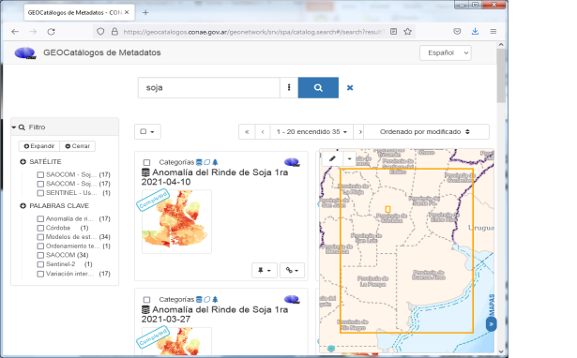
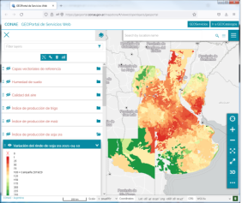
CONAE
High level products and distribution
SAOCOM enables Surface Soil Moisture (SM) monitoring at plot scale.
The project promotes to add value by releasing open access products.
Root soil water content.
Decision support systems for agriculture.
Maps of anomalies and inter-seasonal mean yield scenarios for the main crops in Pampas Region (wheat, maize, soybean).
Free technological solutions for sharing maps
GEOCatalog of metadata:
GEOServices web under
standards of the OGC:
GEOPortal: non-expert users or without GIS

Slide 27
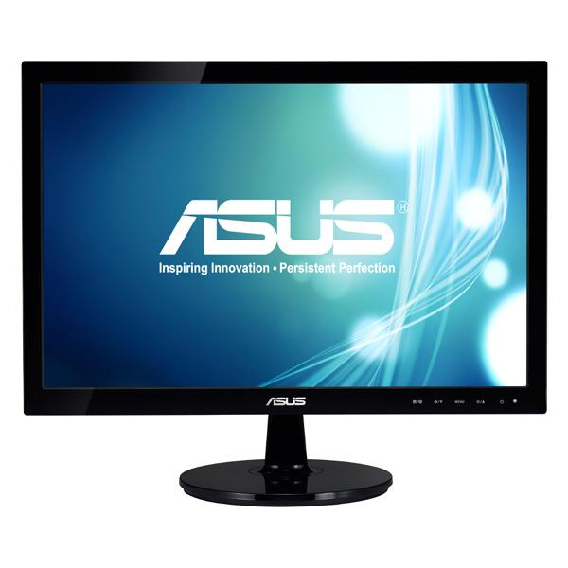
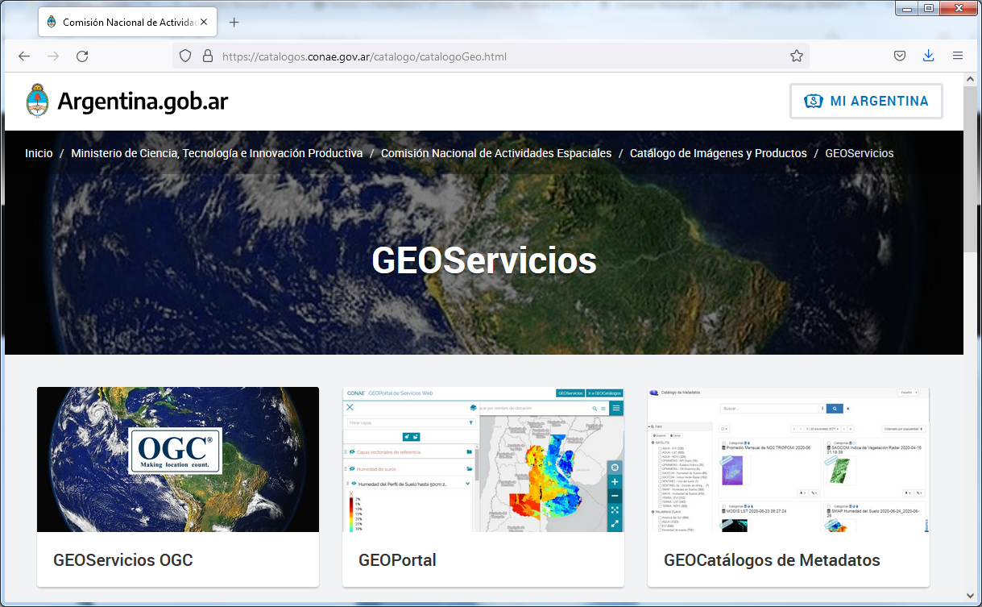
CONAE
High level product access and GEOServices
https://catalogos.conae.gov.ar/catalogo/catalogoGeo.html

Slide 28
CONAE
High level product access and GEOCatalog
Example of the available products for the 2020/21 soybean campaign.
GIS software is mandatory.
https://geocatalogos.conae.gov.ar/
(Left) After choosing a product.
The arrow signals the link for downloading.

Slide 29
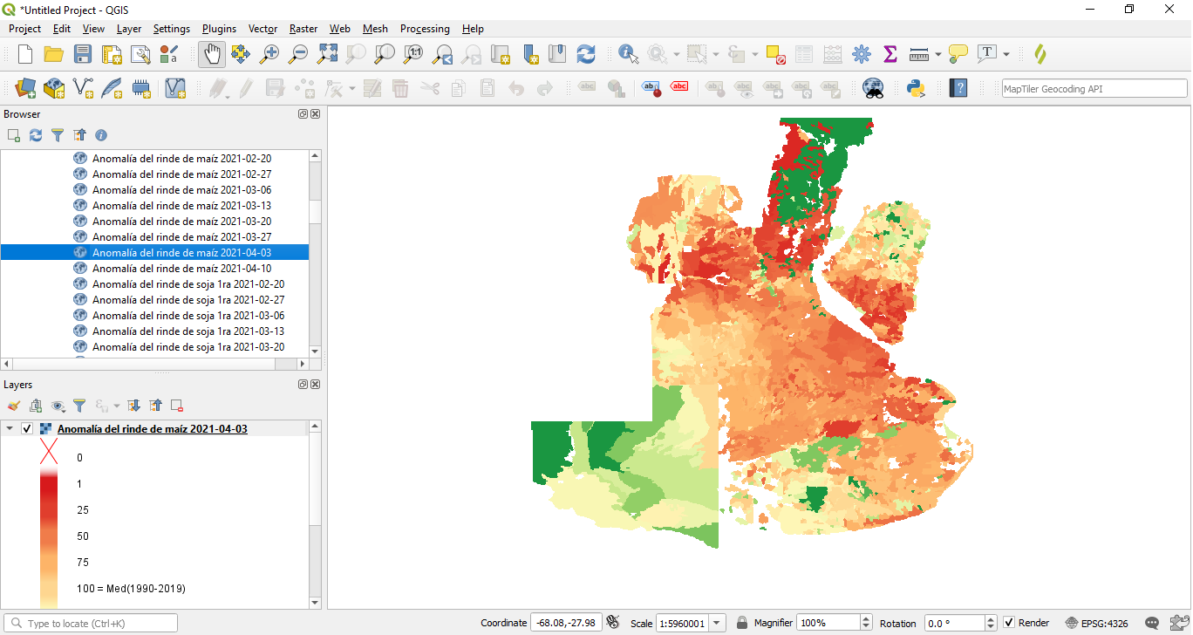
CONAE
High level product access and OGC-WMS services
https://geoservicios3.conae.gov.ar/geoserver/Cultivos/wms
Example of WMS GEOservice visualization with QGIS software for the map of anomalies in the maize yield mean scenario.
Latest data version is ensured
New connection WMS:
Layer -> Add Layer -> Add WMS/WMTS Layer

Slide 30
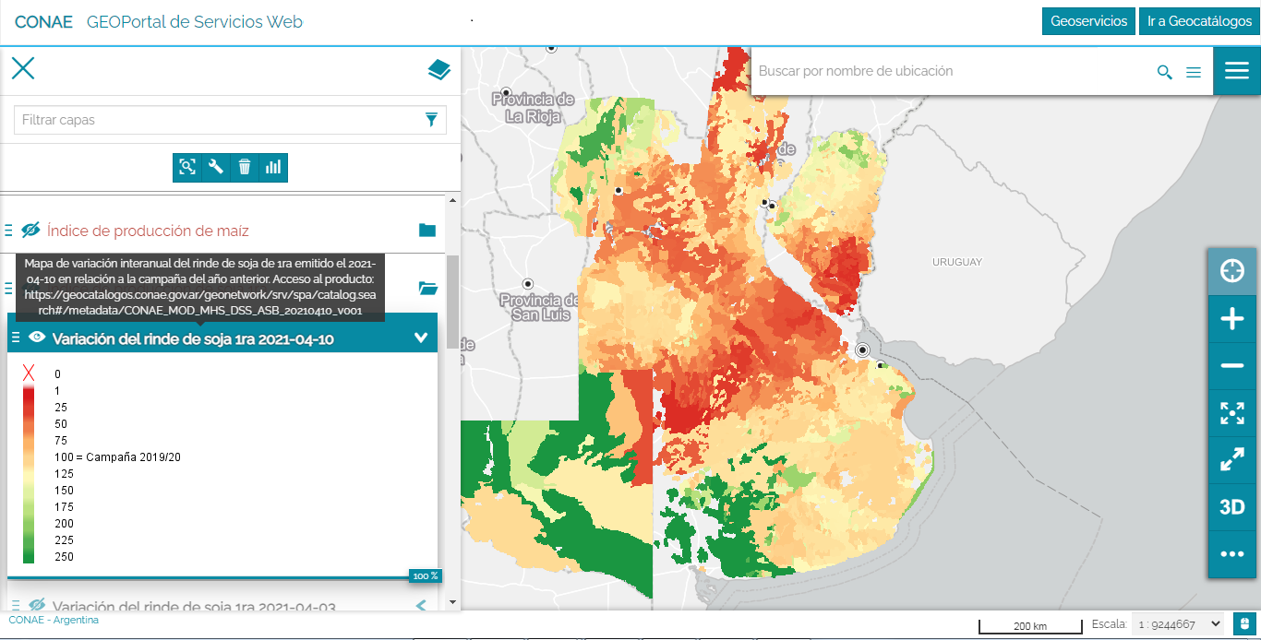
CONAE
High level product access and GEOPortal
https://geoportal.conae.gov.ar/
Example for the inter-seasonal soybean map displayed on the GEOPortal focused on non–expert users.

Slide 31
CONAE
Final considerations
A system for making mean yield scenarios maps based on normal or previous year estimates for wheat, maize and soybean is available.
3 data access gates are available: GEOCatalog of metadata, GEOPortal and WMS GEOServices.
Maps are weekly updated.
Value is add to SAOCOM mission with high level products which provide timely and valuable support information to stakeholders focused on the Pampas Region agriculture sector.
Notes:
‹#›

Slide 32
Geoscience Australia
The Australian Government announced establishment of Australia’s first civilian satellite program, a whole-of-government initiative worth $1.16 billion to 2038-39 and $38.5 million per annum ongoing for Phase 1 of a National Space Mission for Earth Observation (NSMEO), which will see Australia design, build, and operate four new satellites.
The Mission will be led by the Australian Space Agency in partnership with Geoscience Australia, the CSIRO, Bureau of Meteorology and the Department of Defence.
As Australia’s satellite land remote sensing organisation, and part of NSMEO, Geoscience Australia will determine the specifications for a series of four Satellite Cross-calibration Radiometers (SCR), operate the satellites after launch and in-orbit testing, and ensure open data is distributed to Australian users and international partners.

Slide 33
Geoscience Australia
The Satellite Cross-calibration Radiometer (SCR) series will comprise 4 small satellites with hyperspectral sensors that act as a transfer radiometer to enable the radiometric calibration of a “reference” instrument to be transferred to civil, or commercial satellites (concept of operations shown in next slide).
The SCR mission will help address one of the biggest challenges of successfully integrating satellite data from multiple sources, for interoperable use.
Expert review panels conducted the SCR Mission Concept Review and Key Decision Point - A, processes in March 2022, the first of the SCR satellites is expected to be launched in 2025.
Geoscience Australia is working with NSMEO partners to establish the Program for operational readiness from July 2023.

Slide 34
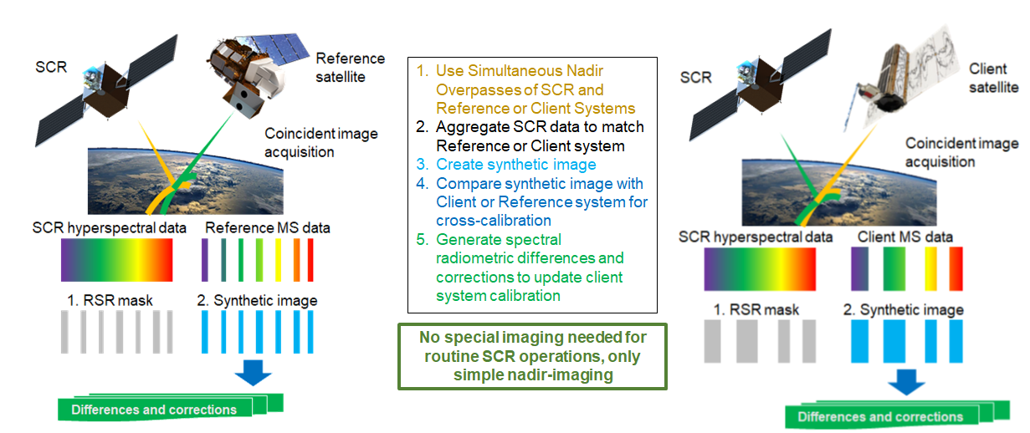
Geoscience Australia
Satellite Cross-calibration Radiometer Concept of Operation

Slide 35
JAXA
JAXA mission
and CARD4L product development update
Takeo Tadono, JAXA EORC
Ake Rosenqvist, soloEO/JAXA

Slide 36
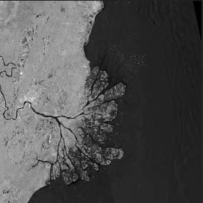
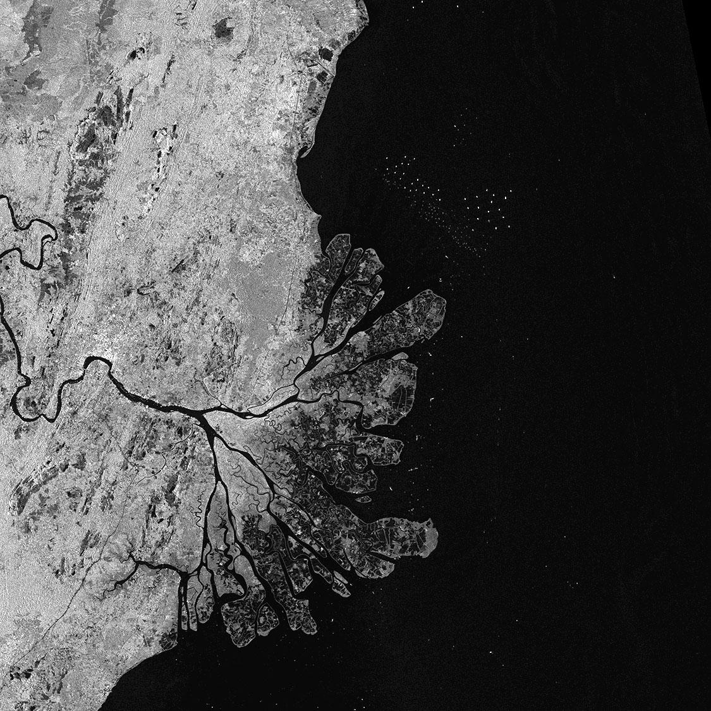
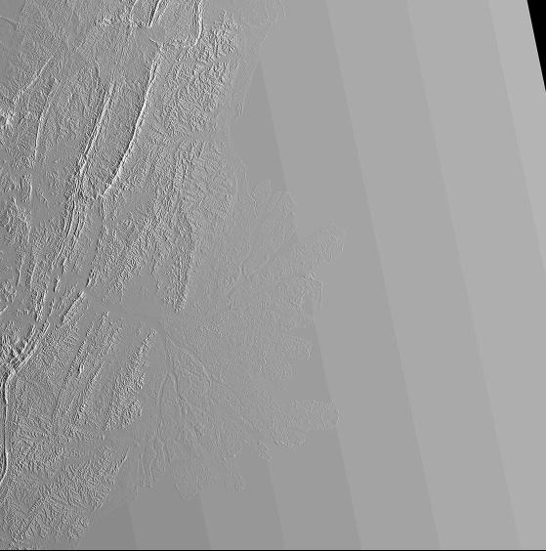
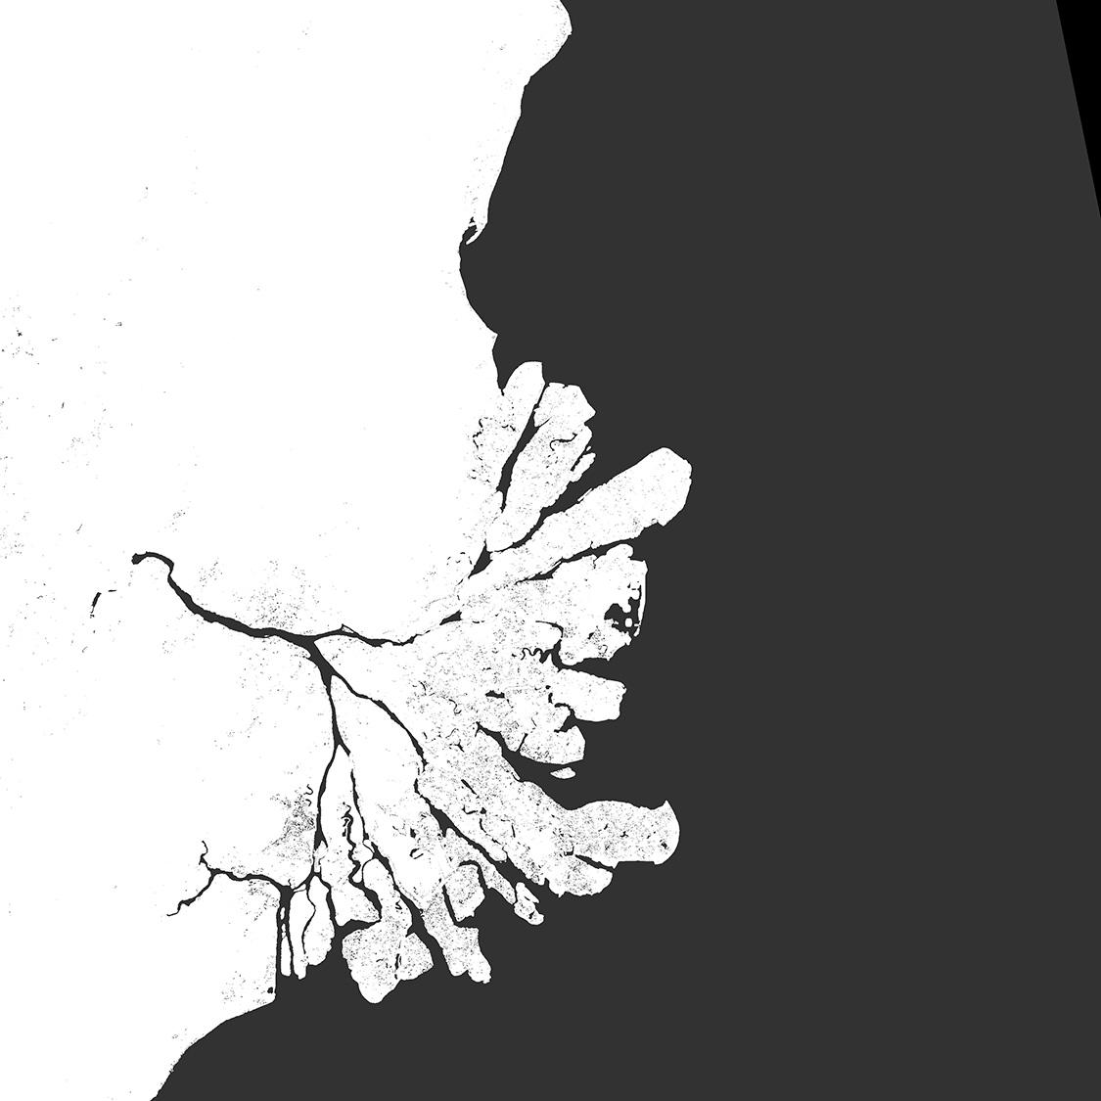
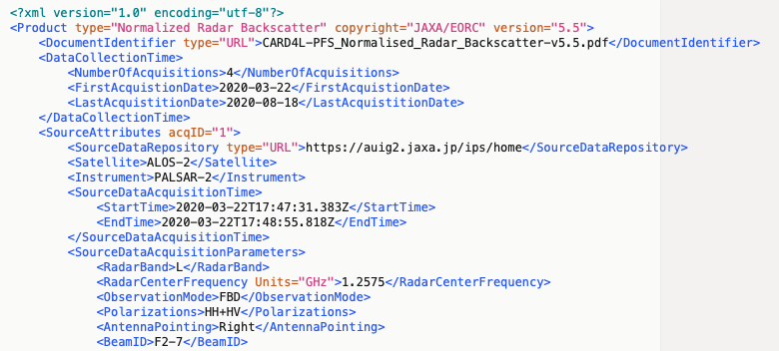
CARD4L SAR products under development
ALOS-2 PALSAR-2 Global Mosaics
Final steps of self-assessment (CARD4L NRB v5.5)
Submission to CEOS review: June 2022
CARD4L Product contents:
Global mosaic products @ 25 m pixel spacing
Annual, 2015 – 2021
Available for public download @JAXA
Radar Measurement data:
Geometric & radiometric Terrain Corrections
Normalised Radar Backscatter as gamma-0, γ⁰
Per-pixel Metadata:
Local Incidence Angle image
Mask image
Acquisition Date image
General metadata:
According to CARD4L metadata spec NRB v5.5
γ⁰ Backscatter (HH)
γ⁰ Backscatter (HV)
Local Inc. Angle
Acquisition ID
Data Mask
General Metadata (XML)
‹#›
Notes:
Polarimetric Radar (POL) – objective to make radar polarimetry accessible
to enable users to explore
CARD4L POL covers two product types:
The first one is Polarimetric Decomposition product – which is comparable to the standard backscatter product, but where the polarimetric information has been enhanced – for instance to separate different scattering mechanisms from each other – by the use of various decomposition techniques. Which decompositions to include is not prescribed in the CARD4L specification, but for Data Providers to decide. which ones to offer to users (e.g. Eigen value; Pauli, Freeman-D; Yamaguchi, etc.)
The second POL product is the Polarimetric Covariance Matrix, which is a set of complex images from which the full polarimetric phase and amplitude can be derived. It is for a bit more advanced users, and can be applied for e.g. polarimetric time-series analysis and Pol-InSAR applications
The CARD4L POL structure is based on NRB, with similar requirements for geometric and radiometric accuracy, and general and per-pixel metadata.

Slide 37
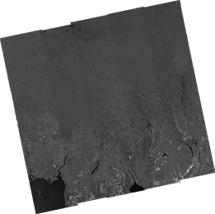
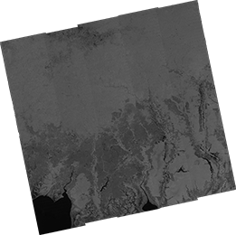
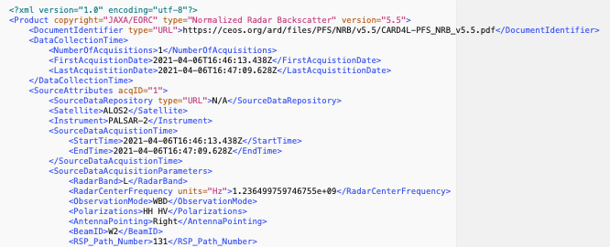
CARD4L SAR products under development
ALOS-2 PALSAR-2 ScanSAR NRB
Final steps of self-assessment (CARD4L NRB v5.5)
Submission to CEOS review: June 2022
CARD4L Product contents:
Full historical ALOS-2 ScanSAR archive @ 25m pixel spacing
Scene-based Level 2.2
Public open from late 2022
Radar Measurement data:
Geometric & radiometric Terrain Corrections
Normalised Radar Backscatter as gamma-0, γ⁰
Per-pixel Metadata:
Local Incidence Angle image
Mask image
General metadata:
According to CARD4L metadata spec NRB v5.5
γ⁰ Backscatter (HH)
γ⁰ Backscatter (HV)
Local Inc. Angle
Data Mask
General Metadata (XML)
‹#›
Notes:
Polarimetric Radar (POL) – objective to make radar polarimetry accessible
to enable users to explore
CARD4L POL covers two product types:
The first one is Polarimetric Decomposition product – which is comparable to the standard backscatter product, but where the polarimetric information has been enhanced – for instance to separate different scattering mechanisms from each other – by the use of various decomposition techniques. Which decompositions to include is not prescribed in the CARD4L specification, but for Data Providers to decide. which ones to offer to users (e.g. Eigen value; Pauli, Freeman-D; Yamaguchi, etc.)
The second POL product is the Polarimetric Covariance Matrix, which is a set of complex images from which the full polarimetric phase and amplitude can be derived. It is for a bit more advanced users, and can be applied for e.g. polarimetric time-series analysis and Pol-InSAR applications
The CARD4L POL structure is based on NRB, with similar requirements for geometric and radiometric accuracy, and general and per-pixel metadata.

Slide 38
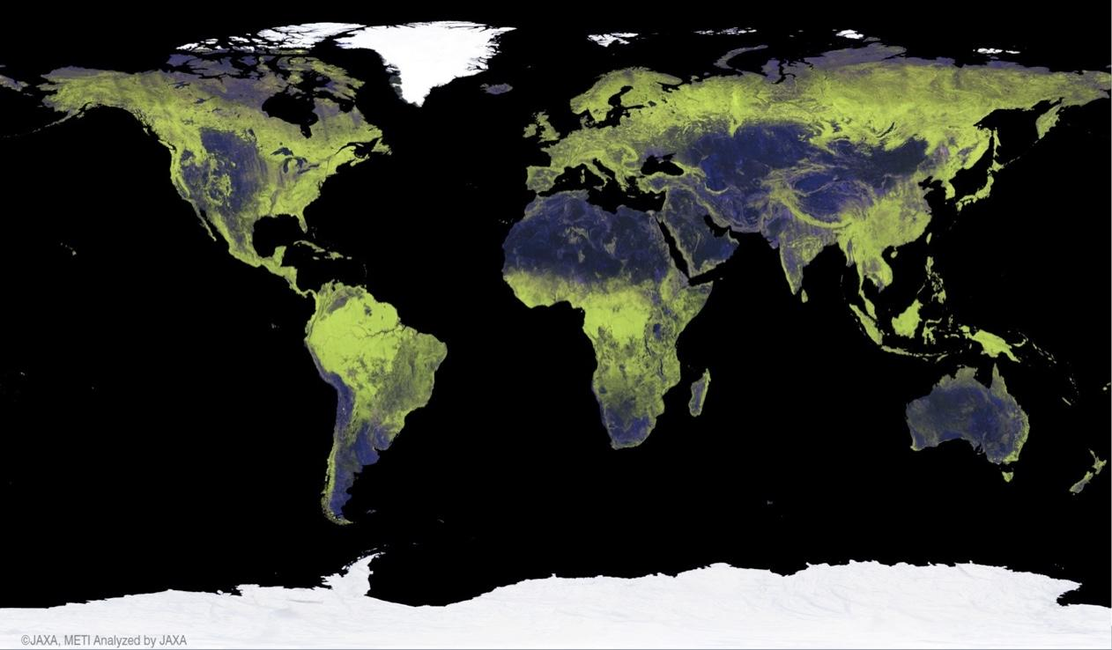
JAXA Annual Global 25 m Mosaics
Global Mosaic revisions
Modifications to the Sigma-SAR processor and EORC mosaicking software undertaken during 2021.
Processing/Re-processing schedule
JFY 2021: ALOS-2 2015–2020 [COMPLETED]
April 2022: ALOS-2 2021 [COMPLETED]
May-Dec 2022: ALOS: 2007, 2008, 2009, 2010
2022 (TBC): JERS-1: 1993-1998
2023/Q1: ALOS-2 2022
New mosaic features:
Improved geometric accuracy
Single-year data only (i.e. no gap-filling from other years in case of missing data)
Cloud Optimized GeoTiff (COG) format
Compliance with CARD4L NRB v5.5
Public download www:
https://www.eorc.jaxa.jp/ALOS/en/dataset/fnf_e.htm
‹#›

Slide 39
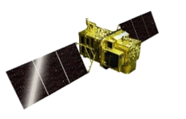
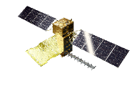
Continuous Observations by ALOS Series Missions
Continuous observations, successor to “DAICHI” (ALOS) since 2006.
Contribute to ensure the safety and security of citizens including e.g., disaster monitoring and management, land deformation monitoring, national developing management, foods and natural resources, environmental monitoring over global scales, etc.
Contribute to industrial development based on Earth observation data i.e., National Spatial Data Infrastructure (NSDI) and new applications.
JFY 2014 | 2015 | 2016 | 2017 | 2018 | 2019 | 2020 | 2021 | 2022 | 2023 | 2024 | 2025 | 2026 | 2027 | 2028 | 2029 | 2030
ALOS-2 (L-SAR)
Post Operation Review Meeting
Launch
Mission Operation
(5 years)
Post-Operation #1
(2 years)
Post Operation #2
(X years)
ALOS-3 (Optical)
TBD
Development
Mission Operation (7 years)
ALOS-3 Follow-on
(Under discussion)
Feasibility Study
Development
ALOS-4 (L-SAR)
TBD
Development
Mission Operation (7 years)
ALOS-4 Follow-on
(Under discussion)
Feasibility Study
Development

Slide 40
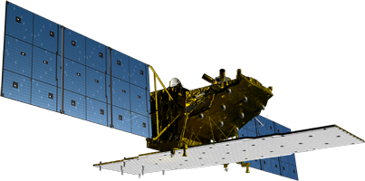
ALOS-2 Overview
Mission objectives:
Disaster monitoring (Earthquakes, Volcanos, Landslides, Flooding, …)
Environmental monitoring (Forests, Ice sheets, …)
Agriculture, natural resources, and oceans
Technology development
Mission sensor | PALSAR-2 (Phased Array type L-band Synthetic Aperture Radar 2)
Launch | May 24, 2014 H-IIA launch vehicle FY24
Mass | 2.1 tons
Lifetime | 5 years (Target: 7 years)
Orbit | Sun-synchronous 628 km altitude 14 days revisit Orbit control: ≦ +/- 500 m
Local sun time | 12:00±15 min (descending) 24:00±15 min (ascending)
Mission data transmission | X-band: 800 Mbps (16 QAM), 200/400 Mbps (QPSK)
Y
X
Z
Solar Arrays
PALSAR-2
(Phased Array type L-band Synthetic Aperture Radar 2)
The Compact InfraRed Camera (CIRC) and SPAISE2 for ship detection are carried as a technology demonstration payloads.
PALSAR-2 L-band SAR antenna
X-band downlink antenna

Slide 41
ALOS-2 PALSAR-2 Calibration Results (Sep. 2021)
On-board internal calibration is performed every 3 months.
Product quality of key observation modes is evaluated regularly using SAR data over calibration sites.
The standard product processing software was updated in June 2018 (radiometric calibration), in Nov. 2018 (correction of range offset), and in May 2021 (updates the software for Spotlight and ScanSAR modes).
> PALSAR-2 remains in good condition and performance.
Calibration summary using PALSAR-2 acquired from July 2014 to Sep. 2021 (as of Sep. 2021).
Items | Results
Geometry (RMSE) | [Stripmap and Spotlight] 5.53 m (L1.1) / 6.73 m (L2.1) [ScanSAR] 60.77 m (L1.1) / 29.33 m (L2.1)
Radiometry | RCS accuracy (1σ) | 0.529 dB (corner reflectors) 0.41 dB (Amazonian forests)
Polarimetry | VV-HH amplitude ratio | 1.003 (σ=0.012)
 | VV-HH phase difference | -0.323 deg (σ=1.436)
 | Cross talk | [HV/HH] -42.858 dB (σ=6.638) [VH/VV] -42.667 dB (σ=5.518)
* https://www.eorc.jaxa.jp/ALOS/a/en/alos-2/a2_calval_e.htm

Slide 42
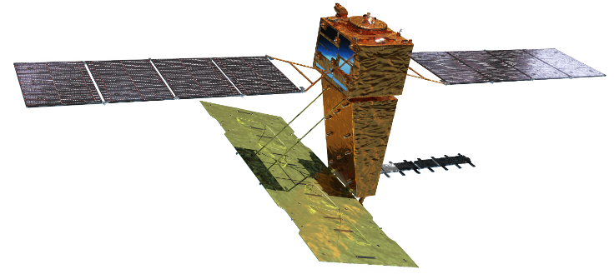
ALOS-4 Overview
Solar array paddle
Phase D
Y
X
Launch | TBD by H3 launch vehicle
Orbit | Same orbit as ALOS-2 Sun-synchronous sub-recurrent orbit Altitude: 628 km Inclination angle: 97.9 degree Local sun time at descending: 12:00 ± 15 min. Revisit time: 14 days (15-3/14 rev/day)
Lifetime | 7 years
Size | X 10.0 m x Y 20.0 m x Z 6.4 m
Satellite Mass | ~2,990 kg
Downlink | 1.8 / 3.6 Gbps (Ka-band)
Mission Instruments | PALSAR-3 (Phased Array type L-band Synthetic Aperture Radar-3) SPAISE3 (SPace based AIS Experiment 3)
Prime contractor | Mitsubishi Electric Corporation
Z
SPAISE3 AIS antenna
PALSAR-3 antenna
Ka-band DT antenna
In-orbit configuration
The ALOS-4 launch was originally scheduled for 2022, after the launch of ALOS-3.
The launch date is currently under consideration due to a review of the development schedule for the H-3 launch vehicle to be used for the launch.

Slide 43
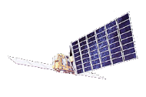
ALOS-4 PALSAR-3
Coverage of 1 repeat cycle (14 days)
Resolution (m)
ALOS-4 PALSAR-3 (200 km)
ALOS-2 PALSAR-2 (50 km)
(2) Wider observation
3
▼
ALOS-2
(2014-)
▼
ALOS-4
(JFY2022-)
Maximum L-band SAR resolution
10
ALOS ▼
(2006-2011)
Swath width of PALSAR-3/-2
(1) Higher resolution
Modes | PALSAR-3 | PALSAR-2
Stripmap (res. 3 / 6 / 10 m) | 100-200 km | 30-70 km
ScanSAR (res. 25m*) | 700 km | 350-490 km
Spotlight (res. 1 x 3 m) | 35km × 35km | 25km × 25km
18
JERS-1 ▼
(1992-1998)
50
70
75
200
Swath (km)
*single look

Slide 44
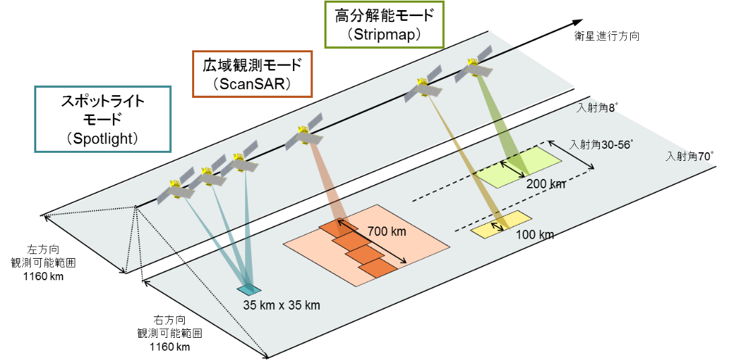
ALOS-4 PALSAR-3 Observation Modes
Stripmap
Azimuth direction
ScanSAR
3 / 6 / 10 m res.
Spotlight
25 m res.
8 deg
30 – 56 deg
1x3 m res.
70 deg
Left observation
Maximum : 1160km
Right observation
Maximum :1160km
Full-polarisation Stripmap with 3, 6, or 10 m resolution capacity with 100 km swath.

Slide 45
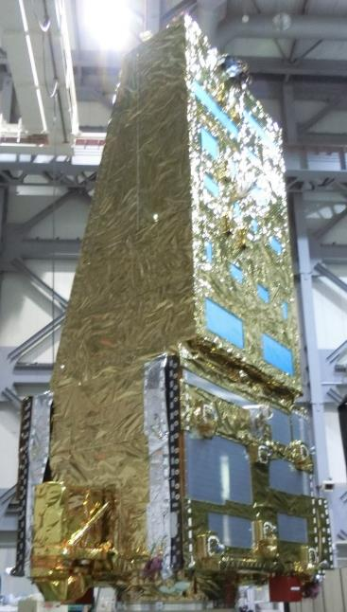
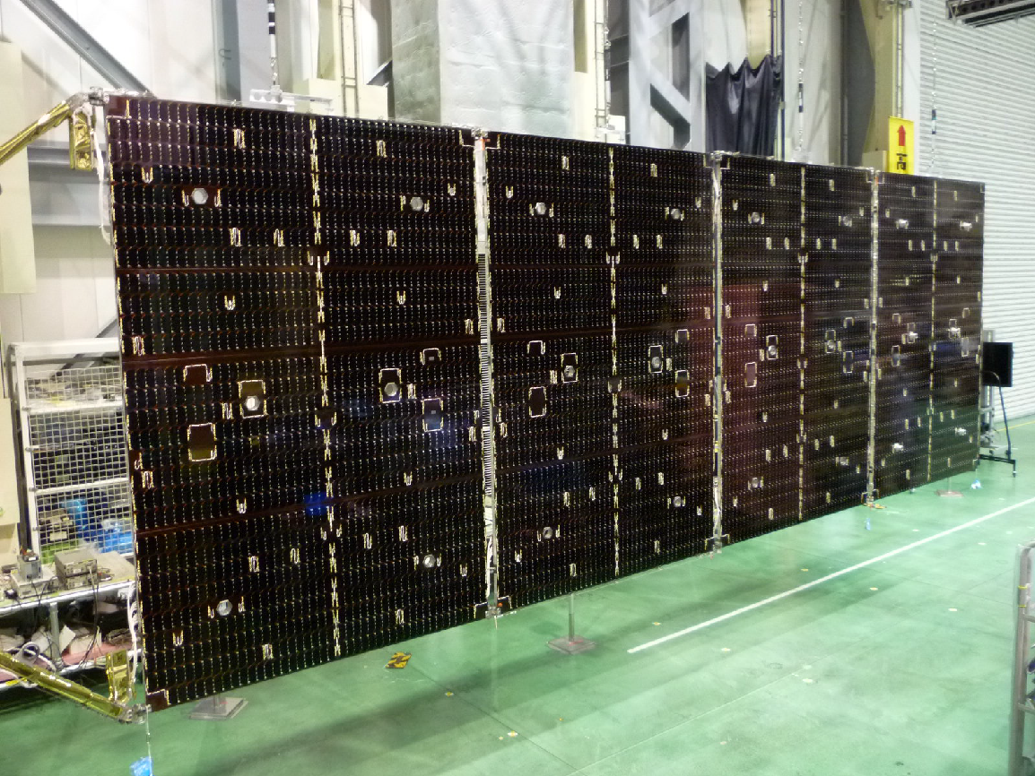
ALOS-4 Proto-Flight Model (PFT) testing
ALOS-4 PFM during micro vibration test.
One of the solar array paddles.

Slide 46
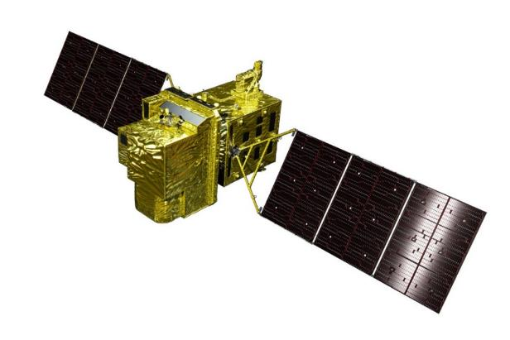
ALOS-3 Overview
Items |  | Specifications
Orbit | Type | Sun-synchronous sub-recurrent
 | Altitude | 669 km at the equator
 | Local Sun Time | 10:30 am +/- 15 minutes at the descending node
 | Revisit | 35 days (Sub-cycle 3 days)
Instruments |  | - Wide-swath and high-resolution optical imager (WISH) - Dual-frequencies Infrared sensor (hosted payload)
Ground Sampling Distance (GSD) |  | - Panchromatic band (Pa): 0.8 m - Multispectral band (Mu): 3.2 m (6 bands)
Quantization |  | 11 bit / pixel
Swath width |  | 70 km at nadir
Mission data rate |  | Approx. 4 Gbps (after onboard data compression: 1/4 (Pa) and 1/3 (Mu))
Mission data downlink |  | - Direct Transmission: Ka and X-band - via. the Optical Data Relay Satellite
Mass |  | Approx. 3 tons at launch
Size |  | 5 m×16 m×3.5 m on orbit
Duty |  | 10 (~12) mins / recurrent
Design lifetime |  | Over 7 years
Phase D
Wide-swath and high-resolution optical imager (WISH)
In-orbit configuration
The ALOS-3 launch was originally scheduled for JFY 2021.
The launch date is currently under consideration due to a review of the development schedule for the H-3 launch vehicle.

Slide 47
ALOS-3 Observation Modes
1 | Strip Map Observation “STM” | The satellite can normally perform observations covering 70 km in width and 4,000 km in along-track direction as the strip-map observation mode. To increase the acquisition frequency, the data will be acquired at less than 25 deg. pointing angle in cross-track direction (GSD < 1m) when the satellite track is over oceans.
2 | Stereoscopic Observation “3D1”, “3D2” | Two possible options to acquire stereo-pair images: 1) in single orbit path “3D1”, and 2) combining two strip-map observations by nadir view and backward view in the neighboring path after three days (sub-cycle revisit orbit, “3D2”). Option 1) will be however not yield sufficient base-to-height ratio (B/H) to derive terrain information. Option 2) includes the possibility to set suitable B/H, and capacity to acquire images over a large areas. However, this will depend on weather conditions i.e., cloud cover, to succeed stereo image acquisitions within a short period as a disadvantage.
3 | Pointing Observation “PNT” | If the user has a certain ground point or an area of interest (AOI), the satellite can observe there using pointing capability within 60 deg. This mode will be used for natural disaster monitoring, for example.
4 | Changing Direction Observation “DRC” | The satellite can observe any given point by the pointing capability up to 60 deg. in all directions against the satellite nadir. In the case of Japan, it can be activated within 24 hours after receiving the request. This will be used when a large natural disaster happens e.g., the expecting Nankai Trough large earthquake.
5 | Wide-Area Observation “WID” | This mode can cover a wide-ranging area of 200 km (in along-track direction) x 100 km (in cross-track direction) by satellite’s single orbital passage. This will be also used when a large natural disaster happens.
#1 and #2 will be used in the basic observation, and #3~5 for responding to natural disasters.

Slide 48
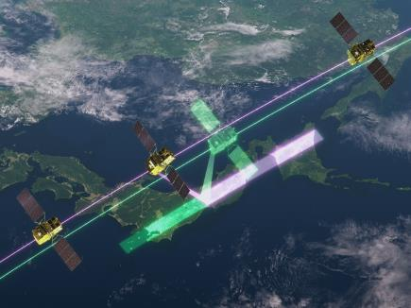
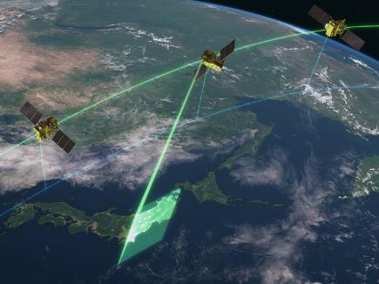
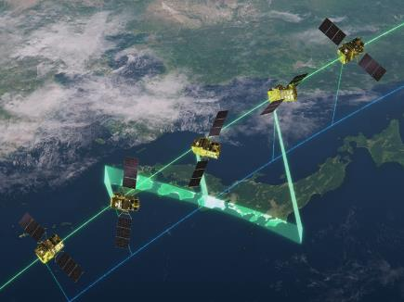
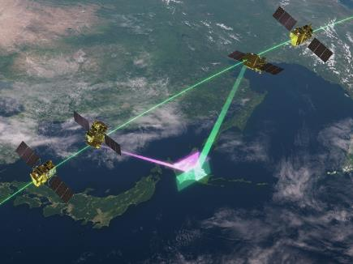
ALOS-3 Observation Modes
Mode 1/2
Mode 3
ALOS-3 Observation Mode
1 | Strip-Map Observation (STM)
2 | Stereoscopic Observation (3D1, 3D2)
3 | Pointing Observation (PNT)
4 | Changing Direction Observation (DRC)
5 | Wide-Area Observation (WID)
Mode #3 to 5 are for emergency observation only.
Mode 4
Mode 5

Slide 49
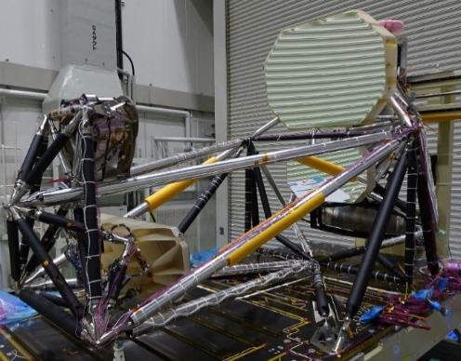
ALOS-3 Proto-Flight Model (PFT) testing
The launch of ALOS-3 has been postponed to JFY 2022 (TBD) due to a change in the development plan for the H3 rocket, the launcher of ALOS-3.
Post qualification test review (PQR) of the Wide-swath and high-resolution optical Imager (WISH) has been completed (July 2020).
The PFT of all flight components/subsystems has been completed, too. The PFT of ALOS-3 satellite system is now underway.
Proto flight model of Wide-swath and high-resolution optical Imager (WISH).

Slide 50
ALOS-3 Standard Products and Target Accuracy
Processing Level | Contents | Specifications Target accuracy
1A | Raw data | [not available to users]
1B1 with RPC | Radiometric system correction | 12 CCD units separated images
1B2 with RPC | Radiometric + Geometric system correction R: Geo-reference G: Geo-coded | Geometric accuracy (1 sigma): 5 m (h) without GCPs; 1.25 m (h), 2.5 m (v) with GCPs Radiometric accuracy (Mu band): +/- 10% (Abs.); +/- 5% (Relative)
1C | Rough ortho rectification using existing DEM/DSM i.e., PRISM DSM (AW3D 5m mesh DSM)
Validation of High-level and Research Products is performed in conjunction with calibration.
Atmospheric correction (ATC) i.e., Surface Reflectance is to be generated as CARD4L-SR.

Slide 51
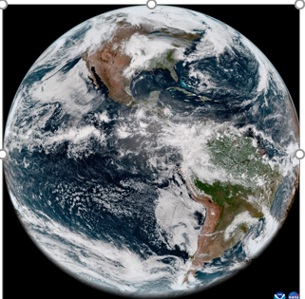
Agency Update - NOAA
Successful launch on 1 March 2022 of GOES-18, which includes Advanced Baseline Imager (land surface imaging sensor). The ABI includes 16 channels that range from visible to thermal IR, spatial resolutions of 500 to 2000m, and temporal resolutions from 30 seconds to 10 minute intervals depending on area of coverage.
https://www.youtube.com/watch?v=y_3zJaZOe1E
Slide ‹#›

Slide 52
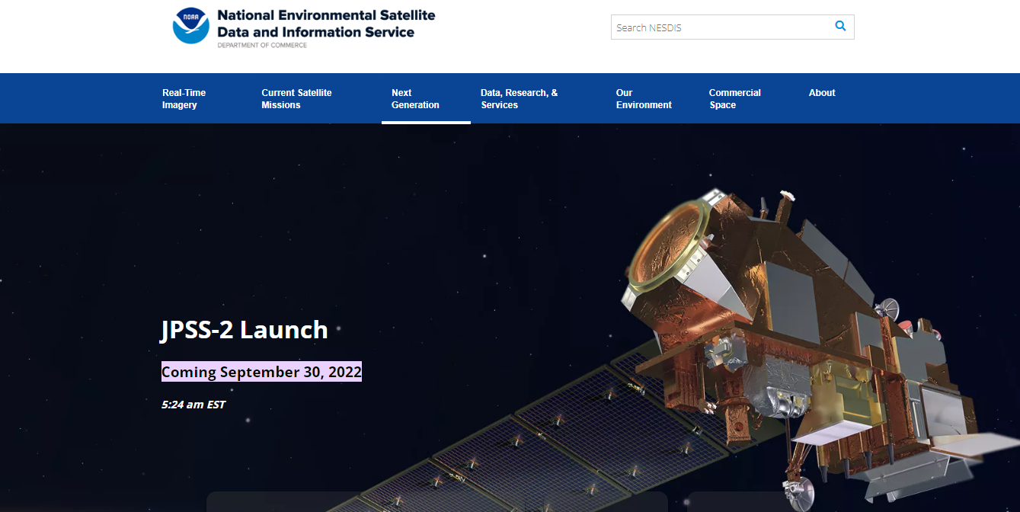
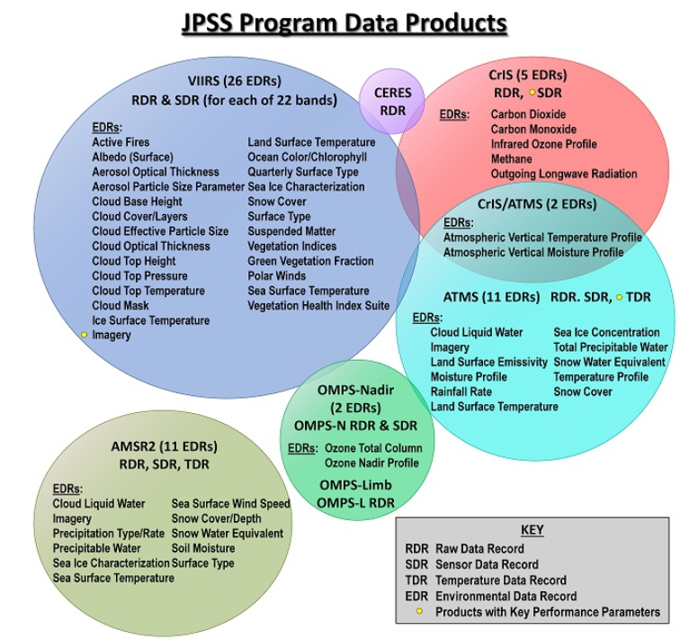
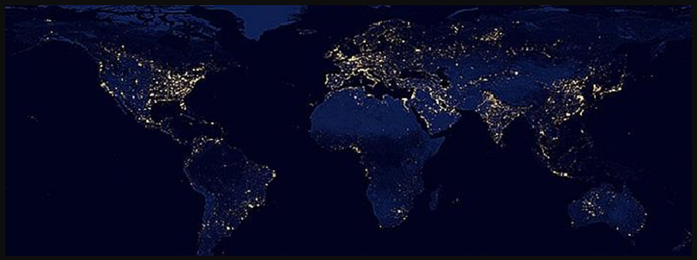
Agency Update - NOAA
Planned launch of JPSS-2:
30 September 2022.
Similar to Suomi NPP and JPSS-1 (NOAA-20), JPSS-2 includes the Visible Infrared Imaging Radiometer Suite (VIIRS).
Example of VIIRS day/night band product.
https://www.star.nesdis.noaa.gov/jpss/JPSS_products.php
Slide ‹#›

Slide 53
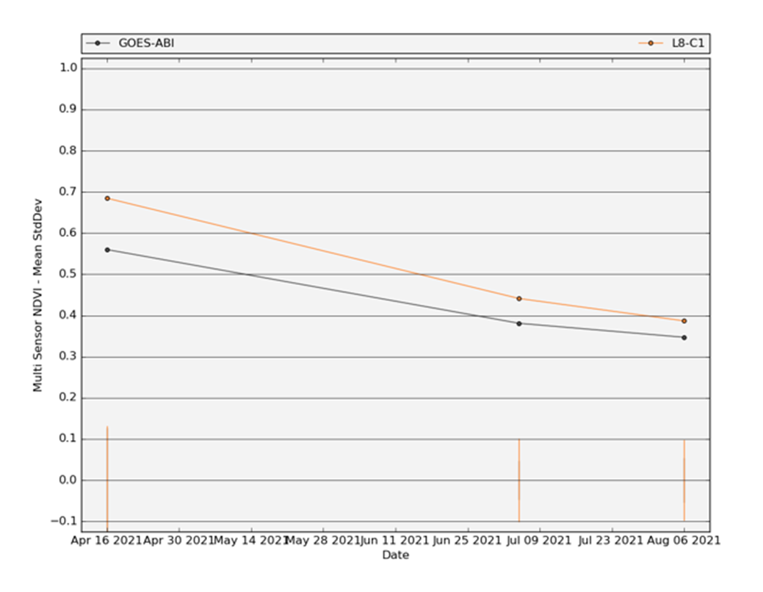
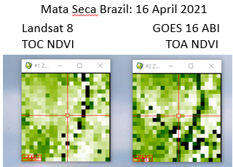
Agency Update - NOAA
USGS-NOAA Land Product Characterization System now includes GOES-16 NDVI product for comparisons with similar Landsat-OLI, VIIRS and MODIS sensor products.
https://lpcsexplorer.cr.usgs.gov
Comparison of Landsat 8 and GOES 16 NDVI for one of three dates examined.
Comparison of Landsat 8 and GOES 16 NDVI for three dates examined during 2021.
Slide ‹#›

Slide 54
ESA Update / ARD Products
Mission | Product | PFS | VC | Status | Availability Date | Comments
Sentinel-2 | L2A | SR | LSI-VC | ✅ | January 2022 | Link with IPF Re-engineering
Sentinel-2 | L2H | SR | LSI-VC | Under Development | TBD | Pilot product
Sentinel-2 | L2F | SR | LSI-VC | Under Development | TBD | Pilot product
Sentinel-1 | NRB | NRB | LSI-VC | Under Development | TBD | Pilot product
ERS SAR | TBC | NRB | LSI-VC | Under Definition/Development | 2023
ERS ATSR | TBC | LST | LSI-VC | Under Definition/Development | 2023
Envisat ASAR | TBC | NRB? | LSI-VC | Under Definition/Development | 2023
Envisat MERIS | TBC | SR | LSI-VC | Under Definition/Development | 2023
CHIME | L2A | SR | LSI-VC | Under Development | 2029 | Link with IPF Re-engineering
CHIME | L2H/L2F | SR | LSI-VC | Under Development | 2029 | Link with IPF Re-engineering
LSTM | L2A | ST, SR | LSI-VC | Under Development | 2029 | Link with IPF Re-engineering
LSTM | L2H/L2F | ST, SR | LSI-VC | Under Development | 2029 | Under Definition/Development
ROSE-L | TBC | NRB…TBC | LSI-VC | Under Development | 2029 | Under Definition/Development
Sentinel-2 | L2A / AR layer | AR | LSI-VC | Under Definition/Development | TBD | Under Definition/Development

Slide 55
ESA Update / Candidate ARD Products
Mission | Product | PFS | VC | Status | Availability Date
Sentinel-3 OLCI SLSTR | SYN | SR | LSI-VC
Sentinel-3 OLCI |  | AR
CRISTAL
EarthCARE
Envisat MERIS |  | AR
Sentinel-3 SLSTR |  | ST, SR | LSI-VC
Sentinel-3 ALT

Slide 56
ESA Update / Sentinel-2 / Towards Collection 1
Collection 1 generated by reprocessing full S2 archive for both Level-1C and Level-2A products.
Reprocessing campaign foreseen to start in June 2022, published progressively on DIAS platforms and completed by Q1 2023.
New processing baselines (04.00) for Level-1C and Level-2A products.
Collection 1 will be CEOS-ARD compliant [http://ceos.org/ard].

Slide 57
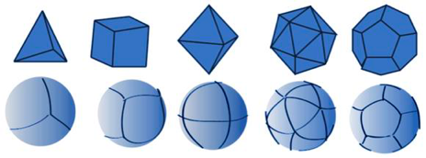
ESA Update / Sentinel-2 / DGGS
ESA has initiated an activity to assess and prototype the usage of a DGGS (Discrete Global Grid System) for Sentinel-2.
The goal is to assess the feasibility of adopting DGGS for Sentinel-2 and testing them for ARD (Analysis Ready Data) products Level-2A, Level-2H and Level-2F.
This will be performed using a cloud-based demonstration platform able to assess in practice the usage of DGGS when distributing, visualizing, processing and analysing Sentinel-2 products.

Slide 58
ESA Update / Sentinel-1
Sentinel-1 ARD is being addressed with the Commission, and a set of actions is being implemented to pursue this.
The Commission formally requested to the Agency to move forward in the development of a Sentinel-1 ARD Normalised Radar Backscatter (NRB) product.
There is a clear need for integrating Sentinel-1 as a new product of the Copernicus catalogue and to facilitate the access to this data.
The new Sentinel-1 ARD NRB product, currently being prototyped, will use the same projection and tiling as Sentinel-2 Level-1C products in order to facilitate the interoperability of the two missions.

Slide 59
ESA Update / ERS and Envisat
ERS and Envisat Surface Reflectance, Surface Temperature and Radar products specifications have been assessed against CEOS Analysis Ready Data for Land (CARD4L) specifications to identify potential improvement activities to allow data from ESA Heritage Missions to become compliant to CARD4L requirements.
A project to align the CARD4L specifications for ERS SAR and Envisat ASAR data to those of an under development enhanced Sentinel-1 product has been started.
A subset of SAR and ASAR data will be processed with corresponding and adapted algorithms to those under development in the enhanced Sentinel-1 product (including the usage of the Copernicus 30m DEM and the Cloud Optimized GeoTIFF format to facilitate compliance between the two products). First results will be presented at the ESA Living Planet Symposium 2022.

Slide 60
ESA Update / ERS and Envisat
Support analyses to the Surface Reflectance and Land Surface Temperature ESA heritage data CARD4L products are also continuing.
In relation to Surface Reflectance, the GRASP atmospheric correction algorithm has been successfully tested on MERIS Full Resolution (FR) data and is a good candidate for piloting the generation of CARD4L Surface Reflectance products.
The activities to implement a cloud shadow mask in the Land Surface Temperature products (derived from (A)ATSR data) to support the generation of Land Surface Temperature ESA CARD4L long time series is progressing according to plans and will be completed during 2022.

Slide 61
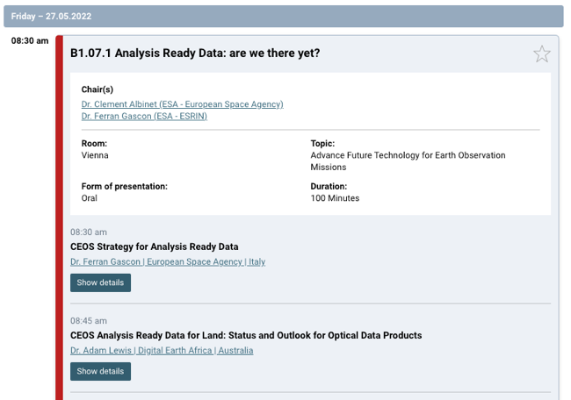

Slide 62
LSI-GEOGLAM Subgroup Report
Getting close on EAVs
Discussing a way forward at ESA Living Planet
After that, will have a more substantive update on the next steps related to requirements and research agenda.
Chris Justice and Alyssa have submitted a proposal with the coleads of CEOS WGCV LPV - Sasha Tyukavina and Sophie Bontemps for a workshop on validation protocols for a few EAVs (related to mapping)
Likely Autumn 2022

Slide 63
DLR – Update on ARD for EnMAP & DESIS
EnMAP:
Launched April 1st, first datatake April 27th
Commissioning phase ongoing, operational phase scheduled for late September (tbc)
CARD4L compliant metadata in place
DESIS:
Joint hyperspectral mission on the ISS by DLR (scientific) & Teledyne (commercial), operational since 2019
Similar processing chain & metadata model as in EnMAP
Currently in discussion if L2A product model updated to meet CARD4L
DLR‘s atm. correction „PACO“ (ATCOR heritage, processor for EnMAP & DESIS, also in-house for S2 & Landsat)
Update ongoing so that metadata & per-pixel are always in line with CAR4L
high interest in a dedicated Hyperspectral PFS (esp. @ L2A, but also L1B & L1C)
willing to contribute!
„Outreach“:
Contributions on „Analysis-Ready Data from Hyperspectral Sensors - The Design of the EnMAP CARD4L-SR Data Product” for ESA LPS (https://lps22.esa.int/) and for EARSeL SIG-IS workshop (https://is.earsel.org/workshop/12-IS-Potsdam2022/)
Contact: martin.bachmann@dlr.de

Slide 67
Product Assessment
Progress

Slide 68
Product Assessments
Topics:
Status of CEOS-ARD datasets
Notable lessons learned from recent peer reviews
Assessments on the horizon
Increasing the pool of reviewers and accelerating the peer review process
Need for agile peer reviews
Assemble an LSI-VC sub-team for peer reviews?
One-on-one telecon review idea? Discuss
Action: nominations for LSI-VC sub team ?
AOB

Slide 69
Product Assessments
Status of CEOS-ARD datasets
Recently completed CARD4L evaluations
ESA Sentinel-2 Surface Reflectance (Compliant at Threshold)
DLR EnMap Surface Reflectance (Compliant at Threshold)
CARD4L submissions currently under evaluation
Element 84 Sentinel-2 Surface Reflectance (in progress)
Sinergise Normalised Radar Backscatter (in progress)
USGS ARD Surface Reflectance (commenced)
USGS ARD Land Surface Temperature (commenced)

Slide 70
Product Assessments
Notes from recent CARD4L evaluation
CARD4L evaluations take time to complete
Resource issue: back-up for PoCs required
Pool of members to provide support could help
CARD4L submissions to be complete for all items

Slide 71
Normalised Radar Backscatter (NRB) & Polarimetric Radar (POL)
NRB v5.5 & POL v3.5 endorsed by LSI-VC in Sep 2021
Parameter inconsistency (items 1.4 & 1.7.1) between PSF and XML metadata specs discovered → Metadata specs updated.
Revised XML specs replaced on CEOS ARD www (13 May 2022)
PFSs not affected
STAC extension for CARD4L NRB: https://github.com/stac-extensions/card4l
Several data providers in process for NRB v5.5 certification
POL
NRB
γ⁰ co-pol γ⁰ cross-pol

Slide 72
Submission status (NRB v5.5)
Approved today!!

Slide 73
Ocean Radar Backscatter (ORB)
CARD ORB – New
Simplified NRB product for ocean applications
PFS lead: ESA (Clément Albinet)
Radar Measurement data:
Radiometric slope correction → Geoid-correction
γ⁰ backscatter → Backscatter expressed as σ⁰
Per-pixel metadata:
Threshold:
Geoid Incidence Angle image
Mask image (including land mask)
Acquisition ID image (for composite products)
Target:
Noise power image (if applied)
Per-pixel Geoid
Look Direction image
CARD ORB (mock-up)
σ⁰ Backscatter (VV)
σ⁰ Backscatter (VH)
Land Mask image
Geoid Inc. Angle image

Slide 74
Status of other SAR/LiDAR PFSs
Geocoded Single-Look Complex (GSLC)
PFS leads: Stanford U./JPL
Complex radar signal (ampl & phase) presented in a ground based coordinate system (rather than in slant range)
Completion foreseen 2022/Q4 - 2023/Q1 (@LSI-VC-13?)
Interferometric Radar (INSAR)
PFS lead: GA
Wrapped/unwrapped interferograms & interferometric coherence
Currently on back burner
LiDAR ARD
PFS lead: JAXA, UMD, NASA
MOLI, GEDI and ICESat-2 mission teams involved
Terrain & Canopy Top Height product
Group revived, but agreed to proceed at “slow pace”
GSLC
INSAR
LiDAR ARD

Slide 75
CARD metadata specifications
Metadata specification developed to accompany all SAR PSFs
Specs for XML format but data provider may select other metadata formats (yaml, json, etc.)
Consistent mapping with all PFS parameter names
Target requirement only
Full uptake by data providers
For ARD-OG: Proposal to consider for all CEOS ARD PFSs
Sample NRB product XML metadata file
XML metadata specification doc (NRB v5.5)

