Slide 1
Global Grids for CARD indispensable or unnecessary?
Peter Strobl, EC-JRC
CEOS LSI-VC-10 virtual meeting, 20 May 2021

Slide 2
Analysis Ready Data (ARD)
An Analysis Ready Data (ARD) product is generated from raw data and processed so that it can be used without the need for further processing to be applied by users.
… minimum processing requirement to be an ARD-compliant product: the data must be processed to a geo-referenced projection to enable the position identification within the data product. …
If “geo-referenced projection“ is to be understood as being transformed to a “georeferenced grid” than this requires re-sampling!

Slide 3
CEOS Analysis Ready Data (ARD)
CEOS Analysis Ready Data (CARD) are satellite data that have been processed to a minimum set of requirements and organized into a form that allows immediate analysis with a minimum of additional user effort and interoperability both through time and with other datasets.
It is fair to assume that “other datasets” means those who also meet the CARD requirements, i.e. they are “gridded” (and thus re-sampled).

Slide 4
CARD Interoperability
Interoperable Products refers to a set of two or more ARD products which are sufficiently documented to enable processing across a continuum of geometric and/or radiometric standards to permit direct quantitative comparison.”
Not the interoperable products themselves are able to ‘interoperate’
(i.e. be compared or analysed together) but their derivates.
‘Interoperability’ here means a ‘can’ not an ’is’ and, if the underlying references are not the same, it requires adaptation (processing)!
How ready is ‘ready’ in ARD?

Slide 5
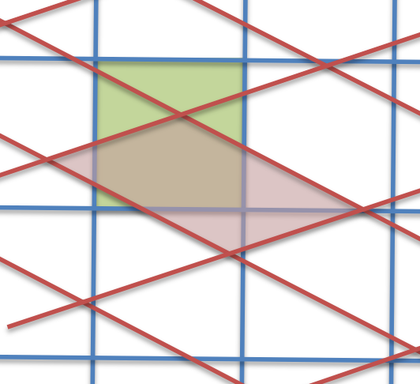
Changing references
Observations need to relate to the same standards or references to be comparable:
scaled data (based on points)
need to be re-scaled (e.g. ºF → ºC)
gridded data (based on intervals)
need to be re-gridded (or resampled)
(e.g. 1” WGS84 /Pseudo Mercator EPSG:3857
→ 30m Mollweide EPSG:54009)
Sounds doable for continuous parameters which can be interpolated
(e.g. radiance, temperature), but categorical data (e.g. masks/flags)?

Slide 6
ARD and Datacubes
ARD are meant to build data cubes!
OGC data cube Community Practise* says:
All layers in a data cube need to share the same grid
to allow interoperability between layers
Co-gridding is an important element of interoperability WITHIN a data cube
*https://portal.ogc.org/files/18-095r7

Slide 7
Datacube Interoperability
BUT
Two data cubes (or ARD datasets) do not need to share the same grid
to be considered interoperable(?)
If so, is interoperability restricted to a ‘one way’ road?
(i.e. a specific cube can only be involved once during an analysis workflow)
And then, how is reproducibility being secured?
(e.g. for Cubes A,B routing A→B gives a slightly different result as B→A, repeating exchange and involving more Cubes worsens things considerably!)

Slide 8
Consequences of re-sampling for interoperability
(unless the volume of data is largely amplified each time)
always entails an interpolation of data
always diminishes data accuracy or entail data loss
always is irreversible
is (more or less) computer-intense
accumulates these effects when repeated!
How compatible is this with FAIR principles?

Slide 9
Big Geospatial Data Analysis Strategies
To avoid repeated re-sampling in complex multi-source environments there are essentially two options:
“Point Cloud” approach:
  Store all observations with their locations (as n-tupels)
  Resample (all input data) to a user selected grid only at the point of analysis
  High processing effort, only end-to-end processing, low re-usability
“Grid System” approach:
  Discretise (re-sample) all observations to common grid system
  (not only in spatial dimension!)
  Limited number of (spatial) representations, lack of user acceptance

Slide 10
INSPIRE* wisdom
“… it would be highly desirable that all the themes with similar needs
make use of the same geographical grid system
in order to maintain their coherence.”
*INSPIRE is the EU initiative to establish an infrastructure for spatial information in Europe that will help to make spatial or geographical information more accessible and interoperable for a wide range of purposes supporting sustainable development. https://inspire.ec.europa.eu/
Source: INSPIRE D2.8.II.1 Data Specification on Elevation – Technical Guidelines (2013)

Slide 11
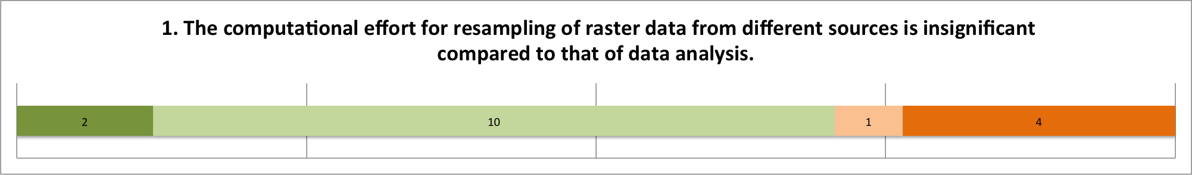
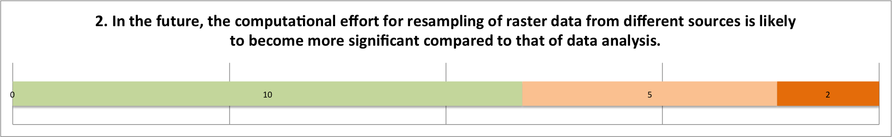
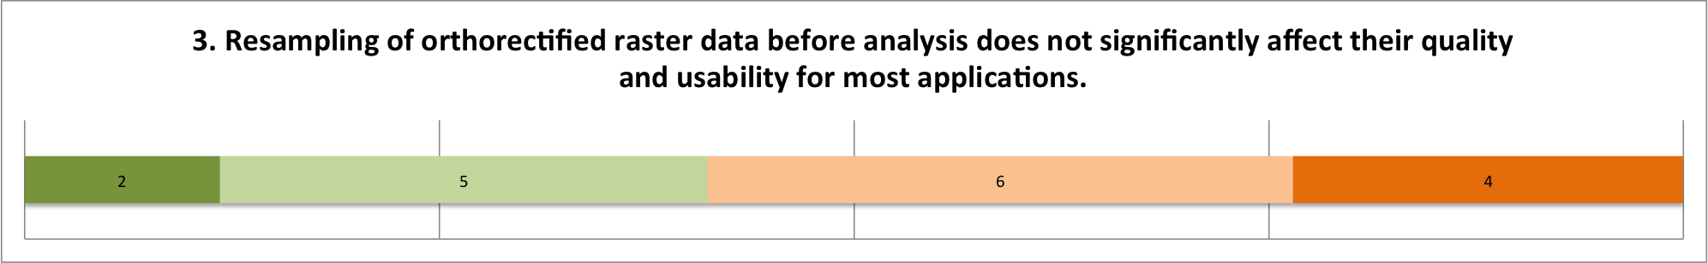
JRC-INSPIRE GRG Workshop 2017

Slide 12
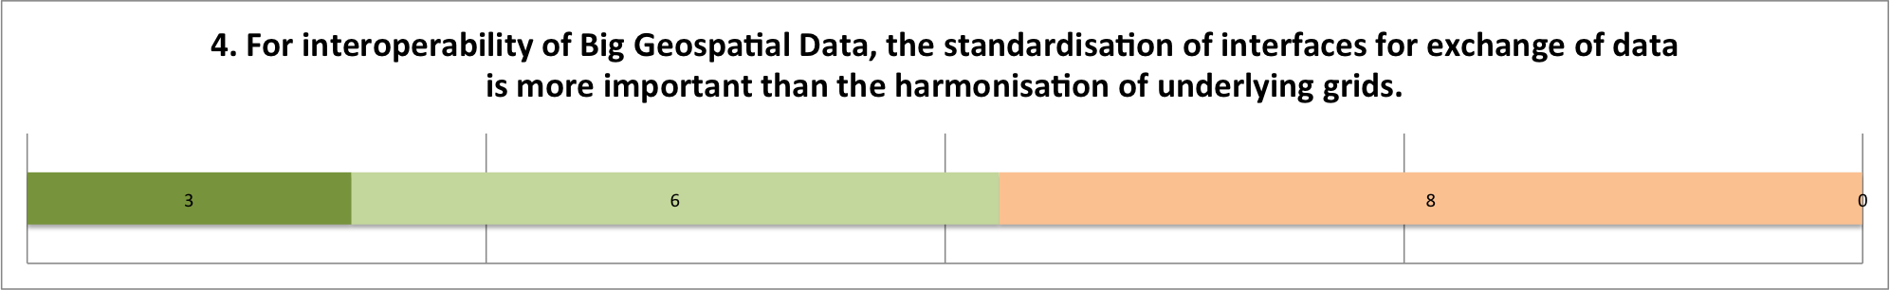
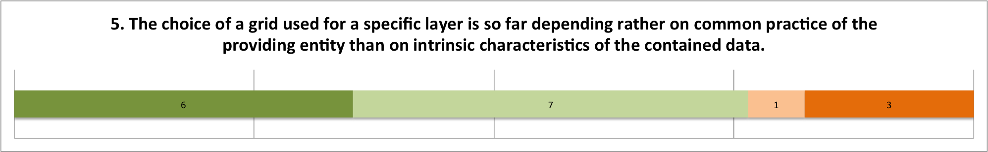
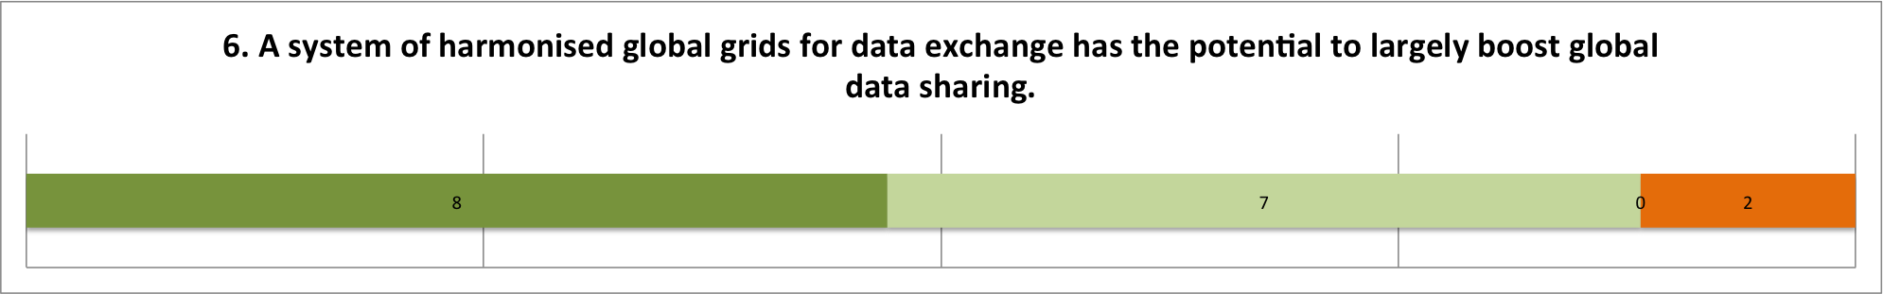
JRC-INSPIRE Workshop 2017 Questionnaire

Slide 13
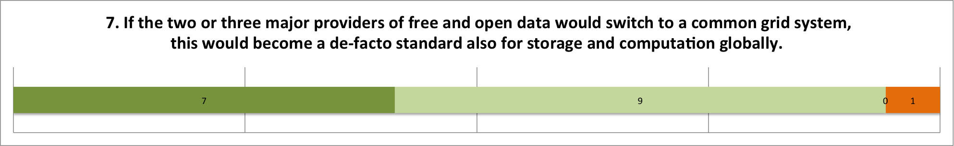
JRC-INSPIRE Workshop 2017 Questionnaire

Slide 14
Geodata representation in the 21st century
Questions for the leading global EO data providers:
Continuous (point-clouds) or discrete (grids)?
If grids then:
Global or continental,
mono-resolution or hierarchical?
Which criteria for ‘good’ global grids?
(e.g. Goodchild/Kimerling)
Main candidate global grid(system)s?
Separate or together?
M. Goodchild (2019):
So, in the final analysis, the big-picture question for DGGSs remains the same as it has been for more than two decades: how do we use the compelling arguments for these multi-resolution systems to persuade the larger scientific community to adopt them, in preference to the distorted representations of digital maps?
https://doi.org/10.3138/cart.54.1.preface

Slide 15
Criteria for (spatial) discretisation
assessable: based on ellipsoidal Earth model
unambiguous: every point on the surface belongs to a cell
gap free: no point on the surface belongs to more than one cell
hierarchical: grids can be refined from coarser to finer levels following mathematical rules (cell refinement)
nested: finer level cells do not overlap coarser cells
intrinsic: the grid is a product of a mathematical tessellation of the ellipsoid, a cell is only determined by location
instantaneous: the grid is defined for any point in time

Slide 16
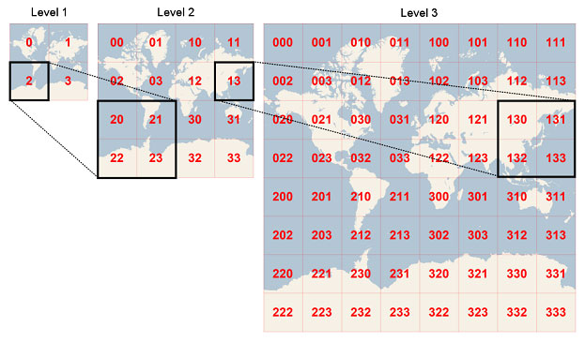
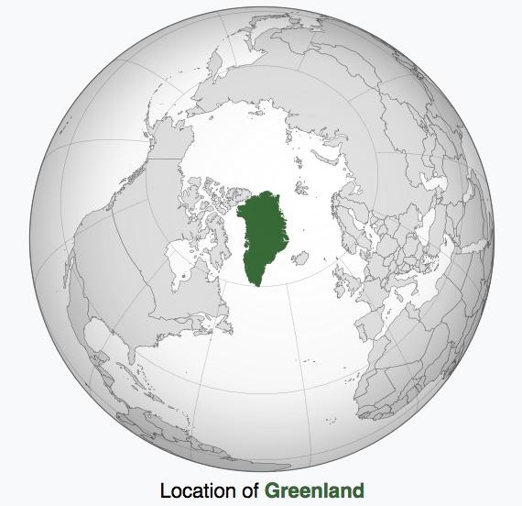
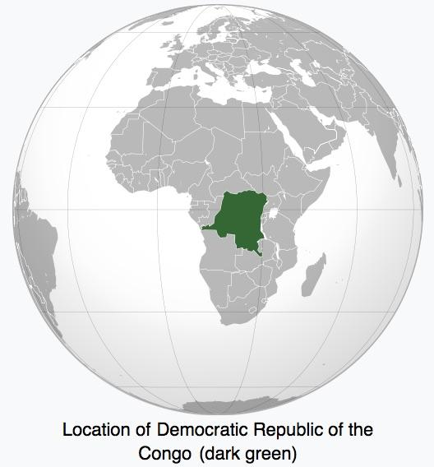
The WMTS standard (base EPSG:3857)

Slide 17
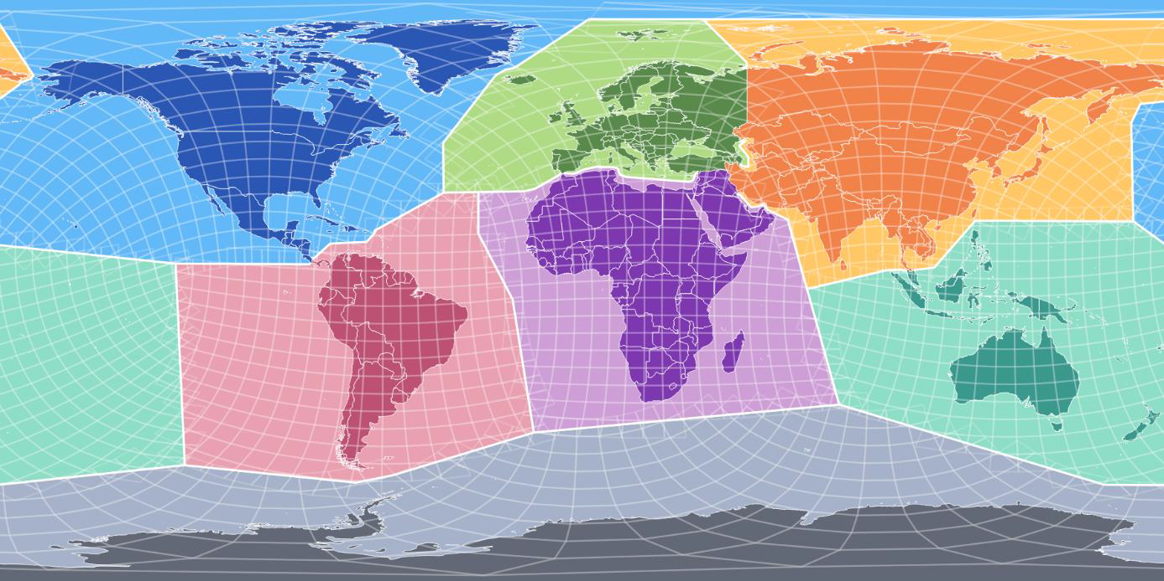
The EQUI7 grid (TU Vienna)
B. Bauer-Marschallinger, Optimisationof global grids for high-resolution remote sensing data, Computers & Geosciences, 2014 doi:10.1016/j.cageo.2014.07.005

Slide 18
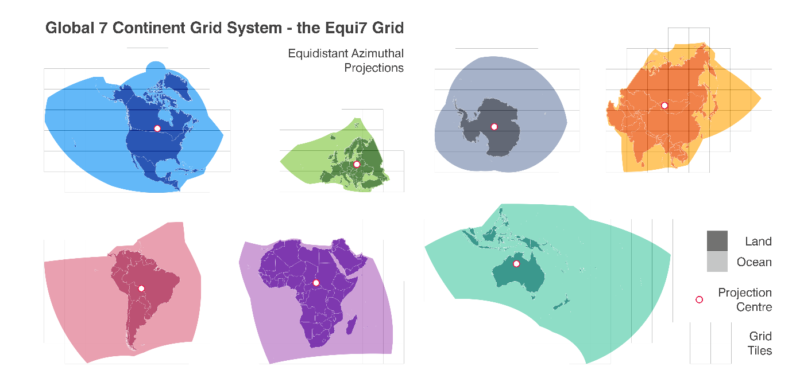
The EQUI7 grid (TU Vienna)

Slide 19
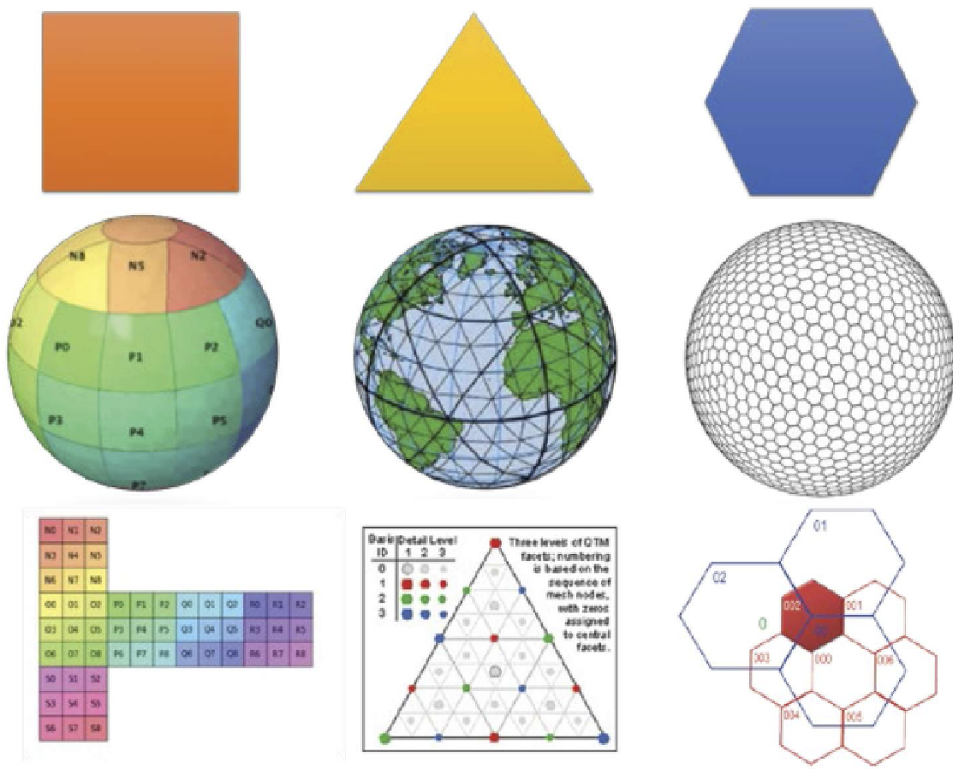
Discrete Global Grid Systems
“…spatial reference system uses hierarchical tessellation of cells to partition and address the globe.
“DGGS are characterized by properties of cell structure, geo-encoding, quantization strategy and associated mathematical functions.”
ISO 19170-1 Geographic information — Discrete Global Grid Systems Specifications —Part 1:Core Reference System and Operations, and Equal Area Earth Reference System https://www.iso.org/standard/32588.html

Slide 20
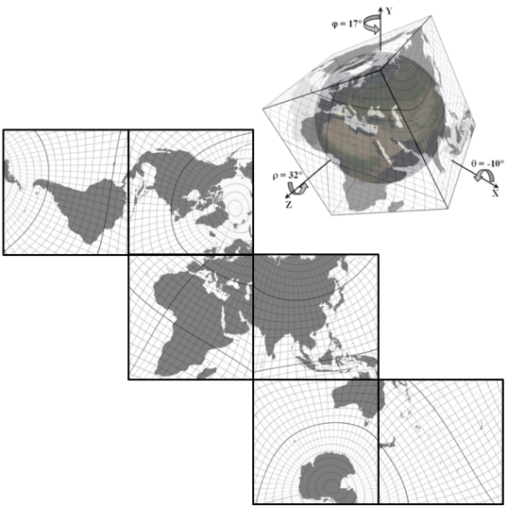
DGGS optimization
After the main choices, i.e.:
  shape (”square”)
  Refinement ratio (4 - quadtree)
  “cube-sphere mapping”
Cube sphere mapping can be optimized to reduce distortions e.g. over land masses
Dimirijevic A., Strobl P., Continuous 2D Maps Based on Spherical Cube Datasets, Proc. 55th International Scientific Conference on Information, Communication and Energy Systems and Technologies (ICEST), doi:10.1109/ICEST49890.2020.9232678, 2020

Slide 21
Discussion
Does CARD require gridding?
Is interoperability (in a processing chain restricted to a ‘one way’ road?
How is reproducibility being secured when data are resampled?
How compatible is repeated resampling with FAIR principles?
Is there room for a “common global CARD grid system”
Which are the top priority criteria for a CARD global grid?

Slide 22
Thank you!
Any questions?
peter.strobl@ec.europa.eu
The information and views expressed in it do not necessarily reflect an official position of the European Commission or of the European Union.
Except otherwise noted, © European Union (2021). All Rights Reserved

