Slide 1
Further Topics, Discussion Time, and Wrap-up
LSI-VC-10 Teleconference #4

Slide 2
Overview
USGS lessons learned regarding Landsat Collection 2 implementation in the cloud [for information]
Requirements (e.g., for AFOLU / Global Stocktake, GEOGLAM, others? USGEO?) [open discussion]
Global grid [open discussion] (Peter Strobl)
Further discussion time [open discussion]
Action review and wrap-up

Slide 3
USGS Collection 2
Cloud Implementation
Lessons Learned
Steve Labahn
USGS

Slide 4
Landsat Cloud Project Scope
Modernize Processing, Access, and Distribution of Landsat Data
Change from a primary business model of downloads to enabling access to the full archive
Enable users to interact with the data in an integrated environment
Ensure provenance and data stewardship
Key Project Objectives:
Establish an enterprise cloud environment for Landsat
Enable access to Collection 1 Level-1 and Level-2 in the cloud
Replicate Collection 1 Level-1 and establish operational data management procedures
Demonstrate global scale production of Landsat data in the cloud through production of Level-2 products using a cloud framework
Process Landsat archive in 1-2 months rather than 18 months
Establish modern access and visualization tools to access data
Establish an Environment and System to Produce and Enable Landsat Collection 2 in the cloud
Demonstrate key science use cases exploiting Landsat data

Slide 5
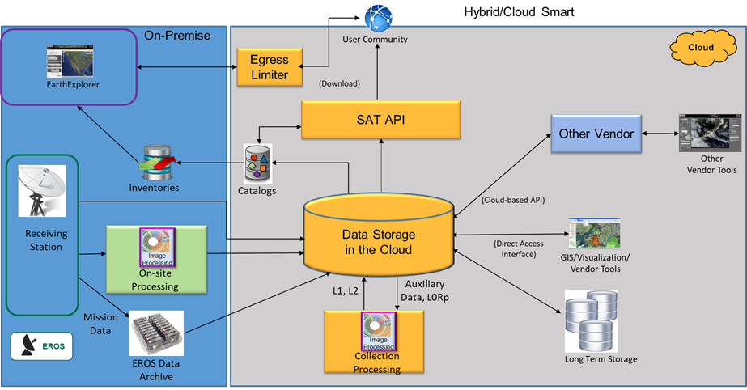
Landsat Cloud Operational Concept View

Slide 6
AWS Tools & Services
Compute:
AWS VPC, EC2, ECR, ECS, Spot Fleets, AWS Elastic Load Balancing, Batch, Lambda, Step functions
Network
Route 53, CloudFront, API Gateway
Storage
AWS S3, ElasticCache, EBS, EFS, Glacier
Database
AWS Aurora PostgreSQL, Redshift, DynamoDB
Messaging
AWS SQS, SNS
Analytics
Athena, Glue
Management Tools
AWS CloudWatch, Cloud Trail, CloudFormation, IAM, Secrets Manager
Developer Tools
AWS Code Deploy
Other non-AWS tools:
JIRA, Confluence, Jenkins, Git, Python, C, Docker, CloudCheckr

Slide 7
Web-Enabled to Cloud-Enabled
Next revolution of Landsat data transitioned from a web-enabled approach to a “Smart Cloud” implementation
USGS historical free and open data policy that enabled great progress in the last transformation to becoming web-enabled was continued into this new cloud environment
New paradigm enables opportunity for users to access the data directly allowing:
Execution of algorithms directly on only the data they need
Selective data usage (e.g., specific bands for use)
Reduced need for permanent IT infrastructure (e.g., serverless compute)

Slide 8
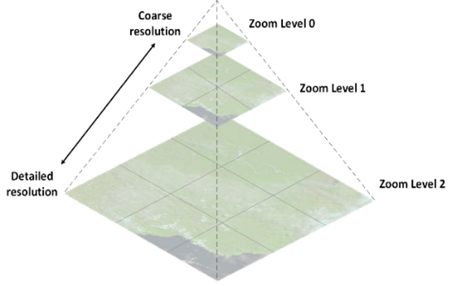
Cloud Optimized GeoTIFF (COG) Format
Conducted trade study on cloud formats, which resulted in the selection of Cloud Optimized GeoTIFFs (COGs)
An enhanced GeoTIFF with tiling and overviews
Uses internal tiling instead of lines to speed access and support better remote reading
Downsampled overviews are generated when lower resolution data is acceptable
No changes to the underlying pixels
Stored in an unbundled format
Data is internally compressed
Enables HTTP Get Range requests
Worked closely with Visualization team to standardize the COG parameters
Delivered prototype COGs for use in LandsatLook development
COG formatting built into Landsat Product Generation System (LPGS)

Slide 9
SpatioTemporal Asset Catalog (STAC)
New collaborative standard for managing access metadata
Open-source on GitHub, hosted by Radiant Earth, includes Landsat extension
Flexibility to support many types of geospatial data (satellite, drone, radar, etc.)
Allows for interoperability between satellite metadata (e.g., Landsat 8 + Sentinel 2)
Lives alongside product-level metadata (MTL, XML)
Exposes data in a common, machine-readable JSON format for both end users and internal processes
Includes direct links to S3 objects
Can be exploited through Jupyter Notebooks by end users to read data directly from the cloud without downloading
Gaining wide adoption by the remote sensing community
i.e., Government, International, Commercial, Academia

Slide 10
Processing Metrics
Collection 2 processing took one month to complete
8.8 million scenes to Level 1 and Level 2
Dates of processing: 19 August – 19 September 2020
Average per day: 293,000/day
Kept initial numbers lower as we were gaining experience with running at-scale cloud processing
On-premises production for Landsat 8 would typically top out at ~25,000/day
Previous Collection 1 processing (only Level 1) took over 18 months (with some downtime between individual missions while code changes were completed)
Docker images were used to run the Image Processing containers
AWS Spot EC2 types:
General purpose w/SSD (m5d) 4xlarge to 24xlarge
Memory Optimized w/SSD (r5d) 4xlarge to 24xlarge
AWS Batch and Step Functions were used for scheduling the jobs
Overall – worked okay, but we did run into limits in that environment
Spot terminations caused some issues in the processing runs
CloudWatch costs were not expected
We had logs turned on for the processing runs, which caused unexpected costs

Slide 11
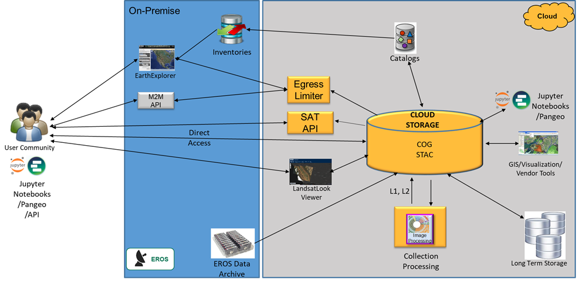
USGS Landsat Collection 2 Access Architecture
Traditional Access:
EarthExplorer (usgs.gov)
Machine-to-Machine (M2M) API
Landsat Commercial Cloud Direct Access User Guide
AWS Command Line Interface (CLI)
Powerful tool for batch processing and script-based workflows
STAC Browser
Web-based GUI that allows users to browse and review STAC records and thumbnails for Landsat data in the cloud
SAT API
Allows users to programmatically search the Landsat data in the cloud for products within their spatial and temporal AOIs
SAT API returns links to objects that the user can then incorporate into their processing workflow

Slide 12
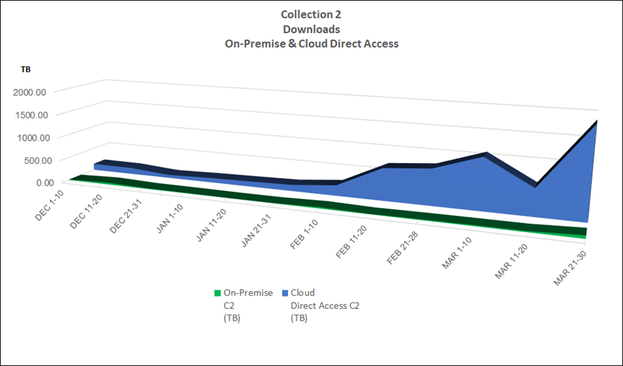
Distribution Metrics

Slide 13
Lessons Learned
What went well:
On-demand database scaling
Increasing read replicas and instance sizes during scale testing in production
Aurora Database Architecture and design (scenes_db, catalog_db)
Migration from Dynamo DB to Aurora
Redshift post processing data validation efforts for Collection 2
Separate accounts for Development, System Test, Production
Separation of Development, System Test, Production was invaluable!
Continuous Integration Continuous Deployment (CICD) processes work well
CloudFormation Templates used for all deployments
Packer used for creating machine images
Ansible Playbooks
Jenkins Pipelines
Signoff process between environments
GitLab runners
GitLab was invaluable as a repository (EROS Enterprise Asset)
AWS cloud storage infrastructure works very well for data distribution
Security groups used to control/limit access to services and applications
Ability to scale processing has been proven to be cost effective

Slide 14
Lessons Learned
Opportunities for improvement:
Batch processing has limitations; AWS recommends migrating to Kubernetes
Contention with resources in the same account
Batch
Step
Spot instances shared between processing and inventory management
Multiple accounts need an enterprise approach to managing the accounts, push out updates, monitoring, etc.
Separate processing and distribution into separate accounts
Two teams independently developing systems/processes and competing for AWS service limits

Slide 15
Action Review and Wrap-up
LSI-VC Sec & Leads

