Slide 1
Looking Forward on CEOS ARD
LSI-VC-10 Teleconference #3

Slide 2
Overview
CARD4L Advisory Note progress [for information and discussion]
WGISS: STAC, COGs
WGCV-IVOS: traceability, uncertainty, etc.
CEOS ARD beyond land [for information and discussion]
CEOS ARD Strategy v2 [for discussion - what should be updated, and what is needed from LSI?]
CARD4L “Inclusivity vs. scientific rigour” (discussion)
VH-RODA follow-up: commercial sector involvement (discussion)
Assessment streamlining / revised peer-review process [for discussion]

Slide 3
CARD4L Advisory Notes
Matt Steventon

Slide 4
CARD4L Advisory Note Progress
Advisory Notes are intended to provide guidance on aspects, such as data formats, without compromising the non-prescriptive nature of the CARD4L Framework
Fourth component of the CARD4L Framework to address data policy, data formats, interoperability, etc.
See these being developed by various expert groups within CEOS, as need arises. To date WGISS and WGCV have been engaged on topics previously raised.
Report from WGISS:
Best practice COGS and STAC are on our task list with the Data and Interop Interest group,
Includes some vocabs for stac measurements (e.g. band names).
No report from WGCV on traceability, uncertainty

Slide 5
CARD4L Advisory Note Progress
Questions
To data providers: are there any topics where such an Advisory Note would be helpful as you work towards CARD4L?
Any topics raised during various industry engagements? VH-RODA?
Does LSI-VC see the need for any other Advisory Notes on the horizon?
Are there Advisory Notes that LSI-VC should be directly working on?
High resolution and downsampling topic?
Anything related to the SAR geolocation accuracy topic?
Do we have interest and capacity in LSI-VC to accelerate the already identified topics? Or happy to wait?

Slide 6
CEOS ARD Beyond Land
Adam Lewis, Ed Armstrong

Slide 7
CEOS ARD Beyond Land
From the CEOS ARD Strategy:
Task 1.2: Identify the need for and prioritise development of future target products as the basis for new CEOS ARD specifications
Task 1.3: Develop further CEOS ARD technical specifications based on established need and prioritisation
Following the example of LSI-VC with CARD4L, and based on the outcomes of task 1.2, CEOS thematic groups to initiate CEOS ARD specifications for their own domains (e.g., geostationary, LIDAR, inland and coastal water surface reflectance, others).

Slide 8
CEOS ARD Beyond Land

Slide 9
ARD Beyond Land, Review and Status
ARD Beyond Land presentations from CEOS SIT-TW encouraged review of CARD4L from non-Land discipline perspectives
Covered SST, atmospheric, coastal and inland waters use cases
Decision CEOS-34-13 (2020 Plenary):
SIT Chair and Ed Armstrong (SST-VC Co-Lead) to form a team of experts to review the CEOS ARD Framework (Definition, Specifications and processes around CEOS ARD) for completeness and suitability (including looking at changes that make it amenable to non-land domains)
Team formed from VC and other Working Group stakeholders December 2020 (SST, LSI, P-VC, AC, WGCV, SIT, COAST and COVERAGE)

Slide 10
ARD Beyond Land, Review and Status
Themes of discussion so far
Converge on key data requirements rather than on data packaging or services (for now). This is consistent with CARD4L.
Communities work with different processing levels and datasets that have differing co-registration and accuracy characteristics - clarity is needed on if and how the ARD framework caters for these
There are, or appear to be, competing and diverging needs in the ARD spectrum. The challenge is to satisfy them.
A significant amount of the discussion is around finding a common language and understanding of the existing CARD4L framework
Next steps
Move the discussion from ‘divergence’ to ‘convergence’
The LSI and WGCV teams will document and share the governance approaches around CARD4L
Identified a need to converge across different disciplines to “core” PFS requirements - LSI team will provide a ‘bare bones’ PFS

Slide 11
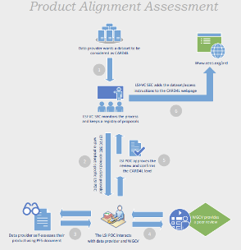
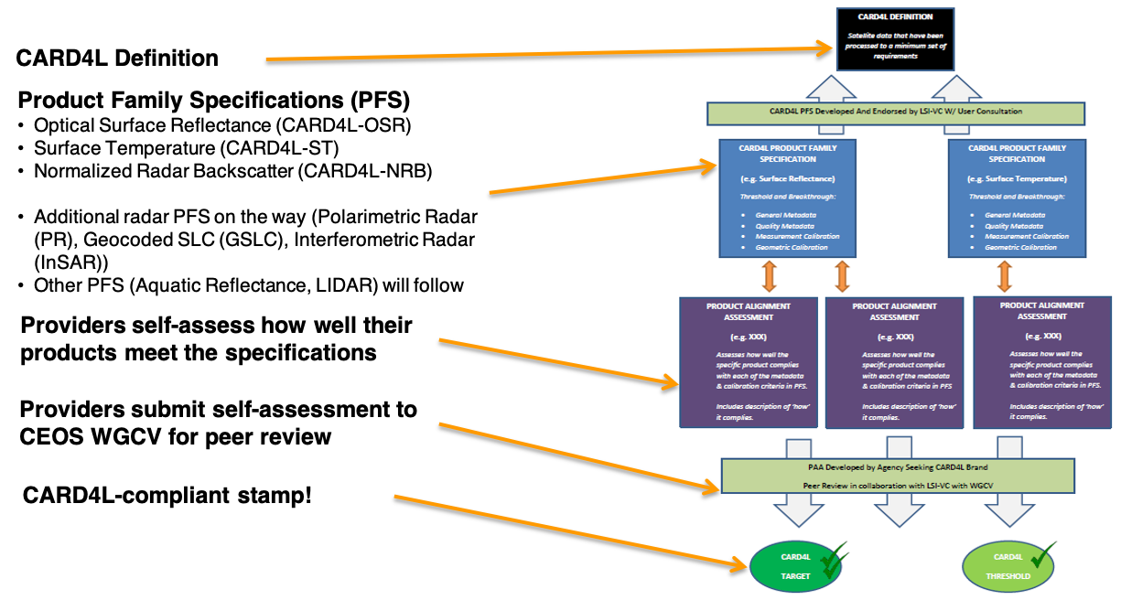
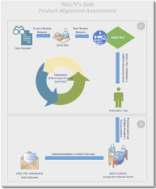
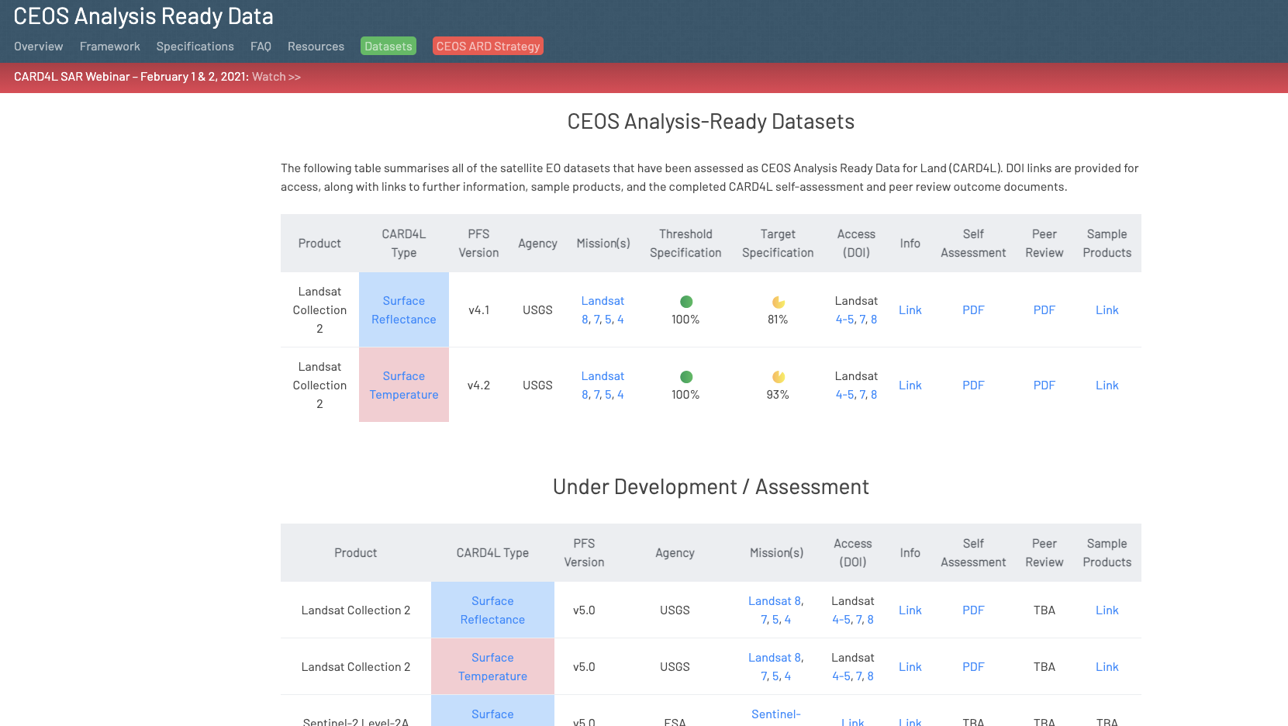
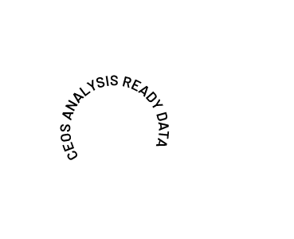
CEOS ARD Governance Framework
Other aspects not yet formally documented

Slide 12
CEOS ARD Governance Framework
The CEOS ARD Governance Framework aims to capture all aspects of the governance of CEOS Analysis Ready Data (ARD), including:
Generalised CEOS ARD definition
The role of the PFS
PFS core elements
Development process for new PFS
Self-assessments and CEOS roles in the process
General process for peer review of self-assessments and approval of CEOS ARD datasets
Classification and promotion of CEOS ARD datasets
The role of Advisory Notes in providing guidance on aspects like file formats, etc. which are not part of the core, non-prescriptive Framework

Slide 13
CEOS ARD Governance Framework
Built on the foundation of CEOS Analysis Ready Data for Land (CARD4L)
Developed by members of the LSI-VC and SST-VC.
Revealed at last week’s Working Teams All Hands Call; in the weeks following organising dedicated follow-up with the VCs.
Key theme: role of the VCs, which would serve as the expert groups that would develop PFS in response to needs/demand and coordinate the assessment of datasets against the specifications for their particular domain
Document will be presented to SIT Technical Workshop later this year, ahead of a targeted endorsement at CEOS Plenary 2021.

Slide 14
CEOS ARD Governance Framework
Framework, governance processes, strategy, and implementation will be coordinated between the CEOS Executive Officer, SIT Chair, and nominated representatives from each of the Virtual Constellations, WGCV, and WGISS.
No additional new CEOS entities are proposed.
CEOS ARD (CARD) coordination meetings including the above participants and others as appropriate will be held annually in the wings of the SIT and SIT Technical Workshop meetings to consider approvals, cross-cutting matters and other leadership matters related to CEOS ARD.
The team is also working on a generic template PFS that captures all of the elements expected to be common to all types of CEOS ARD.
The PFS remain flexible based on the needs of the authors and domains.

Slide 15
CEOS ARD Strategy v2

Slide 16
CEOS ARD Beyond Land

Slide 17
CEOS ARD Strategy v1
The first version of the CEOS ARD Strategy has been a helpful resource to direct and focus CEOS efforts on ARD.
We are seeing good traction on the development and continued evolution of Product Family Specifications
Initial CARD4L assessments have been completed, CARD4L products out in the wild (e.g., Landsat Collection 2), increasing number of assessments in progress
Two key documents accomplished:
CEOS Interoperability Terminology Report
CEOS Paper on the Interplay of Industry and CEOS ARD
Held talks regarding standardisation and agreed a position on this question
Extensive communication and promotion at key events and dedicated CEOS ARD webinars.
Increasing awareness of CEOS ARD across community including industry
Significant resources being collated: https://ceos.org/ard/

Slide 18
Early ideas for v2 – for discussion and development
Update the Strategy to reflect progress and developments in the space
Formalisation of a comprehensive framework for CEOS ARD in general (i.e., beyond land)
Continued promotion to users, data providers, data distributors
webinars, key meetings
SDG applicability
Advisory Notes to provide guidance on key topics as complements to the non-prescriptive PFS
Continued pilot activities (incl. EAIL)
Increased linkage between WGISS systems and CEOS ARD and the cloud – discovery of and access to CEOS Agency ARD
MIM Database links to CEOS ARD products
In general: topics related to accessibility and utilisation of CEOS ARD – increasing impact of CEOS data, including via an increased scope of the CEOS ARD concept

Slide 19
CARD4L “Inclusivity vs. Scientific Rigour”
Ake Rosenqvist
JAXA/soloEO

Slide 20
CARD4L - Inclusivity vs. scientific rigour
CARD4L definition: EO data that have been processed to a minimum set of requirements and organized into a form that allows immediate analysis with a minimum of additional user effort. Provides interoperability both through time and with other datasets.
Standards: all metadata in one place, requirements for geometric and radiometric quality, relevant per-pixel metadata.
Key drivers:
Broaden the user base - especially reaching out to non-expert users
Encourage CEOS agencies - as well as other data providers - to generate and distribute standardised EO data products
Increase CEOS visibility
etc.
Balance: Provision of products that meet a certain standard (scientific rigour), at the same time as accommodating broad adoption of CARD4L standard amongst data providers (in particular CEOS agencies).

Slide 21
CARD4L - Inclusivity vs. scientific rigour
Discussion points:
The intended role of “Threshold” and “Target” requirements
The minimum level of the Threshold requirement
A requirement is set at a level may exclude certain CEOS agencies or missions from participating, but while lowering the level may (or not) compromise data quality?
Example 1:
NRB geometric accuracy - threshold beyond reach for several key SAR missions (e.g. ALOS, NISAR, RCM, BIOMASS, SAOCOM, NovaSAR)
As Threshold, should the requirement be, e.g. data provider indicates an estimate of the geometric accuracy (bias & std), OR set a level “liberal” enough for key (CEOS) missions, OR maintaining high scientific rigour at the expense of certain (CEOS) missions/data providers
Example 2: What constitutes Threshold Per-pixel metadata?
Not available would render the product unuseful?
Used by a sufficiently large user community?
Useful, but not critical? (or not critical for common users?)

Slide 22
VH-RODA Follow-up: Commercial Sector Involvement

Slide 23
VH-RODA Follow-up: Commercial Sector Involvement
Commercial sector brought additional concepts/thoughts like:
ARS (Analysis Ready Services), going beyond the notion of product that limits the range of downstream applications, or
the need to move towards product Levels 4 and 5.
Commercial space involvement
General consensus that sensor agnostic, standardised and easy-to-use products are interesting for non-expert users.
Commercial sector is showing some support to CEOS-lead CARD4L initiative (2 commercial products under certification: Sinergise Sentinel-1 and Element 84 Sentinel-2).
Need to reinforce CEOS-led initiatives to promote ARD in general and CARD4L in particular (e.g. in venues like ARD workshop, JACIE, VH-RODA) to foster adoption of CARD4L by the commercial sector.
Need to reinforce the promotion of the benefits brought by existing and future CARD4L products in the general effort towards facilitating missions interoperability + advantage of being first movers.

Slide 24
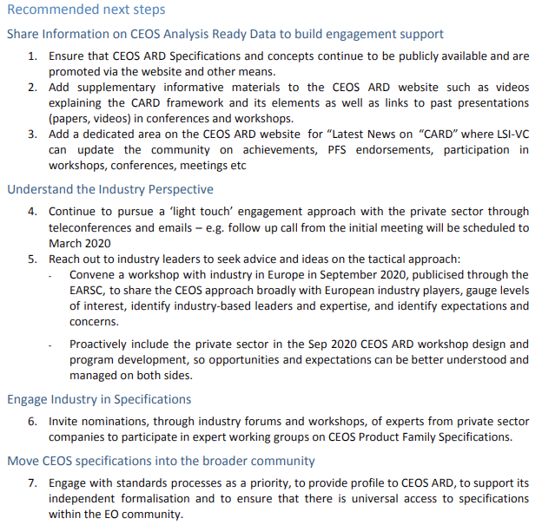
CEOS Analysis Ready Data: Involving the Private Sector
Document endorsed at CEOS Plenary 2020, here

Slide 25
VH-RODA Follow-up: Commercial Sector Involvement
Possible actions:
Revisit the CEOS Analysis Ready Data: Involving the Private Sector paper recommendations and devise an action plan for LSI-VC
Establish an email list through LSI to have the commercial sector involved and updated on CARD4L. Perhaps using the VH-RODA participant list and WGCV/IVOS contacts.
ARD Webinar #3 targeted specifically at the commercial sector?
Promotion of the benefits brought by existing and future CARD4L products in the general effort towards facilitating missions interoperability + advantage of being first movers
CEOS ARD architectures; DIAS, ODC, etc.
How CARD4L fits with new approaches related to cloud hosting/processing, online analysis platforms, COG, STAC, machine learning, etc., and what would be beneficial or necessary to ensure ongoing relevance.

Slide 26
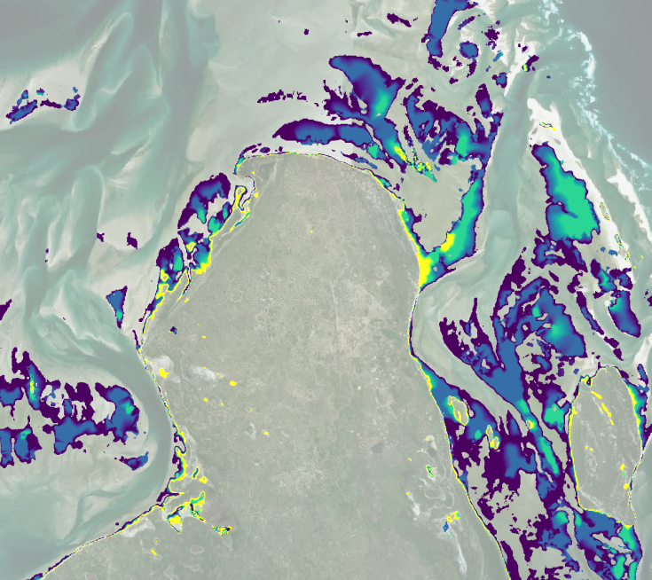
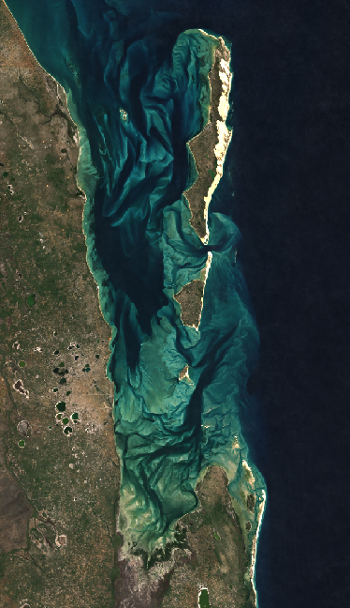
Sentinel 1
Mozambique - S1 intertidal elevation notebook first proof of concept!
S1 coverage composite for January 2021

Slide 27
Assessment streamlining / Revised Peer-review Process

Slide 28
Assessment Streamlining / Revised Peer-review Process
Recall discussion from 16 March teleconference:

Slide 29
Assessment Streamlining / Revised Peer-review Process
Recall discussion from 16 March teleconference:

Slide 30
Assessment Streamlining / Revised Peer-review Process
Discussion from 16 March teleconference:
Lately in excess of 18 weeks turnaround.
Long turnaround presents problems for data providers (e.g., hinders any necessary adjustments to work flows / product development). Need to streamline, at least for the threshold level perhaps.
The assessment workload for WGCV is high and perhaps unsustainable. It was suggested that for the threshold level assembling the peer review panel is perhaps not necessary. Instead, this might be handled by the single WGCV POC alone, through self-declaration and one-on-one discussions.
The threshold requirements and their often qualitative nature make them amenable to a self-declaration and lightweight review. The Target requirements are often more quantitative and require a more rigorous review.
The streamlining proposal was agreed in principle, with exact details to be worked out over the coming months.

Slide 31
Assessment Streamlining / Revised Peer-review Process
Further discussion time if needed
Additional input for Medhavy to take to WGCV-49 (June 29 - July 2, 2021)

Slide 32
Wrap-up
LSI-VC Leads

