Slide 1
LSI-GEOGLAM and LSI-Forests & Biomass
LSI-VC-10 Teleconference #2

Slide 2
Overview
LSI-GEOGLAM subgroup updates / report / action items
LSI-Forests & Biomass subgroup updates / report / action items
AFOLU Roadmap
LSI role on land cover products – for AFOLU, Global Stocktake and more broadly in CEOS
Using Open Data Cube to support AFOLU and GST (Brian)

Slide 3
LSI-GEOGLAM Subgroup
Brad Doorn, NASA

Slide 4
GEOGLAM Update – On-Going
G20 Agriculture Deputies Meeting, April 2021. Strong support statement form the Ministers later this year. Acknowledgment of our 10 year anniversary and the co-development work we are now doing in Africa
Capacity/Co-Development Working Group strategy document development. Linkage to CEOS CapDev activity
Essential Agriculture Variables Working Group. Work has been Covid-delayed but continues. The definition phase is well underway and link to efforts around the priority areas (SDG's Climate and Disaster Risk Reduction)
Update current GEOGLAM documents to incorporate EAV’s; including GEOGLAM Community Research and Operationalization Agenda and GEOGLAM EO Data Requirements (including accuracy).
EAV Website under-development
Priority EAV Definitions under-review: agriculture area, crop type, crop yield, crop conditions
Reviewing EAV’s and Impact on AFOLU efforts

Slide 5
GEOGLAM Update – Climate Mitigation
AFOLU and the Roadmap
Existing agriculture products are not suitable for assessments under the GST, or NDC’s in LDCs
Open science is transforming the monitoring landscape and enabling new solutions
Opportunity and necessity to move towards systematic operational analytics to replace one-off products
WorldCereal, A Major Step Forward
Most important, it is building a WorldCereal system, not just one-off products, that will:
Produce Global cropland maps at 10 m resolution, accuracies 80% +, on a seasonal basis
Initiate a global in situ reference dataset for agriculture
Develop and test state-of-the-art classification algorithms
Opportunities for CEOS-GEOGLAM Forward Agenda:
Managed reference network for in situ data
Harmonized global data sets of Landsat 8 and Sentinel 2, including full archive validated satellite-driven agricultural data products addressing Essential Agriculture Variables
Incorporation of new data streams as they become available

Slide 6
GEOGLAM Update – Climate Adaptation
Supplemental Guidance for National Adaptation Plans
UNFCCC Supplemental Guidance for the National Adaptation Plan (NAP) Process
Focused on co-development of national scale agricultural monitoring systems
May provide a roadmap to expand GEOGLAM co-development to meet expanding needs from least developed countries
Opportunities for CEOS-GEOGLAM Forward Agenda:
Articulation of evolving satellite data user requirements for agricultural monitoring including user requirements for future missions
Capacity (co)development for LDC’s to collect and provide the information needed for their national mitigation and adaptation planning and response programs-Links to CEOS CapDev Wkgrp?

Slide 7
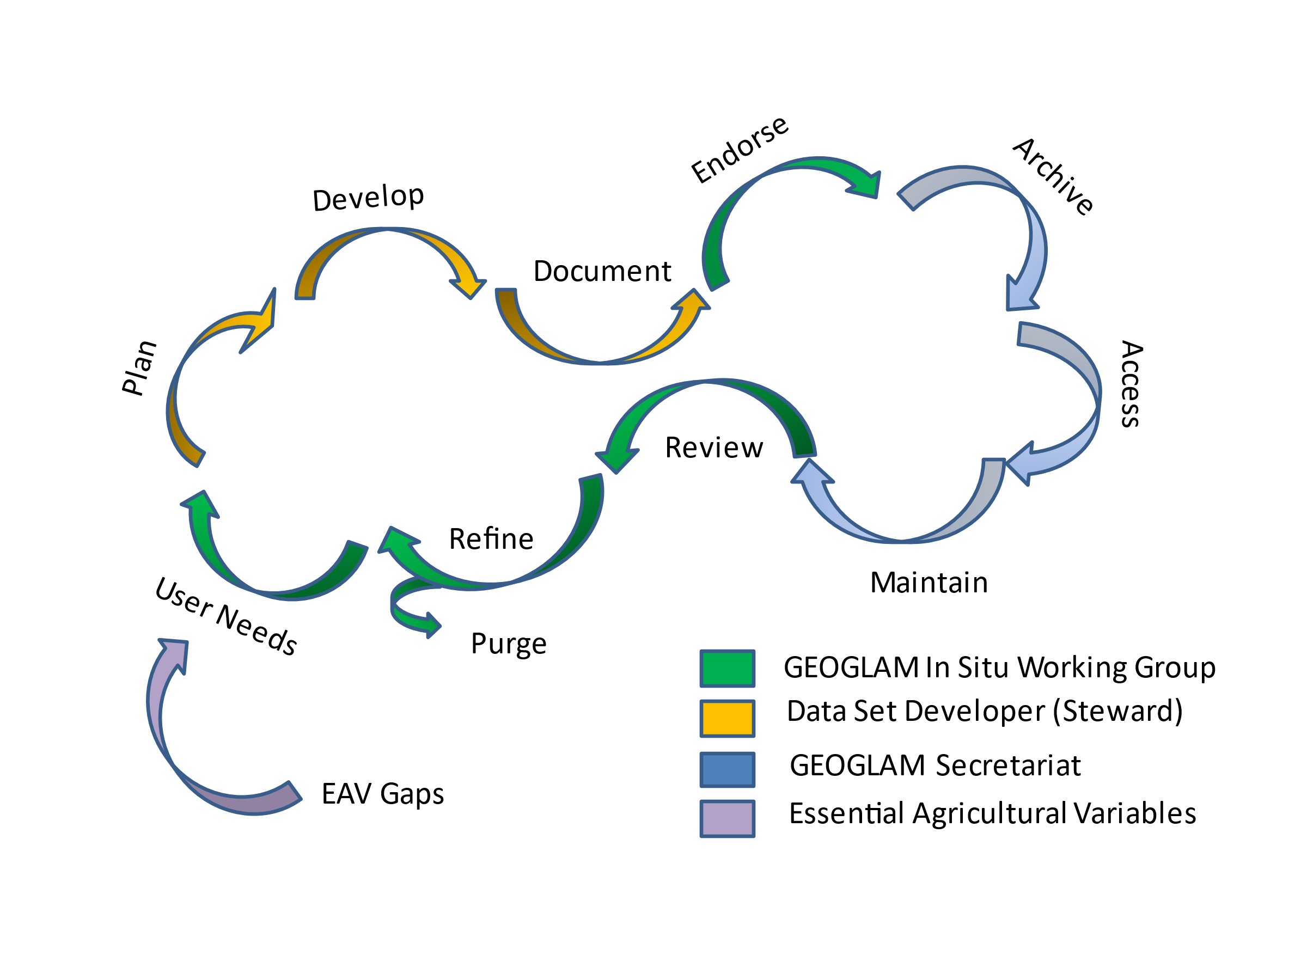
GEOGLAM Update – Enhanced In Situ Data Mgmt.
Initiative 1: In Situ Data Coordination for GEOGLAM
Develop a GEOGLAM In Situ Data Curation Strategy and Guidelines
Data lifecycle management, update 2018 Data management discussion paper (Figure 1 below)
Define GEOGLAM’s potential role in in situ data coordination
Discuss the role of knowledge management (e.g., GEO Knowledge Hub) and define a federated approach to data management (e.g., STAC, AgroStac, and other systems) in support of in situ data coordination
Identify Existing In Situ Data Holdings
In Situ Data Quality Assessment Guidance
In Situ Data Collection Tools and Guidance

Slide 8
GEOGLAM Update – Enhanced In Situ Data Mgmt.
Initiative 2: Intercomparison Guidelines and Pilot
Develop Intercomparison Guidelines and Best Practices
Metadata analysis
Qualitative assessment
Products direct inter-comparison (areas of disagreement / agreement)
EO-based interpretation through the extraction and analysis of relevant vegetation metrics by class
Quantitative assessment, usability assessment for different use cases / user groups
Pilot Study
Participants will help identify target crop maps over East Africa for intercomparison.
Build and document the Intercomparison Database (including both mapping products and in situ datasets used for the generation of these products-linked to in situ work)
Coordinate GEOGLAM work with CEOS LPV Working Group efforts on the inter-comparison guidelines

Slide 9
Forests & Biomass Team Session
LSI-VC-10, 17-18 May 2021
Committee on Earth Observation Satellites
Osamu Ochiai (JAXA) & Frank Martin Seifert (ESA)
Notes:
Osamu to speak < 10 mins

Slide 10
Contents
1. LSI-VC Forests and Biomass Team update (5 mins)
2. AFOLU Roadmap activity update (20 mins)
3. Broader GST Strategy & relevance to LSI-VC (15 mins)
4. LSI-VC Leadership and Roles - Discussion (40 mins)

Slide 11
LSI-VC Forests and Biomass Team
In 2019, SIT Chair proposed that CEOS ‘sunset’ ad-hoc teams after they have served their purpose. And identify permanent homes as appropriate.
Main observation acquisition strategy task was already satisfied given massive increase in free and open capacity
SDCG evolved to become the Forests and Biomass Team of LSI-VC at 33rd Plenary in Hanoi, Oct 2019 (along with the GEOGLAM Team)
ESA (Frank Martin Seifert) and JAXA (Osamu Ochiai) co-lead the team
USGS co-lead lost
Notes:
Main point: Measure changes in AFOLU / biomass for mitigation and adaptation activities

Slide 12
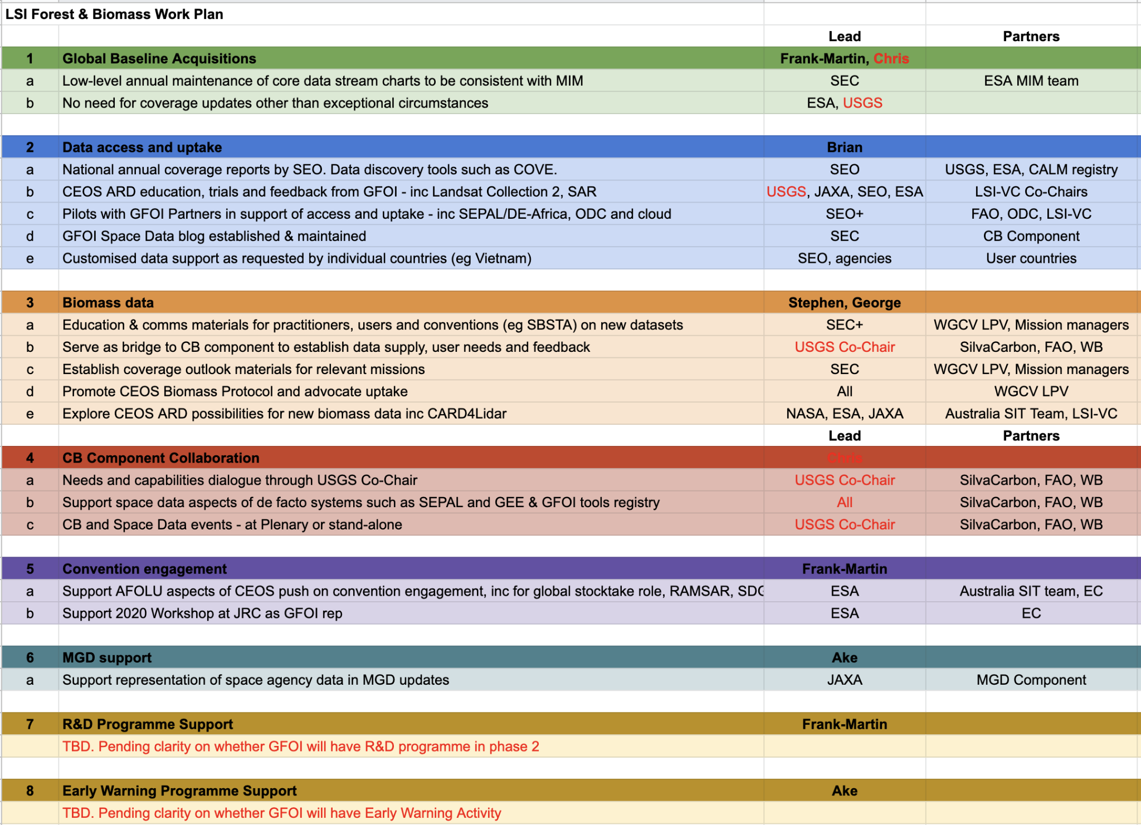
LSI-VC Forests and Biomass Team
More of a watching brief for CEOS in GFOI these days - GFOI mostly in-country programmes and capacity building
Structured WP maintained (need to address USGS representation)

Slide 13
LSI-VC Forests and Biomass Team
2020 and 2021 activities dominated by the need to provide leadership and capacity for the development of AFOLU datasets and roadmap for the UNFCCC Global Stocktake process in support of the CEOS strategy
Important for LSI-VC and its agencies to demonstrate leadership in this area. LSI-VC has overseen land surface issues for more than 10 years in CEOS and its agencies are the major investors in the underlying missions and products
GST/AFOLU remains our major task in the F&B team for the foreseeable future
Linking GFOI and AFOLU country interaction
Responding to GFOI issues should any others arise
Periodic review of the WP

Slide 14
AFOLU Roadmap Activity Update
20 mins
Committee on Earth Observation Satellites

Slide 15
Background
Recognised for land sector issues in recent IPCC reports - substantial capabilities of CEOS agencies in this area and needs raised by UNFCCC
AFOLU Task Team, led by LSI-VC Forests and Biomass, established
Discussion paper prepared for 2020 CEOS Plenary
A CEOS AFOLU Initiative for the UNFCCC Global Stocktake Process: A Discussion Paper for CEOS Plenary to explore the development of a CEOS AFOLU Roadmap
Provide a clear statement of the technical capabilities of CEOS agency EO satellite data and their characteristics - capabilities and datasets for inclusion in the UNFCCC Synthesis Report on Systematic Observations
Propose a specific way forward for 2021 and deliverables for GST1 as the critical first deadline
Significant interest expressed at Plenary on coordination of the CEOS activities for the GST & ensuring necessary communication, inc between GHG and AFOLU
CEOS-34-07 : CEOS Agriculture, Forestry, and Other Land Use (AFOLU) Roadmap Team to follow up with CEOS Agencies to determine their willingness to contribute to the development of an AFOLU Roadmap. In 2021, the effort will prioritise AFOLU Products for the first UNFCCC Global Stocktake give the urgency, followed by a longer-term vision in a CEOS Roadmap document.

Slide 16
AFOLU Team Participation
Co-Lead: Osamu Ochiai, JAXA & GFOI Co-Lead
Co-Lead: Frank Martin Seifert, ESA & GFOI Co-Lead
Member
Shanty Reddy, Australia
Kostas Papathanassiou, DLR
Richard Lucas, ESA/CCI
Shaun Quegan, UK & ESA/CCI
Heather Kay, ESA/CCI
Zoltan Szantoi, EC & LSI VC
Ian Jarvis, GEOGLAM
Alyssa Whitcraft, GEOGLAM
Martin Herold, GOFC-GOLD
& ESA/CCI
Stephen Ward, JAXA
Ake Rosenqvist, JAXA
Takeo Tadono, JAXA
Benjamin Poulter, NASA
Michael Falkowski, NASA
Hank Margolis, NASA
Krishna P Vadrevu, NASA
Sassan Saatchi, NASA
Laura Duncanson, UMD
Ritvik Sahajpal, UMD
Brad Doorn, NASA
Christine McMahon-Bognar, NASA
Brian Killough, NASA
Kevin P Gallo, NOAA
Steven Labahn, USGS
Chris Barber, USGS
Sylvia Wilson, USGS
John Remedios, UKSA
Ruben Van De Kerchove, VITO
Nancy Haris, WRI
Fred Stolle, WRI
SIT Vice Chair Team
Ivan Petiteville, ESA
Stephen Briggs, ESA
GHG Task Team
David Crisp, NASA
Mark Dowell, EC/JRC
WGClimate
Albrecht Von-Bergen, DLR

Slide 17
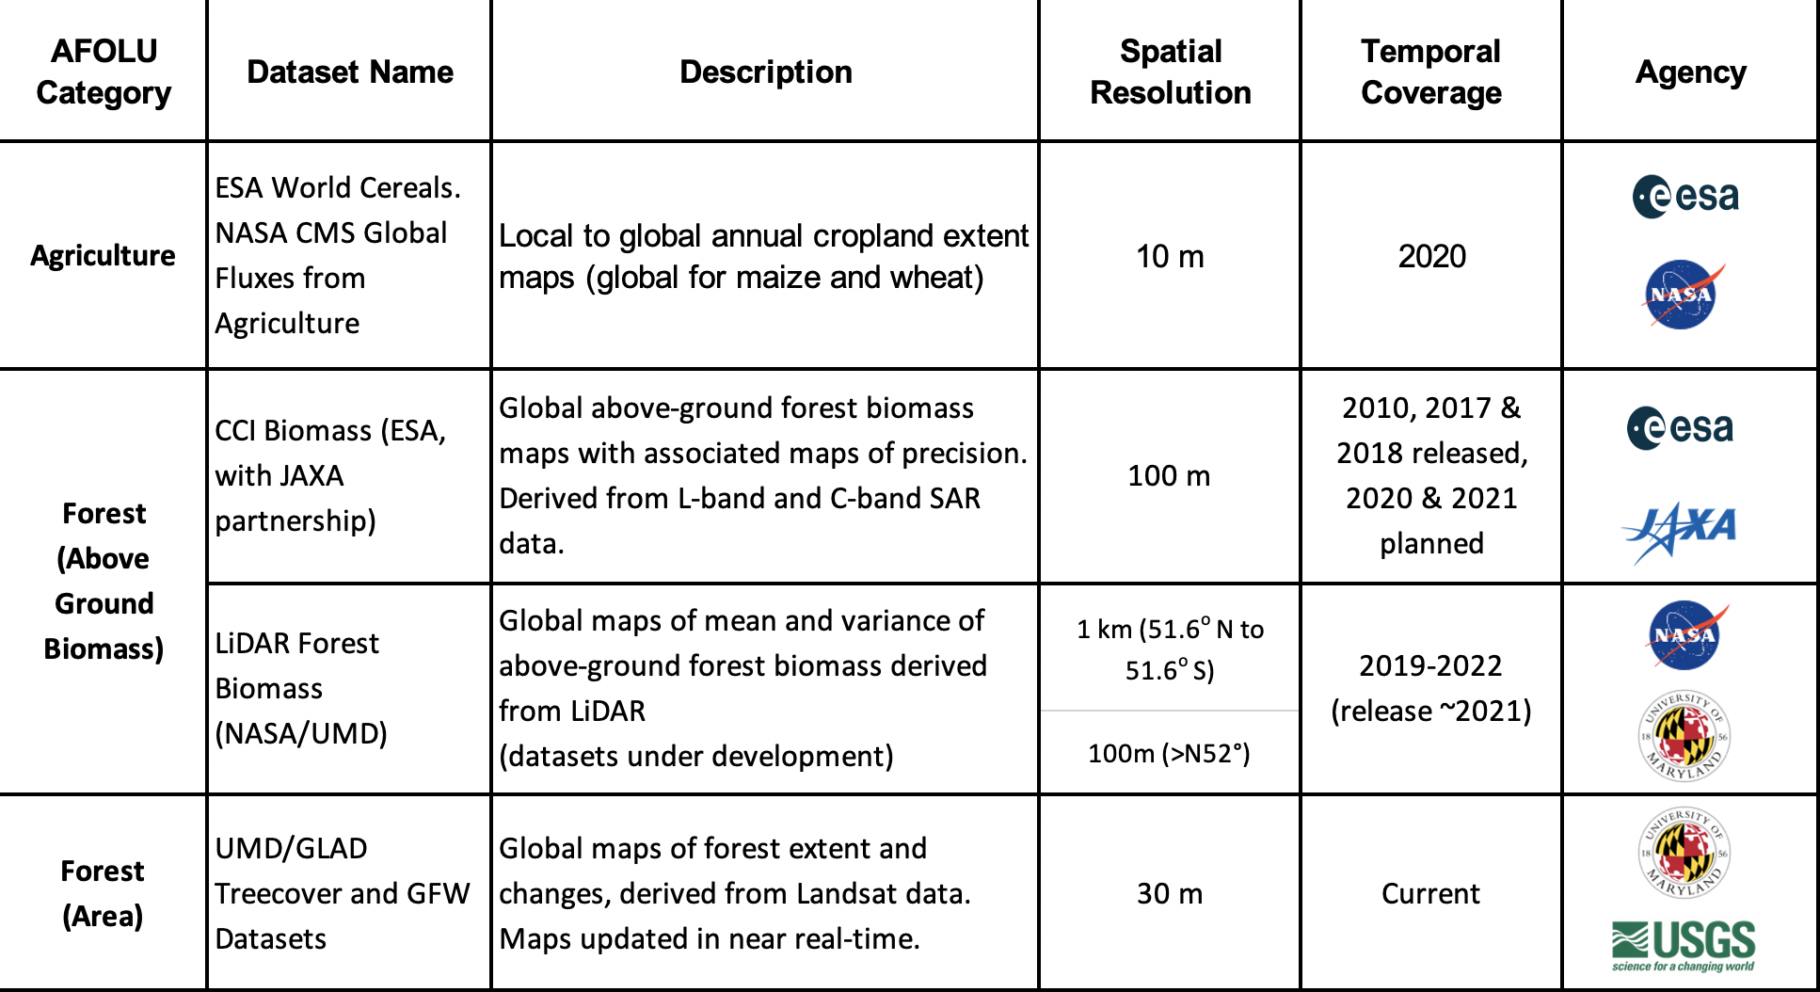
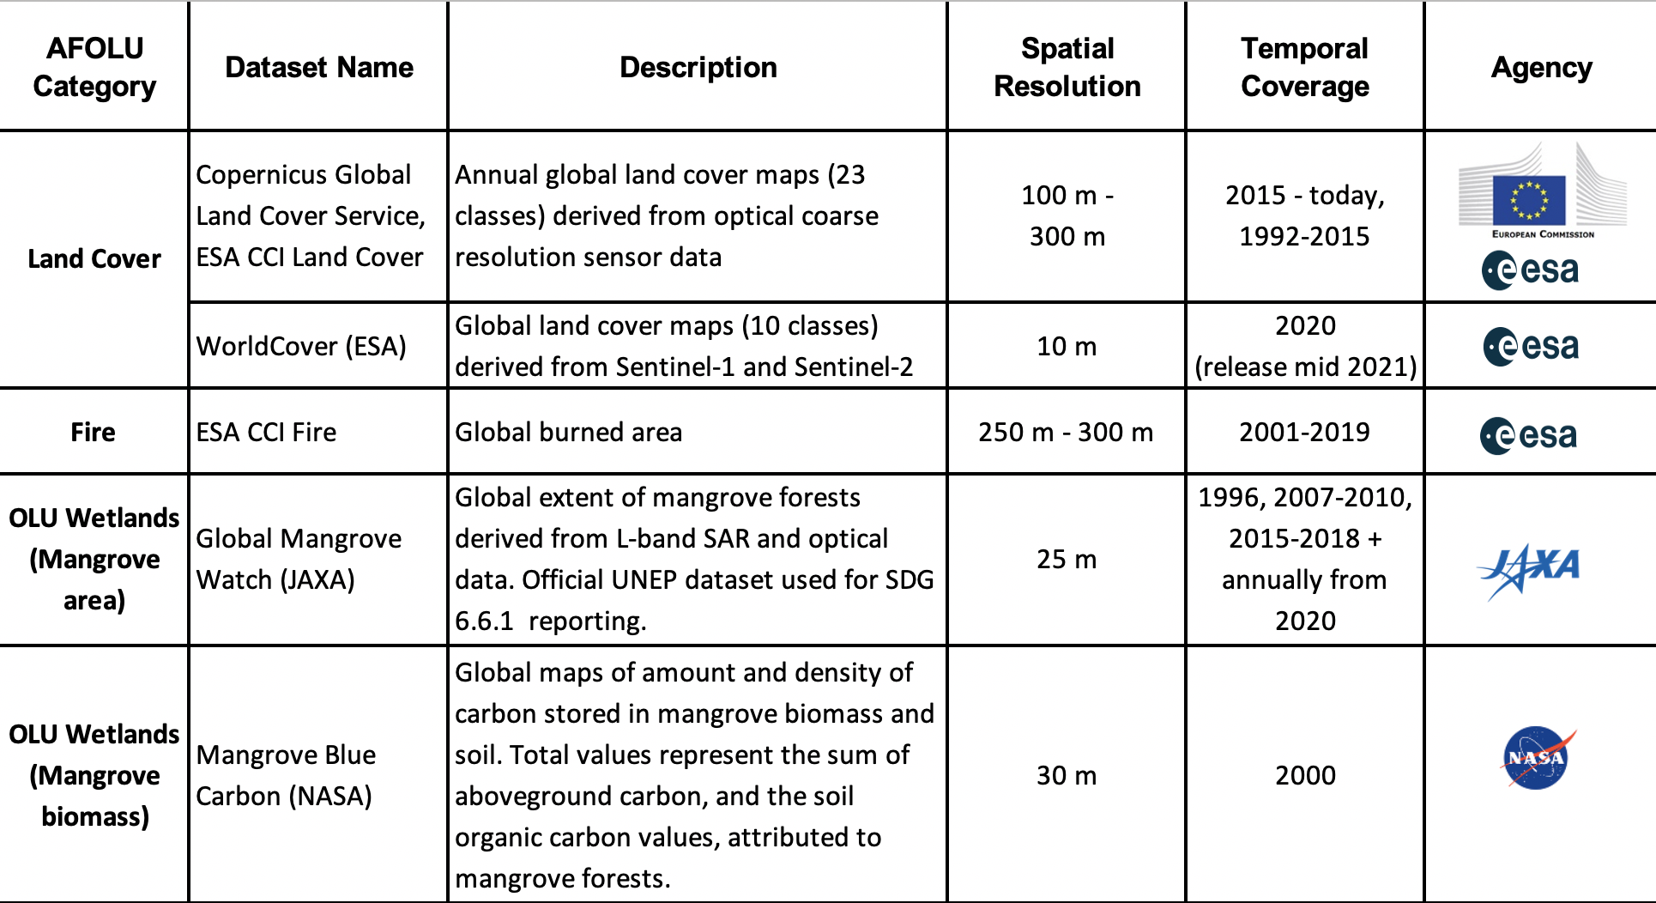
2021 Activities
Top priority to the availability of relevant datasets in time for COP-26 (early Nov 2021) along with the prototype GHG products
A comprehensive roadmap can follow successful completion of GST1 deliverables
Task team agreed to focus on - a small number of mature AFOLU products, complete with comprehensive guidance and communication materials to the UNFCCC Synthesis Report. Both national and global scale products are in scope.
2020 capabilities review identified a number of promising candidates

Slide 18
2021 Activities
Further prioritisation considered to identify key datasets being communicated (the process should be by on-going elaboration)
The AFOLU Team tasked small expert teams in each key dataset (below) formed by ideally most relevant agencies and with different geographic balance
Above Ground Biomass: Laura Duncanson / Sassan Saatchi (NASA), Martin Herold (GOFC/GOLD & ESA/CCI)
Land Cover & Change - inc Forests: Martin Herold (GOFC-GOLD & ESA/CCI), Ben Poulter (NASA), Michael Cherlet (EC), Ake Rosenqvist (JAXA) and Frank Martin Seifert (ESA)
Mangroves (OLU): Ake Rosenqvist (JAXA), Richard Lucas (ESA/CCI)
Agriculture: Ian Jarvis (GEO Sec) and GEOGLAM colleagues
The expert teams prepared a short report outlining the CEOS coordinated input to GST1 (what may be possible given more time after GST1)
Solicit CEOS Principals necessary support in order to deliver the datasets by COP-26
Expert Teams will present 1-2 slides with their suggestions as to both default and optimal outcomes for their product type for GST1 and what is required from CEOS agencies to achieve each one

Slide 19
Last call & SIT-36 outcomes
Confirmed that GST1 outcomes are the top priority for the time being.
an integrated set of products with comprehensive user guidance
Expert teams proposed a baseline and enhanced target for COP-26 (and beyond) for each of the key AFOLU datasets
A test group of national inventory users being identified and engaged to provide feedback on the product selection and application
Dataset producer engagement flagged to Principals and asked to expect approach for support (baseline or enhanced targets)
SIT Chair (with SIT Vice-Chair support for continuity) progressing with a broad and coordinated strategy towards the GST, including on communications

Slide 20
AFOLU Dataset summary
 | COP-26 (Nov 2021) | GST1 (2021-23?) | Beyond (2024+) | Notes
Biomass (Forest AGB) | Fall back is individual existing datasets Synthesised biomass product providing estimates at a jurisdictional level globally | Synthesized, jurisdictional level biomass, emission factors (and prototype biomass change) | Synthesized spatially explicit, annual biomass, emission factors and biomass change | Work plan and schedule provided
Land Cover & Forest (area) | -- Copernicus annual global land cover - C3S/CCI Land Cover - WorldCover, - HILDA+ - Global Forest Watch tree cover loss and forest fluxes | Synthesised map products and estimates of land cover and change at regional, and global levels Global tree cover and forest emissions and removals | Statistically robust activity data estimates (6 IPCC classes) at national and global levels Global annual forest emissions and removals at 30-100 m resolution. | GOFC-GOLD coordination proposed
OLU - Mangroves & Wetlands | - Global Mangrove Watch cover and change (1996-2016) - Global Mangrove biomass (2000) | Global mangrove cover and change at 25 m (2019+) Global mangrove biomass at 12 m (2015) | Global annual mangrove emissions and removals at 10-25 m resolution. | In coordination with GMW
Agriculture | Demonstration WorldCereal products for at least 5 countries (Argentina, Spain, France, Ukraine and Tanzania) | Initial WorldCereal map and analytical system. On-going seasonal analysis products | Continual system improvement and production of seasonal state and change products | In coordination with GEOGLAM
Indicates off the shelf datasets possible. Indicates additional resources needed.

Slide 21
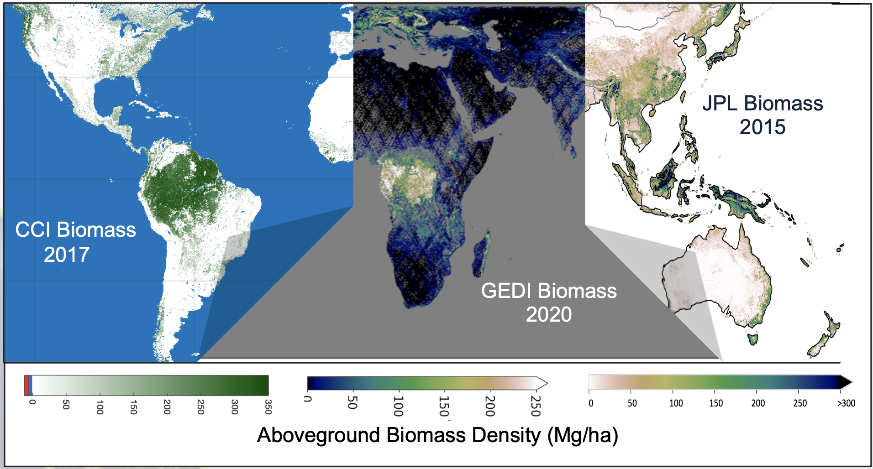
Proposed Biomass Product Harmonization Activity for the GST1
Several biomass products will be publicly available in advance of the GST (e.g. NASA’s GEDI, ESA’s CCI Biomass)
To bolster uptake of these considerable CEOS agency investments, a single CEOS-endorsed biomass product is desirable and demonstrations of space-based biomass uptake by countries

Slide 22
GST1 Input - Biomass
First expert meeting on 13. April 2021:
Support from key agencies: NASA, ESA, JAXA, DLR, UK Space agency ...
Includes ongoing projects and initiatives (CCI-Biomass, GEDI, ICESAT, ALOS ...)
Agencies putting additional resources towards harmonized biomass for GST by COP 26 (final decisions pending)
Implementation plan for GST harmonized biomass for COP 26 demonstrations:
Delivery of updated datasets, global and regional biomass maps for comparison, validation and global estimation by mid-July
Products will be assessed following the WGCV biomass protocol using available reference data - collection of suitable reference data should start (many partners, agreements)
MAAP-platform as basis for such an open science effort: ready soon to start for populating with algorithms and datasets
Country demonstrators to showcase uptake of space-based biomass data for national estimation
Harmonization and biomass estimation framework at jurisdictional level is still under discussion

Slide 23
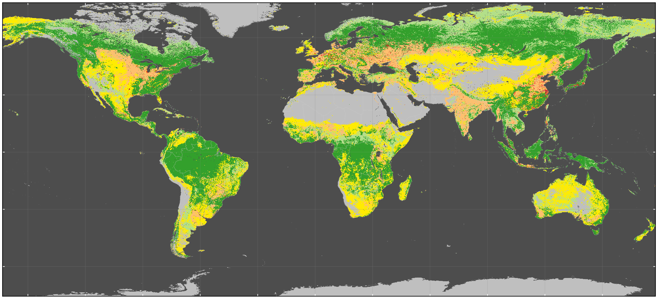
GST1 Input - Land Cover,
Forest, Wetlands and Change
Forest/land cover/wetland and change essential for national GHG inventories estimating activity data and to global AFOLU modeling and assessments
Many agencies producing relevant data and products; aim of a joint effort is to provide synthesis of available products and experiences in three main areas:
Support of national GHG inventories for activity data estimation following the IPCC GPG: showcase experiences of countries using satellite-derived activity data and demonstrate progress in novel products related to land use change, wetlands, forest/land degradation, fire/burnt area
Improved global land change data for AFOLU and modeling assessments: Present long-term harmonized global land cover change data and novel, next generation global land cover/change products at higher spatial/temporal/thematic detail
Enhance consistency/comparability of national GHG inventories and global GHG estimates: Develop best available global land cover change estimates at regional level for statistical comparison with country-reported data
Activities: expert meetings, coordinate input from CEOS partners, synthesis towards COP26 presentation
Coordination builds upon GOFC-GOLD land cover

Slide 24
GST1 Input - Land Cover & Forest, Area and Change
The following products are proposed as the most suitable choices to present the dedicated CEOS agency support for the GST by UNFCCC COP26 in Nov. 2021:
Useful for countries and national reporting:
LCLUC Global Mangrove Mapping data on AGB and Total Biomass (30 m, NASA JPL/GSFC)
Copernicus annual global land cover service (2015-onwards, 100 m, EC)
WorldCover (2020, 10 m, ESA)
For (longer-term) global modeling and GHG assessments:
LC CCI annual 1992-2015 (now continued under Copernicus climate service C3S until today, 1 km change, ESA/EC)
HILDA+ 1960-2019 global, annual land cover change harmonized with FAO statistics (synthesis product for modeling community)
For linking national reporting with global estimation (in a statistical sense)
Nancy Harris/GFW forest fluxes data 2000-2019 (NASA)
Copernicus annual global land cover service and regional land cover change statistics (using reference data for estimation, EC/ESA)

Slide 25
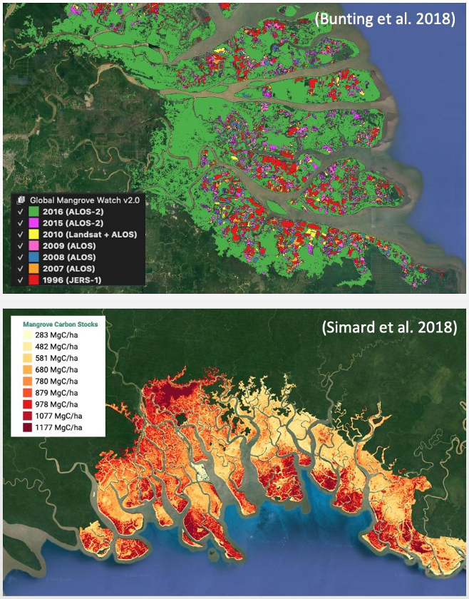
GST1 Input - Other Land Use
Mangroves and Wetlands
Activity Data – Global Mangrove Watch (JAXA K&C)
Global maps of mangrove area and annual changes at 25 m derived from L-band SAR and optical data. Open access in public domain.
1996–2018 available for COP-26. 2019-2021 for GST1.
Official UNEP SDG 6.6.1 mangrove dataset.
Emission Factors - LCLUC Global Mangrove Mapping (NASA JPL/GSFC)
Global maps of mangrove Height, AGB and total biomass at 30 m. Open access in public domain.
Baseline year 2000 derived from SRTM DEM.
New 2015 baseline at 12 m from TanDEM-X DEM available for GST1.

Slide 26
GST1 Input - Land Cover,
Forest, Wetlands and Change
What else can be done with additional resources:
Support of national GHG inventories for activity data estimation following the IPCC GPG:
Enhanced synthesis/lessons learned for update of EO-data in tropical countries for national forest estimation and reporting
Work on specific country demonstrators for uptake of more novel novel EO-data streams in national reporting: land use change, wetlands, forest/land degradation, fire/burnt area
Improved global land change data for AFOLU and modeling assessments:
Work on uptake of long-term harmonized global land cover change data global modeling approaches
Improved global dataset separating managed and unmanaged land
Enhance consistency/comparability of national GHG inventories and global GHG estimates:
Develop best available global land cover change estimates at regional level for statistical comparison with country-reported data (could be done based on Copernicus global land cover service and available reference data)
Linking IPCC land class and area changes with emissions and removal estimates (i.e. combining with harmonized biomass derived factors?)

Slide 27
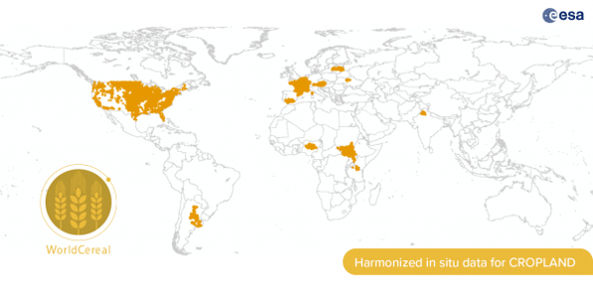
GST1 Input - Agriculture
Reminder of baseline targets for GST1:
WorldCereal is a consortium effort funded by ESA, led by VITO and supported by the GEOGLAM community
Most important, it is building a system, not just one-off products, that will produce:
Cropland Map: Global, 10 m resolution, accuracies 80% +, on a seasonal basis for 2022
Crop Type Map: Initial 2022 focus on global maize and wheat
Initiate a global in-situ reference dataset for agriculture, transitioning to a GEOGLAM community initiative post 2022
Developing and testing classification algorithms and tools (open access)
Actions required for delivery and guidance: Harmonized global data sets of Landsat 8 and Sentinel 2
⇒ WorldCereal: A major step forward, but just a first step…

Slide 28
GST1 Input - Agriculture
3. Discussion of enhanced targets and development of detailed propositions
Beyond GST1, Moving towards a systematic approach to monitoring…
WorldCereal will develop the initial system, but several activities required to ensure delivery of ongoing agriculture state and change to the GST and support for NDC’s
Gaps Include:
A reference network for in situ data
Algorithms to address a wider range of crops important for global food security, carbon accounting and stocktaking and change
Building on the Landsat-Sentinel2 archive, validated satellite-driven agricultural data products addressing Essential Agriculture Variables
Incorporation of new data streams as they become available
Articulation of evolving user requirements for agricultural monitoring
Capacity (co)development for LDC’s to collect and provide the information needed for their national mitigation and adaptation planning and response programs

Slide 29
GST1 Input - Summary of actions & actors
 | COP-26 (Nov 2021) | Leadership on baseline products | Leadership on enhanced products proposal | Provider agencies
Biomass | Fall back is individual existing datasets Synthesised biomass product providing estimates at a jurisdictional level globally | Multi-mission group (L Duncanson, S Satchi, M Herold) and agency experts | Multi-mission group (L Duncanson, S Satchi, M Herold)
Land Cover & Forests | - Copernicus annual global land cover - C3S/CCI Land Cover - WorldCover, - HILDA+ - Global Forest Watch tree cover loss and forest fluxes | M Herold, B Poulter, M Cherlet, with participation from ESA, VITO, WRI/GFW USGS/UMD on Forests? | M Herold, B Poulter, M Cherlet, with participation from ESA, VITO, WRI/GFW USGS/UMD on Forests?
OLU- Mangroves & Wetlands | - Global Mangrove Watch cover and change (1996-2016) - Global Mangrove biomass (2000) | A Rosenqvist, R Lucas on Mangroves | A Rosenqvist, R Lucas on Mangroves
Agriculture | Demonstration WorldCereal products for at least 5 countries (Argentina, Spain, France, Ukraine and Tanzania) | I Jarvis, S Gilliams (VITO), with participation of ESA and USGS | I Jarvis, S Gilliams (VITO), with participation of ESA and USGS

Slide 30
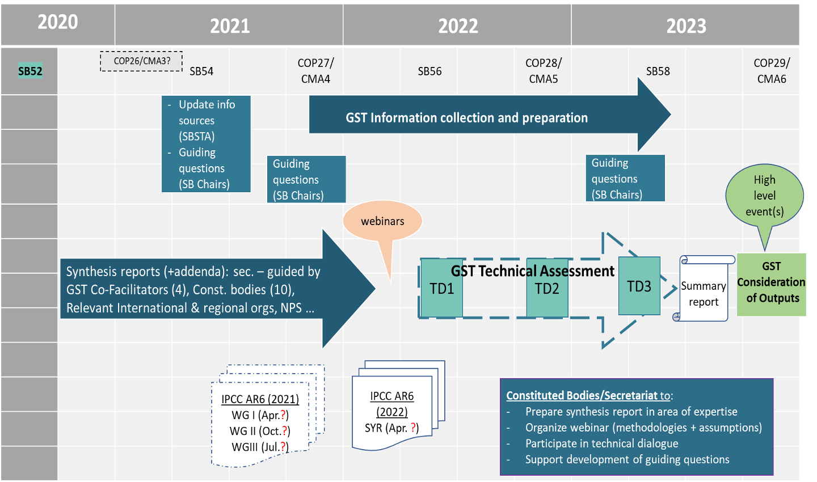
Latest UNFCCC SEC Engagement
Global Stocktake Timeline
Notes:
Next meeting 18 May - 15:00 GST

Slide 31
UNFCCC SEC engagement
SO paper...

Slide 32
Engaging with countries to improve understanding
and uptake of EO data: Action 3 of the Roadmap
Sylvia N. Wilson, USGS

Slide 33
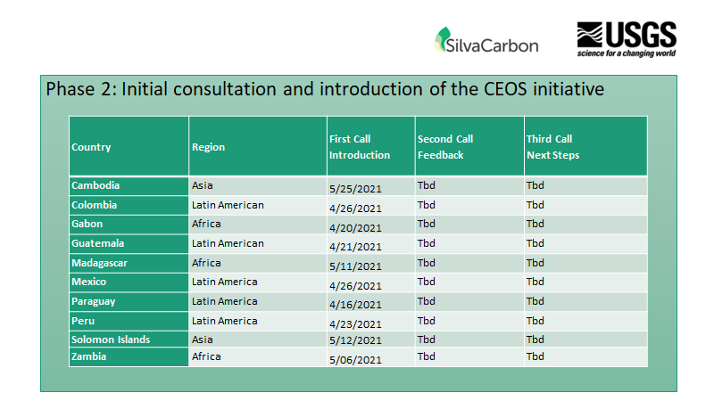

Slide 35
Dataset Producer engagement
AFOLU roadmap needs to be implemented by Space agencies’ contributions to produce datasets in the shortlist
Senior-level (CEOS Principal) engagement needed to ensure key agency’s contributions
Propose to contact relevant Principals in coming weeks
USGS confirmed with Matt Hansen on GFW

Slide 36
AFOLU Roadmap
Discussion and questions?

Slide 37
CEOS GST Strategy
Adam Lewis
<15 mins
Committee on Earth Observation Satellites

Slide 38
Heritage 1/3
Plenary discussion encouraged SIT Chair Team to establish an ad-hoc study team to:
Confirm the requirements for the GHG and AFOLU datasets, and explore the extent to which these two datasets can be used separately and together to inform the development and verification of emission estimates for GST1.
Consider the longer-term commonalities in approach needed between the thematic activities in CEOS to achieve the integrated policy support envisioned.
Confirm the full set of target datasets and communication materials intended in support of GST1 by the different teams and the CEOS agencies undertaking the investment of the data production in 2021.
Consider the organisational aspects necessary - both for the urgent objectives related to GST1 and for an effective long-term integrated approach to a Roadmap for the Stocktake process.
Full TORs.

Slide 39
Heritage 2/3
4 calls to date with expanding participation, including GCOS SC Chair and ECMWF
Frequent updates from GHG & AFOLU teams on their COP-26 targets and beyond
Strong consensus in the study team on the need for a high-level strategy statement which identifies all the potential aspects and dimensions for CEOS engagement in the Global Stocktake process. This should include a sense of priorities, be clear on what is underway and remains to be done, and guidance on the need for linkages between the different thematic activities and groups across CEOS. SIT Vice-Chair (ESA) took on the paper leadership. SIT Chair Team contributed suggested actions to take forward the recommendations.
At SIT-36, several agencies asked for more time and attention to the paper to address comments and suggestions

Slide 40
Heritage 3/3
27 April call very productive in achieving consensus on recommendations and actions
A fully updated and clean version (3.0) of the Strategy Paper circulated 5th May - which reflects all of the comments and suggestions received on the last version as well as any refinements agreed on the call. Actions embedded as an annex.
Paper will be reported to CEOS SEC on 13th May
Goal is to finalise soon and prosecute actions, especially for COP-26
eg SIT Chair Team will coordinate tasks such as a portal on ceos.org for all GST datasets
Paper will be revisited at SIT TW with a view to endorsement by CEOS Plenary

Slide 41
GST Strategy and Communications
SIT Chair Team has promoted a comprehensive strategy as part of its priorities last 2 years
SIT Vice-Chair Team led draft Strategy paper
latest telcon is next week
Suggestion of a CEOS Data Cube for the GST… discussion with SEO and LSI-VC?
Actions from SIT-36 in relation to communications
working with SEO to establish dedicated GST1 products and guidance website on ceos.org
needs coordination with all data and guidance providers, including GHG team, AFOLU team and individual agencies
CEOS Chair exploring national delegation statement to COP-26
Notes:
Main point: Measure changes in AFOLU / biomass for mitigation and adaptation activities

Slide 42
LSI-VC Interest
Generally… maintaining CEOS leadership on land surface aspects
Specifically... action #1 from the GST paper:
WGClimate GHG Task Team should consult with the relevant elements of CEOS, including VCs, and Associates such as ISC, WCRP and GCOS, together with modellers, to check the GHG Implementation roadmap on completeness concerning requirements for terrestrial observation (SIF; NPP, land cover, biomass, etc.) for supporting mitigation actions through the development of MVS. The actions in Annex C of the roadmap shall be complemented as needed
Initial action: Ensure that all products from terrestrial observations needed to derive biogenic emissions as priors for Monitoring and Verification System (MVS) such as CoMVS are considered in the GHG TT Roadmap Annex C. (for SIT TW 2021)
Notes:
Main point: Measure changes in AFOLU / biomass for mitigation and adaptation activities

Slide 43
Discussion
Generally… maintaining CEOS leadership on land surface aspects
Specifically... action #1 from the GST paper:
WGClimate GHG Task Team should consult with the relevant elements of CEOS, including VCs, and Associates such as ISC, WCRP and GCOS, together with modellers, to check the GHG Implementation roadmap on completeness concerning requirements for terrestrial observation (SIF; NPP, land cover, biomass, etc.) for supporting mitigation actions through the development of MVS. The actions in Annex C of the roadmap shall be complemented as needed
Initial action: Ensure that all products from terrestrial observations needed to derive biogenic emissions as priors for Monitoring and Verification System (MVS) such as CoMVS are considered in the GHG TT Roadmap Annex C. (for SIT TW 2021)
Notes:
Main point: Measure changes in AFOLU / biomass for mitigation and adaptation activities

Slide 44
Discussion
~ 40 mins
Committee on Earth Observation Satellites
Notes:
Welcome to the Carbon and Biomass session. This was intended to be the largest of our sessions in Hobart auss how CEOS might consider strengthening the policy relevance of our datasets with the main UN and national stakeholders that use our data to make and manage policy. We still have a substantial agenda with significant points for discussion by Principals.
nd featured a number of external speakers to bring some alternative perspectives to our work and to equip us to disc

Slide 45
Seed topics from the slide deck
Forests & Biomass Team
How about a 3rd lead for F&B team?
Reassigning the USGS F&B GFOI WP tasks
The main biomass product activity is mostly outside CEOS in the multi-mission team (mainly US-Europe)
AFOLU
Substantial dataset coordination activities ahead for GST1, 2 etc… can we use LSI-VC telcons and meetings to steward and track these activities?
Similarly the national inventory user test group - pioneered by USGS/SilvaCarbon, this would be a great asset for LSI-VC to foster and have in its structure?
Support for F&B (and GEOGLAM) team from LSI-VC Co-Leads in approaching CEOS Principals on the enhanced dataset options? Including your own agencies.
Representation at the virtual AFOLU-GHG JRC Workshop
Notes:
Main point: Measure changes in AFOLU / biomass for mitigation and adaptation activities

Slide 46
Seed topics from the slide deck
GST Strategy
Engagement with WGClimate GHG task team on the terrestrial supplement to the GHG Roadmap Annex C for SIT TW 2021
And similar land-sector actions that may arise…
Is there a place for ARD in the CEOS GST strategy to support countries and simplify data aspects?
LSI a logical contributor/home to a CEOS Data Cube for the GST?
Notes:
Main point: Measure changes in AFOLU / biomass for mitigation and adaptation activities

Slide 47
Using the Open Data Cube to support AFOLU and GST
Brian Killough CEOS SEO
Committee on Earth Observation Satellites

Slide 48
ODC for AFOLU and GST
A commitment to produce and host and Open Data Cube (ODC) to support AFOLU and GST will require a considerable discussion to assess ...
What is the benefit of an AFOLU and GST data cube? Why is this needed versus current methods and data sources?
Will the data cube be the accepted as the primary source of data to support AFOLU and GST or will users get their data from preferred sources?
Will the data cube be free/open and allow users access and analysis without cost?
Who are the users and do they have sufficient technical knowledge to utilize a data cube?
What are the core datasets? Is ARD required? Will these datasets be available into the future as consistent time series?
How will such data be managed? Is the intent to use a cloud and discourage local downloading?
Will the AFOLU and GST teams commit to making documentation and tools to use this data?
Who will host these datasets and manage them into the future. This requires a commitment of resources which could be significant.
Is something needed for COP-26 by November 2021?
Notes:
Main point: Measure changes in AFOLU / biomass for mitigation and adaptation activities

Slide 49
A Data Cube Vision for AFOLU/GST
The Open Data Cube is merely a data management system that take advantage of common open source methods for accessing data
Datasets can come from many different sources but can be adjusted to allow interoperable use (e.g. grid projections, resolution). A review of the current priority datasets suggests there are many sources of data … clouds (e.g. AWS, Google, MS-Azure) and Agencies (Copernicus, JAXA).
The typical implementation is on a cloud computer, but local installations are possible with added complexity
Analysis products are typically done through Jupyter notebooks and Python code
Notes:
Main point: Measure changes in AFOLU / biomass for mitigation and adaptation activities

Slide 50
Wrap-up
LSI-VC Leads

