Slide 1
CARD4L and the Product Family Specifications (PFS)
LSI-VC-10 Teleconference #1

Slide 2
Overview
CARD4L assessment progress (Matt for Medhavy)
Consider endorsement of the new Aquatic Reflectance CARD4L PFS [for decision]
SAR & Lidar PFS updates [for information] (Ake Rosenqvist)
Normalised Radar Backscatter & Polarimetric Radar annual revisions
Geocoded SLC, Interferometric Radar & LiDAR development status
Status of in-development PFS [for information]
Nightlight Radiance (Brian)
Hear from participants on the latest plans regarding CARD4L assessment and production [for information]
KARI, JAXA, ESA, ISRO, NASA, DLR, CSA,,,,, others.

Slide 3
CARD4L Assessment Progress
v5.0 USGS SR and ST assessments are nearing completion, awaiting response from a panel member
ESA Sentinel-2 SR submission (at Threshold level) has now been received. A quick turnaround assessment is planned, as no review panel is being assembled for this partial assessment.
Element 84 Sentinel-2 SR: further questions have been sent back to Element 84. The assessment is for threshold and partial target.
The DLR EnMap review (simulated products provided) is underway.
INPE and KARI are planning to initiate self-assessments / peer reviews

Slide 4
Aquatic Reflectance PFS
Christopher Barnes
CEOS LSI-VC, USGS/KBR

Slide 5
Aquatic Reflectance PFS
Coordinated by: Andreia Siqueira (GA) & Chris Barnes (USGS/KBR)
Development began in March 2020 with endorsement targeted for LSI-VC-10
Applies to data collected by multispectral and hyperspectral sensors operating in the VIS/NIR/SWIR wavelengths over coastal and inland water bodies
Using the Surface Reflectance PFS as a baseline, GEO-Aquawatch, Water-ForCE and subject matter experts around the world met virtually to review/modify and/or generate new Threshold and Target requirements
Technical Lead: Arnold Dekker (SatDek)

Slide 6
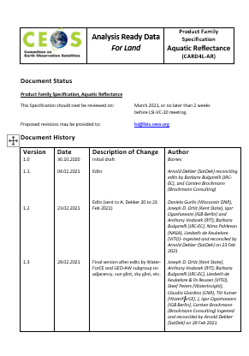
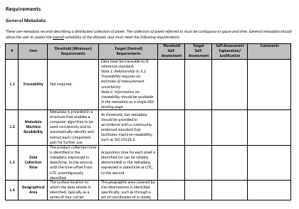
Aquatic Reflectance PFS
Requirements summary of changes:
General Metadata (17/17)
No requirement changes
Per-Pixel Metadata (13/20)
1 requirement modified
Sea/Lake/River Ice Mask
10 new requirements identified
Adjacency Effects
Altitude (ASL)
Bidirectional Reflectance Distribution Function
Deep/Shallow Water
Floating Vegetation/Surface Scum Mask
Optically Deep or Optically Shallow Assessment
Sky Glint Mask
Sun Glint
Turbid Water Flag
Whitecap/Foam Mask

Slide 7
Aquatic Reflectance PFS
Requirements summary of changes continued:
Radiometric and Atmospheric Corrections (6/15)
1 requirement modified
Atmospheric Reflectance Correction
10 new requirements identified
Adjacency Effects Correction
Bidirectional Reflectance Distribution Function
Floating Vegetation/Surface Scum Correction
Geometric Corrections (1/1)
No requirement changes
~80% of the Aquatic Reflectance PFS requirements correspond with Surface Reflectance PFS requirements
Other Trace Gaseous Absorption Corrections
Sky Glint Correction
Sun Glint Correction
Surface Reflected Vegetation Spectral Correction
Turbid Water Correction
Whitecap and Foam Correction

Slide 8
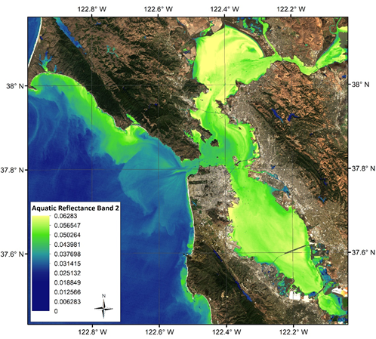
Aquatic Reflectance PFS
Next steps:
Seeking Aquatic Reflectance PFS Version 1.0 review and endorsement at LSI-VC-10
Make Version 1.0 available from the CARD4L website to solicit community feedback
USGS intends to conduct an informal self-assessment evaluation against its Landsat 8 Provisional Aquatic Reflectance Product
Landsat 8 Provisional Aquatic Reflectance Product. OLI Band 2 (Blue band) San Francisco Bay, CA.

Slide 9
Radar and Lidar PFS
Ake Rosenqvist JAXA/soloEO

Slide 10
CARD4L SAR & LiDAR
Current status
Completed 2019 & 2020, Annual rev. 2021
Normalised Radar Backscatter (NRB)
Polarimetric Radar (POL)
Under development:
Geocoded SLC (GSLC)
Interferometric Radar (INSAR)
New under consideration:
Multi-mission NRB
To be revived:
Lidar Terrain & Canopy Height
Notes:
To date, there are 4 CARD4L products specifications for SAR products:
Normalised Radar Backscatter (NRB), which is a backscatter-only product (as the name indicates) and it doesn’t contain any phase information. It is the most basic and commonly used radar product, suitable also for users with little or no experience of SAR data.
Polarimetric Radar (POL), aimed at users interested in exploring radar polarimetry
Geocoded SLC (GSLC), which are specs for geocoded complex data, aimed to help non-SAR experts to do InSAR applications.
Interferometric Radar (INSAR) - specifications for interferometric products using two or more SAR images as input
I will provide a brief description of the 4 SAR specifications in the following slides.
The endorsed specification documents are available for public download at CEOS.org/ARD

Slide 11
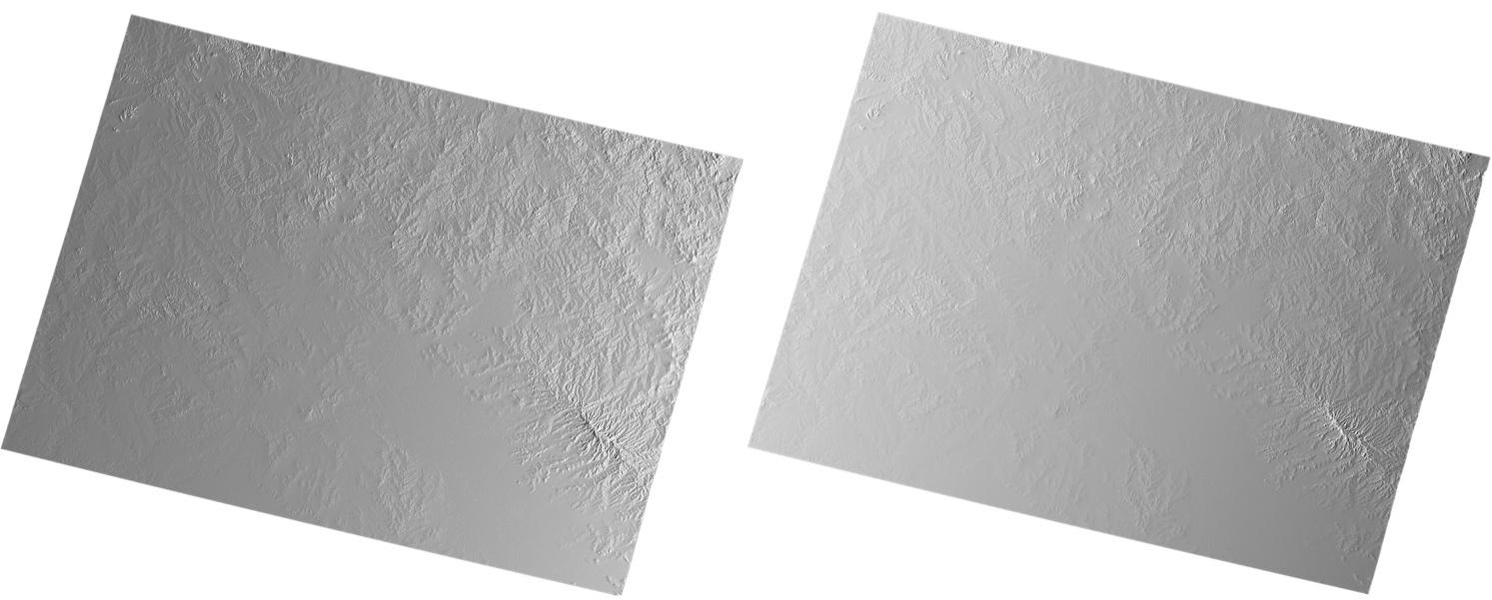
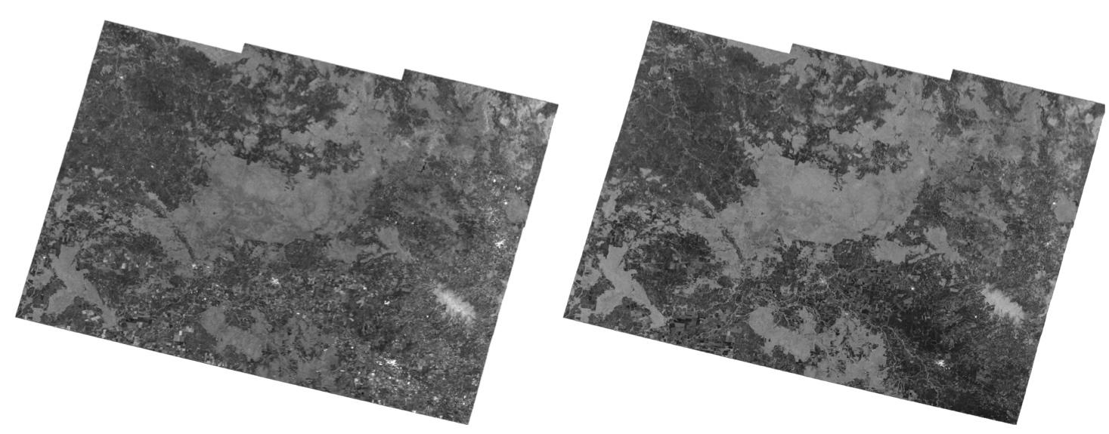
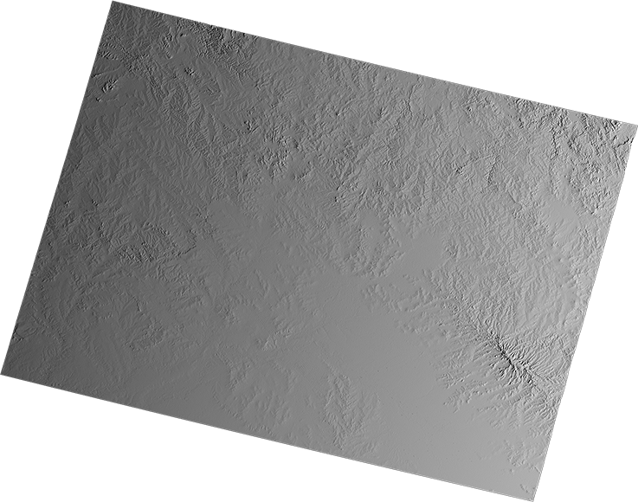
CARD4L SAR
Normalised Radar Backscatter (NRB)
Per-Pixel Metadata
Radar Measurements (RTC γ⁰)
Scattering Area
Local Inc Angle
VV VH
Normalised Radar Backscatter expressed as Gamma-0 (γ⁰), with Radiometric Terrain Correction (terrain flattening) applied.
NRB structure is used as basis for all SAR PFSs.
NRB endorsed at LSI-VC-7 (2019). 2nd annual revision planned for LSI-VC-10 (today), but postponed to resolve outstanding issue w.r.t. Geometric Accuracy (item 4.3)
Data Mask
Sigma-to-Gamma
Noise Power
Ellipsoid Inc Angle
CARD4L NRB sample (Processing: Z-S Zhou, CSIRO)
Notes:
Starting with the CARD4L Normalised Radar Backscatter (NRB), this is an example of what a CARD4L NRB product should comprise of:
The actual sensor measurement data (in this example, the radar backscatter images, provided as Radiometrically Terrain Corrected Gamma-0 for each polarisation band)
General metadata, with all relevant information about the data take, processing steps, geometry and radiometry of the product, provided in a format that is both machine-readable and readable by humans (e.g XML, Json, YAML)
Per pixel metadata – which are image data of the same geometry as the measurement data, including for example, Data/No-Data Mask image, Local incidence angle and scattering area image. Depending on the data provider, the per-pixel metadata may be selected on demand by the user, or (for pre-processed products) consist of a fixed selection.

Slide 12
Ionospheric effects
on SAR geolocation accuracy
Refraction of microwave signals passing the ionosphere, resulting in a shift in range (cross-track) direction and uncertainty in absolute geolocation.
Geolocation error in turn affects accuracy of Radiometric Terrain Correction
Magnitude of range displacement function of radar wavelength and Ionosphere total electron content (TEC).
Refraction increasing with increasing radar wavelength.
Ionosphere
Refraction of microwave signals
Shorter wavelengths
Longer
wavelengths
Band
λ [cm]
X C S L P
3 5 9 23 69
Notes:
A number satellite data providers are working to develop CARD4L compliant SAR products to include in their product catalogues. We will hear from a few of them here today in the following presentations.
Thank you for your attention.

Slide 13
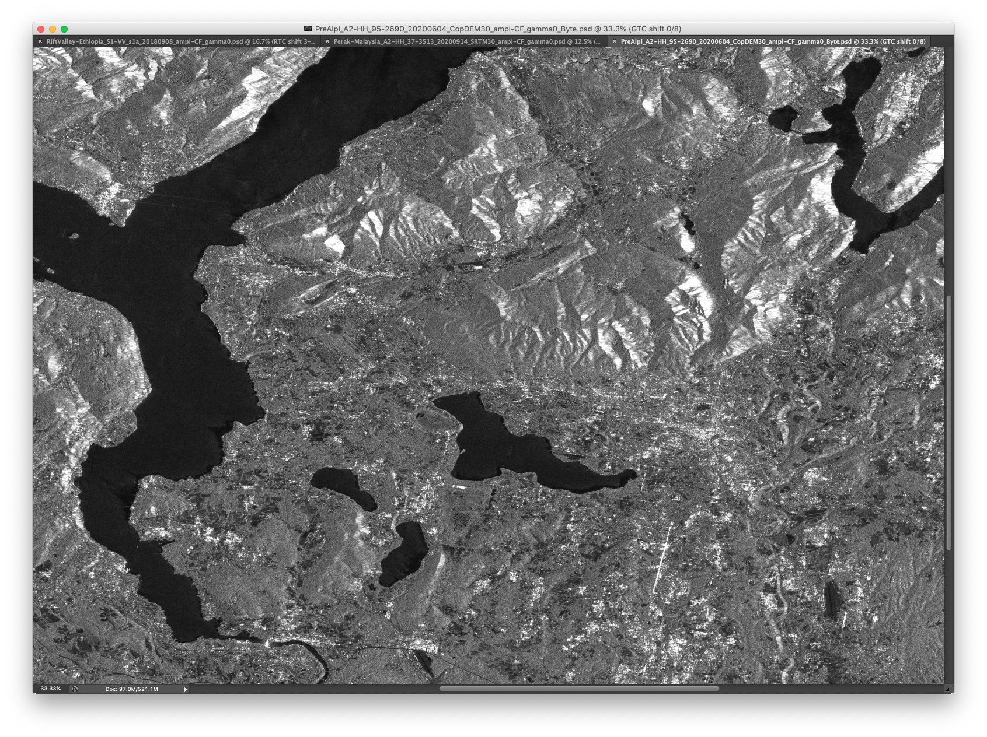
Geometric Terrain Correction (GTC)
0 DEM shift
RTC geolocation displacement test (ALOS-2 PALSAR-2 stripmap 10m)

Slide 14
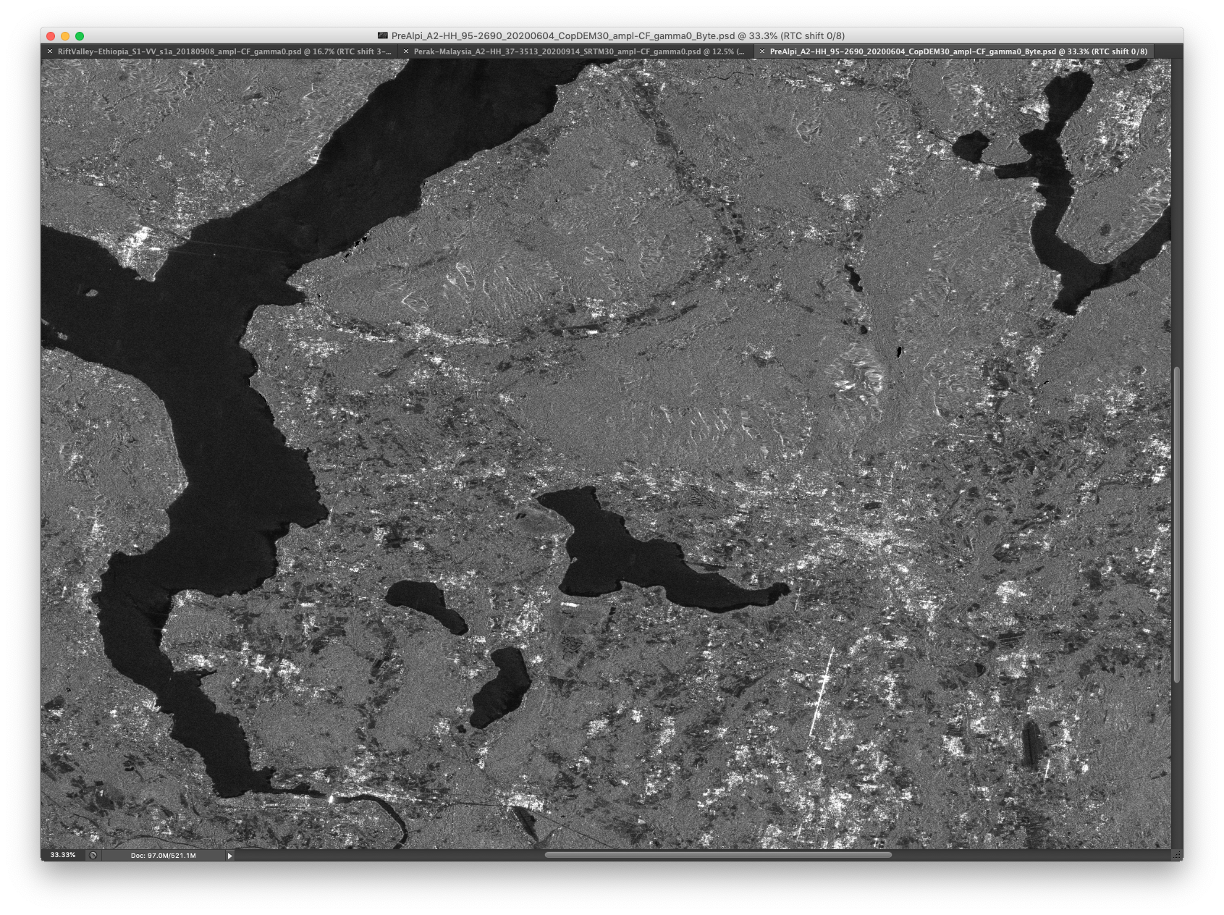
Radiometric Terrain Correction (RTC)
0 DEM shift
RTC geolocation displacement test (ALOS-2 PALSAR-2 stripmap 10m)

Slide 15
Radiometric Terrain Correction (RTC)
1 px shift N and E
RTC geolocation displacement test (ALOS-2 PALSAR-2 stripmap 10m)

Slide 16
Radiometric Terrain Correction (RTC)
2 px shift N and E
RTC geolocation displacement test (ALOS-2 PALSAR-2 stripmap 10m)

Slide 17
Radiometric Terrain Correction (RTC)
3 px shift N and E
RTC geolocation displacement test (ALOS-2 PALSAR-2 stripmap 10m)
Radiometric Terrain Correction (RTC)

Slide 18
Ionospheric effects
on SAR geolocation accuracy
Study initiated by CARD4L SAR team to assess impact
Assessing a range of CEOS mission data
ALOS/ALOS-2, Sentinel-1, Radarsat-1/2, RCM, NovaSAR.
(SAOCOM, TSX, CSK, if available)
Over a range of geographical areas with different topography and land cover
Aim to complete study in June.
Question: Can endorsement be foreseen between LSI-VC meetings, or will it have to wait until LSI-VC-11 (Sept?)
Example: PALSAR-2 geometric uncertainty.
Note EW (range) > NS (azimuth)
Notes:
A number satellite data providers are working to develop CARD4L compliant SAR products to include in their product catalogues. We will hear from a few of them here today in the following presentations.
Thank you for your attention.

Slide 19
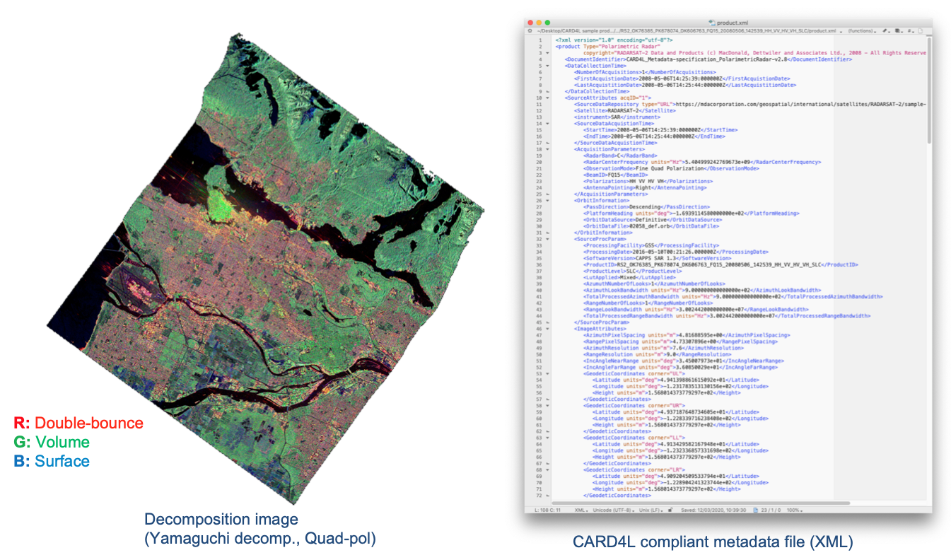
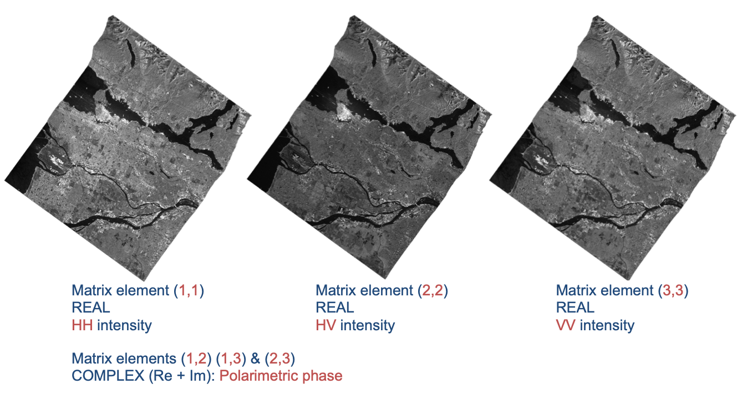
CARD4L SAR
Polarimetric Radar (POL)
PFS development led by NRCan, CSIRO & JPL
CARD4L POL covers two product types:
Polarimetric Decomposition
Polarimetric Covariance Matrix
POL structure mirrors that of the NRB, with the exception of the measurement data (🡪)
Endorsed at LSI-VC-9 (2020). Annual revision planned for LSI-VC-10, but postponed until NRB Geometric Accuracy requirement agreed upon.
RADARSAT-2 (MDA) Processing: F. Charbonneau (NRCan)
Notes:
Polarimetric Radar (POL) – objective to make radar polarimetry accessible
to enable users to explore
CARD4L POL covers two product types:
The first one is Polarimetric Decomposition product – which is comparable to the standard backscatter product, but where the polarimetric information has been enhanced – for instance to separate different scattering mechanisms from each other – by the use of various decomposition techniques. Which decompositions to include is not prescribed in the CARD4L specification, but for Data Providers to decide. which ones to offer to users (e.g. Eigen value; Pauli, Freeman-D; Yamaguchi, etc.)
The second POL product is the Polarimetric Covariance Matrix, which is a set of complex images from which the full polarimetric phase and amplitude can be derived. It is for a bit more advanced users, and can be applied for e.g. polarimetric time-series analysis and Pol-InSAR applications
The CARD4L POL structure is based on NRB, with similar requirements for geometric and radiometric accuracy, and general and per-pixel metadata.

Slide 20
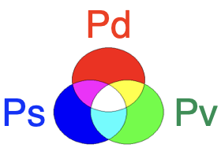
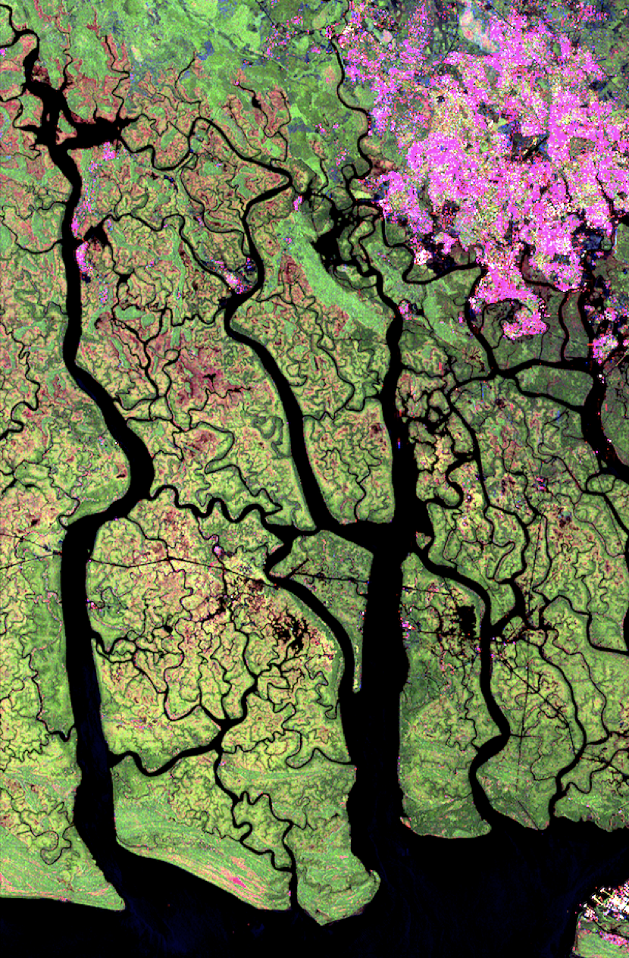
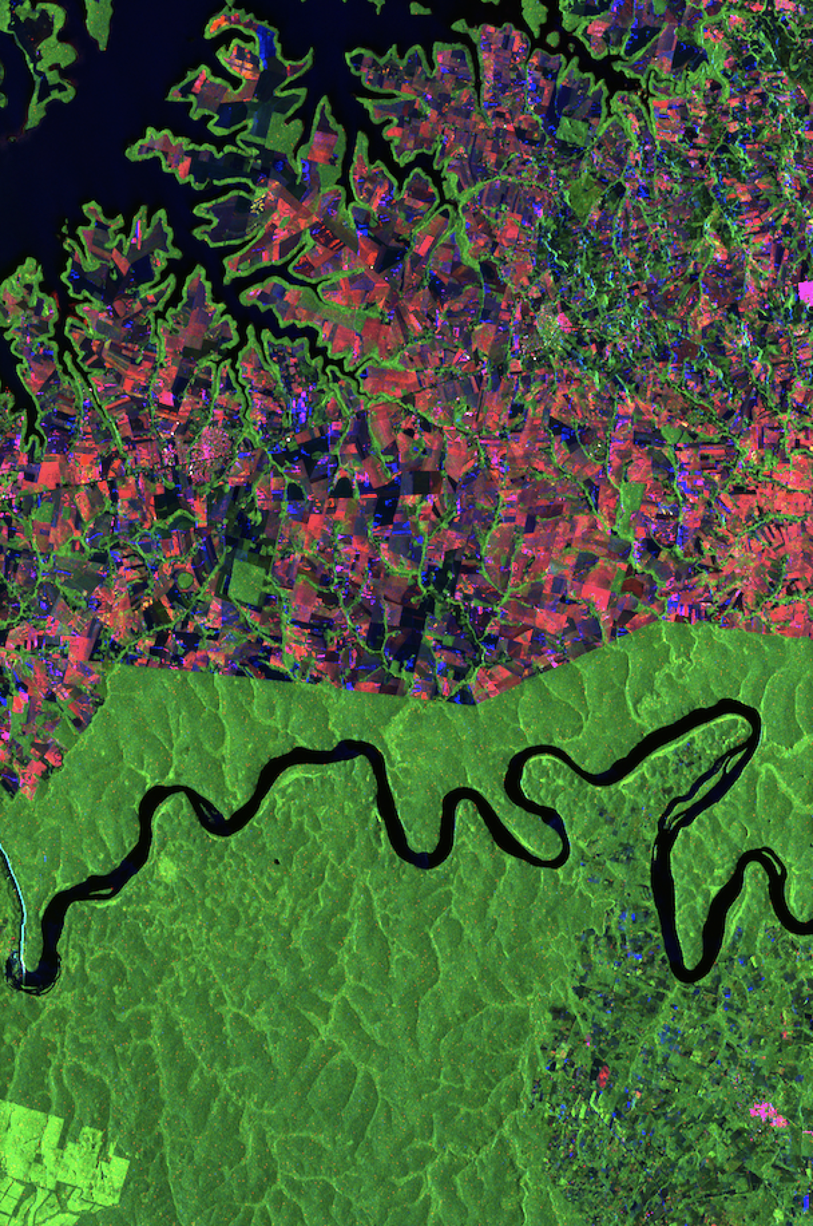
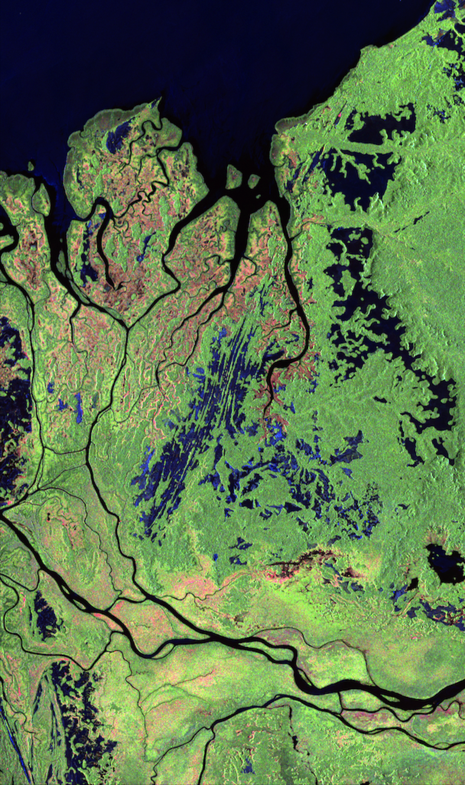
CARD4L SAR
Polarimetric Radar (POL) - – Polarimetric decomposition
Provides information about scattering mechanisms
Brings out the colour in radar ;-)
Cape Lopez Bay, Gabon Niger delta, Nigeria Iguazu, Brazil/Argentina
ALOS-2 Polarimetric Processing: Y. Yamaguchi (Niigata Univ.)
Notes:
Polarimetric Radar (POL) – objective to make radar polarimetry accessible
to enable users to explore
CARD4L POL covers two product types:
The first one is Polarimetric Decomposition product – which is comparable to the standard backscatter product, but where the polarimetric information has been enhanced – for instance to separate different scattering mechanisms from each other – by the use of various decomposition techniques. Which decompositions to include is not prescribed in the CARD4L specification, but for Data Providers to decide. which ones to offer to users (e.g. Eigen value; Pauli, Freeman-D; Yamaguchi, etc.)
The second POL product is the Polarimetric Covariance Matrix, which is a set of complex images from which the full polarimetric phase and amplitude can be derived. It is for a bit more advanced users, and can be applied for e.g. polarimetric time-series analysis and Pol-InSAR applications
The CARD4L POL structure is based on NRB, with similar requirements for geometric and radiometric accuracy, and general and per-pixel metadata.

Slide 21
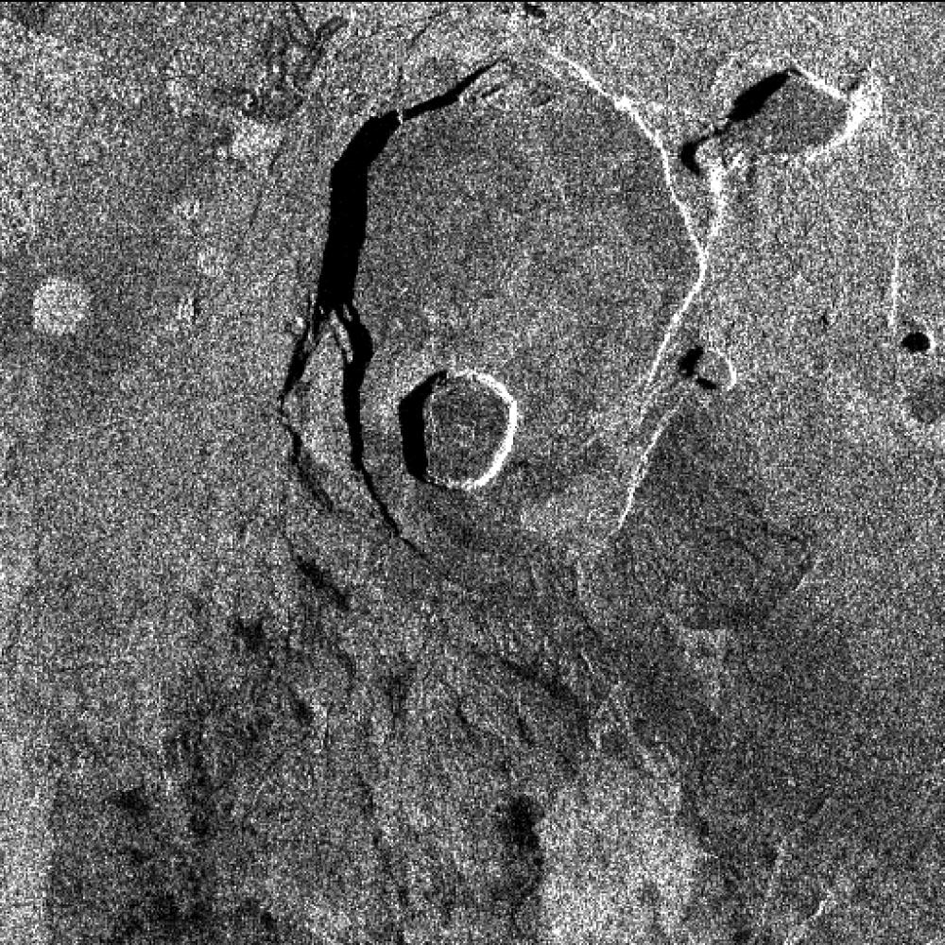
CARD4L SAR
Geocoded Single-Look Complex (GSLC)
PFS development led by Stanford Univ. and JPL.
Single Look Complex (SLC) is the base Level-1 SAR image product. It comprises information about the received radar amplitude and phase, provided in range/Doppler (slant range) geometry
The CARD4L GSLC product describes the complex radar reflectivity on the surface with all propagational phases removed, so that the amplitude and phase values represent properties of the surface and not the instrument
GSLC data are presented in a common, often user-defined, ground based coordinate system (e.g. UTM, geogr. coord.), rather than in radar slant range coordinates, to facilitate use by non-radar-specialists.
Aim to submit for endorsement at LSI-VC-11.
Stack of geocoded SLC images
(Zebker et al, 2018)
Notes:
Single Look Complex (SLC) is the standard Level-1 SAR image product. It comprises information about the amplitude and phase of the received radar energy, provided as a complex number.
SLC are given in slant range geometry and require additional processing software and a fair amount of radar expert knowledge to be used.
The CARD4L GSLC product on the other hand, is an enhanced pre-processed version of the SLC, that describes the complex radar signal at each point on the ground surface with all average propagational phases removed, so that the amplitude and phase values represent properties of the ground surface, without influence by the radar instrument
CARD4L GSLC products are presented in a common geographical coordinate system – such as e.g. UTM - rather than in slant range radar coordinates, to facilitate use by non-radar-specialists
The CARD4L GSLC product specification is still under development and we expect it to be completed within the next few months.

Slide 22
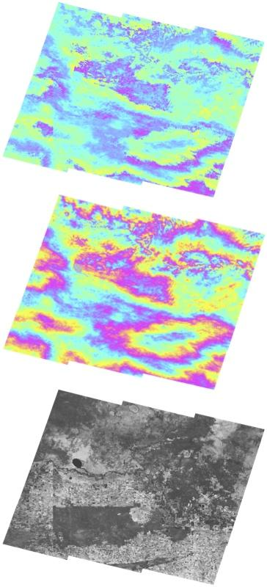
CARD4L SAR
Interferometric Radar (INSAR)
PFS development led by Geoscience Australia
A suite of three products generated by InSAR processing of two images captured of the same geographic area at different times:
Wrapped interferogram: Image of differential phase signals between two SLC images
Unwrapped interferogram: Image of differential phase signals where the wrapped fringes are summed (“unwrapped”) to give a continuous phase signal across the image
Interferometric coherence: Image of phase coherence between the two images.
Aim to submit for endorsement at LSI-VC-12
Sentinel 1 interferometric products (Geoscience Australia team)
Notes:
CARD4L INSAR product specifies a suite of three products generated by InSAR processing of two observations of the same geographic area at different times:
Wrapped interferogram is an image showing the differential phase signals between the two complex images. The signal is ‘wrapped’ in quantities of 2*πι radians, giving an image with ‘fringes’.
The Unwrapped interferogram is an image where the wrapped fringes have been added up to give a continuous phase signal across the image. There are different approaches to do this unwrapping and CARD4L does not prescribe which methods to use.
Interferometric coherence is an image of phase coherence between two SLC images.
The CARD4L INSAR product specification also is still under development, and expected to be completed in the second half of 2021

Slide 23
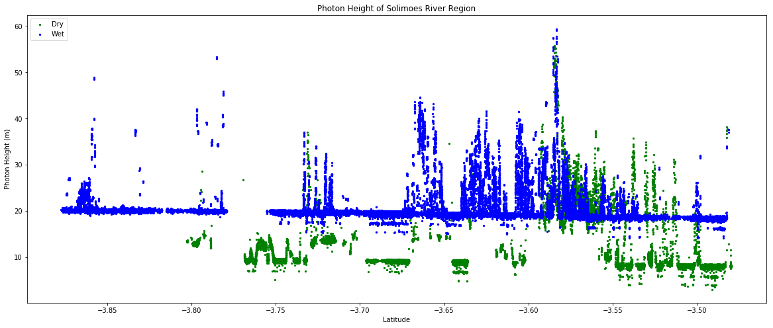
CARD4L LiDAR
LiDAR Terrain and Canopy Top Height
Lidar measurements of vegetation canopy structure and height. GEDI and ICESat-2 launched in 2018 + MOLI targeted for 2024. Plan to develop CARD4L for LiDAR well received by mission teams.
New CARD4L subgroup on LiDAR launched in 2019
Group members representing 3 spaceborne LiDAR missions + science users
Target PFS: Terrain & Canopy Top Height
Progress in 2020 slow ...
Attempt to revive activity in 2021, depending on interest from LiDAR mission group and users.
ICESat-2 photon height
(Amazon river transects at dry and wet season)
Notes:
CARD4L INSAR product specifies a suite of three products generated by InSAR processing of two observations of the same geographic area at different times:
Wrapped interferogram is an image showing the differential phase signals between the two complex images. The signal is ‘wrapped’ in quantities of 2*πι radians, giving an image with ‘fringes’.
The Unwrapped interferogram is an image where the wrapped fringes have been added up to give a continuous phase signal across the image. There are different approaches to do this unwrapping and CARD4L does not prescribe which methods to use.
Interferometric coherence is an image of phase coherence between two SLC images.
The CARD4L INSAR product specification also is still under development, and expected to be completed in the second half of 2021

Slide 24
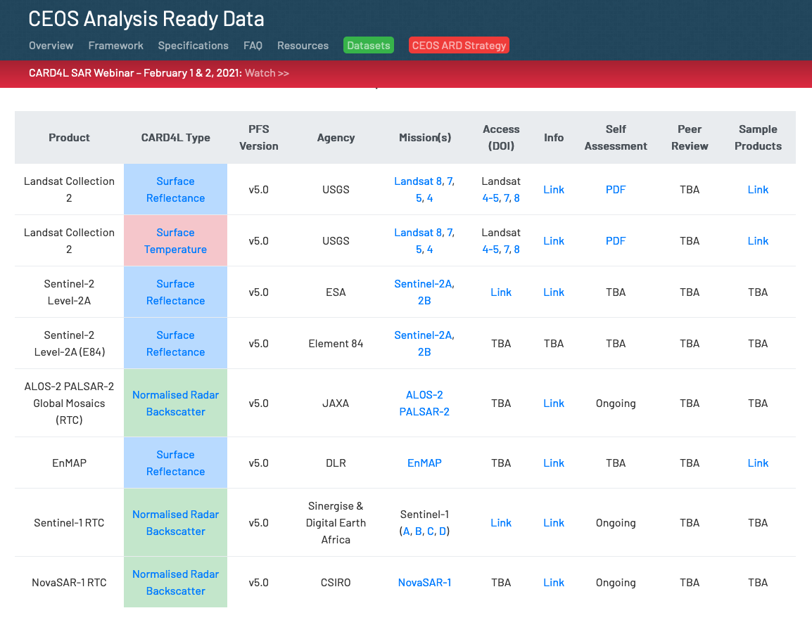
CARD4L SAR - Outreach
CARD4L SAR Outreach
CARD4L SAR Webinar (Feb 2021)
150 participants from 40+ countries
300+ views on CEOS YouTube Channel (www.youtube.com/watch?v=Pe-7WXle-EI)
WGCV SAR meeting (Oct 2020)
Special CARD4L session
AGU 2020 Fall meeting (Town Hall Panel)
ARD2020 Symp (Nov 2020)
CARD4L SAR Uptake
CARD4L SAR Educational Resources
Guidance document to be developed, starting in mid 2021
”Easy to understand” descriptions for data providers and (non-expert) users on what the CARD4L SAR products and per-pixel metadata represent and how they can be used.
JAXA
DE-Africa
CSIRO

Slide 25
Nighttime Lights Surface Radiance PFS
Brian Killough CEOS SEO, NASA

Slide 26
Summary of PFS Plans
Coordinated by Brian Killough (CEOS SEO, NASA) with detailed support from Miguel Roman (NASA, USRA) and Zhousen Wang (NASA GSFC).
Development began in Oct 2020 with endorsement planned for LSI-VC-11 (later 2021).
Working with a team of ~20 people (NASA, NOAA, CEOS) to develop the PFS.
Applies to data collected by nighttime light sensors operating in the VIS/NIR wavelengths. Resolutions are in the order of 10m to 1km.
Uses the surface reflectance PFS as a baseline with several modifications and additions.

Slide 27
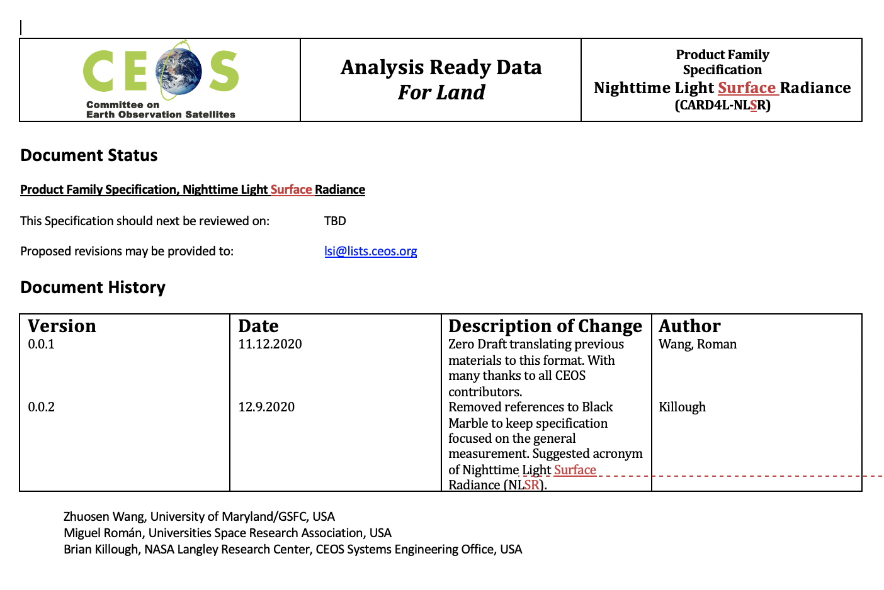
Summary of PFS Plans
There have been a number of revisions by team members. The current version (0.4) is nearing completion.
~ 80% of the Nighttime Light Surface Radiance PFS requirements correspond to the Surface Reflectance PFS requirements.
Per-Pixel Metadata - replaced solar with lunar (radiance and viewing angles) and , added brightness temperature and solar zenith angle.
Atmospheric Corrections - removed aerosol, water vapor and ozone corrections. Added general atmospheric scattering, lunar radiance corrections and stray light corrections.
Several important paper references have also been added to the document.

Slide 28
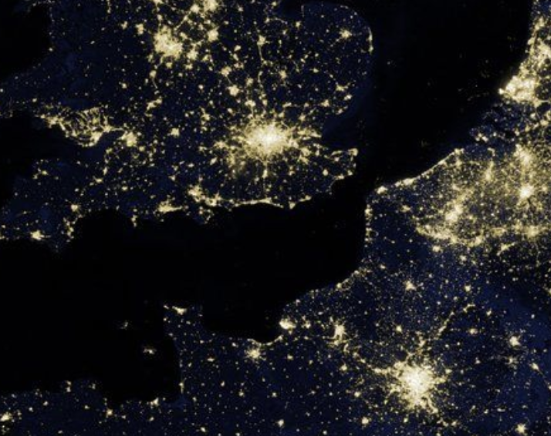
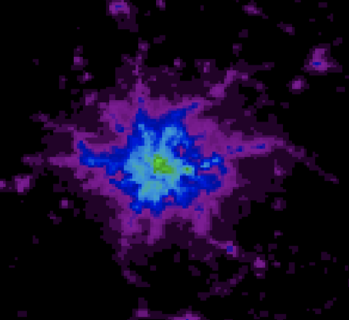
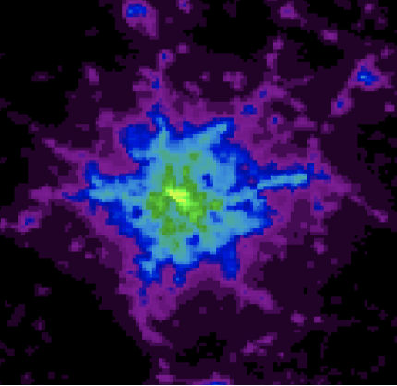
Next Steps
Seeking Nighttime Light Surface Radiance PFS version 1.0 review and endorsement at LSI-VC-11.
Make version 1.0 available from the CARD4L website to solicit community feedback.
Identify a specific dataset example (e.g. NASA's Black Marble) to conduct a self-assessment against the PFS and later consider full CARD4L review and approval.

Slide 29
Agency Updates: CARD4L Assessment and Production

Slide 30
KARI

Slide 31
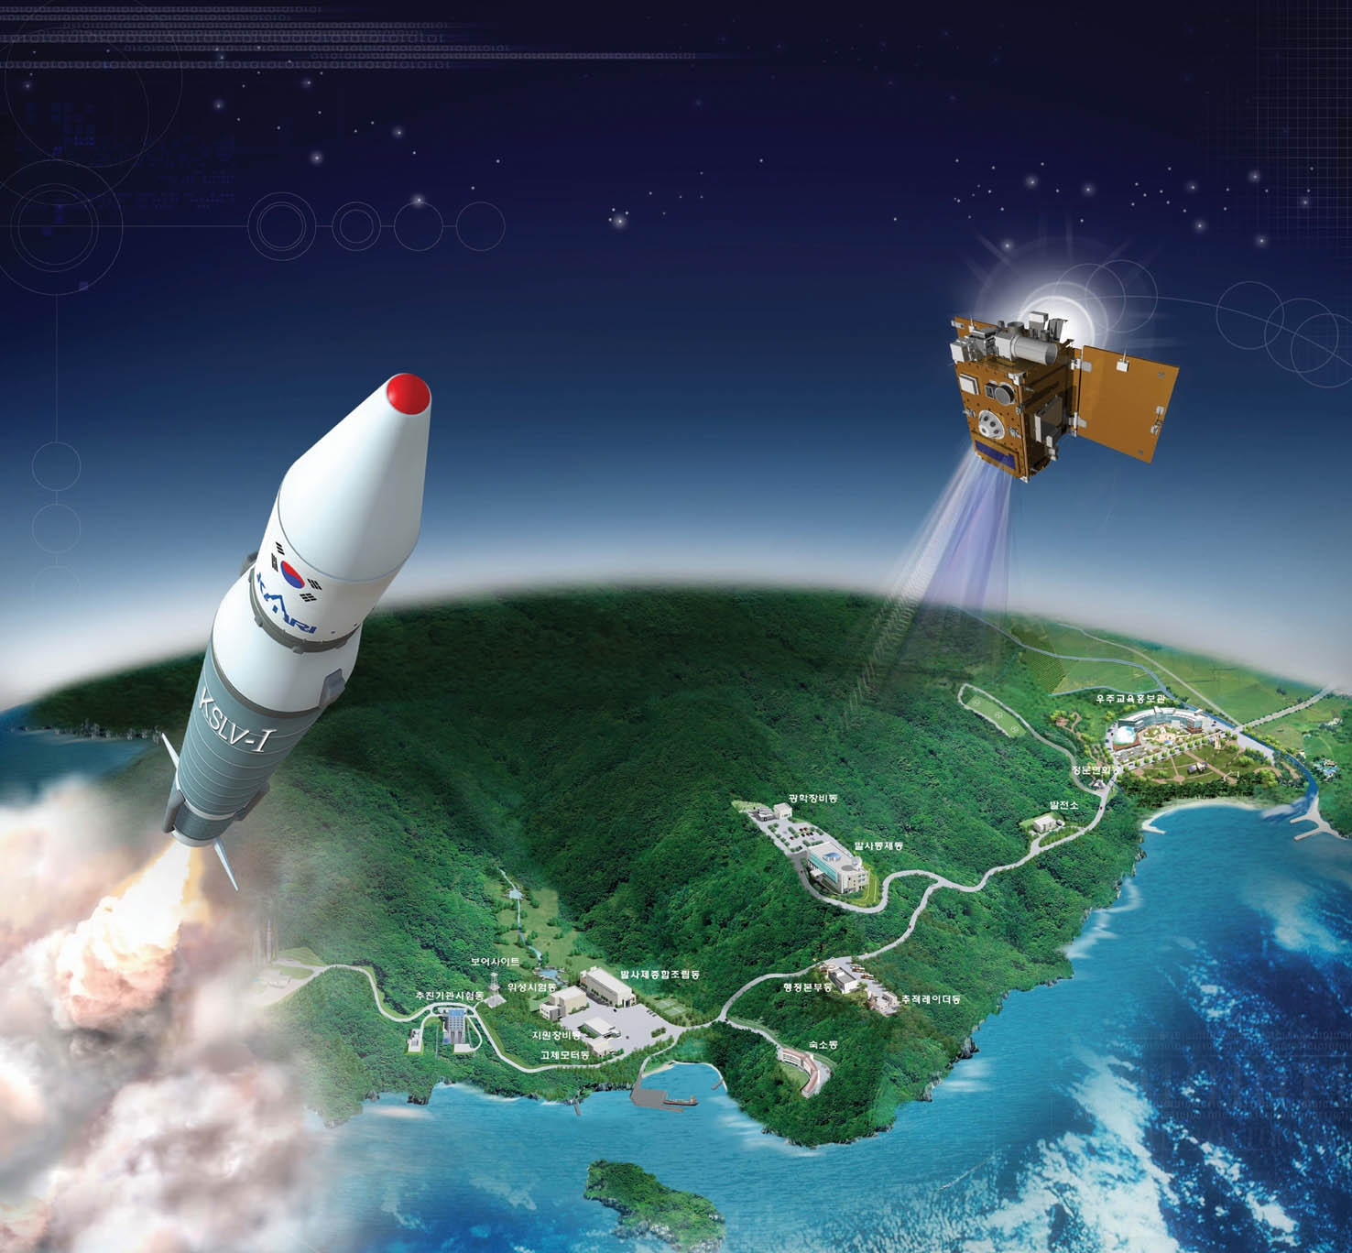
Study on CARD4L Compliance of KOMPSAT-3 & 3A Products
2021. 5. 12
Korea Aerospace Research Institute
Image Data System Development Division

Slide 32
Experiments for achieving CARD4L
Current K3/K3A data does not meet CARD4L PFS even Threshold requirement.
Technical challenges to CARD4L specifications for current K3/K3A data
Per-pixel metadata
Pixel-level cloud/cloud shadow detections
Surface reflectance measurements
Atmospheric corrections
Geometric Correction
Sub-pixel accuracy : less than 0.5 Pixel rRMSE
We performed experiments to see if CARD4L on K3/K3A is feasible
Experiments about three major technical components above

Slide 33
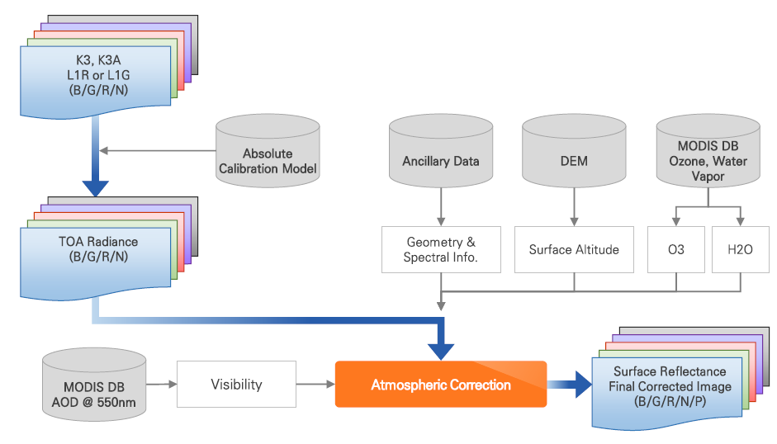
Cloud Detection
Flow Chart
Atmospheric Corrections
Cloud Detection [1]
K3, K3A
L1R or L1G
(B/G/R/N)
Cloud Shadow
Candidate area Detection [2]
Cloud shadow candidate altitude: 1~3km
Atmospheric Correction
Cloud Shadow Detection [3]
Surface Reflectance
Final Corrected Image
(B/G/R/N/P)
Per-Pixel Data
[1] Qing Zhang and Chunxiz Xizo, Cloud Detection of RGB Color Aerial Photographs by progressive Refinement Scheme, IEEE, November 2014
[2] Victor J.D. Tsai, A Comparative Study on Shadow Compensation of Color Aerial Images in Invariant Color Models, IEEE, June 2006
[3] Tianxing Wang and 3 others, Effect of Solar-Cloud-Satellite Geometry on Land Surface Shortwave Radiation Derived from Remotely Sensed Data, RemoteSens, July 2017

Slide 34
Atmospheric Corrections
Verifications
Reference: RadCalNet Data on Railroad Valley Playa (USA)
Provided by CEOS
Providing surface reflectance, AOT @ 550nm, Water vapor, Ozone, etc.
Data for cross-check: Surface reflectance using AERONET + OTB tool
Developed by Hansung Univ.
— : RadCalNet — : Hansung — : KARI

Slide 35
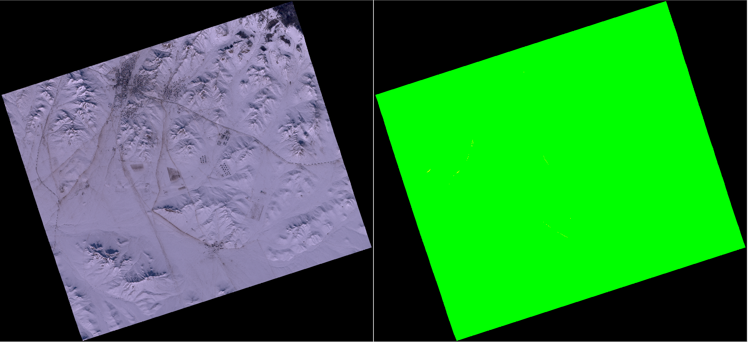
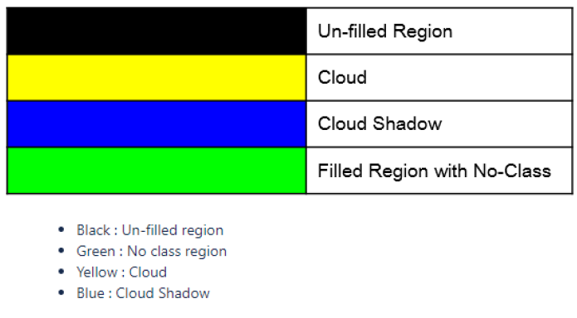
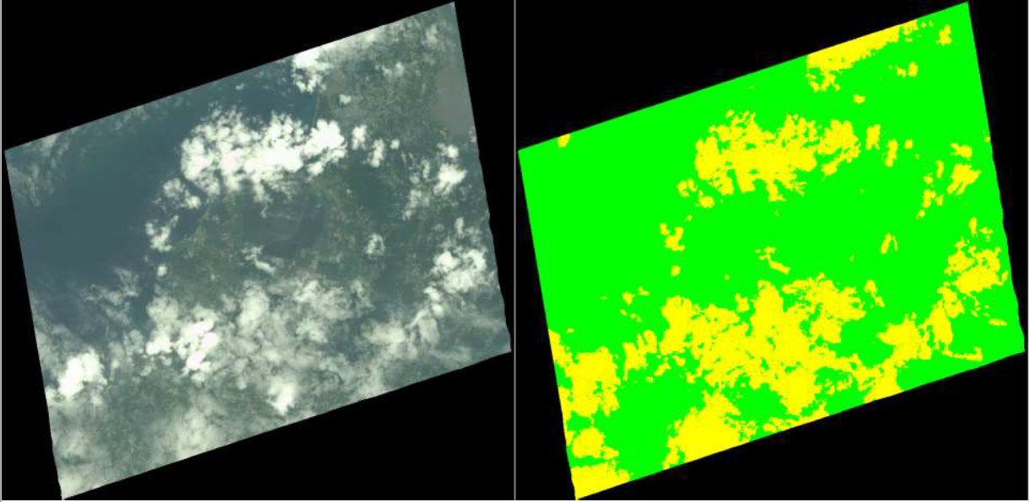
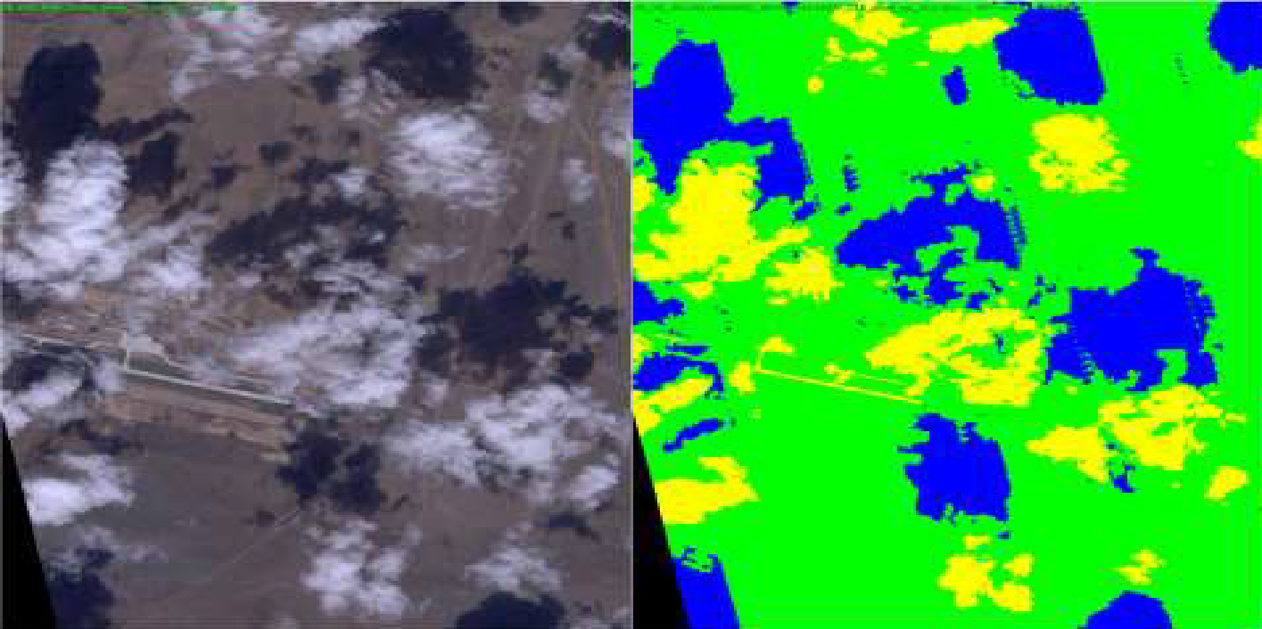
Cloud Detection
Results

Slide 36
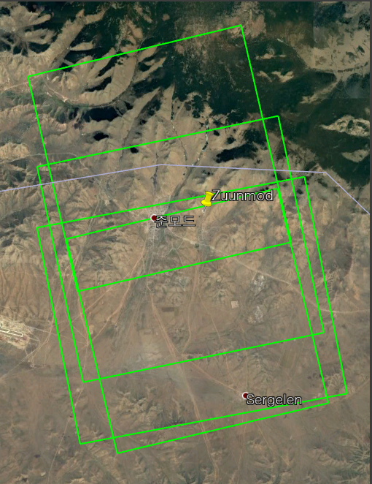
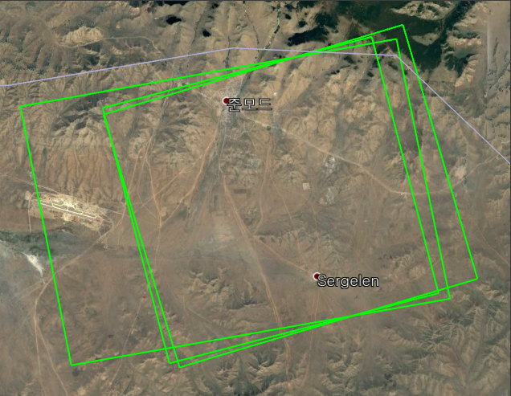
Geometric Accuracy Check for ARD
Zuunmod : K3 (3) K3A (4)

Slide 37
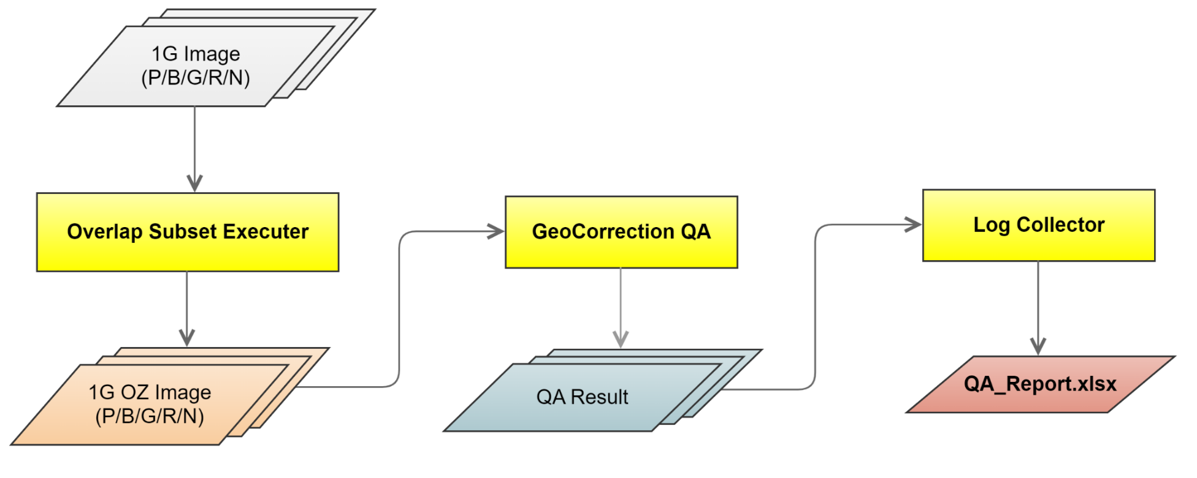
Geometric Accuracy Check process
L1G Image : Original & APC (Auto Precision Correction)* Image)
Down-sampling : 1x, 2x, 3x, 4x, 8x
GeoCorrection QA : Video comparison through video matching
*Auto Precision Correction (APC) : Translation model (Offset model)
Perform 4-corner coordinate shift without performing L1G resampling
Reference Map : Google Map

Slide 38
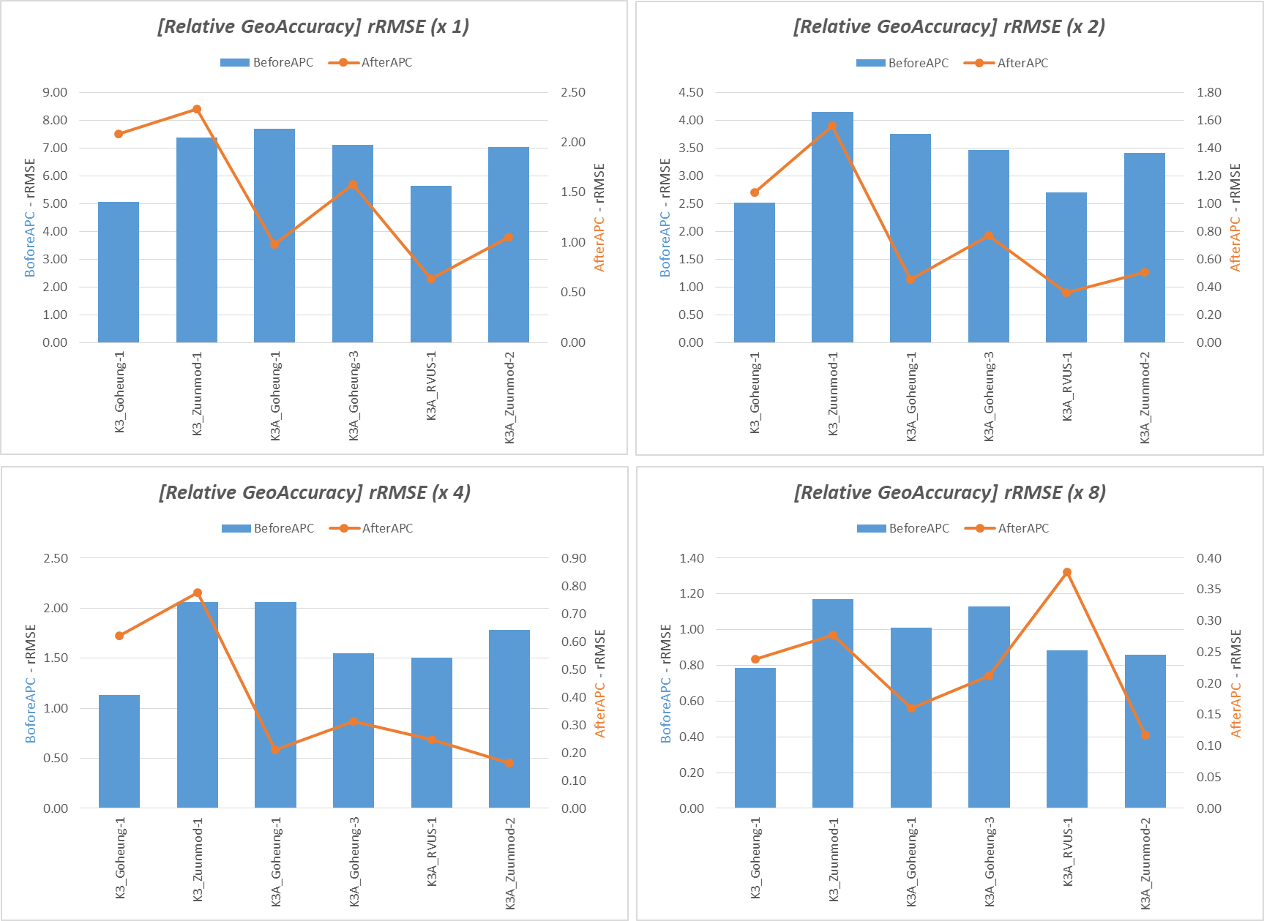

Slide 39
Conclusion
We assessed compliance of K-3/3A (KOMPSAT-3/3A) level 1 products with CARD4L-SR PFS. Since the K-3/3A is high-resolution satellite, many requirements are still challenging.
To investigate whether CARD4L on K3/K3A is feasible, we performed experimental tests on cloud/cloud shadow detection and atmospheric corrections and geometric correction requirements.
We obtained promising results to comply CARD4L requirements for cloud/cloud shadow detection and atmospheric corrections. However, Geometric Correction requirement (Sub-pixel accuracy : less than 0.5 Pixel rRMSE) is almost impossible to meet for K3 / K3A original resolution.
- Down sampling image (about 5 m resolution) for K3 /K3A show the possibility to meet the CARD4L requirements.

Slide 40
JAXA

Slide 41
JAXA mission and
CARD4L product development update
Takeo Tadono, JAXA EORC
Ake Rosenqvist, soloEO/JAXA
LSI-VC-10 #1 – May 12, 2021

Slide 42
ALOS-2 mission status
ALOS-2 payload performance nominal – No geometric, radiometric or polarimetric anomalies have been observed
ALOS-2 in extended mission phase since May 2019
Observation duty cycle reduced to 30% (from 50%) to conserve mission resources
Observations in Fine Beam Stripmap mode limited to one single global coverage per year (target)
Observations in 50 m ScanSAR mode proceed without reduction. Regional observations every 3 cycles (42-day repeat, 9 obs/year). Focus on pan-tropics and crustal deformation areas.

Slide 43
ALOS-4 mission development status
ALOS-4 PALSAR-3 to provide continuation and enhanced performance of ALOS-2 PALSAR-2. Key improvements include wider swath and observation capacity in both dual- and full polarimetric modes.
Currently in Phase D – Proto-Flight Model (PFM) manufacturing and tests
Launch shifted – now foreseen within JFY 2022 (2022/04-2023/03)
Operations to commence 6 months after launch (3 mo check-out, 3 mo Cal/Val)
Global observation strategy under development
Joint operations with ALOS-2 planned until ALOS-2 EOL
Joint A-2/A-4 operations

Slide 44
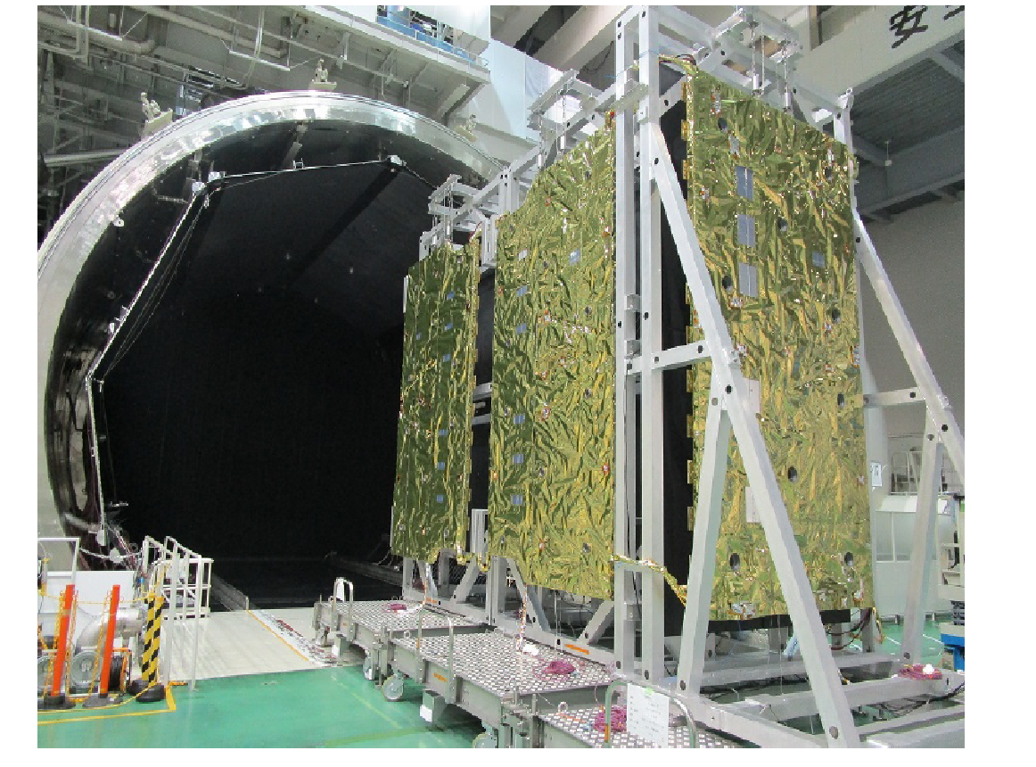
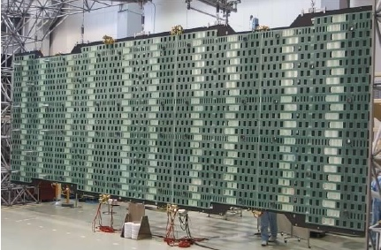
ALOS-4 mission development status
ALOS-4 PALSAR-3 to provide continuation and enhanced performance of ALOS-2 PALSAR-2. Key improvements include wider swath and observation capacity in both dual- and full polarimetric modes.
Currently in Phase D – Proto-Flight Model (PFM) manufacturing and tests
Launch planned within JFY 2022 (2022/04-2023/03)
Operations to commence 6 months after launch (3 mo check-out, 3 mo Cal/Val)
Joint operations with ALOS-2 foreseen
PALSAR-3 antenna PFS tests

Slide 45
ALOS-4 mission development status

Slide 46
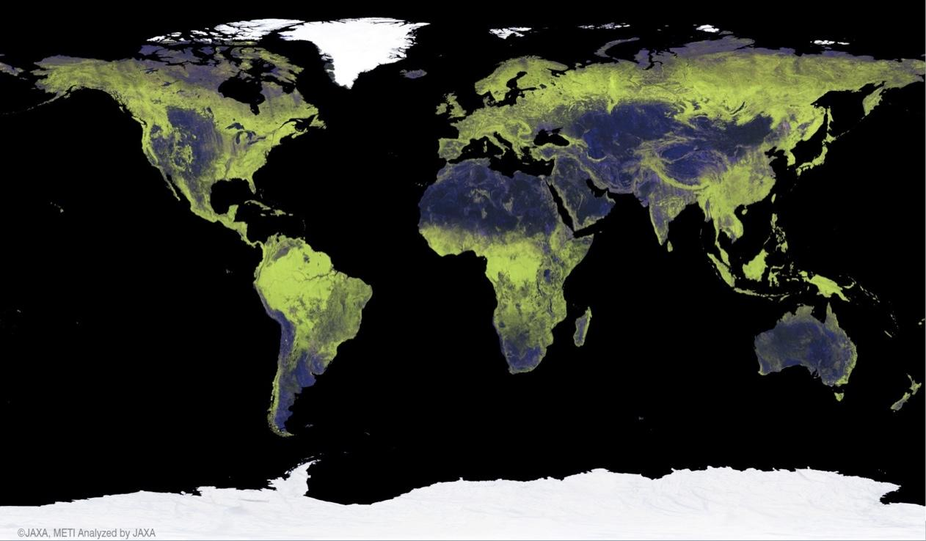
CARD4L product development update
LSI-VC-10 #1 – May 12, 2021

Slide 47
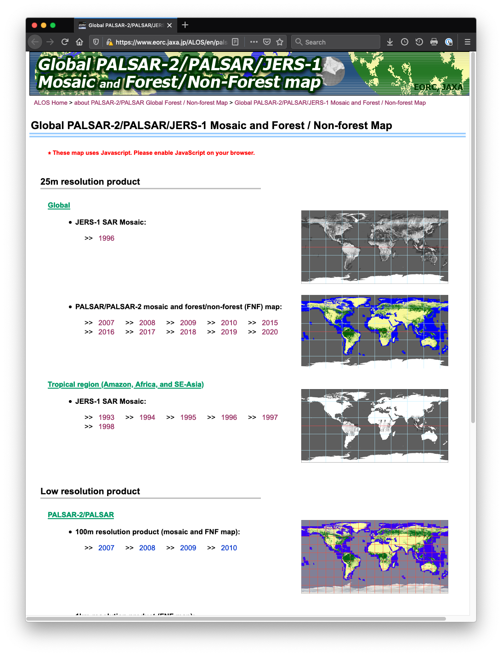
JAXA Annual Global 25 m Mosaics
Processing/Re-processing schedule
Completed: 2019 & 2020 PALSAR-2
2021 Q2-Q3: 2015, 2016, 2017, 2018 PALSAR-2
Q3-Q4: 2007, 2008, 2009, 2010 PALSAR-1
TBC: 1993-1998 JERS-1
Q4: PALSAR-2 Quad-pol mosaic (NEW)
New mosaic features:
Improved geometric accuracy
Single-year data only (i.e. no gap-filling from other years in case of missing data)
GeoTiff format
and... CARD4L NRB compliant!!
New!

Slide 48
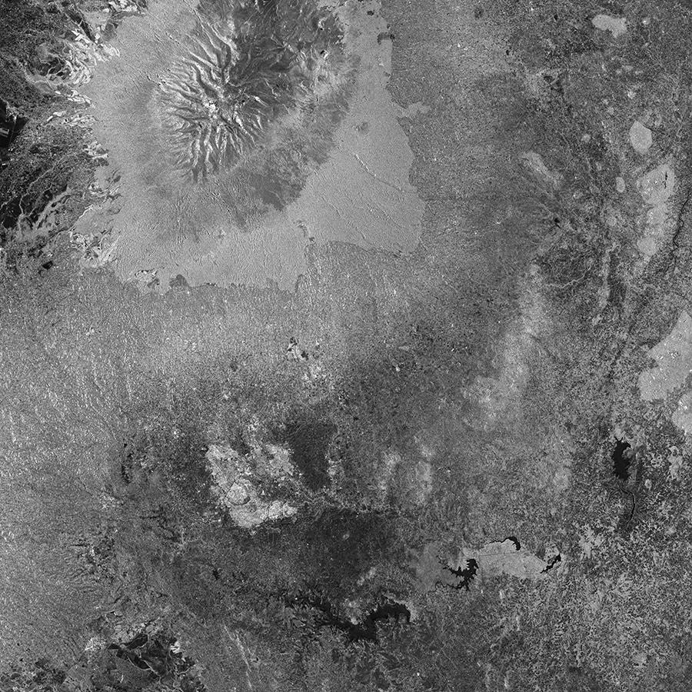
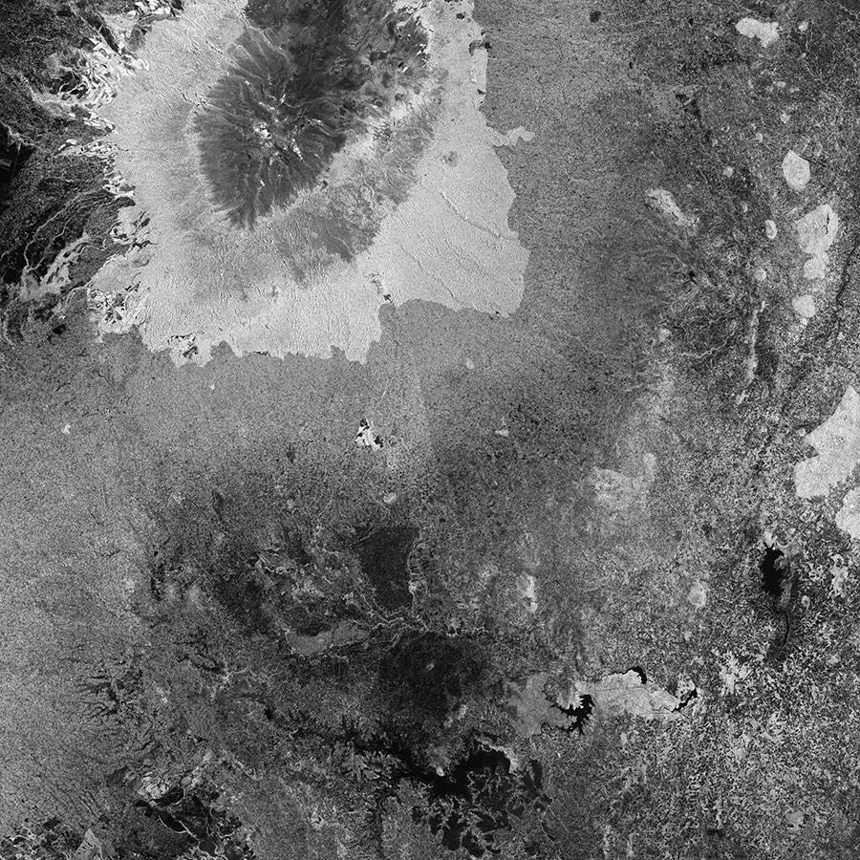
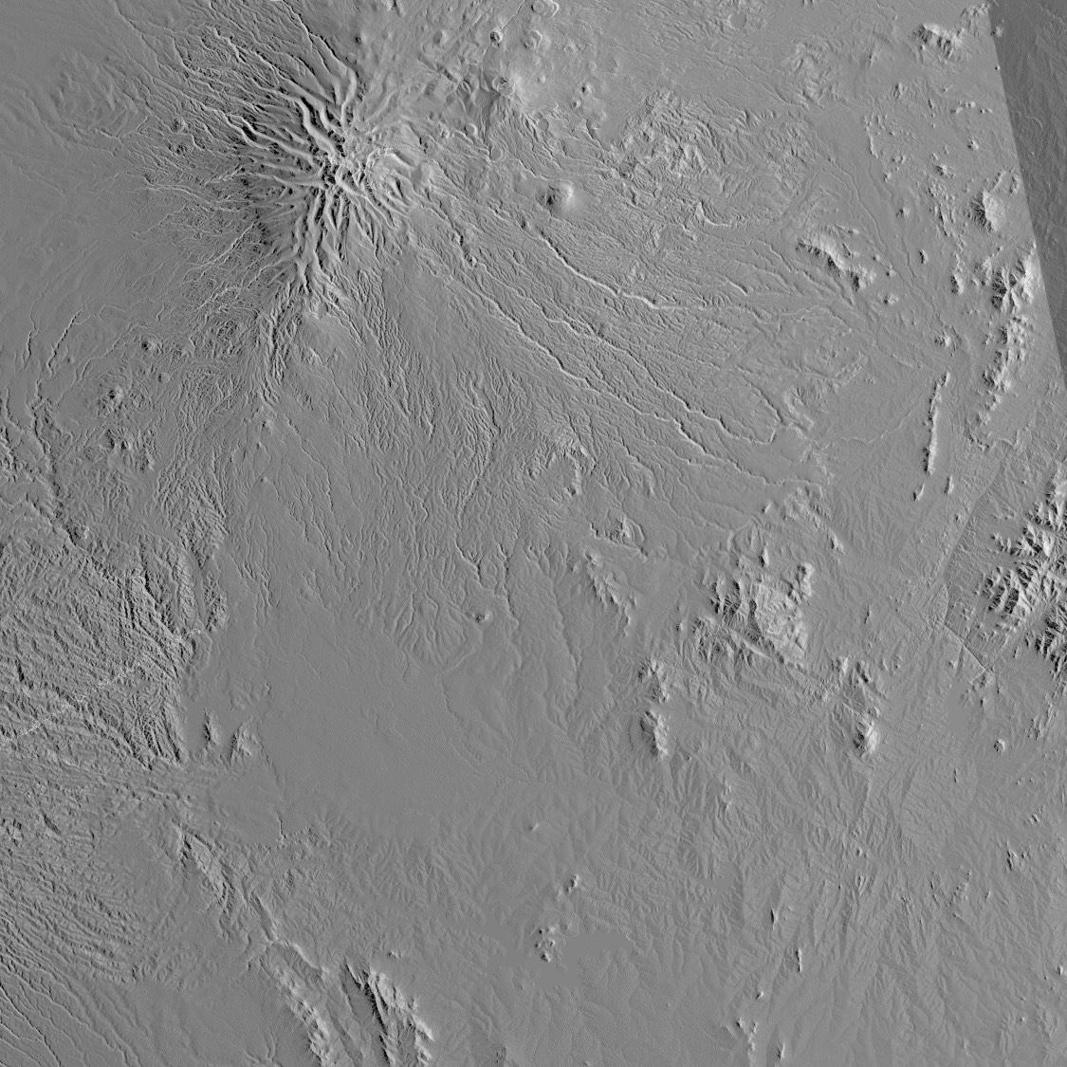
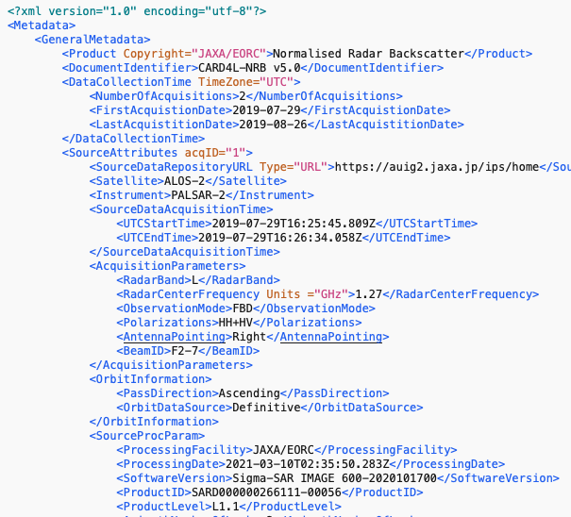
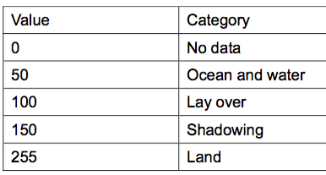
Mosaics – CARD4L self-assessment
Global PALSAR Mosaics:
“Analysis-Ready”
– but not CARD4L (yet)
Measurement data:
HH & HV gamma-0 (γ⁰) backscatter
Geometric & Radiometric Terrain Correction
Per-pixel metadata:
Local incidence angle image
Observation date image
Mask image (valid data; no-data; lay-over; radar shadow; water)
General metadata:
CARD4L formatted XML
Format
GeoTiff
HH γ⁰ backscatter HV γ⁰ backscatter
Local incidence angle Observation date
Mask image CARD4L XML header
Notes:
The mosaic products can be referred to as “analysis-ready”, however they do not YET fully comply with the CARD4L NRB standards.
The mosaics are provided in 1x1 degree tiles, in geographic lat/long coordinates, and comprise the following data layers:
Measurement data:
The HH & HV polarisation images are given as gamma-nought backscatter
They have been subject to full Geometric & Radiometric Terrain Correction
There are 3 Per-pixel metadata images included:
Local incidence angle image
Observation date image, which indicates on a per-pixel basis, the corresponding observation date
And a Mask image, with information about valid data; no-data; radar shadow and lay-over; and water surfaces)
The General metadata is the key point of non-compliance with the CARD4L standards, as it presently only consists of a simple ENVI header.
The file format is generic raw, with the backscatter data provided as 16 bit Unsigned Integer

Slide 49
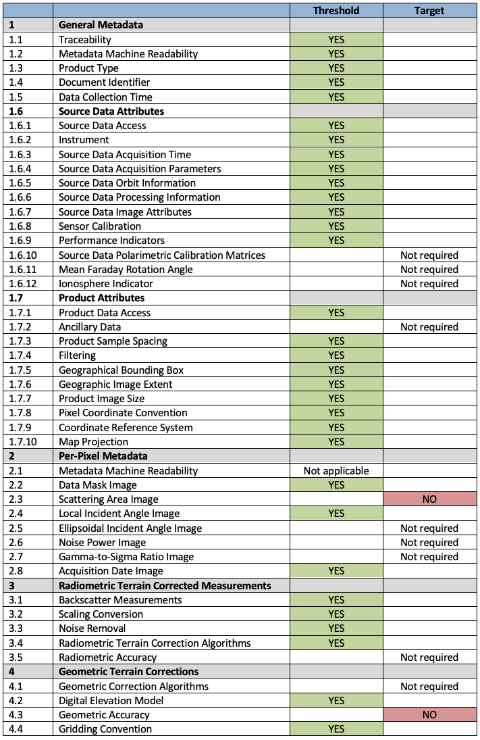
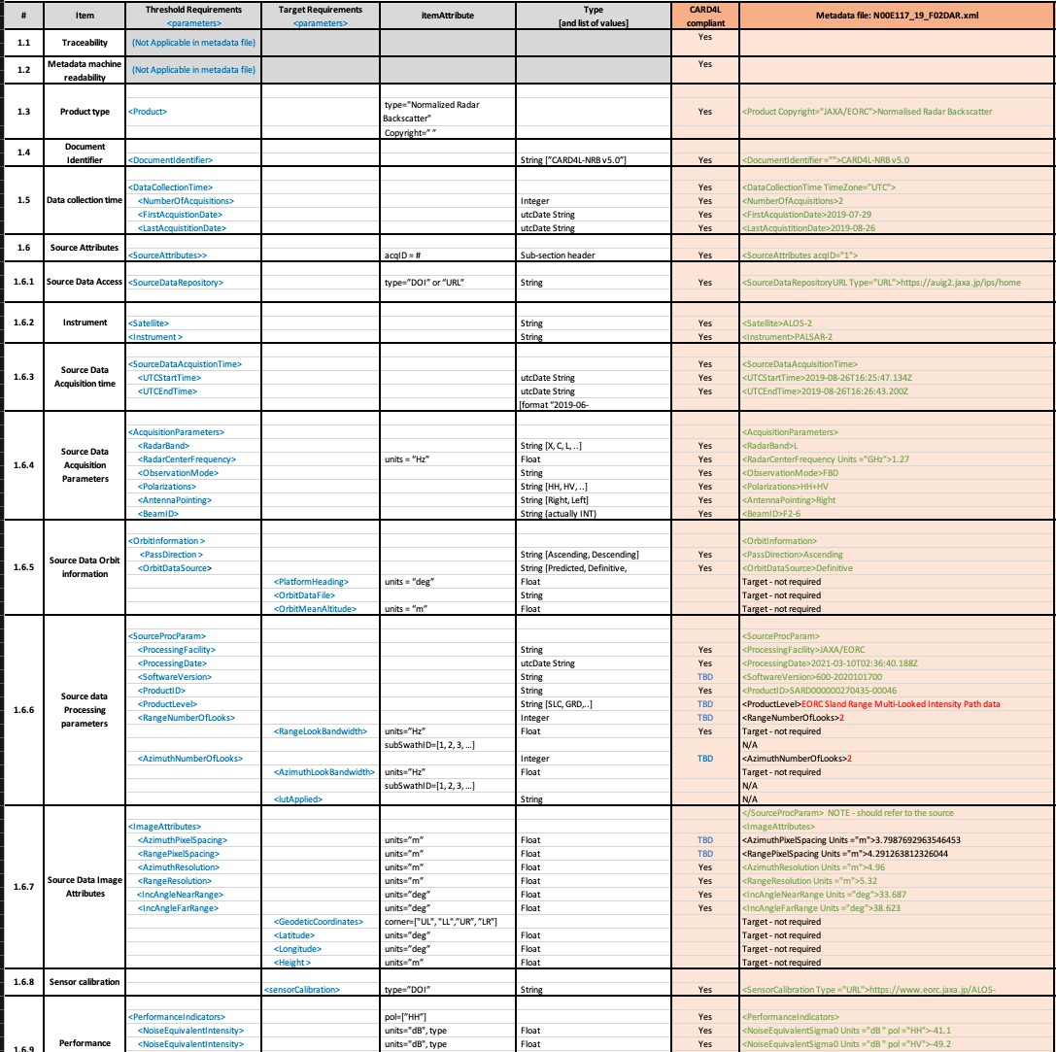
Mosaics – CARD4L self-assessment
CARD4L NRB v5.0 :
Self-assessment completed
Target compliance with v5.0 except two items:
Scattering Area (per-pixel metadata)
Geometric Accuracy
Awaiting update to NRB. Outstanding issues foreseen to be resolved.
Notes:
JAXA EORC is currently undertaking a major reprocessing effort of all global mosaic data, and that presented a perfect opportunity to assure that the new products are fully CARD4L compliant
The re-processed mosaics will feature
improved geometric accuracy
They will be composed of data from the year in question only, in order to maintain the temporal integrity of the mosaics. This is important for instance when using the data for change analysis
The mosaics will be provided in GeoTiff format to accommodate direct ingestion in standard GIS software such as QGIS or ARC-GIS
Processing/Re-processing schedule
The 2019 & 2020 PALSAR-2 are being processed as we speak, with public release in late March or April
The 2015 through 18 PALSAR-2 mosaics are scheduled for the 2nd and 3rd quarter of this year
All PALSAR-1 mosaics are to be re-processed in the second half of this year
And in collaboration with the ESA CCI Biomass project, reprocessing of all historical JERS-1 data is also planned
At the end of the year, a new mosaic product consisting of all fully polarimetricl data acquired with ALOS-2 is planned. This is very exciting and we hope this product will stimulate new SAR polarimetry applications. This also presents a potential opportunity to assure compliance with the CARD4L Polarimetric Radar (POL) specifications.
CARD4L self-assessment of the mosaic products is ongoing, including the development of complete general metadata information.
the aim is to achieve at least threshold compliance with the CARD4L Normalised Radar Backscatter (NRB) specifications
The target is to submit the assessment for review by CEOS WG CalVal in mid 2021

Slide 50
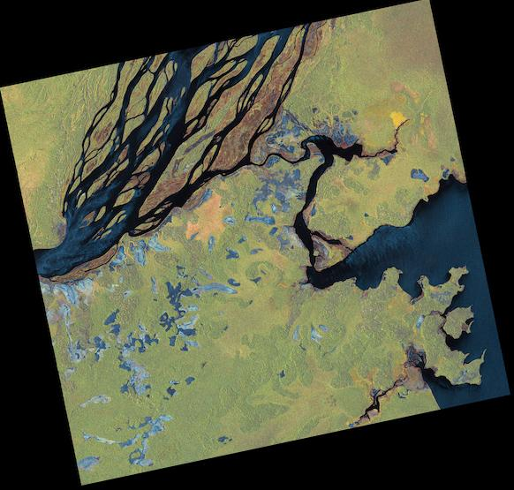
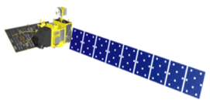
Standard products – CARD4L NRB target
Scene-based standard products:
Reprocessing of ALOS and ALOS-2 archives by JAXA Super Computer (JSS2/JSS3) ongoing
 |  | CY 2020 |  |  |  | CY 2021
 |  | 1Q Jan Mar | 2Q Apr Jun | 3Q Jul Sept | 4Q Oct Dec | 1Q Jan Mar | 2Q Apr Jun | 3Q Jul Sept | 4Q Oct Dec
ALOS | AVNIR-2 (10 m)
 | PALSAR FBS, FBD (10 m)
ALOS-2 | PALSAR-2 ScanSAR * (25m)
Data Processing
Global
Data Distribution (Public open)
Processing
Distribution (Public open)
Japan(L2.2)
Global (L2.2)
Processing
Japan (L1.1, L2.1)
* Production of ALOS-2 ScanSAR L2.2 (RTC) to start before the end of 2021. Software tool for conversion to CARD4L NRB product level to be provided

Slide 51
Thank you
LSI-VC-10 #1 – May 12, 2021

Slide 52
ESA

Slide 53
ESA Update on ARD
Ferran Gascon, Copernicus Sentinel-2 Mission Manager
and CEOS LSI-VC ESA representative
CEOS LSI-VC#10
12 May 2021

Slide 54
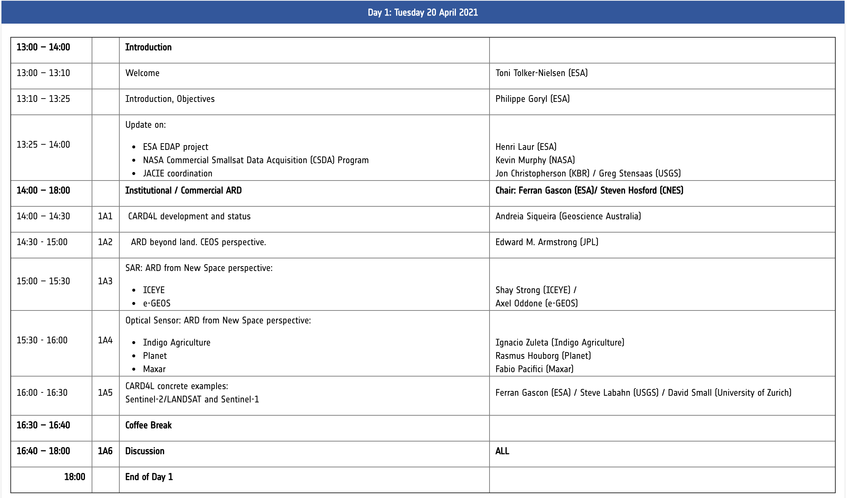
VH-RODA 2021 Workshop

Slide 55
VH-RODA / Session on Institutional & Commercial ARD
Definition of Analysis Ready Data (ARD)
Institutional sector well advanced with:
CARD4L specifications defined for 5 product families,
additional CARD4L specifications in the pipeline,
CEOS-endorsed terminology and
interest in developing CEOS ARD specifications for non-land applications.
Commercial sector brought additional concepts/thoughts like:
ARS (Analysis Ready Services), going beyond the notion of product that limits the range of downstream applications, or
the need to move towards product Levels 4 and 5.
Commercial space involvement
General consensus that sensor agnostic, standardised and easy-to-use products are interesting for non-expert users.
Commercial sector is showing some support to CEOS-lead CARD4L initiative (2 commercial products under certification: Sinergise Sentinel-1 and Element 84 Sentinel-2).
Need to reinforce CEOS-led initiatives to promote ARD in general and CARD4L in particular (e.g. in venues like ARD workshop, JACIE, VH-RODA) to foster adoption of CARD4L by the commercial sector.
Need to reinforce the promotion of the benefits brought by existing and future CARD4L products in the general effort towards facilitating missions inter-operability + advantage of being first movers.

Slide 56
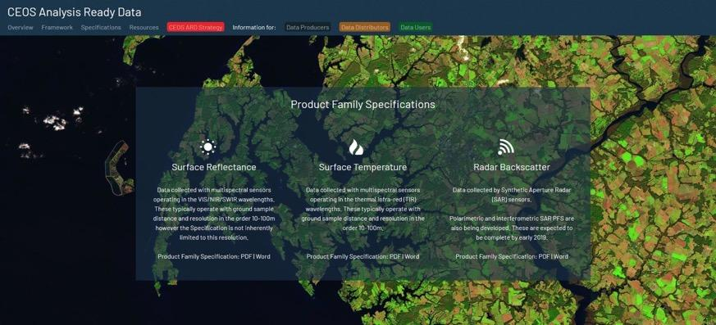
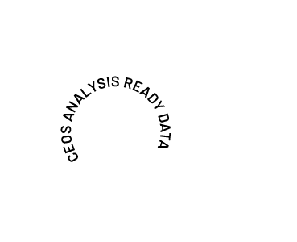
S2 Analysis Ready Data (ARD) – Level-2A
Process initiated to certify Sentinel-2 Level-2A products.
Sentinel-2 products expected to be compliant CARD4L requirements soon, after full activation of geometric refinement and inclusion of a DOI (Digital Object Identifier) in the metadata.

Slide 57
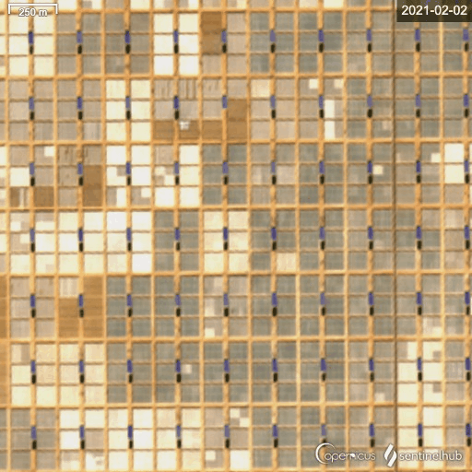
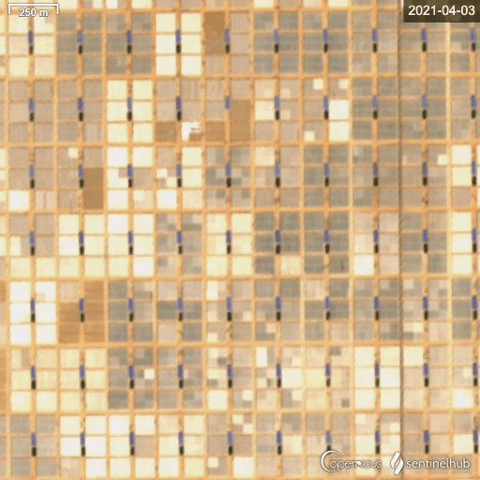
Sentinel-2 Towards CARD4L compliance
Improvement of geometric performances since 30 March 2021:
Absolute geolocation accuracy from 11m improved to 8 m (CE95).
Multi-temporal co-registration accuracy from 12m improved to 5 m (CE95).
Greenhouses in Egypt's former desert
Not Refined Geometry
Refined Geometry
Copyright: New China TV
Copyright: contains modified Copernicus Sentinel data (2020), processed with Sentinel Hub EO Browser

Slide 58
Towards Sentinel-2 Collection 1
Collection 1 will be generated reprocessing full S2 archive for both Level-1C (TOA reflectance) and Level-2A (surface reflectance and cloud mask) products.
Reprocessing campaign foreseen to start during Q4 2021.
Collection 1 available to users by second half 2022.
Collection 1 will feature several improvements on both Level-1C and Level-2A products.
Collection 1 targets CARD4L compliance for Level-2A products (currently only DOI inclusion is missing).

Slide 59
S2 - Landsat Interoperability
Geometry :
S2 GRI (Global Reference Image)
Copernicus DEM (Digital Elevation Model)
DEMIX (DEMs Intercomparison eXercise)
DGGS (Discrete Global Grid System)
Top-Of-Atmosphere Radiometry :
Sensor inter-comparison using an integrating sphere
S2 “inspired” by Landsat-8 bands
Absolute radiometry inter-comparison
Surface Reflectance and Cloud Mask:
ACIX (Atmospheric Correction Intercomparison eXercise)
CMIX (Cloud Mask Intercomparison eXercise)
CARD4L [ http://ceos.org/ard ]
Harmonised and Fused Products
Sen2Like

Slide 60
VC-19-05: Open-source library for surface reflectance product generation
Sen2Llike software available in open-source at: https://github.com/senbox-org/sen2like
Sen2Like pilot productions provided to several teams (Copernicus Services, Szantoi et al., Labahn et al., Roy et al., Schaaf et al.).
Pilot productions also available to LSI-VC members.
Sen2Like being compared with NASA HLS.
Sen2Cor will become also available also in open-source on GitHub during Q3 2021.
Sen2Cor new release in open-source will support both Sentinel-2 and Landsat.

Slide 61
Landsat + Sentinel-2 in Google Earth Timelapse
Google statement:
“As far as we know, Timelapse in Google Earth is the largest video on the planet, of our planet. And creating it required out-of-this-world collaboration. This work was possible because of the U.S. government and European Union’s commitments to open and accessible data. Not to mention their herculean efforts to launch rockets, rovers, satellites and astronauts into space in the spirit of knowledge and exploration. Timelapse in Google Earth simply wouldn’t have been possible without NASA and USGS Landsat program, the world’s first (and longest-running) civilian Earth observation program, and the European Union’s Copernicus program with its Sentinel satellites.”
https://blog.google/products/earth/timelapse-in-google-earth/
Notes:
One of the most comprehensive pictures of our changing planet is now available to the public.
24 million satellite images from Sentinel-2 and Landsat from the past 37 years have been embedded into a new layer of Google Earth.

Slide 62
Thank you
Columbia Glacier (Alaska)
Notes:
Columbia Glacier in Alaska
Sentinel-2 image acquired in August 2019. On top of the image we have annotated historical glacier calving front lines from 1986 using data from Landsat and Sentinel-2.
Main result : The glacier has been retreating of about 20 km in 33 years (1986-2019)

Slide 63
ISRO

Slide 64
CARD4L and Product family specification(PFS): Assessment and Production: RS2/2A Products-NRSC/ISRO LSI-VC-10 : 12 May 2021
T. Radhika, NRSC, ISRO

Slide 65
Objective
Design an approach to generate Analysis Ready Data (ARD) set using IRS sensors data.
Currently we propose to generate ARD sets from Resourcesat-2 series (RS2/RS2A)
ARD (Surface Reflectance Family) product includes temporal sets in compliance with CARD4L product family specs..
Top of Atmosphere (TA) reflectance (reflectance calculated “at sensor,” not atmospherically corrected)
Surface Reflectance (SR) (atmospherically corrected)
Pixel Quality Assessment (QA) (common and sensor specific quality bands included)
General meta data
Quality meta data
From relevant/similar sensors

Slide 66
Resourcesat-2/ 2A:
The Resourcesat-2(RS-2) satellite was launched by the Indian Space Research Organization (ISRO) on April-2011, followed by Resourcesat-2A(RS-2A) on Dec-2016, to ensure systematic and repetitive coverage of the earth’s surface to provide data for integrated land and water resource management.
 | AWiFS | LISS-3 | LISS-4
No of Bands | 4 | 4 | 3
Spectral Band2 (µ) | 0.52 – 0.59 (green) | 0.52 – 0.59 (green) | 0.52 – 0.59 (green)
Spectral Band3 (µ) | 0.62 – 0.68 (red) | 1.55 – 1.70 (SWIR) | 1.55 – 1.70 (SWIR)
Spectral Band4 (µ) | 0.77 – 0.86 (NIR) | 0.77 – 0.86 (NIR) | 0.77 – 0.86 (NIR)
Spectral Band5 (µ) | 1.55 – 1.70 (SWIR) | 1.55 – 1.70 (SWIR) | -
Resolution (m) | 56 | 24 | 5.8
Swath (km) | 740 | 140 | 70
Revisit period (days) | 5 | 24 | 5

Slide 67
Status of RS2/2A Data products :CARD4L framework
Expertise in realizing Ortho- Surface reflectance(SR) products
Thorough Validation carried out with Insitu measurements - varied reflectance features , ISRO-CAL sites and with OLI
RS-2/2A SR product is in good agreement with OLI with R2 > 95 % for R2A and R2 ~ 90 % for R2
Geometric Accuracy : better than a pixel (CE90)
QA band with cloud and cloud shadow
Variation of SR values is more on Aquatic features

Slide 68
PFS assessment
Threshold : 5/7, Target 5/11
Threshold : 9/10, Target 7/17
Threshold : 4/4, Target 4/6
Threshold : 0/1, Target 0/1

Slide 69
Way Forward ..
AOD data pre-Processing
Deriving Per pixel uncertainty in terms of geometry and radiometry
Land/water, Snow/Ice and Terrain shadow mask
Measurement Normalization
Subpixel accuracy over all types of terrains
Collaboration to overcome Challenges
Process exchange on Atmospheric data handling : High variations in neighbouring AOD values
Process exchange for Non- availability of AOD data over Himalayan region and AOD from LS8 .
Exchange of RS2/2A SR products and Reports .
Thank you..

Slide 70
Analysis Ready Satellite Data at NASA
Christopher Lynnes

Slide 71
DLR: EnMAP
ARD / CARD4L Metadata
Martin Bachmann et al., DLR
for the EnMAP Ground Segment

Slide 72
Wrap-up
LSI-VC Leads

