Slide 1
EnMAP ARD / CARD4L Metadata
Martin Bachmann et al., DLR
for the EnMAP Ground Segment
Supported by the DLR Space Administration with funds of the German Federal Ministry of Economic Affairs and Energy on the basis of a decision by the German Bundestag (50 EE 0850).

Slide 2
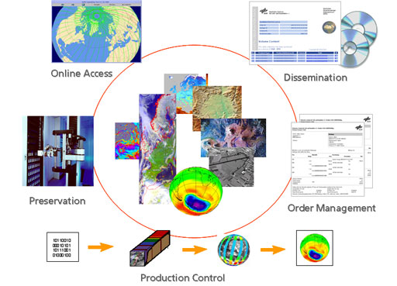
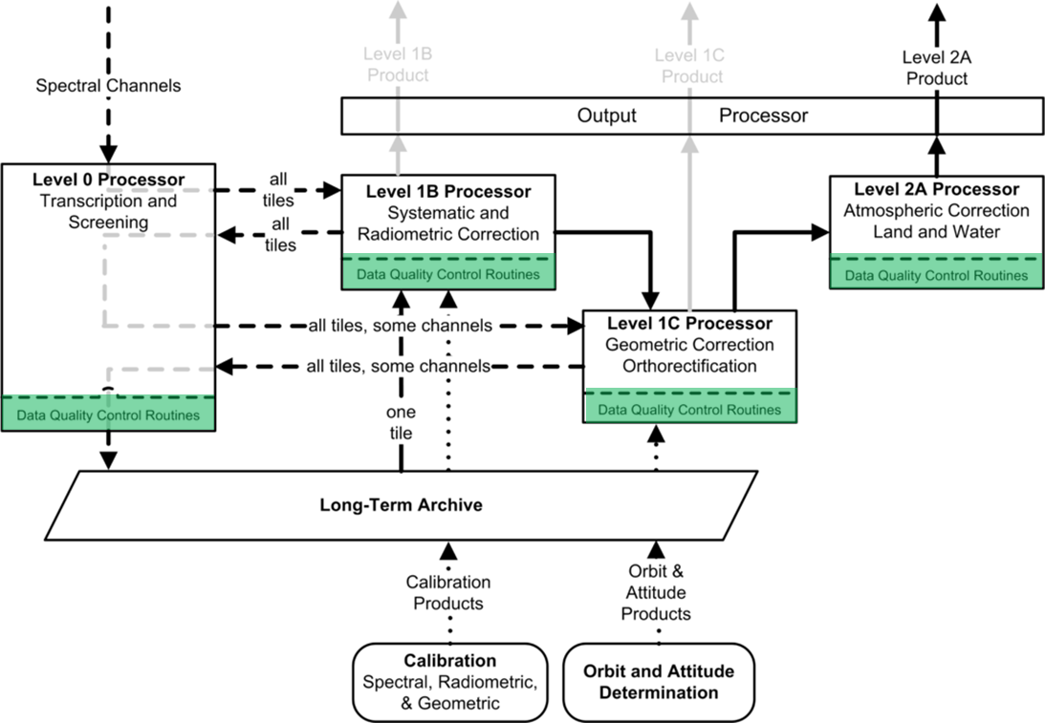
Overview
DLR‘s multi-mission infrastructure „DIMS“
Incl. TerraSAR-X, ENVISAT and others
GEOSERVICE: ISO19115 & INSPIRE
Current topics: ARD-complient hosting of S-1 & S-2 archives
EnMAP – German Hyperspectral Mission
COPERNICUS contributing mission
Launch: Q1 2022
Processing up to L2A (ortho-rectified BOA reflectance)
L2A: tiled products, 218 bands
Processing similar to DESIS @ ISS
Complete sample products available: https://www.enmap.org/data_tools/testdata/

Slide 3
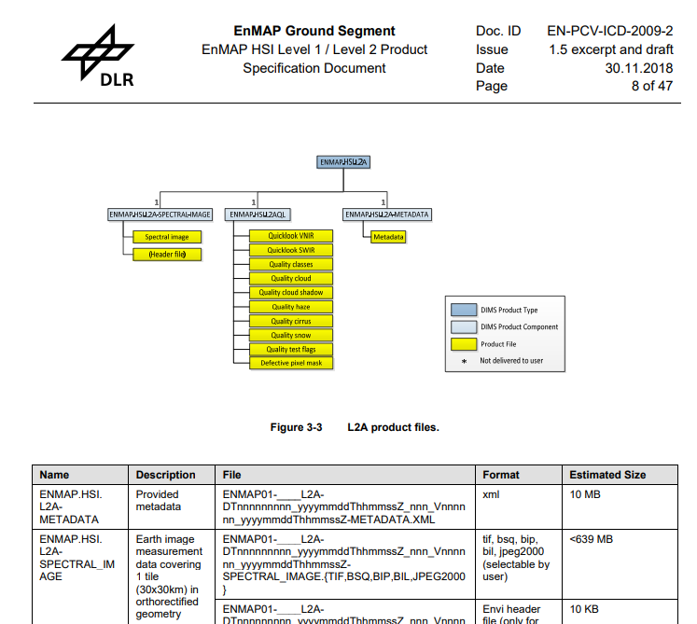
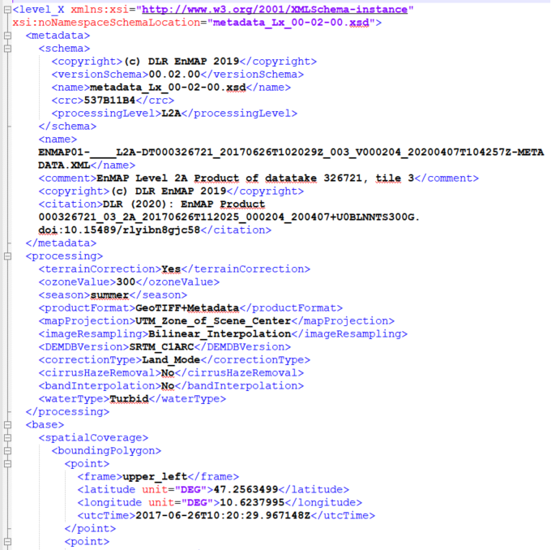
EnMAP – Product Specifications & Metadata
Archived product: L0+ incl. metadata up to L2A
L1B, L1C, L2A (land & water) user product generation on demand
L2A product: Datacube + Quicklooks + 8 QualityLayers + XML Metadata
CARD4L-SR (V.5.0) is suitable for hyperspectral data
@ L0, L1B, L1C, L2A:
Layers:
Quickloooks (VNIR, SWIR)
Classification
Cloud
Cloud shadow
Haze
Cirrus
Snow
QC flags (sat., strip., quality)
Defective Pixel Mask
Metadata:
Data Quality
Geo. accuracy (matching)
Atm. conditions
…

Slide 4
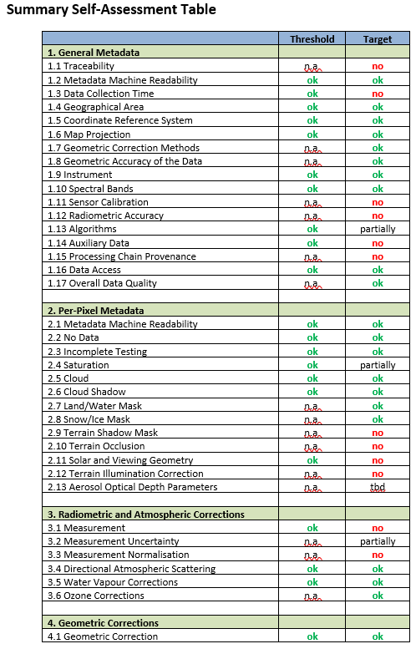
Obstacles reg. full „target“ conformity
Auxiliary information (esp. reference image, DEM + derivates) partially commercial
Traceability of instrument lab. calibration would require industry commitment / likely change of contracts
Parts of the geo/spec/rad calibration information is provided within metadata (RPCs, spectral smile)…
… other parameters (esp. straylight) too exhaustive to be provided
In-orbit radiometric performance will be documented within publications, uncertainty budget @ L2A in development

Slide 6
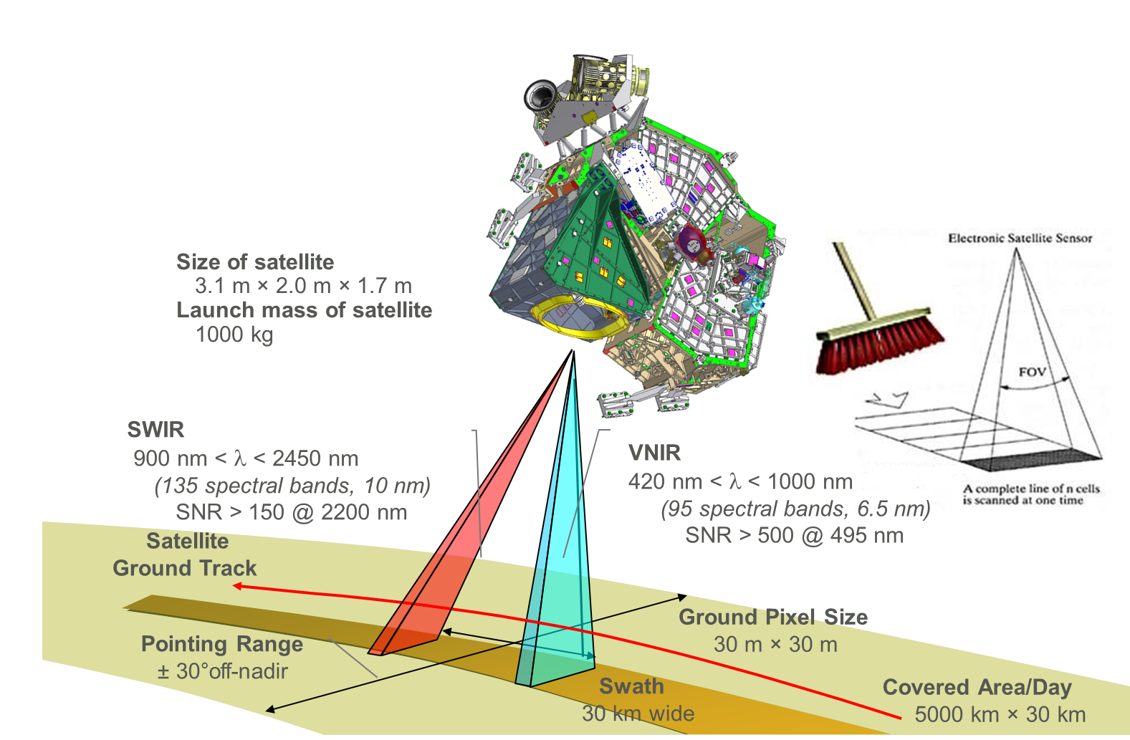
EnMAP – Mission
Parameter | Value
Spectral Accuracy | 0.5 nm (VNIR); 1.0 nm (SWIR)
Radiometric Accuracy | 5.0% (absolute); 2.5% (relative)
Geometric Accuracy | 100 m (30 m with control points)
On-Board Calibration Equipment
Orbit:
Sun-synchronous, 11:00, 398/27
Launch:
12/2021
Source: DLR, OHB

