Slide 1
SDCG Introduction FM Seifert, G Fosnight & SDCG Coordination Office
LSI-VC / SDCG:Coordination Frascati, 22 February, 2016

Slide 2
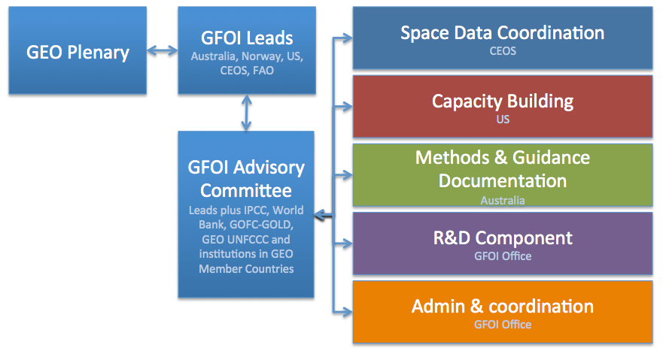
GFOI
CEOS represented on the GFOI Leads group and Advisory Committee
Stephen Briggs, ESA ➔ Masanobu Shimada, Jaxa

Slide 3
Space Data component heritage
The CEOS Space Data Coordination Group for GFOI has worked with the world’s largest providers of Earth observation data to ensure that all countries have access to the satellite data required for national forest monitoring and annual reporting of greenhouse gas emissions and forest carbon stocks to the UNFCCC under the provisions of REDD+ and consistent with IPCC guidelines
Notes:
I would second what Steve has said. We need to encourage large implementation supporters like GIZ to consider seeing GFOI as an approach whose MGD and supporting data can ensure fidelity and acceptance of their investment in national MRV systems. Its an insurance policy to guarantee the results of the investment in a policy context. If they were to require consideration of GFOI as part of their aid project process it would be ideal. I guess you will not be so explicit but you should show the path…?
For me, the important issue for us is to maximise the different paths for delivery of services to the final users. This can be done by FAO, by Silvacarbon, through Australia/ClInton but I would like to be less dependent on, especially, FAO hence my attempts to get UK and Germany involved. Ideally we would have the infrastructure of GFOI - data, MGD, CapB and R&D - helping to support a range of delivery mechanisms, as broad as possible, with no extra effort in principle. Hence what we would really like is for GFZ to support in-country activities and service delivery using the GFOI data/MGD, and as part of the overall GFOI partnership. I hope UK will also do so.

Slide 4
SDCG
SDCG Exec:
Co-chairs: USGS (Gene Fosnight), ESA (Frank Martin Seifert)
SEC: Govt. Australia (Stephen Ward, George Dyke & Matthew Steventon)
Participation of:
CNES – Steven Hosford
CONAE – Laura Frulla
CSA – Yves Crevier
DLR – Helmut Staudenrausch
GEOSEC – Osamu Ochiai
GFOI Office – Tom Harvey
INPE – Dalton Valeriano
JAXA – Nobuyoshi Fujimoto,
NASA/SEO – Brian Killough

Slide 5
CEOS Space Data Strategy for GFOI
Implementation of Baseline Global Data Acquisition Strategy
Space Data Services Available
Data Supply in Support of GFOI R&D Activities
Publicly open (“core”) satellite data, phased implementation - full global coverage by 2016.
A coordinated strategy for national data acquisitions accommodating countries’ specific technical requirements, heritage, and experience.
Covers a wider range of satellite data sources, including commercial.
Includes support for science studies assisting the development and evolution of the MGD for GFOI and addressing specific country needs.
Assuring the availability of consistent time-series of optical and radar (SAR) satellite data over global forest cover.
At least one annual national cloud-free optical coverage over each country.

Slide 6
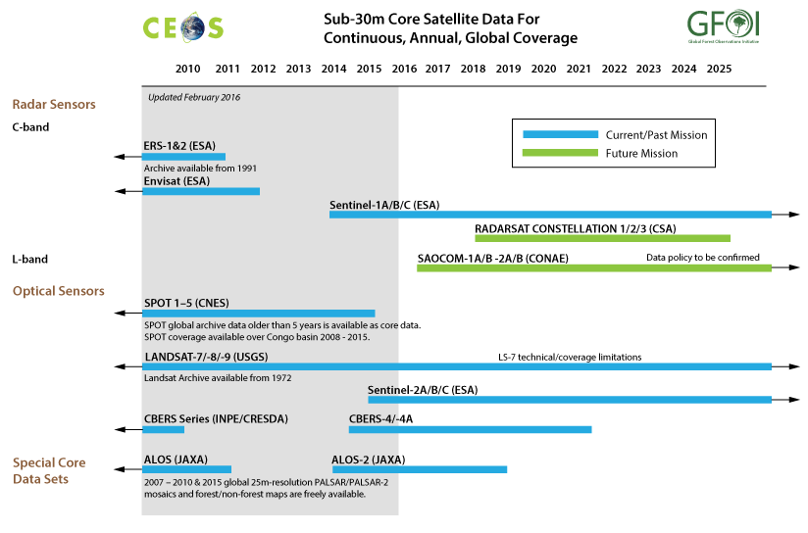
SDCG Data Streams – Core

Slide 7
Space Data Support to GFOI R&D
Complement to the Global Baseline Data Acquisition Strategy (Element-1) and National Space Data Services Strategy (Element-2)
R&D focus provides a mechanism also for space agencies and data providers with commercial satellite missions to support GFOI aims
Developed to support the GFOI R&D Component needs for satellite data which are not available through the “core” missions:
Very High Resolution (optical and radar)
Radar (L-, C-, X-band SAR) data
Research undertaken by international team of experts managed by the GFOI R&D component
Ultimate aim to help progress high priority applications – which are not yet included in the MGD – to operational status.

Slide 8
SDCG Workplan: 2015 Outcomes
Status Going Into to SDCG-9
* Full outcome text in 3yWP and SDCG-8 agenda
On Track / Complete | 6/17 [+3]
Progressing | 8/17 [-1]
Not Progressing / Unknown | 3/17 [-2]
February 2016
 | Outcome* | Status |  | Outcome* | Status
Baseline | #1: Global Coverage | In Progress | Service (Cont’d) | #10: Cloud Computing Pilots | Kenya+Colombia
 | #2 Data Flows | First Complete Draft for Review |  | #11: National Model | Not yet
 | #3: Info. Products | Being identified in #2 | R&D | #12: E3 Strategy | Complete
Services | #4: MGD Integration | In progress – discussion with FAO and MGD |  | #13: Data for R&D | In progress – ASI, CNES
 | #5: CB Meetings | Continuing SC Support |  | #14: Broker Commercial | SDCG-8 Day
 | #6: Ensured coverage (CDS) | For LS+S2A | Component Coord’n | #15: Customer Experience | Not yet
 | #7: Interop. Discovery Tools | For LS. S2A? |  | #16: Priority Country Service | Kenya only
 | #8: Core Data Assembly | Data Flow Study, Space Data Guide |  | #17: Country I/F Management | Not yet
 | #9: MGD 2.0 Integration | In progress – MGD 2.0 feedback

