Slide 1
Global Data Flows Study GFOI and Space Agencies Symbiosis
LSI-VC & SDCG joint session 22 Feb 2016, Frascati

Slide 2
Why are we here?
SDCG is working directly with GEO GFOI capacity building partners to provide countries with the data they need to meet REDD+ donor requirements
LSI-VC is the Land Surface Imaging VC tasked with providing coordination among all space agencies.
SDCG seeks to provide user needs to LSI-VC to help prioritize product evolution.

Slide 3
Global Data Flows - Objectives
Evaluates alternate solutions for reducing barriers to effective use of satellite data in implementing measurement, reporting and verification (MRV) methodologies within national forest monitoring systems (NFMS) in support of REDD+.

Slide 4
Global Data Flows
Analysis Ready Data is the future of space data and will remove barriers to its use.
Analysis ready data are geometrically, radiometrically and atmospherically corrected and ready for use in resource applications
Resource staff should not need data preprocessing skills
Data supply is no longer the limiting factor
Data access and data rich applications is now the limiting factor
Huge data volumes
Multiple core data sources

Slide 5
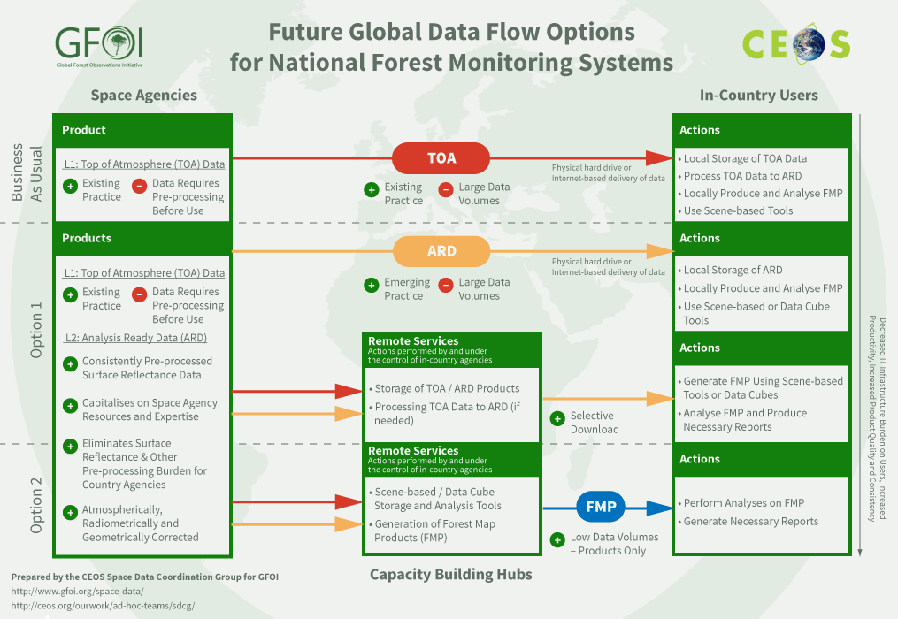
Data Flows

Slide 6
Analysis Ready Data
Optical: geometrically, radiometrically, and atmospherically corrected Surface Reflectance
Radar: orthorectified and calibrated to decibels
Tiled/data cubes

Slide 7
Coordination among Space Agencies
Cross calibration of products
Share common DEMs
Share common land mask
Coordinate data acquisition plans
Coordinate ARD specifications

Slide 8
Potpourri of needs
Mirrored archives
Level 0 /mission data – reduction in resampling steps
Support for International Cooperators
Repatriation and processing of older data
Band difference adjustment
Bidirectional Reflectance Distribution Function adjustment
Multimission Data Cubes

Slide 9
Way forward
Encourage CEOS Space Agencies to coordinate production and access to Analysis Ready Data – where next?
Invite Users and Capacity Building partners – how can space agency products and access be improved
How can LSI-VC work with SDCG and the GEO projects to ensure that needs are addressed?
Data
Requirements
Facilitators
Product
Requirements
Capacity Building Partner
Space Agency
National Forest Agency
Technology Partner
Donor

