Slide 1

SEO Tools and Data Services
A summary report to the LSI-VC (Agenda #8)
Brian Killough
CEOS Systems Engineering Office (SEO)
February 23, 2016

Slide 2
What is the CEOS SEO?
SEO = Systems Engineering Office
Funded by NASA-HQ, located at NASA Langley (Hampton, Virginia)
Technical Functions
Systems Engineering Tool Development: COVE tool, Data Cube user interface tools (unique, free and open)
Space Data Coordination - GEOGLAM (Agriculture and Food Security) and GFOI (Carbon/Deforestation)
Special Projects – Country Coverage Reports, Data Services Pilot Projects, Data Policy Portal, Gap Analyses
MIM (Missions, Instruments, Measurements) Database ... with ESA
Management Functions
CEOS Websites, Mailing Lists, Document Management System, and
Devlierables Tracking Database
Education Outreach (GEO and IGARSS)
Training and Capacity Building (SilvaCarbon, Working Group on Capacity Building)

Slide 3

What is COVE ?
The CEOS Visualization Environment (COVE) is a browser-based suite of tools for searching, analyzing and visualizing actual and potential satellite sensor coverage.
COVE is FREE and OPEN for anyone to use!
COVE includes 260 missions, 705 mission-instrument combinations.
COVE is linked to several mission archives to get metadata and browse images for past acquired data: Landsat, SPOT, Pleaides, Radarsat-2, ALOS-1, TerraSAR-X.
There is a large international user base ...
5800+ unique users in 2015.
The NASA SEO maintains COVE is constantly assessing inquiries from the user community to add new missions, instruments, mode and features to the tool for expanded capability.
www.ceos-cove.org
The COVE suite of tools includes:
COVE – The main tool for global visualizations
Rapid Acquisition Tool – A tabular tool for analyses
Coverage Analyzer - A tool for long-term coverage analysis
Mission and Instrument Browser – Details on the COVE mission database

Slide 4
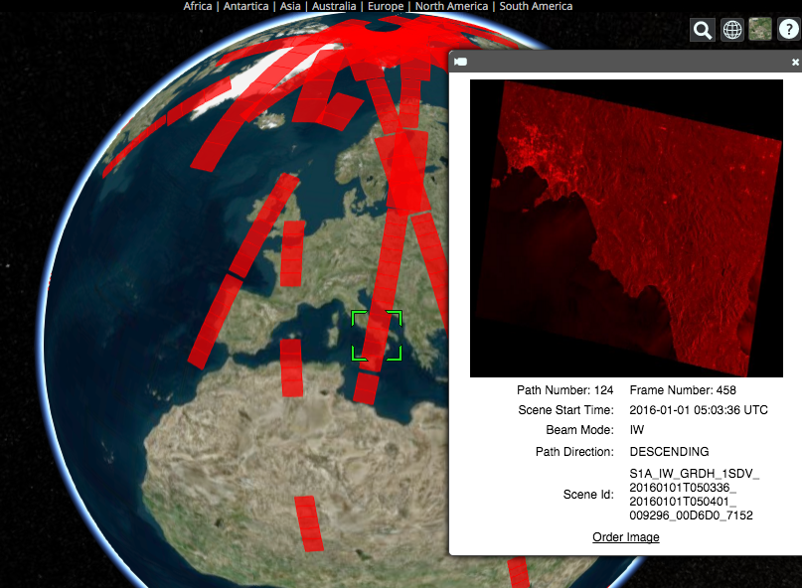
Recent COVE Updates
January 2016: Changed from Google Earth to Cesium for globe interface
New Missions: Sentinel-1A/2A, CBERS-4, RCM 1-3 (notional), FY-3C, PROBA-V, TET-1.
New Overlays: Landsat/Sentinel constellation revisit performance, Global Phenology (2001/2014 monthly NDVI Min/Max)
New Analysis Tools: Custom Mission Tool allows the creation of a notional mission for analyses.
New Archive Link: Sentinel-1A !!!!
Future Archive Links: Sentinel-2A
(end 2016).
Example of COVE connection to the
Sentinel-1A data archive. COVE now
shows actual acquired data locations,
quick-look images, and links to order the data.

Slide 5
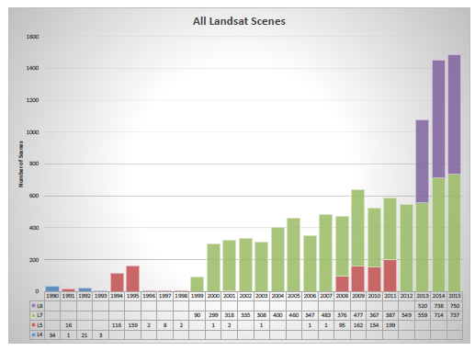
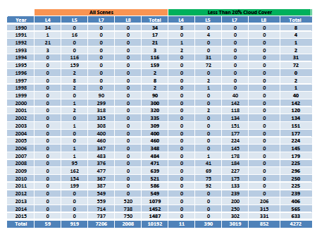
Landsat Country Reports
The CEOS Systems Engineering Office (SEO) has prepared detailed historic Landsat coverage reports for 70 GFOI countries.
The SEO created these reports using automated scripts connected to the Landsat archive. All Landsat scenes (missions 5,7,8) from 1990 through 2015 were included.
These reports (PDF and EXCEL format) are here: http://tinyurl.com/GFOIcountryreports
The reports include summary graphs, tables, and other detailed data for every acquired scene (mission, path/row, cloud%, processing level).
These reports will be valuable for countries to assess available scenes and cloud cover for future data ordering.

Slide 6


The Data Cube Vision
The CEOS Data Cube infrastructure will become a highly utilized free and open source software toolset for creating local, regional or national pixel-based time-series of multiple datasets that are spatially aligned according to user needs (spatial region, time period, data layers, grid projection).
Users will connect free/open user interface tools to the Data Cube for common analyses (cloud-free mosaics, change detection, time series statistics) or utilize Advance Programming Interface (API) connections to develop their own interface tools.
Space Agencies will systematically supply
analysis- ready data products that are easily ingested into Data Cubes.

Slide 7

Data Cube Architecture
Analysis-Ready Data Products
Working with CEOS Space Agencies to develop plans for sustained provision of Analysis Ready Data (ARD).
Sentinel-1A and Sentinel-2A are the highest priority.
Ingestor
Testing prototype Data Cubes for Kenya and Colombia.
Testing local, regional hub and cloud deployment.
Developing ingestors to add more datasets: SRTM, ALOS Mosiacs, MODIS, SPOT-5, Sentinel-1A/2A.
Data Cubes
Developing and testing prototype user interfaces for custom mosaic creation, time-series statistics, change detection (water, land, vegetation).
Developing Advanced Programming Interfaces (APIs) for users to create their own user interfaces
API
User Interface

Slide 8




Kenya Pilot Project
  The project is led by NASA-SEO and supported by the Australian Government (DOTE) and the Clinton Foundation (CCI and SLEEK).
  Two operating versions of the Kenya Data Cube:
  Amazon Cloud and a local SEO computer. Considering options for the SERVIR-Africa Hub.
  11.5 TB of Landsat data (7500+ scenes back to year 2000). Pixel information from 42 path-row regions were extracted and reformatted into a cube.
  The cube contains 68 time-series tiles (1-deg square) with 933 million pixels.
  The Kenya team is still utilizing scene-based methods to develop historic forest maps. Future testing of Data Cube concepts is likely in mid-2016.

Slide 9



Colombia Pilot Project
  The project is led by NASA-SEO and the Colombian Government. Supported by CSIRO (Australia, CEOS Chair Team) and IDEAM (Institute of Hydrology, Meteorology and Environmental Studies).
  A mini-cube (4 Landsat path-row regions) was delivered in Oct 2015. Includes all historic Landsat data back to 2000. Contains 20 time-series tiles (1-deg square).
  Total area = 246,020 km², 273 million pixels.
  The Colombia government presented the Data Cube concept to the Ministry in late 2015 and was approved to implement the Data Cube architecture for national scale applications in 2016.
  The Colombia team is working closely with the NASA-SEO team to expand their Data Cube to the full country. They are also very interested in user interface tools to produce custom mosaics, detect change, and conduct time series analyses (land and water). Conducted a team telecon on Feb 17.

Slide 10
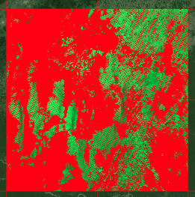
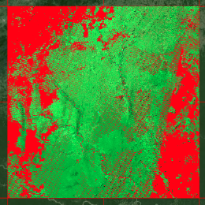
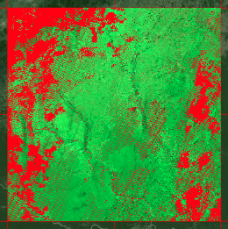
Custom Mosaic Tool
Product: Landsat 7
Region: Southern Colombia
Output: RGB Bands-7,4,2 (SWIR2, NIR, GREEN)
Filter (RED): = Cloud, Shadow, Water, No Data
January-June 2014
46 scenes
27% no data (mostly clouds)
January-February 2014
16 scenes
70% no data (mostly clouds)
January-April 2014
30 scenes
36% no data (mostly clouds)
<2 minutes run time
for each mosaic with
output in GEOTIFF

Slide 11
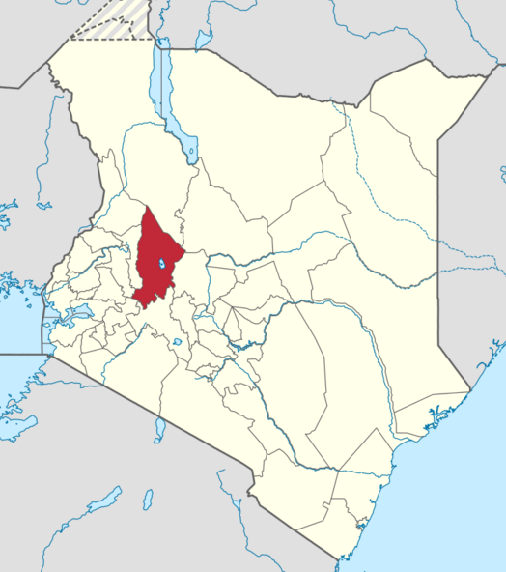
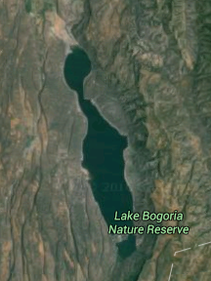
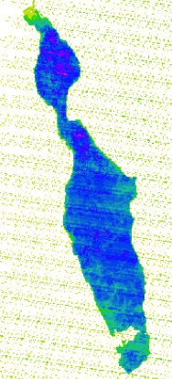
Water Detection Tool
Western Kenya, County of Baringo
Lake Bogoria Nature Preserve
Landsat-7, Year 2013
Water Detection Tool
Data Cube User Interface
* Counts water / non-water QA flags
* Able to see Landsat-7 “SLC banding”
* Blue = Often water, Yellow = Infrequent
* Able to assess drought/flood risk extent

Slide 12
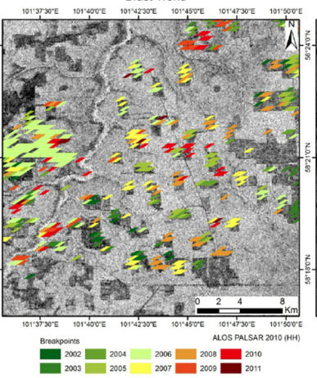
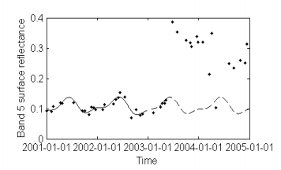
Change Detection Tools
Considering plans to implement a land Change Detection tool.
Breaks For Additive Seasonal and Trend (BFAST) is being used by FAO and Colombia for change detection analyses. An example of BFAST is below-right.
Rapid analyses of dense time series will utilize the power of the Data Cube. Developing a concept to plot pixel-level time series for any band or index to support change detection validation. Strongly desired by Colombia.

Slide 13
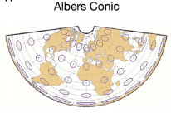
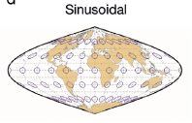
Grid Projections
Brian reviewed the latest draft of the OGC Open Geospatial Consortium (OGC) Discrete Global Grid System (DGGS) Core Standard – draft 9/30/15
Key requirements for DGGS include: global coverage, no overlap of cells, tessellations for changing spatial resolution, equal area cells, cell reference is the centroid.
UTM Projection: Universal Transverse Mercator (UTM) used for Landsat, MODIS Level-3 CMG products, and Sentinel-2. Conformal map projections preserve angles and approximate shapes but distort distance and area. Not a valid DGGS.
Albers Projection: Equal area conic projection. Used for Landsat WELD products and planned for USGS CONUS Data Cube. Although scale and shape are not preserved, distortion is minimal between the standard parallels (typically 20-deg and 50-deg latitudes).
Sinusoidal Projection: Equal area projection is a pseudocylindrical map projection. Used by some MODIS products. Distortion is lowest throughout the region of the map close to those lines (equator and prime meridian).
Lambert Azimuthal Projection: Equal area projection is a mapping from a sphere to a disk. Commonly used as a map projection in cartography. Do not know any space data usage.

Slide 14

Analysis Ready Data (ARD)
The Data Cube vision depends on CEOS Space Agencies systematically supplying analysis-ready data (ARD) products that are easily ingested into Data Cubes with little country effort.
To date, such systematic ARD is available for Landsat, but not for the core Sentinel missions. How do we move toward systematic ARD provisions?
The SEO has investigated Sentinel-1A processing and found there are too many options and details for standard users. We are seeking a single script that will create standard ARD products for users, rather than a user interface. Google Earth Engine just announced they are processing Ground Range Detection (GRD) scenes. Should we take the same approach for CEOS Data Cubes?
The SEO has also investigated Sentinel-2A processing. Atmospheric correction algorithms do not appear to be decided (Germany or France). USGS would like the processing to be similar to Landsat for synergy of datasets. Amazon Web Services (AWS) is now hosting the data on S3. What do we do about SR products?

Slide 15
CEOS Ad Hoc Working Group for GEOGLAM
GEOGLAM is a community of agriculture data users with an intent to improve coordination among many activities.
The CEOS Ad Hoc Working Group for GEOGLAM aims to coordinate and organize data requirements and data access.
Coordinating EO data for R&D including cloud-based data services tools for JECAM (starting in 2016) and Asia-RiCE (ending in 2016).
Adding features to the COVE tool to support systems analyses for archive assessments of past agriculture data. Improved baseline crop masks and calendars with 3-5 year updates.
Evaluating current, specific data needs & user readiness via survey.
Facilitating access to rapidly-processed archival data
Confronting data utilization barriers, e.g. by promoting ARD and Data Cube testing
Future transition of Ad Hoc Team to LSI-VC with GEOGLAM Secretariat presence in LSI-VC. Several years away ...
Notes:
Expand this chart to 2-3 slides. A suggestion is to expand the long-term data requirements bullet (both EO and high level(analysis ready) data products, including commercial (add Pleiades), include survey, include historical/baseline data, include national acquisitions, Access (include COVE apps, include cloud study, include Datacube, include archive access)

Slide 16
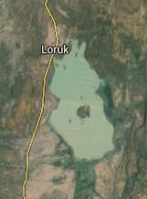
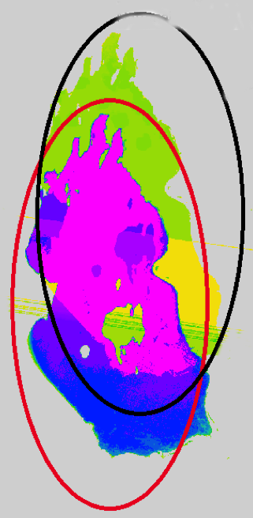
Spatial Alignment Issue
Western Kenya, County of Baringo
Lake Baringo National Park
Landsat-7, Year 2000
“Shadowing” effect is caused by pixel misalignment in Landsat SR product
* Results from the Water Detection Tool using the Kenya Data Cube
* Blue = Often water, Yellow/Green = Infrequent water
* This issue is still under investigation

Slide 17
Landsat “Collections”
At the January 2016 Landsat Science Team Meeting, USGS presented plans for new “collections” in the Landsat archive. Tier-1 collections will meet requirements of geodetic accuracy (<11.9 meters, ~1/3 pixel, RMS georectification error) to allow time series stacking.
This approach should reduce issues with spatial alignment of data in Data Cubes.
Landsat 4-7 will begin moving to “collections” in May 2016. L8 will not get started until October 2016 due to delays caused by the TIRS encoder anomaly.
Reviewed 47826 scenes over Colombia and 17376 scenes over Kenya from Landsat 5/7/8 to determine whether the georegistration was <11.9 meters.
~95% of the scenes met the <11.9 meter georegistration threshold. There is a loss of 1670 scenes for Colombia and 336 scenes for Kenya. Many of these were in the Data Cube prototypes, so reingestion is required to remove those scenes.
There were a large number of unprocessed (PR) files in the archive. 15035 for Colombia and 2071 for Kenya. We will ask USGS to process those scenes.

