Slide 1

Session 2: CEOS Analysis Ready Data for Land (10:50 – 11:00)
Committee on Earth Observation Satellites
Geoscience Australia
LSI-VC / SDCG / GEOGLAM Joint Meeting
JRC, Ispra
6th September 2018

Slide 2
Presentation Outline
Overall CARD4L Status Report
  Background
  CARD4L Framework
  Assessment process
  PFS Future Steps

Slide 3
CEOS ARD for Land - Background
LSI-VC served as the forum for developing the CEOS Analysis-Ready Data definition (now known as CARD4L – CEOS Analysis-Ready Data for Land)
The CARD4L definition and the overall framework were endorsed by the CEOS Plenary in 2016
CARD4L underpins a large amount of the future data architectures work being progressed within CEOS
The purpose of CARD4L is to allow many users to more rapidly use data. This also allows space agencies to maximise the potential of their data.

Slide 4
CEOS ARD for Land - Definition
CEOS Analysis Ready Data for Land (CARD4L) definition:
  CARD4L are satellite data that have been processed to a minimum set of requirements and organized into a form that allows immediate analysis with a minimum of additional user effort, and, interoperability both through time and with other datasets
CARD4L is a framework for establishing ‘minimum requirements’ for products that:
  Are ready for ‘immediate analysis’
  Require minimal additional user effort to prepare
  Interoperable with other CARD4L datasets

Slide 5
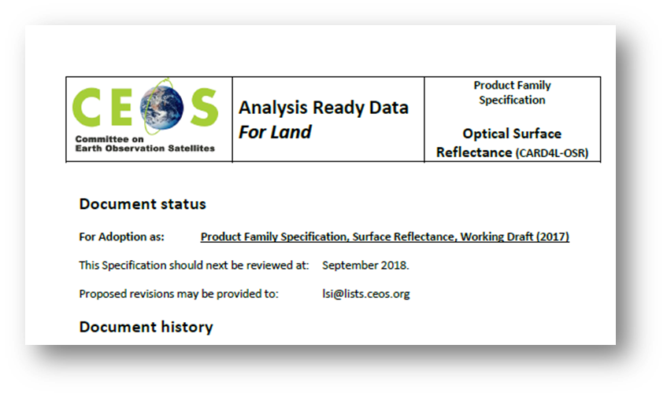
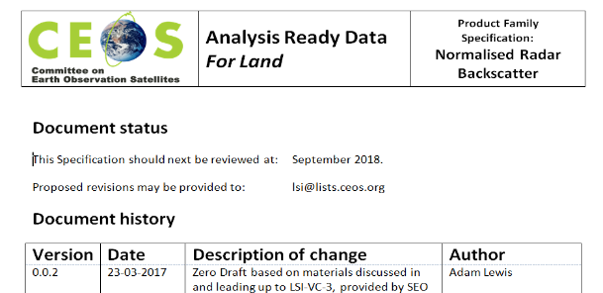
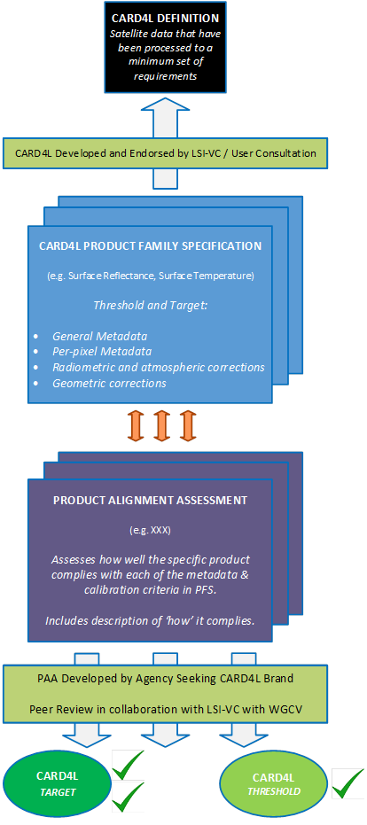



CEOS ARD for Land - Framework
WGCV’s Role at the CARD4L
Product Alignment Assessment
Definition of CARD4L
Current (Surface Reflectance, Land Surface Temperature and Radar Backscatter)
Under development (Polarimetric covariance, Polarimetric decomposition, INSAR LOS, INSAR Coherence, Geocoded SLC)
Data provider expresses
interest to LSI-VC for
product review
LSIVC POC sends
requests to WGCV POC
WGCV POC puts Data
Provider into contact with WGCV evaluator
Product Family Specs
WGCV interacts with Data
Provider on their
documentation
Providers
Self-assessment
Product Alignment Assessment
LSI-VC POC informed
by WGCV POC of vote
outcome
Peer review
CARD4L Acceptance
Review Panel provides
recommendation to WGCV
for vote
Summary of Data Provider’s
documentation provided to
WGCV CARD4L Acceptance
Review Panel
CARD4L Stamp

Slide 6
CEOS ARD for Land - Framework
Definition of CARD4L
Current (Surface Reflectance, Land Surface Temperature and Radar Backscatter)
Under development (Polarimetric covariance, Polarimetric decomposition, INSAR LOS, INSAR Coherence, Geocoded SLC)
Product Family Specs
Providers
Self-assessment
Product Alignment Assessment
Peer review
CARD4L Stamp

Slide 7
Product Family Specifications – Current Status
Initial Product Family Specifications
  Surface Reflectance:
    PFS doc v3.0 currently being validated/tested by ESA (S2) & USGS (Landsat) (link)
  Surface Temperature:
    LBT PFS doc v3.1 was/has been validated by ESA (S3) & USGS (Landsat) (link)
    LST PFS doc V0.1 circulated (16/08) (link)
  Radar Backscatter:
    PFS doc v3.2 (latest) circulated to LSIVC list (22/08) (link)
    Upcoming validation by JAXA (ALOS mosaics)

Slide 8
Product Family Specifications – Current Status
Under development PFSs for Radar products (link)
  Polarimetric covariance – Francois Charbonneau (NRCan/RNCan)
  Polarimetric decomposition – Marco Lavalle/Bruce Chapman (JPL), Takeo Tadono/Ake Rosenquvist (JAXA) and Zheng-Shu Zhou (CSIRO)
  INSAR LOS – Medhavy Thankappan (Geoscience Australia)
  INSAR Coherence – Ben Lewis (Geoscience Australia) and Nuno Miranda (ESA)
  Geocoded SLC – Bruce Chapman (JPL)
Oct/Nov 2018
Drafts open for review
Dec 2018
Jul 2018
SAR ARD definition Team created
Jun 2018
Additional PFS proposed
Aug 2018
1st PFS Drafts received
Sep 2018
PFS Drafts presented at LSIVC6
First versions finalized
SAR ARD definition Team disbanded
Feb 2019
Final versions presented/LSIVC7
Feb 2018
SAR ARD definition Team proposed/LSIVC5
Jan 2019

Slide 9
PFS Future Steps
Feedback from WGCV
PFSs/Month
Sep 2018
Oct 2018
Dec 2018
Jan 2019
Feb 2019
Onwards
Surface Reflectance
Self-assessment process/ESA (S2)/USGS (Landsat)
Surface Temperature
Discuss updates/LSIVC6
Radar Backscatter
Present latest version at LSIVC6
Self-assessment process (JAXA)
Additional Radar PFS
Drafts presented at LSIVC6
Drafts open for review
First versions finalized
SAR ARD definition Team disbanded
Nov 2018
Self-assessment process (USGS)
Feedback from ESA/USGS/JAXA/GA
self-assessment incorporated
Documents circulated to the LSIVC list
Present refined SR/ST/RB versions at LSIVC7
for endorsement/present additional RADAR PFS
Incorporate user survey
and Planets workshop Feedback
PFSs Stability
Updates will be carried out as necessary but no more than once a year
Notes:
Establish a maintenance plan

Slide 10
Thank you!

