Slide 1
USGS Landsat Overview
6 September 2018
Jenn Lacey, USGS
Observing Systems Branch Chief
jlacey@usgs.gov, +1 (605) 594-2505
Steve Labahn, USGS
Landsat International Ground Station Network Manager
Committee on Earth Observation Satellites (CEOS) Project Manager
LSDS Science Information System (LSIS) Project Manager
labahn@usgs.gov, +1 (605) 594-2701

Slide 2
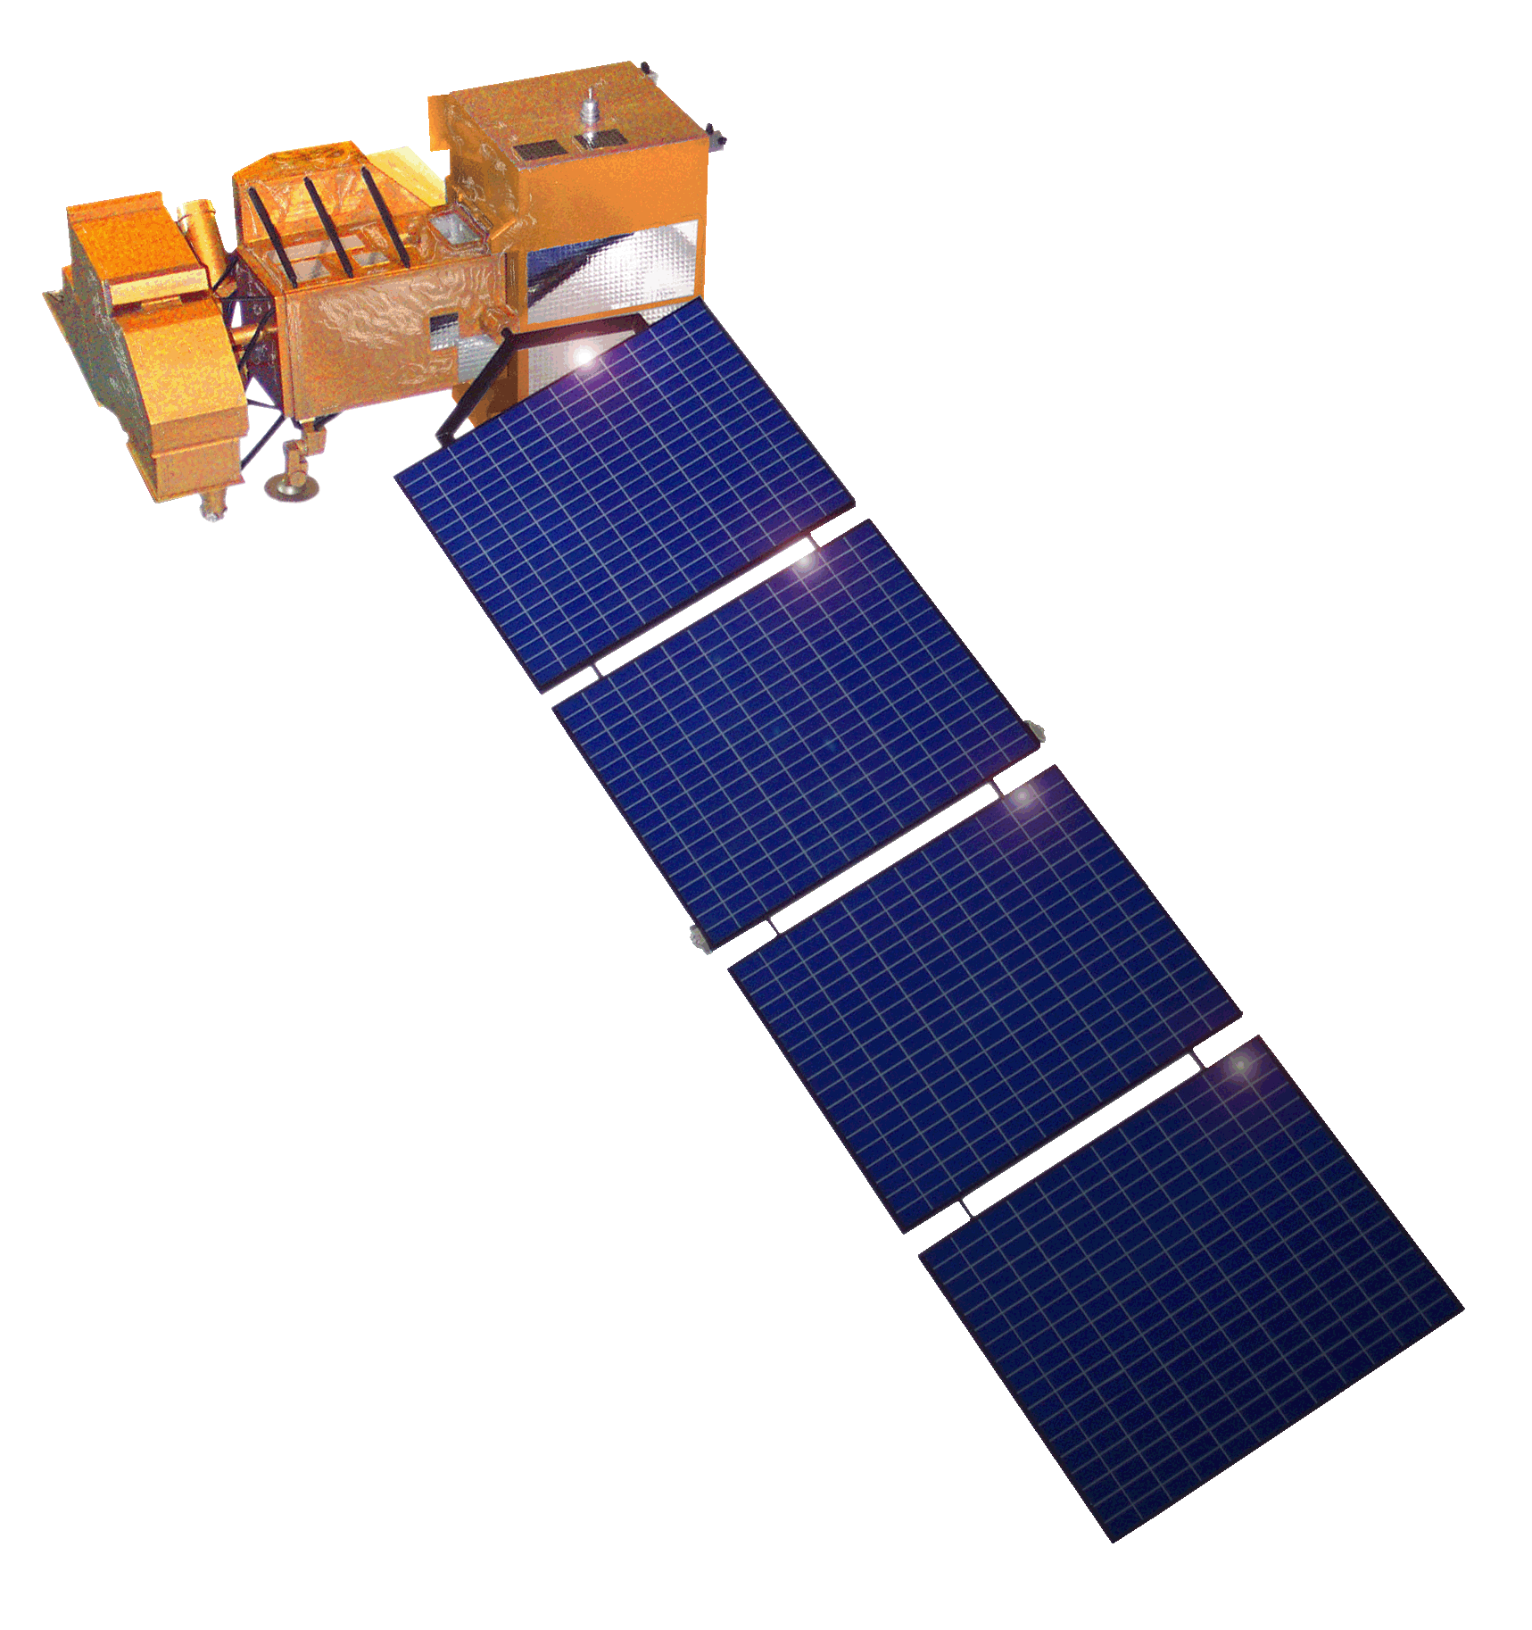
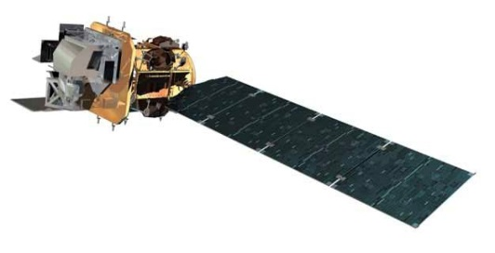
Landsat Operational Mission Status
Landsat 7
Acquiring ~470 scenes/day through a continental acquisition strategy
On-orbit observatory performance continues to be outstanding
13 active international ground stations
Finalized end of mission planning to extend L7 science operations to overlap with L9
  Assumes December 2020 L9 launch readiness date
  Science mission life-cycle potential extends to July 2021
  Decommissioning will follow L9 launch or end of science mission operations, whichever comes first
Landsat 8
Acquiring ~740 scenes/day with continental acquisition strategy
On-orbit observatory performance continues to be outstanding
21 active international ground stations and growing
Enhanced Landsat Ground Network (LGN) robustness and reliability through use of international partnerships
Flight Operations now performed under USGS contract for combined mission operation and Landsat Multi-satellite Operations Center (LMOC) development
Notes:
Final

Slide 3
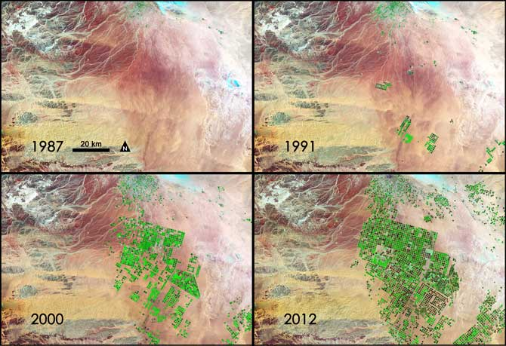
Landsat 9 Mission Overview
  Mission Objectives
Provide continuity in multi-decadal Landsat land surface observations to study, predict, and understand the consequences of land surface dynamics
  Core Component of Sustainable Land Imaging program
  Mission Parameters
Single Satellite, Mission Category 1, Risk Class B
  5-year design life after on-orbit checkout
  At least 10 years of consumables
Sun-synchronous orbit, 705 km at equator, 98°inclination
16-day global land revisit
Partnership: NASA & USGS
  NASA: Flight segment & checkout
  USGS: Ground system and operations
Category 3 Launch Vehicle
Launch: Management Agreement - December 2020
Agency Baseline Commitment – November 2021
  Mission Team
NASA Goddard Space Flight Center (GSFC)
USGS Earth Resources Observation & Science (EROS) Center
NASA Kennedy Space Center (KSC)
Instruments
Operational Land Imager 2 (OLI-2; Ball Aerospace)
    Reflective-band push-broom imager (15-30m res)
    9 spectral bands at 15 - 30m resolution
    Retrieves data on surface properties, land cover, and vegetation condition
Thermal Infrared Sensor 2 (TIRS-2; NASA GSFC)
  Thermal infrared (TIR) push-broom imager
  2 TIR bands at 100m resolution
  Retrieves surface temperature, supporting agricultural and climate applications, including monitoring evapotranspiration
Spacecraft (S/C) & Observatory Integration & Test (I&T)
Northrop Grumman Innovation Systems (NGIS), formerly Orbital ATK (OA)
Launch Services
United Launch Alliance (ULA) Atlas V 401
Mission Operations Center (MOC) and Mission Operations
General Dynamics Mission Systems (GDMS)
Increase in pivot irrigation in Saudi Arabia from 1987 to 2012 as recorded by Landsat. The increase in irrigated land correlates with declining groundwater levels measured from GRACE (courtesy M. Rodell, GSFC)

Slide 4
Landsat 9 Status
Joint development between NASA and USGS (same as Landsat 8)
  NASA responsible for space and launch segment, mission success through handover
  USGS responsible for ground segment and on-orbit operations after handover
Landsat 9 is a rebuild of Landsat 8 with targeted upgrades
  Upgrade to fully Class B (TIRS was a Class C instrument on Landsat 8)
  TIRS-2 address on-orbit issues with Landsat 8 TIRS (stray light and position encoder)
  Ground System upgraded to multi-mission capabilities (Landsat 9 development takes priority)
Overall mission making excellent progress
  Launch vehicle contract awarded in October 2017 to United Launch Alliance (ULA)
  Key Decision Point C was on December 6, 2017
  Ground System Critical Design Review planned in September 2018
  OLI-2 and TIRS-2 instruments in fabrication and on-track for mid-2019 delivery to the spacecraft
On-track for launch in December 2020 with transition-to-operations in March 2021

Slide 5
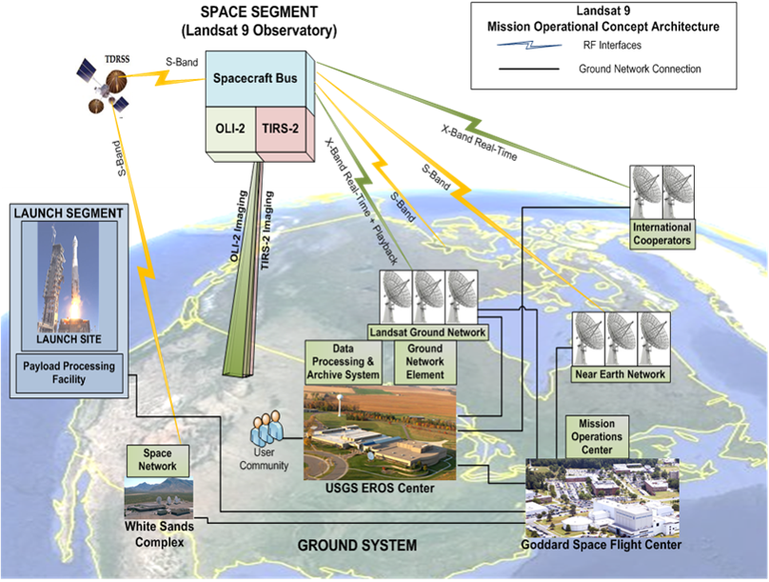
Landsat 9 Mission Architecture

Slide 6
Landsat 9 Ground System Architecture

Slide 7
Sustainable Land Imaging Architecture Study Team
NASA/DOI/USGS SLI AST will execute a study for the design and implementation approach of a spaceborne system to provide global, continuous Landsat-quality multispectral and thermal infrared measurements for approximately a ten-year period starting in 2026
Oversight provided by the NASA Associate Administrator for Science and the DOI Assistant Secretary for Water and Science
AST-2019 will inform NASA and DOI/USGS acquisition strategies on options for both the space and ground segments, potential contributions from international partners and commercial Earth Observation data suppliers, and business model alternatives
  Address large increase in the number of commercial and international providers of Earth observation data in the previous few years
Ground System a major driver for AST-2019 (and USGS NLI)

Slide 8
Active Landsat Ground Stations https://landsat.usgs.gov/igs-network
13 Active L7 Stations 21 Active L8 Stations

Slide 9
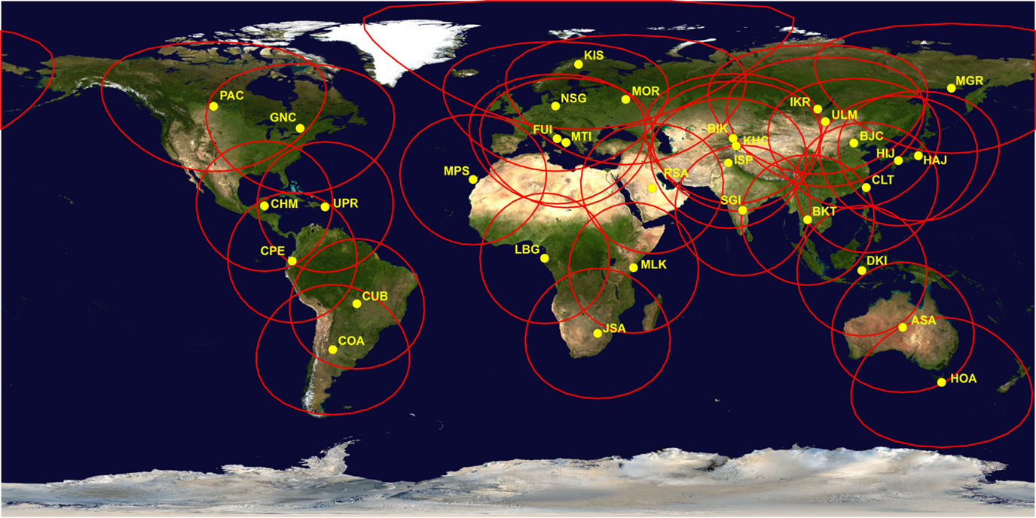
Landsat Global Archive Consolidation (LGAC)
Historical Landsat Ground Stations
* Does not include Landsat Ground Network (LGN) stations

Slide 11
Landsat Collection 1 Status
Landsat Collection 1 processing complete
  Landsat 1-5 MSS processing now complete
    Released to the public on May 15th
    Existing Pre-Collection MSS data remains available for public download through October 1st
  TM No-PCD processing is complete
    Processing completed in mid-March
    No collective “release” for these scenes; trickled into existing Collection 1 as processed
Collection 1 processing now limited to Landsat 7 and 8 forward processing, new LGAC data, and is proceeding nominally

Slide 12
Landsat Collection 2 Products
Level-1 Products
  Minor structural changes to preserve current Level-1 offerings
  Angle bands (solar and sensor viewing zenith and azimuth) to assist users who want to generate their own TOA reflectance and brightness temperature bands
  Minor metadata enhancements and consistency changes
  Updated geometric registration base (either GRI or L8/OLI-based)
  Improvements to the precision modeling process to enable more Level 1TP products
  Algorithm to detect IC shutter intrusion events and flag them in the metadata
  Minor bug fixes and Cal/Val enhancements

Slide 13
Landsat Collection 2 Products
Level-2 Products
  Processed from all Level-1 inputs that meet SZA constraint and have auxiliary data
  LEDAPS (L4-7) and LaSRC (L8) algorithms used to provide surface reflectance data
  Auxiliary bands associated with surface temperature processing to be included
    Emissivity, emissivity standard deviation, atmospheric transmittance, upwelled radiance, downwelled radiance, thermal radiance, and cloud distance
  Updated Quality Band specification for both Level-1 and Level-2 products
  Still finalizing:
    Level-2 product metadata
    Surface reflectance and surface temperature product latency
    Whether to include both bands 6L and 6H for L7 (surface temperature)
    L8/L9 split-window option and alternative auxiliary data sources (surface temperature)
    Registration base – suitability of L8 / OLI ground control if GRI is unavailable

Slide 14
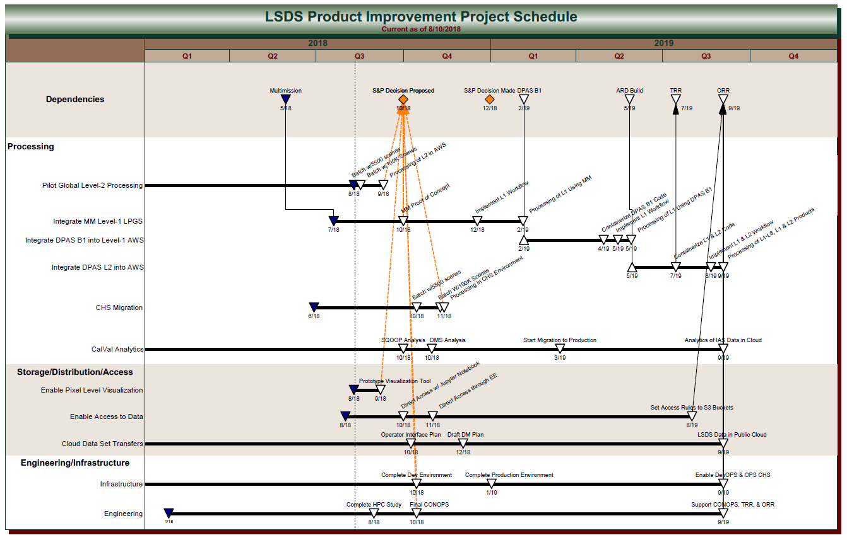
Landsat Collection 2 Planning

Slide 15
Questions?

