Slide 1
ESA update
for CEOS LSI-VC
Susanne Mecklenburg
European Space Agency
Thanks to ESA colleagues for contributions: S.Hosford, F.Gascon, P.Potin, B.Rosich, N.Miranda, A.Vollrath
LSI-VC-6, JRC, 4-7 September 2018

Slide 2
Focus on
Update on Copernicus Space Segment
ESA’s contribution to FDA activities
  Copernicus Data Access
  Data and Information Access Services (DIAS)
ESA’s contribution to ARD activities
  Current and future data products over land
  Current activities
  Future developments
MRI activities → see session 6 / Friday am

Slide 3
Copernicus Space Segment – update

Slide 4

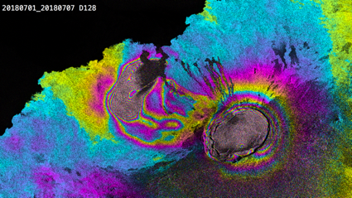
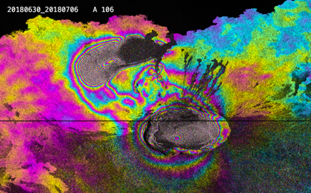
Sentinel-1 Mission Status
Sierra Negra and Fernandina
volcano eruption, Galapagos
Sentinel-1A and Sentinel-1B mission operations → nominal
The Sentinel-1 Yearly Mission Review successfully took place in May 2018
Sentinel-1 contribution to emergency activations continues to be high, for flood monitoring in particular
Many application results based on the use of Sentinel-1 data, both in the operational and scientific domains, were presented at:
  SeaSAR 2018, from 7 to 10 May at ESA-ESRIN
  EUSAR 2018, from 4 to 7 June 2018, in Aachen, Germany
  IGARSS 2018, from 23 to 27 July 2018 in Valencia, Spain.
… with, in particular, an important number of talks & posters based on the exploitation of the Sentinel-1 high coverage frequency and the availability of the related data time series.
Interferogram descending pass 01-07 July 2018
Interferogram ascending pass 30 Jun – 06 Jul 2018
Copyright: Contains modified Copernicus Sentinel data (2018) / University of Miami

Slide 5
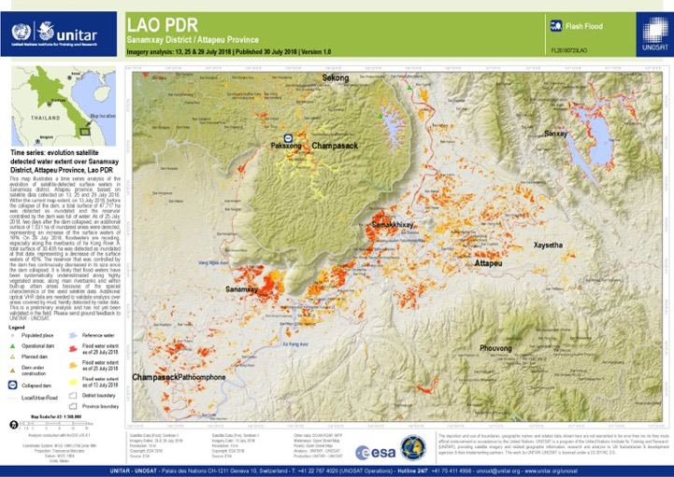
Sentinel-1 Mission Status
Support to Emergency Activations
Copernicus Emergency Management Service
Floods in Finland (May 2018)
International Charter Space & Major Disasters
Floods & dam collapse in Laos (July 2018)
Copernicus Emergency Management Service: Activation EMSR284
Authorized User: Finland|Government Situation Centre
Copyright: Contains modified Copernicus Sentinel data (2018) / processed by CEMS / e-geos
Copyright: Contains modified Copernicus Sentinel data (2018) / processed by UNITAR / UNOSAT

Slide 6

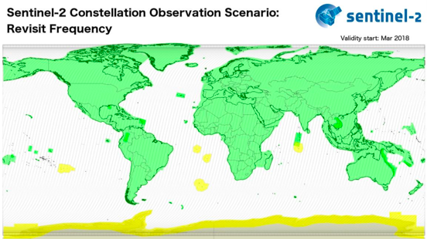
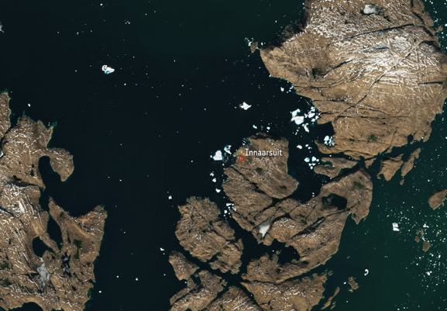
Sentinel-2 mission status
Sentinel-2A and Sentinel-2B mission operations → nominal
Performing global and systematic acquisitions (5-day revisit) since 17 February 2018
5 days
5 days
5 days
5 days
5 days
10 days
The “Sentinel-2 Constellation Mission Operations Review” successfully took place in June 2018
New core product (Level-2A surface reflectance) generated and distributed since 26 March 2018:
  Current Level-2A production covers the Euro-Mediterranean region (for both S-2A and S-2B)
  Start of Level-2A worldwide production during Q3 2018
Captured by Sentinel-2A on 9 July 2018: shows a huge iceberg perilously
close to the village of Innaarsuit on the west coast of Greenland.
Copyright: Contains modified Copernicus Sentinel data (2017/2018) / processed by ESA

Slide 7
Sentinel-2 mission status
Denmark scorched, impact of summer 2018 heatwave
Agricultural fields around the town of Slagelse in Zealand (DK)
Amsterdam
Copyright: Contains modified Copernicus Sentinel data (2017/2018) / processed by ESA

Slide 8



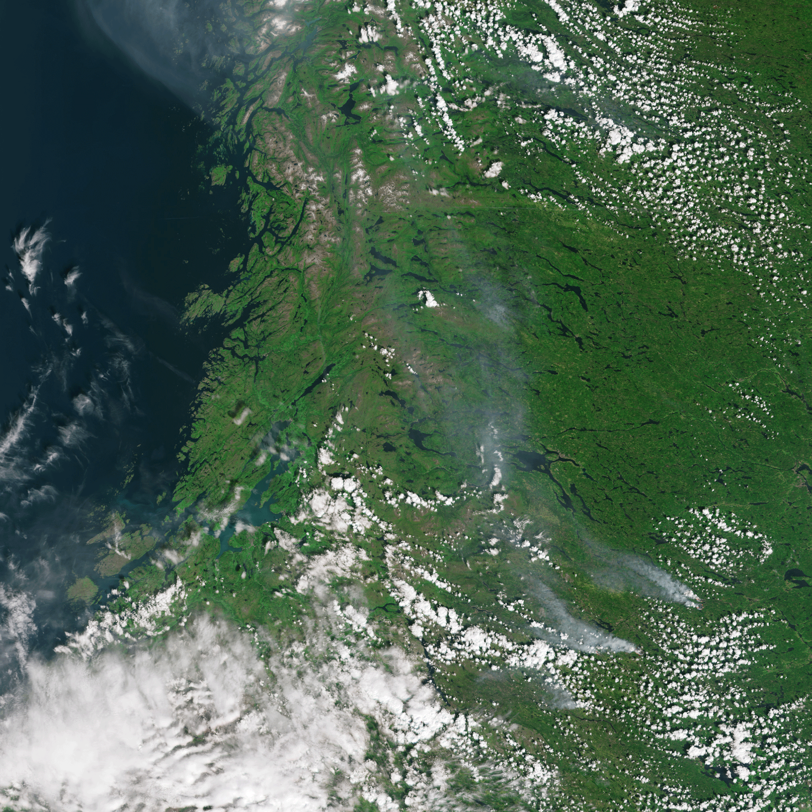
Sentinel-3 mission status
Sentinel-3A mission operations → nominal
All Level 1 and Level 2 Land and Marine core data product have been released
Definition and implementation of two new core data products (Aerosol Optical Depth and Fire Radiative Product) on-going; sample products expected in Q3 2018, with the official release planned shortly thereafter following a period of validation
Reprocessing campaigns ongoing for optical and altimetry data
Intense on ground validation activities on-going to ensure the best possible user acceptance of the S-3 products
Sentinel-3B currently in commissioning phase with routine operations expected to start beginning of 2019. The Tandem Phase and orbit phase shift to 140 degree between Sentinel-3A and Sentinel-3B is opening new applications areas
Fires in Sweden, 17 July 2018
Wide view with Sentinel-3 OLCI, zoom with Sentinel-2

Slide 9
Sentinel-3 mission status
Impact of July 2018 heatwave
Sentinel-3 OLCI images
Copyright: Contains modified Copernicus Sentinel data (2018) / processed by ESA

Slide 10
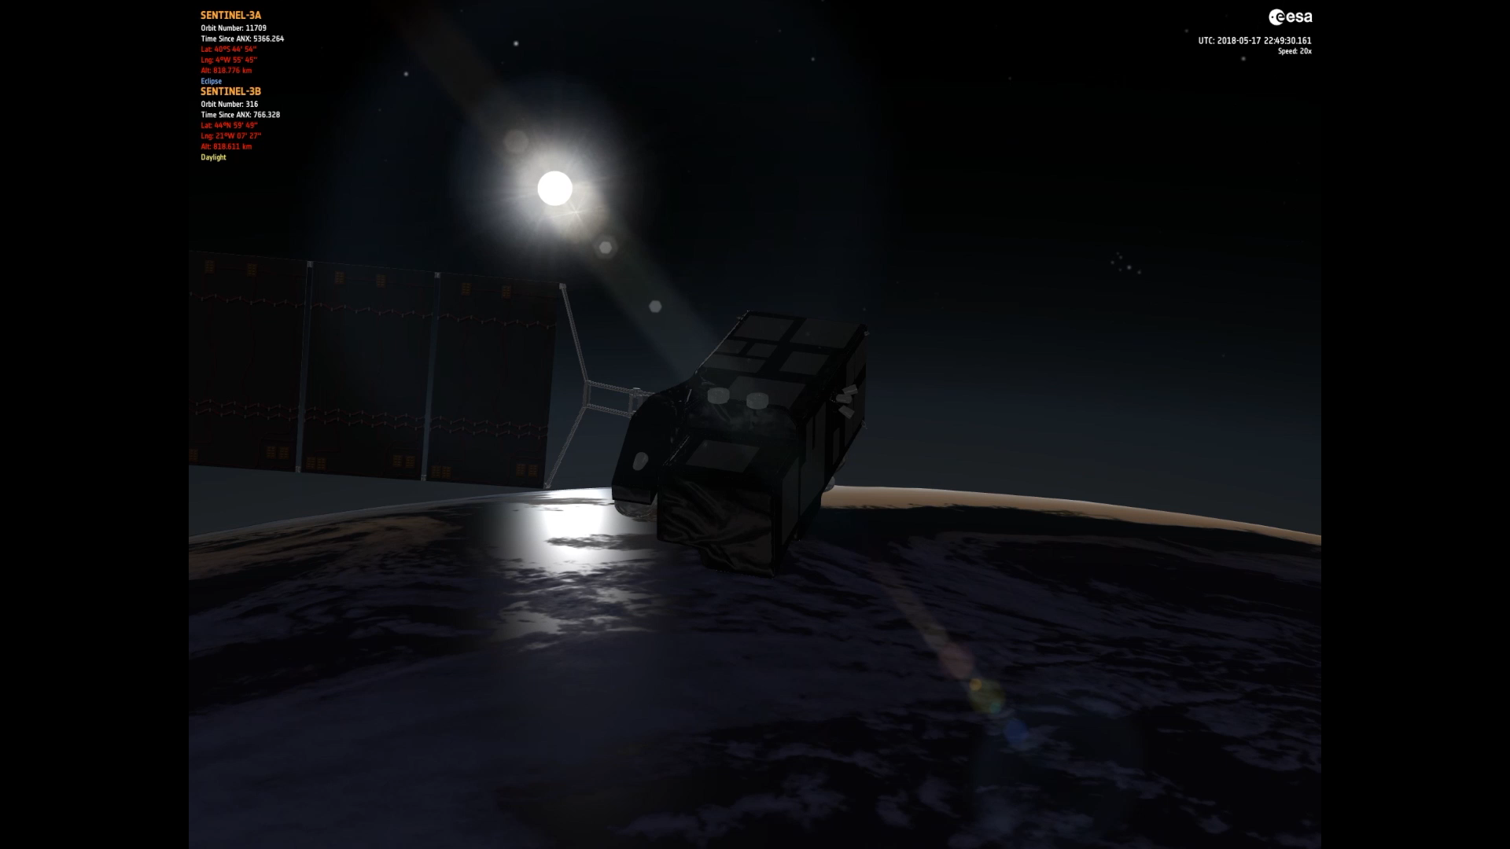
Tandem Phase | S3A and S3B 30 sec/ ~ 210km apart
Differences in performance of payload instruments will exist and need to be understood
It is essential that relative (absolute) bias between S3A/B/C/D instruments are known properly for Climate Data Record construction
GCOS Satellite Climate Monitoring Principles (GCMP) requests a tandem flight for all satellite instruments
30 sec/~ 210 km: Minimise uncertainty due to geophysical ocean space and time variability and atmospheric space and time variability

Slide 11
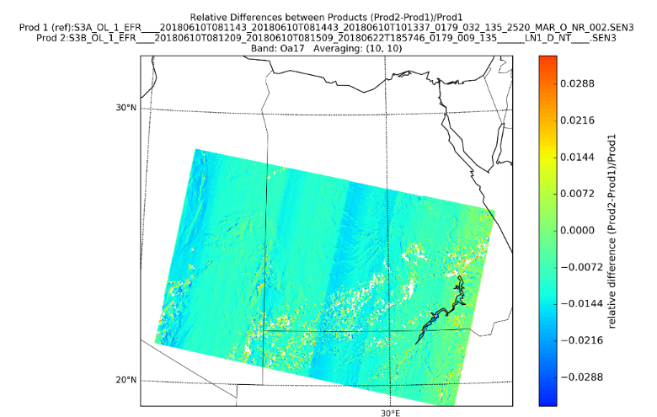
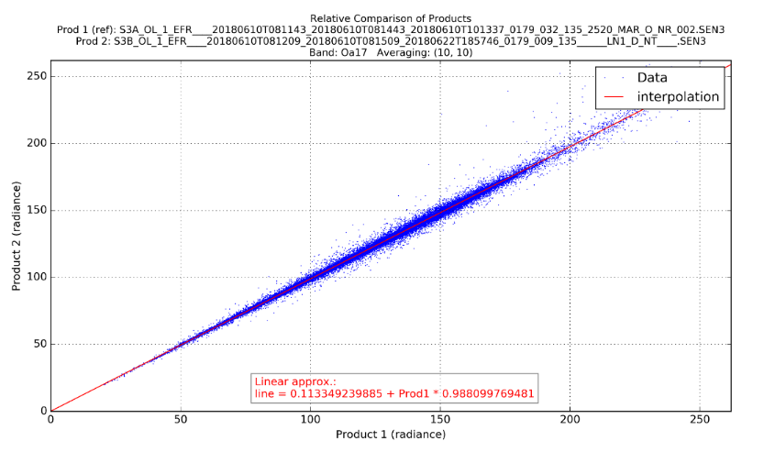
Tandem Phase – first results - OLCI
Products:
  S3A_OL_1_EFR____20180610T081143_20180610T081443_20180610T101337_0179_032_135_2520_MAR_O_NR_002.SEN3 S3B_OL_1_EFR____20180610T081209_20180610T081509_20180622T185746_0179_009_135______LN1_D_NT____.SEN3
Band: Oa17
Comparison of OLCI A and B data allows seem to indicate that the radiometry of the 2 instruments is aligned within few %.

Slide 12
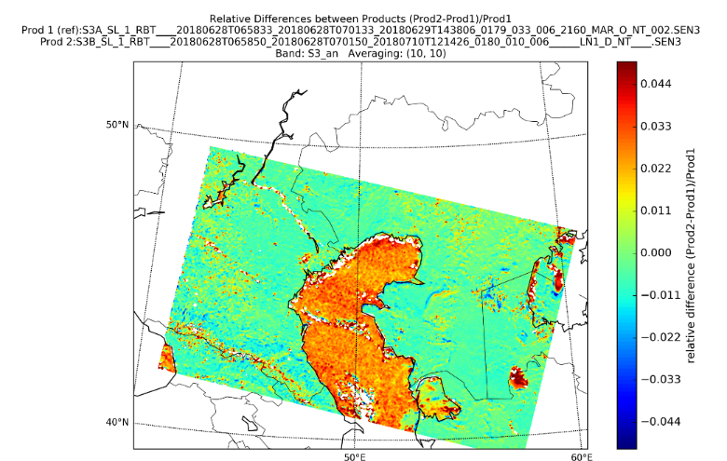
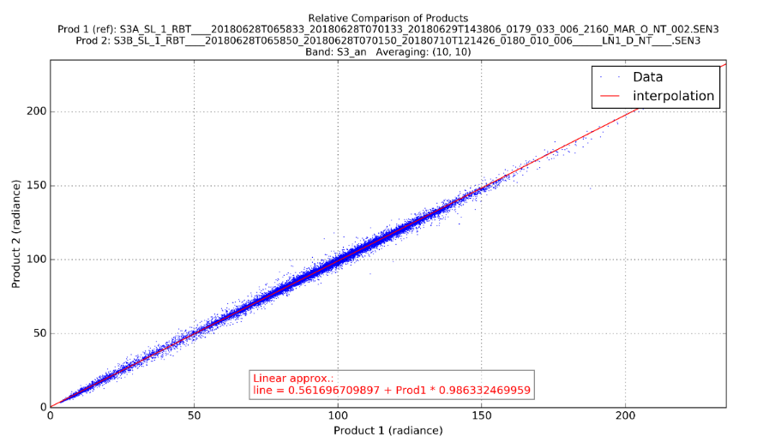
Tandem Phase – first results SLSTR
Products:
  S3A_SL_1_RBT____20180628T065833_20180628T070133_20180629T143806_0179_033_006_2160_MAR_O_NT_002.SEN3S3B_SL_1_RBT____20180628T065850_20180628T070150_20180710T121426_0180_010_006______LN1_D_NT____.SEN3
Band: S3an
Caspian sea
Comparison of SLSTR data seem to indicate that the sensors are aligned within few %.

Slide 13
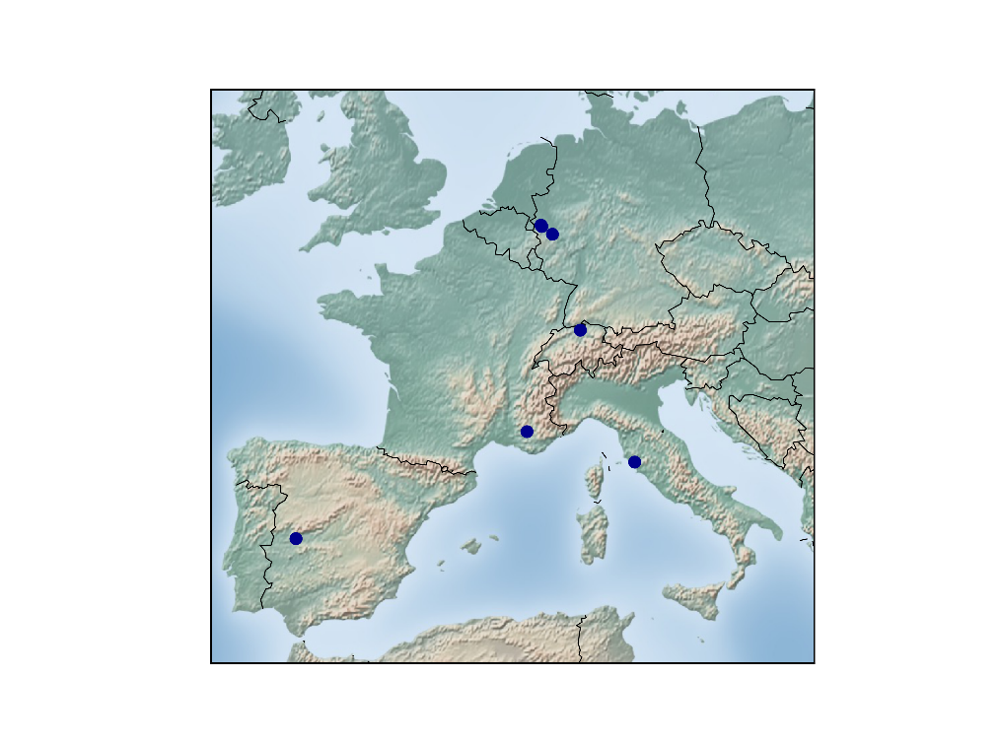
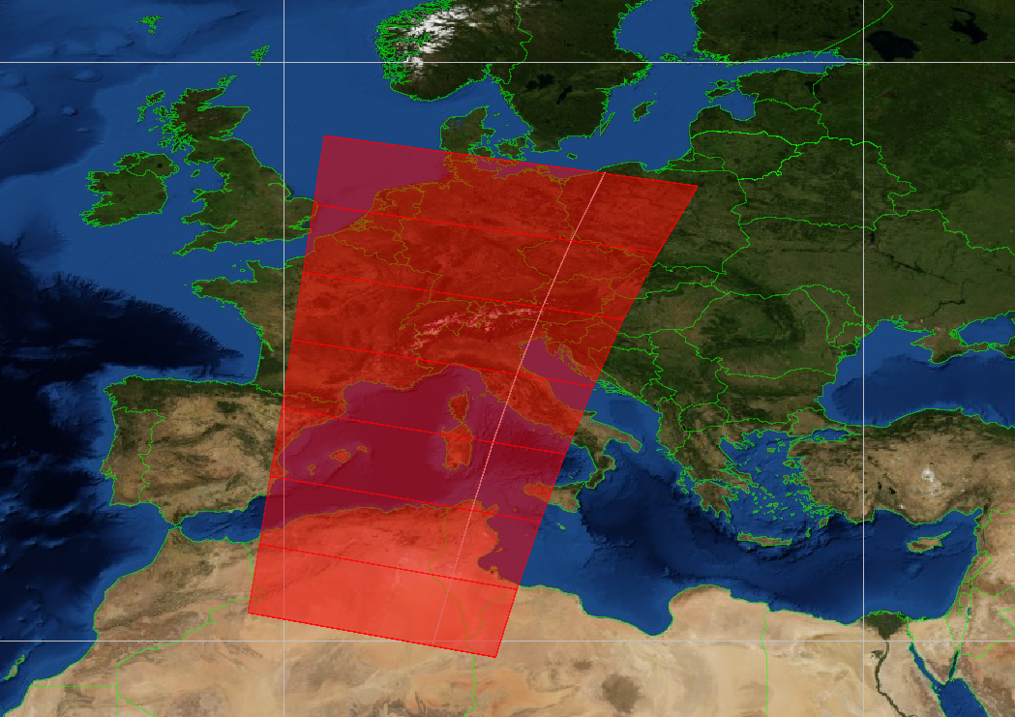
Tandem Phase and FLEX
General Objectives for a campaign in 2018
Further develop FLEX mission concept
Perform S2/S3 calibration/validation during Phase E1 of S3B (Launch April 2018)
Explore Future Mission concepts for High Priority Copernicus Missions (HPCM)
By Means of:
Sentinel-3 B to be reprogrammed for single orbits to have 44 additional channels to support campaign
Collecting airborne hyperspectral data over representative monitoring sites, concurrent with ground-based measurements for time intervals compatible with spaceborne missions (5-10 days) over a period of 2 -3 month during the growing season 2018
Goal:
    Documenting the information content of multi-temporal
    Imagery for the mapping of agricultural, forest, and coastal conditions.
Test Sites in Europe
Reprogramed S3B

Slide 14
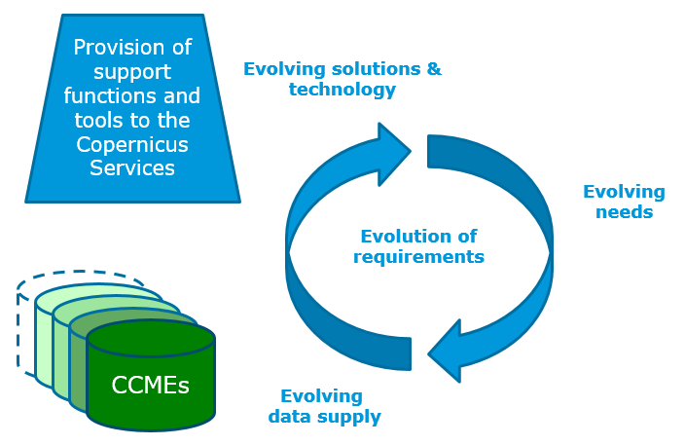
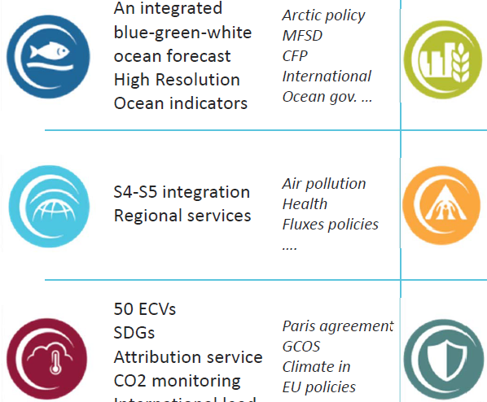
Copernicus Contributing Missions
The Contributing Missions are a key element of the Copernicus Space Component in synergy with the Sentinels.
Preparatory activities for the long-term evolution of the relations with the commercial Contributing Missions
→ Joint EC-ESA working group in place to elaborate a roadmap proposal:
  working along 3 streams : licensing and procurement models, improved operational concepts for data delivery, gap analysis
  completing its task by mid-2019
  based on a comprehensive consultation with Industry and MS
“Supply-Demand-Technology” cross-stimuli
Copernicus Services specific needs and common requirements
Notes:
2020+ revise the current portfolio for contributing missions based on evolving users requirements also considering evolving IT/data access requirements and other legal forms as PPP

Slide 15
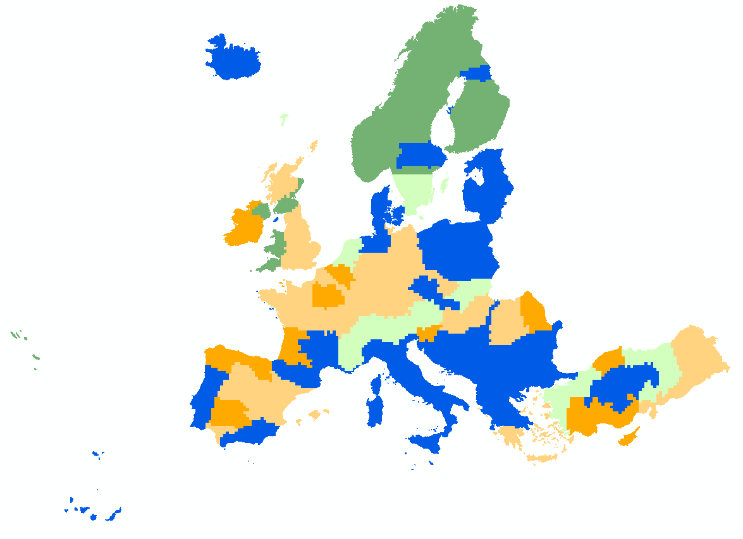

Copernicus Contributing Missions
VHR2018 formally kick-off with acquisitions ongoing :
Consortium : Airbus Defense & Space FR, Deimos Imaging, Planet, Space4environment and IGN with primary and back up missions and risk mitigation acquisition plans.
ITT for Copernicus global DEM will close on 18 Sept. 2018
ITT for Copernicus Contributing Missions access support functions and platform (PRISM) (i.e. CDS new contract) will close on 26 Sept. 2018
Regular progress meetings with all Copernicus Services
Meeting with Emergency Service and related Contributing Missions in Oct. 2018 to introduce the concept of Pro-Active Tasking and Parallel Tasking, in the framework of the Multi-Scheme Data Supply concept.
Pilot tests of the CCMs Data Access Platforms for the Emergency and Security Services will be initiated.
Very High Resolution VHR 2018
Data acquisition baseline

Slide 16
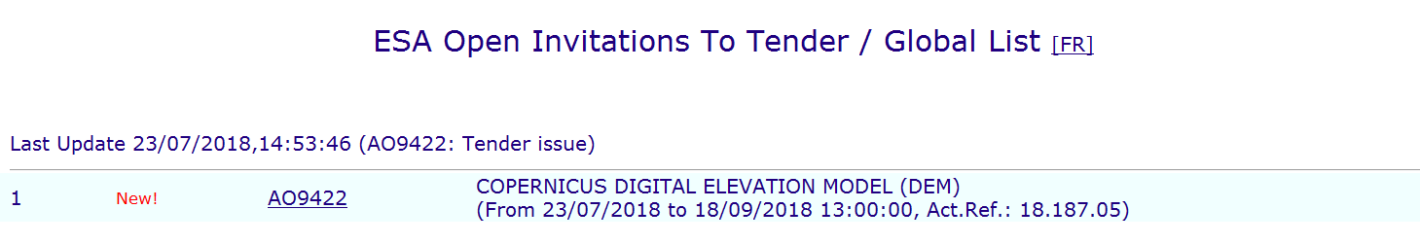
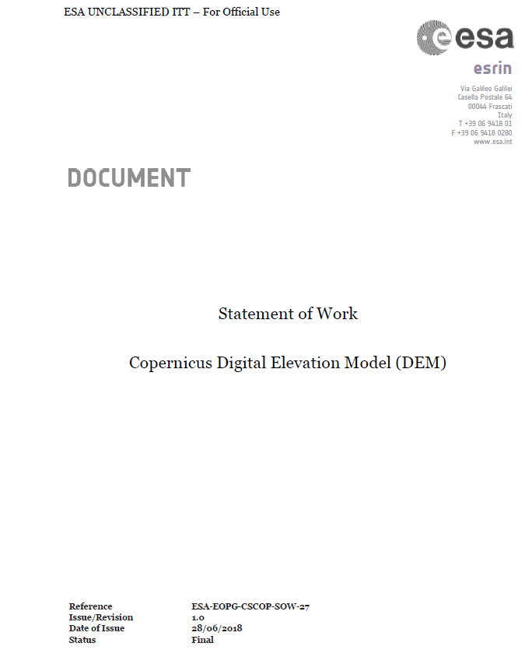
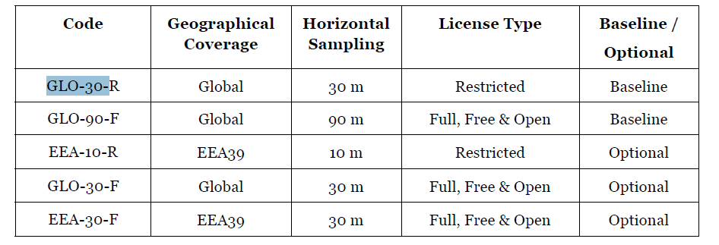
DEM Invitation to Tender
Table 1: Copernicus DEM instances. "Global" DEM instances shall cover all landmasses, while "EEA39" (European Environment Agency 39) shall cover all countries/regions indicated in Annex I. The Horizontal Sampling is understood as defined in Section 1.5.5. License types Restricted and Full, Free & Open are defined in Annex III. The DEM instances marked as "Baseline" will be part of the procured items undertaken at contract signature. For DEM instances marked as "Optional", the bidder shall mandatorily provide an offer but the Agency reserves the right to activate its purchase at any time before the closure of the contract.

Slide 17
Copernicus Space Component Evolution
  23 May 2018 => Copernicus 2.0 Long-Term Scenario workshop. Topics covered included:
    Primary observation requirements to be addressed by High Priority Candidate Missions (HPCMs)
    Relations with private initiatives
    Approach towards Sentinel operations (ESA/EUMETSAT)
    Gap analysis
  28 June 2018 => Joint PB-EO and Copernicus Committee CSC Copernicus evolution workshop meeting on the implementation of Copernicus 2.0 for the post-2020 period:
    MFF structure, priority and budget request as well as proposed Space Programme Regulation illustrated by COM
    CSC-4 Programme proposal for 2019 ESA Council at Ministerial level outlined by ESA
    Initial feedback provided by Member States

Slide 18
Copernicus Space Component Evolution
  December 2017 => ESA released the Invitation To Tenders for Copernicus Space Component Phases A/B1 of Potential Expansion Sentinels:
    Phase A/B1 of Anthropogenic CO2 Monitoring Mission
    Phase A/B1 of High Spatio-Temporal Resolution Land Surface Temperature (LST) Monitoring Mission
    Phase A/B1 of Polar Ice and Snow Topographic Mission
    Phase A/B1 of Passive Microwave Imaging Mission
    Phase A/B1 of HyperSpectral Imaging Mission
    Phase A/B1 L-Band SAR Mission
  Activities have started mid 2018.
Notes:
Revised Draft LTS including cost estimates and detailed planning well received by ESA’s Member States
Copernicus Space Component Phases A/B1 of Potential Expansion Sentinels cover preparatory activities for potential future Sentinel missions responding to new observation needs and priorities identified by users

Slide 19
ESA FDA activities - Data Access

Slide 20
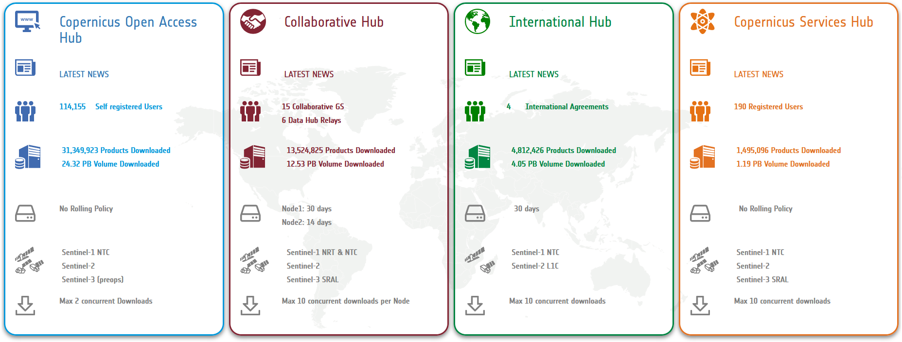
Sentinels Data Access at ESA - Configuration
4 Sentinel data access hubs operated by ESA
Statistics at end December 2017

Slide 21


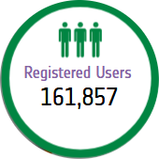


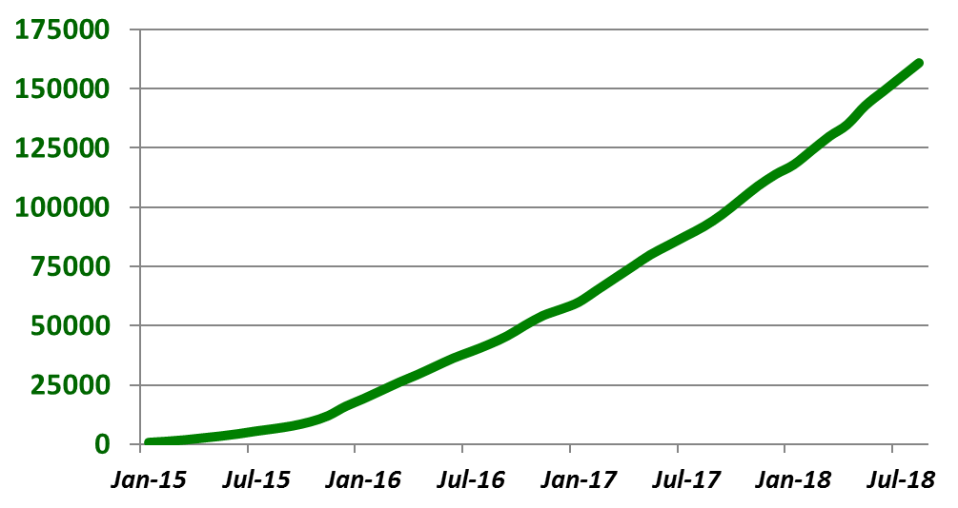


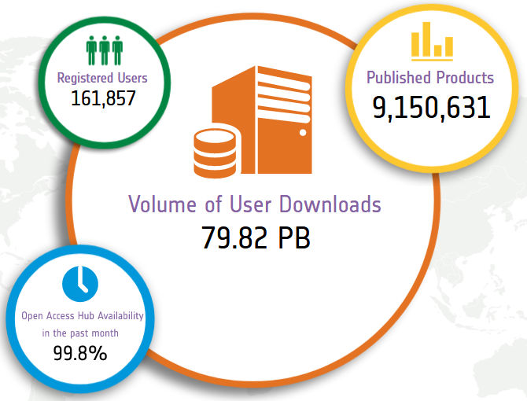
Evolution of registered users on Sentinel Open Access Hub
Number of registered users
Statistics at mid-August 2018

Slide 22
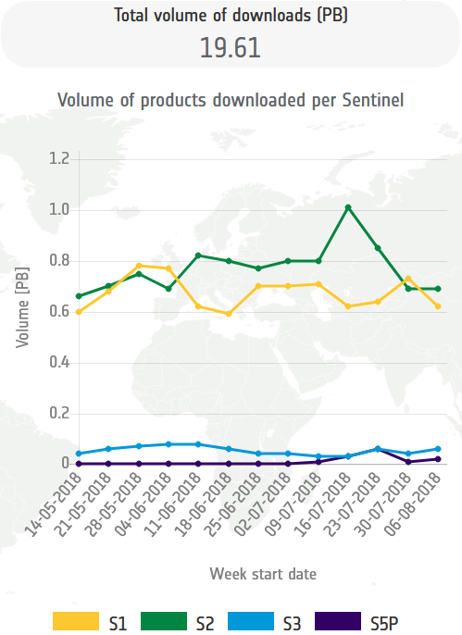
Sentinels Data Access – Open Access Hub
Total volume of data volume on ESA Open Access Hub during last 3 months
Statistics of ESA Open Access Hub do not include active users downloading Sentinel data through :
Eumetsat (Sentinel-3)
Partners within national collaborative ground segment (in Europe)
Partners within international ground segment (e.g. US or Australia)
20 PB downloaded in 3 months
Statistics of ESA Open Access Hub do not include active users using Sentinel data
(without downloading products)
through image visualisation and handling tools:
“EO Browser” (see next slide)
Statistics at mid-August 2018
Notes:
Even though the Open Access Hub operated by ESA is the principal collector of user interest for accessing Sentinel data, there are other entry points and services demonstrating the very high interest to Sentinel data and Copernicus activities.

Slide 23
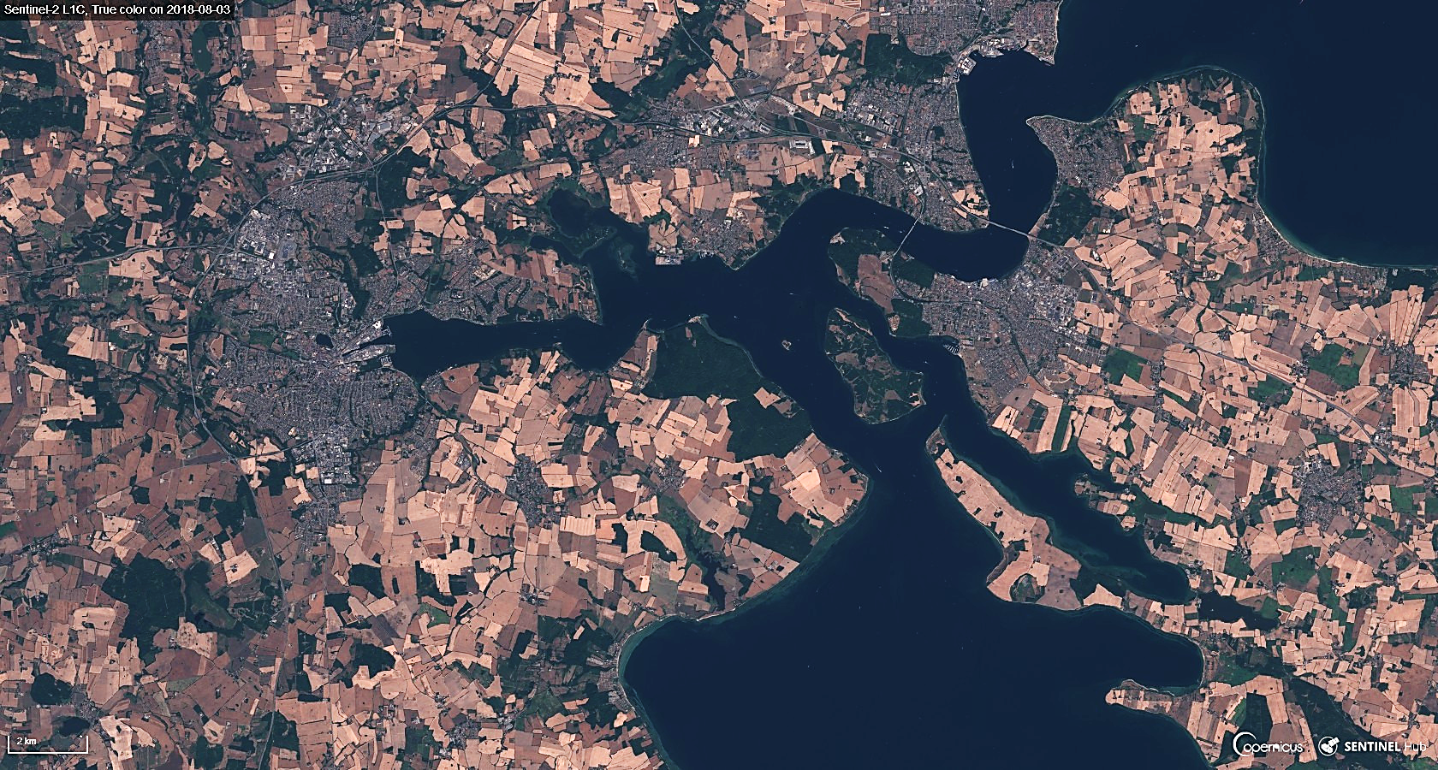
Sentinels Data Access – Image visualisation
Many Sentinel data users (in particular general public) only need basic image handling tools (i.e. not requiring data download)
EO Browser is a good example of such tool (~2300 unique users per week)
http://apps.sentinel-hub.com/eo-browser
Sentinel-2
Kolding, Denmark (3 August 2018)

Slide 24
ESA FDA activities - DIAS

Slide 25






DIAS ecosystem
ALL DIAS
offer access to Copernicus Data and Information, including Sentinel data and the Copernicus services information.
may provide access to additional EO & non-EO data according to the respective DIAS business models.
allow users (end users and Third-parties) to freely discover, view and download available data & information
offer cloud computing & storage resources to be procured by Third-parties for further data processing
Provide additional interfaces and services available to store and integrate “user data” into the DIAS “data offer”.
Provide interfaces for local processing, offering standard OGC interfaces, popular cloud APIs (e.g. swift), and/or new innovative solutions (e.g. ENS, data cube, etc.) to access the Data Offer.
Front
office service
Front
office service
Front
office service
Front
office service
Front
office service
Front
office service
Front
office service
Front
office service
Front
office service
Front
office service
Front
office service
Copernicus DIAS interfaces
Copernicus Data & Information
Other EO and non-EO data
User data integrated into DIAS

Slide 26
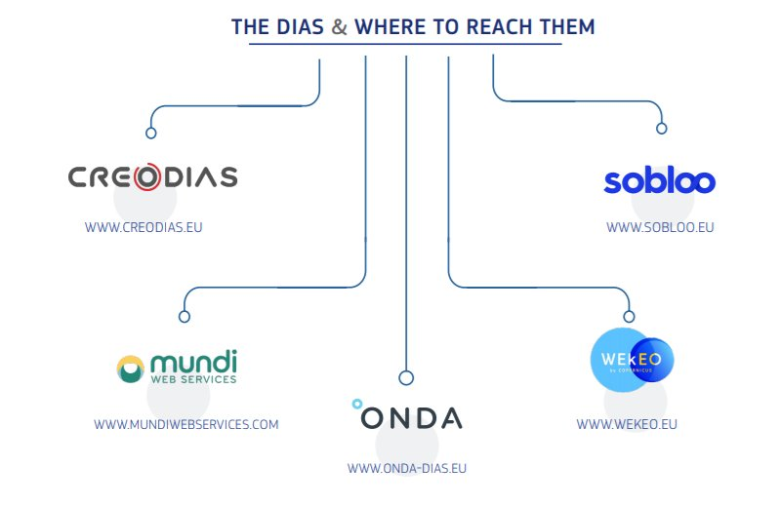
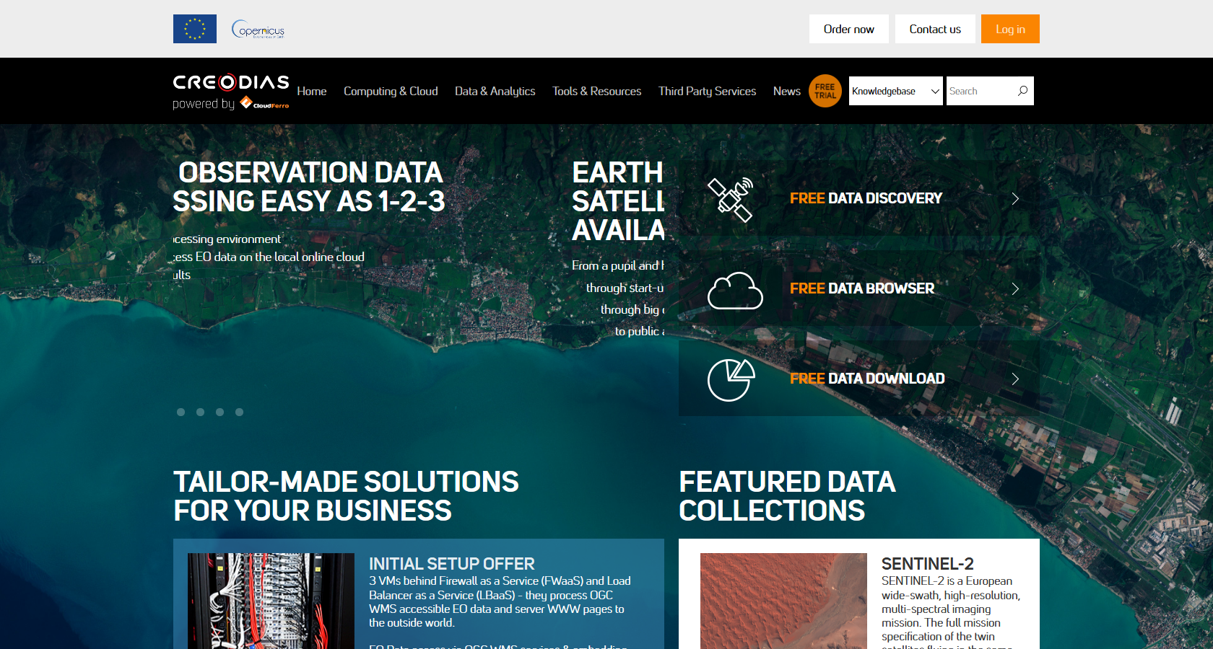
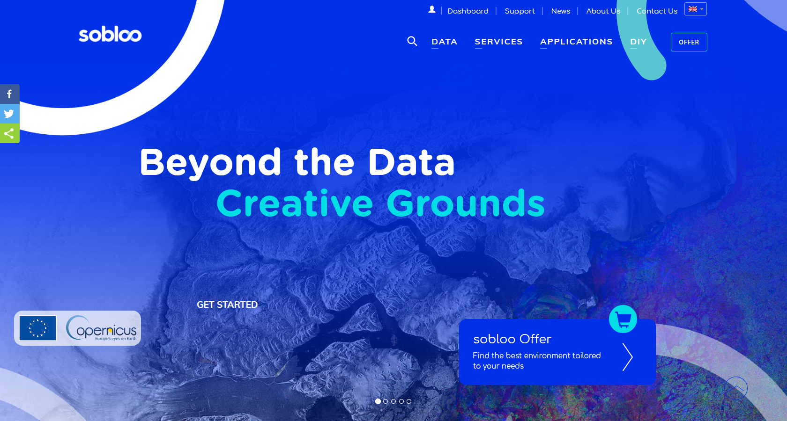
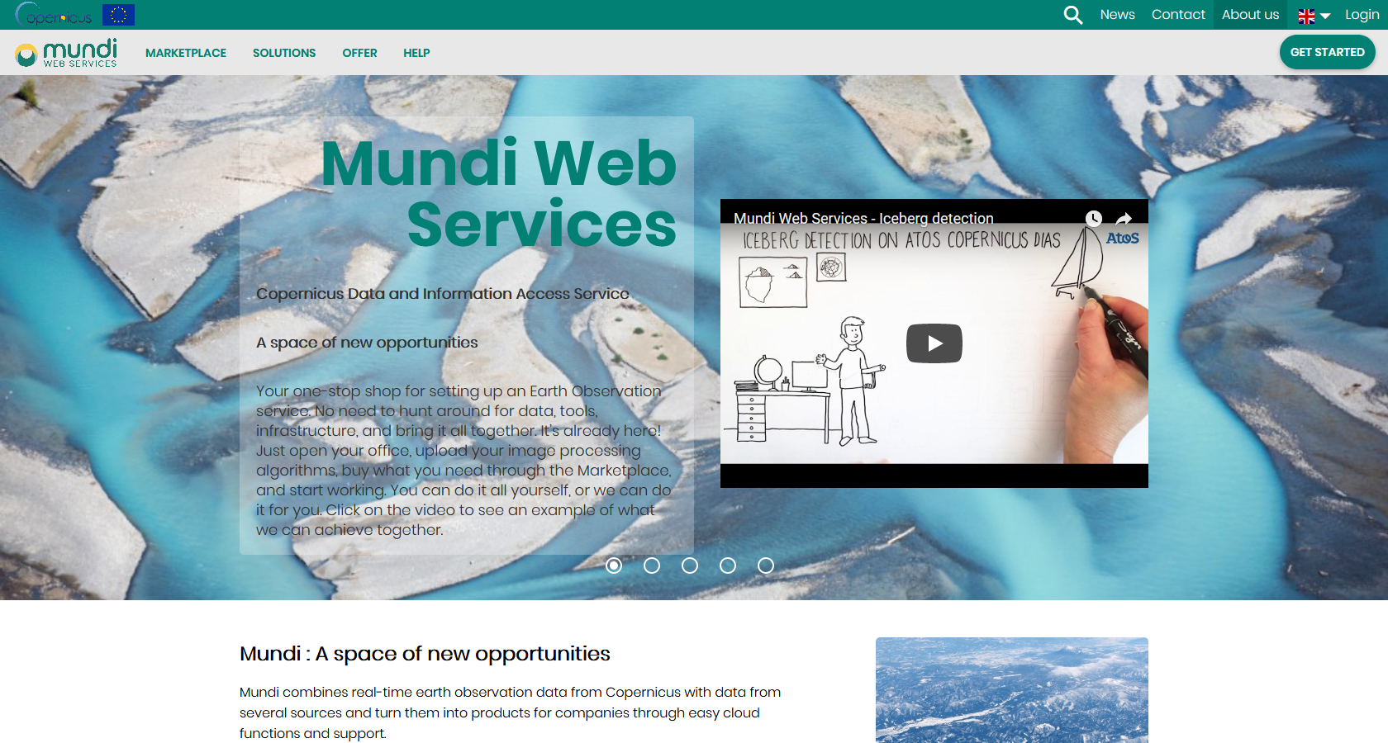
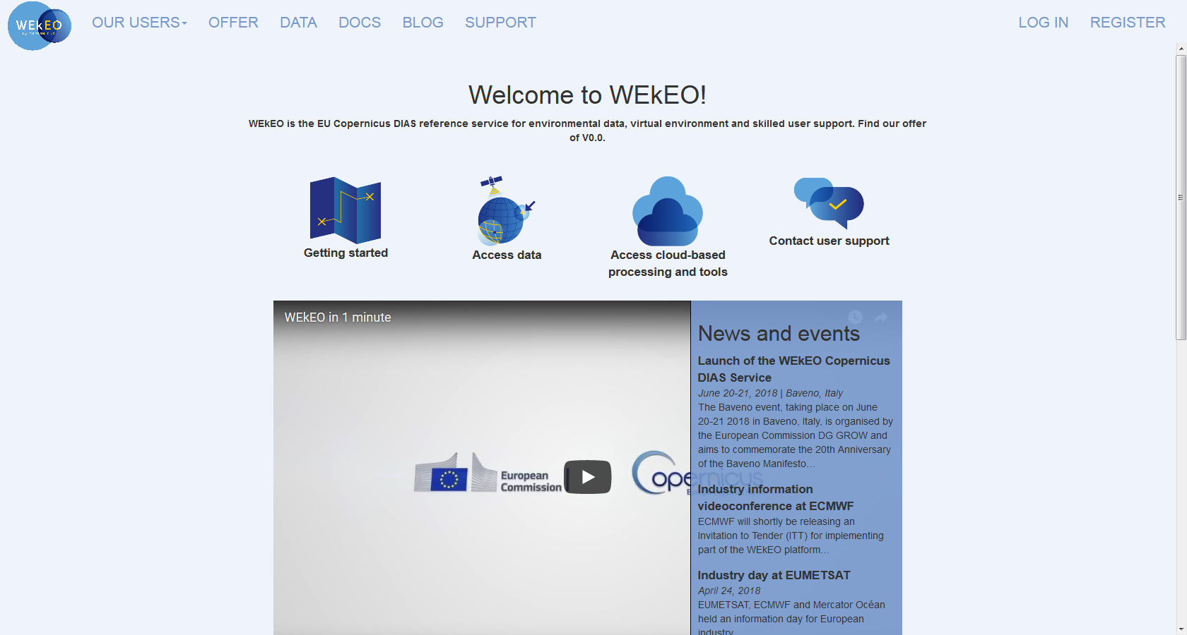
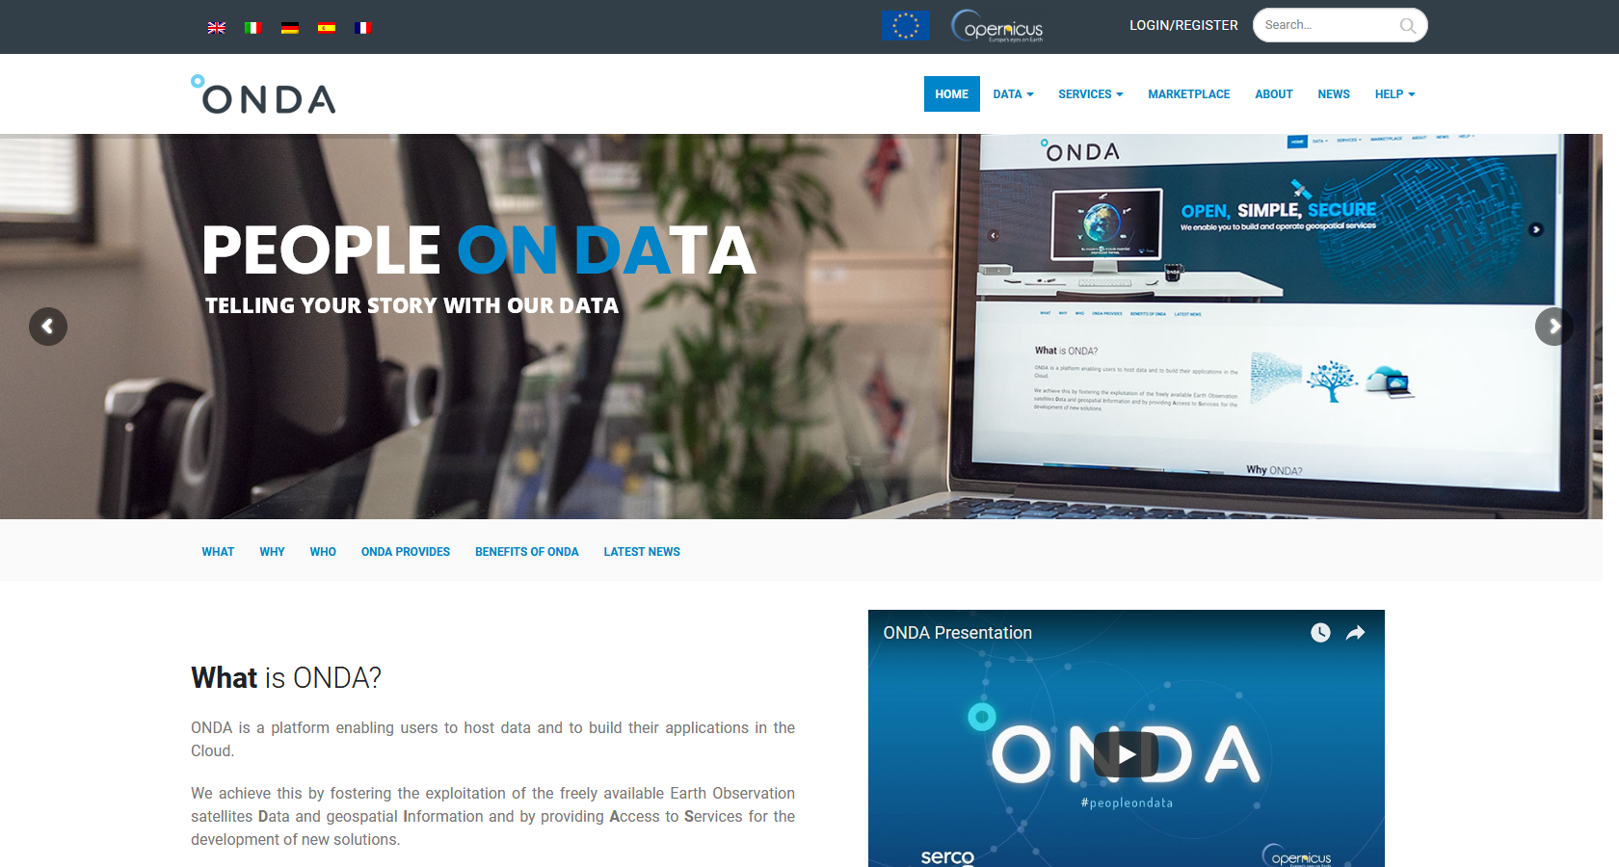
Data & Information Access Services (DIAS)
e.copernicus.eu/DIAS

Slide 27

Datacube instantiation service on DIAS
In June, ESA/EC proposed to DIAS providers to develop a demonstration “Datacube instantiation service” built on their data holdings/infra
4 Industrial consortia responded positively to this proposal
Objectives
Facilitate datacube generation building on extensive DIAS data holdings
Define AOI/time period/data deliver datacube
Check point early October
Possibility of feedback on this demonstration service at CEOS Plenary

Slide 28
ESA’s contribution to ARD activities

Slide 29
ESA ARD data products over land
Current
Sentinel-2 Surface Reflectance
Sentinel-3
  Land Surface Temperature
  Synergy products
GlobTemperature
Proba-V Surface Reflectance
Future
  Sentinel-1 SAR: ESA Study to develop & consolidate SAR ARD demonstrator and definition
  Sentinel-2/Landsat ARD Prototype Products / Level-3 HS2L8
Sentinel-2/Sentinel-3 ARD Prototype Products / Level-3 HS2S3

Slide 30
ESA’s contribution to ARD
Pilot ARD assessments show ESA products are “Quasi” compliant to ARD Product Family Specifications
  Sentinel-3 Land Surface Temperature (this meeting, D.Ghent U Leicester)
  Sentinel-2 Surface Reflectance (R. Iannone, ESA)
DOI planned for product type (e.g. LST) and in future also algorithm (e.g. LST retrieval) identification
ARD stocktake / Symbios
Lead on defining the process for CARD4L product alignment process with CEOS WG CAL/VAL
New ARD activities
  Prototype products over land being developed
  ESA Study to develop and consolidate SAR ARD demonstrator and definition
  ARD on demand
  DIAS data cube instantiation service
ITT for Copernicus global DEM will close on 18 Sept. 2018

Slide 31
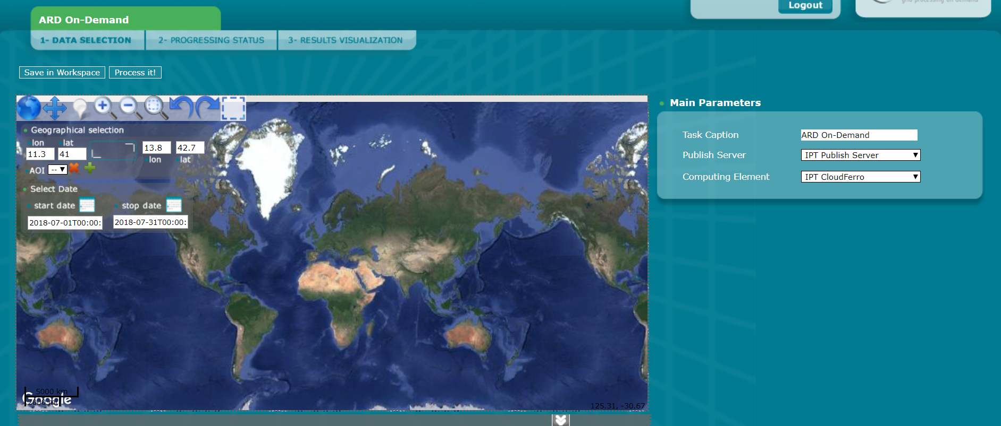
ARD on demand
Propose made-to-measure ARD generated on-the-fly to the user community
Provides an opportunity to generate “locally” harmonised/interoperable products

Slide 32
ARD on demand: pilot service
Prototype developed during the summer
Offers
Landsat-8 dataset over Europe
Sentinel-2 dataset global coverage
The atmospheric correction algorithm to be used can be selected among:
Sen2Cor (only S2 supported)
LaSRC
ICOR
MAJA (works only with S2 in the beta version, not yet available for L8)
Projection and Output Format can be selected.
Plan is to propose as a short-term demo service for the CEOS community before Plenary.

Slide 33
ARD SAR study
Eases the usability of data for non-experts
Direct analysis without any further pre-processing needed
Especially for non-SAR experts very useful
Sentinel-1:
  Backscatter only:
    straight-forward , i.e. calibration and geocoding
    Backscatter coefficient (i.e. Gamma0 vs. Sigma0) convertable via a LUT
    Speckle-Filtering?
  Backscatter + Coherence:
    Involvement of 2 scenes per product (i.e. for coherence) or more?
  → Maybe better to think of ARD scenarios that include specific applications and can be produced on the fly

Slide 34
ARD scenarios and on-the-fly processing
Sentinel-1 data‘s value is in time-series
  → better noise reduction
  → temporal dynamics as new features (in Machine Learning sense)
  → lots of scene → heavy processing
Preparation of ARD is fundamental for further data analysis
  → no single ARD for all analysis
  → instead, automated workflows for specific ARD scenarios
Pre-processing needs domain knowledge, but can be automised
Open SAR Toolkit (OST) → development at phi-lab

Slide 35
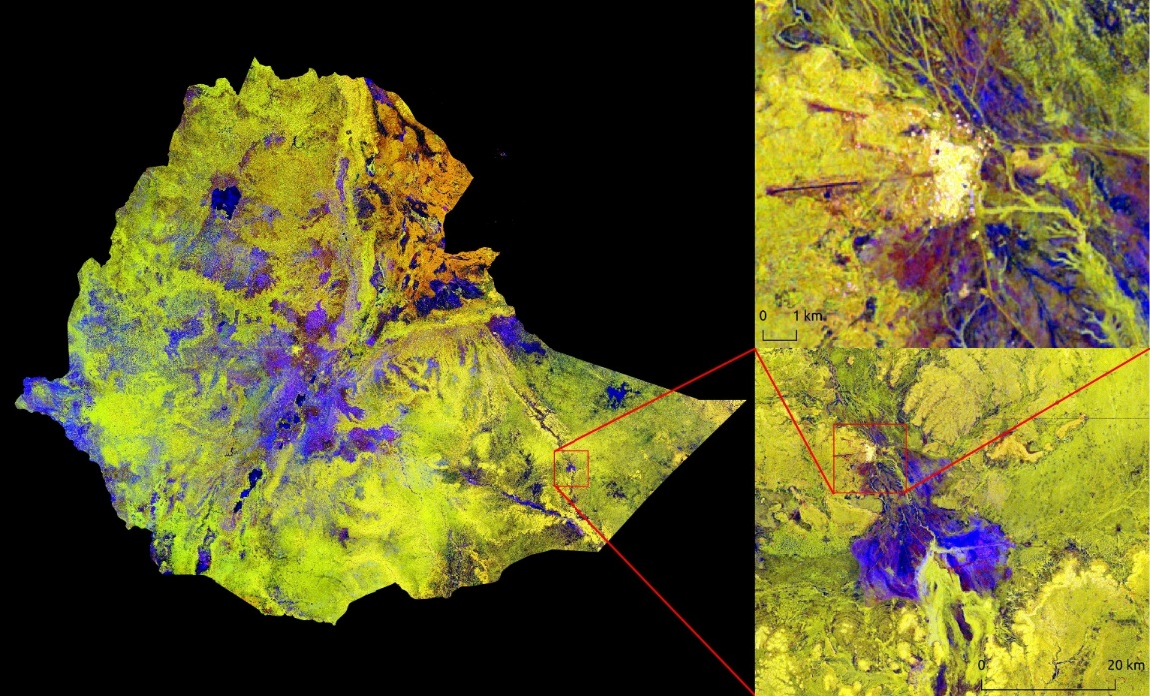
Example of possible speed-up
Example Ethiopia:
  8 swaths consisting of 5-8 frames
  7 acquisitions per swath, consisting of 2 polarizations
  Resolution output 30m
  Applied terrain flattening (computational expensive, but necessary for LC classification)
  Included generation of Layover/shadow mask and multi-temporal speckle filtering
  Time-series as well as Timescan generation
Timescan of Ethiopia showing the minimum value of VV in time in red,
the minimum value of VH in time in green and the SD of VV in blue

Slide 36
Take home messages
The Copernicus Space Component delivers high quality and timely data to the user community
  Current fleet of missions: nominal operations and all core data products released
  C/D units in preparation
  Long-term Scenario/ future Sentinel extension and expansion/ consolidated
ESA’s provides important contribution to FDA activities
  ARD, CARD4L, assessment process, implementation
  Excellent Copernicus data access service provided, including data provision working in partnership in international environment
  DIAS contracts now up and running
ESA’s provides important contribution to ARD activities
  ESA’s data products over land provide a considerable contribution to the CEOS ARD portfolio and are “quasi” compliant to ARD principles
  ARD on demand
  ARD (self) assessment procedure
  New ARD activities/productss triggered by ESA
ESA lead for MRI activities has been appointed: Ferran Gascon (Sentinel-2 mission manager) → see presentation Friday am Session 6

