Slide 1
CEOS DB API and Waveband Improvements
Committee on Earth Observation Satellites
G Dyke
LSI-VC-6 Joint Meetings
Session 3
JRC, Italy
6 September 2018

Slide 2
API Objective and Pilot Functionality
Enabling machine-to-machine access to the CEOS Database via an API
Enable the content to be leveraged by external developers
Pilot functionality: supporting gap analysis
[Beta Version Implemented] call by missionID to expose by JSON mission: status, launch and EOL date, mission instruments, agencies, and measurements
[Beta Version Implemented] call by instrumentID to expose by JSON instrument: type, resolution, waveband information, instrument missions, agencies, and measurements
[Remains to be Implemented] call by waveband (nm or GHz range; band name) to expose by JSON instruments with certain properties
Implementation on AWS to support scaling
DynamoDB + Lambda + API Gateway + Cloud Formation

Slide 3
CEOS Agency Surveys
API Admin/Dev
API User
Developer
Dev / Survey User
Public Web User
database.eohandbook.com
Remote Desktop
Browser
SS MGMT Studio
LIVE / PRODUCTION
SQL Server Mart
(services not server)
Dev Server (EC2)
MIM MS SQL DB Production
JSON
JSON
Web Server (IIS)
MIM MS SQL DB Dev
Web Server (IIS)
CEOS DB web application code (ASP.NET, C#)
T-SQL
CEOS DB web application code (ASP.NET, C#)
T-SQL
Live DB Mirrored
(e.g. annual survey update)
Mirrored to DynamoDB via Python admin scripts
API
AWS API Gateway
AWS Lambda Functions (C#)
Missions, mission
Instruments, instrument
Add, remove
AWS DynamoDB Table
DB Backups (manual, auto)
DropBox, iDrive
Code Repository (C#, T-SQL, JS, Py)
Project Locker
Dev Desktop Environments
Supporting Services
AWS
API
Dev DB
Production DB
Support
CEOS DB Architecture - 21 Aug 2018

Slide 4
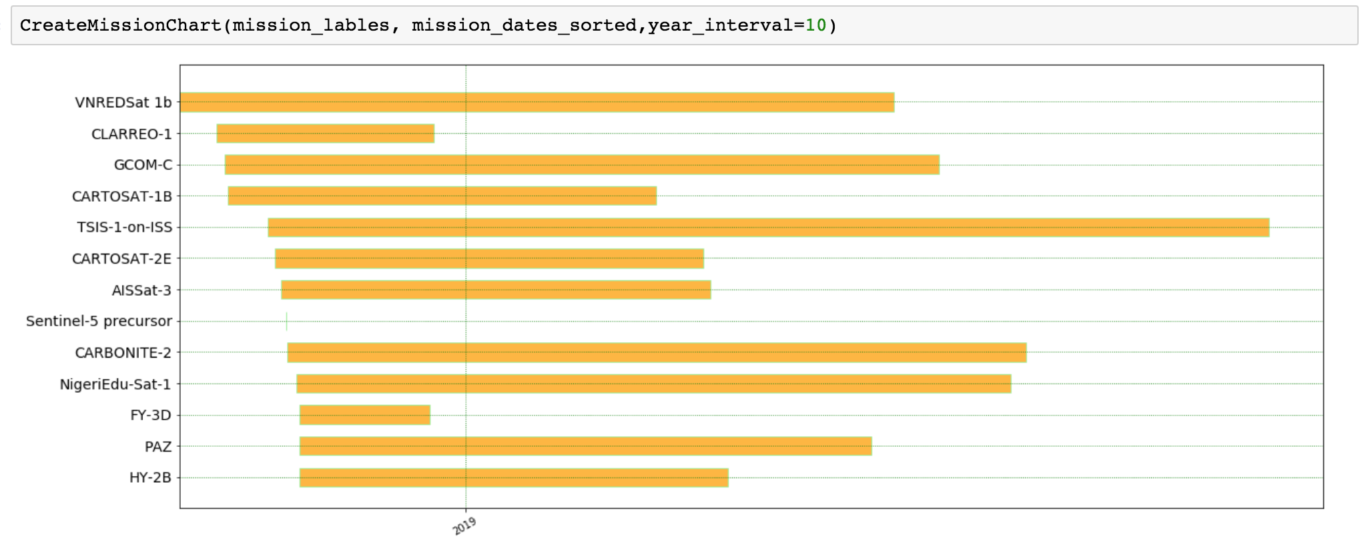
Sample Output – Mission Timeline
Filter by mission launch date supports mission gap analysis
Additional filters by instrument type, measurements, waveband categories

Slide 5
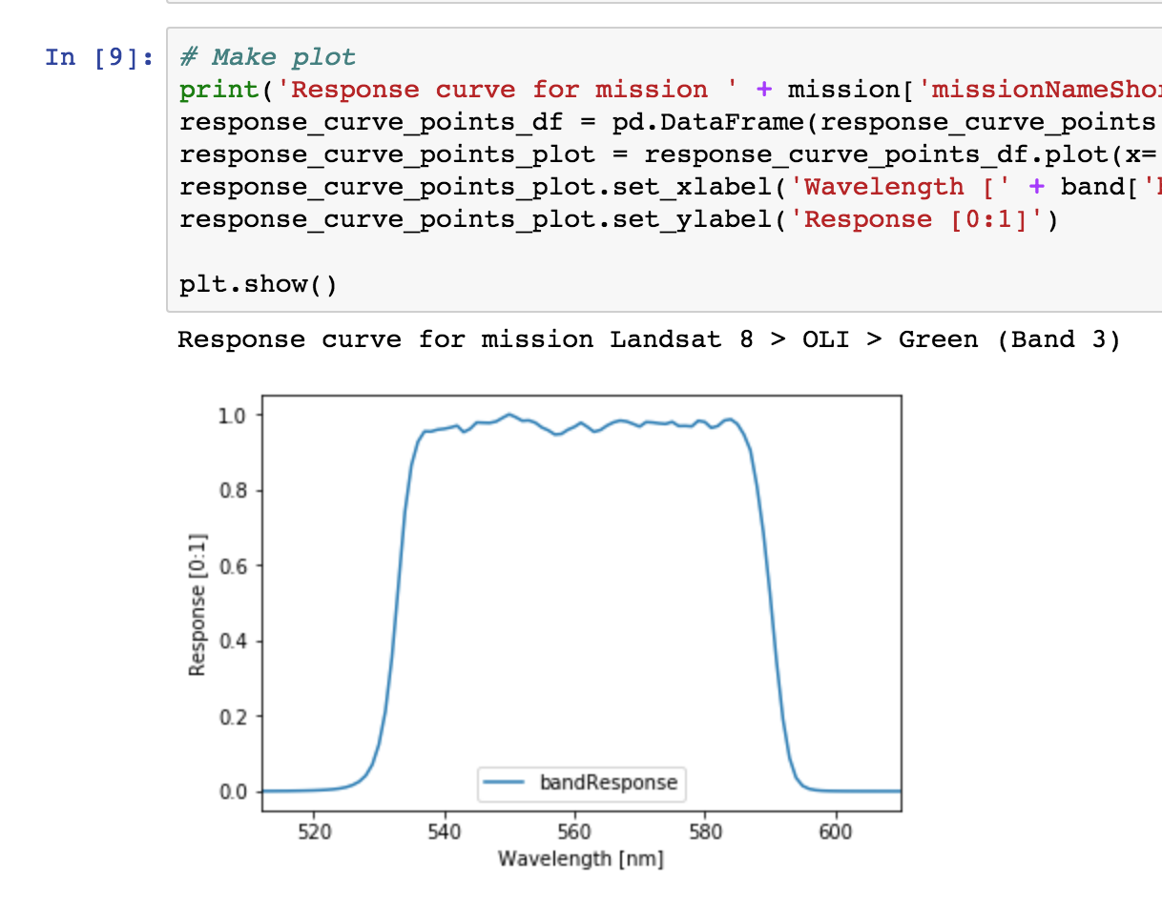
Sample Output – Response Curve
Ingested L8 response curve based on instrument specs online
Have similar information for Landsat-7, Sentinel-2 – to be added as capacity and demand dictate
Others possible

Slide 6
Next Steps
Implement authentication
Implement Measurements functionality
Finalise sample notebooks (to be posted on GitHub)
Basic documentation
Add to test user base
SEO currently only one
Targeting new test users by end-October
More general beta release to follow

Slide 7
LSI Toolkit?
Many applications of the API possible
Initial function has been support gap analysis
Could package this capability with the release as an ‘LSI Toolkit’
Would include a targeted set of Python notebooks released along with API that would enable the basic functions of land cover gap analysis
Extensible to domains beyond land, but first focus could be LSI
Could also add a new type of information to the CEOS Database: ‘Products’
’Products’ could first address ARD products which could be used in gap analysis
Reference CARD4L PFS and highlight the availability of PFS-compliant data sets
Other functions? For discussion…

Slide 8
Backup

Slide 9
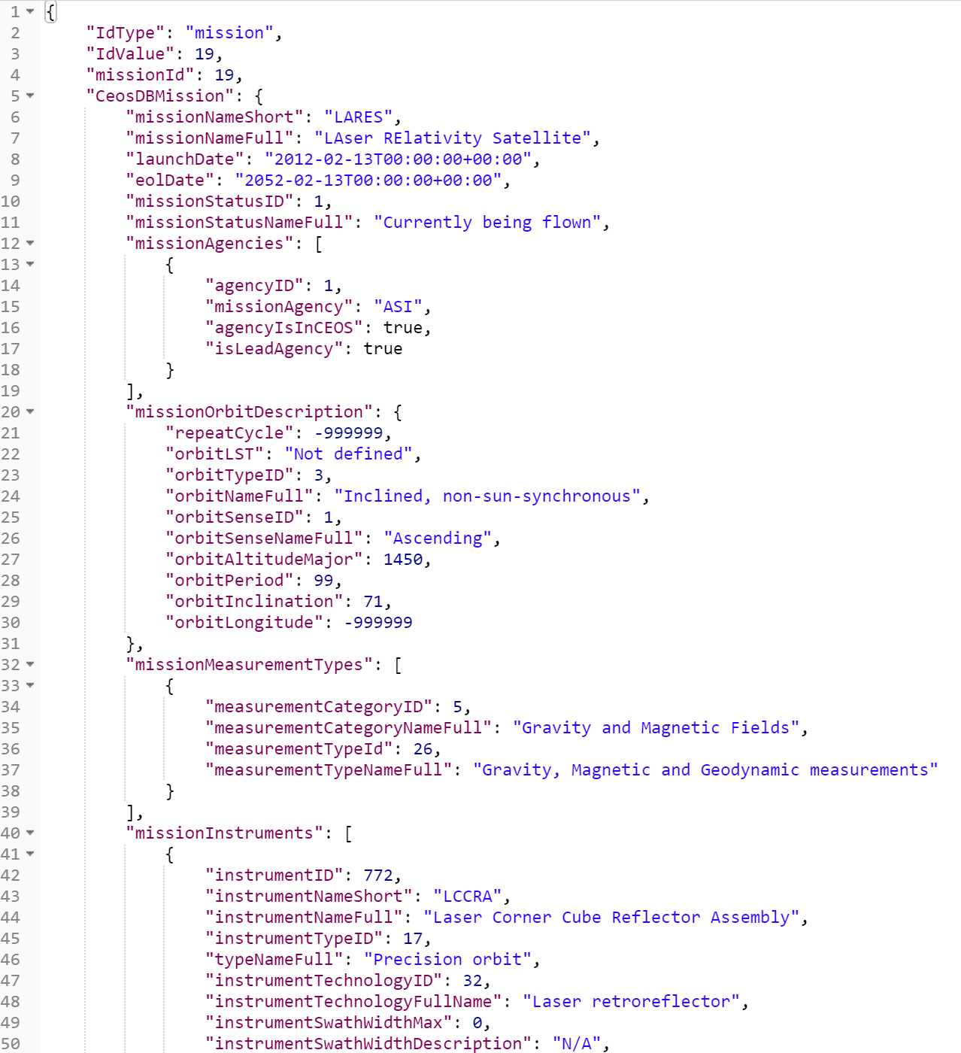
Sample Output - JSON
Sample JSON output for /mission/19

Slide 10
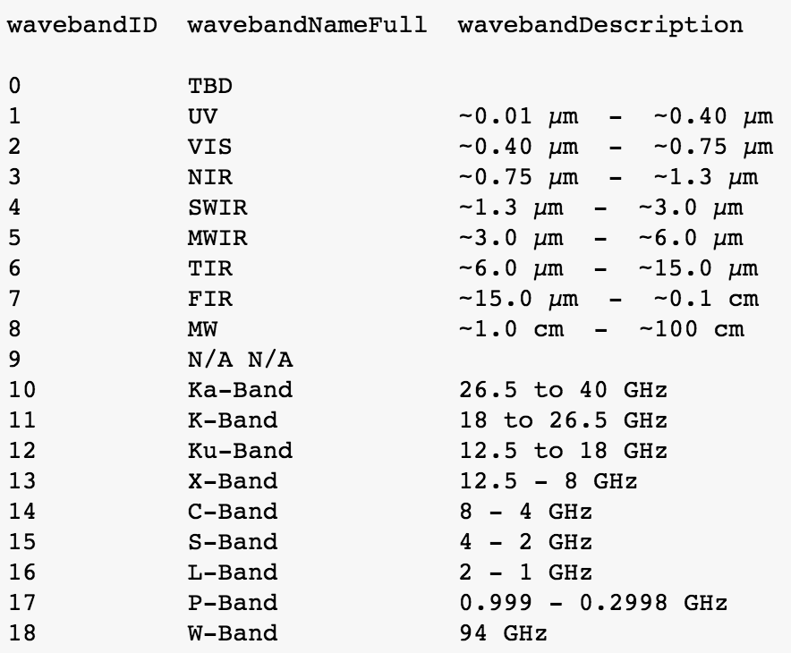
Sample Output – Waveband Filter
Filter by waveband category
Filter by waveband target range (optical only implemented so far – radar TBA)

