Slide 1

CEOS Context
LSI/SDCG/GEOGLAM Joint Meeting
Committee on Earth Observation Satellites
Steven Hosford
6th September, 2018

Slide 2
Summary
General CEOS context
  Leadership
  Evolutions
CEOS Work Plan information
CEOS Land Surface Imaging Context
LSI and thematic requests
Future directions/challenges

Slide 3

News / Updates
CEOS Chair priorities for 2018
Priority ‘A’: Laying the foundation for an international CO2 and GHG emission monitoring system
Priority ‘B’: Continue and progress work within CEOS on Data access and use
Both priorities advancing well: each has convened workshops during the year to focus work of CEOS entities.
Progress to be presented to the CEOS community at Plenary 32.

Slide 4
Evolution of FDA AHT
Transitioning of FDA activities
  Analysis Ready Data (ARD)
    LSI-VC
  Data Cubes
  Open Data Cube consortium (Link to CEOS: Brian)
  EO User Platform Evolution (e.g. Copernicus DIAS)
  Link to CEOS: EC/ESA
  User Metrics and EO Resource Inventory
  WGISS
  Data Analytics
  TBD

Slide 5
News / Updates
CEOS Entity Leadership changes
  2018 CEOS Chair – European Commission
  2019 CEOS Chair – Vietnam National Space Centre
  Only other transition at Plenary 2018 is WGCalVal Chair
  NASA (Kurt Thome) – CSIRO (Cindy Ong)
  Search continues for a Deputy CEOS Executive Officer to replace current CEO from October 2019.
  All other CEOS WGs looking for Vice-Chairs from 2020

Slide 6
CEOS upcoming meetings
July
June
Living Planet Symposium
Milan, 13^{th –} 17th May
WG CalVal, Darmstadt, 28th-30th August
August
May
WG Disasters, Napoli, 4th-7th Sept
LSI-VC/SDCG/GEOGLAM, Ispra
April
SIT Technical Workshop,
Darmstadt, 13th-14th Sept
September
SIT-34, TBD, USA,
1st-5th Oct
March
WG/ADT meetings
CEOS 32nd Plenary, Brussels, 16th-18th Oct
October
WGISS, Munich, 22nd-25th Oct
WGCapD, Dehradun,
4th-8th March
November
February
GEO-XV Plenary, Kyoto, 31st-1st Nov
December
January
CEOS/GEO bilateral

Slide 7
CEOS Workplan 2018-2020
Number | Title | Status | Completion
FDA-07 | Product Specifications in accordance with the CARD4L Framework | Open | 2018-Q1
VC-30 | Interoperability case study for Landsat and Sentinel-2 | Open | 2018-Q4
VC-31 | Evaluate CARD4L among target user communities | Open | 2018-Q4
VC-32 | CARD4L Product Assessment Framework | Open | 2018-Q3
VC-33 | Maintain the CARD4L Product Family Specifications (PFS) | Open | 2018-Q4
VC-34 | CARD4L Engagement Strategy | Open | 2018-Q3
VC-36 | Monitoring MRI implementation examples | Open | 2018-Q4
VC-37 | CEOS Information Tool Improvements | Open | 2018-Q4
8 of 8 open deliverables to be completed this year
Deliverable updates required before 30/09

Slide 8
CEOS Work Plan timeline
CEOS Work Plan is one of CEOS’s governing documents
Based on a 3 year period
Update annually
1st request for updates
Deadline for updates
1st draft of work plan
Finalised work plan
July
June
August
May
April
September
March
October
November
February
December
January

Slide 9
CEOS 2019-2021 Work Plan
CEO emails CEOS entities requesting updates
9th November
Deadline for updates
14th December
Work Plan V0 released
25th January
Work Plan V0 comments by
15th February
Work Plan V1 released
22nd February
5 weeks for
CEOS Entity inputs
3 weeks for
CEOS Entity feedback

Slide 10
CEOS 2019-2021 Work Plan
Messages to those of you providing CEOS Work Plan inputs:
Please plan to spend some time on your CEOS WP inputs
    9th Nov – 14th Dec
    25th Jan – 15th Feb
If your deliverable is linked to the GEO Work Programme please provide the GEO WP identifier

Slide 11
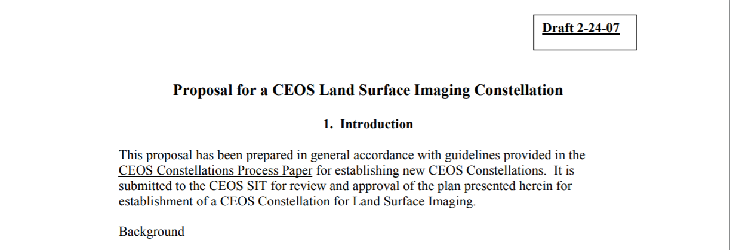
LSI history
First proposed in 2007

Slide 12
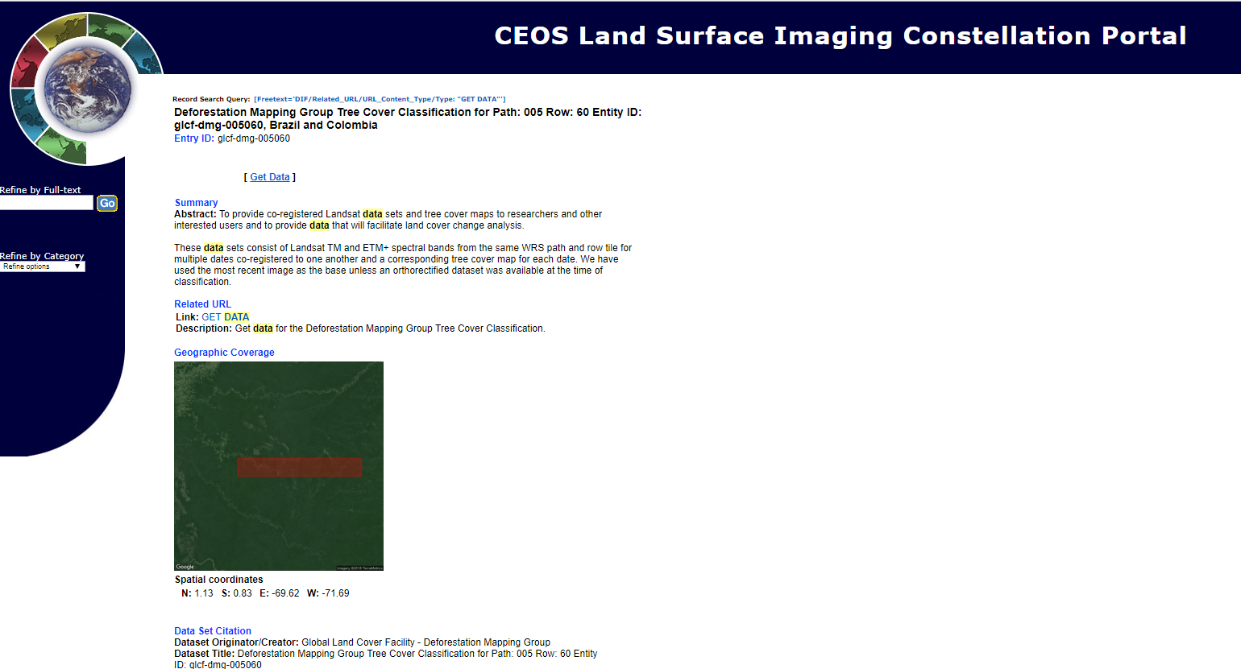
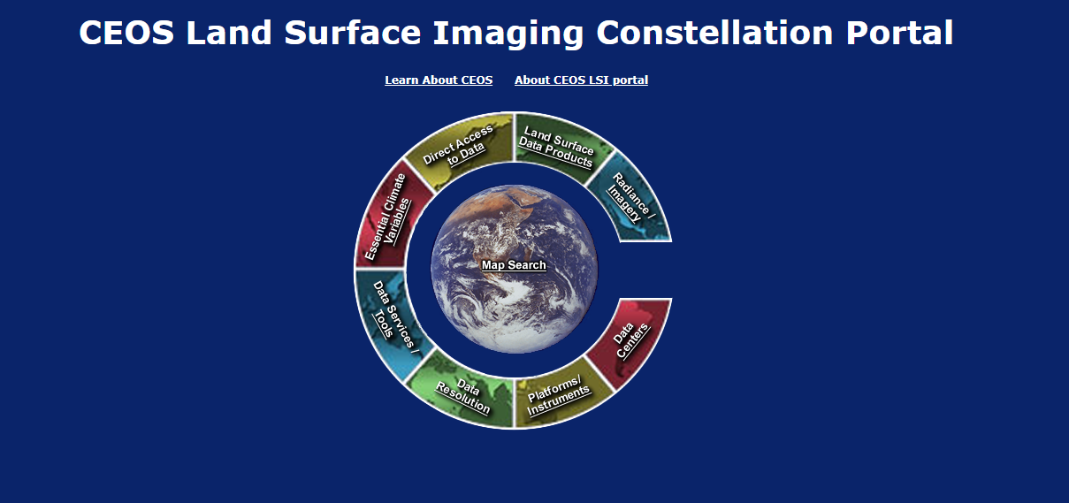
LSI history
Initial focus on
  Systems architecture (gap analysis, etc. )
  Information on data sources
LSI portal prototype is designed to enhance the ability of LSI users to locate, understand, and access LSI data and also to serve as a test-bed for new information technologies and architectural approaches to enhance interoperability among CEOS member systems.

Slide 13

LSI and thematic requests
End 2008/ early 2009: First thematic requests received by LSI
  taken from LSI presentation to SIT-23 (March, 2009)
SIT-25 (Sept 2010)
2hrs on FCT at SIT-25
Initial data coordination functions for FCT carried out by LSI
CEOS Plenary 25 (Lucca)
Proposal and creation of a dedicated GFOI Space Data Coordination Group
Functions
Satellite acquisition planning
Easy access to data and services (including tools)
R&D

Slide 14
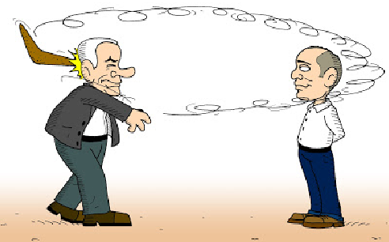
LSI and thematic requests

Slide 15
Challenges for LSI-thematic interaction
Operationalise the CARD4L product alignment assessment
  Resources
  Organisation
  Responsiveness
Interaction with the private sector
  Private sector success is good for SAs & for CEOS (not competition)
  Appropriate role for institutional actors?
  40 years of institutional capacity can help to bootstrap private data sources?
Nonprofit/NGO sector
  Significant energy and resources
  Broaden contributors to LSI?

