Slide 1
COVE Tool Updates
Joint SDCG/GEOGLAM/LSI-VC Meeting
September 6, 2018
Ispra, Italy
Brian Killough
CEOS Systems Engineering Office
NASA Langley Research Center

Slide 2
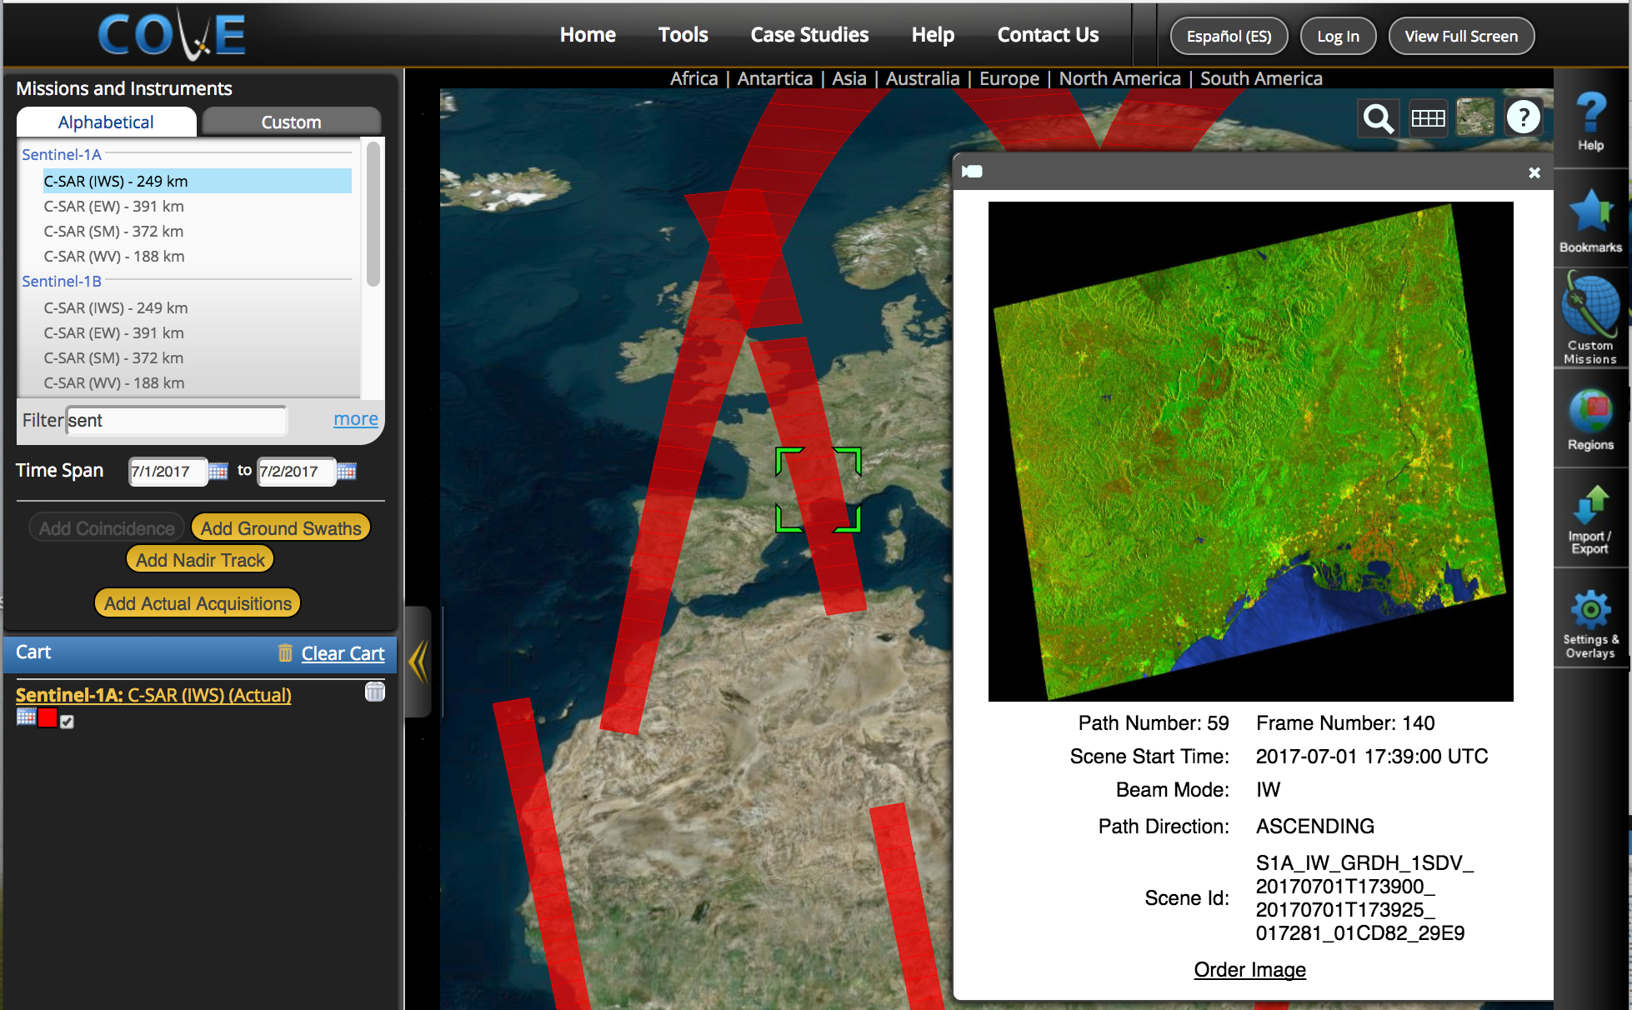
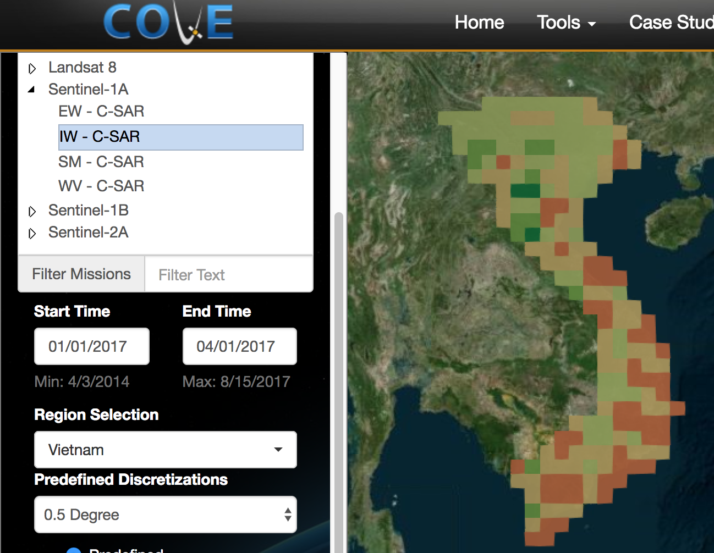
COVE Tool Summary
The CEOS Visualization Environment (COVE) is a browser-based suite of tools for searching, analyzing, and visualizing actual and potential satellite sensor coverage.
COVE is FREE and OPEN for anyone to use! There is a large international user base with 4000+ users in 2017.
COVE includes 131 missions and is linked to several mission archives to get metadata and browse images for past acquired data: Landsat-5/7/8, Sentinel-1, Sentinel-2, and CBERS-4.
Coverage Analyzer and Data Browser: New tools for coverage assessments and scene data to support data ordering.
www.ceos-cove.org

Slide 3
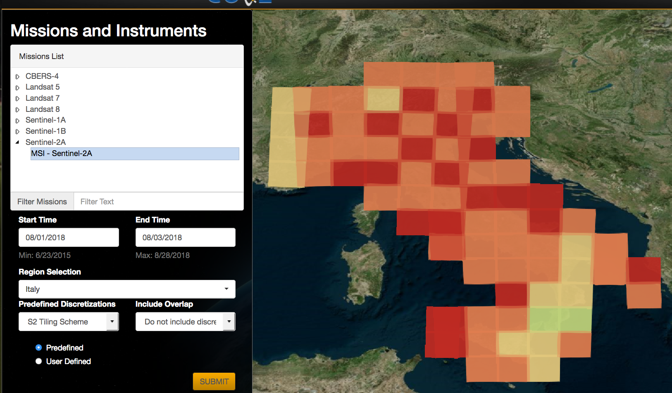
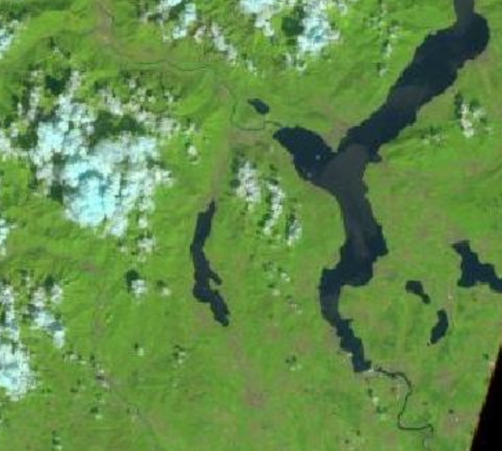
Coverage Analyzer
Support for Landsat 5/7/8, Sentinel-1A/1B, Sentinel-2A and CBERS-4.
Output using discretizations for Landsat WRS, Sentinel-2 tiles, and various Lat-Lon degrees (0.10, 0.25, 0.5, 1.0).
Example Case: Ispra, Italy, August 3, 2018 Sentinel-2A, MSI Instrument - COVE query results - Table with scene info - Browse image

Slide 4
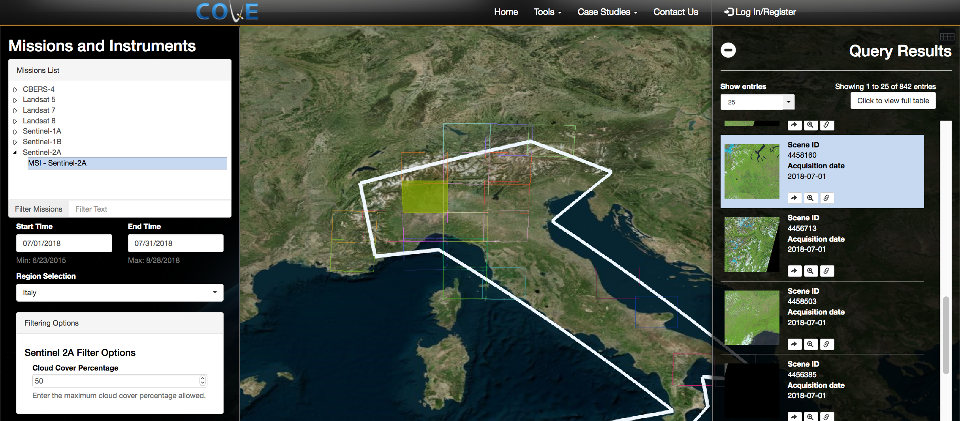
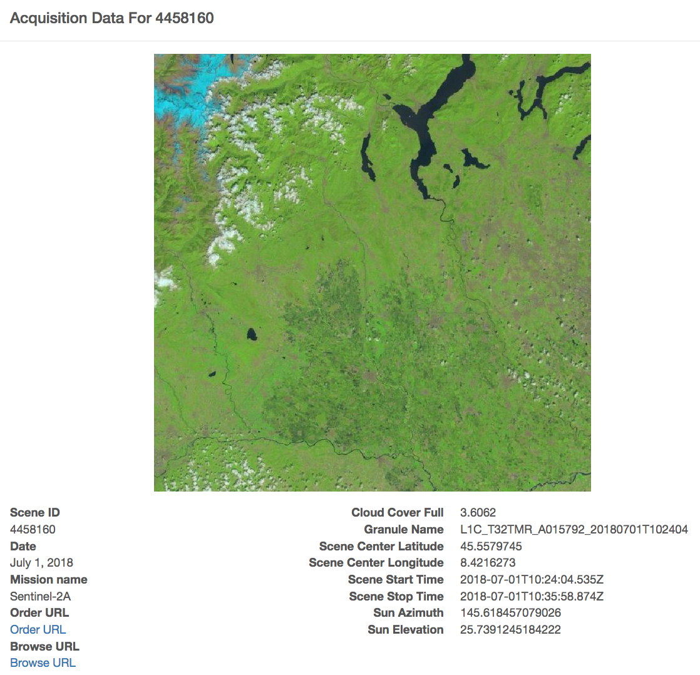
Data Browser
Support for Landsat 5/7/8, Sentinel-1A/1B, Sentinel-2A, and CBERS-4 ... similar to Coverage Analyzer
Filtering for cloud cover threshold (optical missions)
Example Case: Italy, August 2018 Sentinel-2A, <50% cloudy - Table Output with scene information and browse images - Links to view the acquisition details, zoom into footprint on the map, and order the scene

Slide 5
Status and Future Plans
The team has made a number of updates to the core COVE tool to improve security and enhance operating performance. Some of these changes have caused issues with a few features that will be resolved in the coming months.
Links to archive databases are a constant issue, as things change on the data provider side. Current issues with S1 archive at ASF to be resolved in 6-8 weeks. Other issues with SPOT, Pleaides, Radarsat-2, ALOS, TerraSAR-X and ResourceSAT-2 will be resolved in the coming months.
Adding a custom mission capability to support future mission concept studies
Adding coverage and revisit performance calculation capabilities
Adding cloud cover overlays derived from Landsat historical metadata (13 in total, 1 raw average, 12 monthly average files)
Adding coincident calculations for both future predictions and historical archive data

