Slide 1

Open Data Cube Pilots
Joint SDCG/GEOGLAM/LSI-VC Meeting
September 6, 2018
Ispra, Italy
Brian Killough
CEOS Systems Engineering Office
NASA Langley Research Center

Slide 2
49 countries in 20 months
9
6
34
Operational
Under Development
Under Review or Expressed Interest
Operational: Australia, Colombia, Switzerland, Taiwan, Kenya, Tanzania, Ghana, Sierra Leone, Senegal

Slide 3
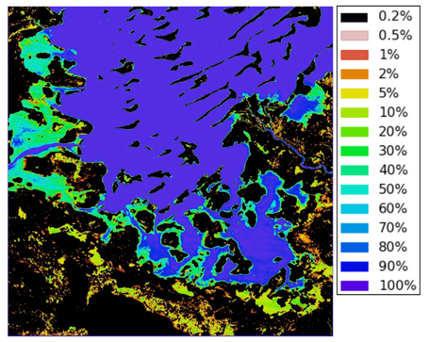
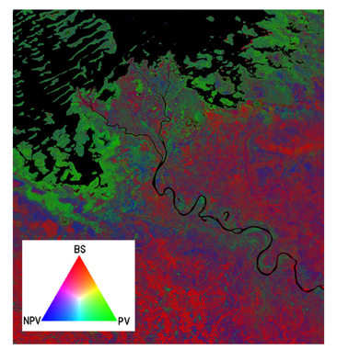
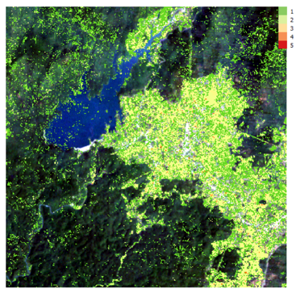
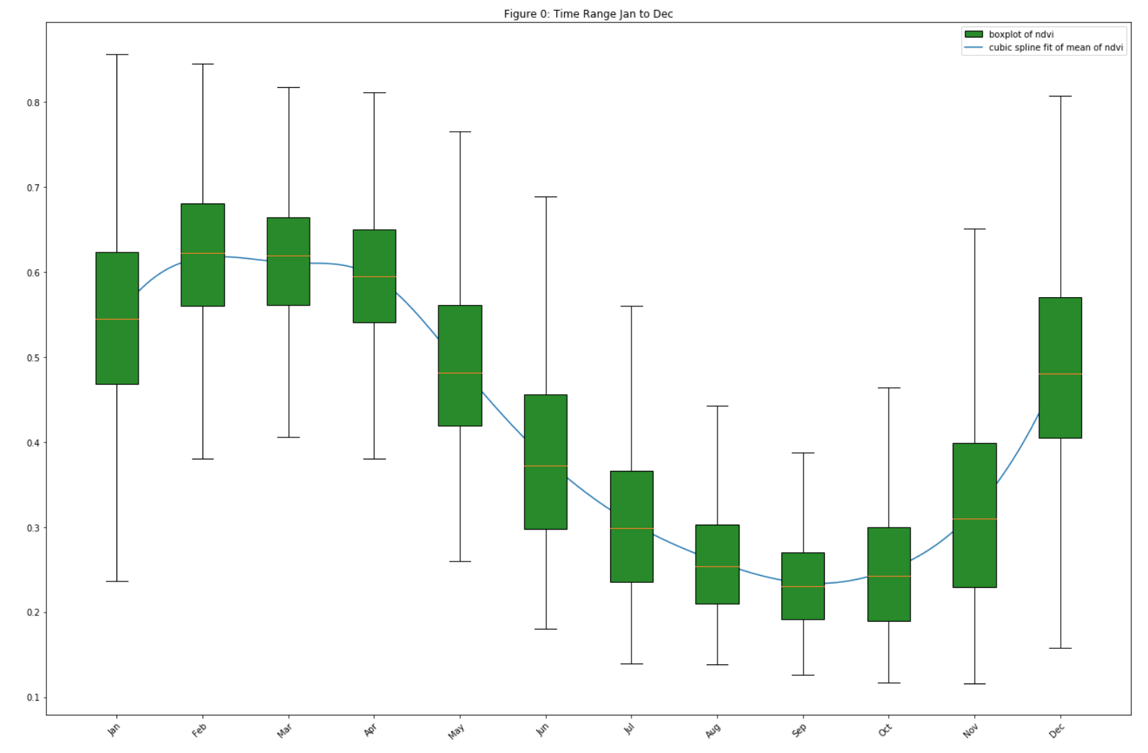
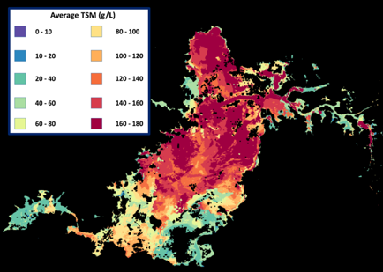
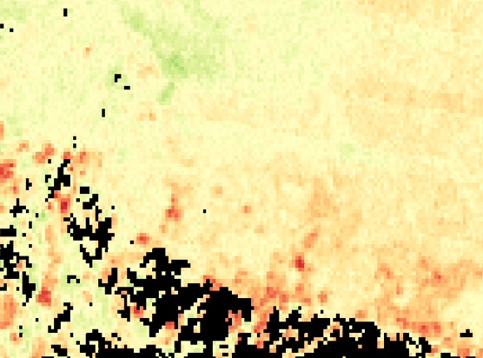
Application Products
20+ algorithms
Cloud-free Mosaics: Recent Pixel, Median, Geomedian, Max-NDVI
Spectral Indices: NDVI, EVI, NDBI, NDSI, NDWI, FC, TCT
Land Classification: K-Means, Random Forest, Snow (from Swiss)
Water: WOFS (from Australia), WASARD (radar), Total Suspended Matter (TSM)
Land Change: PyCCD (from USGS),
PCA (from Colombia), NDVI Trend (Vogelmann), NDVI Anomaly, S1 Radar (Deutscher), Coastal Change,
SLIP-Landslides (NASA GSFC)
New Data Cube Application Library (DCAL) is coming soon!

Slide 4
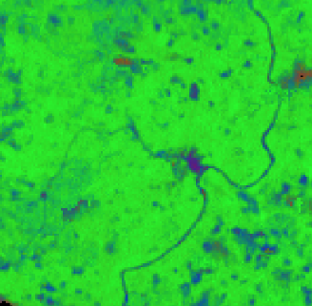
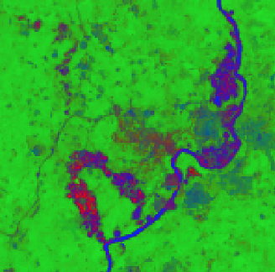
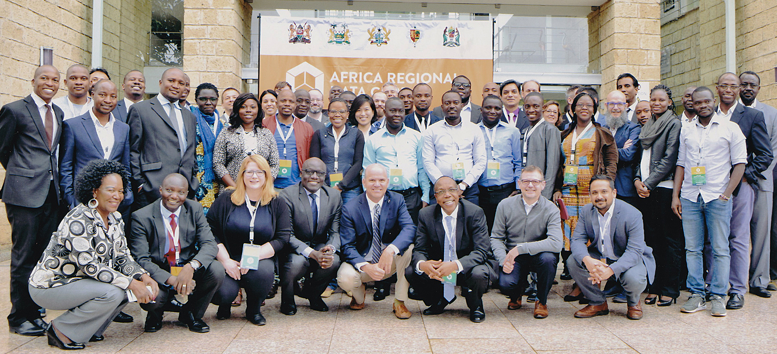
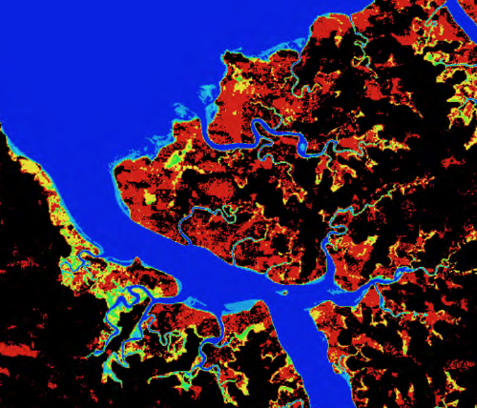
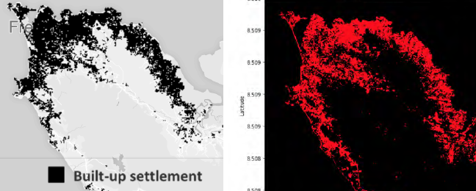
Africa Regional Data Cube
  Launched in May 2018 for 5 countries (Kenya, Tanzania, Sierra Leone, Senegal, Ghana). Initially based on Landsat ARD, with S1, S2 and ALOS coming soon!
  Supported by Amazon (donated cloud services) and GPSDD (training)
  Recent web-based remote training for Ghana (July 31), Tanzania (August 16), and Sierra Leone (Aug 24). Face-to-face training planned for late 2018.
  Initial support has been focused on algorithms to support desired use-cases for each country. These include ...
  Kenya: Dadaab Refugee Camp expansion, deforestation and vegetation extent, livestock rangelands
  Tanzania: Chenene Forest Reserve deforestation and agriculture phenology
  Ghana: Illegal mining (on right)
  Sierra Leone: Flooding and urbanization (below)

Slide 5
More Use-Cases
Analysis Ready Data (ARD) is impacting several other Data Cube use-cases ...
Colombia is operationalizing their Data Cube to support forest monitoring and IPCC reporting
Switzerland is using their Data Cube to develop new snow detection algorithms and develop time series snow coverage maps.
UK-Rhea (commercial company) is using the Data Cube to develop a drought monitoring system for Uganda
UK-Catapult is leading the “Common Sensing Project” to monitor climate change resilience in the Pacific Islands using a Data Cube.
Taiwan is using the Data Cube to monitor forest and vegetation restoration in landslide areas. They are also developing an algorithm for the detection of Pine Beetle outbreaks.
Uruguay Is using the Data Cube to adjust their water sampling approach to coincide with satellite overpasses in order to improve water quality data in their reservoirs.
The Gates Foundation is using water extent time series data from the Lake Chad Data Cube to compare with their population density maps to strategically supply polio vaccines to small villages around the lake. Many of these villages become "isolated" during the rainy season and are only accessible for a small portion of the year.

Slide 6
Thoughts on ARD
Analysis Ready Data (ARD) is no longer a desire of global users, but is now becoming a requirement and an expectation
The Data Cube pilots are an ideal way to prove the benefits of ARD, as every pilot is using ARD. Most global users (not scientists or commercial groups) DO NOT desire, or feel comfortable, making their own ARD, but want it provided.
There is a growing interest in radar data, but few users understand its benefits or know how to use this data. Data Cube pilots are a great place to demonstrate open source radar algorithms on ARD.
CEOS needs to make it easier for global users to get ARD. Landsat is easiest. ALOS is a bit harder, but Ake Rosenqvist has been providing great support to generate mosaics over any location. Sentinel-1 is even harder, as few users(outside Europe) understand the choices in the S1 Toolbox and lack algorithms. The hardest is Sentinel-2, as few users (outside Europe) understand how to apply the Sen2Cor algorithm for pre-processing and then do not have application algorithms in-hand.

Slide 7
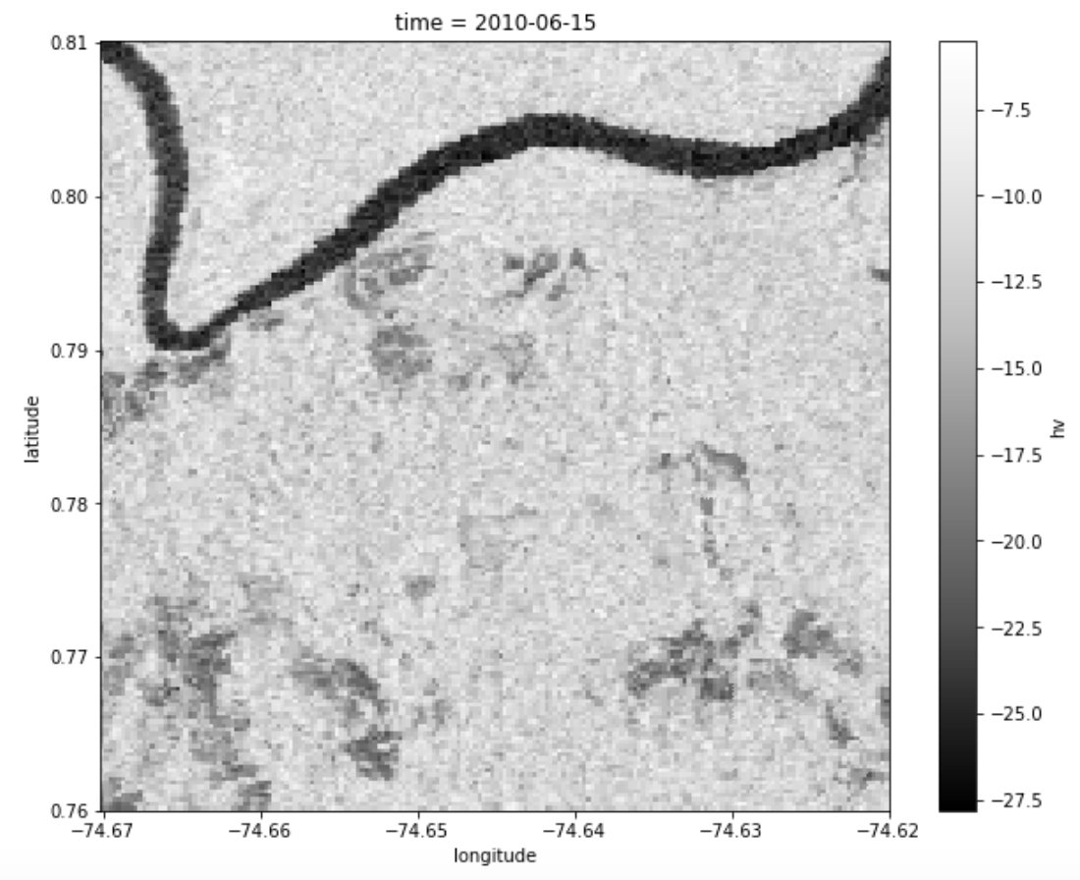
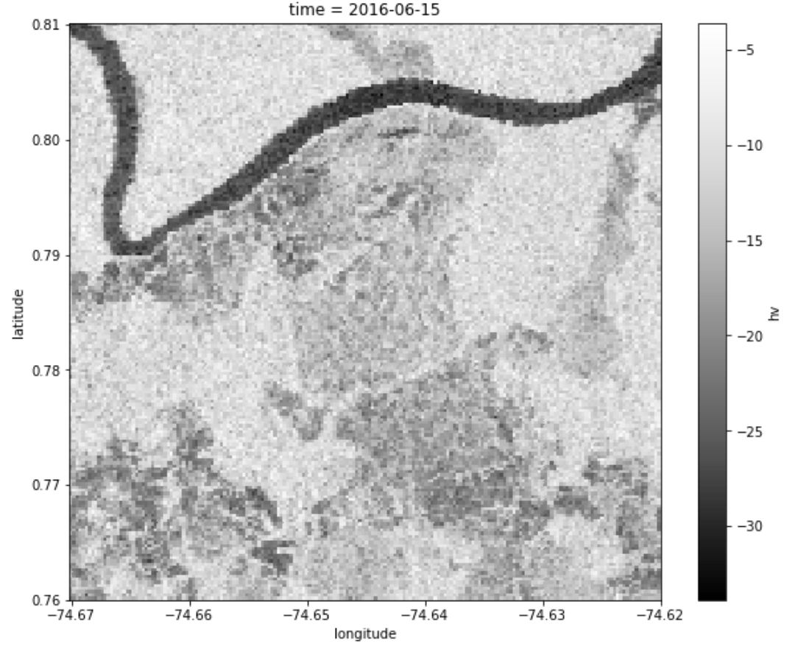
ALOS in Data Cubes
Open Data Cube Results: HV band in 2010 (left) and 2016 (right)
ALOS annual mosaics from JAXA over central Colombia (Caqueta region)
The "dark" regions in the 2010 image (left) are consistent with non-forest areas (water, bare soil grassland). After the deforestation, the "dark" regions of have increased, which likely correspond to new non-forest areas, or deforestation.

Slide 8
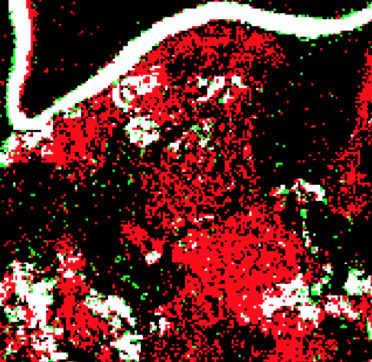
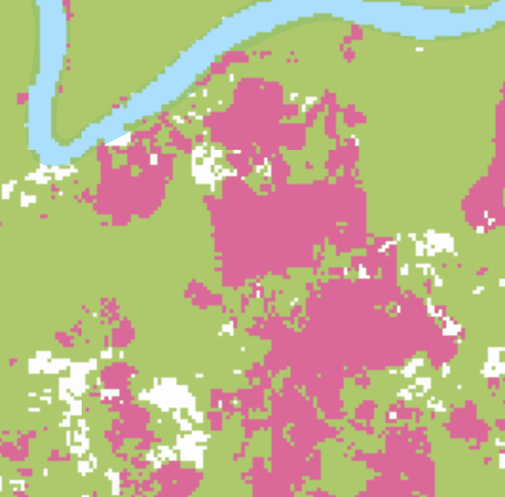
ALOS in Data Cubes
Open Data Cube Results
HV Threshold Change from 2010 to 2016
RED pixels show vegetation loss (e.g. deforestation). GREEN pixels show vegetation increase. WHITE pixels are non-forest. BLACK pixels experienced no significant change.
Global Forest Watch Results
Deforestation from 2010 to 2016
GREEN = Forest mask, RED = Forest Loss, WHITE = Non-forest

