Slide 1
National Land Imaging Study
Overview for the CEOS Land Satellite Imaging – Virtual Constellation (LSI-VC)
13 October 2020
Greg Snyder
USGS National Land Imaging Program
gsnyder@usgs.gov

Slide 2
U.S. National Plan for Civil Earth Observations, 2019
Goal 1: Support and Balance the Portfolio of Earth Observations
Objective 1.2: Implement innovative Federal procurement and acquisition
  Action: Identify shared agency needs related to land imaging and evaluate options for optimally addressing those needs with current resources through increased agency coordination.
To do this, USGS proposes a 1-year National Land Imaging Study to be completed by April 30, 2021
  Study will focus on developing findings and recommendations that will benefit agencies and applications within the following 5 years (2022-2026)
  Leverage and build on databases of user needs and capability information collected over the last few years as well as analytical tools currently under development

Slide 3
National Land Imaging Study Scope
“Land Imaging” Definition
  Land imaging is the collection of routine or targeted information about the surface of the Earth, to include elevation, composition, cover (including surface water), texture, and structure
  Measurements of geophysical parameters such as gravity, the magnetic field, etc. and
  sub-surface information will be excluded

Slide 4
Land Imaging Study Scope
Data from space-borne sensors that can provide land imaging information
  Electro-optical, thermal infrared, SAR radar/interferometers, passive microwave, altimeters, etc.
  U.S. civil, international, commercial systems
  Products derived from those sensors (e.g. new products, data harmonization)
  Enhancements to data acquisition or data delivery
National datasets that provide land surface information
The study will focus on systems available to users within the 5-year study window
  However, new capabilities just beyond study window (e.g. NASA Decadal Survey missions, Landsat Next) may influence the development of recommendations and will be considered in the analysis
Will NOT include in situ sensors or airborne missions

Slide 5
National Land Imaging Study Phases
Analysis of
Alternatives
Recommendation
Development
Study Prep
Gap Analysis
Phase I
Phase II
Phase III
Phase IV
Prepare Terms of Reference
  Establish study boundaries
Assess and augment user need completeness; collect underrepresented needs from agencies and applications
Verify analytical tool performance
Analyze user needs against land imaging architecture
Identify the set of needs that are well-served by the architecture, and not well-served (these are the gaps)
Conduct expert review of identified gaps
Identify and analyze candidate solutions to mitigate gaps, strengthen the architecture
Select high-feasibility solutions for deeper analysis
Conduct detailed analysis of feasible solutions and develop recommendations
Conduct expert review of recommendations
Develop final products
  Presentation
  Report
1 Aug 20
1 Nov 20
15 Dec 20
30 Apr 21

Slide 6
User Needs
Notes:
What’s included in the study

Slide 7
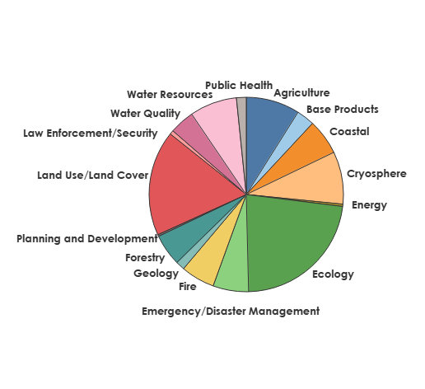
NLI Study User Needs Scope and Application Coverage
Distribution of needs by application
Study includes analysis of 759 unique user needs
Collected via direct interviews with subject matter experts in an iterative manner
  Ensures consistency of data across applications
  Allows for enhancements or collection of additional information at any time
User needs cover the broad land imaging user community
  Nearly all Federal Civil Agencies represented and expanding
  Spatial scales from sub-meter to multi-kilometer
  Temporal scales from near real-time to decadal

Slide 8
Core Architecture

Slide 9
Core Architecture Components
Sensors that provide routine and freely available data to users
Baseline to evaluate how well the land imaging architecture meets user needs in a given year
Analysis includes combinations of sensors that are commonly used together
  Terra and Aqua MODIS
  Sentinel series instruments
  Landsat series instruments
  Landsat and Sentinel 2 series instruments
Each platform/sensor is modeled in the architecture in the years they are operational
ESA
Sentinel 1
Sentinel 2
Sentinel 3
Sentinel 6
SMOS
FLEX
BIOMASS
LSTM
CHIME
NASA
Terra
Aqua
SMAP
SWOT
ICESat
PACE
NISAR*
SBG
SDC
NOAA
GOES
JPSS
USGS
Landsat
ISRO
ResourceSat

Slide 10
Architecture Evaluation Process

Slide 11




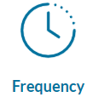


Architecture Evaluation Concept
Land Imaging
User Needs
User need/
capability pair
scores
MARCE
(Scoring Module)
Land Imaging Capabilities
Architecture Evaluation
Matches geophysical parameter
Scores 4 individual attributes
Integrated with the other factors already pre-built into the tool
Rating
4 directly scored attributes
(can be weighted)

Slide 12
Architecture Analysis Process Steps
Overall workflow for Phase II:
  Identify user need set and core architecture components & attributes
  Run MARCE (scoring module)
  For each user need, evaluate how well met they are by the architecture, which attributes were the limiting factors, and whether user need satisfaction changed over time
  Determine what capabilities were the top contributors (were the highest rated capability for the largest number of needs)
  Evaluate architecture resiliency (# of sensors scoring very well against a user need) over time as an assessment of “risk”
  Summarize core architecture strengths and weaknesses (potential gaps and targets for recommendations)

Slide 13
Exploring the Data
Examples from an early run for illustration – NOT final results!

Slide 14


2021 - User Need Agency Distribution and Average Scores
Notes:
One way to summarize the outcome of the architecture evaluation at a high level is to create word clouds illustrating different aspects of the data.
On this chart, the size of the text represents the relative number of user needs that were included in the evaluation.

Slide 15
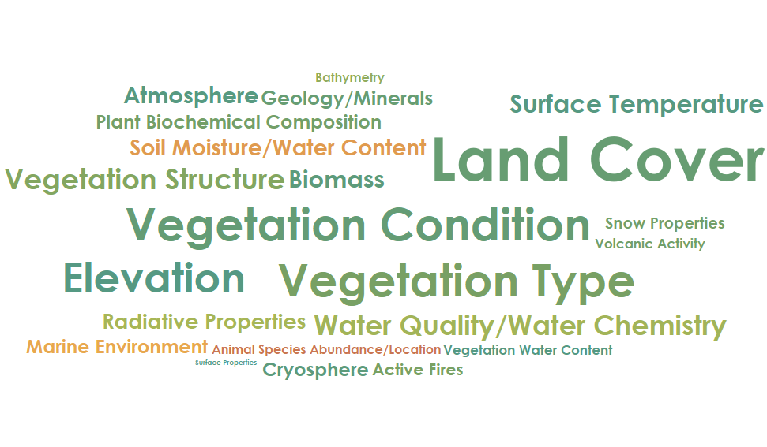
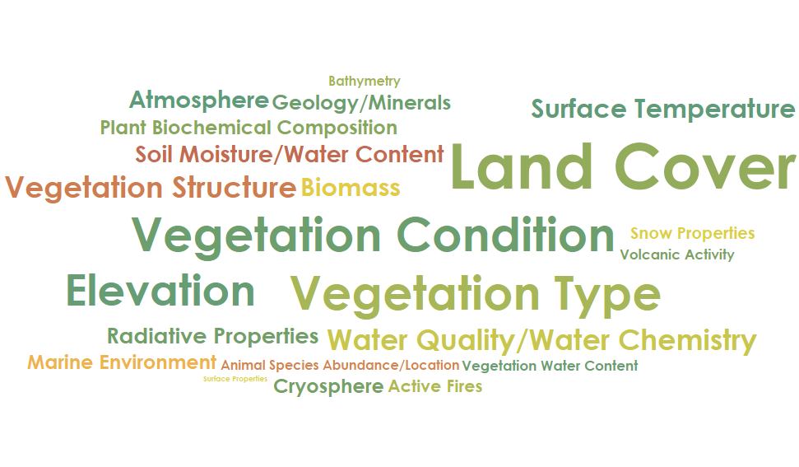
With and Without International Partners - 2029
With International Partners
Without International Partners
Notes:
These 2 word clouds are both for 2029 – so a single year, but it illustrates the importance of our international partners in meeting US user needs. The larger the text associated with a geophysical parameter group names, the more user needs we have within those geophysical parameter groups. So, for instance many more user needs for Land Cover and Vegetation Condition than for Biomass or Bathymetry.

Slide 16
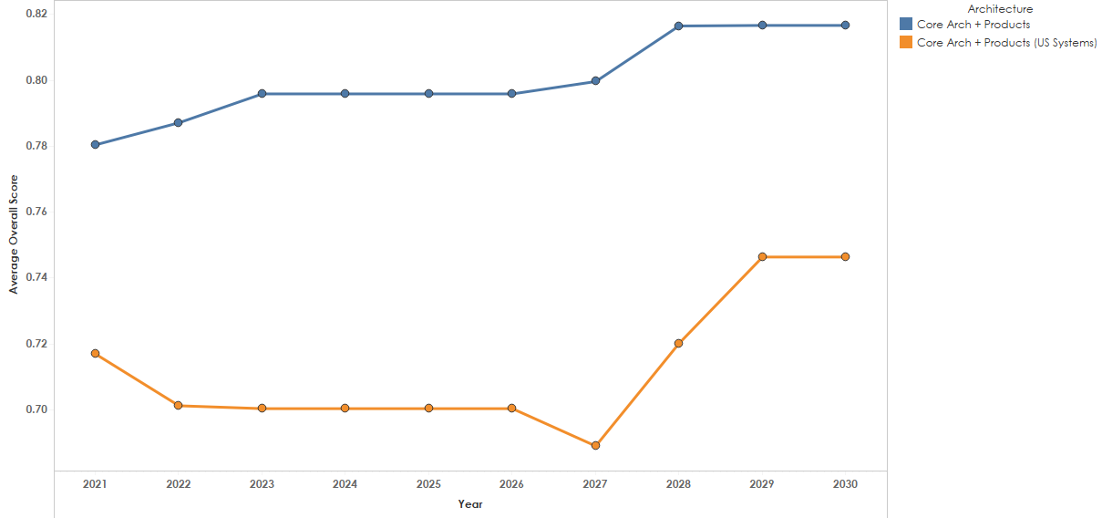
Arch Performance over Study Window
CHIME
LNext
FLEX
Sentinel 1C
NISAR
LSTM
PACE
Sentinel 2C
SBG
LNext
SMAP
ASTER
Launch
End of Life
Notes:
This again shows the international contribution to the architecture’s overall performance against our set of user needs, but in this case shows how that changes over time. Note the influence of new systems that launch in green, and the impact when a system reaches end of life in red.

Slide 17
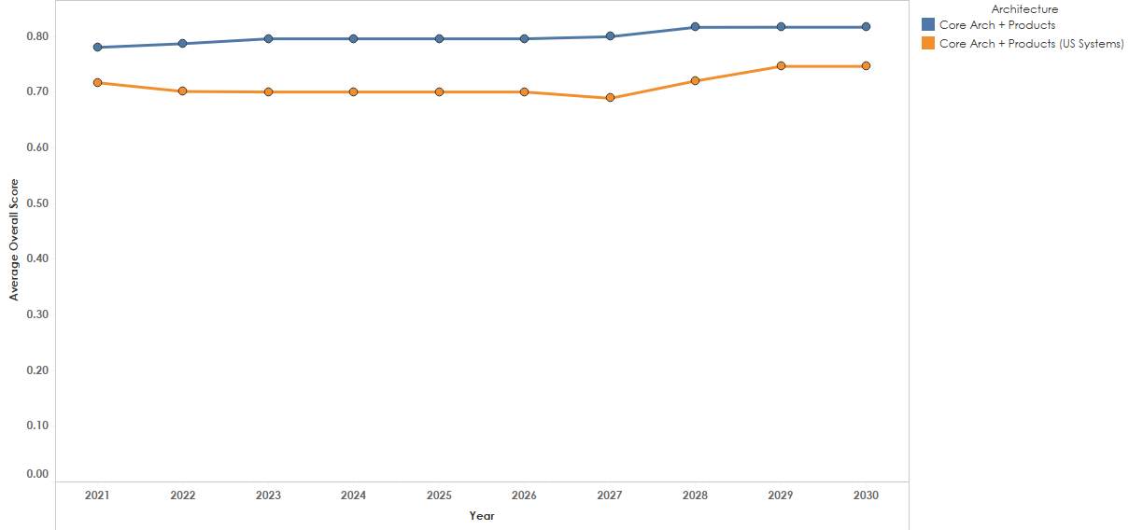
Arch Performance over Study Window
SBG
PACE
Sentinel 2C
FLEX
Sentinel 1C
NISAR
LSTM
CHIME
LNext
SMAP
ASTER
Launch
End of Life
Notes:
This again shows the international contribution to the architecture’s overall performance against our set of user needs, but in this case shows how that changes over time. Note the influence of new systems that launch in green, and the impact when a system reaches end of life in red. Overall there is a lot of stability in the architecture over time with incremental improvements over time. The X-axis scale is compressed compared to the previous chart.

Slide 18
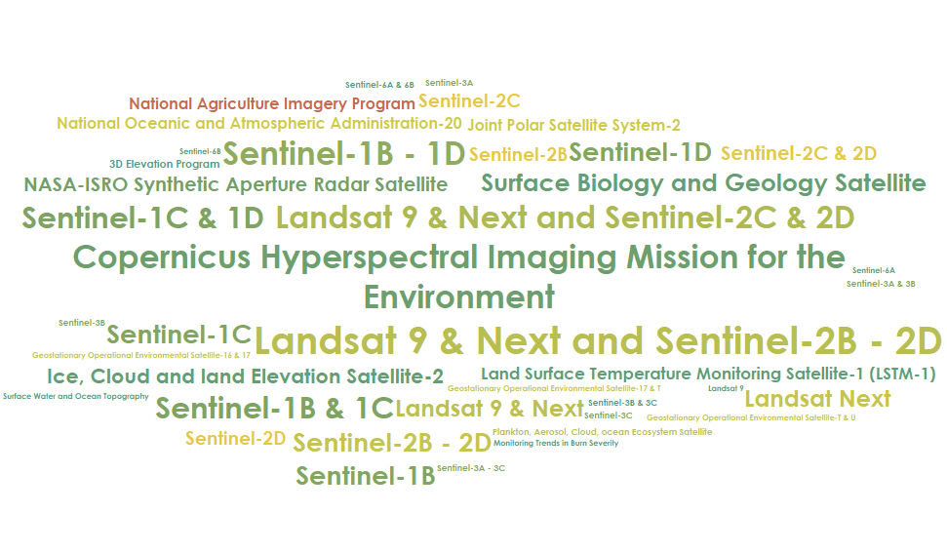
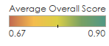
Top Sensors in 2029
Notes:
In this view, the size of the element is proportional to the number of user needs for which that sensor was the top-scoring sensor (note that when multiple systems have the same top score, they both get credit). The color again represents the overall average score across the user needs for which the sensor was top scoring.

Slide 19
Comments and Questions?

