Slide 1
An Overview of Copernicus Sentinel-2 Surface Reflectance Products from an Analysis Ready Data Perspective
Valentina Boccia, Ferran Gascon, ESA
Rosario Q. Iannone, Rhea
Enrico G. Cadau, Serco
27th May 2022

Slide 2
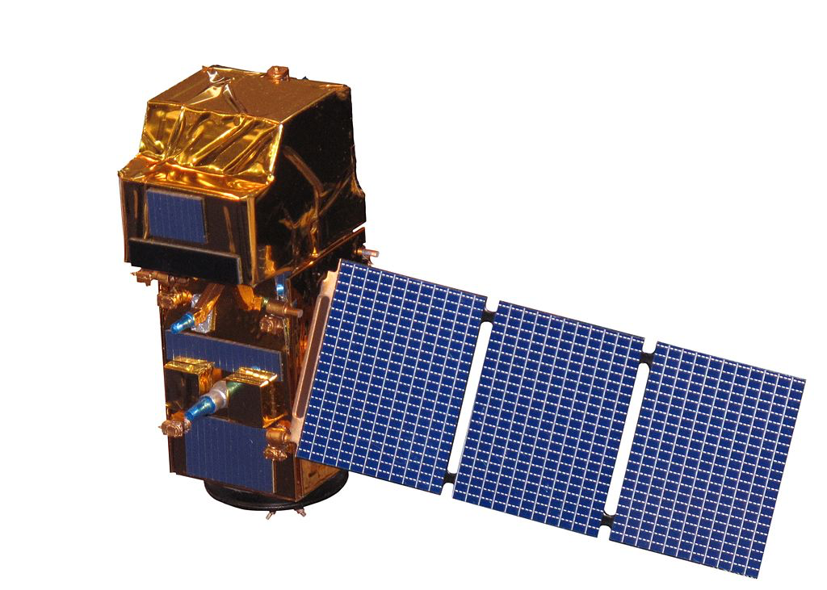
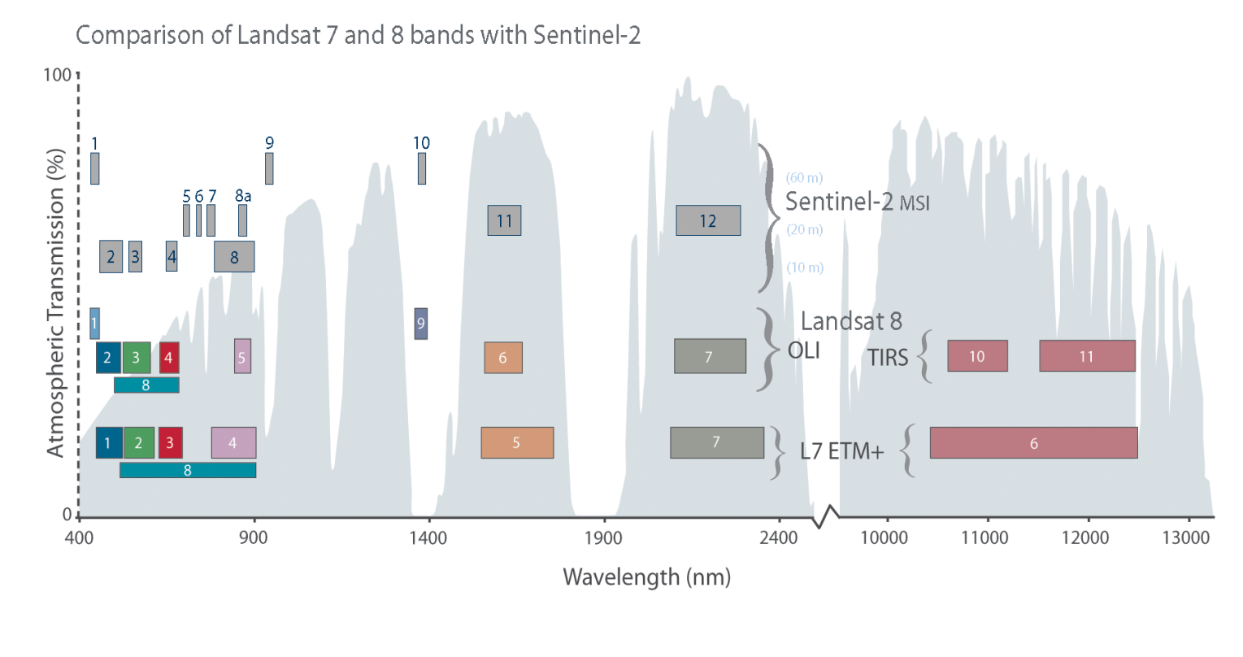
Copernicus Sentinel-2 Mission
Optical multi-spectral mission for the monitoring of land and coastal regions.
Constellation of two satellites (Sentinel-2A and Sentinel-2B).
Polar sun-synchronous orbit at an altitude of 786km, with LTDN 10h30.
Swath of 294km.
Free & open products for feeding a large range of applications.

Slide 3
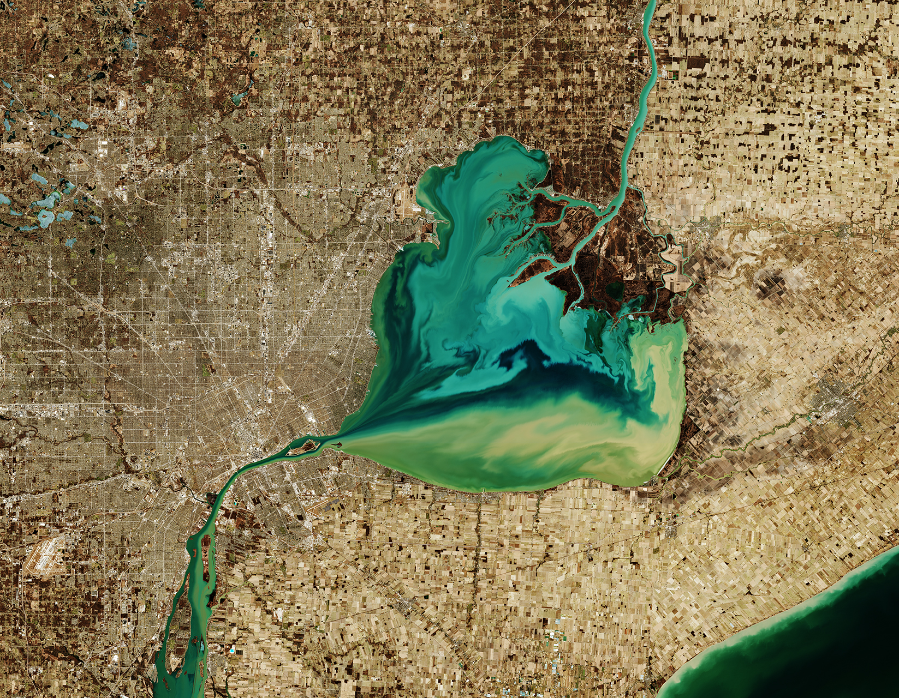
Copernicus Sentinel-2 Products
Product Name | Measurement Provided | Distribution | Production
Level-1B | Top-of-atmosphere radiance in sensor geometry | Expert users (planned) | Systematic
Level-1C | Top-of-atmosphere reflectance in cartographic geometry | Public | Systematic
Level-2A | Surface reflectance and pixel classification in cartographic geometry Analysis Ready Data (ARD) | Public | Systematic + SNAP
Lake St. Clair

Slide 4
Copernicus Sentinel-2 Products
B11
ARD Products

Slide 5
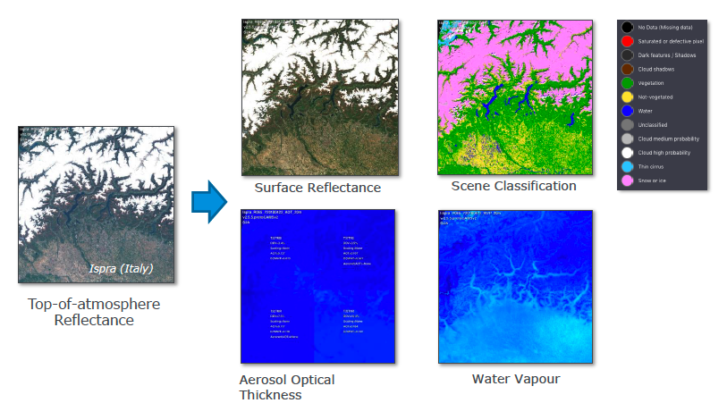
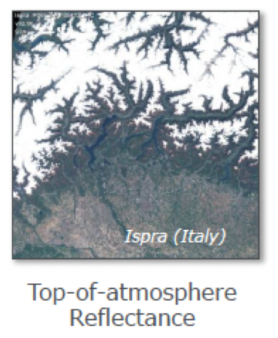
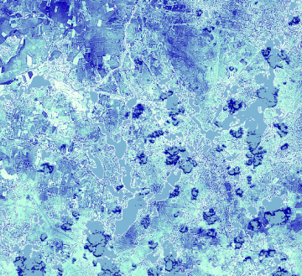
Sentinel-2 Level-1C and Level-2A Products
+ Cloud & Snow Confidence QI
Sen2Cor
Level-1C
Level-2A

Slide 6
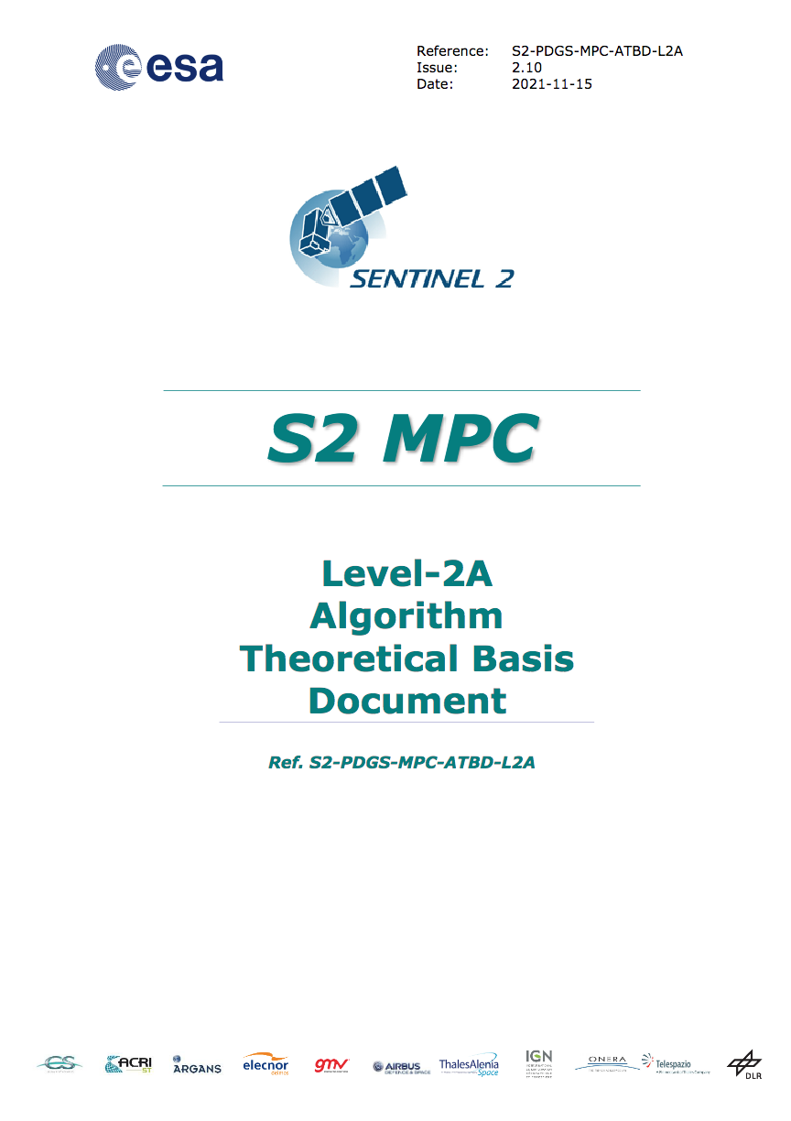
New sen2cor 2.10
https://step.esa.int/main/snap-supported-plugins/sen2cor/sen2cor-v2-10/
L2 ATBD (Algorithm Theoretical Basis Document) v2.10 was published online.

Slide 7
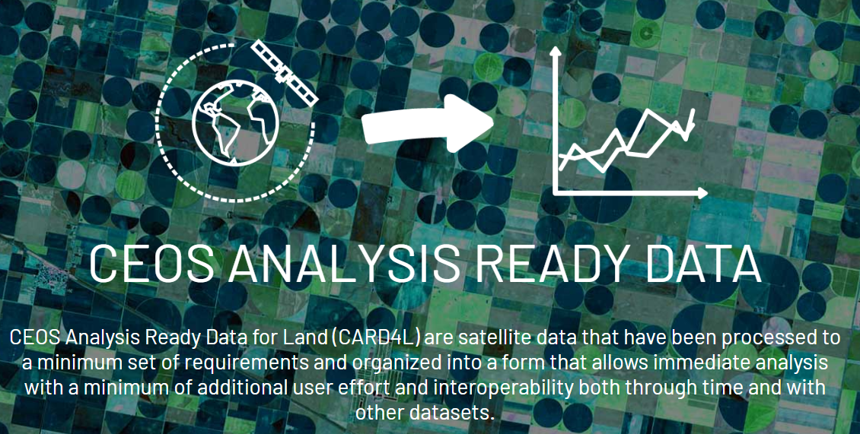
Sentinel-2 Products - Self-assessment to CEOS ARD
ESA has performed a self-assessment of the Sentinel-2 Level-2A product w.r.t. the CEOS ARD specifications for Surface Reflectance
http://ceos.org/ard

Slide 8
Sentinel-2 Products - Self-assessment to CEOS ARD
ESA has performed a self-assessment of the Sentinel-2 Level-2A product w.r.t. the CEOS ARD specifications for Surface Reflectance
http://ceos.org/ard

Slide 9
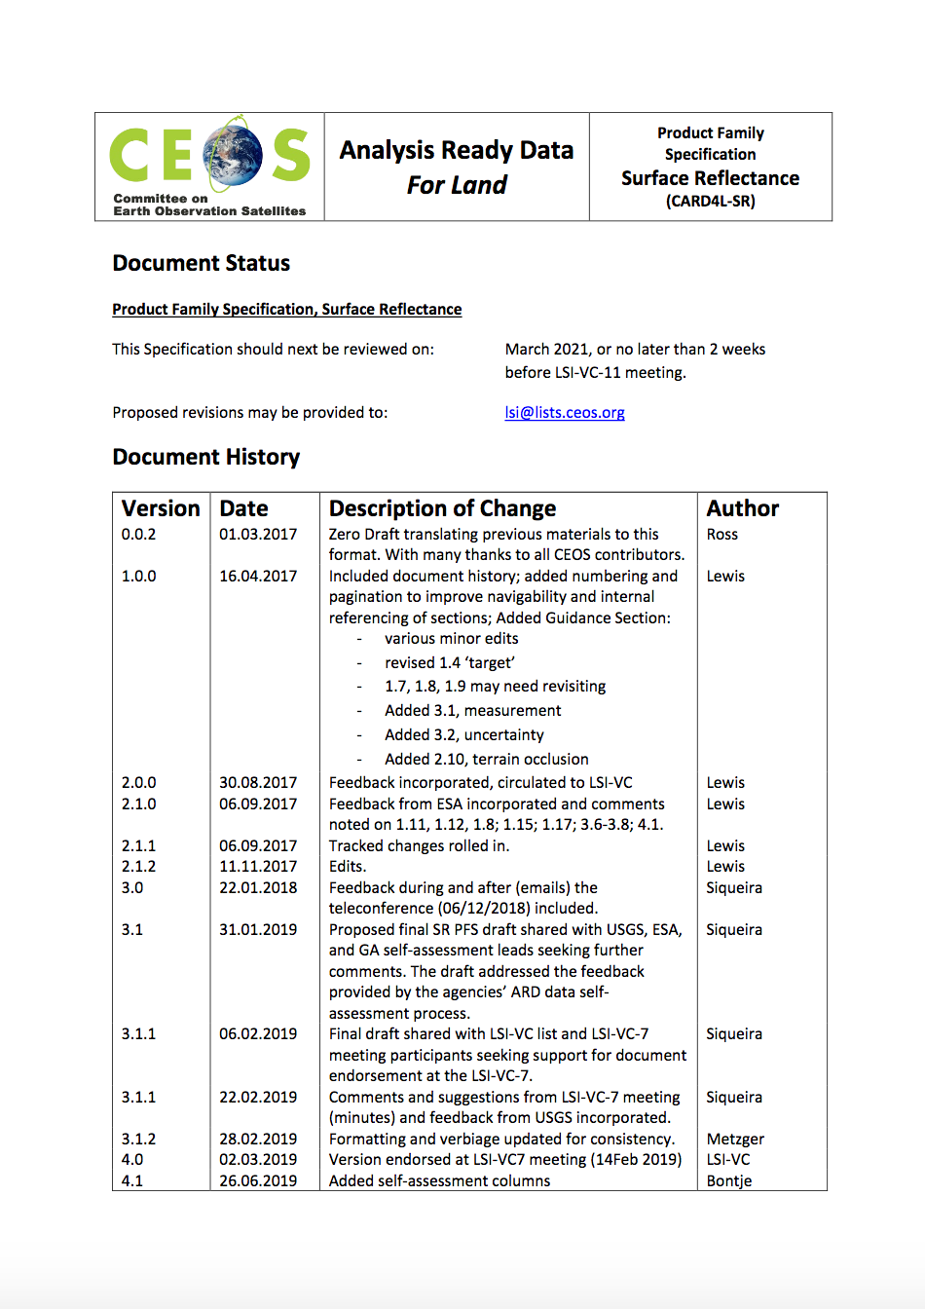
CEOS Analysis Ready Data for Land – CEOS ARD
CEOS ARD Product Family Specifications (PFS) for Surface Reflectance include requirements regarding:
General metadata
Per-pixel metadata
Radiometric and atmospheric correction
Geometric correction
For each requirement:
http://ceos.org/ard
THRESHOLD – minimum requirement considered sufficient to render the product ready for analysis;
TARGET – more stringent requirement that further improves the product quality/usefulness.
B11

Slide 10
Sentinel-2 & CEOS ARD PFS Surface Reflectance
THRESHOLD (Minimum Requirements) General Metadata
Traceability
Metadata machine readability
Data collection time
Geographical Area
Coordinate Reference System
Map Projection
Geometric Correction Methods
Geometric Accuracy of the Data
Instrument
Spectral Bands
Sensor Calibration
Radiometric Accuracy
Algorithms
Auxiliary Data
Processing Chain Provenance
Data access
Overall Data Quality
Data Collection Time
Instrument
Coordinate Reference System
Data Access
Information on data access should be available in the metadata as a single DOI landing page. Note 1: Manual and offline interaction action (e.g. log in) may be required.
Spectral Band
Not Required
S2 products Status:
Compliant
Not Compliant

Slide 11
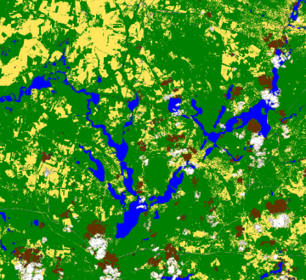
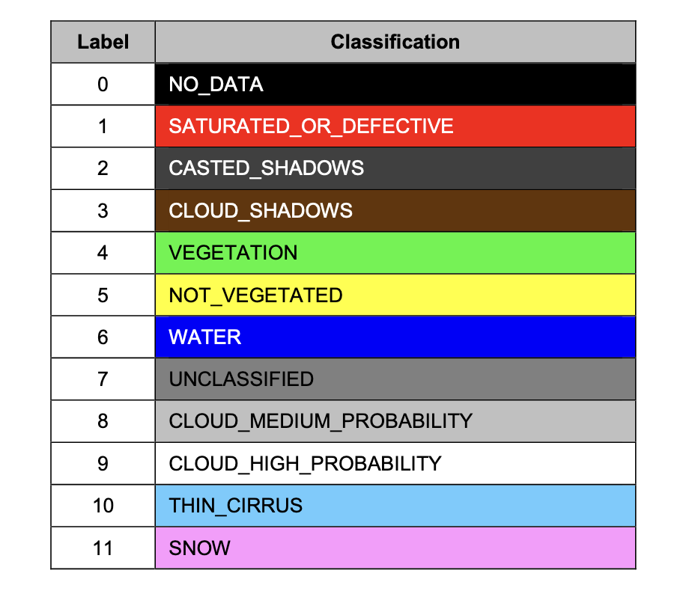
Sentinel-2 & CEOS ARD PFS Surface Reflectance
THRESHOLD Per-Pixel Metadata
Metadata machine readability
No Data
Incomplete Testing
Saturation
Cloud
Cloud Shadow
Land/Water Mask
Snow/Ice Mask
Terrain Shadow Mask
Terrain Occlusion
Solar and Viewing Geometry
Terrain Illumination Correction
Aerosol Optical Depth Parameters
THRESHOLD Radiometric and Atmospheric Correction
S2 products Status:
Measurement
Measurement Uncertainty
Measurement Normalisation
Direction Atmospheric Scattering
Water Vapor correction
Ozone Correction
Not Required
Compliant
Not Compliant

Slide 12
Sentinel-2 & CEOS ARD PFS Surface Reflectance
Sentinel-2 products compliant with CEOS ARD threshold requirements by beg-2022, after:
Global activation of geometric refinement meeting multi-temporal registration performances <0.5 pixel 95% Circular Error.
Inclusion of a DOI (Digital Object Identifier) in the metadata.

Slide 13
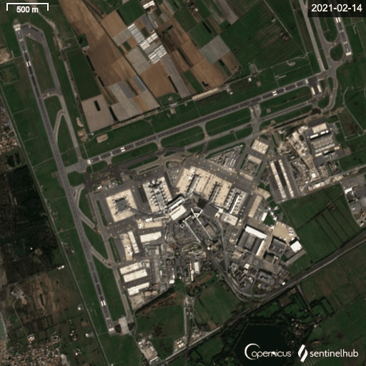
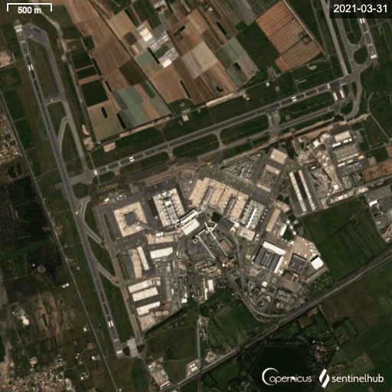
Sentinel-2 & CEOS ARD PFS Assessment
Sentinel-2 images of Rome Fiumicino airport
Since 30 March 2021, geometric refinement applied over Europe and Africa.
Since 23 August 2021, applied worldwide.
Multi-temporal registration performances <5m at 95% Circular Error.
Not refined geometry
Refined geometry
Copyright: contains modified Copernicus Sentinel data (2021), processed with Sentinel Hub EO Browser
Absolute geolocation accuracy from 11 m improved to 8 m (CE95)
Multi-temporal co-registration accuracy from 12 m improved to 5 m (CE95)
B11

Slide 14
Sentinel-2 & CEOS ARD PFS Assessment
On 25th January 2022: Major Products Update !
Activation of PB 04.00 (PSD 14.9) featuring the following main improvements:
Level-1C:
Handling of negative radiometric values (implementing an offset);
Addition of new ECMWF parameters in the AUX_DATA: u/v wind components (10u and 10v) and relative humidity (r)
Inclusion of CAMS (Copernicus Atmosphere Monitoring Service) parameters: aod550, surface geopotential (z), bcaod550, duaod550, omaod550, ssaod550, suaod550, aod469, aod670, aod865 and aod1240
Addition of a Digital Object Identifier (DOI) in the L1C metadata.
Generation of the quality L1C masks in raster format in jp2;
Addition of Snow/Ice Mask;
Removal of radiometric bias between S2A and S2B (with S2A as reference);
Level-2A:
Adaptation of Level-2A processor to the L1C evolutions;
Improvement of Scene Classification:
Consistent aerosols correction over complete datastrip (using CAMS auxiliary data);
Provision of band B01 also at 20m resolution (currently provided only at 60m resolution);
Addition of L2A Quality Indicators (new fields in tile metadata + additional xml L2A_QI_report in the QI_DATA folder);
Addition of a Digital Object Identifier (DOI) in the L2A metadata according to CEOS ARD SR Specifications.

Slide 15
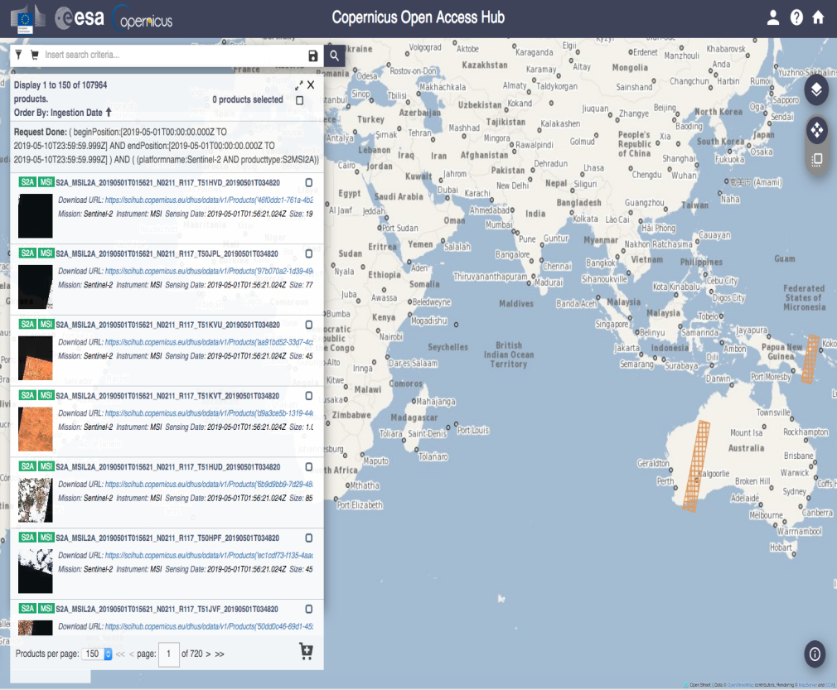
Sentinel-2 & CEOS ARD PFS Assessment
ESA data access is ensuring that Sentinel-2 core products are accessible online to all users.
https://sentinel.esa.int/web/sentinel/sentinel-data-access/sentinel-products/sentinel-2-data-products/collection-1-level-2a
https://scihub.copernicus.eu/dhus/
DOI:
10.5270/S2_-znk9xsj

Slide 16
Generation of Sentinel-2 Collection-1
Preparatory activities for the reprocessing of the entire Sentinel-2 mission EO data archive (both L1C and L2A), i.e. for generation of the S2 Collection-1 (C1), are on-going.
Processing Baseline PB 04.00 will be the starting point to reprocess both S2 L1C and L2A data. Some further improvements are under discussion.
The S2 Collection-1 will be compliant to the CEOS Analysis Ready Data for Land (CEOS ARD) specifications at threshold level.

Slide 17
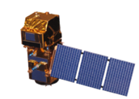
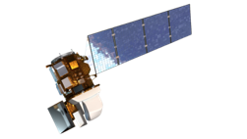
Sentinel-2 / Way Forward/ L2H and L2F
Harmonisation (Level-2H product) includes consistent atmospheric corrections (same ATM algorithm), spectral adjustments, BRDF adjustments and re-gridding.
Fusion (Level-2F product) brings L8/9 resolution to S2 one.
L2F
S10
L10
S2 L1C/2A
Archive
Stitching
Geometric Processing
Atmospheric Correction
BRDF Adjustment
Fusion
L2H
S10
L30
L8/9 L1T Archive
Stitching
Geometric Processing
Atmospheric Correction
BRDF Adjustment
Spectral
Adjustment
Level-2H: harmonised Sentinel-2 and Landsat 8/9 products (native spatial resolutions kept):
L2H-S2: B01 B02 B03 B04 B8A B11 B12 + red-edge bands + B8.
L2H-L8: B01 B02 B03 B04 B05 B06 B07 + (B08 B10 B11).
Level-2F: fused Landsat 8/9 to Sentinel-2 products (S2 spatial resolution for Landsat data):
L2F-S2: B01 B02 B03 B04 B8A B11 B12 + red-edge bands + B8.
L2F-L8: B01 B02 B03 B04 B05 B06 B07 + (B08 B10 B11).
2 new ARD products

Slide 18
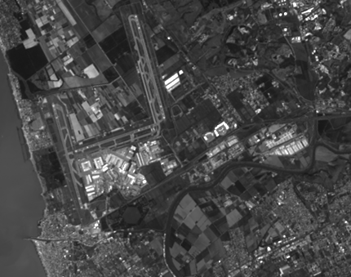
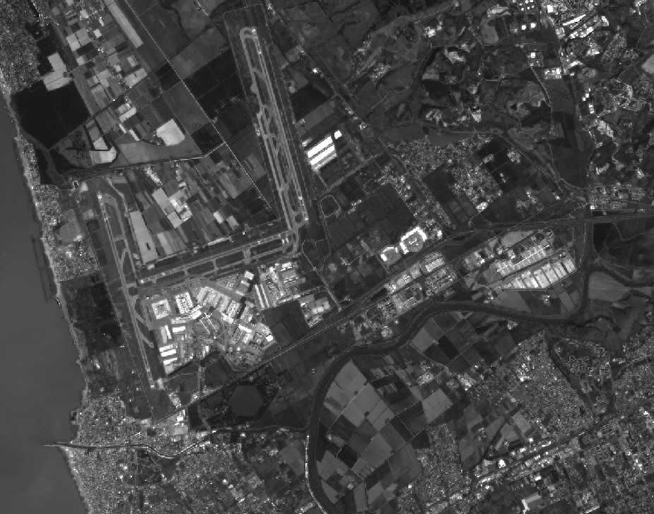
Sentinel-2 / Way Forward/ L2H and L2F
B02
B02
fusion
L2H L9 – 22/03/2022 (30m)
L2F L9 – 22/03/2022 (10m)

Slide 19
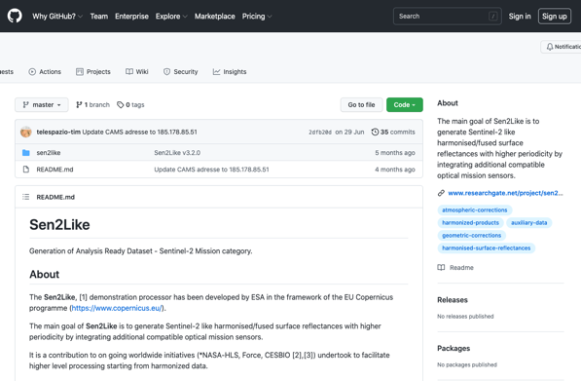
S2-Landsat Harmonised and Fused Products
Sen2Like version 3.3 featuring the following improvements:
BRDF correction (in NBAR) can use VJB coefficient in place of ROY;
Add a new module for intercalibration correction;
Use SCL files from L2A, if exist, to compute validity mask;
Add a fusion auto check and his result in intermediate product and output;
Local product are now filter by cloud cover as CREODIAS product;
Automatic Copernicus DEM download and usage.
Processor (Sen2Like 3.3) available on GitHub: https://github.com/senbox-org/sen2like

Slide 20
Sentinel-2 & CEOS ARD Conclusion
Sentinel-2 products compliant with CEOS ARD threshold requirements on 25th January 2022, with the inclusion of a DOI (Digital Object Identifier) in the metadata and Geometric Refinement.
ESA active involvement in the defining process of the CEOS ARD Product Family Specifications document;
Process to be initiated to certify the Sentinel-2 Level-2A products compliance to CEOS ARD Surface Reflectance PFS at Target level.

Slide 21
Thank you
Barranquilla, Colombia

