Slide 1
CEOS Strategy for Analysis Ready Data
Ferran Gascon
ESA LPS
27 May 2022

Slide 2
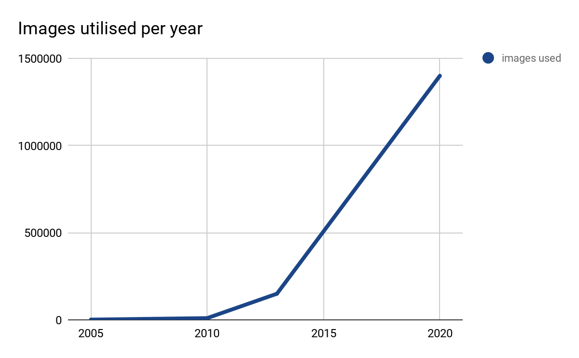
Automation and interoperability
Big data - exponential growth, needs automated processing that frees the user to focus on the applications.
Time-series analysis needs data that are comparable through time
Operational continuity through time needs comparability between sensors L5/L7/L8/L9 … S2A/S2B
Notes:
There three ‘drivers’ for analysis ready data - the ‘why’. They are interconnected.
Big data. The exponential increase in data flow means that it’s inefficient to be repeating any unnecessary processing, including Pre-processing. It is also impossible to process even a fraction of the data in ‘bespoke’ ways. Specialised pre-processing is a thing of the past. More than ever before, users need to be able to engage with the data, not with the pre-processing.
Scientific advance to time-series analysis. Scientifically we now know how much information lies in the time-series of observation. But to use a time-series you have to be able to compare the data through time - knowing that if a data value changes that change is likely due to a change on the ground / in the water.
Operational systems. The new capabilities of land Observation mean that these can become operational. However, to be operational you have to be able to plan beyond one sensor. The data from different sensors of the same family or general ‘type’ will have to be interleaved, or cross-calibrated, or used to produce the one product that will endure through time.

Slide 3
Geophysical measurements
In response:
Rather than working with images that need extensive and specialised pre-processing, we work with geophysical measurements as the basic data point
‘analysis-ready’
Measurements are inherently intercomparable
We’re working (mostly) on the land and water surface - so we prefer land surface measurements
E.g. Surface reflectance, aquatic reflectance, surface temperature, and normalised radar backscatter.
Geophysical measurements are the core idea behind CEOS Analysis Ready Data (CEOS-ARD)
Notes:
The broad solution to these problems will be to move land surface imaging from being ‘top of atmosphere’ to being ‘land surface’ and to move from image analysis, which is essentially empirical, to regarding each pixel as a measurement of the land surface, quality assured and corrected for known and controllable sources of error.
That is the journey we are on now.
Progress is really good. The teams working on this have identified a number of such measurements, including the four mentioned on this slide. Specifications have been developed, and data are being produced.
The next speaker, Andreia, will go into the CEOS framework itself.

Slide 4
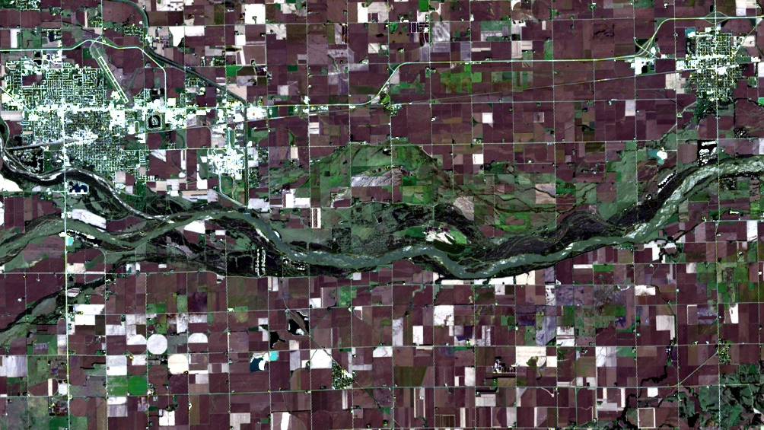
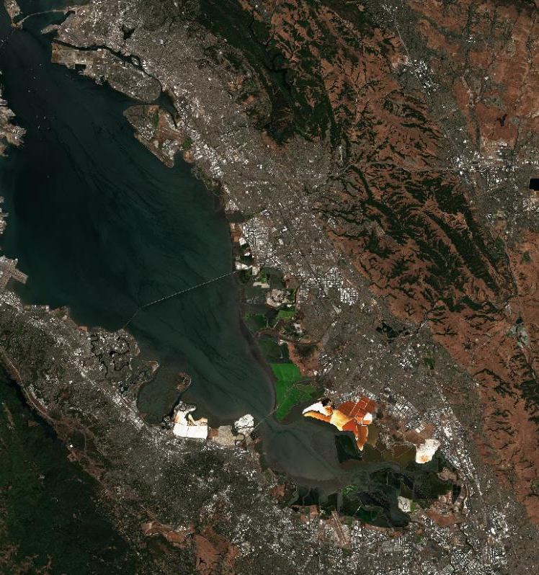
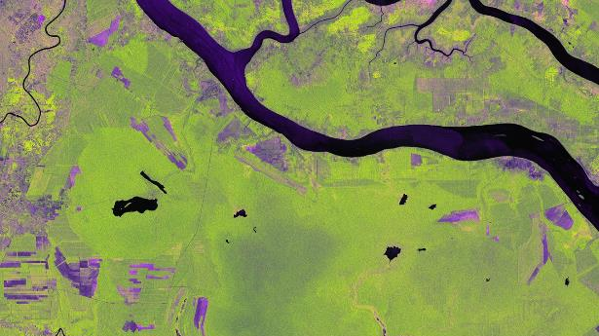
USGS Collection 2 Landsat 8 Level-2 Surface Reflectance
CEOS-ARD Examples
ALOS-2 PALSAR-2 Polarimetric Decomposition
©JAXA
Proc. by F. Charbonneau
Copernicus Sentinel-2 Level-2A Surface Reflectance
ALOS-2 PALSAR-2 Normalised Radar Backscatter
©JAXA
Proc. JAXA EORC
Notes:
CARD4L examples:
USGS Collection 2 – landsat 8 level-2 surface reflectance is an example of CEOS ARD. Formal self-assessment and peer-review – results will be made available on the CEOS ARD webpage.
the Level 2A surface reflectance product from ESA.
Expectation is that JAXA ALOS-2 PALSAR-2 polarimetric decomposition and Normalised radar backscatter will also be CEOS ARD compliant datasets.

Slide 5
CEOS Analysis Ready Data (CEOS-ARD) are satellite data that have been processed to a minimum set of requirements and organized into a form that allows:
immediate analysis with a minimum of additional user effort
interoperability both through time and with other datasets
http://ceos.org/ard
Notes:
There are two points to be made about this slide.
We needed to define the term ‘ARD’. In CEOS we did this in 2016: CEOS ARD are satellite data that have been processed to a minimum set of requirements and organised into a form that allows immediate analysis with a minimum of additional user effort, and interoperability both through time and with other datasets.
This work was initially led by the Land Surface Imaging sub-group of CEOS, or LSI. Which includes members from over 12 space agencies. More than that, a much wider community of experts in remote sensing - including passive reflection, passive thermal, Radar and more recently Space Lidar have been involved in groups working on the technical detail.

Slide 6
CEOS ARD Story So Far...
Initially (2016-2019) lead by the CEOS Land Surface Imaging Virtual Constellation
Definition
Product Family Specifications
Assessment Procedure
CEOS Working Group Cal/Val Peer Assessment
Product assessments
ceos.org/ard
Branding
Various outreach activities, conferences, meetings
Webinars

Slide 7
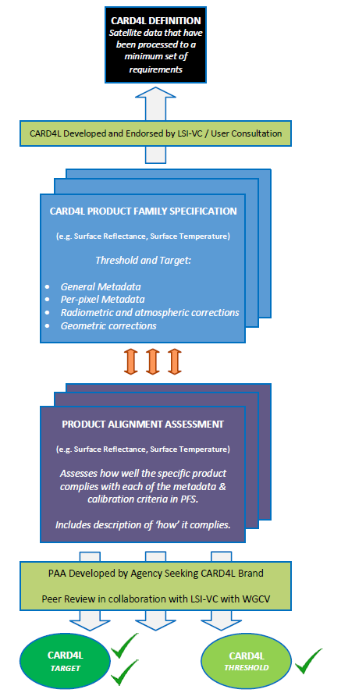
CEOS-ARD Framework
1) CEOS-ARD Definition
2) Product Family Specifications (PFS)
3) Product Alignment Assessment
Providers self-assessment
Peer-review assessment
ceos.org/ard
CEOS-ARD compliant stamp!
Notes:
the CEOS Analysis Ready Data framework has 3 elements:
1. the definition, which Adam already talked about in his presentation
The Product Family Specifications, which are technical documents and provide details on what type of corrections the data providers need to do, in order to deliver Analysis Ready Data to their user community.
§ Initially 3 PFS were created and endorsed (SR, ST and NRB)
§ and more recently, a new PFS for Polarimetric Radar was endorsed by the LSI-VC community
§ There are also other PFSs under development which are mainly driven by user needs
And, The last part of the framework is the Product Alignment Assessment process which has two steps:
§ The first one is the self-assessment process (which is a process where data providers self-assess their products using the specifications to understand how well their products meet the CEOS Analysis Ready Data specifications) and
§ the peer-review process - which is an independent assessment to confirm the CEOS ARD product level (threshold or target level)
· Once the Product alignment Assessment process is completed and the CEOS ARD product level is confirmed, the CARD dataset is catalogued for promotion and ease of access for users.

Slide 8
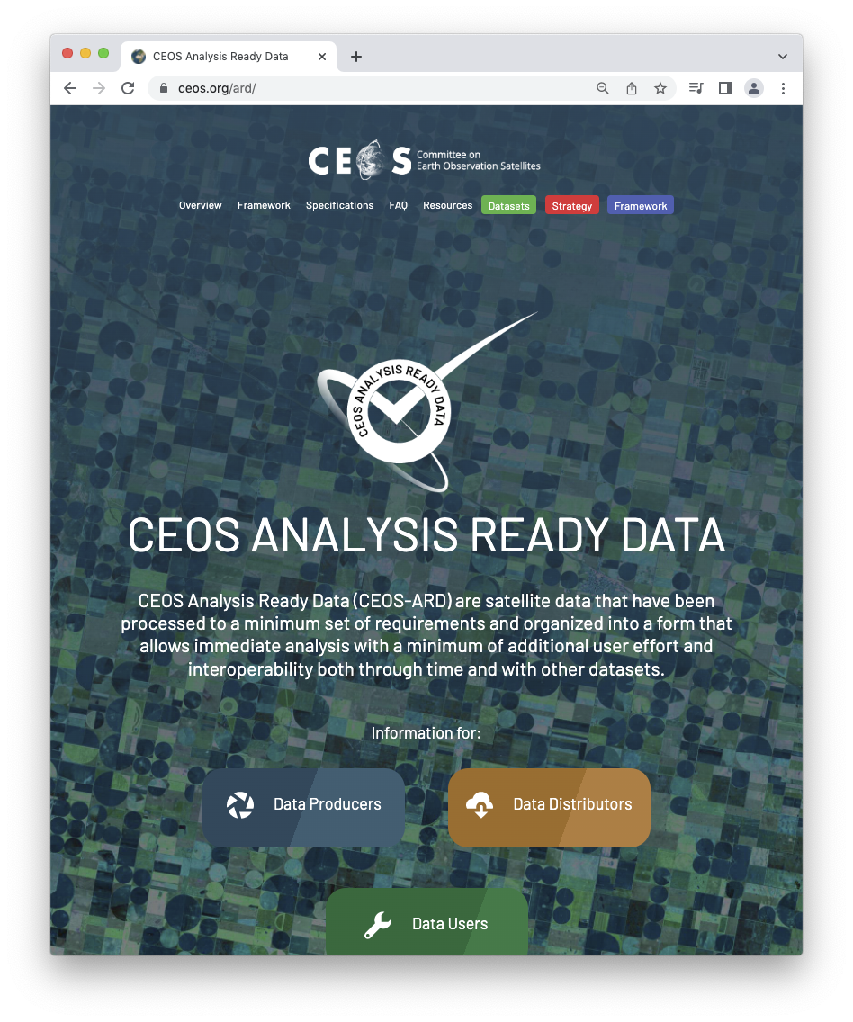
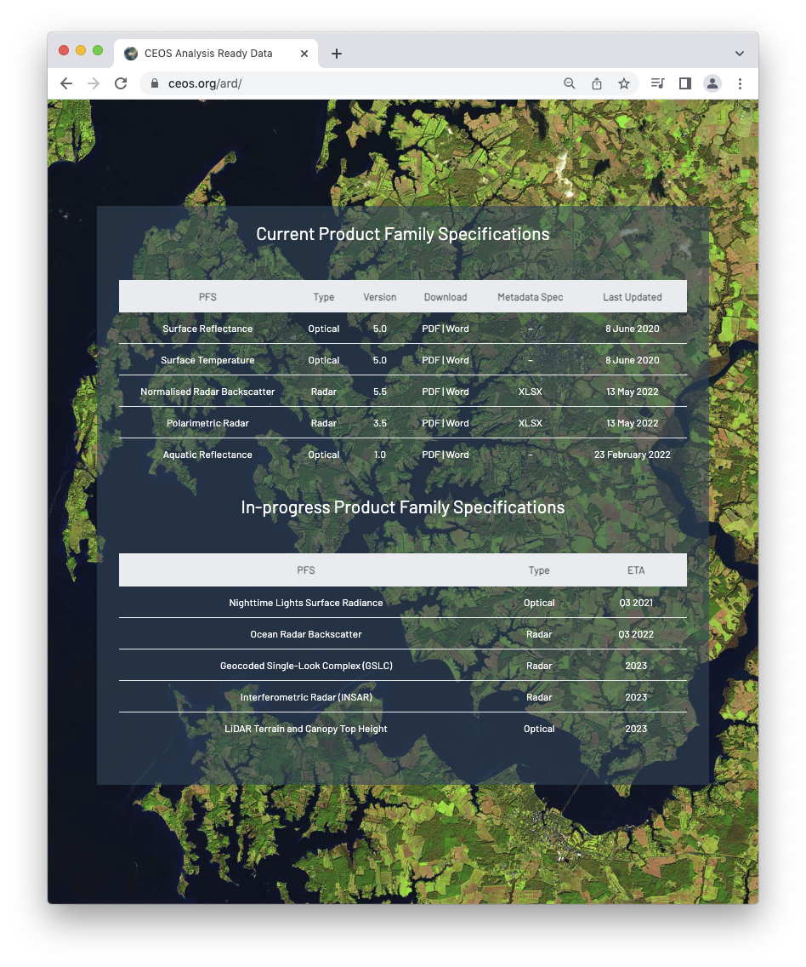
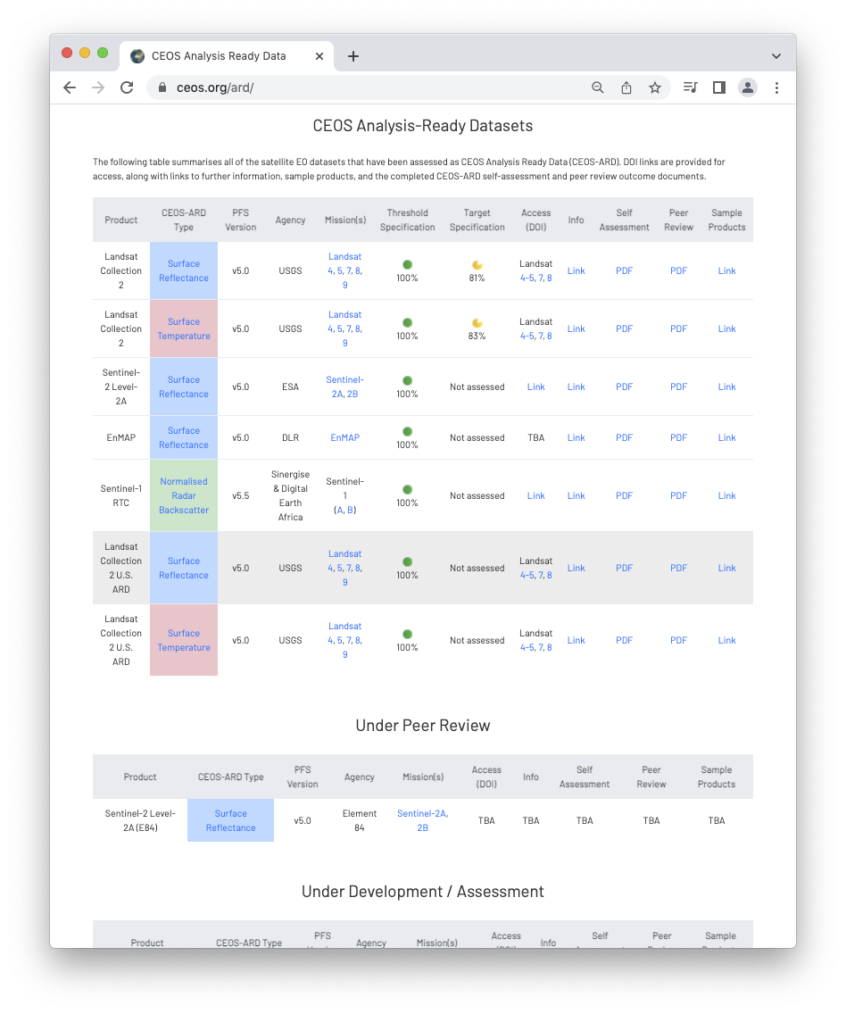

Slide 9
Beyond Land (CARD4L)
CEOS Analysis Ready Data broadened to be ‘beyond land’ in 2021.
Governance framework for CEOS Analysis Ready Data (CEOS-ARD) endorsed at CEOS Plenary 2021
Available here
Formalises the process LSI-VC has used for CARD4L and generalises it
References the CEOS-ARD Oversight Group, which was also initiated at CEOS Plenary 2021 as a result
Other key documents:
Template for Product Family Specifications
CEOS-ARD Strategy 2021

Slide 10
New
Product Family Specification!

Slide 11
CEOS ARD Strategy 2021
Provides direction for the next stage of CEOS activity on ARD
Aim to ensure that CEOS data is as impactful as possible
Leadership, Governance and Accessibility and utilisation of CEOS ARD emerge as pillars of the strategy
Available here

Slide 12
ARD Leadership
Outreach
Webinars
Community Engagement
Mission Planning
User Needs
Requirements
Value of CEOS-ARD
CEOS-ARD Evolution
Governance and Support
CEOS-ARD Oversight Group
CEOS Resources
WGCV peer review
CEOS ARD Strategy 2021
Accessibility
Comprehensive ARD catalogue
Machine-to-machine compatibility of CEOS-ARD
Advisory Notes
CEOS-ARD across data platforms / the cloud

Slide 13
CEOS-ARD Oversight Group
Core component of the CEOS-ARD Governance Framework
Forum for all matters related to CEOS-ARD
Representatives CEOS Virtual Constellations
integral to the effort
CEOS entities with the technical expertise to recommend, develop and maintain Product Family Specifications
Coordination across CEOS
Promote CEOS-ARD in a unified way

Slide 14
CEOS-ARD OG Activities
CEOS coordination on ARD
CEOS-ARD Strategy
CEOS-ARD Governance Framework
Support and guide
Coordination of CEOS-ARD Product Family Specifications (PFS)
Template PFS
Technical topics: accessibility, utilisation, discovery, formats, STAC, pilots, etc.
Community representation
Outreach activities
Champion ARD concept
ARD Standards
Primary focal point for CEOS-ARD

Slide 15
Recent CEOS-ARD OG Topics
ARD Standardisation
Clear request from government and commercial sectors
Likely necessary for widespread engagement
Taking discussion forward with ISO, OGC, IEEE, etc.
CEOS-ARD STAC Sprint (March 1-3)
SpatioTemporal Asset Catalog (STAC): common specification to describe a range of geospatial metadata, so it can more easily be indexed and discovered by building interoperable catalogues
Work ongoing on CEOS-ARD extension (mapping CEOS-ARD requirements to STAC fields)
Also covers processing provenance and validation
Revising template PFS for atmospheric/ocean/land product consistency
EUMETSAT providing input on atmospheric composition ARD

Slide 16
How to get involved?
Uptake beyond CEOS is critical
Any data provider can submit a self-assessment
Regular PFS updates – all feedback goes into the process
Involvement in the CEOS Virtual Constellations
Development of new Product Family Specifications
Technical inputs and discussions
Contact: matthew@symbioscomms.com
Standardisation discussion
Based on the foundation of CEOS-ARD
Opportunity to input to that process

Slide 17
More information
ceos.org/ard
CEOS-ARD Newsletter Sign-up
CEOS ARD Webinar #1 – July 1, 2020
CEOS ARD Webinar #2 (SAR) – February 1 & 2, 2021

Slide 18
Thank you!
Questions?

Slide 19
CEOS-ARD OG Members
Ferran Gascon (Lead) SIT Chair Team
Matthew Steventon Secretariat
Andreia Siqueira LSI-VC
Steve Labahn LSI-VC
Peter Strobl LSI-VC
Maycira Costa OCR-VC
Mark Higgins OST-VC
Raj Kumar Sharma OSVW-VC
Ed Armstrong SST-VC
Chris Kidd P-VC
Barry Lefer AC-VC
Medhavy Thankappan WGCV
Philippe Goryl WGCV
Makoto Natsuisaka WGISS
Jorge Del Rio Vera WGCapD
Mailing list: ard-oversight-group@lists.ceos.org

