Slide 1
Toward a family of SAR ARD products
Living Planet Symposium 2022 in Bonn
Clément Albinet¹, Anna Wendleder², John Truckenbrodt³, Jonas Eberle², Katrin Molch², Achim Roth², Antonio Valentino⁴, Sabrina Pinori⁵, Kajal Haria⁶
1 ESA - European Space Research Institute, Italy
2 DLR, Germany
3 University of Jena / DLR, Germany
4 RHEA, Italy
5 Serco, Italy
6 Telespazio VEGA, U.K.
27th May 2022

Slide 2
Content
    Introduction: Why joint DLR and ESA product?
    Sentinel-1 ARD
      Product definition
      Processing steps
    DLR processor for Sentinel-1
    ESA Sentinel-1 ARD prototype
    ESA-DLR coordination
    Other SAR ARD products in development at ESA & DLR
    Time schedule and access for users to S1 ARD NRB
    Conclusion

Slide 3


Introduction: Why joint ESA and DLR product?
Definition CEOS Analysis Ready Data (ARD):
“[…] data that have been processed to a minimum set of requirements and organized into a form
that allows immediate analysis with a minimum of additional user effort and interoperability both
through time and with other datasets.” (http://ceos.org/ard )
Main benefits of an ARD product:
No need for larger data preprocessing by users
Align gridding and projections of different datasets
Considering requirements of users
Joint DLR and ESA Sentinel-1 ARD Normalized Radar Backscatter (NRB) product:
Developed at DLR (terrabyte) and ESA (COPA)
Coordinated definition of SAR ARD products and same processing steps
Applied on existing missions like Sentinel-1, ERS-1/2, and ENVISAT
Extended to future missions like Sentinel-1 NG, HRWS, Tandem-L, ROSE-L, BIOMASS

Slide 4
A family of SAR ARD products
Landsat
Sentinel-2
ERS-1/2
ENVISAT
Sentinel-1
Sentinel-1 NG
BIOMASS
ROSE-L
HRWS

Slide 5
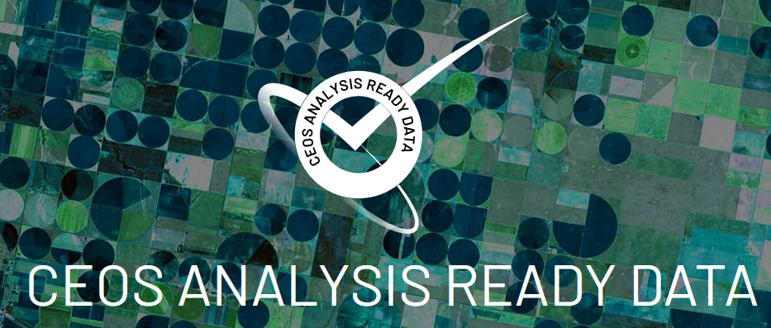
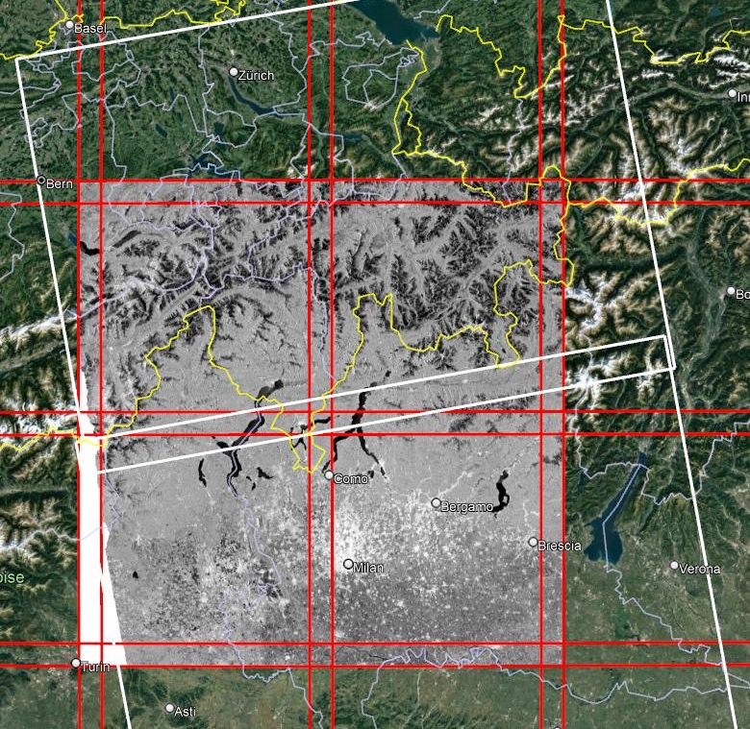
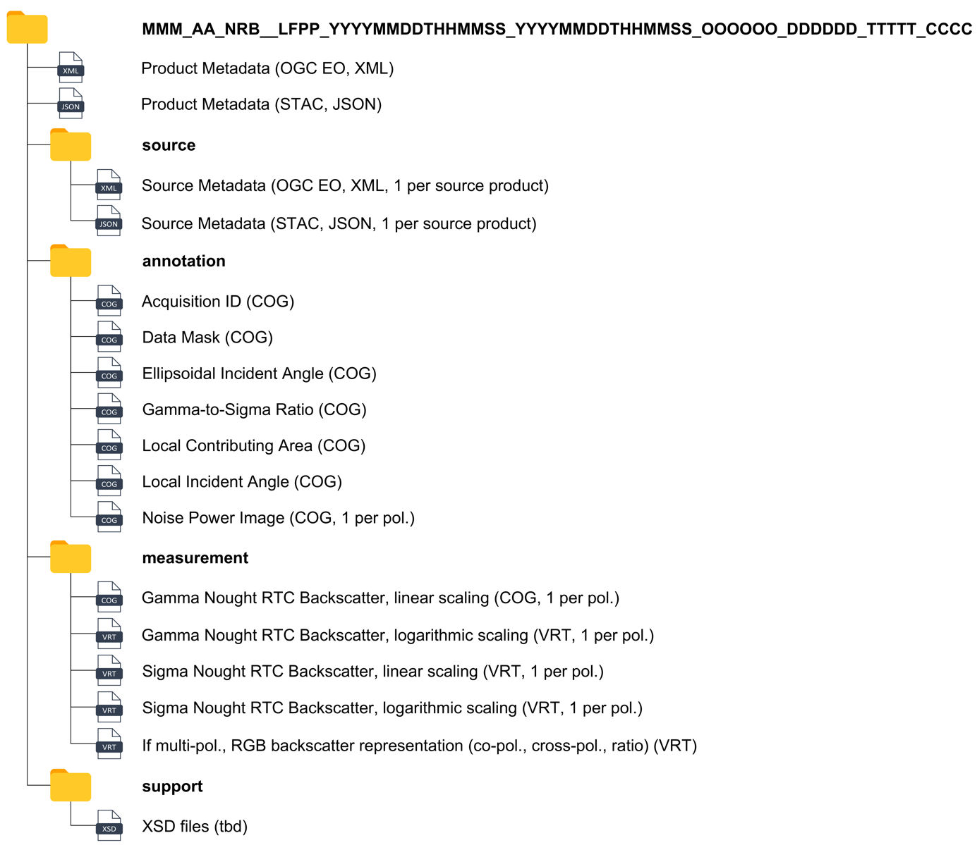
Sentinel-1: Product definition
Based on CEOS CARD4L NRB guidelines
Input data: Sentinel-1 SLC and Copernicus DEM
Mandatory output:
  Measurement (Gamma Naught RTC)
  Local incidence angle
  Data mask (few MB)
  Aquisition id (few hundreds kB)
Product organisation and name convention: according to COPA Product Specification
Target geometric accuracy:
« Output product sub-sample accuracy should be less than
or equal to 0.1-pixel radial root mean square error. »
Gridding: Same tiling system as Sentinel-2 (MGRS)
Cloud-Optimised: GeoTIFF, VRT, XML, and STAC

Slide 6
Sentinel-1: Processing steps
Apply Orbit Files
using available orbit file (precise or restituted)
Thermal Noise Removal
using algorithm of ESA Specification or Park et al.
Radiometric Calibration
converting DN to radiometrically calibrated backscatter
Terrain Flattening
correct terrain-influenced radiometry (gamma naught)
Terrain Correction
using Copernicus DEM (1 arc seconds)

Slide 7
DLR processor for Sentinel-1
Processor Multi-SAR System:
Processor developed at DLR (based on C/C++)
Pre-processing system for all SAR data from level 1 to level 2
Supports data from ERS-1/2, Envisat ASAR, RADARSAT-1/2, ALOS PALSAR-1/2, TSX, and Sentinel-1
Adjustments and extensions for Sentinel-1 ARD processing
Processing environment HPDA (High Performance Data Analytics) terrabyte:
Cooperation between DLR Earth Observation Center (EOC) and Leibniz Supercomputing Center (LRZ)
Cloud/HPC-based data processing environment with 36 Pbyte storage
Data processing:
  Global up-to-date processing to ARD
  User-specific systematic and individual processing
Data storage: Sentinel, Landsat, MODIS, etc.
Data management: Cloud-optimized data formats, SpatioTemporal Asset Catalog (STAC) metadata

Slide 8
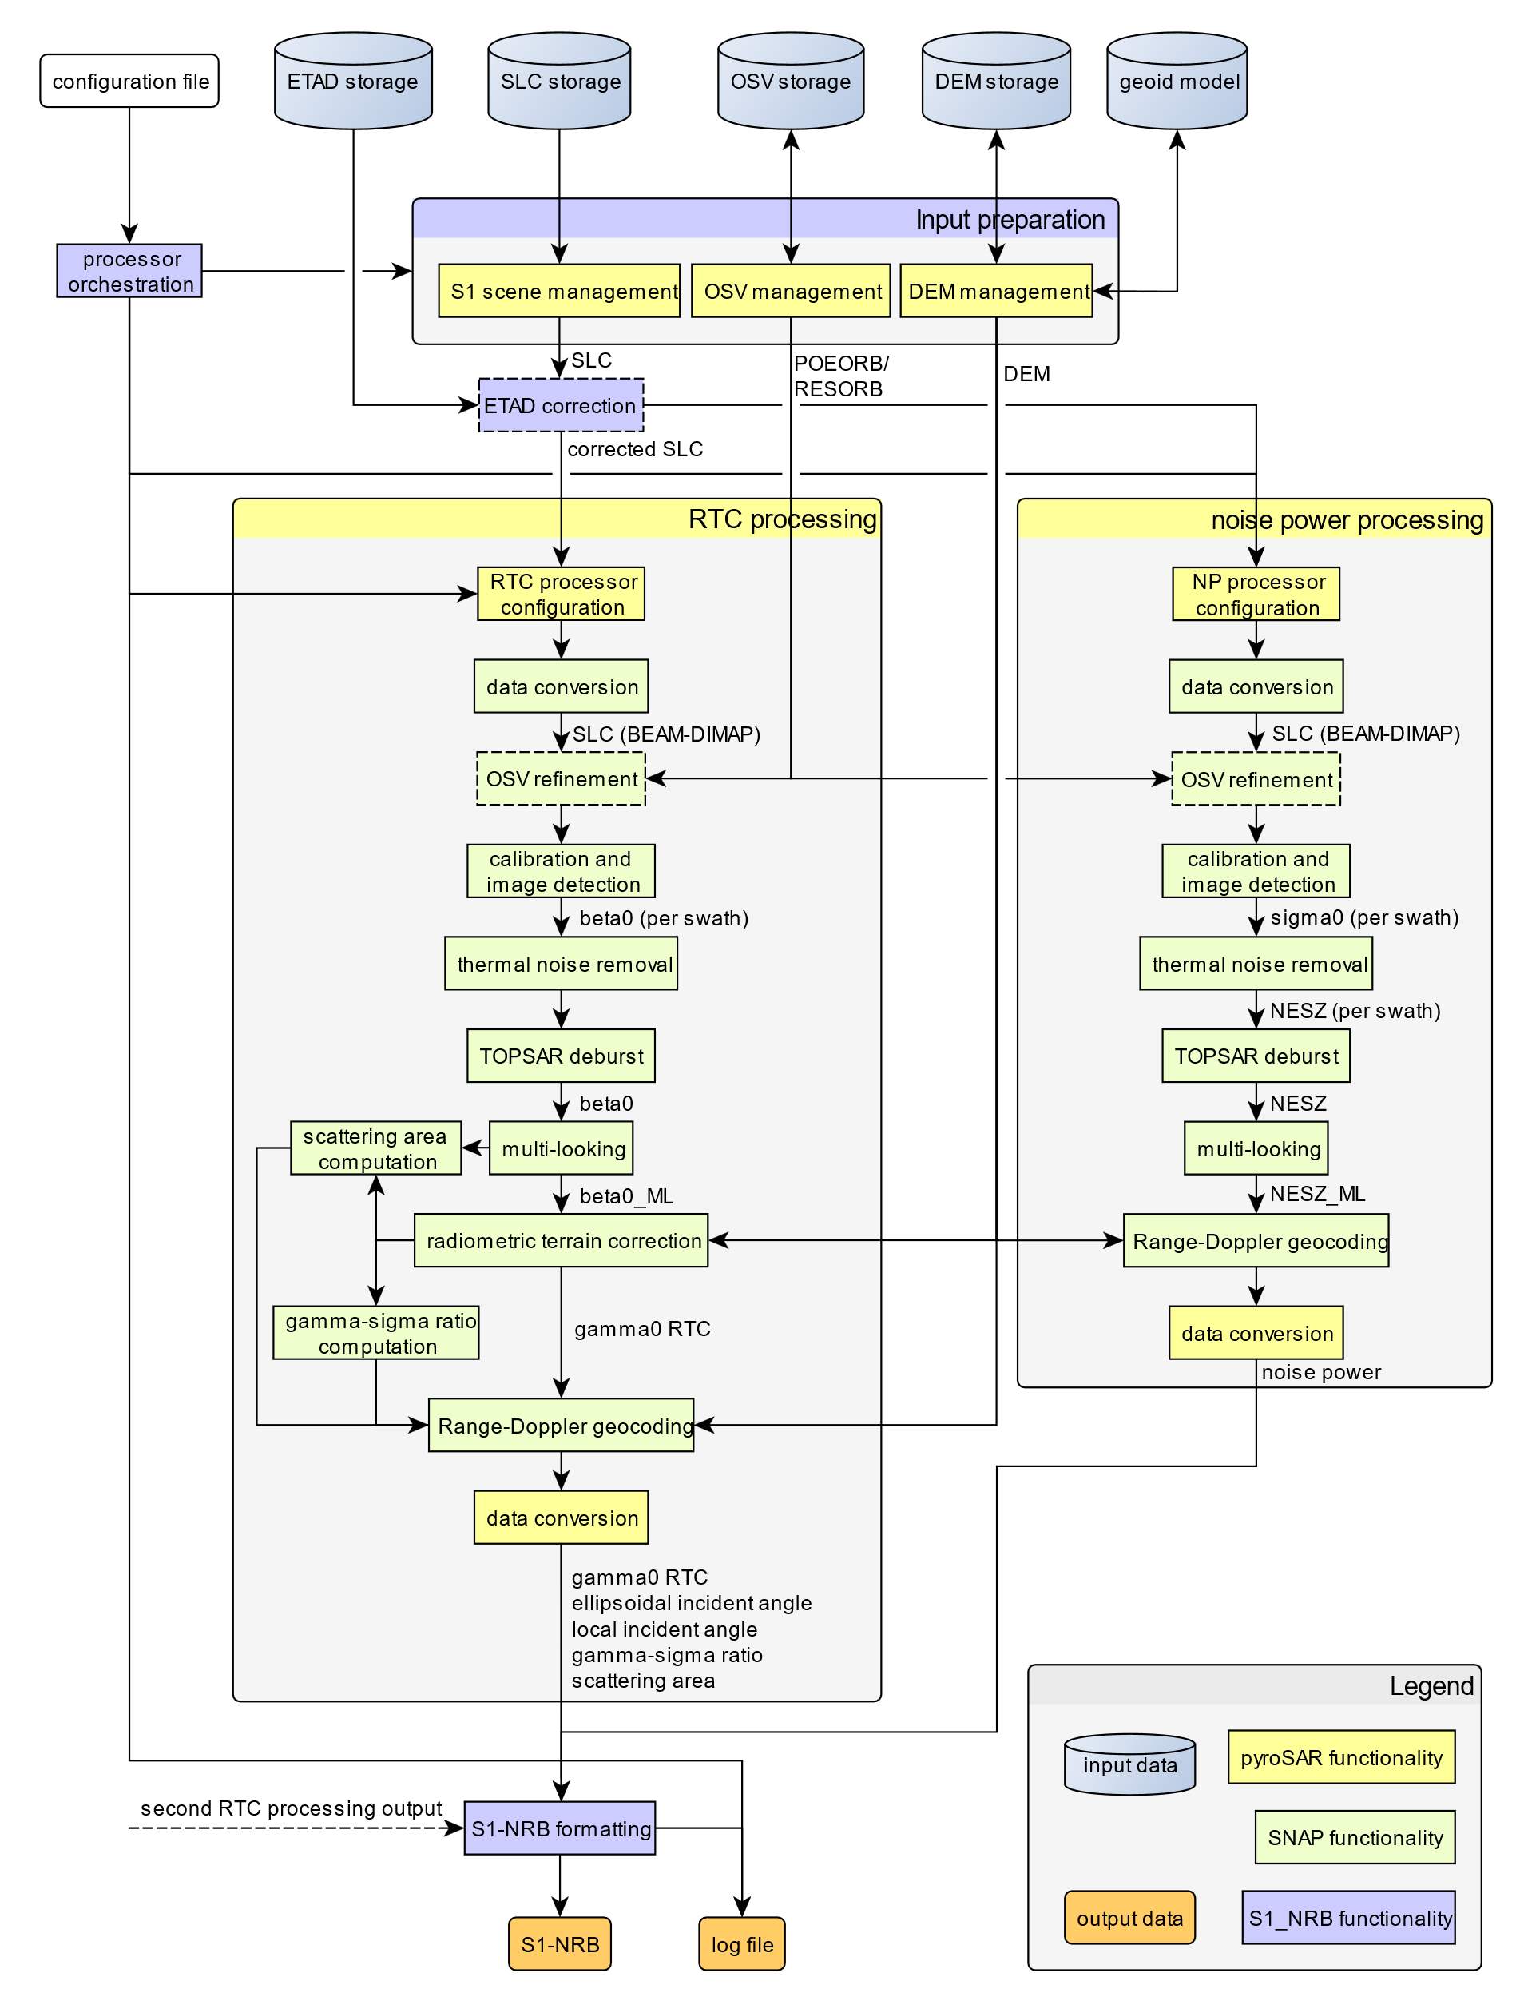





ESA Sentinel-1 ARD prototype
Current activity aims at developing a prototype processor and validate it through a test dataset over a few use cases.
Further operationalisation of this processor, and integration in the Sentinel-1 ground segment is targetted for end of 2024, in order to have a systematic generation of this product (with NRT).
ESA is considering a non-copy left type of open-source licence (Apache 2) for the operational processor.
Based on SNAP and PyroSAR.
Currently not optimised.
Prototype processor available for on the fly data generation on the Costal Thematic Exploitation Platform (C-TEP).

Slide 9
ESA-DLR coordination around 5 axes
Joint Sentinel-1 ARD NRB product:
  Objective to have ESA and DLR product definitions aligned.
Joint ESA and DLR Sentinel-1 ARD NRB processor:
  Exchanges of modules and code developed.
  Share the new modules developed (e.g. file packaging).
Coordination on use cases:
  Complementary use cases in terms of spatial and temporal coverage, and instruments.
Coordination on validation:
  Complementary validations in term of radiometry, geometry, processing modules, etc.
Exchange of information related to internal ESA and DLR activities:
  Monthly coordination meetings.

Slide 10
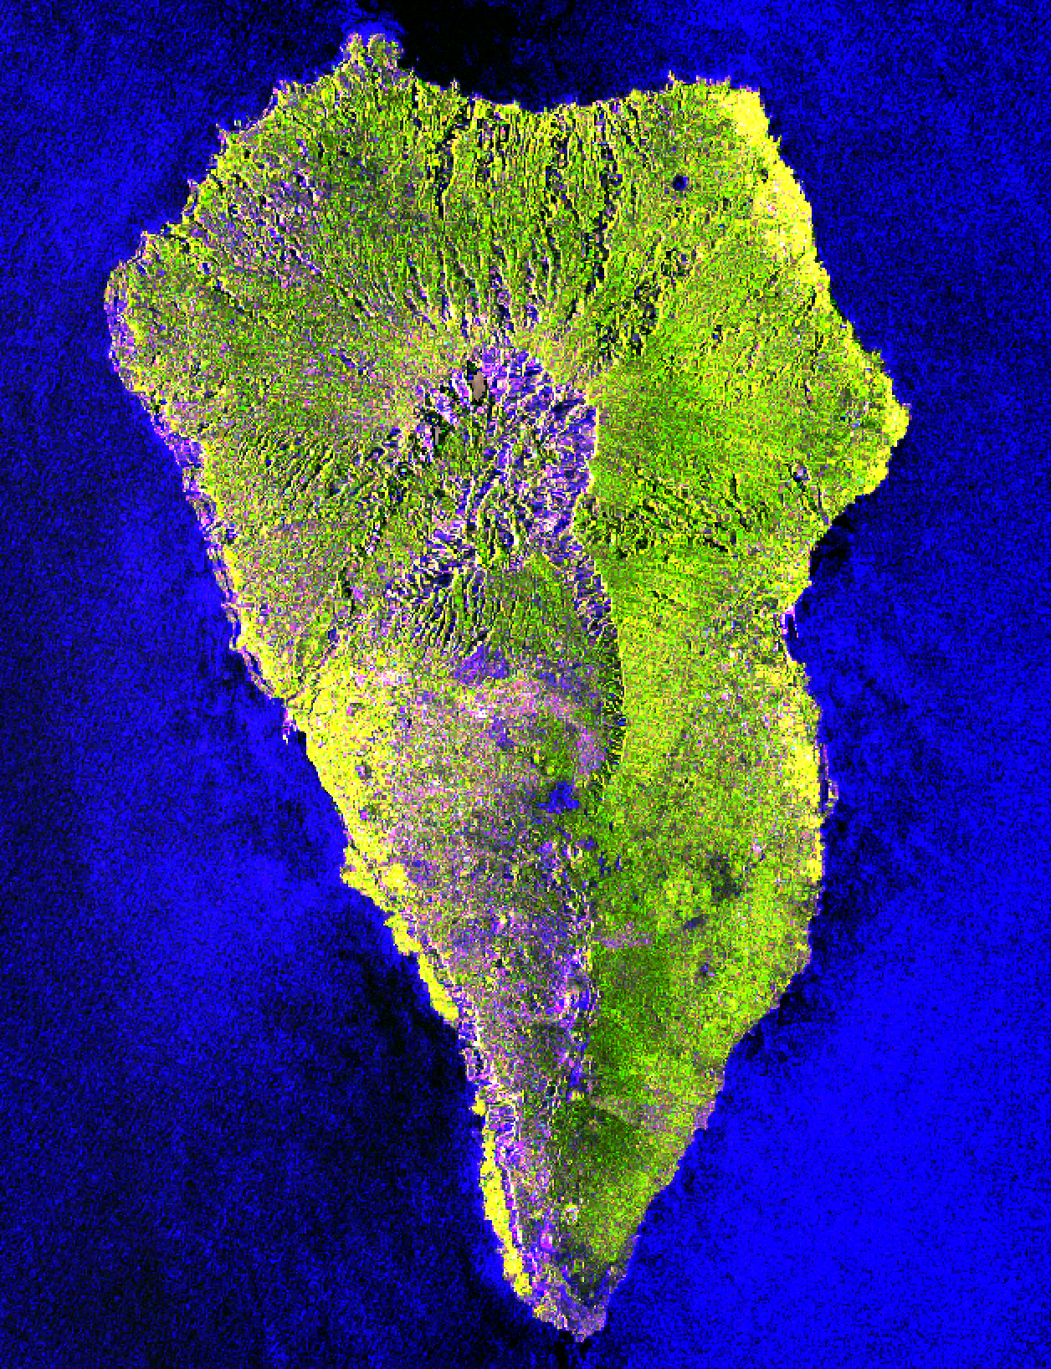
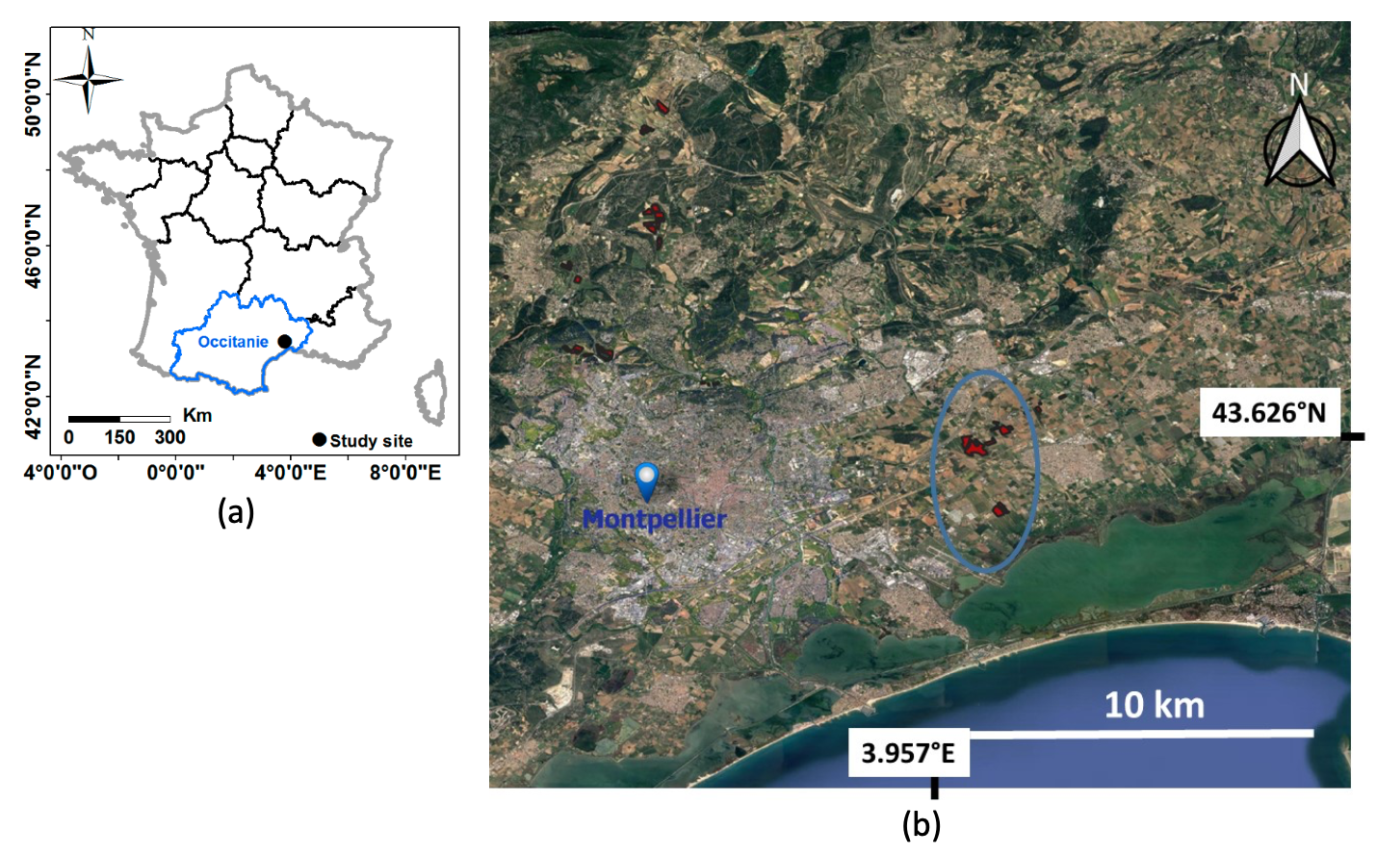
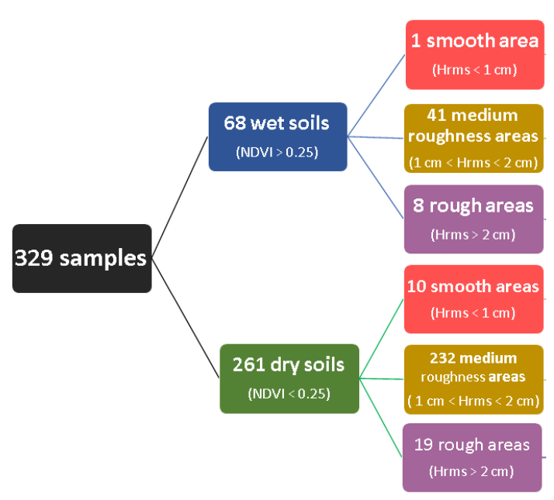
Examples of products and validation
Location of the study site in France (in red, the plots where the in-situ data was collected) and characteristics of the study area database.
Comparison of Sigma0 and Gamma0 for soil moisture inversion:
  gamma naught will give better results than sigma naught if working on small plots or at pixel scale because the radiometric quality of the data will be better with gamma than with sigma.
Example of product (La Palma - Spain)

Slide 11
Other SAR ARD products in development at ESA & DLR
C-band SAR NRB product for ERS-1, ERS-2 SAR and ENVISAT ASAR.
  Poster: Tuesday – 24.05.2022 - 05:57 pm - Poster Session Day 2
  Kajal Haria | Telespazio UK
  LPS22: B4.01 Heritage Missions and Long Time Data Series: ERS-1/2 SAR and ENVISAT ASAR CARD4L NRB Product Development Project, ID64603
How can we make Polarimetry Analysis Ready? (Sentinel-1, RADARSAT and TerraSAR-X)
  Poster: Friday – 27.05.2022 - 01:04 pm - Poster Session Day 5
  Birgit Wessel | German Aerospace Center (DLR)
  LPS22: B1.07 Analysis Ready Data: are we there yet?
SAR ARD products planned for HRWS (High-Resolution Wide Swath) mission
Potential P-band SAR NRB product could be defined and generated for the BIOMASS mission.
L-band SAR NRB product requested for ROSE-L in the Mission Requirement Document.

Slide 12
Time schedule and access for users to ARD NRB
2021
2022
2023
2024
2025
2026
2027
ESA S1 ARD definition and developement
ESA S1 ARD Systematic generation
DLR S1 ARD definition and developement
DLR S1 ARD Systematic generation
ERS-1/2 and ENVISAT ARD definition and developement
ERS1/2 and ENVISAT ARD generation
BIOMASS ARD definition and developement
BIOMASS ARD Systematic generation
ROSE-L ARD definition and developement
ROSE-L ARD Systematic generation

Slide 13
Conclusion
Outlook
The proposed family of SAR ARD products will ease data analysis and exploitation by being « cloud-computing compliant », open SAR data to new communities, and allow interoperability between these products.
Way forward:
Definition of a SAR ARD product for Ocean (following the CEOS related guidelines).
Processing of historical Sentinel data (DLR).
Operational product format and corrections applied could diverge from the prototype.
Related activities under definition:
Follow-on ETAD activities: Investigation of no-latency geolocation improvement, i.e., with PREORB and (TBC) independent of L1A (or L0)
  Poster: Monday – 23.05.2022 - Antonio Valentino | RHEA for ESA | B1.06 - Towards NRT Sentinel-1 ARD products: model based atmospheric corrections for improved geolocation
Open, validated, optimised, and documented RTC processor (with D. Small).
Fundamental Data Record - FDR: Backscatter composites from Sentinel-1 and Radarsat.

