Slide 1
Guidelines for CEOS Analysis-Ready Data (CARD) Radar Product Specifications
Committee on Earth Observation Satellites
Ake Rosenqvist^{1,2}, Bruce Chapman³, Clément Albinet⁴, Danilo Dadamia⁵, Francois Charbonneau⁶, Matt Garthwaite⁷, Guillaume Hajdush⁸, Josef Kellndorfer⁹, Marco Lavalle³, Tom Logan¹⁰, Franz Meyer¹⁰, Nuno Miranda⁴, Katrin Molch¹¹, Paolo Pasquali¹²; Marko Repse¹³, Andreia Siqueira⁷; David Small¹⁴, Takeo Tadono², Medhavy Thankappan⁷, John Truckenbrodt¹⁵, Fang Yuan⁷, Howard Zebker¹⁶, Zheng-Shu Zhou¹⁷ 1 – soloEO; 2 – JAXA; 3 – NASA JPL; 4 – ESA; 5 – CONAE; 6 – NRCan; 7 – Geoscience Australia ; 8 – CLS group; 9 – EBD; 10 – ASF; 11 – EC/DG-DEFIS; 12 – sarmap; 13 – Sinergise; 14 – Univ. Zürich; 15 – FSU Jena; 16 – Stanford Univ; 17 – CSIRO
WGCV SAR workshop, Nov 2-4, 2021
Notes:
So Good morning, good day and good evening again
My name is Ake Rosenqvist and I represent JAXA and the Committee on EO satellites – CEOS
On behalf of the SAR expert colleagues listed here, I will provide an overview of CEOS Analysis-Ready Data for Land (CARD4L) Product Specifications for Synthetic Aperture Radar (SAR)

Slide 2
Analysis Ready Data (ARD) & CEOS Analysis Ready Data (CARD)
Why Analysis Ready Data?
Recognition by satellite data providers of the need – and expectations – for EO products that do not require expert knowledge to ingest and analyse.
EO user community:
Increase in non-expert users
Move from R&D towards operational applications with requirements for Big Data (e.g. time-series analysis over national-global scales, Data Cubes)
Analysis Ready Data (ARD)
Term frequently used by satellite data providers today but common ARD standard lacking
No common standards → lost opportunity for interoperability
CEOS Analysis Ready Data (CARD)
CEOS effort to develop a set of well-defined ARD specifications for key sensor types (optical, SAR, Lidar) which data providers – CEOS organisations and private sector – can opt to include in their suites of satellite data products offered to users.
Key driver – help broaden the EO user community (especially important for SAR!)
Notes:
So what is “Analysis Ready Data”?
ARD is a term used widely by satellite data providers nowadays. A common definition is lacking, but it broadly refers to a data product provided at a processing level that accommodates utilisation for the application(s) the data provider in question has in mind. Without coordination however, it follows that while ARD products from one data provider can be expected to be internally consistent, ARD products from different providers most probably cannot. The lack of common standards is a lost opportunity for interoperability
CEOS Analysis-Ready Data for Land, CARD4L, is a joint effort by CEOS to develop a set of well- defined ARD specifications that data providers can opt to include in their suites of satellite data products offered to users. A CARD4L product is defined as “satellite data that have been processed to a minimum set of requirements and organised into a form that allows immediate analysis with a minimum of additional user effort, and provides interoperability both through time and with other datasets” [1].
A specific objective of CARD4L is to broaden the EO user community by provision of data products that do not require expert knowledge to ingest and analyse. This is perhaps particularly relevant for Synthetic Aperture Radar, where the potential to contribute to today’s great environmental challenges with unique information is significant, but with the SAR user community remaining small and expert-oriented even after 25 years of operational SAR missions.

Slide 3
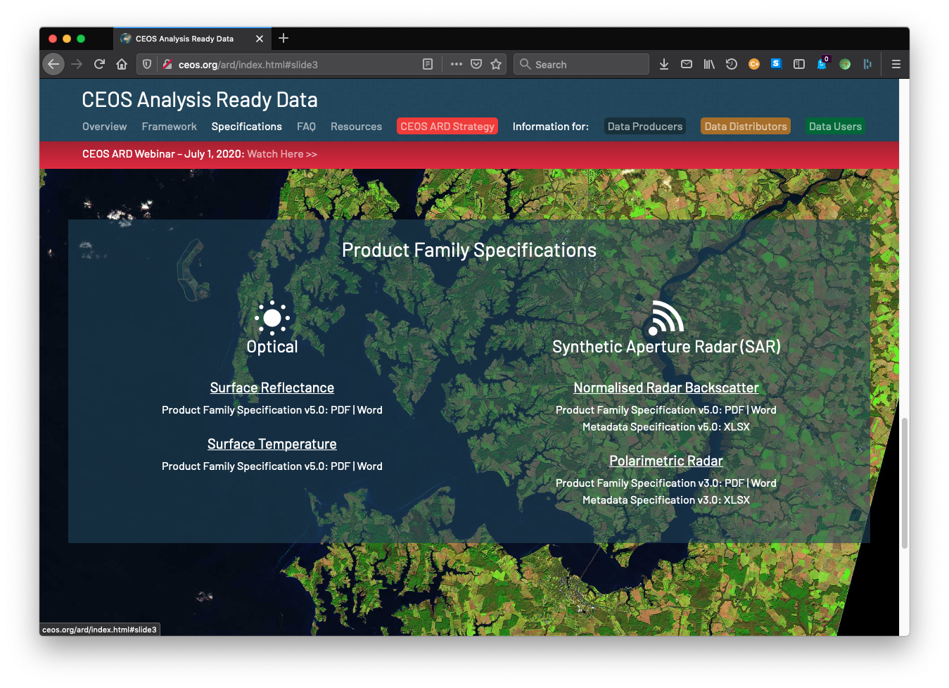
CARD Radar products
Current status
CEOS ARD specifications (CARD4L) for SAR products:
Endorsed and available at http://ceos.org/ard
Normalised Radar Backscatter (NRB)
Polarimetric Radar (POL)
Surface Reflectance (SR)
Surface Temperature (ST)
In the pipeline:
Ocean Radar Backscatter (ORB)
Geocoded SLC (GSLC)
Interferometric Radar (INSAR)
Nightlight Radiance
Aquatic Reflectance
Lidar Terrain & Canopy Height

Slide 4
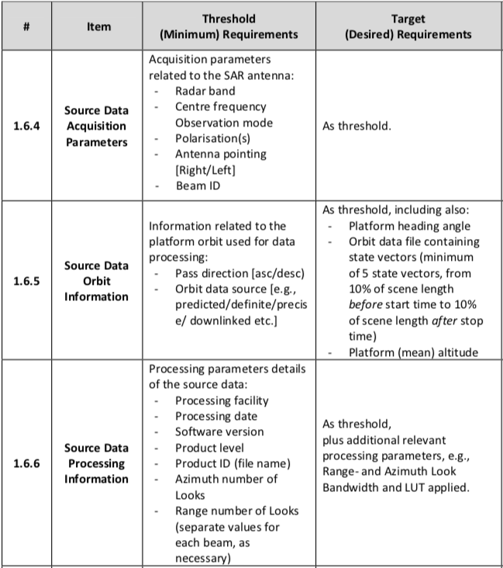
CEOS ARD – SAR
Specifications for Data Providers
CARD specs (Product Family Specifications – PFS)
“Guidance document” for data providers:
Geometric corrections
Radiometric corrections
General meta (ancillary) data
Per-pixel (image) meta data
Two levels of requirements
Threshold (mandatory) requirement
Target (desired) requirement
Extract from CARD4L NRB specification document
Notes:
So what do the CARD4L specs look like?
The specification documents - referred to as “Product Family Specifications” – can be seen as guidance documents for Data Providers aiming to develop CARD4L compliant SAR products.
The CARD4L specifications detail 'Threshold’ and 'Target’ requirements for geometric and radiometric corrections, general metadata (such as what is shown to the left), and per-pixel (or image-) metadata,.
In order for a product to be approved as “CARD4L compliant”, all Threshold requirements must be met (for the NRB there are 44 requirements specified). Target requirements are optional for the data provider

Slide 5
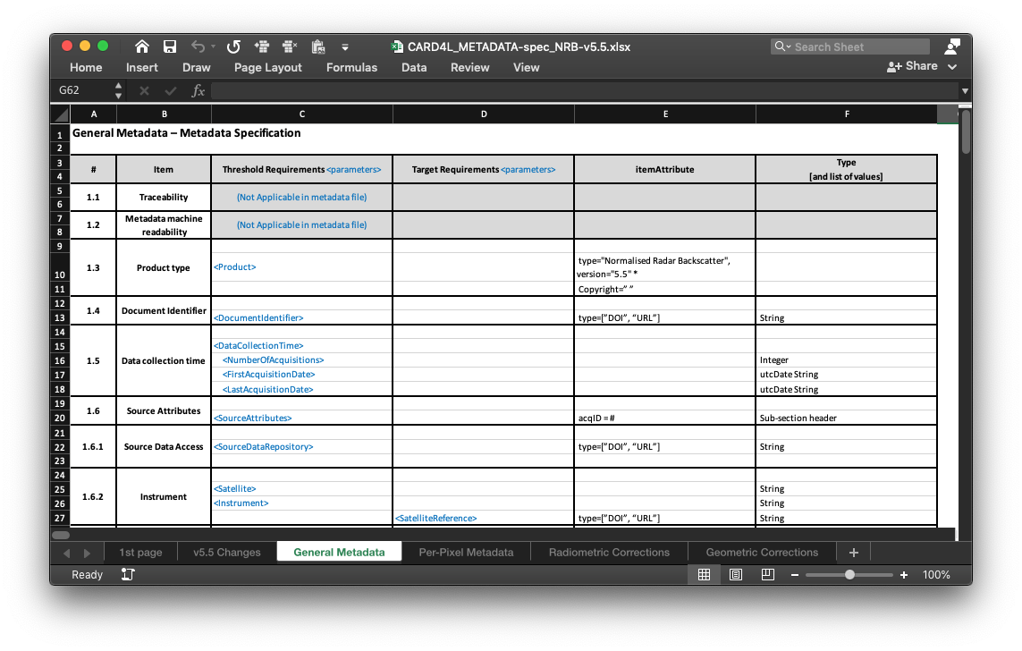
CARD Radar
Metadata specs
Metadata Specifications
Metadata specification developed to accompany each Radar PSF
Consistent mapping of parameter names between PFS and metadata
Specs for XML format but data provider may select other metadata formats (yaml, json, etc.)
Non-mandatory (Target req.)
Extract from XML metadata file for a POL CARD4L product

Slide 6
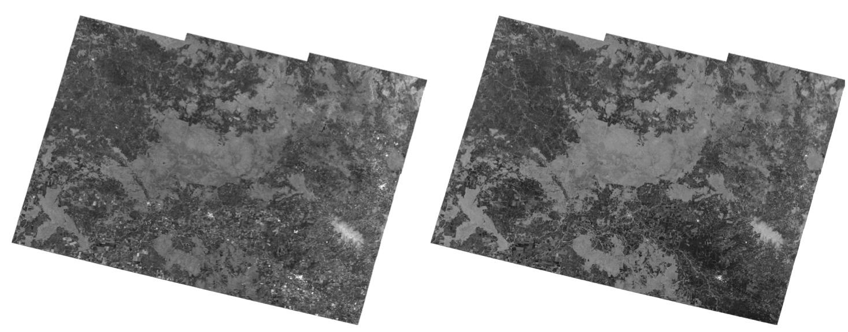
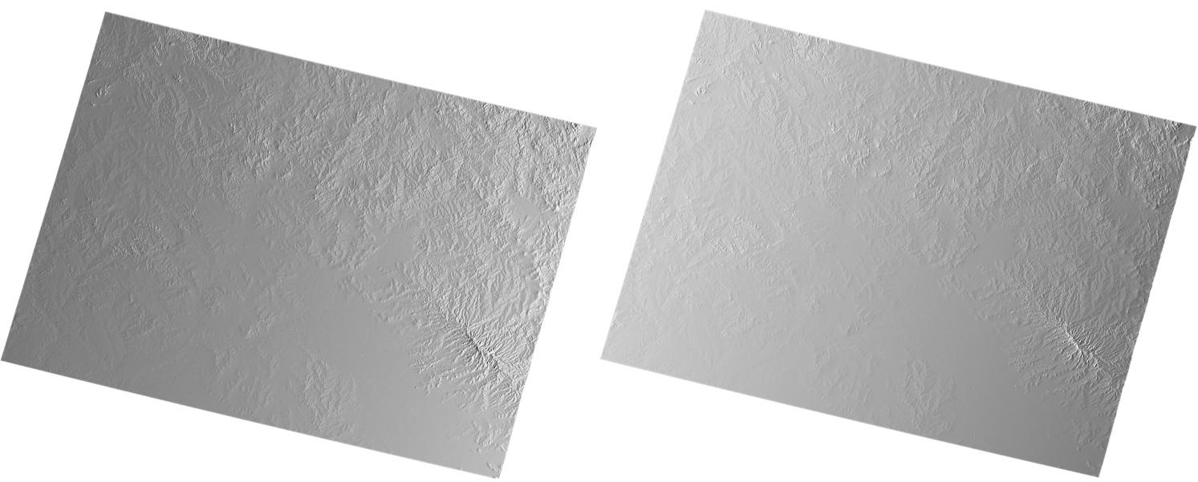
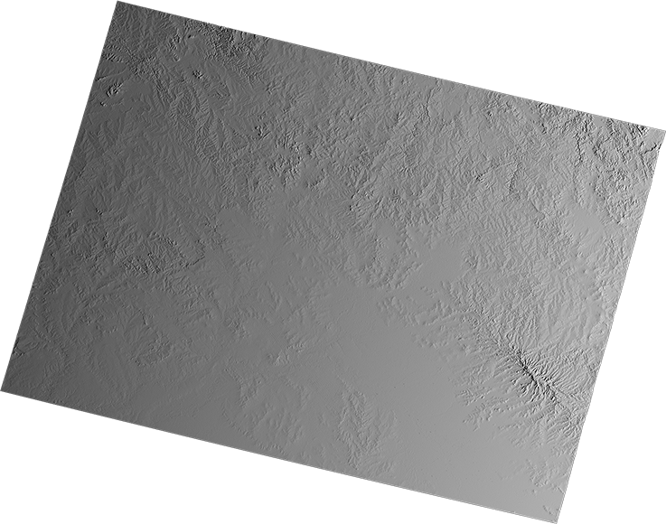
CARD Radar
General PFS structure
1. Radar Measurement
Geometric and Radiometric specs
2. Per-Pixel Metadata (image data) (NRB example)
Scattering Area
Local Inc Angle
3. General Metadata
Data Mask
Sigma-to-Gamma
Noise Power
Ellipsoid Inc Angle
Acquisition ID
Per-pixel DEM
CARD4L NRB sample (Processing: Z-S Zhou, CSIRO)

Slide 7
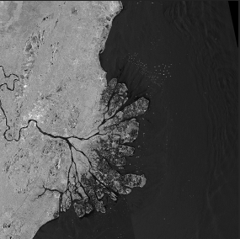
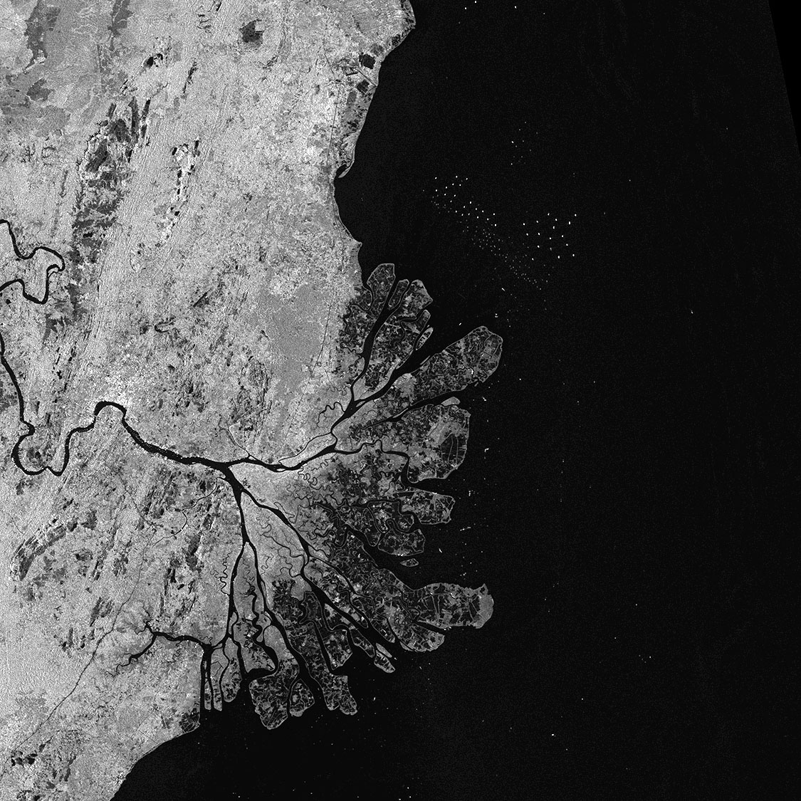
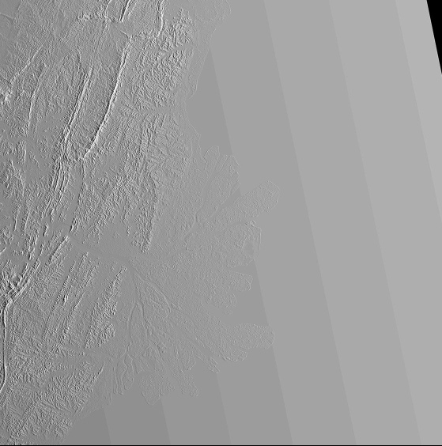
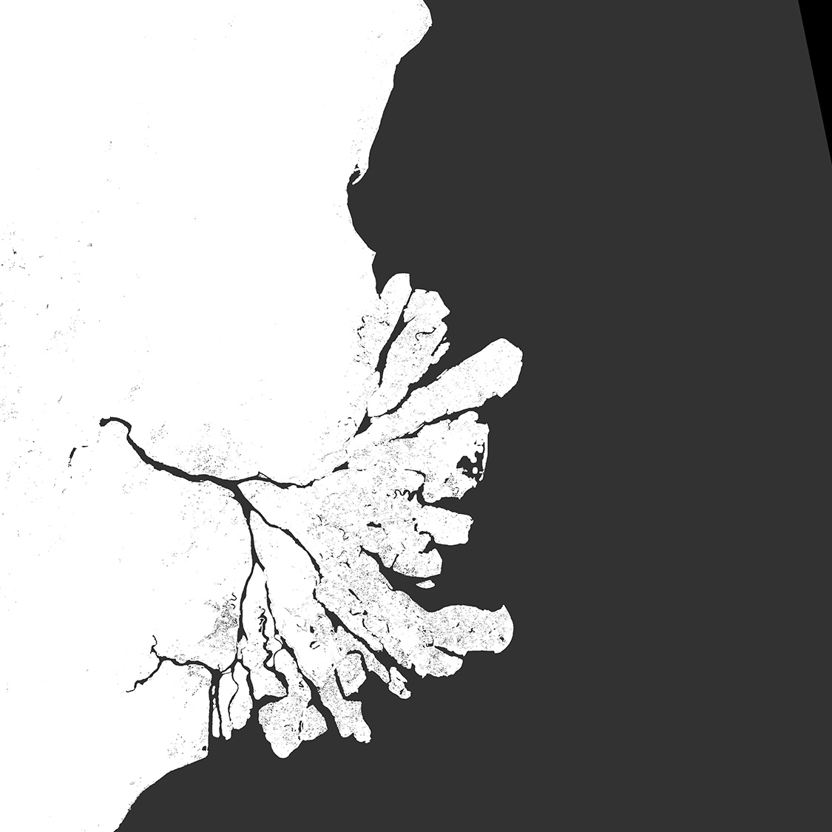
CEOS ARD – SAR Normalised Radar Backscatter (NRB)
ALOS-2 PALSAR-2 (Global mosaic) Processing: JAXA EORC
CARD NRB
Radar Measurement data:
Geometric Terrain Correction (ortho)
Radiometric Slope Correction
Backscatter expressed as gamma-nought, γ⁰
Per-pixel metadata:
Threshold (required):
Local Incidence Angle image
Mask image
Acquisition ID image (for composite products)
Target (desired):
Scattering Area image
Gamma-to-Sigma ratio image
Ellipsoid Inc. Angle image
Noise power image (if applied)
Per-pixel DEM
General metadata:
Detailed specs about source data and (CARD) product (44 entries).
Metadata XML format spec provided (Target)
γ⁰ Backscatter (HH)
γ⁰ Backscatter (HV)
Local Inc. Angle
Acquisition ID
Data Mask
Notes:
Polarimetric Radar (POL) – objective to make radar polarimetry accessible
to enable users to explore
CARD4L POL covers two product types:
The first one is Polarimetric Decomposition product – which is comparable to the standard backscatter product, but where the polarimetric information has been enhanced – for instance to separate different scattering mechanisms from each other – by the use of various decomposition techniques. Which decompositions to include is not prescribed in the CARD4L specification, but for Data Providers to decide. which ones to offer to users (e.g. Eigen value; Pauli, Freeman-D; Yamaguchi, etc.)
The second POL product is the Polarimetric Covariance Matrix, which is a set of complex images from which the full polarimetric phase and amplitude can be derived. It is for a bit more advanced users, and can be applied for e.g. polarimetric time-series analysis and Pol-InSAR applications
The CARD4L POL structure is based on NRB, with similar requirements for geometric and radiometric accuracy, and general and per-pixel metadata.

Slide 8
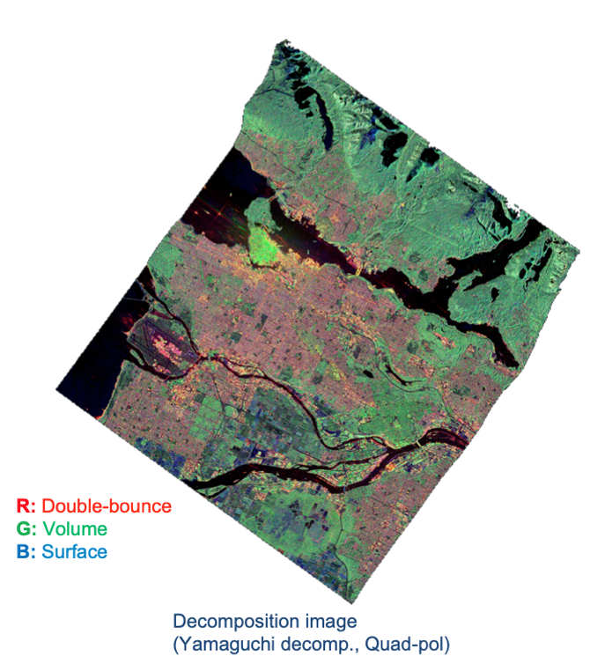
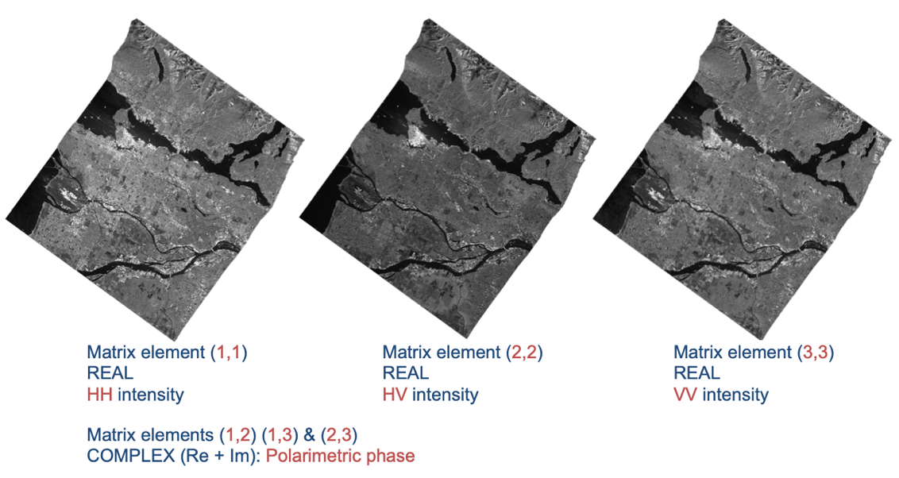
CEOS ARD – SAR Polarimetric Radar (POL)
RADARSAT-2 (MDA) Processing: F. Charbonneau (NRCan)
CARD POL structure based on CARD Normalised Radar Backscatter
General Metadata, Per-pixel Metadata, Geometric & Radiometric corrections near-identical to NRB
Main difference in Measurement data
POL Measurement Data covers two product types:
Polarimetric Decomposition
Data Providers to decide what decompositions to offer to users (e.g. Eigen value; Pauli, Freeman-D; Yamaguchi, etc.)
Polarimetric Covariance Matrix
Polarimetric phase and amplitude preserved
For polarimetric time-series and Pol-InSAR applications
RADARSAT-2 (MDA) Processing: F. Charbonneau (NRCan)
Notes:
Polarimetric Radar (POL) – objective to make radar polarimetry accessible
to enable users to explore
CARD4L POL covers two product types:
The first one is Polarimetric Decomposition product – which is comparable to the standard backscatter product, but where the polarimetric information has been enhanced – for instance to separate different scattering mechanisms from each other – by the use of various decomposition techniques. Which decompositions to include is not prescribed in the CARD4L specification, but for Data Providers to decide. which ones to offer to users (e.g. Eigen value; Pauli, Freeman-D; Yamaguchi, etc.)
The second POL product is the Polarimetric Covariance Matrix, which is a set of complex images from which the full polarimetric phase and amplitude can be derived. It is for a bit more advanced users, and can be applied for e.g. polarimetric time-series analysis and Pol-InSAR applications
The CARD4L POL structure is based on NRB, with similar requirements for geometric and radiometric accuracy, and general and per-pixel metadata.

Slide 9
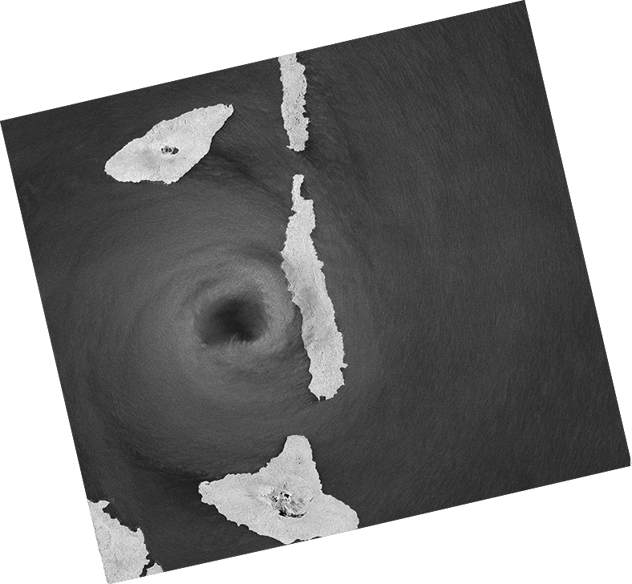
CEOS ARD – SAR Ocean Radar Backscatter (ORB)
CARD ORB – Simplified version of the CARD NRB product for ocean applications
Radar Measurement data:
Geoid-corrected backscatter
Expressed as σ⁰
Per-pixel metadata:
Threshold (required):
Geoid Incidence Angle image
Mask image (including land mask)
Acquisition ID image (for composite products)
Target (desired):
Noise power image (if applied)
Per-pixel Geoid
Look Direction image
The CARD ORB product specification is under development. Completion/release foreseen for Q3-Q4/2022.
σ⁰ Backscatter (VV)
σ⁰ Backscatter (VH)
Data Mask image
Geoid Inc. Angle image
Sentinel-1 IWS CARD ORB (mock-up) (Processing: soloEO)
Notes:
Polarimetric Radar (POL) – objective to make radar polarimetry accessible
to enable users to explore
CARD4L POL covers two product types:
The first one is Polarimetric Decomposition product – which is comparable to the standard backscatter product, but where the polarimetric information has been enhanced – for instance to separate different scattering mechanisms from each other – by the use of various decomposition techniques. Which decompositions to include is not prescribed in the CARD4L specification, but for Data Providers to decide. which ones to offer to users (e.g. Eigen value; Pauli, Freeman-D; Yamaguchi, etc.)
The second POL product is the Polarimetric Covariance Matrix, which is a set of complex images from which the full polarimetric phase and amplitude can be derived. It is for a bit more advanced users, and can be applied for e.g. polarimetric time-series analysis and Pol-InSAR applications
The CARD4L POL structure is based on NRB, with similar requirements for geometric and radiometric accuracy, and general and per-pixel metadata.

Slide 10
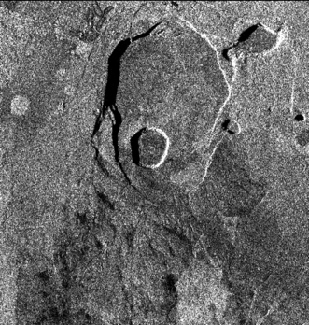
CEOS ARD – SAR
Geocoded SLC (GSLC)
Geocoded Single-Look Complex (GSLC)
The CARD GSLC product describes the complex radar reflectivity (amplitude & phase) at each point on the surface with all average propagational phases removed.
GSLC data are presented in a common, often user-defined, ground based coordinate system (rather than in slant range), to facilitate use by non-radar-specialists.
Same structure as the CARD4L NRB.
The CARD4L GSLC product specification is under development. Completion/ & release foreseen in 2023
Stack of geocoded SLC images
(Zebker et al, 2018)
Notes:
Single Look Complex (SLC) is the standard Level-1 SAR image product. It comprises information about the amplitude and phase of the received radar energy, provided as a complex number.
SLC are given in slant range geometry and require additional processing software and a fair amount of radar expert knowledge to be used.
The CARD4L GSLC product on the other hand, is an enhanced pre-processed version of the SLC, that describes the complex radar signal at each point on the ground surface with all average propagational phases removed, so that the amplitude and phase values represent properties of the ground surface, without influence by the radar instrument
CARD4L GSLC products are presented in a common geographical coordinate system – such as e.g. UTM - rather than in slant range radar coordinates, to facilitate use by non-radar-specialists
The CARD4L GSLC product specification is still under development and we expect it to be completed within the next few months.

Slide 11
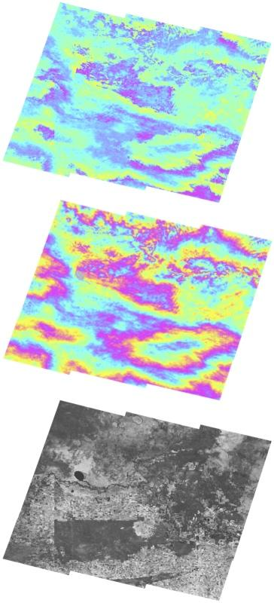
CEOS ARD – SAR
Interferometric Radar (INSAR)
Interferometric Radar (INSAR)
A suite of three products generated from an InSAR pair, or a stack:
Wrapped interferogram: Image of differential phase signals between two SLC images
Unwrapped interferogram: Image of differential phase signals where the wrapped fringes are summed (“unwrapped”) to give a continuous phase signal across the image
Interferometric coherence: Image of phase coherence between the two images.
The CARD INSAR product specification is under development. Completion/release foreseen in 2023.
Sentinel 1 interferometric products (Geoscience Australia team)
Notes:
CARD4L INSAR product specifies a suite of three products generated by InSAR processing of two observations of the same geographic area at different times:
Wrapped interferogram is an image showing the differential phase signals between the two complex images. The signal is ‘wrapped’ in quantities of 2*πι radians, giving an image with ‘fringes’.
The Unwrapped interferogram is an image where the wrapped fringes have been added up to give a continuous phase signal across the image. There are different approaches to do this unwrapping and CARD4L does not prescribe which methods to use.
Interferometric coherence is an image of phase coherence between two SLC images.
The CARD4L INSAR product specification also is still under development, and expected to be completed in the second half of 2021

Slide 12
CEOS ARD Radar Access
CEOS ARD specifications for Normalised Radar Backscatter and Polarimetric Radar endorsed by CEOS. Latest updates: Dec 2021
Further SAR CARD products under development (ORB, GSLC, INSAR)
Public open CARD NRB products (NRB compliance presently under assessment by CEOS WG CalVal) :
ALOS-2 PALSAR-2 (Global mosaic products) – JAXA
https://www.eorc.jaxa.jp/ALOS/en/dataset/fnf_e.htm
Sentinel-1 (Digital Earth Africa) – Sinergise (CARD4L approved last week!)
https://registry.opendata.aws/deafrica-sentinel-1/
Public open CARD POL sample product available at:
RADARSAT-2 – NRCan
ftp://ftp.ccrs.nrcan.gc.ca/ad/Charbonneau/CARD4L/
Notes:
What are the steps a data provider needs to go though to have a product approved as CARD4L compliant :
Download the latest CARD4L specs from the CEOS ARD webisite
Undertake product self-assessment with respect to each of the CARD4L parameters and indicate compliance status (non-compliant / Threshold or Target compliant) in CARD4L check list)
Rectify any non-compliant parameter/issue
Once all parameters are deemed compliant at either Threshold or Target level, contact the CEOS LSI-VC point of contact, who will initiate a Formal peer review by WG CalV al
Products passing the WGCV review are considered CARD4L compliant

Slide 13
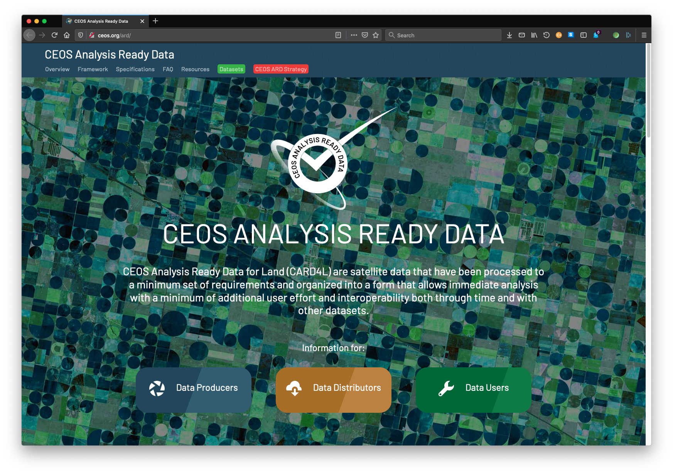
CEOS ARD Synthetic Aperture Radar
More information at http://ceos.org/ard
Notes:
A number satellite data providers are working to develop CARD4L compliant SAR products to include in their product catalogues. We will hear from a few of them here today in the following presentations.
Thank you for your attention.

