Slide 1
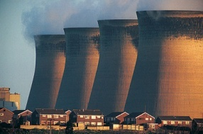
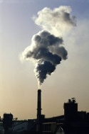
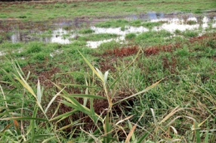
GHG-CCI
The GHG-CCI project of ESA’s Climate Change Initiative: Overview and Status
CCI Integration Meeting, ECMWF, 14-16 March 2011
Michael Buchwitz,
Institute of Environmental Physics (IUP),
University of Bremen, Bremen, Germany
and the GHG-CCI team

Slide 2
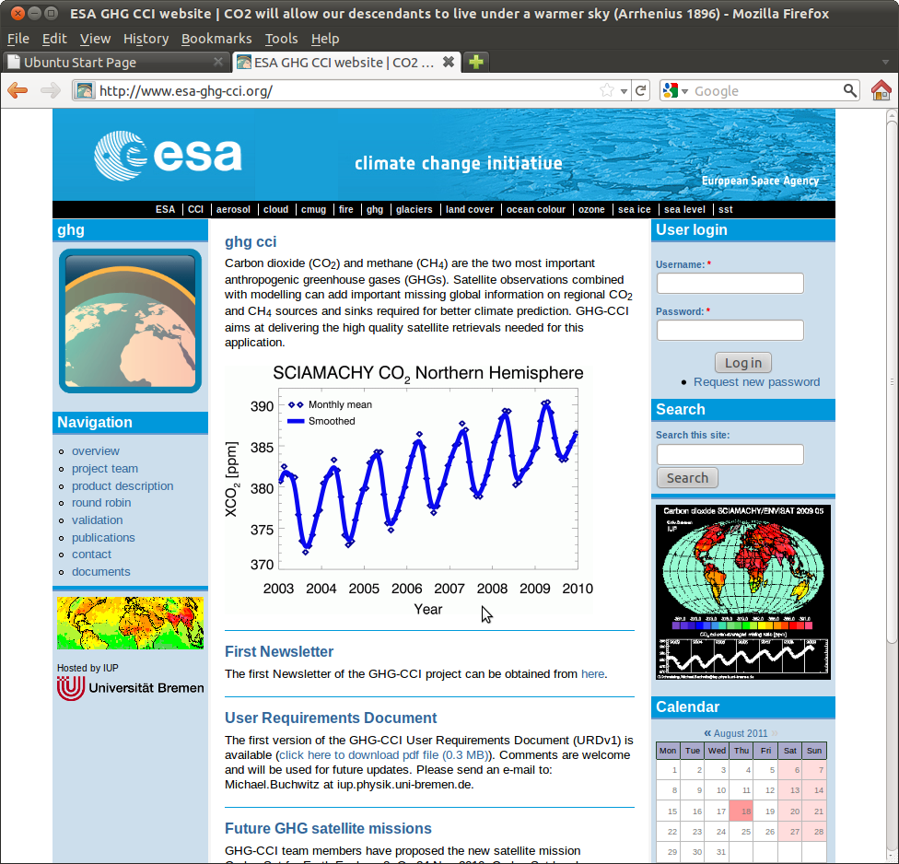
ESA Climate Change Initiative (CCI)
to generate Essential Climate Variables (ECVs)
www.esa-ghg-cci.org/
ESA Programme led by Mark Doherty
GHG-CCI: TO C. Zehner
Currently 13 ECV projects:
Aerosol-CCI
Cloud-CCI
Fire-CCI
GHG-CCI - CO₂ & CH₄
Glaciers-CCI
LandCover-CCI
OceanColour-CCI
Ozone-CCI
SeaLevel-CCI
SST-CCI
SoilMoisture-CCI
SeaIce-CCI
IceSheets-CCI
+ CMUG (Climate Modelling User Group)
Lead: Roger Saunders (UK Met Office)
Hadley Centre, ECMWF, MPI-Meteorology, Météo France
2

Slide 3
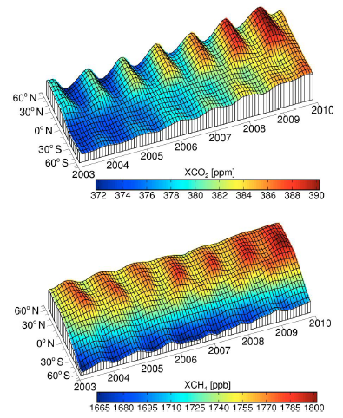
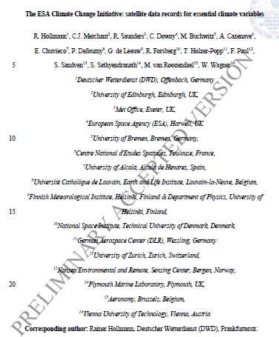
First CCI overview paper
Hollmann et al., BAMS, 2013
SCIAMACHY/WFMD XCO₂
SCIAMACHY/WFMD XCH₄
3

Slide 4
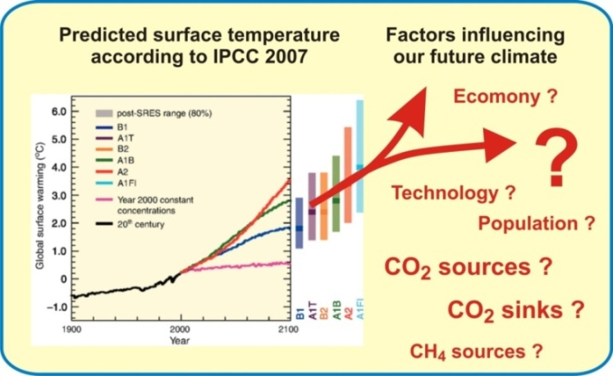
ECV GHG ?
CO₂ and CH₄ are the two most important anthropogenic greenhouse gases and increasing concentrations result in global warming.
Reliable climate prediction requires a good understanding of the natural and anthropogenic (surface) sources and sinks of CO₂ and CH₄.
Important questions are, for example
Where are they ?
How strong are they ?
How do they respond to a changing climate ?
A better understanding requires appropriate global observations and (inverse) modelling.
ECV GHG (GCOS-154^{*)}):
“Retrievals of greenhouse gases, such as CO₂ and CH₄, of sufficient quality to estimate regional sources and sinks.”
*) „SYSTEMATIC OBSERVATION REQUIREMENTS FOR SATELLITE-BASED DATA PRODUCTS FOR CLIMATE“
4

Slide 5
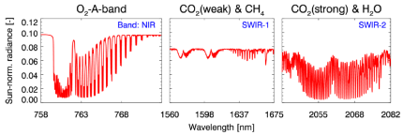
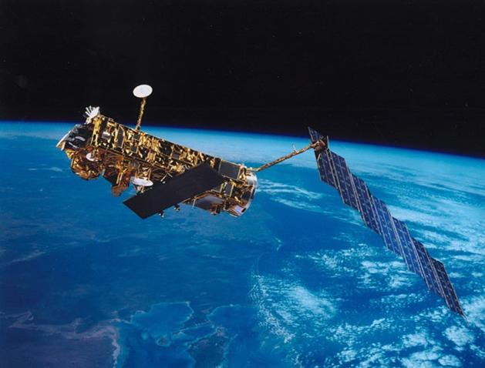
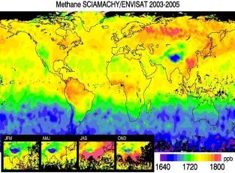
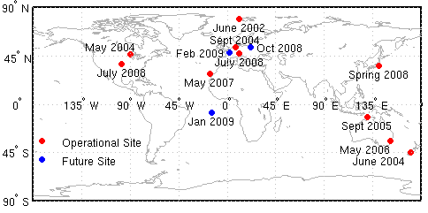
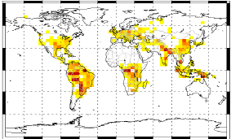
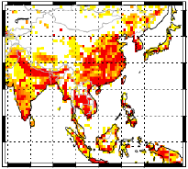
How to achieve this ?
Global satellite observations
Calibration (L 0-1)
Upper layer
CO₂ & CH₄
Calibrated radiances
Global information on near-surface CO₂ & CH₄
SCIAMACHY/ENVISAT
TANSO/GOSAT
IASI,
MIPAS,
SCIA/occ,
AIRS,
ACE-FTS,
…
Retrieval
(L 1-2)
Atmospheric GHG
distributions
Global observations
Reference observations
?
CO₂
Validation
CH₄
CO₂
?
Improved information on
GHG sources & sinks
Inverse modelling
(L 2-4)
CH₄
5

Slide 6
GHG-CCI Project Team
Science Leader
M. Buchwitz (IUP)
Management Team
M. Buchwitz (IUP, Science Leader)
H. Bösch (Univ.Leicester, Project Manager)
M. Reuter (IUP, Deputy PM)
O. Hasekamp (SRON)
J. Notholt (IUP-V, Validation Lead)
F. Chevallier (LSCE, CRG Lead)
EO Science Team
(EOST)
Project Manager
H. Bösch (Univ.Leicester)
Deputy: M. Reuter (IUP)
EOST1: SCIAMACHY & GOSAT
Lead: M. Buchwitz, IUP
IUP, Univ.Leicester, SRON
EOST2: TIR (IASI, MIPAS, … )
Lead: C. Crevoisier, LMD
LMD, KIT, IUP
VALT: Validation
Lead: J. Notholt, IUP
IUP, KIT, BIRA, EMPA
Climate Research Group (CRG)
Lead: F. Chevallier, LSCE
System Engineering Team (SET)
Lead:
G. Lichtenberg, DLR
LSCE, JRC, FastOpt
DLR

Slide 7
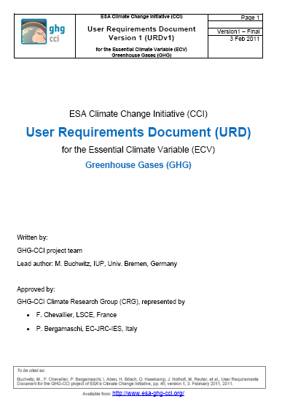
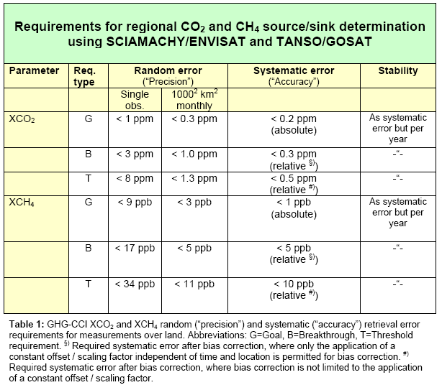
User Requirements
~0.12%
Available on
http://www.esa-ghg-cci.org/
~0.5%
7

Slide 8
GHG-CCI Phase 1 Schedule
1 Sep 2010
1 Sep 2011
1 Sep 2012
Now
Year 1 |  | Year 2 |  | Year 3
Round Robin
Several cycles:
(Re)processing - analysis - improvements
Final assessment & decision
Selected
algorithms
CRDP = Climate Research Data Package
CRDP generation
CRDP
PVIR = Product Validation and Intercomparison Report
CRDP validation
PVIR
CAR = Climate Assessment Report
CRDP user assessment
CAR
8

Slide 9
Algorithms & Products
compared during Round Robin (RR)
Core
Products
GHG-CCI ECV Core Algos. (ECAs)
For comparison
 | IUP |  | UoL |  | SRON |  | NIES | NASA
 | BESD | WFMD | OCPR | OCFP | SRPR | SRFP | Official GOSAT & PPDF | ACOS
SCIA XCO₂ | ECV? | ECV?
SCIA XCH₄ |  | ECV? |  |  | ECV? (IMAP)
GOSAT XCO₂ |  |  |  | ECV? (OCO) |  | ECV? (RemoTeC) | cmp | cmp
GOSAT XCH₄ |  |  | ECV? (OCO) | ECV? (OCO) | ECV? (RemoTeC) | ECV? (RemoTeC) | cmp
Additional Constraints Algorithms (ACAs) / data products:
LMD: AIRS CO₂, IASI CO₂&CH₄, ACE-FTS CO₂, …,
KIT: MIPAS CH₄, IUP: SCIAMACHY/solar-occultation CH₄ & CO₂, …
FCDR: DLR: SCIA L1 (in coop. with SQWG), JAXA: GOSAT L1, …
9

Slide 10
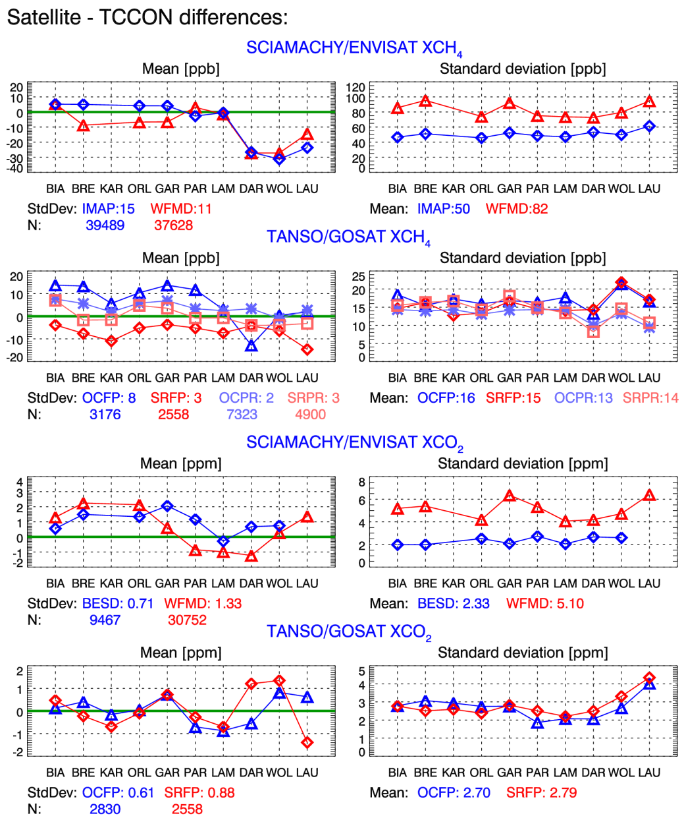
GHG-CCI Round Robin:
Validation Results
Round Robin Validation @ TCCON sites:
Key results:
SCIAMACHY XCH₄:
Both algorithms similar biases & scatter for 2003-2005
Up to 30 ppb biases at SH sites !?
After 2005 (instrument degradation) IMAP lower scatter
GOSAT XCH₄:
All 4 similar (but OCFP largest biases)
GOSAT has better precision for single obs. than SCIA (but SCIA has much more data)
SCIAMACHY XCO₂:
BESD has better precision and accuracy than WFMD (but WFMD x4 more data)
SCIA/BESD same precision and accuracy than GOSAT (but more data)
GOSAT XCO₂:
Both algorithms similar
Buchwitz et al., RSE (accepted), 2013
10

Slide 11
GHG-CCI: Key performance estimates (status @ end of Round Robin)
GHG-CCI ECV Core Data Products: Estimated data quality ^{#)}
Product | Sensor | Algorithm | Precision Single observation | Precision Regional / monthly | Relative accuracy
XCH₄ _{[ppb]} | SCIAMACHY ²⁰⁰³⁻²⁰⁰⁵ ^{(> 2005)} | IMAP WFMD | 30 (50) 30 (70) | 10 (<15) 9 (13-16) | 4 – 13 (2003-2009) 3 – 12 (2003-2009)
 | TANSO | OCPR SRFP | 14 15 | 5 9 | 3 5
Required (URD): |  |  | < 34 (T) < 17 (B) < 9 (G) | < 11 (T) < 5 (B) < 3 (G) | < 10 (T) < 5 (B) < 1 (G)
XCO₂ _{[ppm]} | SCIAMACHY | BESD WFMD | 2.4 4.3 | 2.0 2.3 | 0.8 1.2
 | TANSO | OCFP SRFP | 2.5 2.6 | 1.3 1.3 | 0.8 1.0
Required (URD): |  |  | < 8 (T) < 3 (B) < 1 (G) | < 1.3 (T) < 1.0 (B) < 0.3 (G) | < 0.5 (T) < 0.3 (B) < 0.2 (G)
#) Typical values obtained using different methods mainly based on comparisons with TCCON (esp. rel. accuracy not fully representative for all conditions). From: GHG-CCI Algorithm Selection Report (ASR, http://www.esa-ghg-cci.org/)

Slide 12
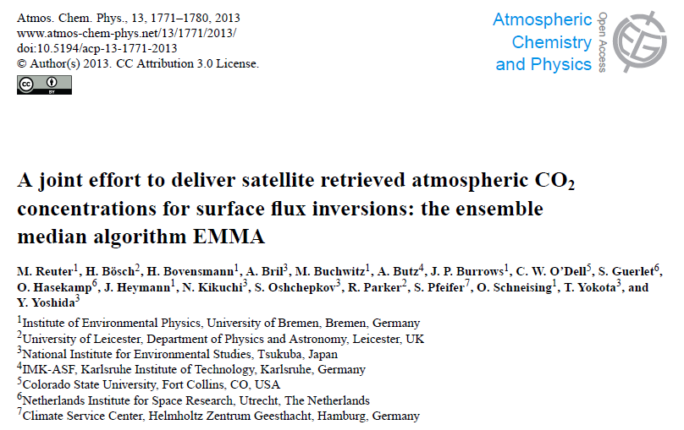
Ensemble algorithm ”EMMA”
A „comparison tool“ for global satellite XCO₂ (truth = unknown !?)
A new „robust“ Level 2 product based on „merging“ individual XCO₂ products
removal of outliers
realistic error estimates from ensemble spread
Reuter et al., ACP, 2013

Slide 13
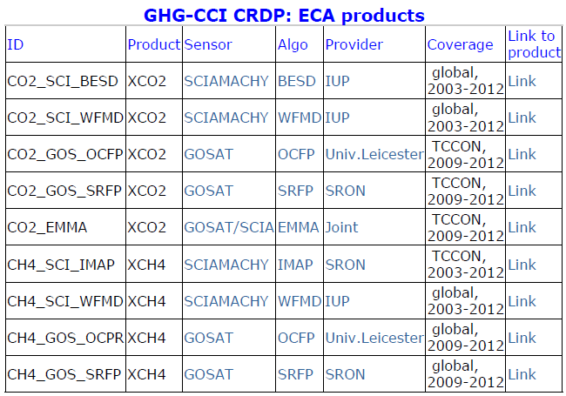
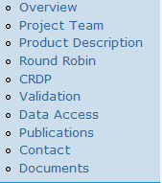
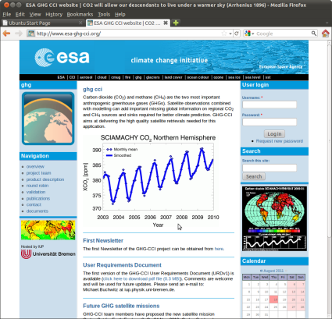
GHG-CCI: Status overview & CRDP
GHG-CCI Phase 1:
Round Robin finished (as planned Aug 2012)
CRDP generation finished (as planned Feb 2013)
Ongoing:
CRDP validation & user assessment
Afterwards CRDP will be publicly available (plan: Sept 2013)
Available already now on request
http://www.esa-ghg-cci.org/?q=node/84
Climate Research
Data Package (CRDP)
www.esa-ghg-cci.org/
New !

Slide 14
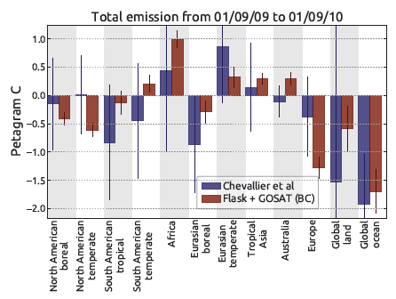
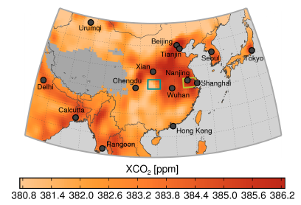
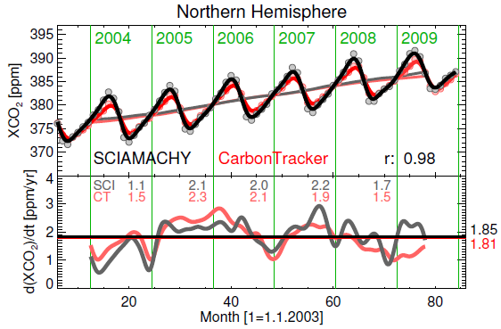
GHG-CCI: Scientific progress
as documented via peer-reviewed publications:
SCIAMACHY/ENVISAT XCH₄: Longer time series with improved quality: Schneising et al., 2011, 2012, Frankenberg et al., 2011
SCIAMACHY/ENVISAT XCO₂: Longer time series with improved quality:
Heymann et al., 2012a/2012b, Schneising et al., 2011, 2012, Reuter et al., 2011
TANSO/GOSAT XCH₄ & XCO₂: 1st published global data sets incl. inverse modeling results:
Guerlet et al., 2013, Basu et al., (ACPD), 2013, Cogan et al., 2012,
Schepers et al., 2012, Parker et al., 2011, Butz et al., 2011
SCIA/GOSAT XCO₂ merged: New innovative ensemble product:
Reuter et al., 2013
& more …

Slide 15
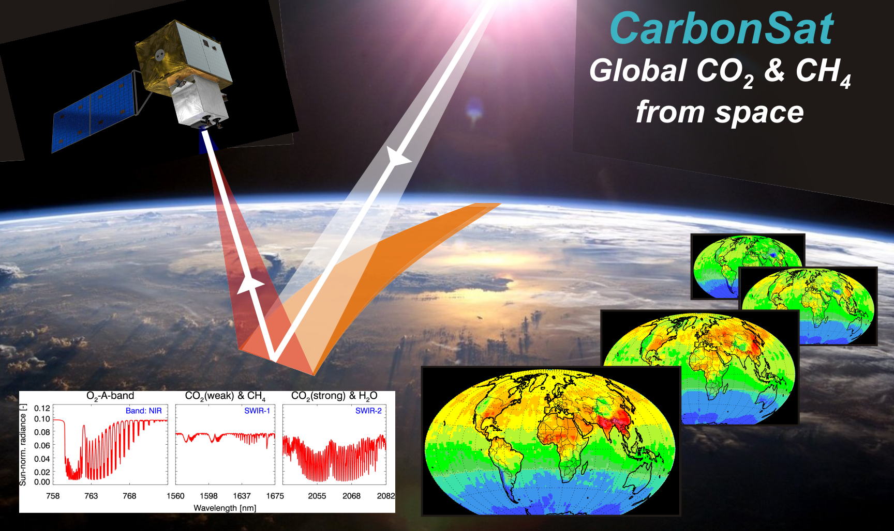
Beyond ENVISAT ?
For CarbonSat Please see talk A. Bombelli
using slides provided by IUP, Univ. Bremen
Earth Explorer 8 (EE8)
Candidate Mission

