Slide 1

GEO AQ CoP activities
and
Atmospheric Composition Metadata
Martin G. Schultz
Forschungszentrum Jülich

Slide 2
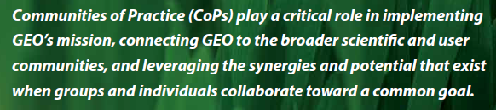
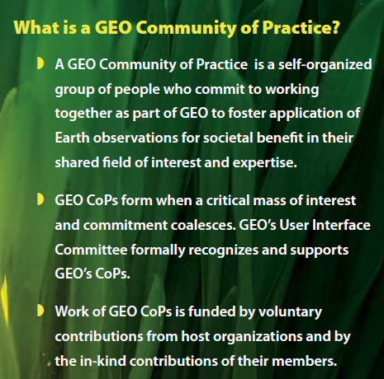
GEO and CoPs
Communities of Practice:
  Air Quality
  Atmospheric Chemistry (void)
  Biodiversity
  Carbon
  Coastal zone
  Cryosphere (under development)
  Energy
  Forest
  Geohazards
  Global Agricultural Monitoring
from GEO Summit 2010

Slide 3
The GEO AQ CoP
Initiated in 2005 via the NASA REASoN program: requirement to participate in ESIP and NASA Earth Science Data Systems Working Group
“The objective of the ESIP Air Quality Workgroup is to connect air quality data consumers with the providers of those data by:
  bringing people and ideas together on how to deliver ES data to AQ researchers, managers and other users
  facilitate and demonstrate the information flow among data providers to air quality consumers “ (Stefan Falke)
Connection to GEOSS in 2008 (test cases)
TFHTAP initiative as „breeding ground“ (2009-present)
Two „practitioner“ workshops (2011, 2012)
Stronger European contributions since 2011 (cf. MACC)

Slide 4

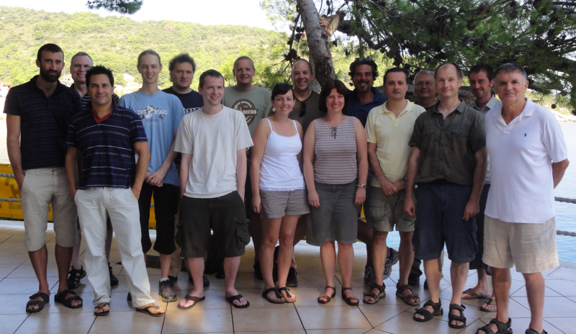
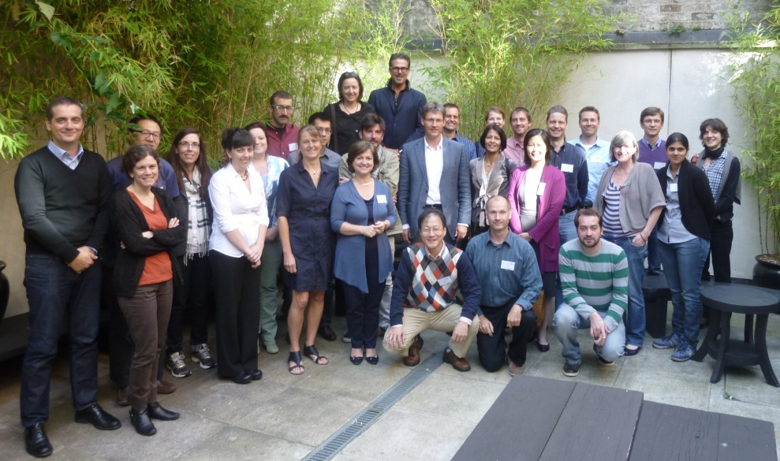
Workshop Data network
Solta, Croatia, August 2011
Workshop Metadata
Dublin, Ireland, September 2012
also: Regional Workshop in Mumbai, Dec. 2012

Slide 5
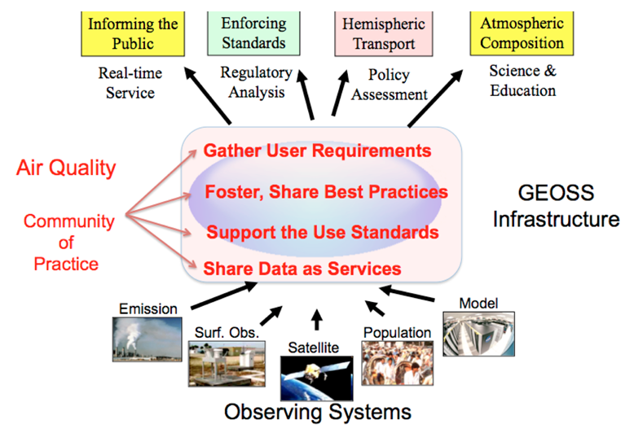
GEO AQ CoP Objectives:
Policy
Application
Services
AQ
CoP
Research
Community
Practices
after Rudy Husar, ESIP winter meeting, 2013 (http://wiki.esipfed.org/index.php/Air_Quality_Breakout,_ESIP_2012_Winter_Meeting)

Slide 6
GEO AQ CoP Activities and Outcomes
Major Outputs
Registered AQ data in GEOSS Common Infrastructure
Prepared AQ user requirement document
Organized topical workshops: Solta, Dublin, Mumbai
Facilitating an interoperable Air Quality Data Network
Co-developed the AQ Community WCS server software
AQ Metadata guidelines document (in preparation)
Governance discussion ongoing: see http://wiki.esipfed.org/index.php/GEO_AQ_CoP_Governance

Slide 7


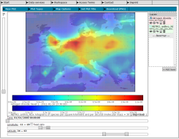

Interoperability in practice:
Jülich OWS INterface (JOIN)
Users
http://join.iek.kfa-juelich.de
Local data
bases
WCS server
Web Interface
MACC
HTAP
Work space
UBA-D
Data
Plots
Information
AirBase
WDCGG
WCS
server
WCS
server
WCS
server
WCS
server
WCS
server
near realtime data (24 h)
External
data bases
ECCAD
DataFed
NILU/EBAS
metno
(HTAP2)
CIERA

Slide 8
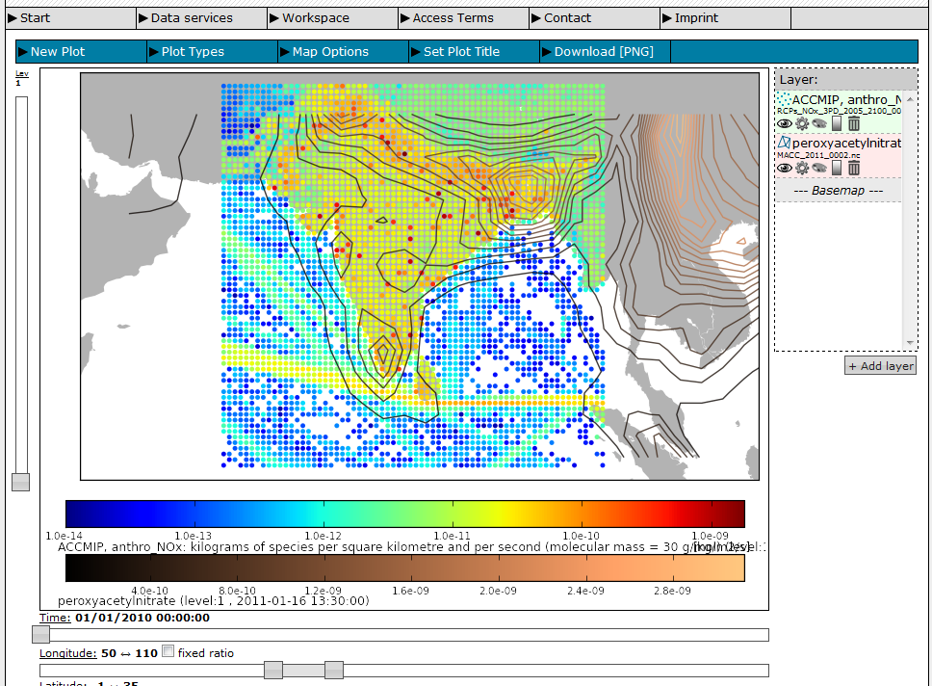
Overlay of data fields (emissions and model fields)

Slide 9
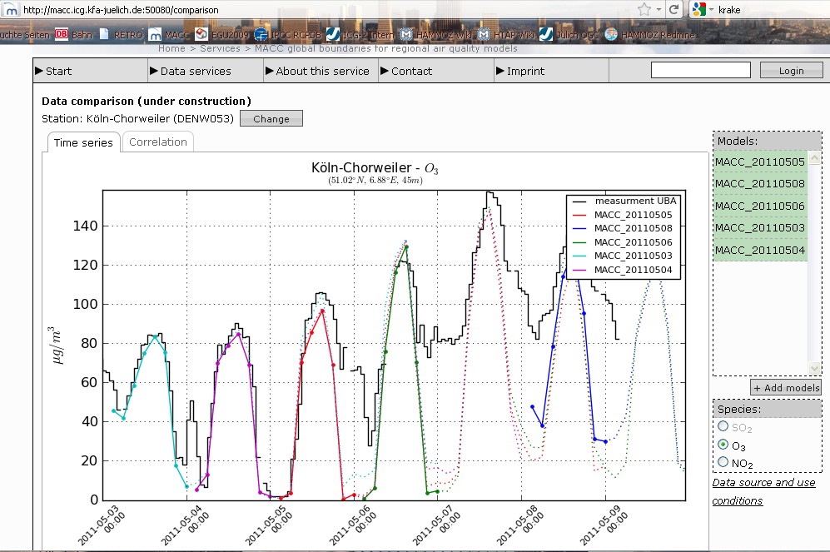
Model-data comparisons
EU
threshold
(8 hours)

Slide 10
What does it take to build a distributed, interoperable system?
Make machines talk to each other
standard data exchange protocols
defined data properties
standard metadata
Make people talk to each other
build trust so that people start sharing (data)
agree on standards and level of standardisation
define a common (metadata) language

Slide 11
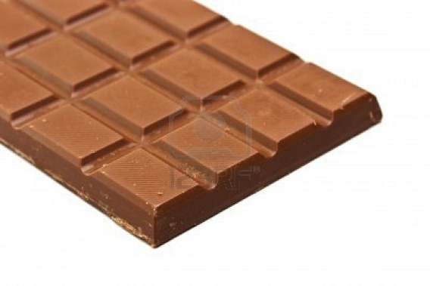
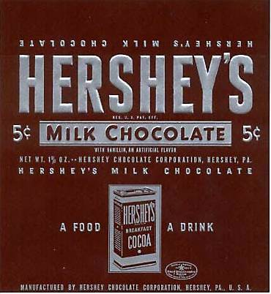
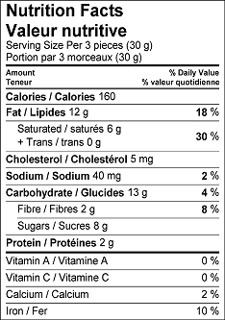
Why care about metadata?
What you want are the data (i.e. chocolate)
How do you find out if this is what you want?
1. Buy it, taste it
2. Read the package information
3. Evaluate metadata record and order from online shop
What do you need to know before you buy?
Brand name (dataset title)
Type of chocolate (dataset type)
Size of chocolate (geospatial extent)
Ingredients (dataset quality)
Best before (dataset history)

Slide 12
The FAUL concept of interoperability
FIND
ACCESS
UNDERSTAND
LINK
without having to program anything as a user
FAUL (as a German word) means „lazy“

Slide 13
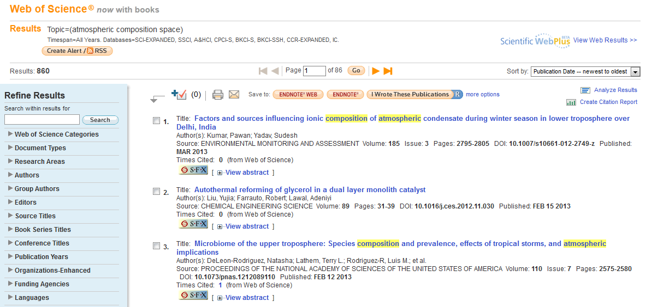
A great example: literature databases
direct access to data (= article) [depending on subscription]

Slide 14
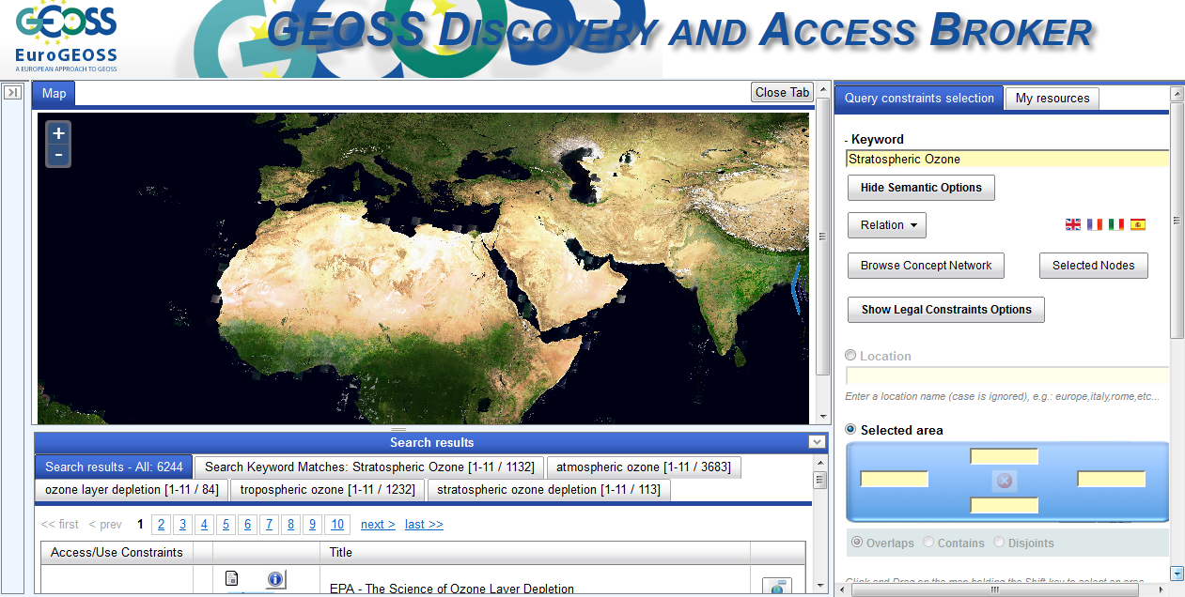
Can we do this for atmospheric composition data/information?
Search: improving ; Dataset access: very limited

Slide 15
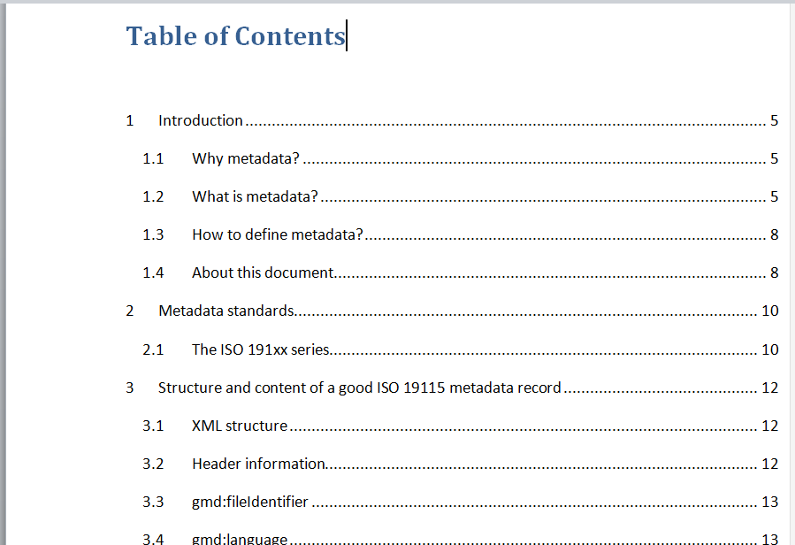
AQ CoP Metadata guideline document
…

Slide 16
The key issue: controlled vocabulary
Common and well-defined ontologies are pre-requisite for meaningful and effective search operations across discipline boundaries
Example: literature search
AUTHOR:
TITLE:
YEAR:
JOURNAL:
ARTICLE TYPE:
…
Analogy: AC data
CATEGORY TYPE:
CATEGORY:
PARAMETER NAME:
UNITS:
PLATFORM:
…

Slide 17
Existing vocabulary collections
NASA GCMD
WMO GAWSIS
EEA GEMET thesaurus
Datafed
EBAS
…
Issues:
Scattered efforts
Duplication of work
Poorly documented or documentation difficult to find

Slide 18
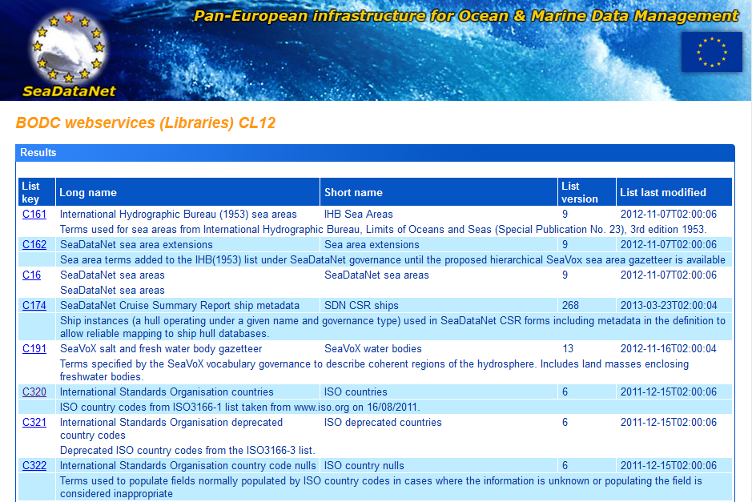
Potential „role model“: SeaDataNet
BODC vocabulary server: http://seadatanet.maris2.nl/v_bodc_vocab/welcome.aspx

Slide 19
AC metadata aspects (Dublin working group outcome)
What?
How good?
How?
Nature of parameter
Standard name
Physical units
DQ flags
Uncertainties
Detection limit
Verification method
Category Type
Category Name
Where?
Measurement:
Instrument type
Instrument name
Measurement technique
Sampling method
Calibration procedure
Data derivation/retrieval
Dataset history
TO BE REFINED!
Location (also vertical!)
Domain
Resolution
Version number
Revision date
Change log
Access to previous versions
Model:
Model type
Model name
Simulation type
Type of output
Output processing
References
When?
Time position
Time boundaries
Sampling intervals
Sampling frequency
Documentation
STandards
Citations/Publications
CalVal databases
Format descriptions

Slide 20
AC metadata aspects (Dublin working group outcome)
Modified modeling metadata elements
Intended to be the minimal description necessary for Data Discovery
Title
Modeling ID = Institution running model + model name(s) + version(s) + run ID
Modeling scope = Regulatory/Research + Directive (if applic) + Regulatory Authority Codelist (if applic)
Modeling method
  Originator
  Model Name(s)
  Model Type(s) [specific tags to be determined from a managed vocabulary: e.g., Regional, Global, Local, AQ, Climate, Met, Emissions, Transport, …]
  Simulation Type(s) [also need managed vocabulary, e.g. Forecast, Hindcast, Analysis, Off-line, On-line, …] – type specific information also needed, e.g. forecast length, …
  Model Version(s)
  Assimilated Observational Data [Define details…]
  Link(s) to Documentation
Model output time period
  Start time
  End time
  Model output frequency (highest output resolution, e.g. hourly)
  Model output frequency type (e.g. average or instantaneous)
  Dataset aggregation period (e.g. monthly, …)
  Number of time periods…[FINISH this later]
Model output spatial characterization
  Geographic Bounding Box = lat/lon coordinates of output domain boundaries
  Geospatial Bounding Box = 3D coordinates of output domain boundaries
  Coordinate Reference System (e.g., horizontal reference = EPSG, OGC, …; vertical reference = pressure, etc)
  Horizontal resolution
  Vertical resolution
Processing spatial characterization
TO BE REFINED!

Slide 21


The way forward
GEO AQ CoP needs to define itself and ensure broad community support
Metadata (vocabulary) discussion should be continued in the GEO AQ CoP framework, because it offers a truly global perspective
Continue efforts to build a functional data network
(important side aspect: NRT and archived data needs)
Maintain efforts to build up trust within the multi-faceted „air quality and atmospheric composition“ community
(requires careful balance between large and small actors, operational and research agencies, geographic regions, etc.)
Identify and realize specific projects which further develop servers, protocols, metadata, and connections (→ funding!)

Slide 22
More information
AQ CoP wiki pages:
http://wiki.esipfed.org/index.php/GEO_AQ_CoP/
AQ CoP mailing list (limited postings):
geo_aq_cop@fz-juelich.de
list info: http://lists.fz-juelich.de/mailman/listinfo/geo_aq_cop

