Slide 1
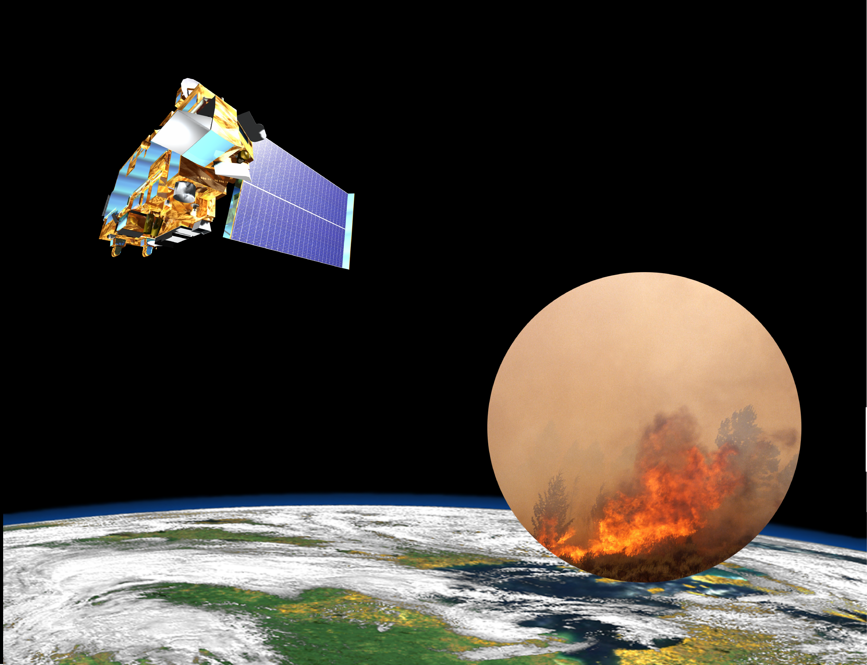
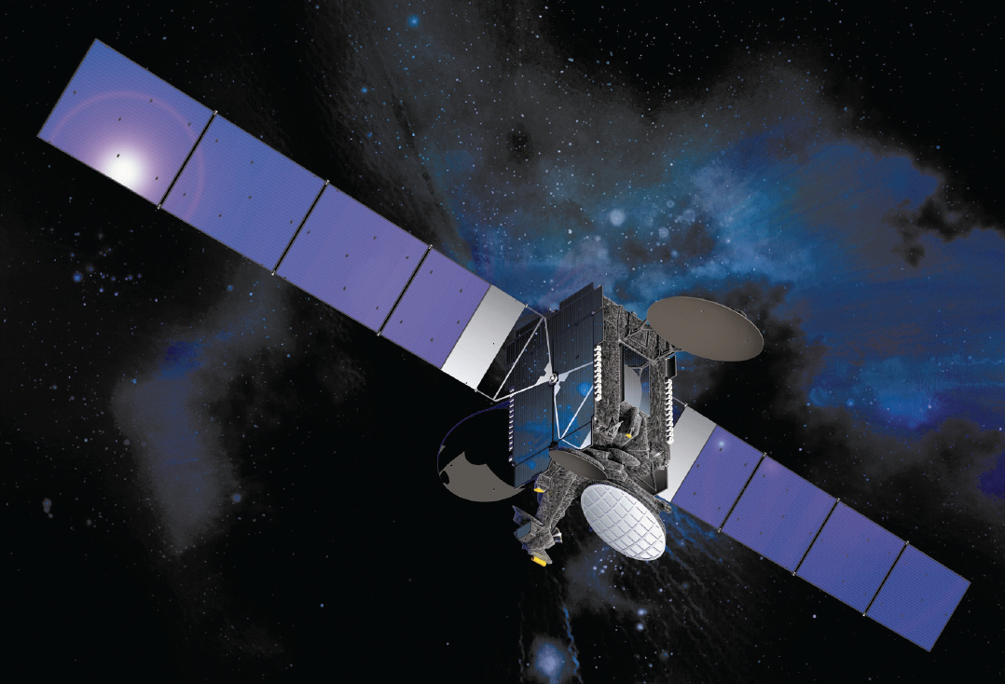
A global GEO OSSE activity for CEOS
David Edwards and Helen Worden (NCAR) with input from CEOS/MACC-II OSSE Workshop and the GEO-CAPE SWG
is sponsored by the National Science Foundation

Slide 2
Observation System Simulation Experiments (OSSEs)
Observing System Simulation Experiments (OSSEs) have been extensively used by the NWP community in order to help develop and optimize contemporary meteorological satellite instruments
OSSEs are now also increasingly used in other fields of earth observation
OSSEs assess the impact of hypothetical observations on a model analysis/forecast/inversion and provide a means to generalize on the limited conclusions of case-studies
The CEOS/ACC whitepaper A Geostationary Satellite Constellation for Observing Global Air Quality: An International Path Forward called for “(OSSE) cooperation to define, conduct, and analyze common scenarios ….align and extend the ongoing regional studies and to systematically incorporate them into global studies.”
Collaboration opportunity between the planned and proposed geostationary Earth orbit (GEO) missions from NASA GEO-CAPE/TEMPO, French MAGEAQ, ESA Sentinel 4, Korean GEMS and Japan

Slide 3
A Chemical Observation System Simulation Experiment (OSSE) for Lowermost Atmosphere CO
Nature & Control Runs
Instrument Simulator
Data Assimilation

Slide 4
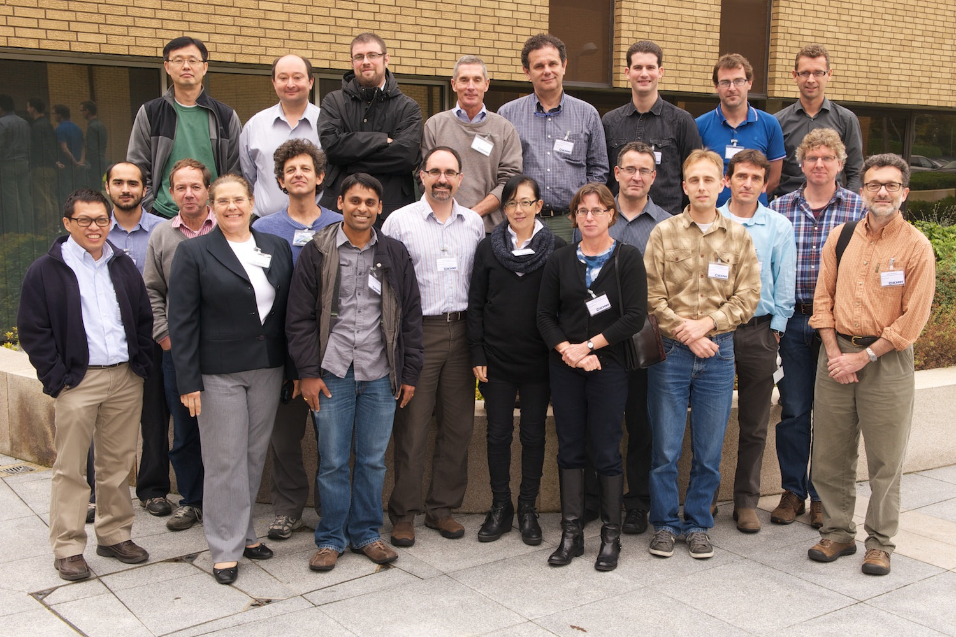
ECMWF Workshop on Atmospheric Composition OSSEs
Agenda:
Discussion on what makes a good OSSE
Talks by ECMWF meteorological OSSE experts describing experience and contrasting with chemical OSSEs
Reports on OSSE activities to-date under GEO-CAPE/TEMPO, MAGEAQ, Sentinel 4, Korea GEMS and Japan – primarily GEO
Breakout groups for the OSSE elements: Simulators, Nature/Control runs and Assimilation
Highlighted pragmatic approaches: These are computationally expensive experiments requiring a breadth of expertise
A CEOS/MACC-II International chemical OSSE Workshop was held at ECMWF in October 2012 attracting 30 participants sharing expertise toward developing common approaches and experiments
The meeting aimed at reviewing experience from NWP, reporting on existing work worldwide on OSSEs for "chemical" satellite instruments, discussing best practices and defining needed infrastructure in order to set up reliable experiments
Goal: Define experiments to document the impact of GEO instruments alone, together over different parts of the globe, and in conjunction with LEO assets
Organizers: J. Al-Saadi (NASA, USA), D. Edwards (NCAR, USA), Y. Kasai (NICT, Japan), V.-H. Peuch (ECMWF, UK), C. H. Song (GIST, Korea)

Slide 5
Experiments
Regional: Aimed at trade-offs between different instrumentation and observing strategies in regional models – these are funded and in progress in several countries e.g. ESA/ISOTROP
Global: Demonstrate value of the CEOS GEO constellation, quantifying regional gains & impact of losing one or more members
For practical reasons, OSSEs will be performed using global models at high resolution instead of a regional model, and will be designed to minimize the impact of this assumption
Two main categories of OSSE are identified:
Forward problem: What is the impact of a proposed measurement system(s) for improving analysis and forecast of the pollutant distribution?
Inverse problem: How does a proposed measurement system(s) help in constraining the upwind precursor emissions and boundary conditions through adjoint analysis?
First step: Consider a primarily tracer study for aerosol and/or CO to investigate the impact of long-range transport; Second Step: Expand this to include ozone chemistry

Slide 6
Infrastructure: NR and CR
Determine appropriate Earth system model(s): Which model(s) best represents the atmosphere (and/or surface etc.) for addressing the scales and physical processes relevant to the OSSE science goal?
Characteristics of NR & CR: Should mimic the difference between the prior atmospheric information input to a retrieval scheme and the actual atmospheric state
NR and CR differ in initial conditions, meteorology, emissions…
Validation of the NR is Essential: Against global observations and field campaigns
Adoption of a common NR should be considered: Different groups can still use their own CR and Assimilation packages
May leverage activities already underway at NASA/GMAO to develop a 10 km global chemistry NR
Cloud fields with sub-grid information based on MODIS simulator
Available CR models to run at 50 km horizontal resolution so that sub-grid information will be available from NR

Slide 7
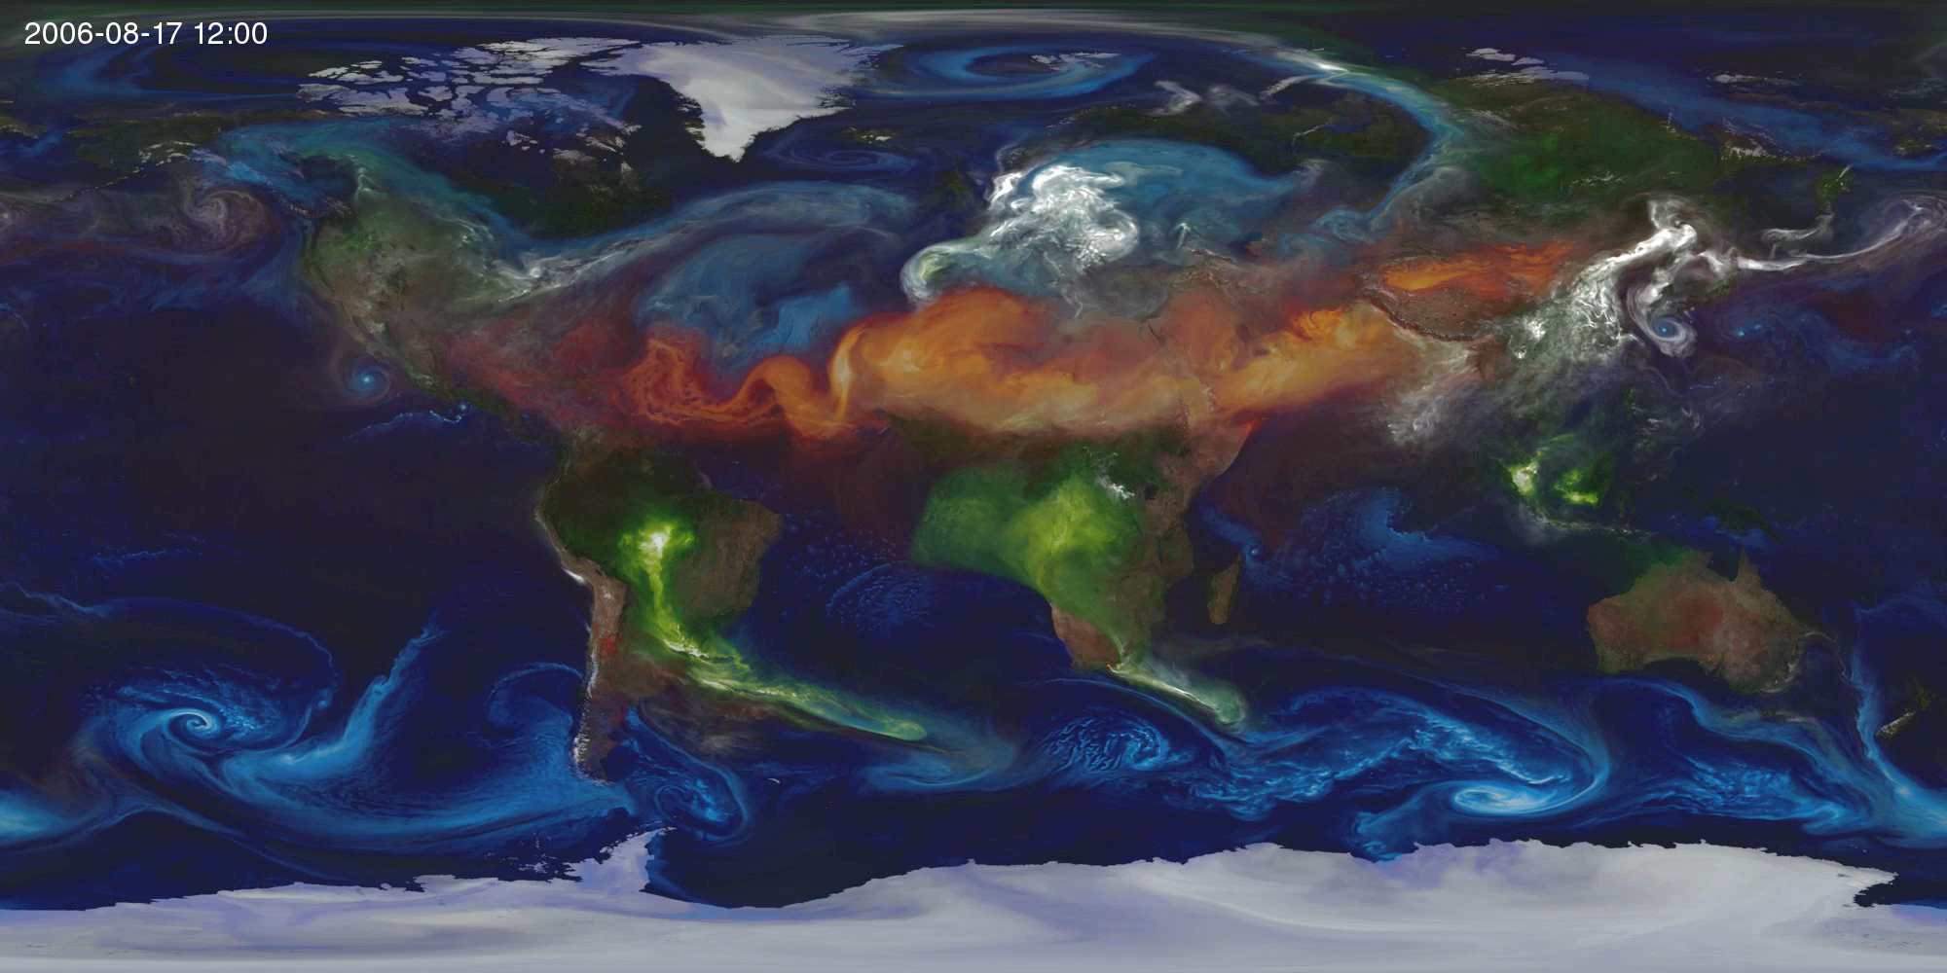
GEOS-5 Global 10 km Nature Run
Components
Atmospheric GCM on cubed-sphere, non-hydrostatic
Prescribed SST, sea-ice
Constituents
Radiatively coupled aerosols
Carbon species
GMI Combo Chemistry (*)
Emissions
Prescribed daily biomass-burning emissions
New 10 km dust source function from Ginoux
Anthropogenic inventories downscaled to 10km
GEOS-5 2013 NR
Global, 10 km
Aerosol, parameterized Chemistry
~2 year simulation
Aerosol, full chemistry
~ 1 month (TBD)
Availability
Free, on-line
~ 6 months
GEOS-5 2016+ NR
Global, 3.5 km
Improved model
Cloud-aerosol microphysics, etc.
GEOS-5 10km Global Mesoscale Simulation: SST, aerosol emissions
(*) GMI combo chemistry used for short experiments only.

Slide 8
Infrastructure: Measurement Simulation
Essential to verify the simulator’s baseline: Compare simulated versus real world performance of existing systems
Forward model development: Calculations must be fast for OSSE applications - full forward model/retrieval calculations are generally too expensive
Full list of parameters required from NR: Cloud features, surface albedo, thermal contrast, interfering species…
Full description of instrument: spectral resolution, SNR, instrument line shape, viewing geometry….
Foster links with instrument builders at space agencies or aerospace companies to help in modeling specific simulators
Clouds: Consider only cloud-free scenes and identify any resulting biases
Sensitivity to clouds depends on instrumentation: can change the definition of a “cloud-free” scene
Scene-dependent measurement simulations are essential !!!

Slide 9
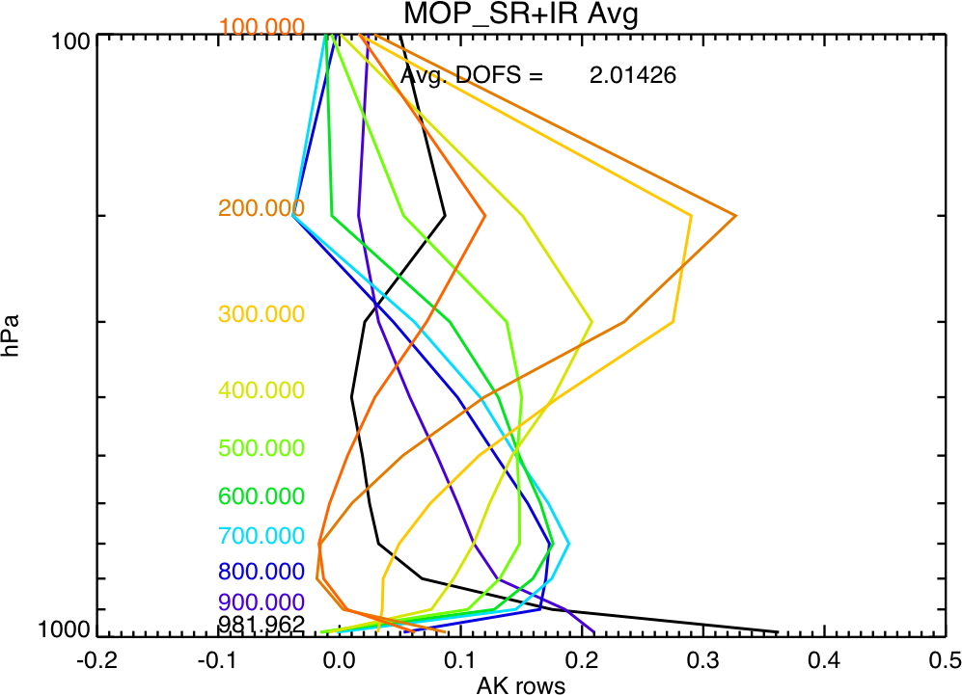
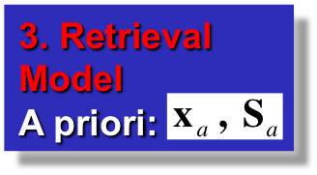
The Observation Simulator
2. The Forward Model
Simulated signal:
Measurement Sensitivity:
1. Nature Run Model Required state:
Instrument DescriptionNoise:
4. Retrieved Products:
Radiative Transfer
Notes:
We now have the basic OSSE frameworks
Learnt some things
Now we need to get more sophisticated and focus in on new developments for the various OSSE modules
Necessary to get to the point where OSSEs can truly be used as a component of tradeoff studies
Start with the Observation Simulator

Slide 10
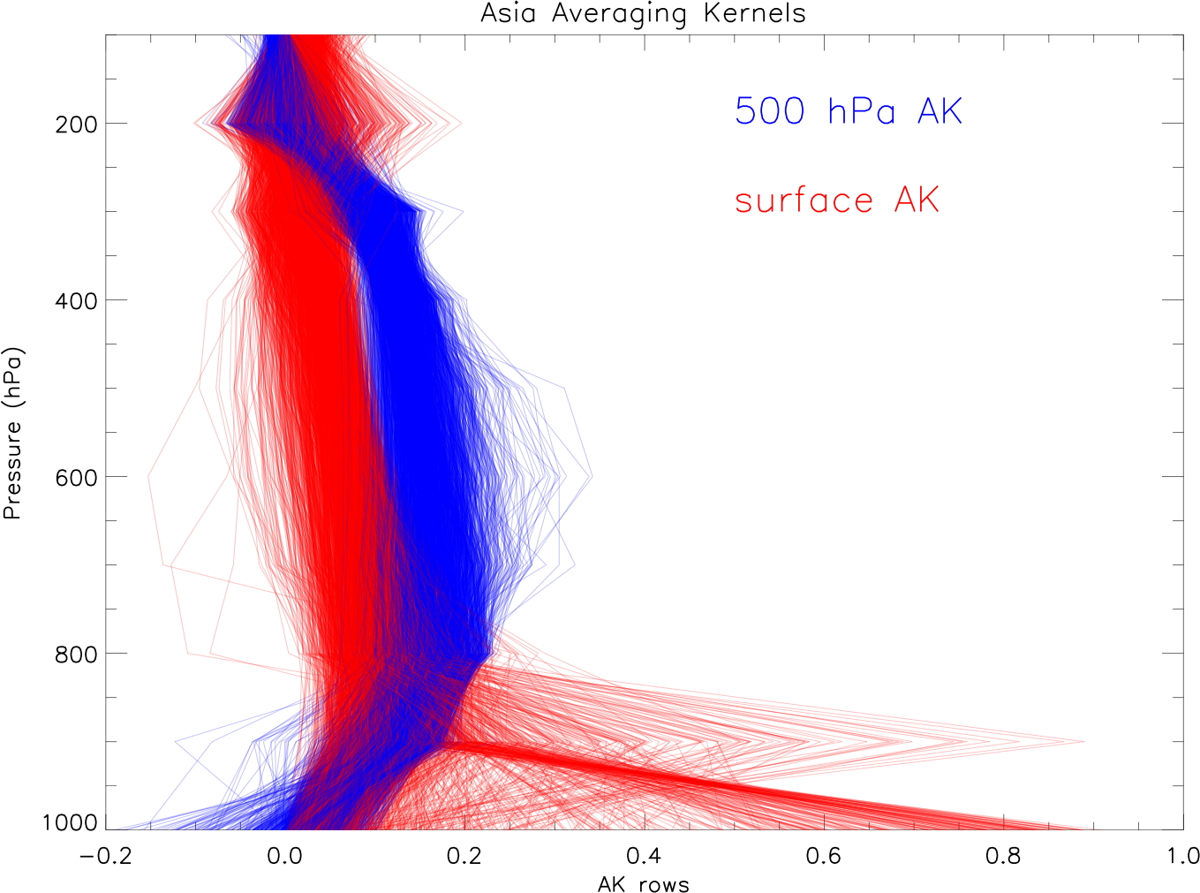
Retrieval Averaging Kernels
Observation Simulator measurement & retrieval characteristics are represented by the Averaging Kernel (AK) and retrieval error
However, running the full Observation Simulator in the OSSE is expensive and very involved
The CO and O₃ OSSEs have been simplified by assuming all observations can be represented with a few AK cases and these are used to sample the Nature Run model everywhere/all day
But AKs vary a lot….
Spread in MOPITT AKs for surface & 500 hPa CO retrievals
Depend on surface characteristics, temperatures, clouds, aerosol loadings, trace gas loadings, viewing and solar angles
Realistic OSSEs need to account for this
Notes:
Major limitation of the OSSEs to-date
Likely to make a difference
Because AK differences depend on surface characterization, might expect geographical biases
Again, we can use heritage measurements to tell us how important this is
Go back to slide 8: Perhaps we can short-circuit this calculation loop

Slide 11
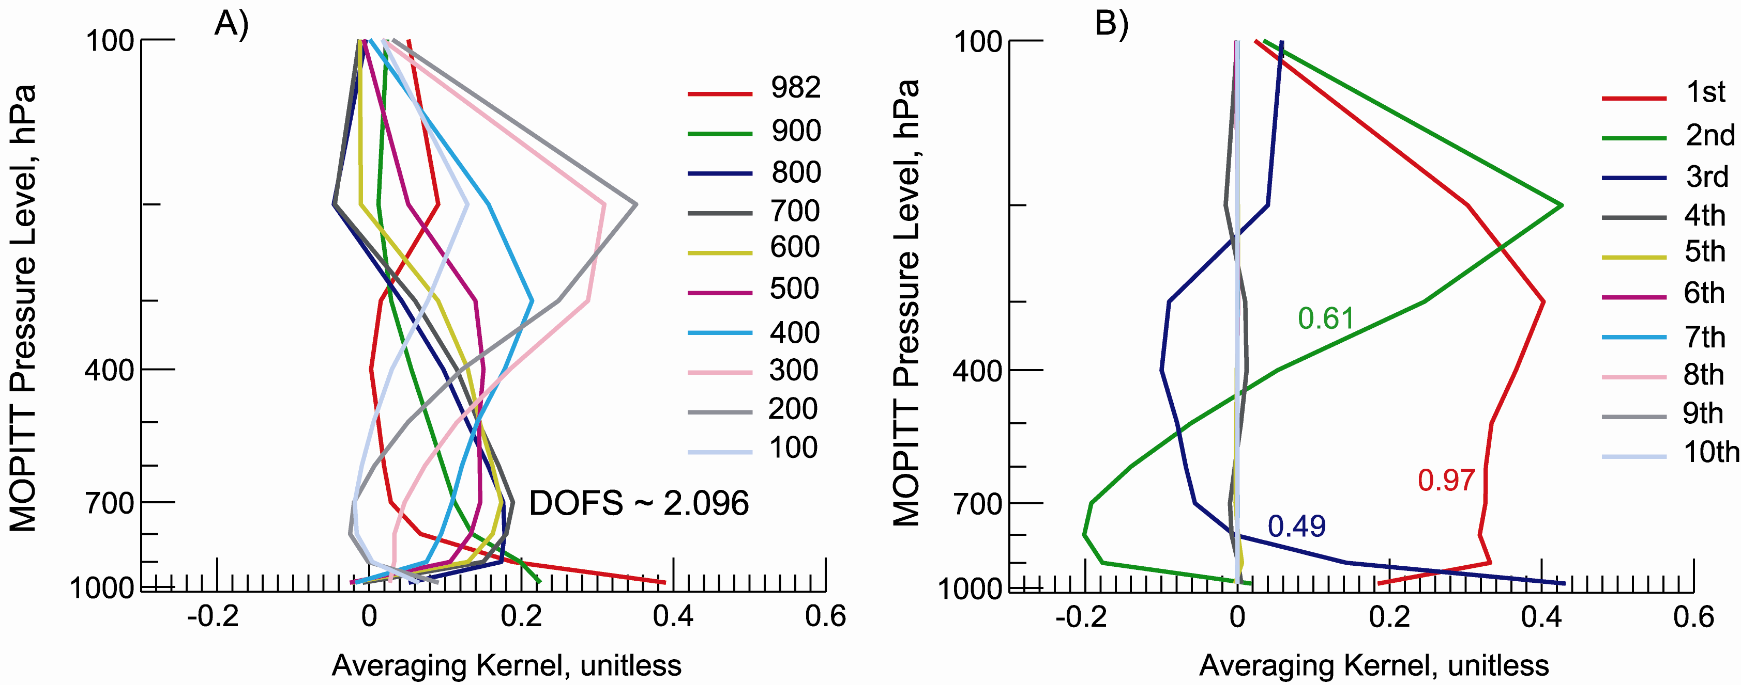
OSSE Development of AK prediction tool
Goal: Decouple OSSE Observation Simulator and Modeling modules
Develop a fast and easy-to-use predictive tool to estimate scene-dependent AKs for a given candidate observation
AK description can be simplified by using a PC representation AK-PC
Tool can be passed from instrument groups to modeling groups
Approach:-
Observation Simulator models produce a large ‘training set’ of AKs for characterized scenes
Use a AK-PC representation - small number (~ DFS) components
Train a regression model between AK-PC training set and scene ‘predictors’
Example of A) the original AK and B) rotated AK-PC for a MOPITT multispectral (TIR+NIR) retrieval sampled over New Delhi. The numbers associated with the 3 leading components of the rotated AK correspond to the fraction of DFS explained by each component
From Arellano et al., sub. JGR, 2011
Notes:
Decoupling the OSSE modules will also help divi-up the work between instrument and modeling groups
Will allow more OSSEs to be performed
Different instrument groups can also check each others Observation Simulator assumptions

Slide 12
Infrastructure: Assimilation
Independent but related data assimilation systems allow us to test the robustness of answers
DA approaches: 4D-Var, KF, DART EnKF, hybrid variational
Retrieval assimilation versus radiance assimilation: Pragmatic considerations will lead to range of approaches because of the different instrumentation involved

Slide 13
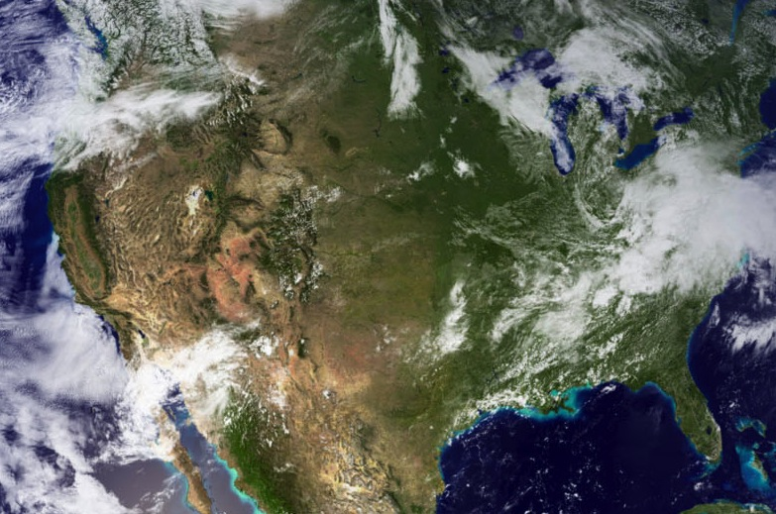
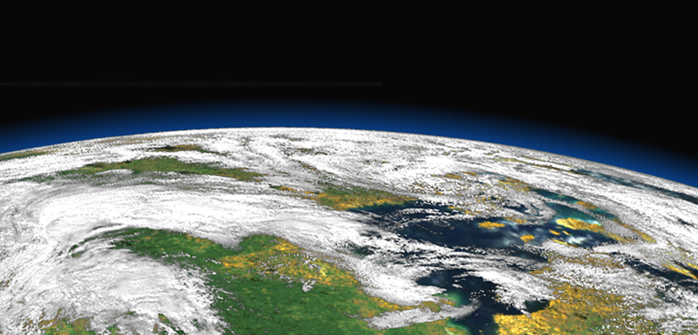
Summary
OSSEs need to account for realistic atmospheric variability: Requires evaluation of NR with observations
OSSEs require realistic variability in measurement simulations generated from NR: Requires incorporation of sensitivities due to cloud, aerosol, trace gases, surface UV-visible reflectivity, and IR emissivity
Simulated retrievals must include realistic range of sensitivities: Requires generation of scene-dependent AKs and errors
OSSEs for relative performance between instruments/viewing scenarios may be more reliable: If comparing a next generation, we need high accuracy and full system evaluation with the existing observing system
NWP experience: OSSE-based decisions have international stakeholders and experiments should be developed as joint global projects. Community ownership and oversight of OSSE capability is also important for maintaining credibility
Atmospheric Composition Remote Sensing & Prediction

Slide 14
Thank You!
NCAR is sponsored by the National Science Foundation

