Slide 1
Claus Zehner
european space agency
Monitoring Volcanic Ash from Space
Activities at the European Space Agency

Slide 2
The ESA Earth Observation “fleet”

Slide 3
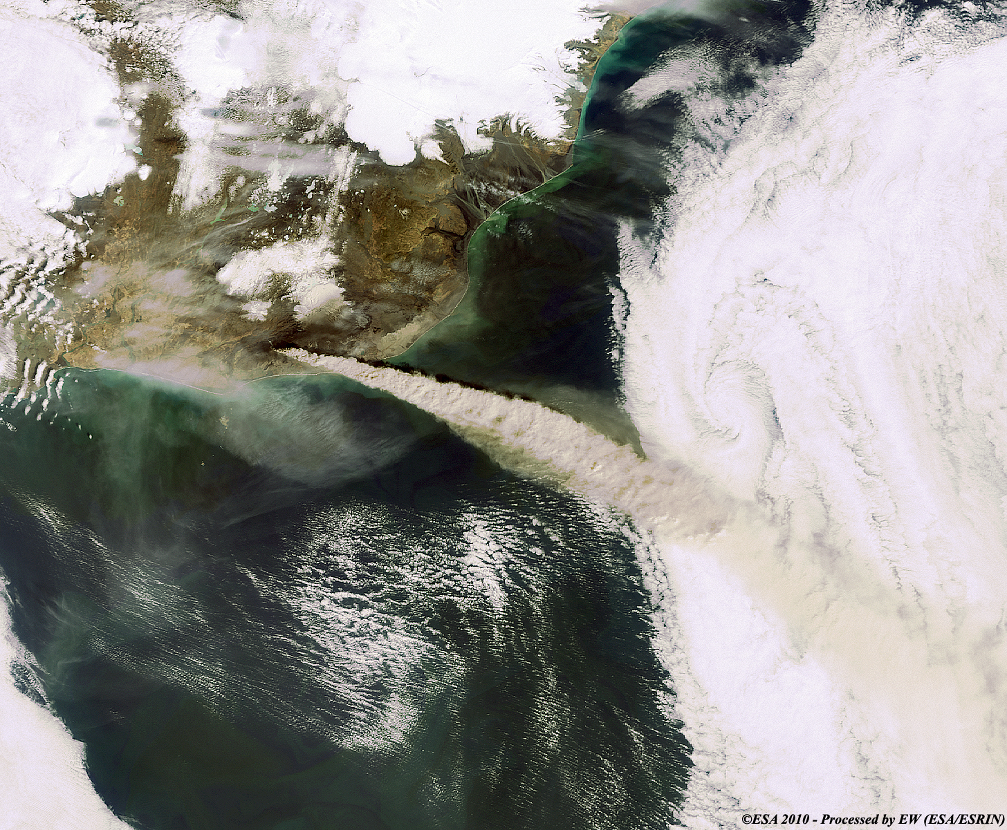
http://earth.eo.esa.int/workshops/Volcano/files/STM_280_web.pdf

Slide 4
ESA Projects on Volcanic Emission Monitoring
Extension of ongoing activities by 3 projects during 2012:
VAST - http://vast.nilu.no/ - 3 years – lead by NILU (F. Prata)
SACS2 - http://sacs.aeronomie.be/ - 18 month– lead by BIRA/IASB (N. Theys)
SMASH – based on the EU www.evoss.eu/ project - 18 month lead by CGS (L. Tampellini)
Enhance the usage of EO satellite data for volcanic ash monitoring
Update existing user requirements
Provision of improved satellite based volcanic emission information based on e.g. SEVIRI, AATSR, MODIS, GOME2, IASI, OMI, AIRS measurements
Provision of improved eruption source information
Establishment of an operational LIDAR network in Ireland (national co-funding)
Establishment of a database for historic eruptions (satellite, ground-based, airborne, modeling data)
Development of an operational demonstration volcanic ash forecasting service (open source code operated at ZAMG) that could be implemented at VAACs or elsewhere
Define a ‘best’ future end-to-end volcanic ash monitoring system

Slide 5
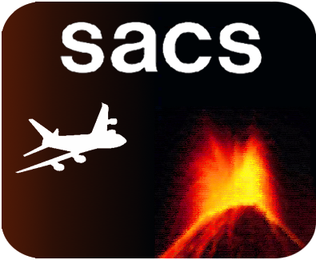
Support to Aviation Control Service
N. Theys, H. Brenot, J. van Gent, M. Van Roozendael (BIRA-IASB)
L. Clarisse, D. Hurtmans, P.-F. Coheur, C. Clerbaux (ULB-LATMOS)
R. van der A, P. Wang, J. van Geffen (KNMI)
P. Valks, P. Hedelt (DLR)
R. Siddans, C. Poulsen (RAL)
D. Balis, M. Koukouli (AUTH)
F. Prata (NILU)
Data Providers:
FMI

Slide 6
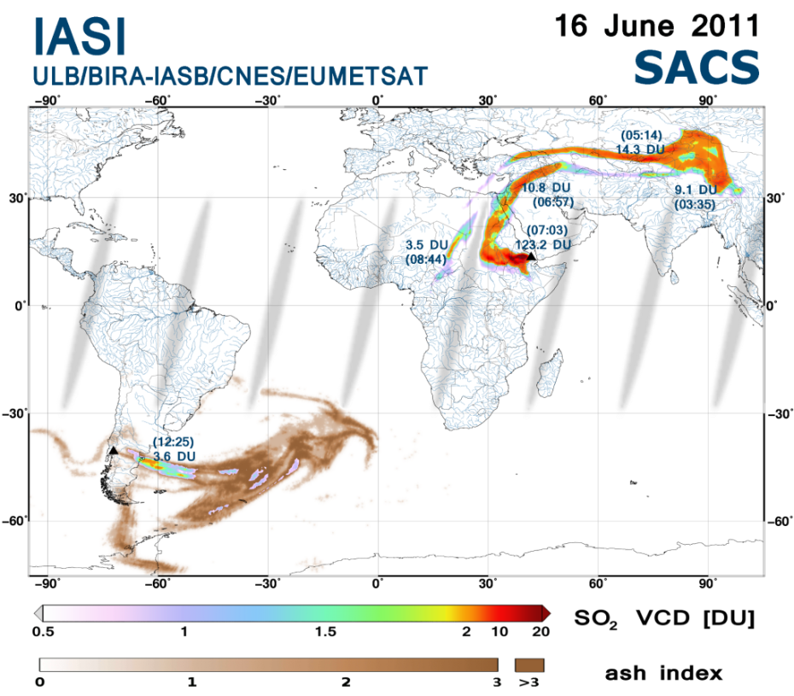
Support to Aviation Control Service
sacs.aeronomie.be
Web-based multi satellite sensor notification system (AIRS, GOME2, IASI, OMI)
Development of improved products (ash, height information)
Number of subscribed users : 150 (e.g. VAACs, aviation companies, pilots, observatories, researchers)
SO₂ and ash from Nabro (Eritrea)
and Puyehue (Chile) detected
by IASI (16 June 2011)

Slide 7
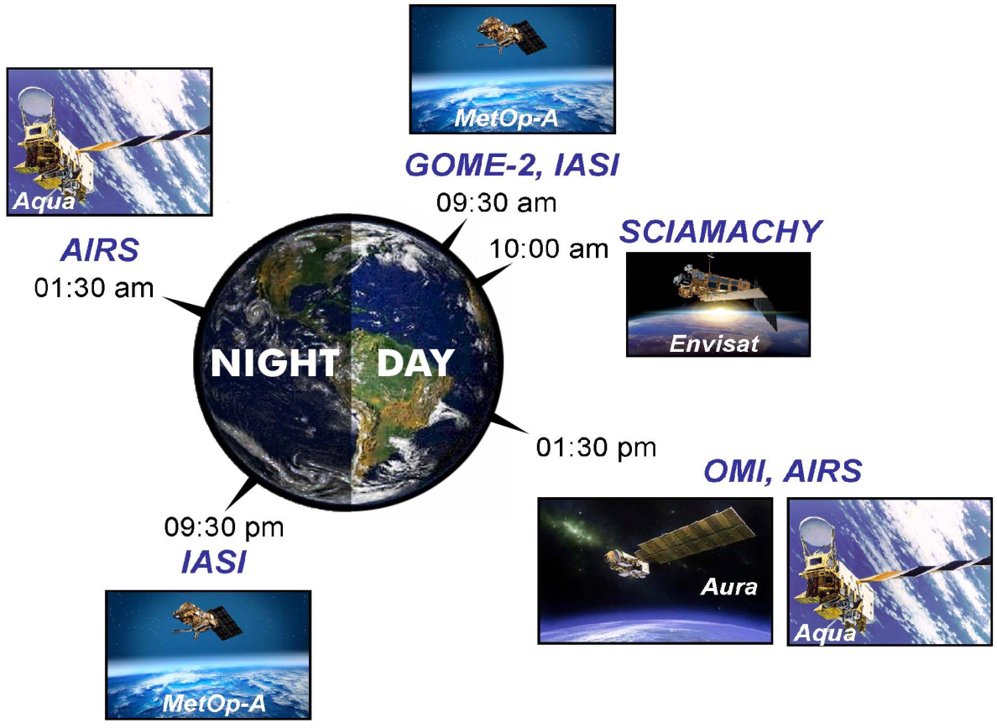
Support to Aviation Control Service

Slide 8
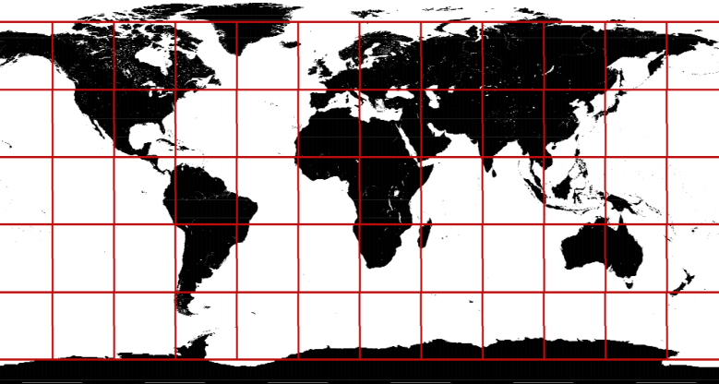
Support to Aviation Control Service
Main Service Features - http://sacs.aeronomie.be:
One e-mail is sent per 12 hours and per 30°x 30° predefined region (first instrument to detect SO₂).
System optimized to avoid false notifications (e.g., anthropogenic SO₂) – success rate: >95%
After a notification, all other notifications (confirmation during the next 12h) are available through the webpage

Slide 9
Support to Aviation Control Service
Bezymianny eruption

Slide 10
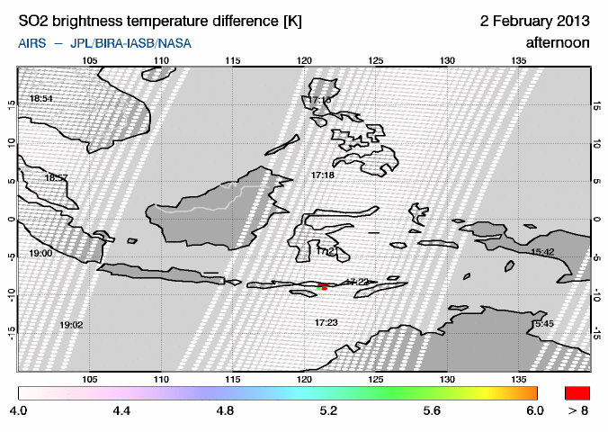
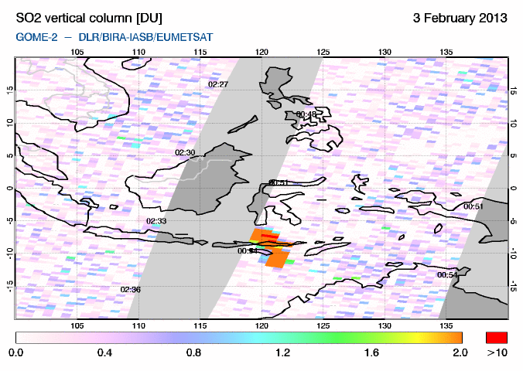
Support to Aviation Control Service
Example warning: Paluweh eruption:
First overpass : AIRS, 1h46 after the start of the eruption.
SACS e-mail warning: 4h23 after the start of
the eruption.

Slide 11
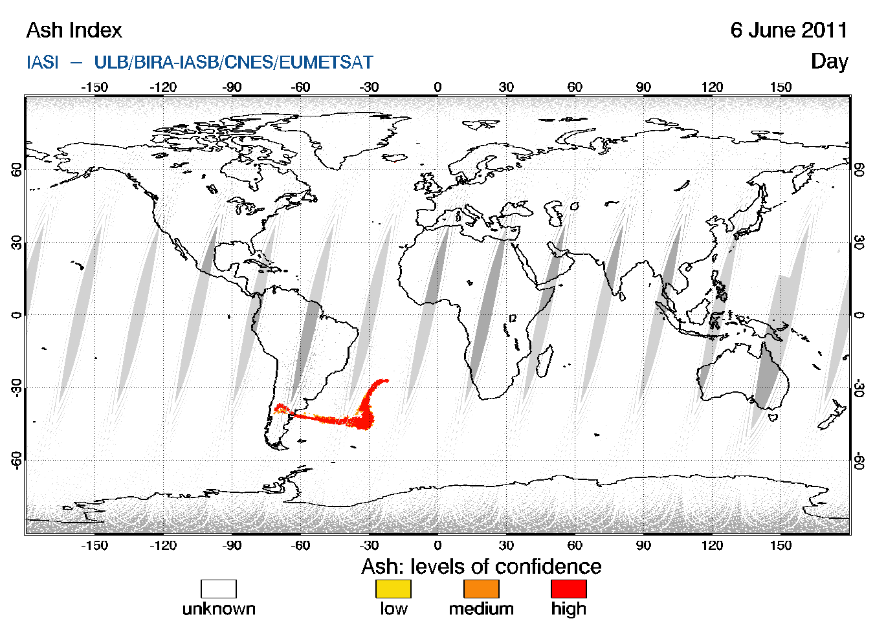
Support to Aviation Control Service
AIRS: on-line since 2 months (F. Prata algorithms)
IASI: on-line soon (L. Clarisse algorithms)
New satellite products for plume detection - IASI and AIRS ash products:

Slide 12
Support to Aviation Control Service
Snapshot of the future SACS NRT webpage

Slide 13
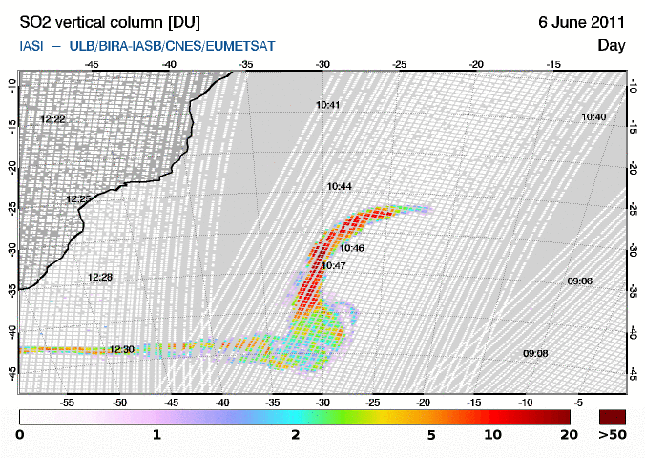
Support to Aviation Control Service
Further improvement of the notification system:
Warning levels
* Level A: Aviation-relevant emissions detected by IASI/AIRS and eventually OMI/GOME-2.
* Level B: Degassing emissions (low altitude) only detected by OMI/GOME-2.

Slide 14
ESA Projects on Volcanic Emission Monitoring
Interaction and complementarity among the 3 projects:
All 3 projects have the same Technical Officer from ESA
Exchange of expertise and results: The AIRS algorithm of F. Prata (VAST) has been implemented recently into the SACS web-based warning system
Different consortia include different satellite retrieval experts (e.g. SEVIRI - NILU, AATSR –FMI, IASI – ULB, MODIS - INGV) and background knowledge
There are complementary approaches being developed on the derivation of improved eruption source information
All 3 projects will provide input data to a volcanic eruption database (e.g. SMASH: INGV Etna groundbased data)
SACS and NILU satellite products will feed into an operational demonstration volcanic ash forecasting service
The SMASH consortoium will define a ‘best’ future end-to-end volcanic ash monitoring system in Europe
VAST has organised a workshop with SMASH and SACS support at Dublin during early March 2013

Slide 15
Volcanic Ash Workshop: Dublin March 04-06 http://vast.nilu.no/UserWorkshop/tabid/10873/Default.aspx
Participants (~50):
Regulators (e.g. IAA)
Airlines (e.g. Aer Lingus, easyjet)
Constructors (e.g. Rolls-Royce)
Flight Captain (e.g. German Pilot Association)
Space Agencies (e.g. Eumetsat, NASA, ESA)
Satellite, ground-based and airborne Retrieval Experts
Modellers
Representatives of the Alaska VAAC

Slide 16
Volcanic Ash Workshop: Dublin March 04-06
Some discussion points - changes since to 2010:
IAA: based on improved knowledge complete airspace closing is not anymore necessary, decision to operate is now with Airlines
Aer Lingus: need for European Ash data derived in a consistent manner and presented in a standardised format to prevent unnecessary airspace closures and to give Airlines, and Regulators reliable data to safely make Responsible Decisions
Flight Captain: need for clear and easy to understand doc´s and volcanic ash satellite pictures with height and concentration info, need for SO₂- charts (also as forecasts)
Rolls-Royce: if you fly through an SO₂ cloud the engine should be replaced after 2 months

Slide 17
Volcanic Ash Workshop: Dublin March 04-06
Outcome: Delta Report to the one from 2010 (about 10-20 pages)
In case we have an Eyjafjoll eruption tomorrow - is the situation today different as compared to the one in 2010?
User Requirements: What has changed during the last 3 years?
Observations/Models Interaction?
What is the ‘best’ future end-to-end volcanic ash monitoring system in Europe (where are the gaps)?
What are the priorities for future actions (EU - Horizon 2020)?

