Slide 1
Status of GEMS
Jhoon Kim
P.I., GEMS
Yonsei University, Seoul, Korea

Slide 2
AMI
GOCI-2
GEMS

Slide 3
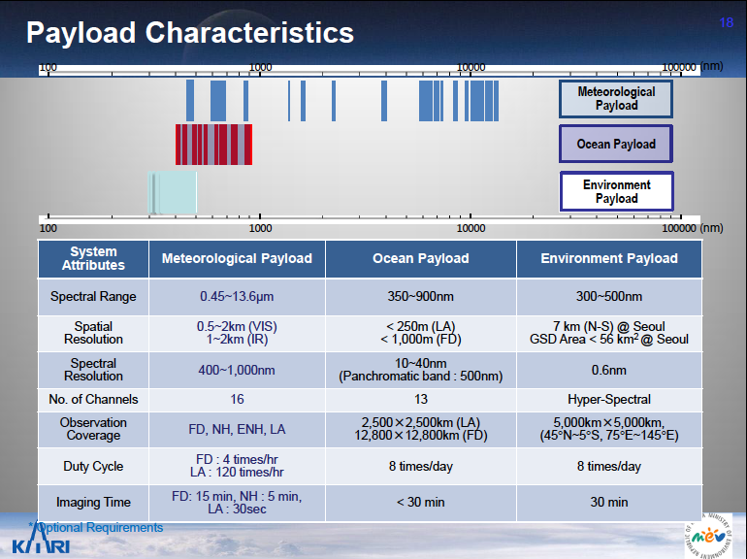
System Attributes | AMI (Meteorology) | GOCI-2 (Ocean) | GEMS (Environment)

Slide 4
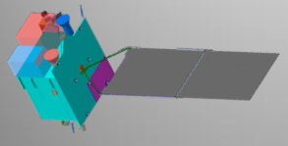
GEO-KOMPSAT-2B GEMS
(Geostationary Environment Monitoring Spectrometer)
Launch: 2018 (planned)
Major specification
 | Specification
Lifetime | 10 yrs
Spatial coverage | 5000 km x 5000 km (5º S ~ 45º N)
Longitude | 128.2 E
Duty cycle | 8 times / 1 day
Spatial resolution | 7 km (NS) x 8 km (EW) @ Seoul (gas) 3.5 km (NS) x 8 km (EW) (aerosol )
Spectral coverage | 300 – 500 nm
Spectral resolution | 0.6 nm (3 samples)
Products | O₃, NO₂, SO₂, HCHO, aerosol, cloud, surface reflectance
Optional IR payload | Under discussion (NASA EV-I, JAXA..) - spectral coverage: 0.76, 2~5 um - Products: O₂-A, CO₂, CH₄, CO
GeoKOMPSAT-2A: AMI
GeoKOMPSAT-2B: GEMS
GOCI-2

Slide 5

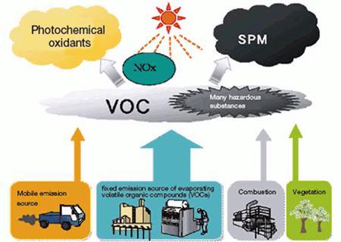
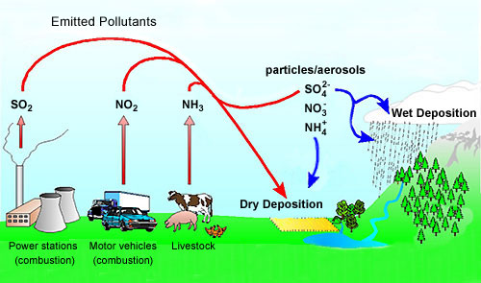
GEMS: Measurements of ozone & aerosol with their precursors
hν (λ<345 nm)
O
O₃
HCHO
hν (<420 nm)
NO
NO₂
Oxidation
(OH, O₃, NO₃)
t~an hour
O₃, RO₂
AOD, type,
Height
Aerosol
Notes:
Formaldehyde (HCHO) is important as a tracer for HOx production,1 and has the potential to provide insight into the nature of convective events. It is one of the most abundant gas phase carbonyls in the atmosphere;2 tropospheric mixing ratios vary typically from 0.2 parts per billion by volume (ppbv) to 20 ppbv,3 depending on elevation and geography, and can reach as high as 60 ppbv.4 Stratospheric HCHO background concentrations are estimated to be much lower (~0.02 ppbv), but current methods lack sufficient sensitivity for a direct measurement. The dominant sources in urban areas include primary emissions from combustion and industrial processing and photochemical oxidation of numerous anthropogenic volatile organic compounds (AVOCs).2,5 Oxidation of biogenic VOCs (BVOCs) becomes important as a source in rural areas,2,5 while methane oxidation provides a source of HCHO (Fig. 1) in the remote troposphere and in the stratosphere.5
HCHO is fairly short-lived (τ ≈ 3 hours)6,7 and is removed from the atmosphere primarily by reaction with OH and by photolysis.2,3 Both of these processes produce HO2,3,6,8,9 and result in a net production of ozone (O3) in the presence of NOx (such as found in polluted urban areas).2 The interaction of HCHO in HOx chemistry has wide-reaching significance. HOx is a major oxidizer throughout the entire atmosphere and is central to catalytic cycles generating O3 in the troposphere and as well as those destroying O3 in the stratosphere, making accurate estimates of these species crucial to atmospheric modeling on both local and global scales.
Because of its implication in HOx cycling, as well as its role as an intermediate in the oxidation of numerous VOCs, HCHO is a useful tracer of the oxidative capacity of the atmosphere. HCHO may provide insight into oxidation processes in complex environments such as the atmosphere above snow-pack, where unexpectedly high OH concentrations have been observed,10 and that within forest canopies.11,12 For the second application, knowledge of HCHO fluxes would be especially useful. Fluxes can be approximated using Monin-Obukhov similarity theory,13 but because of the assumptions required for similarity theory direct HCHO flux measurement by eddy correlation is more desirable, leading to a more accurate closed budget of the species of interest.14–17

Slide 6
Baseline products
Product | Impor- tance | Min (cm⁻²) | Max (cm⁻²) | Nominal (cm⁻²) | Accuracy | Spectral window (nm) | Spatial Resolution (km²) @ Seoul | SZA (deg) | Retriev-al
NO₂ | Ozone precursor | 3x10¹³ | 1x10¹⁷ | 1x10¹⁴ | 1x10¹⁵ | 425 - 450 | 56 | < 70 | BOAS / DOAS
SO₂ | Aerosol precursor | 6x10⁸ | 1x10¹⁷ | 6x10¹⁴ | 1x10¹⁶ | 310 – 330 | 56 x 4 pixels | < 50 (60*)
HCHO | Proxy for VOCs | 1x10¹⁵ | 3x10¹⁶ | 3x10¹⁵ | 1x10¹⁶ | 327 – 357 | 56 x 4 pixels | < 50 (60*)
O₃ | Oxidant, pollutant | 4x10¹⁷ | 2x10¹⁸ | 1x10¹⁸ | 2% or 6 DU (TOz) | 300-340 | 56 | < 70 | TOMS, OE
AOD (AI, SSA, AOCH) | Air quality, Climate | 0 (AOD) | 5 (AOD) | 0.2 (AOD) | 20% or 0.1@ 400nm | 300-500 | 56 | < 70 | Multi-spectral
Clouds | Data quality, climate | 0 (COD) | 50 (COD) | 17 (COD) |  | 300-500 | 56 |  | Raman, O₂-O₂
Surface Property | Environ-ment | 0 | 1 | - |  | 300-500 | 56 |  | Multi-spectral

Slide 7
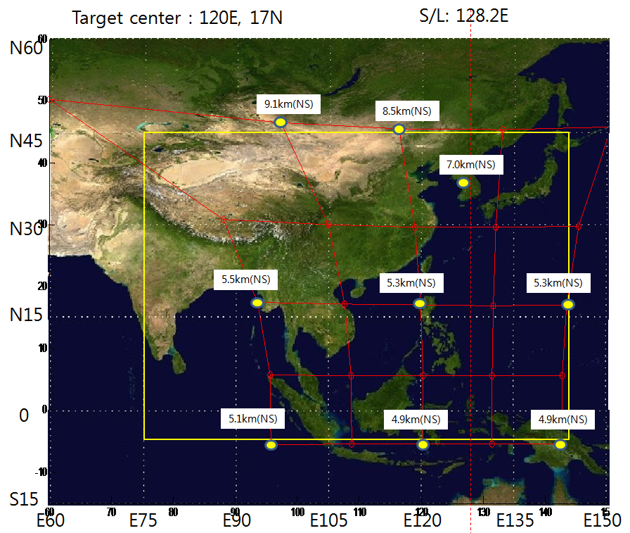
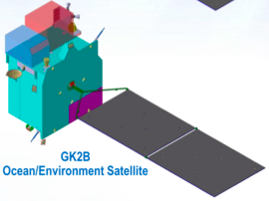
Projected FOV & GSD - NS GSD @ Seoul : 7.0km
Projected FOV
Region of interest
Option 2
Option 1
Clear Sector Method

Slide 8
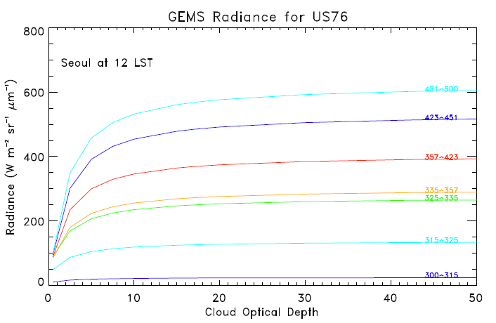
Input Radiance
Wavelength bin
Clear sky

Slide 9
SNR Requirements
Wavelengths (nm) | SNR | Related gas | Uncertainty (cm⁻²) | SZA (deg) | Remark
315-325 | 1500* 720 | SO₂ | 1.0 x 10¹⁶ 3.3 x 10¹⁶ | 60 | YJK, KC
327-356 | 1394* 1500* 720 | HCHO | 1.0 x 10¹⁶ 1.0 x 10¹⁶ 2.1 x 10¹⁶ | 50 70 | KC YJK, KC
423-451 | 2049* 1500 | NO₂ | 1.0 x 10¹⁵ 1.5 x 10¹⁵ | 70 | YJK, KC
433-465 | 1931* | CHOCHO | 4.0 x 10¹⁴ | 50 | KC
* Spatial coadding is required to increase the SNR.
(Kelly Chance, Y.J. Kim)

Slide 10
Before Launch
After Launch
R_{λ}(Sat.)
GEMS_Lv1b
Radiance spectrum
MET. field
CTM
RTM
Radiance spectrum Sim
Emission
YES
Cloud detection
Cloud
Rad Cloud fraction
Cloud height
NO
GEMS
Instrument
Requirement
Dynamic range
Spectral range
Spectral resolution
Spatial resolution
SNR
MTF
Operation Scenario
AMF
Aerosol
Surface
Hourly AMF
Stratospheric Comp.
AI, AOD, SSA
Surface reflectance
NO₂
SO₂
HCHO
O₃
Trop. NO₂ VCD
Trop. SO₂ VCD
HCHO VCD
Trop. O₃ VCD
Total O₃ VCD
CAL/VAL
AQ Forecast
Public Service
Data Assimilation
Climate Change Policy

Slide 11
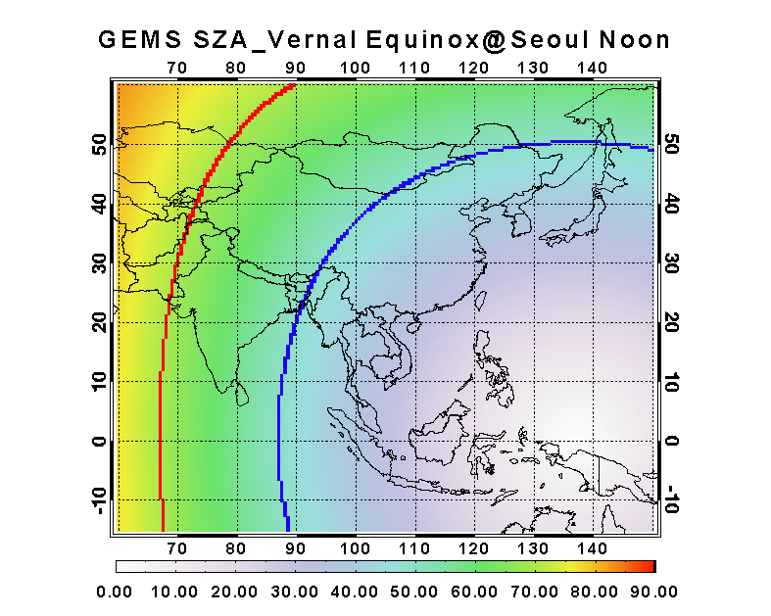
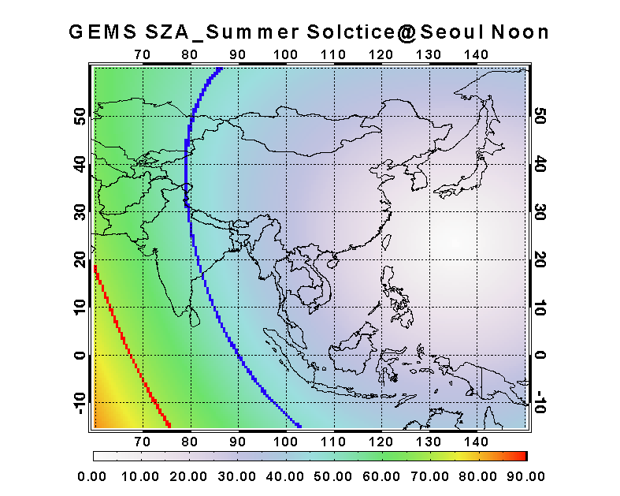
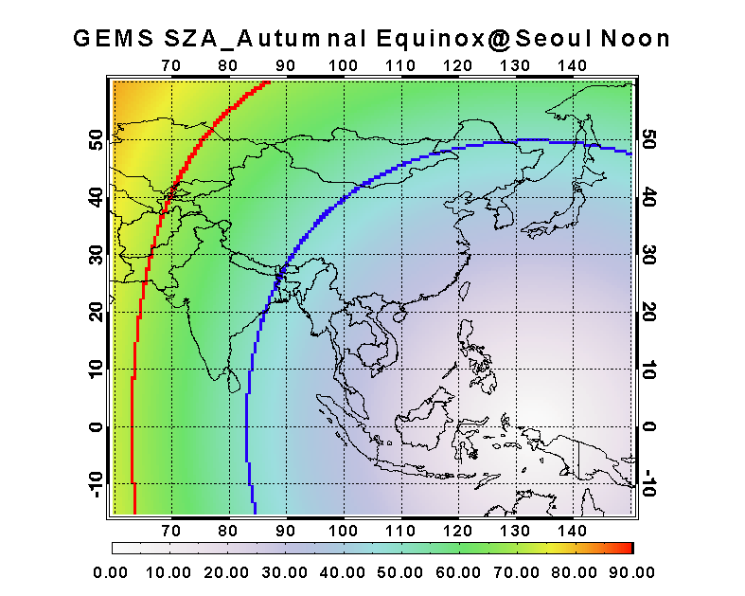
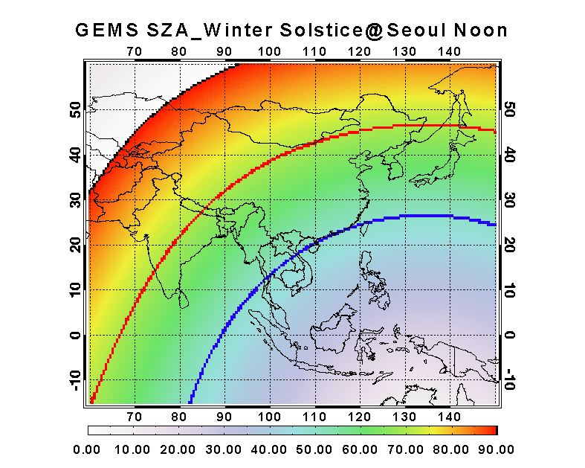
GEMS SZA
50°
70°
90°

Slide 12
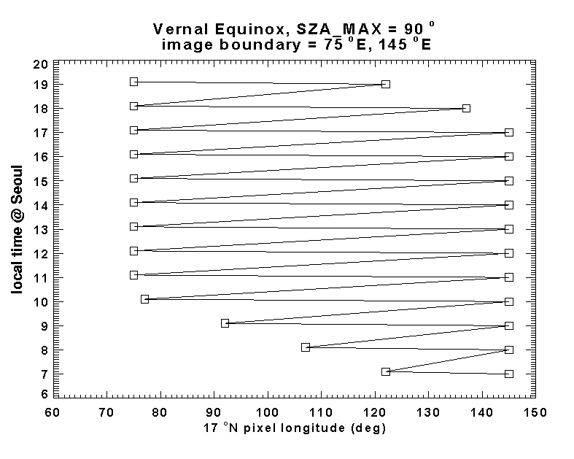
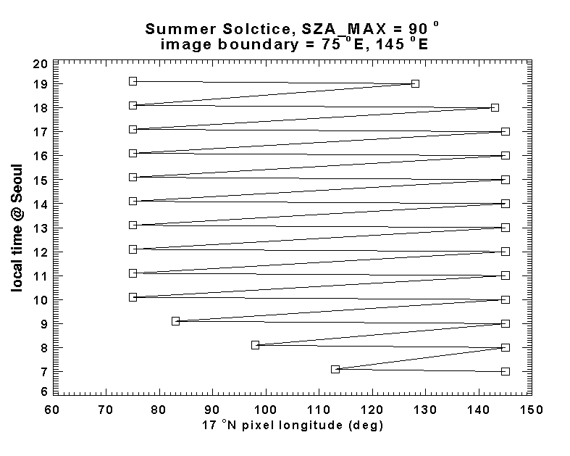
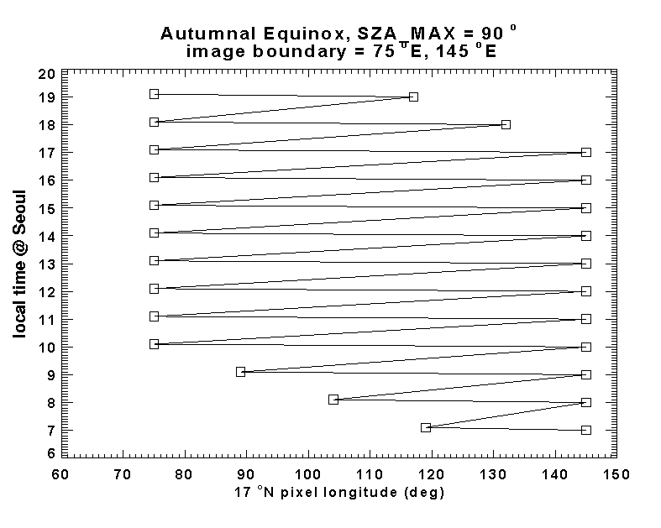
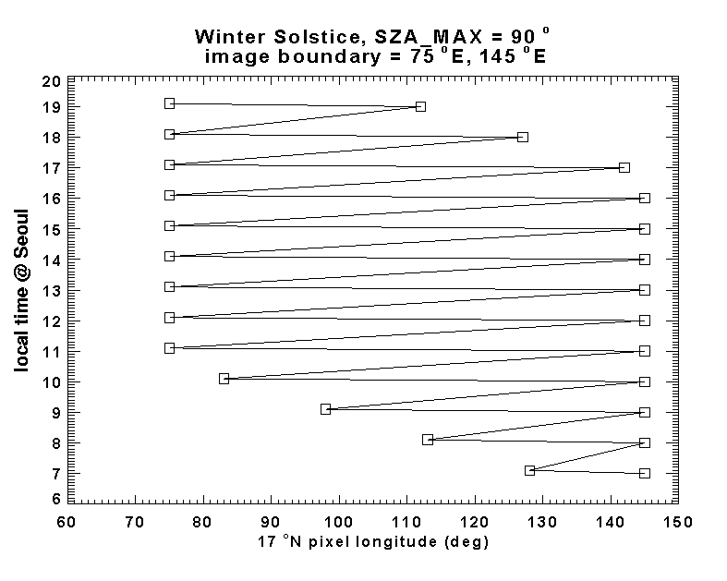

Slide 13
Operation mode
Operation mode |  | Observation Freq. (min) | E-W Scan coverage (@lat. of Seoul)
Normal |  | 60* | 75 E – 145 E (70 deg wide)
Special | EA(East Asia) | 60* | 110 E – 140 E (30 deg wide)
 | EEA(Enhanced East Asia) | 60* | 115 E – 130 E (15 deg wide)
 | LA(Local Area) | < 30 | In emergency by ground command
Imaging time 30 minutes + Transmission 30 minutes
to avoid mechanical disturbance with GOCI-2

Slide 14
GEMS Requirements(1/3)
System Attributes | Requirements
Lifetime | > 10 years
Reliability | > 0.85 @7 yrs, TBD@EOL
Field of regard | > 5000 km (N/S) × 5000 km (E/W) N/S range : 45°N~5°S E/W range : selectable between 75°E~145°E Orbital position :116.2E<Pos.<128.2E
Duty cycle / Imaging time | 8 images during daytime (30 min imaging + 30 min rest) × 8 times / day
Ground sampling distance | < 7 km (N/S) at Seoul GSD area < 56 km² at Seoul (Aspect Ratio shall be less than 1:3)
Data quantization | ≥ 12 bits
MTF (instrument level) | > 0.3 in N/S direction @Nyquist frequency > 0.3 in E/W direction @Nyquist frequency

Slide 15
GEMS Requirements(2/3)
System Attributes | Requirements
Spectral range | 300 nm to 500 nm
Spectral resolution | < 0.6 nm
Spectral sampling | < 0.2 nm
Signal-to-noise ratio | > 720 @ 320nm > 1500 @ 430nm
Radiometric calibration accuracy | < 4% (including std lamp uncertainty)
Spectral calibration Accuracy | < 0.02 nm
Spectral calibration stability | < 0.02 nm (within 24hr)
Polarization factor | < 2% No inflection point within 20nm for all the wavelength range
Spectral Feature | < 0.05% (within 3 nm)
Stray Light | < 2% (310-500 nm)

Slide 16
GEMS Requirements(3/3)
System Attributes | Requirements
Volume | < 1050mm(X) x 1200mm(Y) x 900mm(Z)
Mass | < 140 kg (total) < 110 kg (sensor unit on top panel)
Total exchanged flux | < +6 W
Interface temperature | -20 ºC ~ +65 ºC (operation mode) -40 ºC ~ +65 ºC (non-operation mode)
Max temperature variation during imaging | < 5 ºC
Power | < 200 W (average, operational) < 100 W (average, survival)
Data rate | < 40 Mbps
Imaging navigation | 1 pixel (1 s)
Pointing stability* | 48 microrad/2s
Pointing accuracy | 0.02 deg

Slide 17
Comparison of Specification
 | GEMS |  |  |  | GEOCAPE [TEMPO] |  |  | Sentinel-4
Spectral range(nm) | 300 – 500 nm |  |  |  | [290 – 690 nm] |  |  | 305-500 / 750-775
Spectral resol(nm) | 0.6 (3 samples) |  |  |  | [0.6] |  |  | 0.5 / 0.12
Spatial resol | 7 km NS x 8 km EW @ Seoul |  |  |  | [2.0 km NS x 4.5 km EW] |  |  | 8 km @ 45 N
Spatial coverage | 5 S – 45 N 75 E – 145 E |  |  |  | 30 N - 65 N 40 W – 60 E |  |  | 20 N – 60 N 30 W – 150 W
Obs. time | 30 min |  |  |  | [1 hour] |  |  | 1 hour
Detector @ T | CCD @ 278 K |  |  |  | [CCD @ 278 K] |  |  | CCD @ 230 K
Onboard calibration | Solar, cal light source |  |  |  | [Solar] |  |  | Solar, cal light source
Volume (m³) | 1.1 x 1.2 x 0.9 |  |  |  | [1 x 1.1 x 1] |  |  | ~1.1 x 1.2 x 0.9
Mass (Kg) | 110 |  |  |  | [100] |  |  | 150
Power (W) | 200 (on orbit) / 100 (transfer) |  |  |  | [100] |  |  | 180
Data rate (Mbps) | 20 (up to 40) |  |  |  | [9] |  |  | 25 Mbps
SNR & Nominal Radiance | Wave- length | Nominal radiance |  | SNR @ λ [nm] | Wave- length | Nominal radiance | SNR | Wave- length | Nominal radiance | SNR
 |  | Goal | Threshold
 | 300-315 | 4.93 | 7.98 |  | 305-330 | 33.5 |  | 305 310 315 | 1.10 2.90 18.0 | 160 320 630
 | 315-325 | 30.4 | 43.4 | 720@320 |  |  | 720 [1290] | 320 | 30.9 | 900
 | 325-335 | 63.8 | 86.6 |  | 320-329 | 54.3 | [480]
 | 335-357 | 65.2 | 91.4 |  | 327-356 | 53.3 |  | 350 | 70.9 | 1000
 | 357-423 | 71.6 | 108.7 |  |  |  |  | 400 | 91.4 | 1200
 | 423-451 | 86.4 | 130.8 | 1500@430 | 423-451 | 67.3 | [1230] | 450 | 101 | 1400
 | 451-500 | 103.7 | 145.5 |  |  |  |  | 500 | 73.1 | 1400

Slide 18
Comparison of Baseline Products
 | GEMS | GEOCAPE [TEMPO] | Sentinel-4
Operation | 2018-2027 | 2019-2021 | 2019-2028
Products | O₃, NO₂, O₄, SO₂, HCHO, AI, AOD, SSA, Cloud | O₃,(UV, Vis), NO₂, SO₂, H₂CO, H₂C₂O₂, AOD, AI, Cloud | O₃, SO₂, (BrO), HCHO, Ring , NO₂, O₄, (IO CHOCHO), AAI, AOD, Cloud
 |  | Typical range | Precision | Typical value | Precision | Typical value | Precision
O₃ | 0-2 km | 4x10¹⁷ ~ 2x10¹⁸ cm⁻² | 1x10¹⁸ | 40 ppb | 10% |  | 10-25%
 | Free Troposph |  |  | 50 ppb | 10%
 | Strato-sphere |  |  | 8 x 10³ | 5%
Total O₃ |  | 250-400 DU | 6 DU | 9 x 10³ | 3%
NO₂ |  | 3x 10¹³ ~ 3x 10¹⁷cm⁻² | 1 x 10¹⁵ cm⁻² | 6 | 1.00 |  | 15-25%
SO₂ |  | 6x10⁸ ~ 1x10¹⁷ cm⁻² | 1x10¹⁶ | 10 | 10.0 |  | 20-50%
HCHO |  | 1x10¹⁵~3x10¹⁶ cm⁻² | 1x10¹⁶ | 10 | 10.0 |  | 20-50%
AOD |  | 0.2 | 0.1 | 0.1-1 | 0.05
AAOD |  |  |  | 0-0.05 | 0.03
AI |  | -1 ~ +5 |  | -1 - +5 | 0.2
Cloud Fraction |  | 0 ~ 1 |  | 0-1 | 0.05
Cloud Top Height |  |  |  | 200-900 hPa | 100 hPa
CHOCHO |  |  |  | 0.2 | 0.4
BrO
Ref. |  |  |  | Kelly Chance |  | Cathy Clerbaux

Slide 19
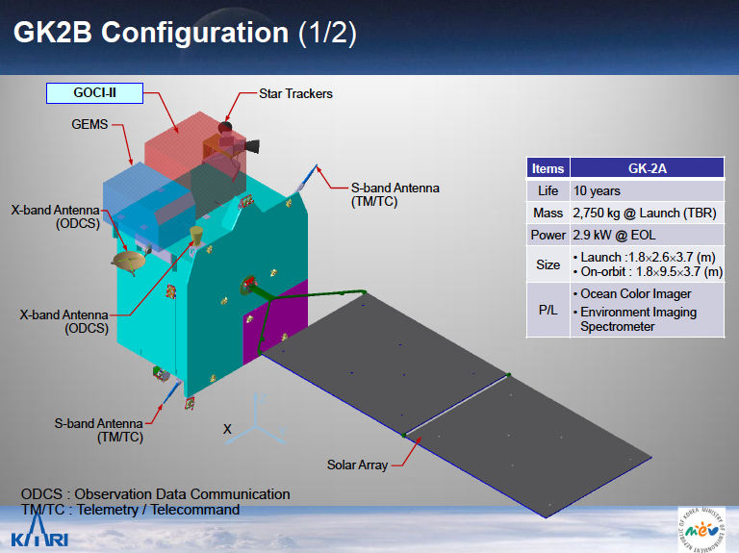

Slide 20
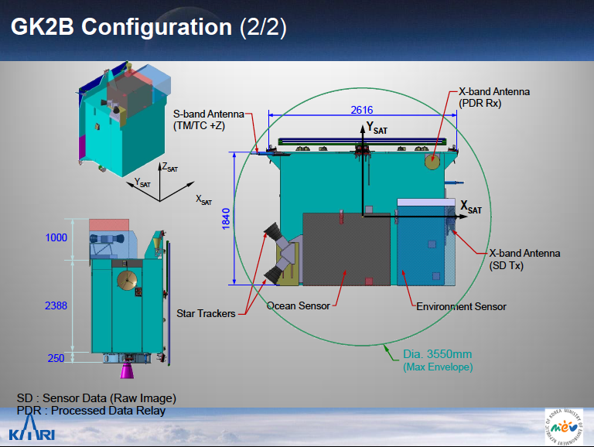

Slide 21
Master Schedule

Slide 22
Status of GEMS Mission
GEMS Program Office
  Established GEMS Program Office in NIER/ME and GEMS Research Center at Yonsei Univ.(2009)
Budget
  Budget request proposal was approved on Dec. 2010 by the Government Budget Review Committee led by the Ministry of Planning and Finance
  Three criteria in Gov. Budget Rev. Comm.:
  Demand from relevant Ministry: strong demand under Climate Change Monitoring &
  Adaptation Program of MoE. Designated as one of the 140 New National Agenda(2013)
  Maturity of technology: TRL ≥ 6 with OMI heritage in LEO
  * Governmental Technical Review is still remained before PDR (Q1 2014)
  Social Benefit of the Mission: B/C ratio = 1.8 (CVM, ABM, COS; benefit for public and industry)
Prime Contractor
  Response to RFI received in Dec. 2010
  Proposal received by Feb. 25, 2013 (RFP issued in Jan., 2013)
  Selection of main contractor for the Joint Development with KARI in Mar. 6, 2013
  (Priority International Contractor, Ball Aerospace, under negotiation)
International Collaboration
  Recognized as a part of ACC by CEOS
  Established Technical Group on Atmospheric Composition Measurements from
  Geostationary Satellites with NASA
  ToR for NASA-NIER/ME collaboration endorsed by NASA HQ and NIER/ME
  Bilateral agreement between Korea MEST and U.S. NASA
  MOU between KARI and NSO
  MOU with NCAR(2010), Harvard CfA (2011), UCLA(2012); Agreement with NASA(for DRAGON, 2011)
Notes:
Contingent Valuation Method(CVM)
Averting Bahavior Method(ABM)
Cost of Savings (COS)

Slide 23
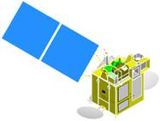


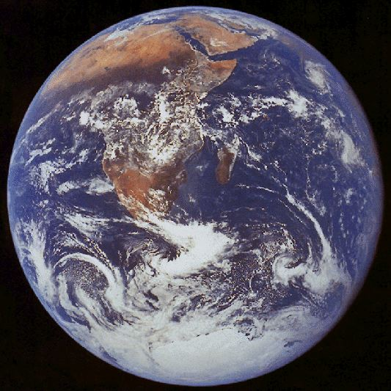





CEOS (Committee on Earth Observation Satellites)
Constellation of GEO Missions to study Air Quality and Climate
TEMPO /
GEO-CAPE
(America)
UV-Vis-IR (tbd)
300-500 nm
SWIR 2.3 & 4.6 μm
Vis &/or TIR
GEMS
GEO KOMPSAT
(Asia)
UV-Vis 300-500 nm
Optional accommodation
for small IR instrument
Constellation synergy
Improving spatial and temporal coverage
to monitor globalized pollutants & SLCF
Sharing basic requirements on data products and
instrument to maintain data quality
Synergy in science and socio-economic benefit
Supporting QA and CAL/VAL
GMES S4
MTG (Europe)
UV-Vis-NIR
305-500, 750-775 nm
Use MTG-S TIR
Notes:
23

Slide 24
Summary
Geo-KOMPSAT-2A and 2B are expected to be launched in 2017-2018 time frame and provide information on aerosol and trace gas amounts with the three instruments of AMI, GOCI-2 and GEMS.
GEMS, a geostationary mission is expected to contribute monitoring air quality and SLCF in Asia in high temporal and spatial resolution.
  GEMS, a scanning UV-Visible spectrometer observations can contribute to provide a set of tropospheric column products over the Asia-Pacific region at spatial resolution of ~ 8 km and temporal resolution of 1 hour.
    O₃ NO₂ HCHO SO₂ AOD (AI, AAI, AOCH)
GEMS can contribute to understand the globalization of pollution events, source/sink identification, and long-range transport of pollutants and SLCF, as a part of the CEOS ACC.

Slide 25
Acknowledgement
GEMS Science Team
Both Korean and International Members
Ministry of Environment (MoE), Rep. of Korea
NIER, MoE
KEITI, MoE
Ministry of Education, Science & Technology (MEST)
KARI

Slide 26
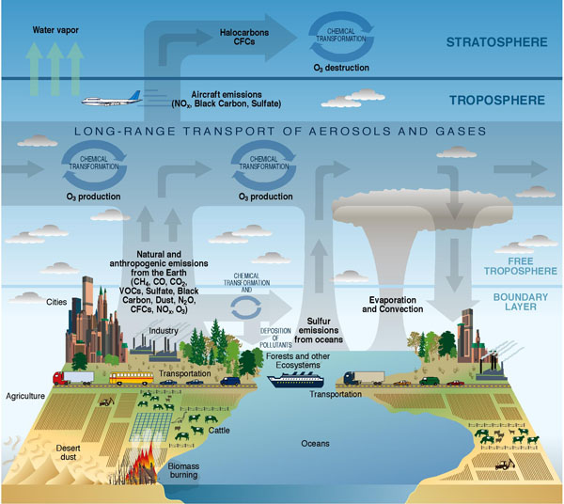
Objective: Measurement of air quality and SLCF
in high temporal and spatial resolution
CLIMATE FORCING
LONG-RANGE TRANSPORT
METEOROLOGY
FEEDBACK
Source
Sink
AIR QUALITY
(local and
regional)
Atmospheric
Correction for
Ocean color
EMISSION
(local and urban scale)
Meteorology
Credit: CCSP Strategic Plan (illustrated by P. Rekacewicz).

Slide 27
Satellite mission for atmospheric environment
Instrument | Detectors | Spectral Coverage [nm] | Spectral Resolution [nm] | Ground Pixel Size [km²] | Global Coverage
GOME (1995-2003) | Linear Arrays | 240-790 | 0.17 | 40×320 | 3 days
SCIAMACHY (2002- 2012) | Linear Arrays | 240-2380 | 0.26 | 30×60 | 6 days
OMI (2004-ongoing)‏ | 2-D CCD @263 K | 270-500 | 0.42 | 13×12 | daily
GOME-2 (2006-ongoing)‏ | Linear Arrays | 240-790 | 0.24 | 40×40 | 1.5 to 3 days
TEMPO | 2-D @278K | 290-690 | 0.6 | ~2×4.5 | Hourly
Sentinel - 4 | CCD@ 230K | 305 -500 750-775 | 0.5 0.12 | ~8 km @ 45ºN | Hourly
GEMS | 2-D @278K | 300-500 | 0.6 | ~7×8 @ Seoul | Hourly
SCIA - suites of atmospheric gases measured for 10 years
OMI - higher spatial resolution, better coverage
GOME-2 - better spatial resolution, better coverage, continuity for 15 years
Geostationary
- better spatial resolution, several measurements per day
- less cloud contamination
- can overcome the limitation in global coverage by constellation
Notes:
현재 운영되고 있는 환경위성은 극궤도 위성만 존재한다.
정지위성이 중요한 이유는 더 좋은 공간 해상도와 실시간 모니터링이 가능하다는점, 구름에 덜 영향을 받는다는점

Slide 28
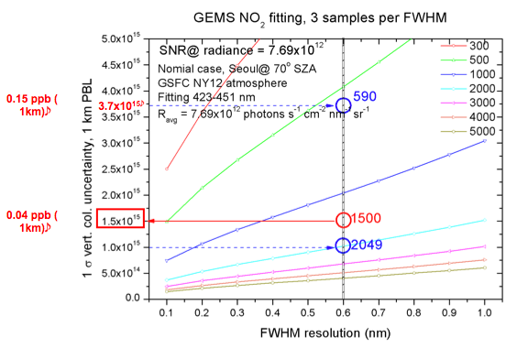
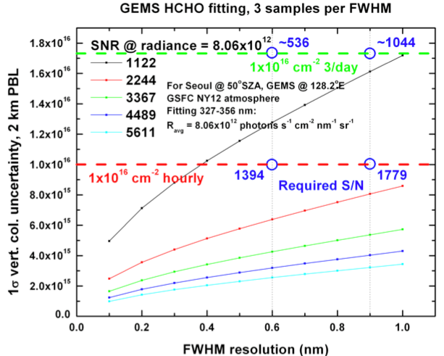
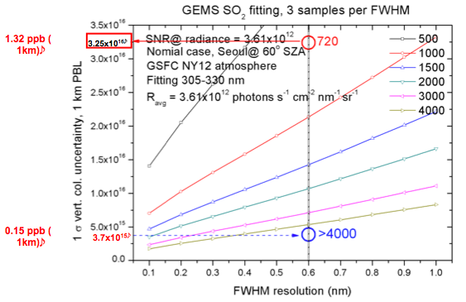
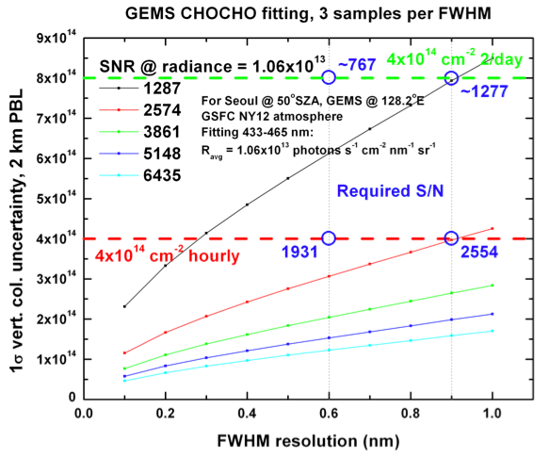
(K. Chance; Y.J. Kim)

Slide 29
Spectral resolution
NO₂
O₃
SO₂
HCHO

Slide 30
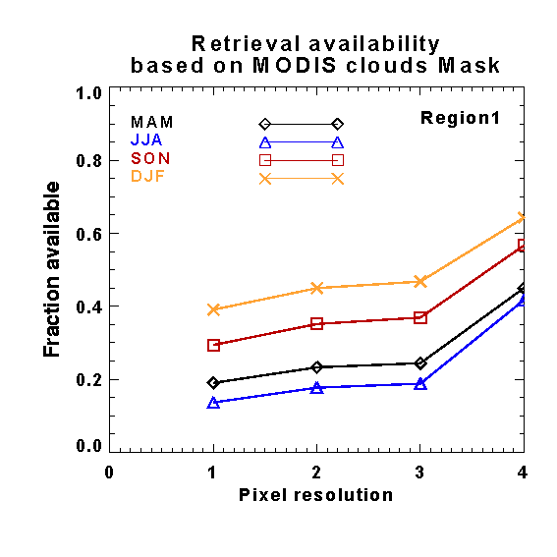
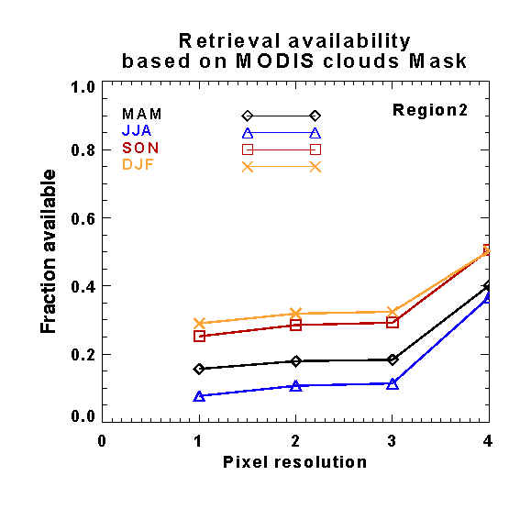
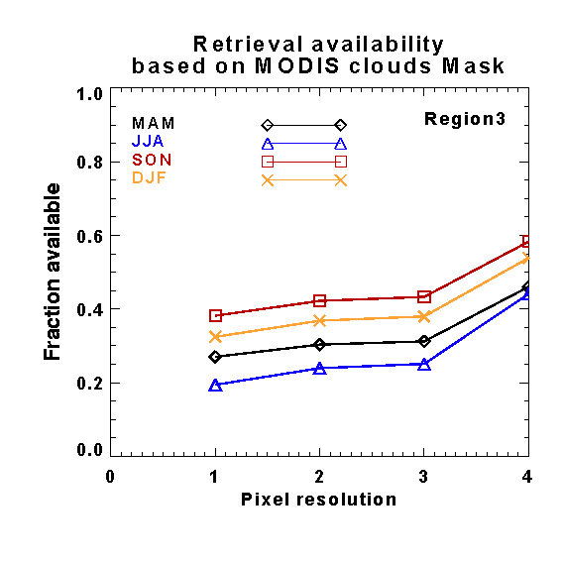
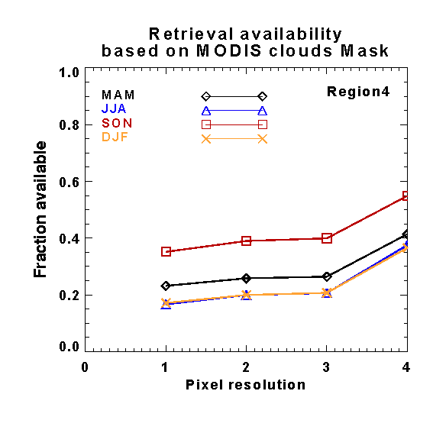
Spatial Resolution - cloud contamination
Pixel resolution
1 | 7.5 x 7.5 ㎢
2 | 5 x 5 ㎢
3 | 2.5 x 7.5 ㎢
4 | 1.25 x 3.75 ㎢

Slide 31
Geo-KOMPSAT-2A
Advanced Meteorological Imager (AMI)
 | MI / GEO-KOMPSAT-1 | AMI / GEO-KOMPSAT-2A
Channels | 5 | 16
Spatial Resolution (km) | 1 / 4 (VIS/IR) | 0.5,1 / 2 (VIS/IR)
Temporal Resolution (min) | 25(Full Disk) | 10(Full Disk)
Level-2 Products | 16 | ~58
Data Rate (Mbps) | 2.6 | ~70
Life time (years) | 7 | 10
Main Purpose of use | Weather Forecasting | + NWP + CM
(Courtesy, KMA)

Slide 32
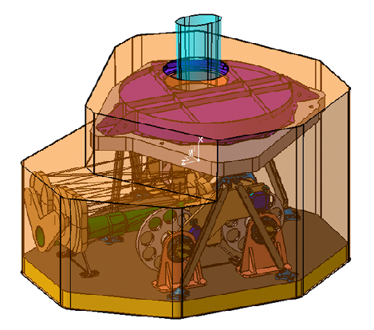
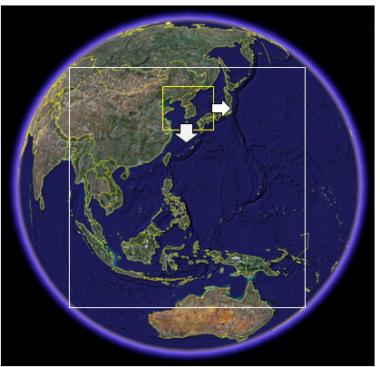
GOCI-II (2018)
Geo-KOMPSAT-2B
 | GOCI-I / GEO-KOMPSAT1 | GOCI-II / GEO-KOMPSAT-2B
Channels | 8 | 13
Special Resolution (km) | 0.5 x 0.5 | 0.3 x 0.3 @ Seoul 1 x 1 for global
Temporal Resolution (hr) | 1 (daytime) | 1 (day+night)
Covered Area | Local | Local Global
SNR | ~1000 | ~1500
Lifetime(yrs) | 7 | 10
(Courtesy, KORDI)

Slide 33
Geo-KOMPSAT-1
 | MI | GOCI
Channels | 5 | 8
Spatial Resolution (km) | 1 / 4 (VIS/IR) | 0.5
Temporal Resolution (min) | 25(Full Disk) | 60
Level-2 Products | 16 | 10
Data Rate (Mbps) | 2.6
Life time (years) | 7 | 7
Main Purpose of use | Weather Forecasting | Ocean Monitoring

Slide 34
Satellite Remote Sensing of Atmospheric Composition
Satellite |  | ERS-2 | Terra | Envisat |  | Aura |  |  | METOP |  | GOSAT | S-4, TEMPO G-CAPE GEMS
Sensors | TOMS | GOME | MOPITT | SCIA- MACHY | MIPAS | HRDLS | OMI | TES | IASI | GOME2 | TANSO
Orbit | PS | PS | PS | PS | PS | PS | PS | PS | PS | PS | LEO | GEO
Launch | 1979 | 1995 | 1999 | 2002 | 2002 | 2003 | 2003 | 2003 | 2007 | 2007 | 2009 | 2018- 2019
O₃ | O | O |  | O | ● | O | O | O | O, ● | O |  | O
H₂O | O | O |  | O |  | O |  | O
CO |  |  | O | O | ● |  |  |  | O
NO |  |  |  | O | ● | O
NO₂ |  | O |  | O | ● | O | O |  | O | O |  | O
HNO₃ |  |  |  |  | ● | O |  | O | ●
CH₄ |  |  | O | O | ● | O |  | O | O |  | O
HCHO |  | O |  | O |  |  |  |  |  |  |  | O
SO₂ |  | O |  | O |  |  | O |  |  | O |  | O
BrO |  | O |  | O |  |  |  |  |  | O
CO2 |  |  |  | O |  |  |  |  | O |  | O
Aerosol | O |  |  | O |  | O | O | O |  | O |  | O
O : Column ● : Profile
PS : Polar sun-synchronous GEO : Geostationary
(Courtesy, C.H. Song)

Slide 35
Monthly Average PDF (Jun., Dec.)
(Courtesy, C.H. Song )
HCHO SO2 NO2 AOD

Slide 36
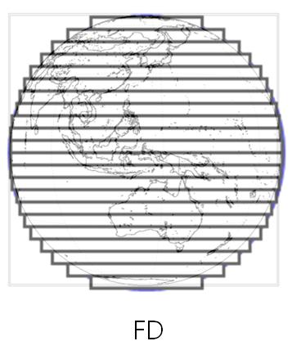
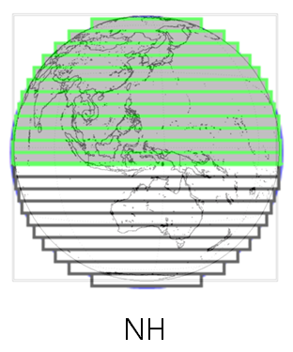
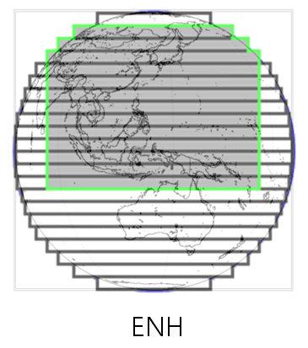
□ Hourly Operation Schedule Scenario(draft) of Met-Imager
(min.)
8 times
/hr
9 times
/hr
10 times
/hr
11 times
/hr
LA(Around Korea
Peninsula
2000km x 2000km)
10 min
5 min
5 min
(Courtesy, KMA)

Slide 37
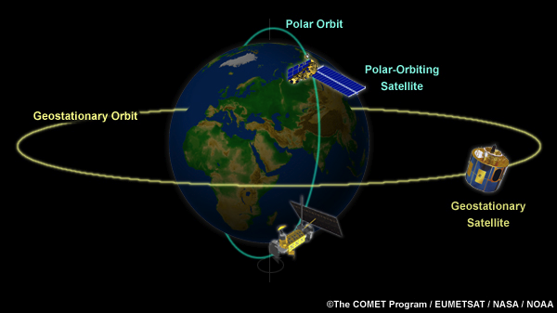
Retrieval Geometry
(sun-synchronous orbit)
Inverse model
(LUT, physical)
Emission
Gas conc.
Surface reflectance
radiance
Forward
model
Response
function

Slide 38
GEMS Algorithm Flowchart
NO₂, SO₂, HCHO
Slant Column Retrieval Algorithm Improvement
Based on BOAS/DOAS
Characterization of Geophysical Fields
Improved AMF Calculation
CTM
RTM
Retrieval of Vertical Column
DOAS: Differential Optical Absorption Spectroscopy
AMF: Air Mass Factor;
CTM: Chemical Transport Model
RTM: Radiative Transfer Model
Validation with LEO satellites, Airborne &
In-situ Measurements
(Courtesy, Y.J. Kim)
Notes:
지상용 DOAS분석 프로그램인 Windoas(윈도아스)를 바탕으로 scd(경사컬럼농도)를 계산하고서 모델(CTM, RTM)을 이용하여 AMF를 산정하여 최종적으로 VCD(수직컬럼농도)를 산출하게 된다. 산출된 최종 결과물은 항공관측 또는 지상측자료와의 비교를 통해 검보정을 수행된다.

Slide 39
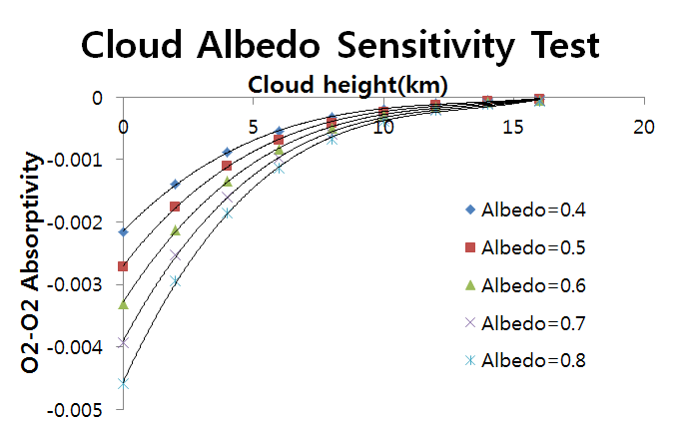
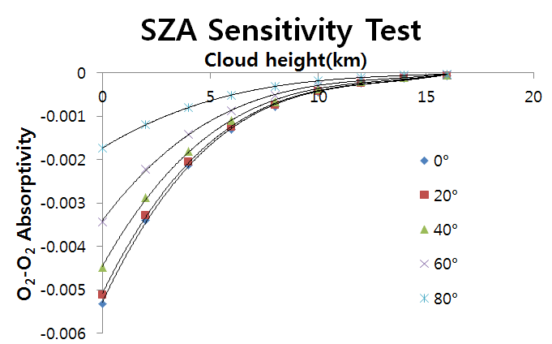
Sensitivity of O₂-O₂ absorption to clouds
RT Model: SCIATRAN 3.0
Cloud model = Lambertian surface with varying albedo 0.4~0.8
solar zenith angle = 37.43°
viewing azimuth angle = 43.572°
Solid line: 3rd order polynomial approximation
insufficient absorptivity difference for high cloud
regular interval
RT Model: SCIATRAN 3.0
varying solar zenith angle between 0° ~ 80°
Cloud model = Lambertian surface with albedo 0.8
viewing azimuth angle = 43.572°
Solid line: 3rd order polynomial approximation
irregular interval
(Courtesy, Y.S. Choi)

Slide 40
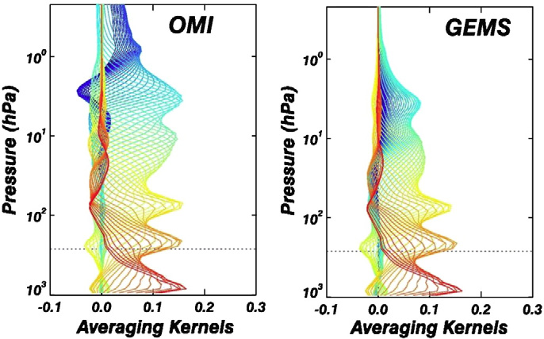
GEMS vs. OMI
(tropospheric and stratospheric ozone)
Comparable Averaging Kernel (AK) profile shape below 55 hPa (~20 km)
Large difference above 55 hPa
22 km
Bak et al.(RSE, 2012)
Notes:
Averaging kernels (AK) : the sensitivity of the retrieved ozone at each layer to the perturbation of ozone at all layers
Degree of freedoms for signal (DFS) : the number of independent pieces of information available at that layer from measurements ( Diagonal element of the AK matrix)

Slide 41
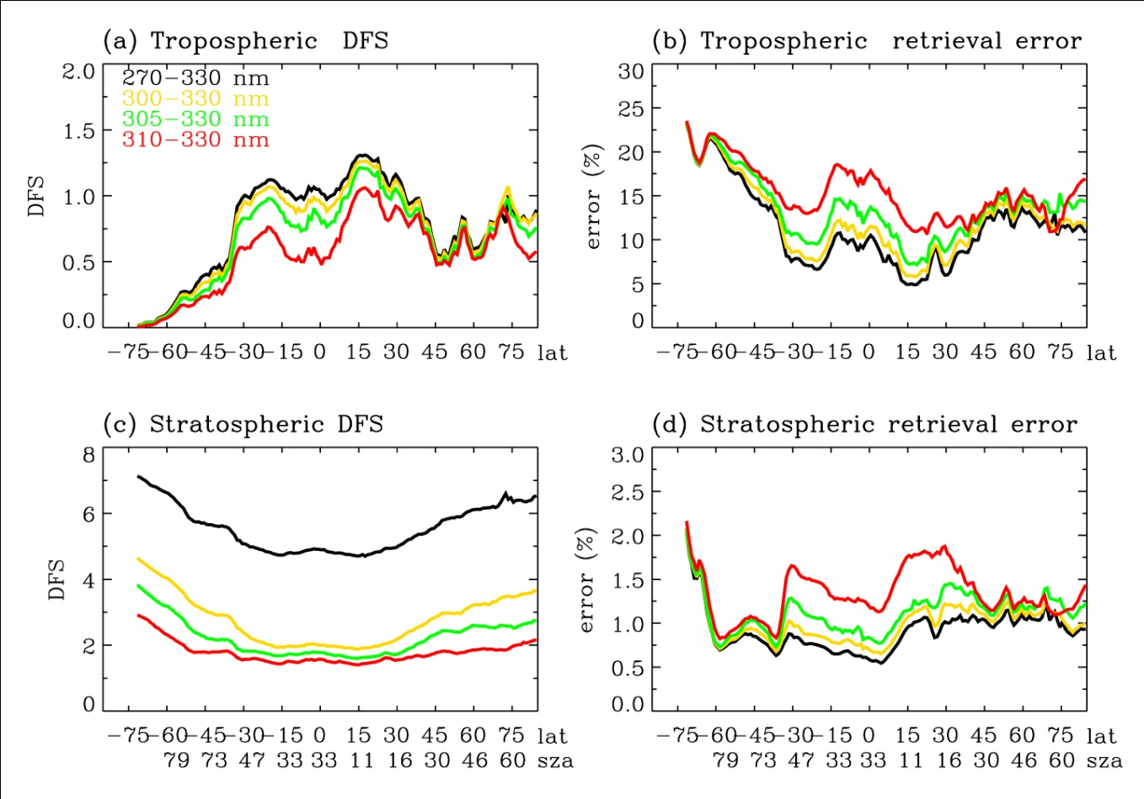
GEMS vs. OMI
(Sensitivity to fitting window)
Troposphere
Stratosphere
OMI
GEMS
Comparable performance to OMI
SNR issue below 310 nm
GEMS: lack of information at wavelength below 300 nm
Much less information content compared to OMI
(Bak et al., AMT, 2013)

Slide 42
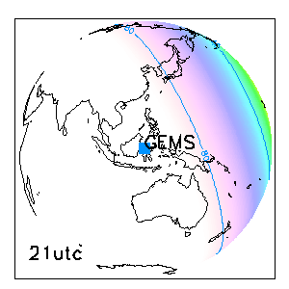
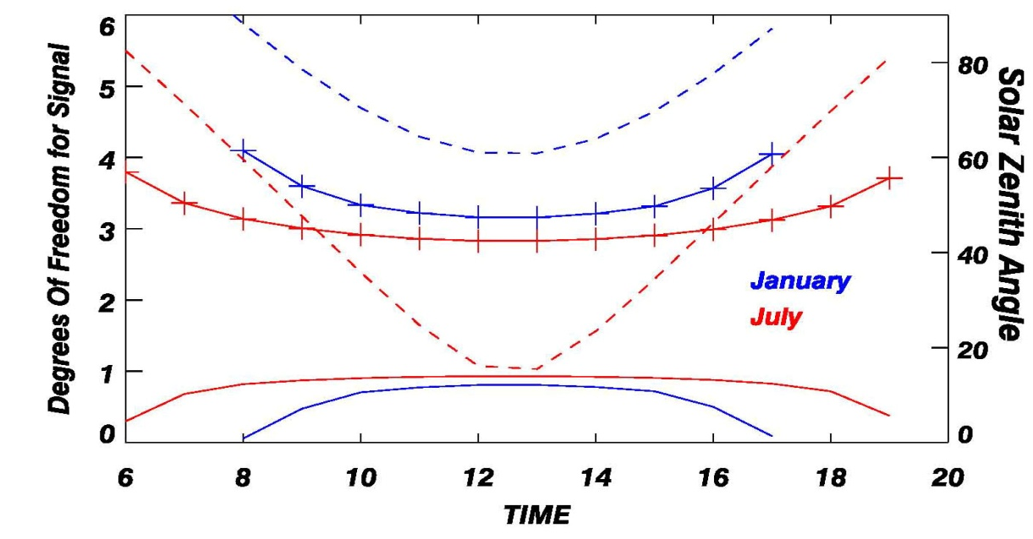
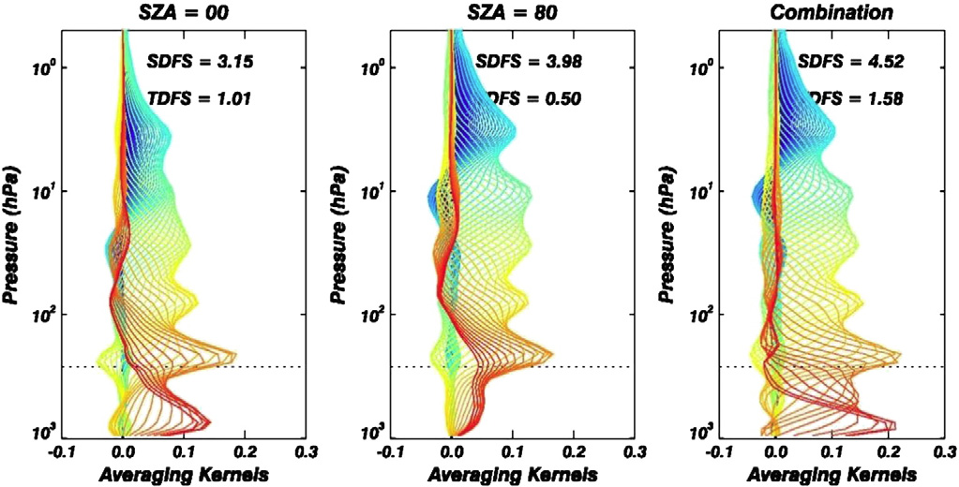
Diurnal changes of ozone signals
SZA
Stratosphere
Troposphere
Bak et al.(RSE, 2012)
High SZA
SZA=0
Good for stratosphere
Good for troposphere

Slide 43
Aerosol Height using O₄ SCD
Aerosol Effective Height [km]
Aerosol Effective Height [km]
S.S. Park
(Ph.D. Thesis, 2013)
340 nm : Fitting error > Height Sensitivity
360 nm : Fitting error ~ Height Sensitivity, Insufficient at high SZA
380 nm : Fitting error > Height Sensitivity. Too small optical depth
477 nm : Fitting error << Height Sensitivity
▷ 477 nm is only suitable band for height estimation.
Notes:
Height의 민감도를 보게 될 경우, 전 흡수대에서 Height가 높을수록 O4 SCD가 감소하지만, 340 nm는 DOAS fitting error가 그 민감도보다 크며, 360, 380 nm는 그 민감도가 fitting error보다는 작으나, 몇몇 geometry에서 산출이 잘 안되는 문제가 있습니다.
이 때문에 477 nm가 가장 적합함을 알 수 있습니다.

Slide 44
Error sources for aerosol height
Error source
  - AOD : Because of shielding effect,
  the O₄ SCD decreases
  as AOD increases.
  SSA : high SSA → Optical path ↑
  Gas amount & Instrument : influence to DOAS fitting
  O₄ cross section : influence in converting from optical depth to SCD.
  Surface albedo :
  high albedo → Optical path ↑
  Aerosol vertical shape : change the optical path length
Error source [Height, m] | MITR | WASO | COPO
AOD (ΔAOD = 0.2) | 169±124 | 161±118 | 176±131
SSA (10% change) | 855±829 | 2311±1655 | 448±425
Atmospheric Gases | < 10
O₄ cross section | ~1.7 % (O₄ SCD)
Instrument (Shift: 0.02 nm) | < 10
Surface Albedo (Δα = 0.01) | 93±185 | 89±126 | 252±571
Aerosol vertical shape | 1843±4570 | 1884±2172 | 928±3332
S.S. Park (Ph.D. Thesis, 2013)
Notes:
이를 height에 대해서 error가 얼마나 되는지 요약한 표입니다.
이 때 가장 큰 영향은 aerosol vertical distribution 과 SSA로 에어러솔의 정보가 매우 중요함을 알 수 있습니다.
Surface albedo 나 기타 영향은 상대적으로 작음을 알 수 있습니다.

Slide 45
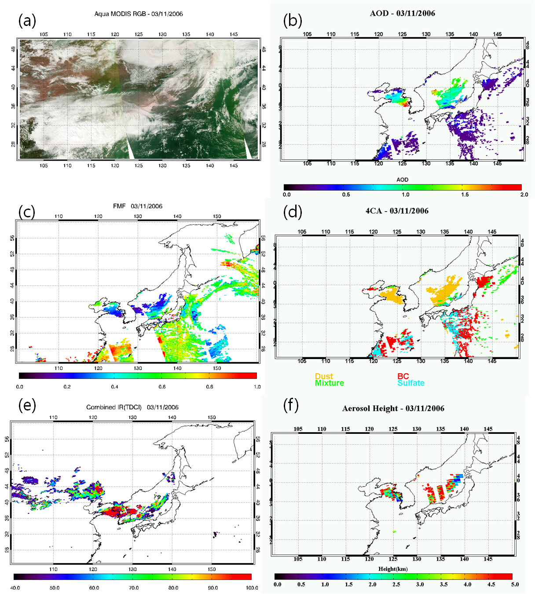
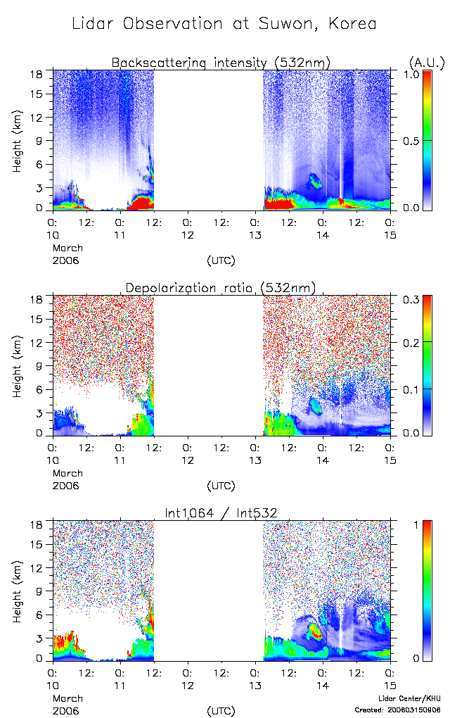
Aerosol height from OMI (2006.03.11)
Because mixing with cloud, the retrieved height is overestimated over East Sea.
Compared with Lidar, the height is overestimated by 30%.
Region | East Asia | East Sea | Yellow Sea | Near Suwon
Aerosol Height [km] | 4.8±2.6 | 5.1±2.5 | 4.0±2.5 | 2.7±1.7
Number of data | 424 | 295 | 129 | 16
(1x1 deg)

