Slide 1
An approach to combine USA/European TOC
D. Loyola, M. Coldewey-Egbers (DLR)
M. Van Roozendael, C. Lerot (BIRA)
CEOS-ACC 9, EUMETSAT, 18-APR-2013

Slide 2
Combining SBUV and GTO
Recommendation from Climate Modelers in the Ozone CCI
Use only measurements and not models for generating the ECVs
Ensemble combination between SBUV and GTO
Independent datasets
Good agreement
Motivation
Improve the spatial coverage
Reduce the variance

Slide 3
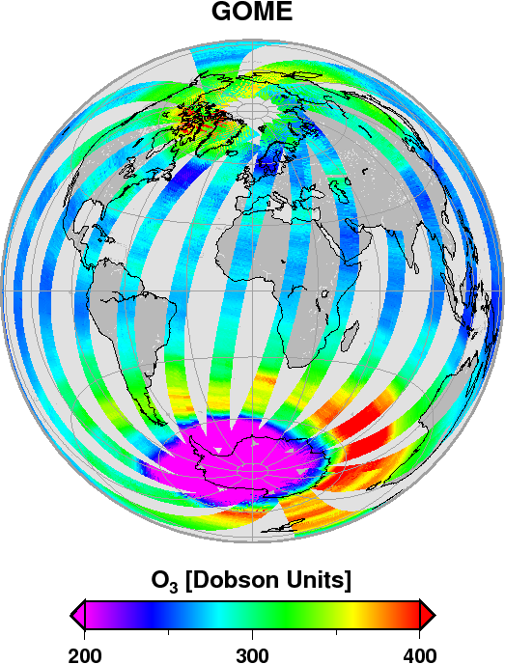
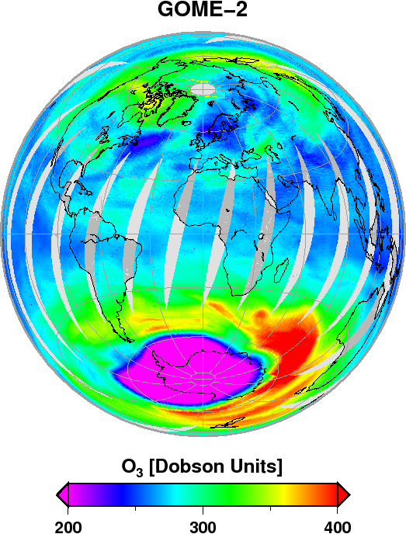
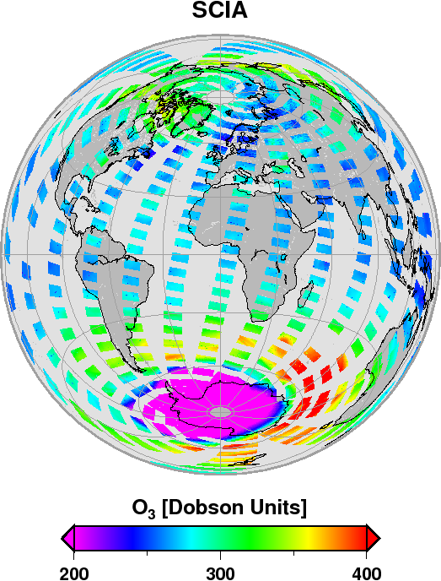
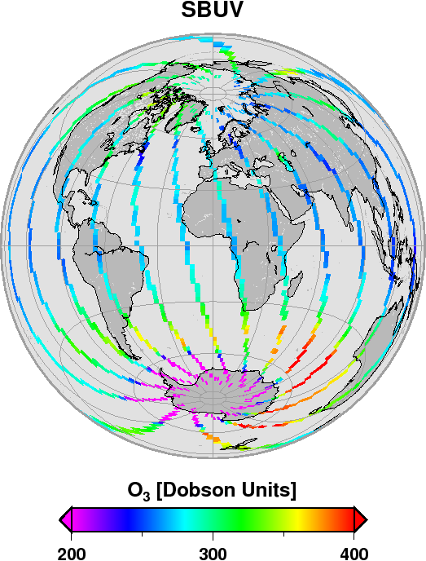
Sampling Effects – Daily

Slide 4
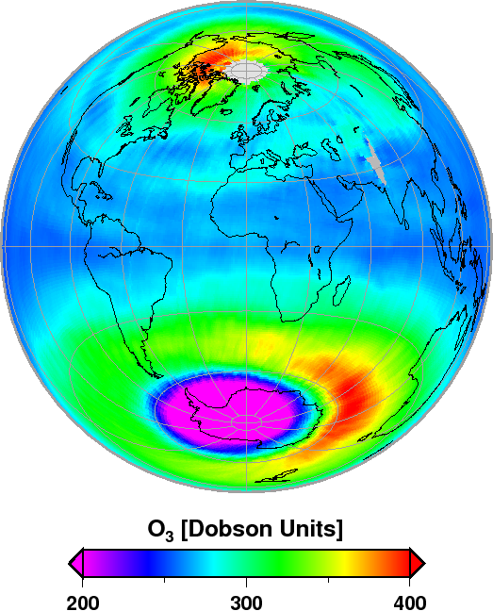
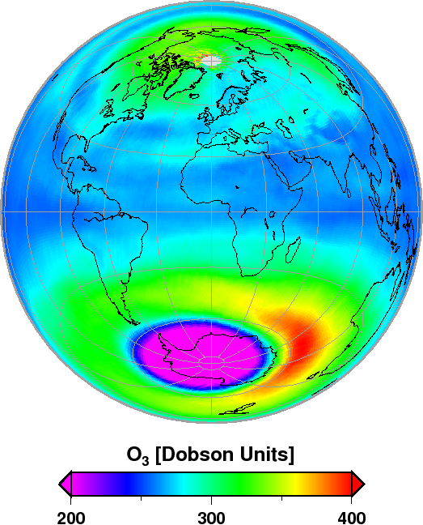
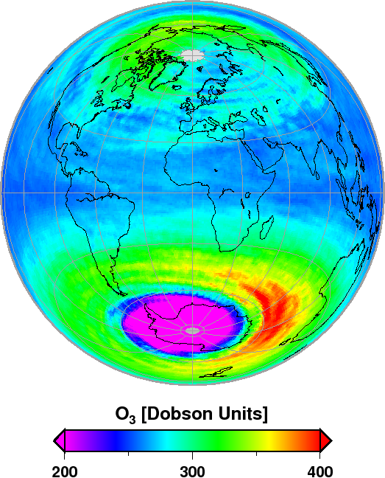
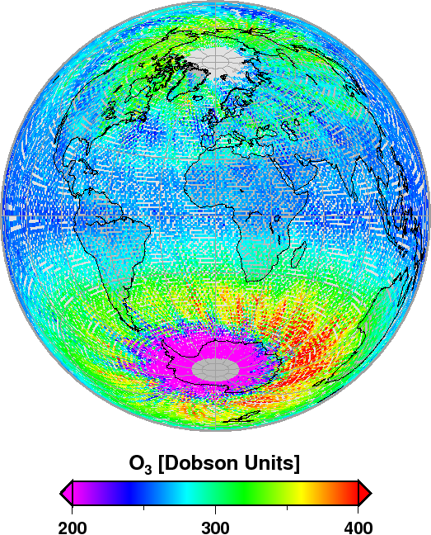
Sampling Effects – Monthly
GOME
GOME-2
SCIA
SBUV

Slide 5
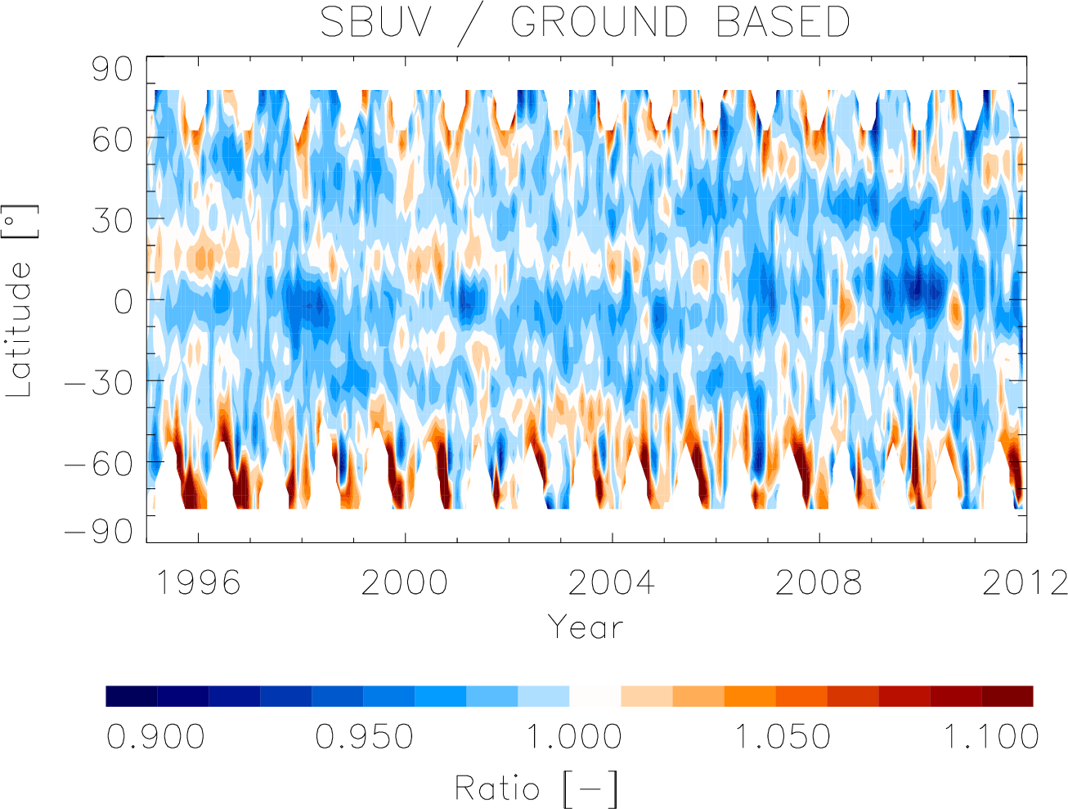
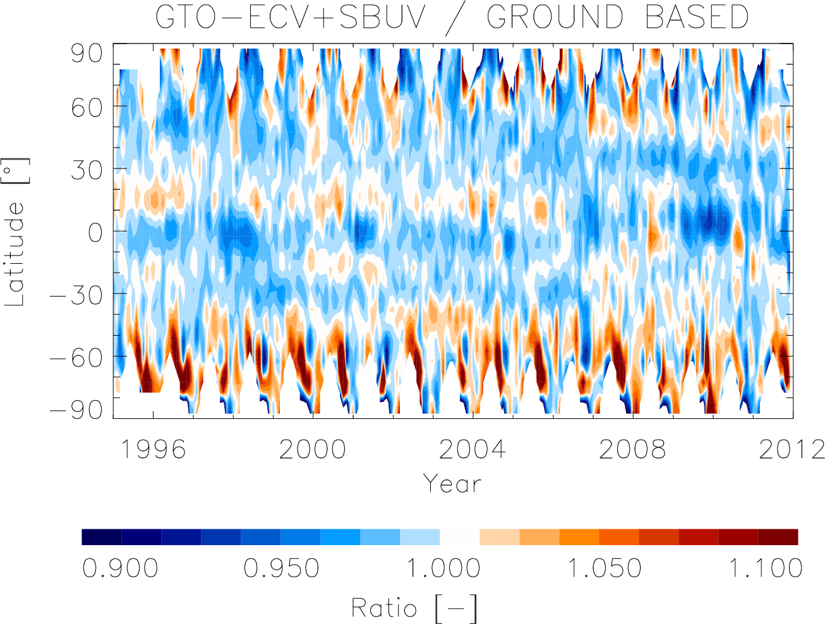
Comparison with Ground-Based
SBUV
GTO&SBUV

Slide 6
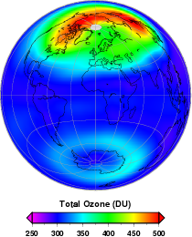
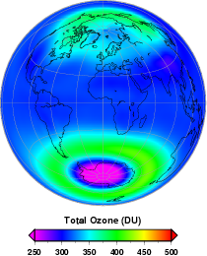
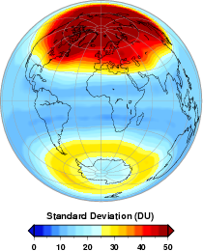
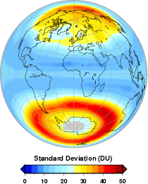
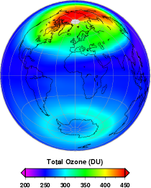
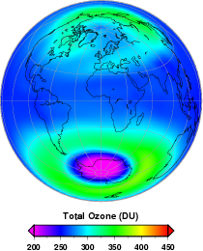
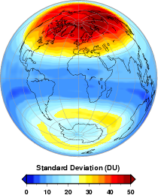
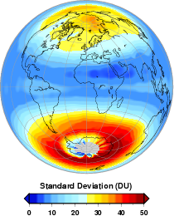
Total Ozone Comparison – Global Distribution
winter (DJF)
autumn (SON)
spring (MAM)
summer (JJA)
Model
Satellite

Slide 7
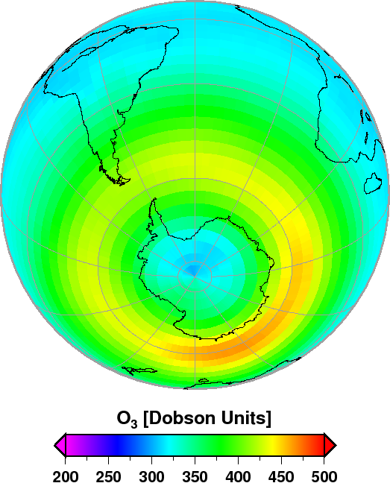
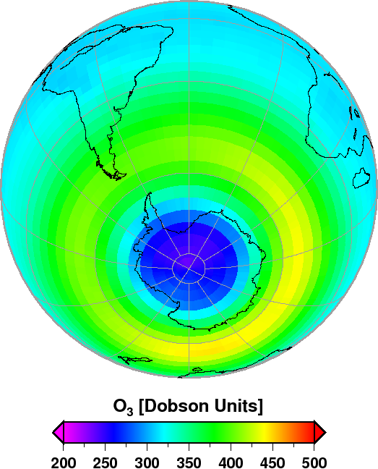
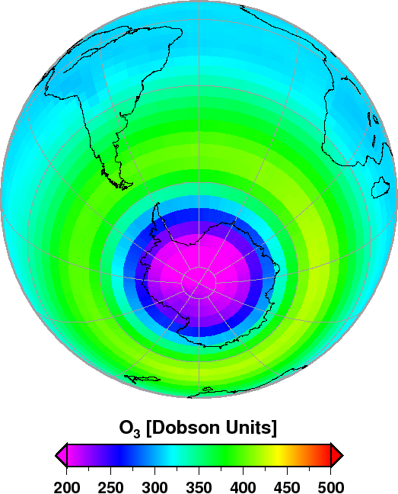
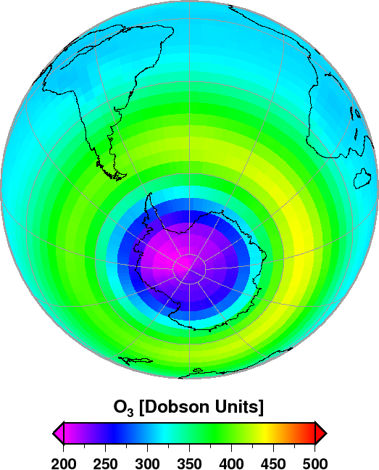
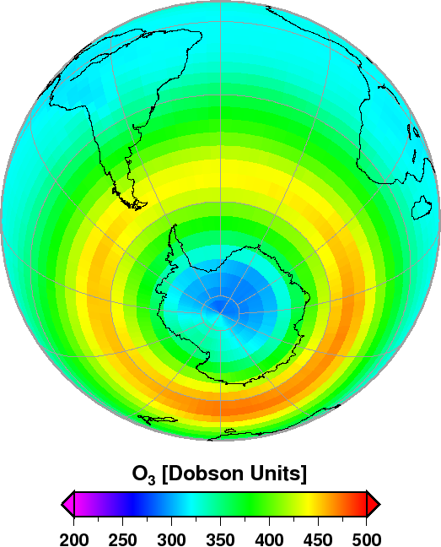
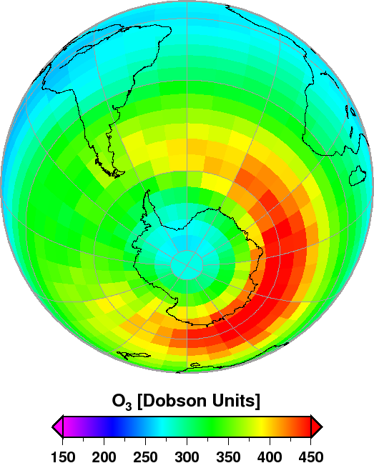
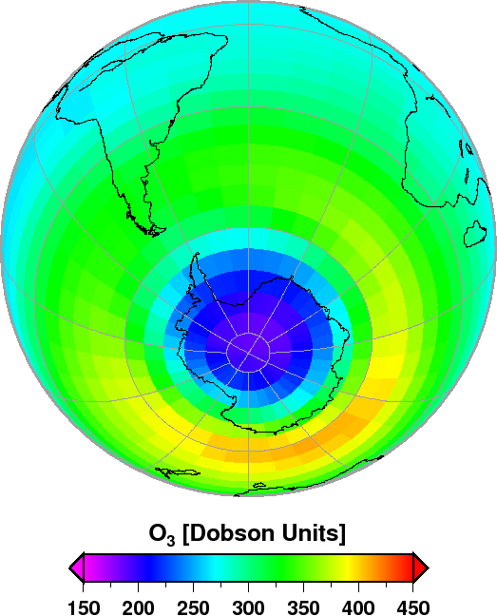
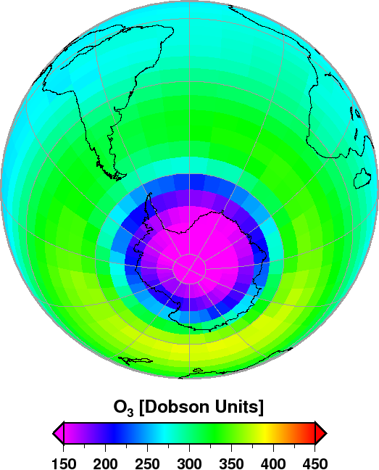
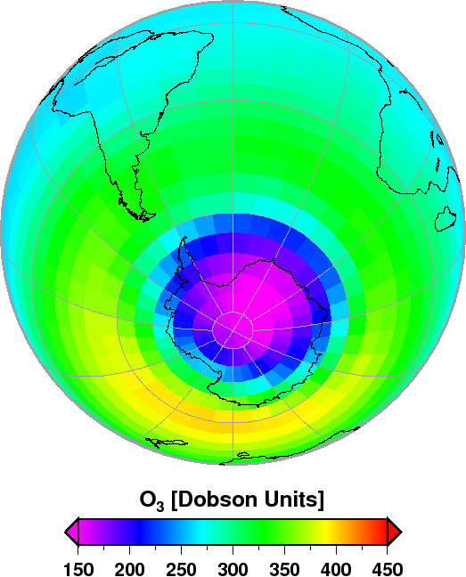
Total Ozone Comparison – Decadal Evolution
1970-1979
1980-1989
1990-1999
2000-2009
2040-2049
…
Model
…
?
Satellite
Fig. 12, Dameris and Loyola, Climate Change book, 2011

