Slide 1
Satellite to Satellite
Intercomparisons
Comparisons of SBUV Total Column Ozone Values to those from GOME, GOME 2, OMI & SCIA
5 Degree Daily Zonal Means
G. J. Labow 4/18/2012

Slide 2
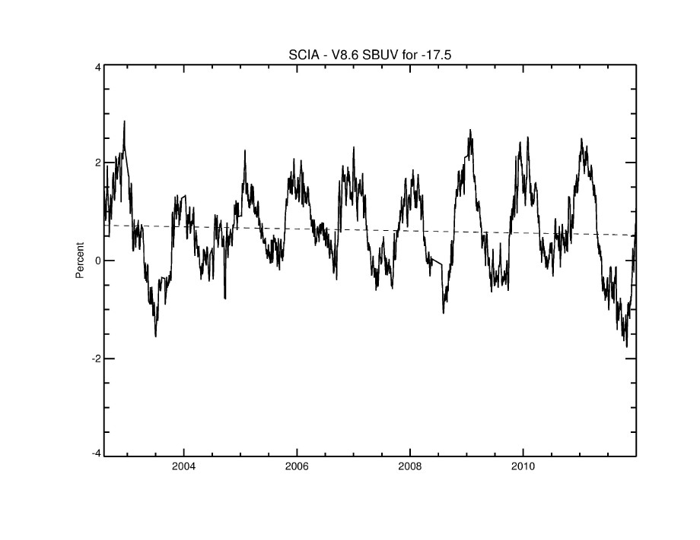

Slide 3
2) Offset (%)
1) Trend (%/decade)

Slide 4
4) Peak to Peak
Amplitude (%)
3) Standard Deviations
(%)

Slide 5
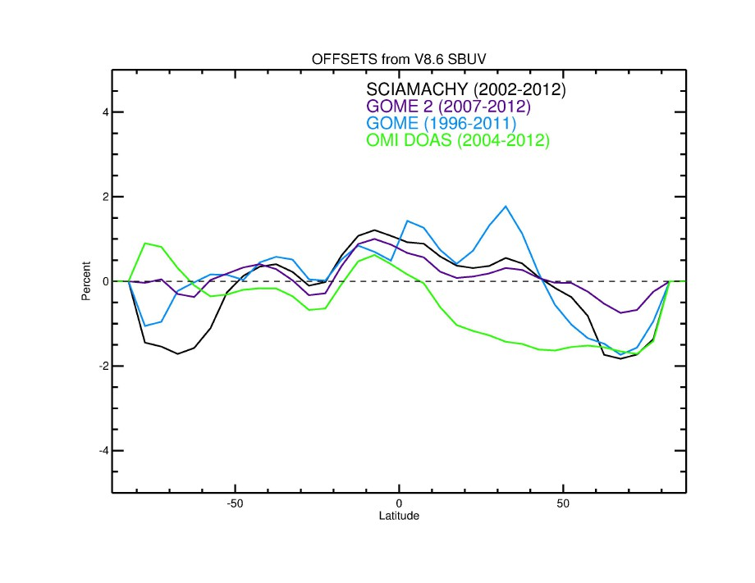

Slide 6
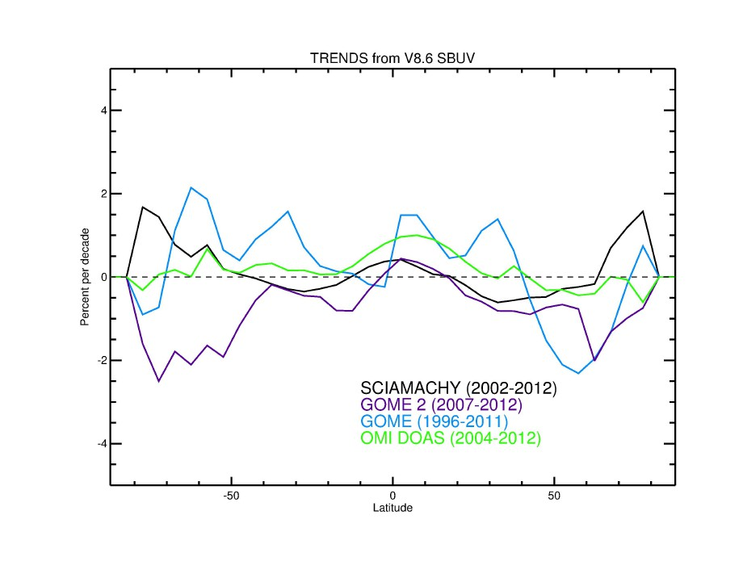

Slide 7
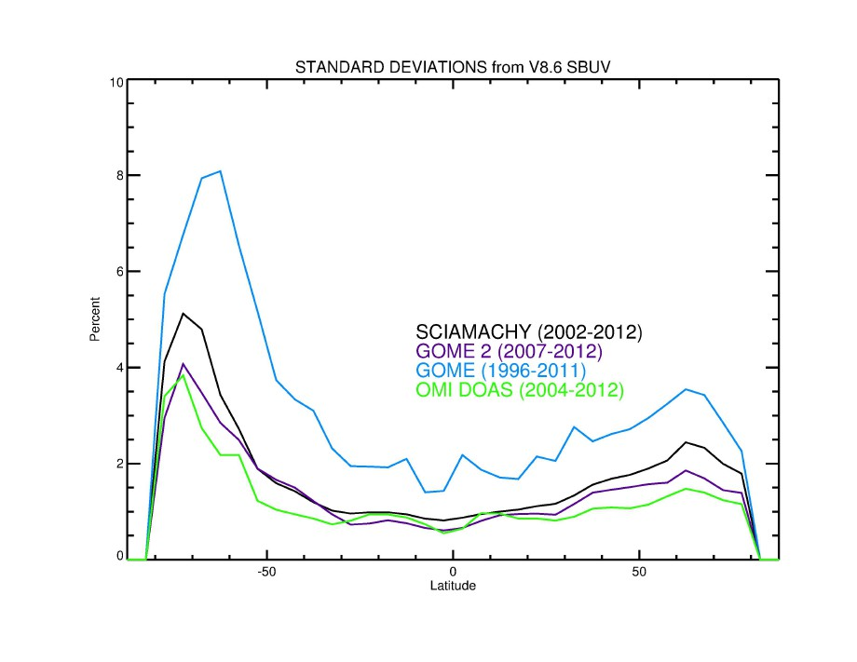

Slide 8
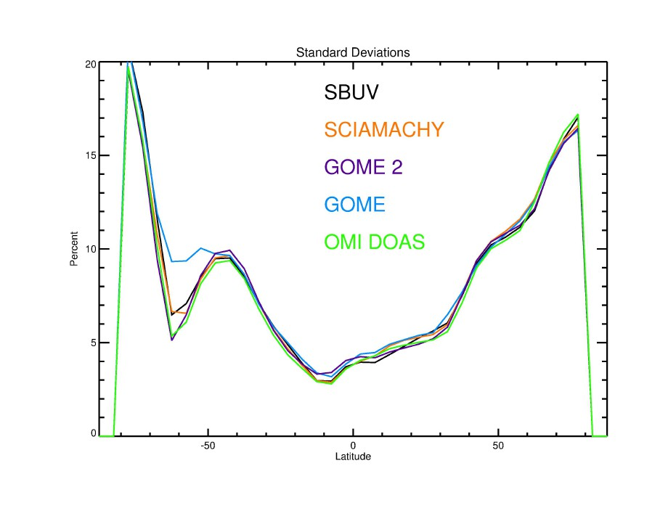
of the mean

Slide 9
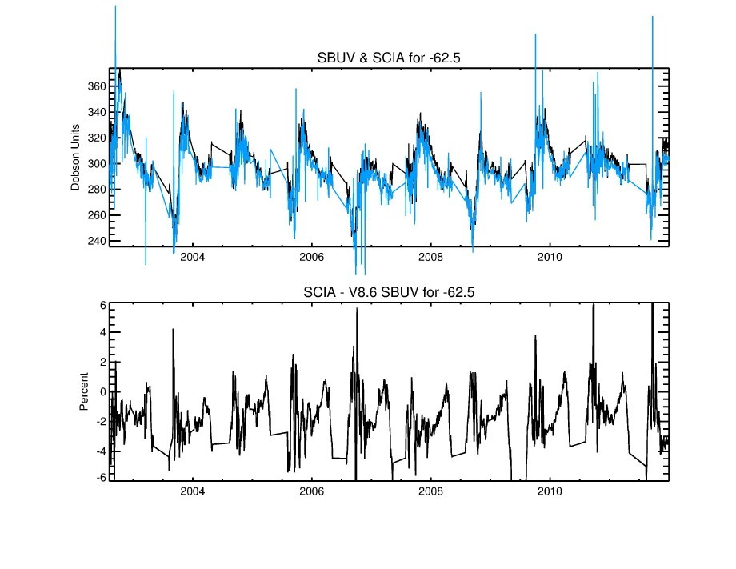
Remember, these are 5 degree ZM’s
SBUV
SCIA

Slide 10
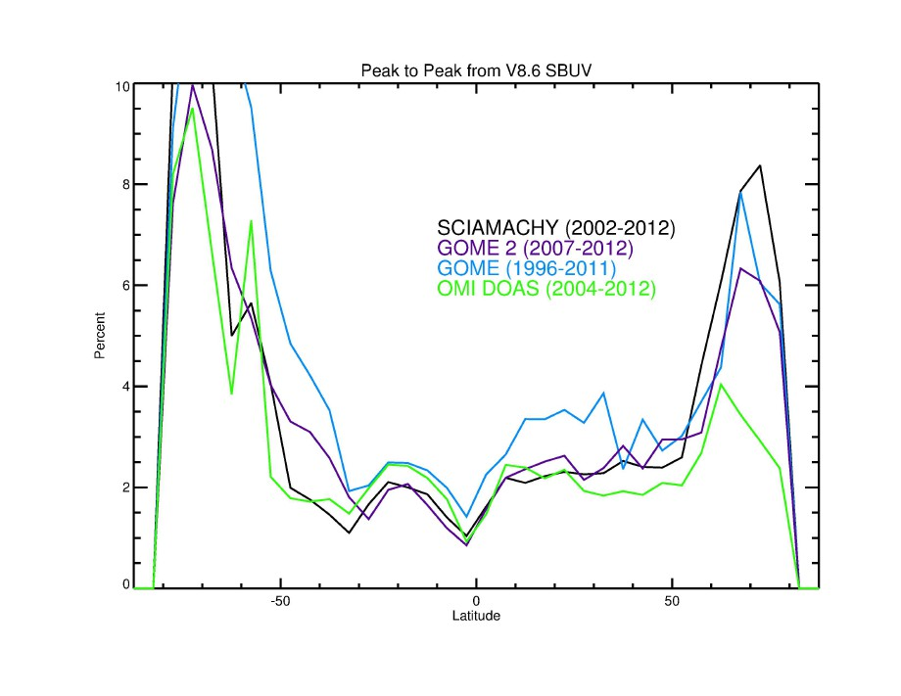

Slide 11
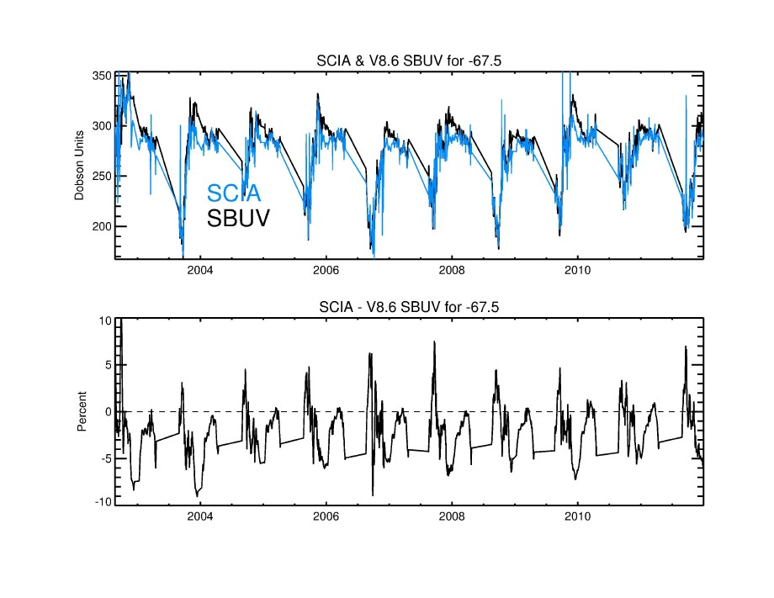

Slide 12
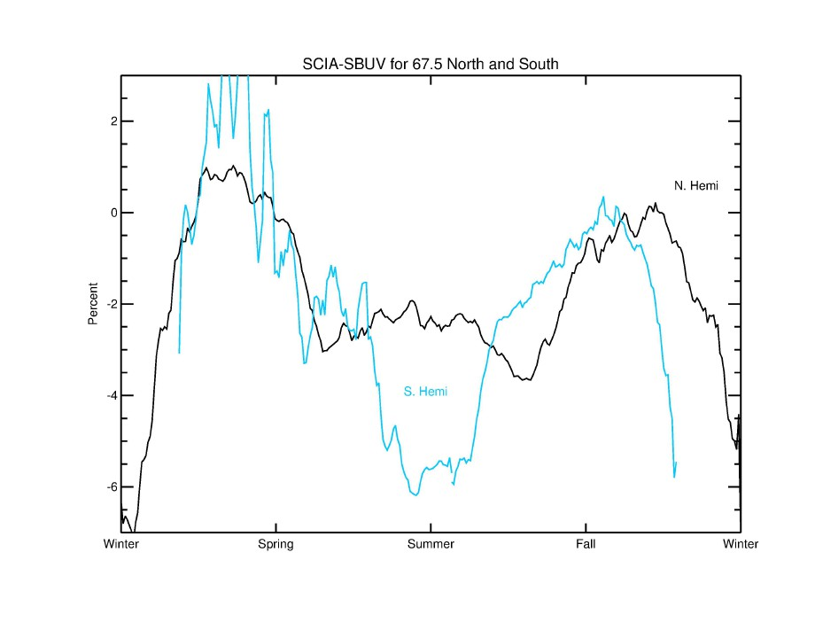

Slide 13
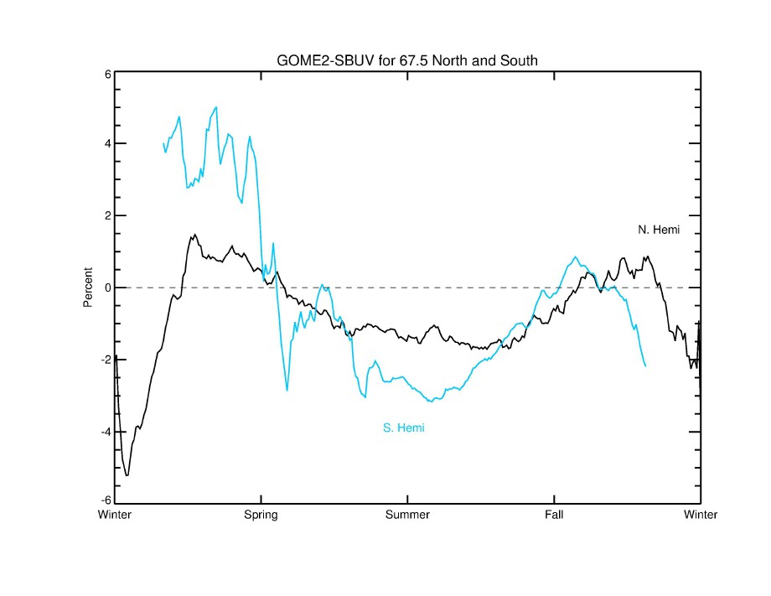

Slide 14
Preliminary Conclusions:
-Agreement at equatorial zones look reasonably good
-Mid latitudes look reasonably good
-Trends & Offsets are all within ~+/-1%
-High latitudes are problematic
Seasonal cycle issues
GOME- has noise issues after 2006

