Slide 1

Key Features of the Latest TOMS Total Ozone Algorithm
David Haffner, SSAI
P.K. Bhartia, NASA-GSFC
Atmospheric Composition Constellation Meeting (ACC-9)
18-19 April 2013, EUMETSAT

Slide 2
Backscatter UV Total O₃ Algorithms
Based on Dave & Mateer (1967)
SBUV V1-6 TOMS V1-8 OMI (NASA algorithm) Suomi/NPP OMPS NM (same as TOMS V8)
Spectral Fitting Algorithms
SBUV continuous scan (Joiner & Bhartia, 1997) GOME-DOAS OMI-DOAS WFDOAS BOAS BIRA/Direct Fit
Optimal Estimation Algorithms
GOME & OMI (Liu et al., 2005, 2010) SBUV V8.6 (Bhartia et al., 2012) Suomi/NPP OMPS NP (same as SBUV V8.6) TOMS V9 (similar to SBUV V8.6)

Slide 3
Backscatter UV Total O₃ Algorithms
Based on Dave & Mateer (1967)
SBUV V1-6 TOMS V1-8 OMI (NASA algorithm) Suomi/NPP OMPS NM (same as TOMS V8)
Spectral Fitting Algorithms
SBUV continuous scan (Joiner & Bhartia, 1997) GOME-DOAS OMI-DOAS WFDOAS BOAS BIRA/Direct Fit
Optimal Estimation Algorithms
GOME & OMI (Liu et al., 2005, 2010) SBUV V8.6 (Bhartia et al., 2012) Suomi/NPP OMPS NP (same as SBUV V8.6) TOMS V9 (similar to SBUV V8.6)

Slide 4
Objectives for V9 TOMS
Provide Error Bars to users
  A frequent request
Supply information to estimate systematic error
  Provide the correct layer Efficiency Factors (EF)
Extend retrievals to 88° SZA
  Report errors on challenging retrievals
  Improve quality of these retrievals
Simplify the entire algorithm
  V8 performed well, but execution was far from seamless
    Pair switching & complex correction for profile effect
    1512 a priori profiles tedious to construct
Quality as good as V8, within error bars
Rodger’s Optimal Estimation a natural choice
  Originally considered just for high SZA, worked well elsewhere

Slide 5
Overview of the Basic Algorithm
Total O₃ calculated from retrieved TOMS profiles
OE uses 3 λ for O₃ information
  312.5, 317.5, 331 nm, flexibility to add more (305-315 nm ideal)
  Brion et al. O₃ x-secs
216 a priori profiles
  mean and covariance calculated from MLS & sondes or GMI Model
  profiles have no total ozone dependence
OE provides error bars, efficiency
factors, and DFS
LER model + corrections for
clouds and terrain
R-λ aerosol correction
SO₂, aerosol contamination
flagged when extreme
March 1989
63°
0°
-63°
VZA
Notes:
313,318,331 = high, medium, low sensitivity
OE cov ← → total ozone dependence : Methods are similar
Here Negative VZA inidcates West, away from Sun
312.5 and other L in 305-315 region have good total ozone information if their profile sensitivity can be accounted for in the retetrieval

Slide 6
V9 TOMS Retrieves Profiles
V9 retrieved 225 DU
V8 retrieved 224 DU
V9 a priori 343 DU
Profiles retrieved at 11 layers
Provides total ozone with a consistent profile
Profile retrieval reduces profile shape related error at shorter wavelengths (benefits SO₂ est.)
Despite lack of total ozone dependence in a priori,
V9 retrieves total O₃ close to V8.
    Total ozone dependent profiles
    used in V8 provided the information that OE gets from covariance matrices.
retrieved
a priori
66S, 74.5E
70° SZA

Slide 7
Total Ozone Comparisons with TOMS V8 and
SBUV V8.6 in March 1989
V9 agrees with V8 within error bars (1-2%) to 84° SZA
V9 reduces error at SZA > 70° (based on SBUV V8.6)
V9 bias must be removed
March 1989

Slide 8
TOMS Efficiency Factors
Integrating
Kernel (IK)
Column Integrating Kernel (CIK)
Efficiency
Factors (EF)
(a.k.a. Averaging Kernel)
sum over columns of IK
elements of CIK
Ideal efficiency
V8 EFs wrong at high SZA
V9
V8
1
V8
10
V9
85° SZA
54° SZA
100
1000
0.5
1.0
1.5
Lower atm. EFs are Rayleigh-Limited in UV
Notes:
Add’l wavelengths wont help with Trop

Slide 9

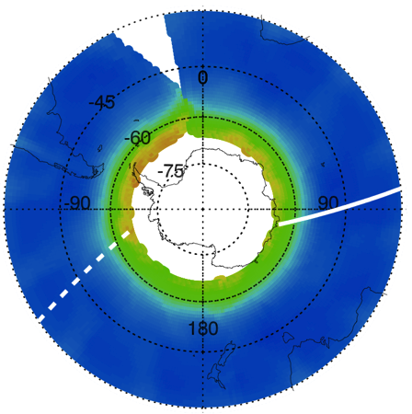
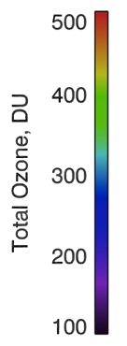
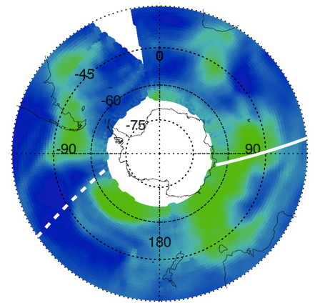
Error Dependence with SZA
Column Error
June 21, 1988
Column Amount
TOMS errors vary by factor of 10.
Most dependence is w/ SZA, not O₃, VZA.
Reason: EFs reduce dramatically in lower atmosphere as path length increases.
Less info. from measurements → greater reliance on a priori → larger uncertainty.

Slide 10

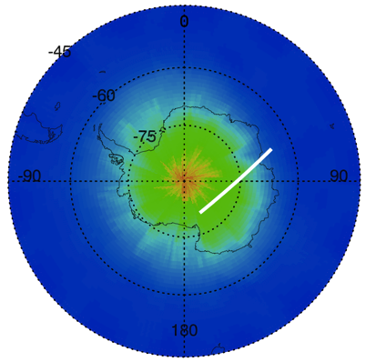
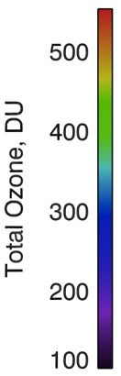
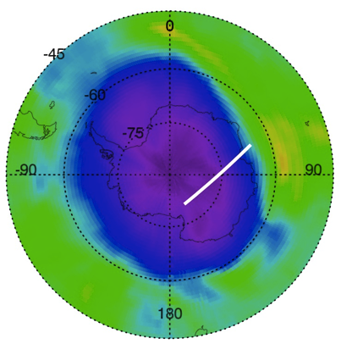
Error Bars for O₃ Hole Conditions
Important to consider when monitoring ozone minima
Column Error in Sep 29, 1987 Ozone hole
Column Amount
Errors increase sharply at high SZA
With error bars we can properly qualify measurements made at extreme SZA.
Errors are important to consider when tracking ozone minima.

Slide 11
Overall Geometry Dependence of Error
March, 1989
1% error at 45 N
VZA dominated
Efficiency Factor 0
2% error at 80 N
Error increases quickly thereafter.
SZA dominated
Notes:
SZA larger on swath LHS (afternoon orbit)

Slide 12
Aerosol Correction
Must correct aliasing of aerosol absorption aerosols into ozone enhancement.
Assume linear dependence of Reflectivity with wavelength
  Follows study by Dave (1977)
Measure LER at 340 and 380 nm
Linearly extrapolate R to O₃-absorbing λs
Retrieve O₃ with wavelength dependent R
Approach fails for thick aerosols → flag

Slide 13
Corrections for Terrain and Cloud Height
Use LER surface model exclusively
First retrieve O₃ at 1 atm sfc presure
Linear R-lambda method corrects Rayleigh error for both terrain and clouds
Terrain: 1) zero EFs and profile below P_{sfc}
2) adjust total ozone
Clouds: 1) retain profile through cloud
2) lower EFs below OCP with est. R_{c}
3) adjust total ozone
Notes:
Uncertainty in profile in cloud

Slide 14
Conclusions
V9 TOMS provides error bars.
V9 TOMS is in good agreement with V8 TOMS. Compares well with V8.6 SBUV.
Can extend retrievals to 88° SZA.
Errors originate mostly in lower atmosphere where Rayleigh scattering limits retrieval of O₃ information (significant at high SZA, i.e. O₃ hole).
V9 provides consistent profiles.
Algorithm offers flexibility.
Notes:
Calibration adjustment necessary.

Slide 15
References
Dave, J.V., and Mateer, C. L.: A Preliminary Study on Possibility of Estimating Total Atmospheric Ozone from Satellite Measurements, J. Atmos. Sci., 24, 414-427, 1967.
Joiner, J. and Bhartia, P.K.: Accurate determination of total ozone using SBUV continuous spectral scan measurements, J. Geophys. Res.-Atmos., 102, 12957-12969, 1997.
Liu, X., Chance, K., Sioris, C.E., Spurr, R.J.D., Kurosu, T.P., Martin, R.V., and Newchurch, M.J.: Ozone profile and tropospheric ozone retrievals from the Global Ozone Monitoring Experiment: Algorithm description and validation, J. Geophys. Res.-Atmos., 110, D20307, doi:10.1029/2005JD006240, 2005.
Liu, X., Bhartia, P.K., Chance, K., Spurr, R.J.D., and Kurosu, T. P.: Ozone profile retrievals from the Ozone Monitoring Instrument, Atmos. Chem. Phys., 10, 2521-2637, 10.5194/acp-10-2521-2010, 2010.
Bhartia, P.K., McPeters, R.D., Flynn, L.E., Taylor, S., Kramarova, N.A., Frith, S., Fisher, B., and Deland,M.: Solar Backscatter UV (SBUV) total ozone and profile algorithm, Atmos. Meas. Tech. Discuss., 5, 5913-5951, doi:10.5194/atmd-5-5913-2012, 2012.

