Slide 1
New and updated ozone cross-sections from IUP Bremen
A contribution to WMO-GAW/ IO3C
IGACO-O3 Absorption Cross-Sections of Ozone Activity (ACSO)
M. Weber, A. Serdyuchenko, W. Chehade, V. Gorshelev, and J. P. Burrows
Contact: weber@uni-bremen.de
NASA/ESA ACC-9 workshop, Darmstadt, Germany, 18-19 Apr. 2013

Slide 2
Content
Motivation
New broadband high spectral resolution UV/VIS/NIR ozone cross-section (Serdyuchenko et al.)
Serdyuchenko et al., Gorshelev et al., under revision, to be submitted to AMTD
Updated SCIAMACHY FM (Bogumil et al.) and revised GOME2 FM3 (Metop A) cross-sections
Chehade et al., AMTD, 2012 & 2013
Impact on ozone retrieval

Slide 3
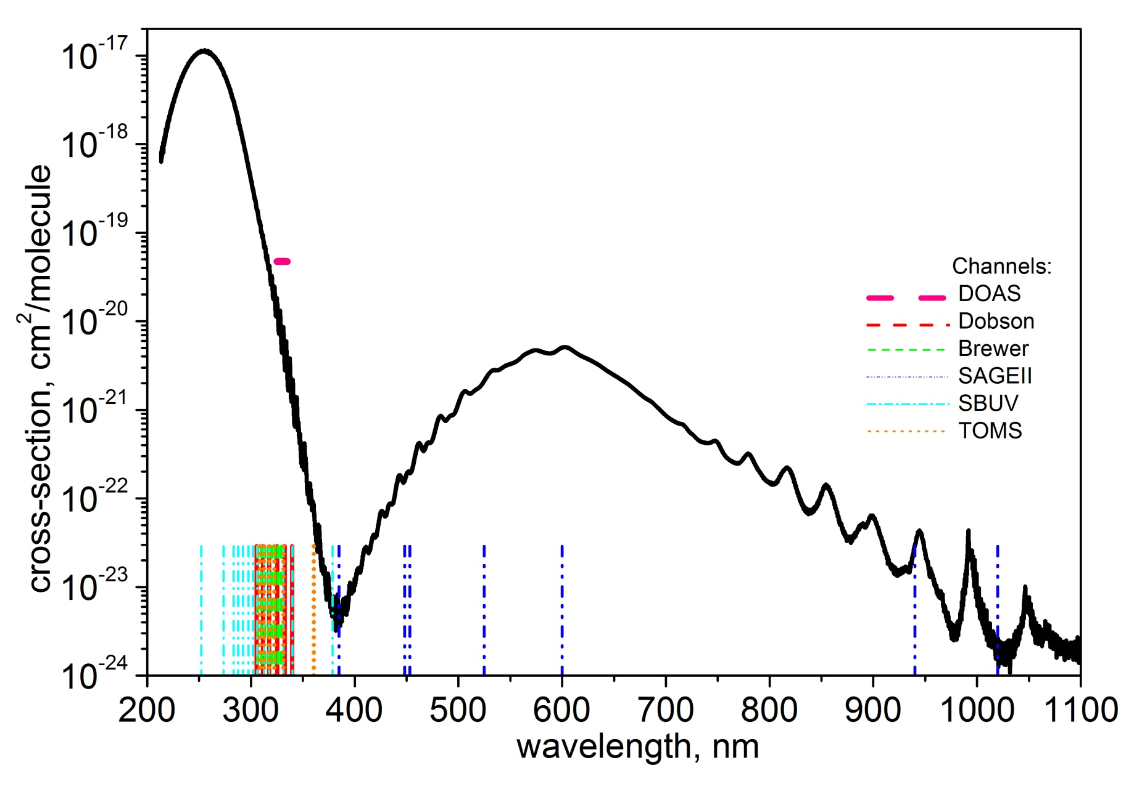
Why broad band ozone cross-sections?
Consistency in UV/Vis ozone (and trace gas/aerosol) remote sensing!

Slide 4
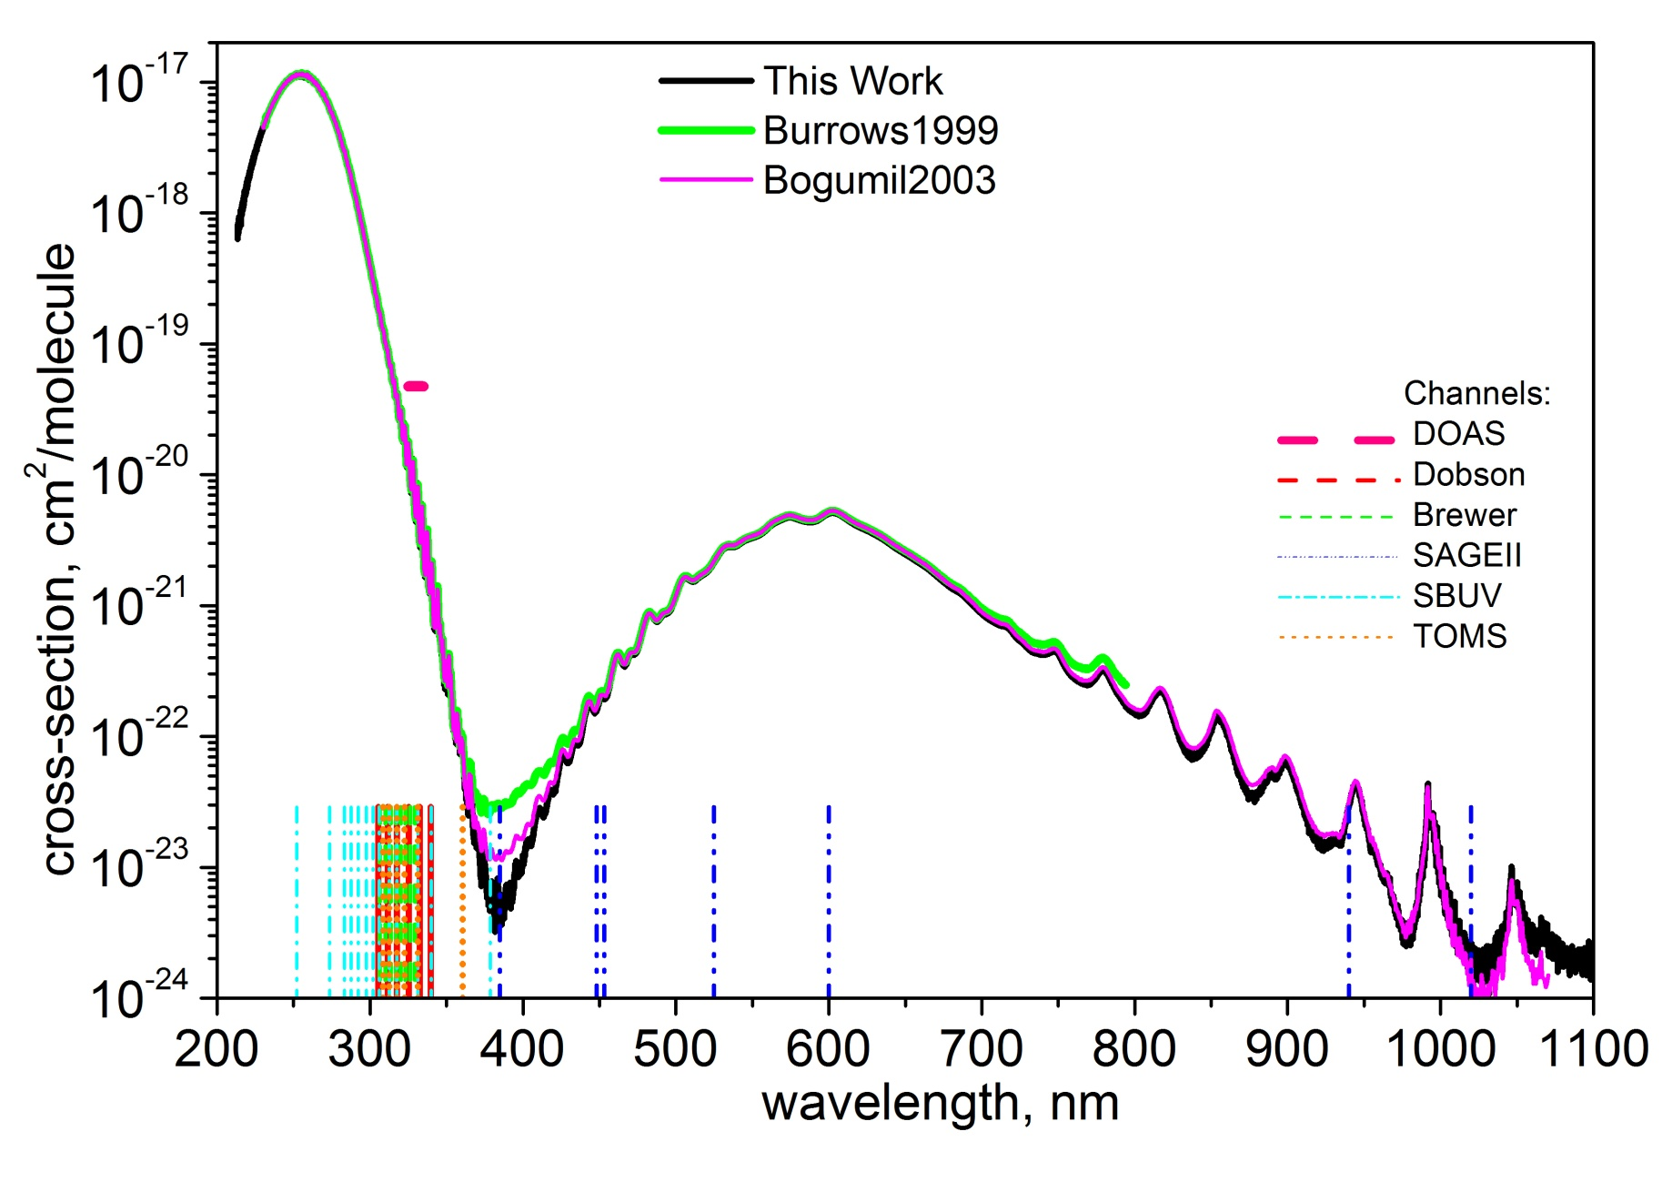
Why high spectral resolution?
Serdyuchenko et al. (high)
GOME FM (medium)
SCIAMACHY FM (medium)
Convolution to medium and low spectral resolution of any remote sensing instruments!

Slide 5
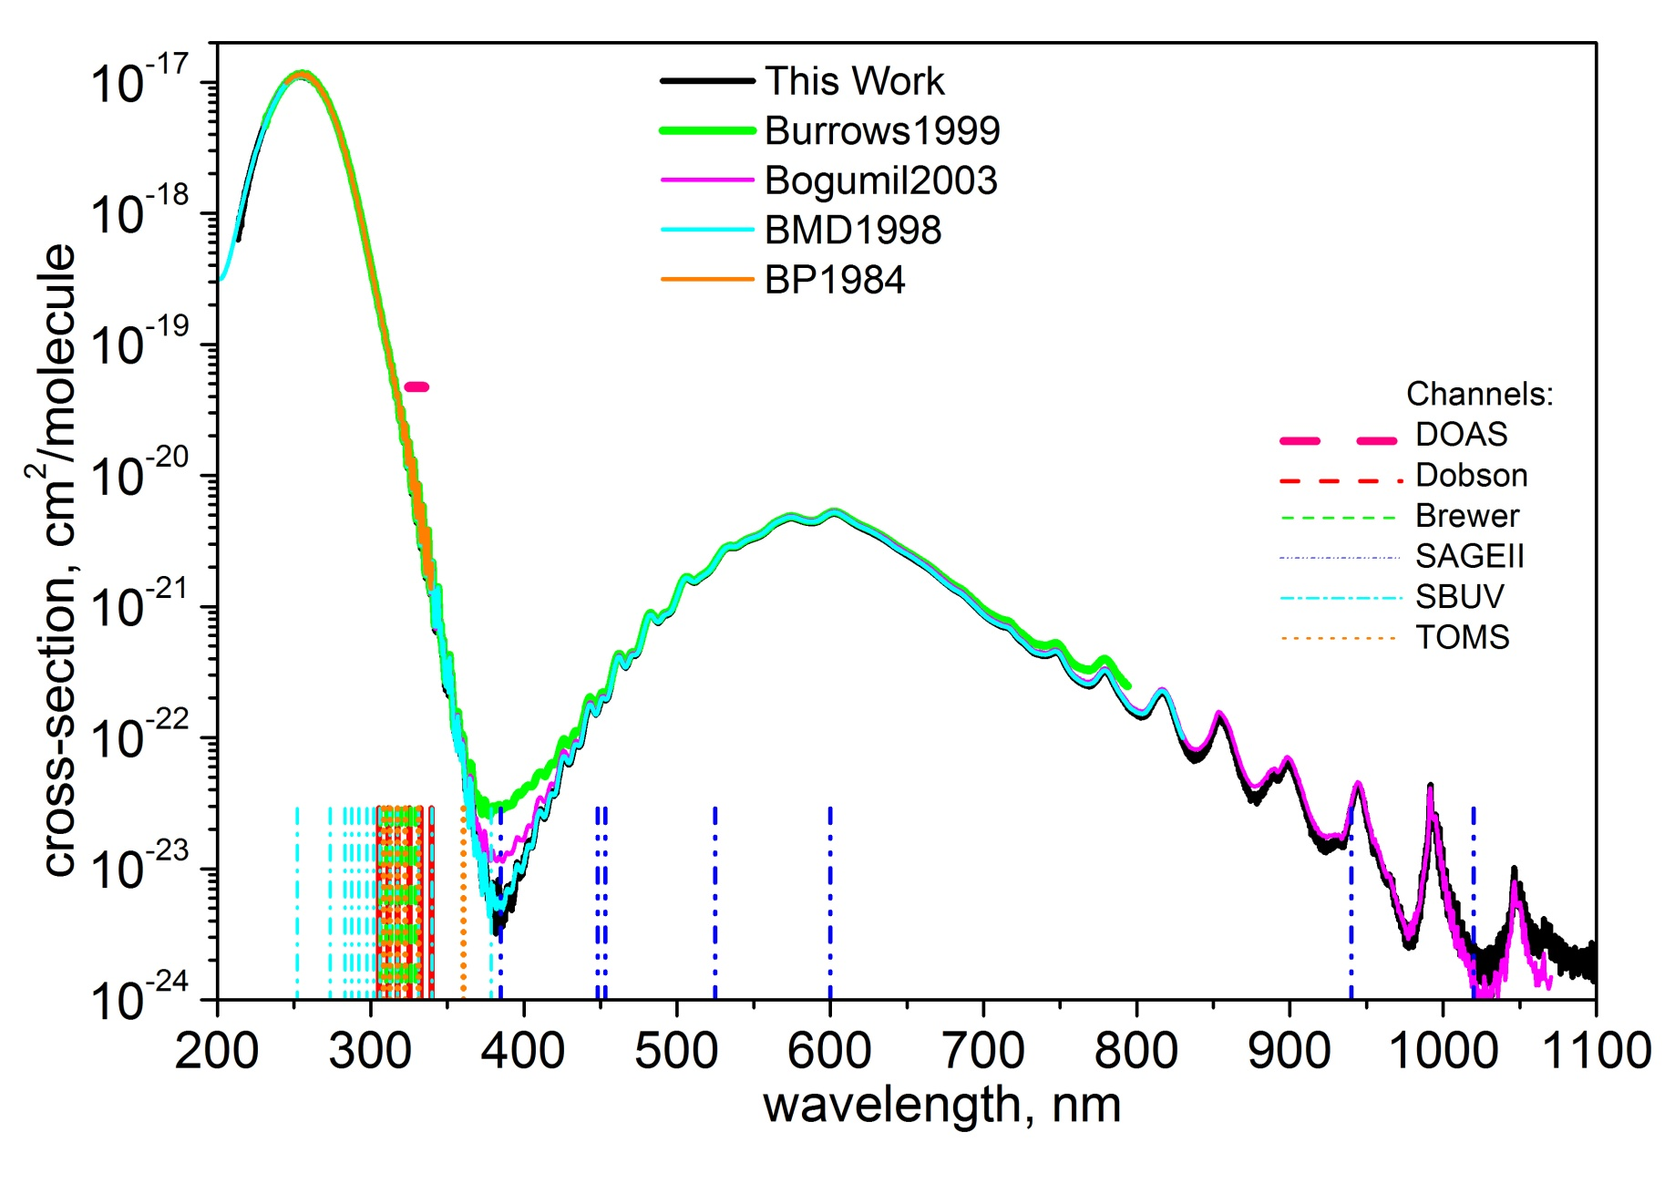
Not many high spectral resolution data with broad coverage
Serdyuchenko et al. (high)
GOME FM (medium)
SCIAMACHY FM (medium)
(high)
(high)
BMD (Brion/Malicet/Daumont)
five temperatures (218 K lowest), complete Chappuis band only at room temperature, absolute
BP (Bass/Paur)
five temperatures, only UV (<340 nm), „noisy“ in the Huggins band (> 325 nm), relative (scaled to Hearn 1961)

Slide 6
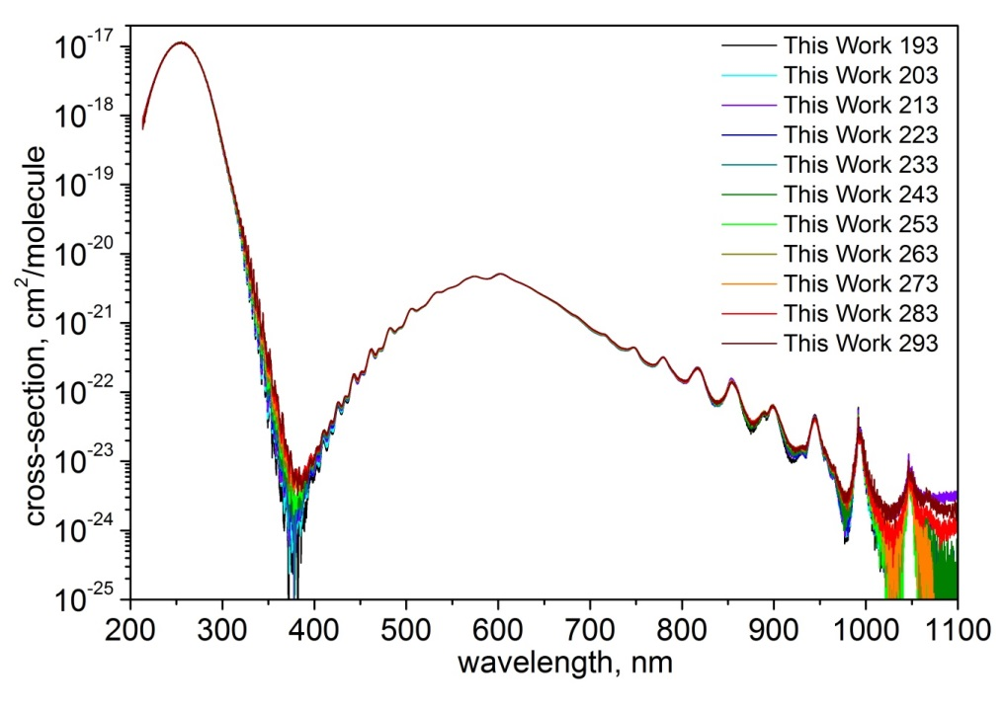
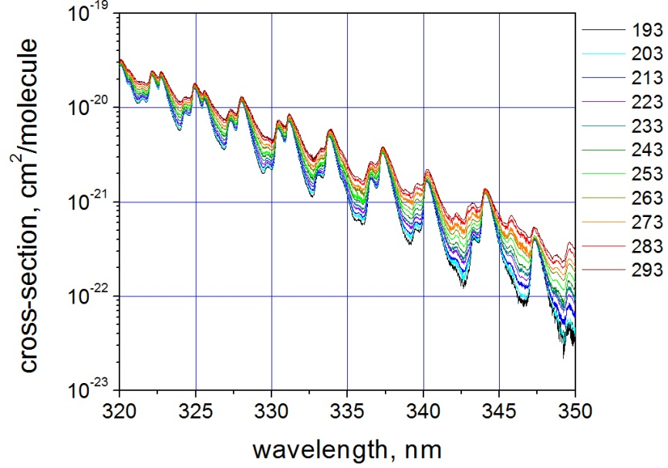
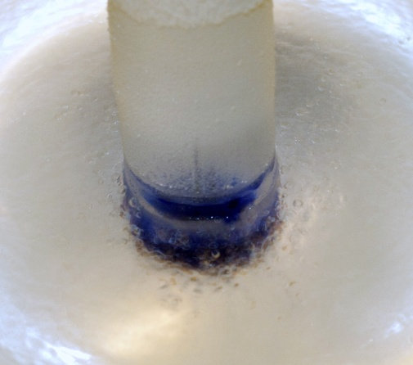
new ozone cross-sections (Serdyuchenko et al.)
to set-ups:
Echelle (UV)
FTS (near UV and VIS/NIR)
237-1050 nm
temperature: range 193K-293K in steps of 10K (11 temperatures)
spectral resolution of about 0.02 nm
absolute measurements (pure ozone)
pure ozone
trapped in
liquid N2

Slide 7
Error budgets of broad band ozone cross sections
Data set | FWHM, nm | Calibration | Uncertainty, %
Burrows et al., 1999 | 0.17 @ 330 nm | absolute | 2.6 – 4.6
Bogumil et al., 2003 | 0.20 @ 330 nm | Using BP | 3.1
BP, 1985 (HITRAN 2008) | <0.025 nm | Using Hearn | 2.3
BMD, 1992-1998 | 0.01-0.02 nm | absolute | 2 - 6
This work , 2012 | 0.02 nm @ 330 nm | absolute | 2 – 3*
*Excluding regions near 380 nm and longer than 800 nm
Uncertainty of all broad band ozone cross-section data incl. Serdyuchenko et al. is 2% and higher
Agreement of Serdyuchenko et al. with other broadband ozone cross-section mostly within the experimental uncertainty

Slide 8
Impact on total ozone retrieval in DOAS window (325-335 nm)
Direct comparison of cross-sections (differential scaling factor and wavelength shifts)
BMD has to be scaled by ~1.4% (yielding 1.4% lower total ozone than Serdyuchenko in DOAS retrieval)
BP has to be scaled 1.1% (yielding 1.1% lower ozone than Serdyuchenko et al.)
Significant wavelength shifts of Bass Paur data (note: ozone sensitivity is about -6 DU per 0.01 nm shift at GOME/SCIA spectral resolution!)
Cross-sections | T [K] | Scaling factors [-] | Shift [nm]
BMD | 218 227 238 | 1.0128(10) 1.0145(09) 1.0142(12) | - - -
Bass Paur (ACSO) | 218 227 238 | 1.0096(31) 1.0115(29) 1.0119(29) | 0.0307(8) 0.0292(7) 0.0278(7)
*scaling and shifts to match Serdyuchenko et al.
** x-sections as polynomial quadratic in T
agreement with BP and BMD (<1.4%) within experimental uncertainty (except for the large wavelength shift in BP)

Slide 9
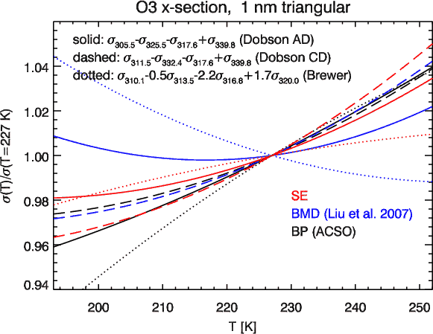
T-dependence of Brewer/Dobson wavelengths
Standard Brewer/Dobson retrieval uses constant temperature (T=-46°C=227K)

Slide 10
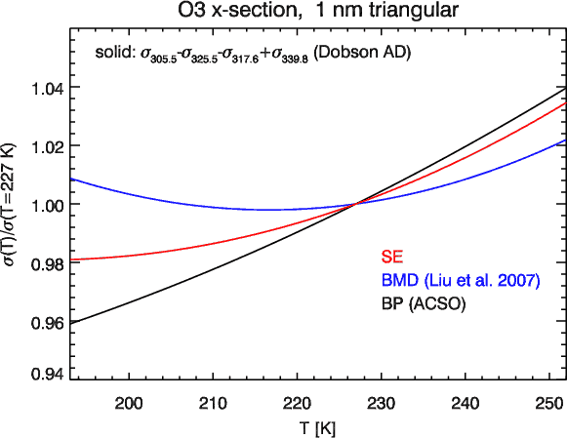
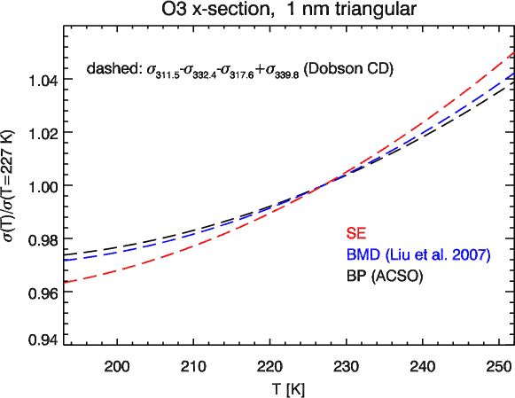
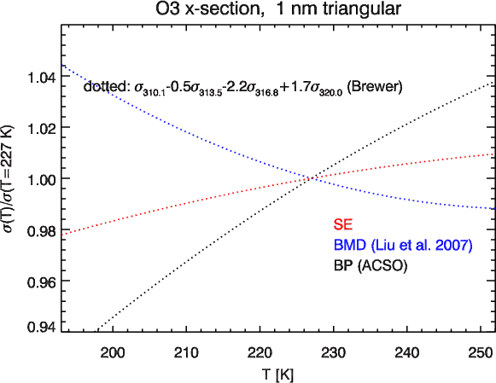
T-dependence of Brewer/Dobson wavelengths
AD
CD
Best agreement between BMD, BP, and Serdyuchenko at CD pair wavelengths
Large spread and sign change in T-dependence at effective Brewer wavelengths
Brewer

Slide 11
Reanalysis of SCIAMACHY FM and GOME-2 FM3 ozone x-section
Motivation:
SCIAMACHY DOAS retrievals yield enhanced total columns by 5% using Bogumil et al. (SCIA FM) cross-sections (Eskes et al., 2005)
GOME-2 DOAS total ozone enhanced by 8% when using GOME-2 FM3 data from Gür et al., 2005.
Reanalysis (brief)
Improve concatenation of relative ozone x-sections(OD spectra) that cover the large dynamic range by using larger overlap regions and using linear fit scaling (2 parameters) rather than ratios (1 parameter)
Absolute scaling using slit function convolved BP and BMD data (important for Huggins band)

Slide 12
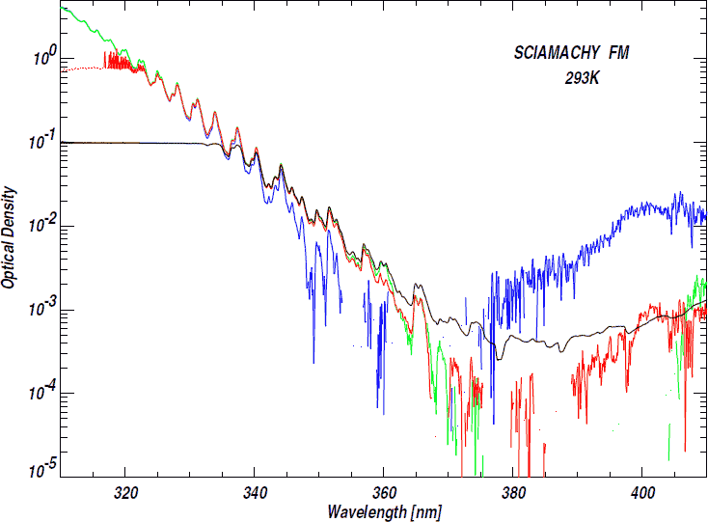
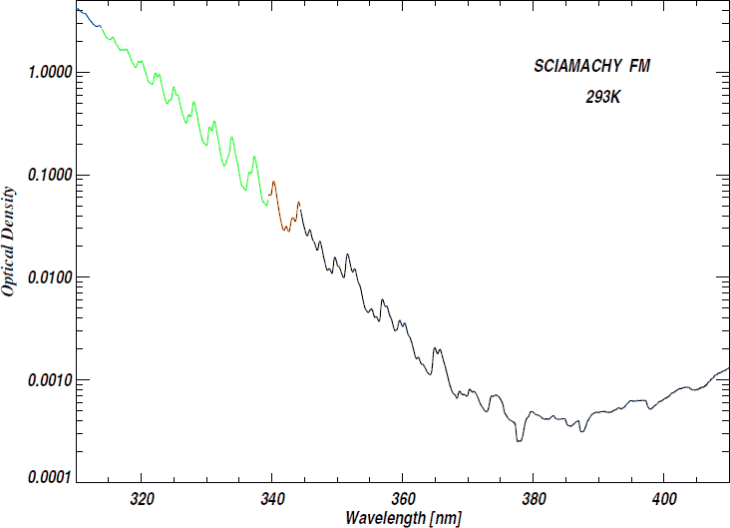
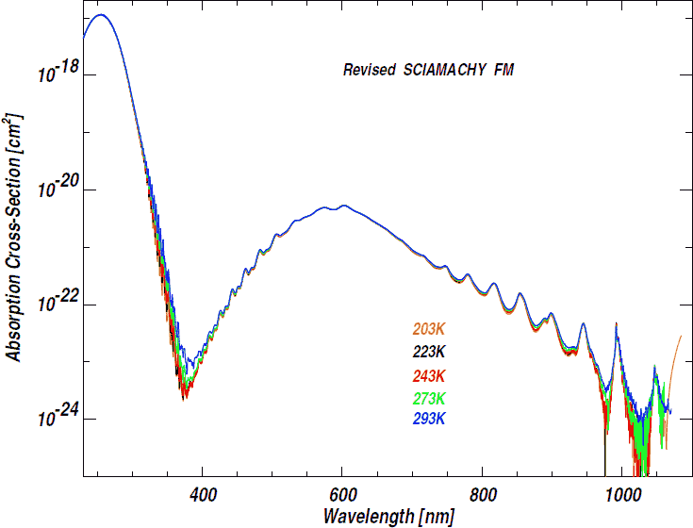
Example: SCIAMACHY FM reanalysis
x
concatenation
absolute scaling
Chehade et al., 2013

Slide 13
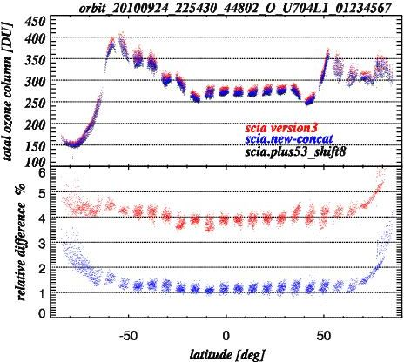
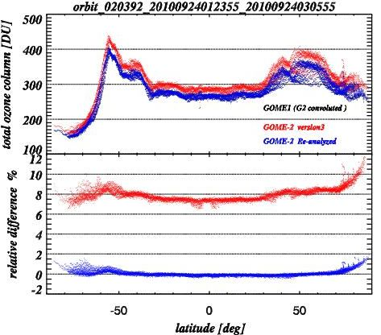
Impact from revised satellite FM cross-sections
WFDOAS retrieval tests of new satellite FM updates using one SCIA and one GOME-2 orbit
optimal shift of x-section by minimising fit residuals
SCIA FM: +0.017 nm
GOME-2 FM: -0.038 nm
compare retrieval to standard WFDOAS retrieval:
SCIAMACHY: Bogumil et al. 2003, +5.3% scaled , +0.008 nm shift
GOME-2: Burrows et al., 1999, convolved +0.017 nm shift
agreement now to within 1% with standard WFDOAS retrieval and GOME/ERS
SCIAMACHY
GOME-2
Chehade et al., 2013

Slide 14
Conclusion
New Serdyuchenko et al. Ozone cross-section are available
Broad spectral coverage, many T‘s, high spectral resolution
As part of the IGACO-O3 ACSO activity thorough testing in the UV/Vis remote sensing community underway (see ACSO workshop, 3-5 June, Geneva, http://igacoo3.fmi.fi/ACSO/cross_sections.html
New laboratory measurements are currently done to further improve Wulf band (>900 nm) and the absorption minimum region (~370 nm) using an improved FTS setup
Future plans: TIR laboratory measurements for improving consistency between IR and UV sensors (GOME-2 vs. IASI)
Satellite FM cross-section at medium spectral resolution have significantly improved by reanalysis
Do we need satellite FM cross-section? yes, they are useful for diagnosing instrument performance (spectral resolution, SNR, etc.)

