Slide 1
Key features of the latest Ozone CCI
Total Ozone Algorithm
C. Lerot, R. Spurr, M. Van Roozendael, D. Loyola, M. Koukouli, D. Balis, J.-C Lambert, J. Granville
CEOS ACC meeting #9 (EUMETSAT), 18-19 April 2013

Slide 2
Motivation and content
Overall motivation: demonstrate new European multi-sensor level-2 and level-3 data sets with improved consistency (targeting GCOS compliance)
CCI total ozone algorithm key features
Soft-calibration of level-1 reflectances
Improvement of European inter-sensor consistency
Conclusion and outlook

Slide 3
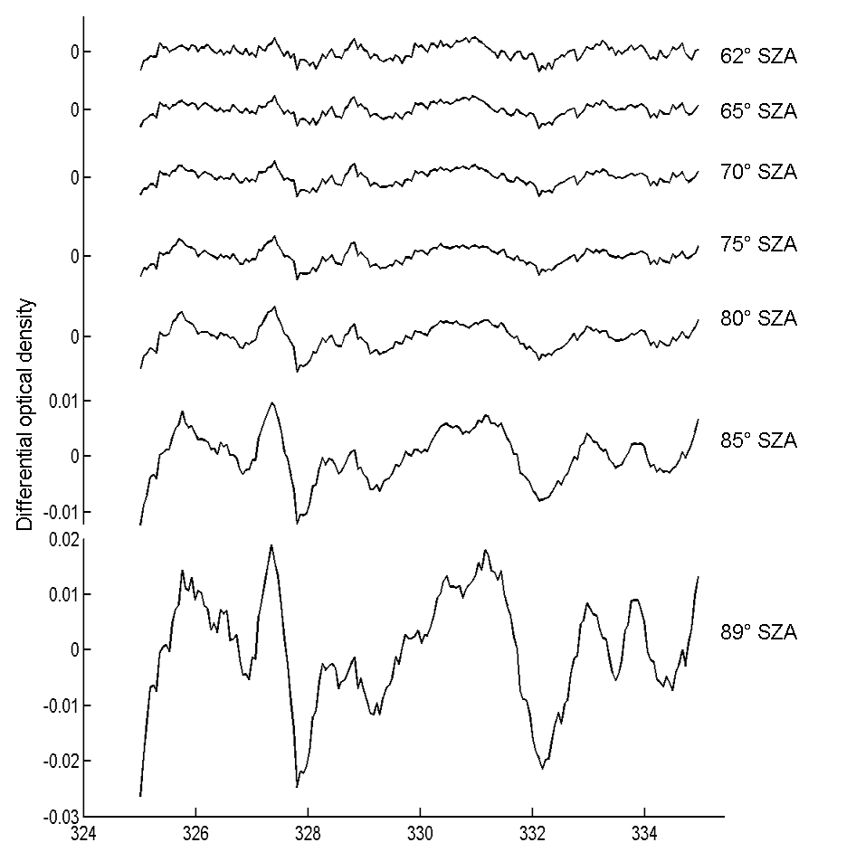
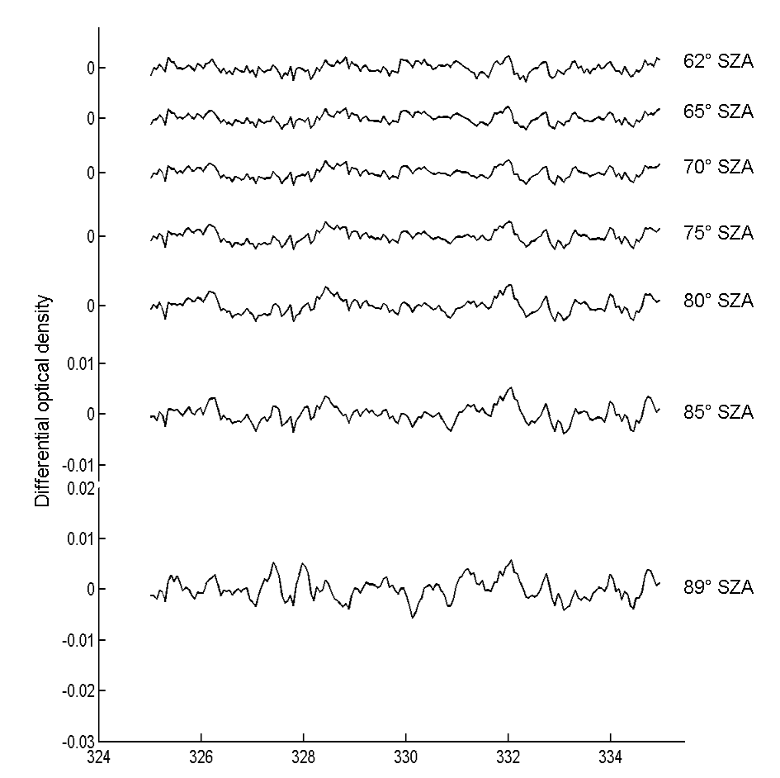
Direct-fitting Algorithm (GODFIT v3)
Algorithm developed for retrieving total ozone from nadir hyperspectral instruments in the Huggins bands (325-335 nm).
Direct fitting approach – closer to the physics than DOAS
Baseline for ESA CCI data sets → www.esa-ozone-cci.org
DOAS residuals
Direct-fitting residuals

Slide 4
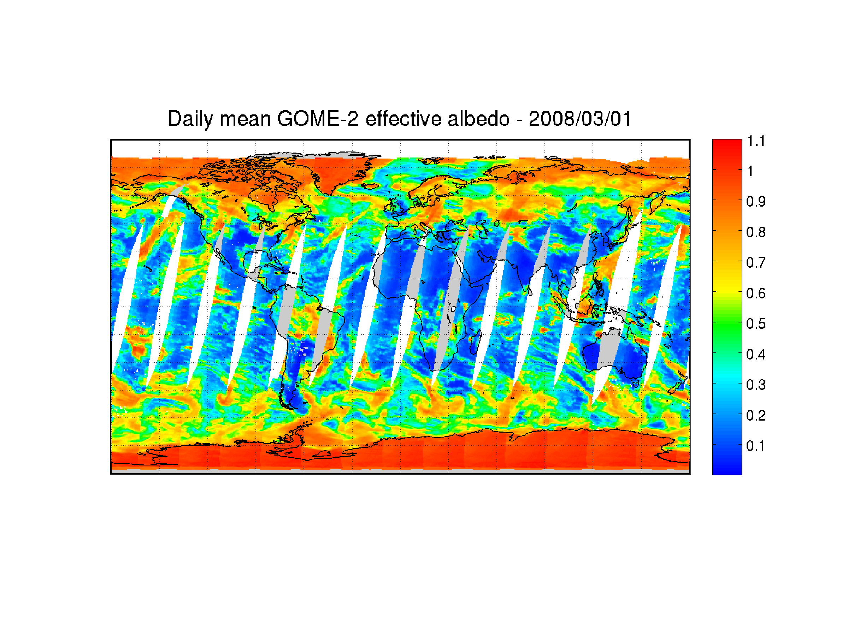
Algorithm’s key features (1)
T°-shift adjustment scheme: the a-priori T°-profile is shifted in the retrieval.
θ(z) = t(z) + S
Shift parameter adjusted in the fit
A priori temperature profile
Actual temperatures used in the forward model
Cloud correction:
  one effective scene, at one effective altitude (weighted average of surface and cloud top height)
  Internal closure mode → the effective scene albedo is retrieved simultaneously to ozone.

Slide 5
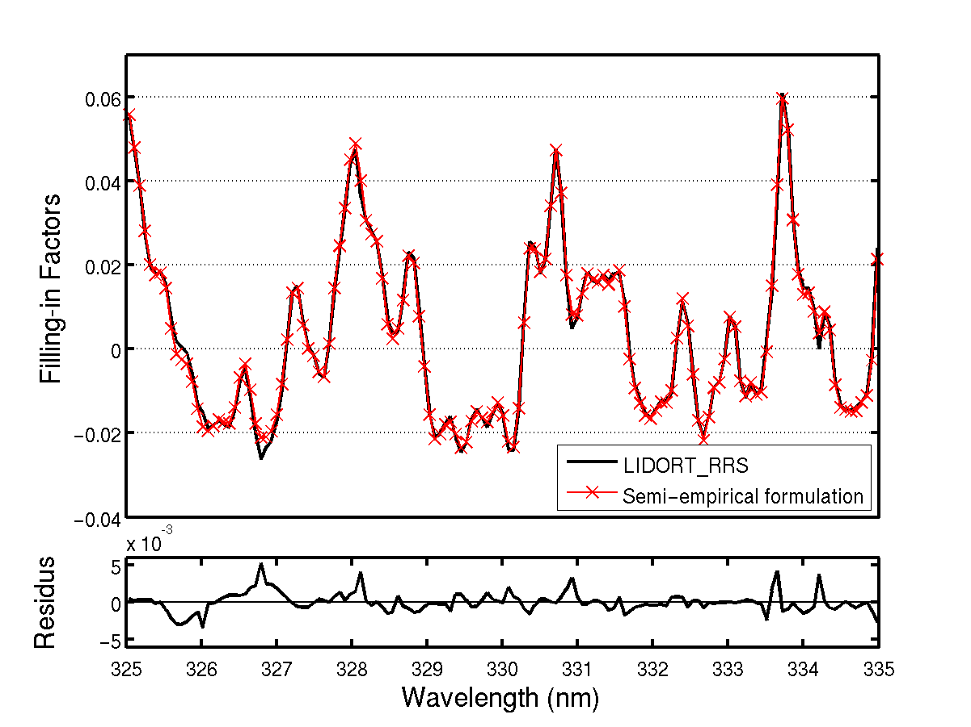
Algorithm’s key features (2)
Semi-empirical Ring correction. The filling-in factors are expressed as:
Probability of RRS
Total O₃: 500 DU
SZA= 85°
VZA= 50°
RAA= 10°
Albedo = 0.8
This formulation includes:
Source and loss terms due to inelastic scattering
Absorption by ozone
smoothing of the ozone absorption by RRS process
ρ₀ is fitted to observations, A_{out} and A_{in} are tabulated after fits to pre-calculated filling-in factors using LIDORT_RRS.

Slide 6
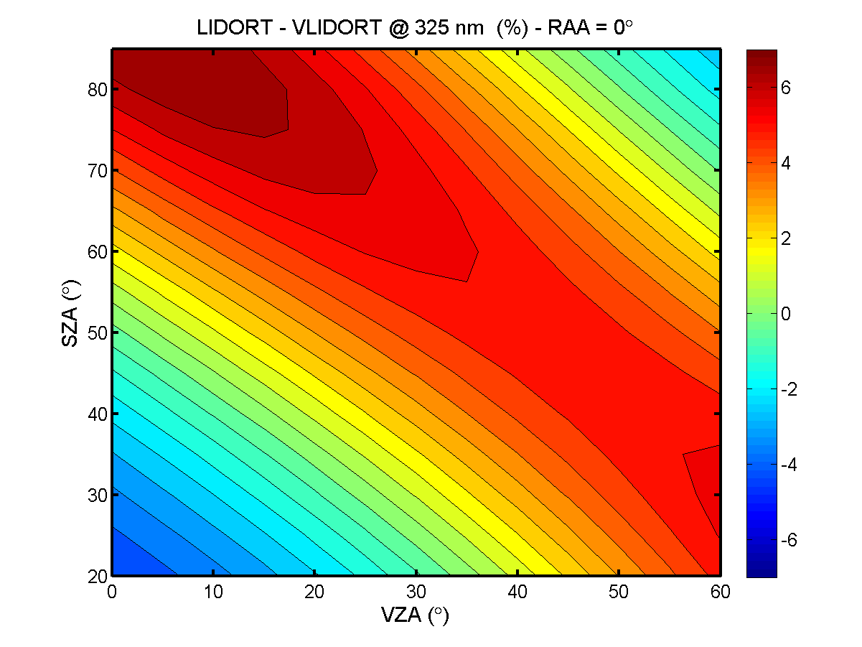
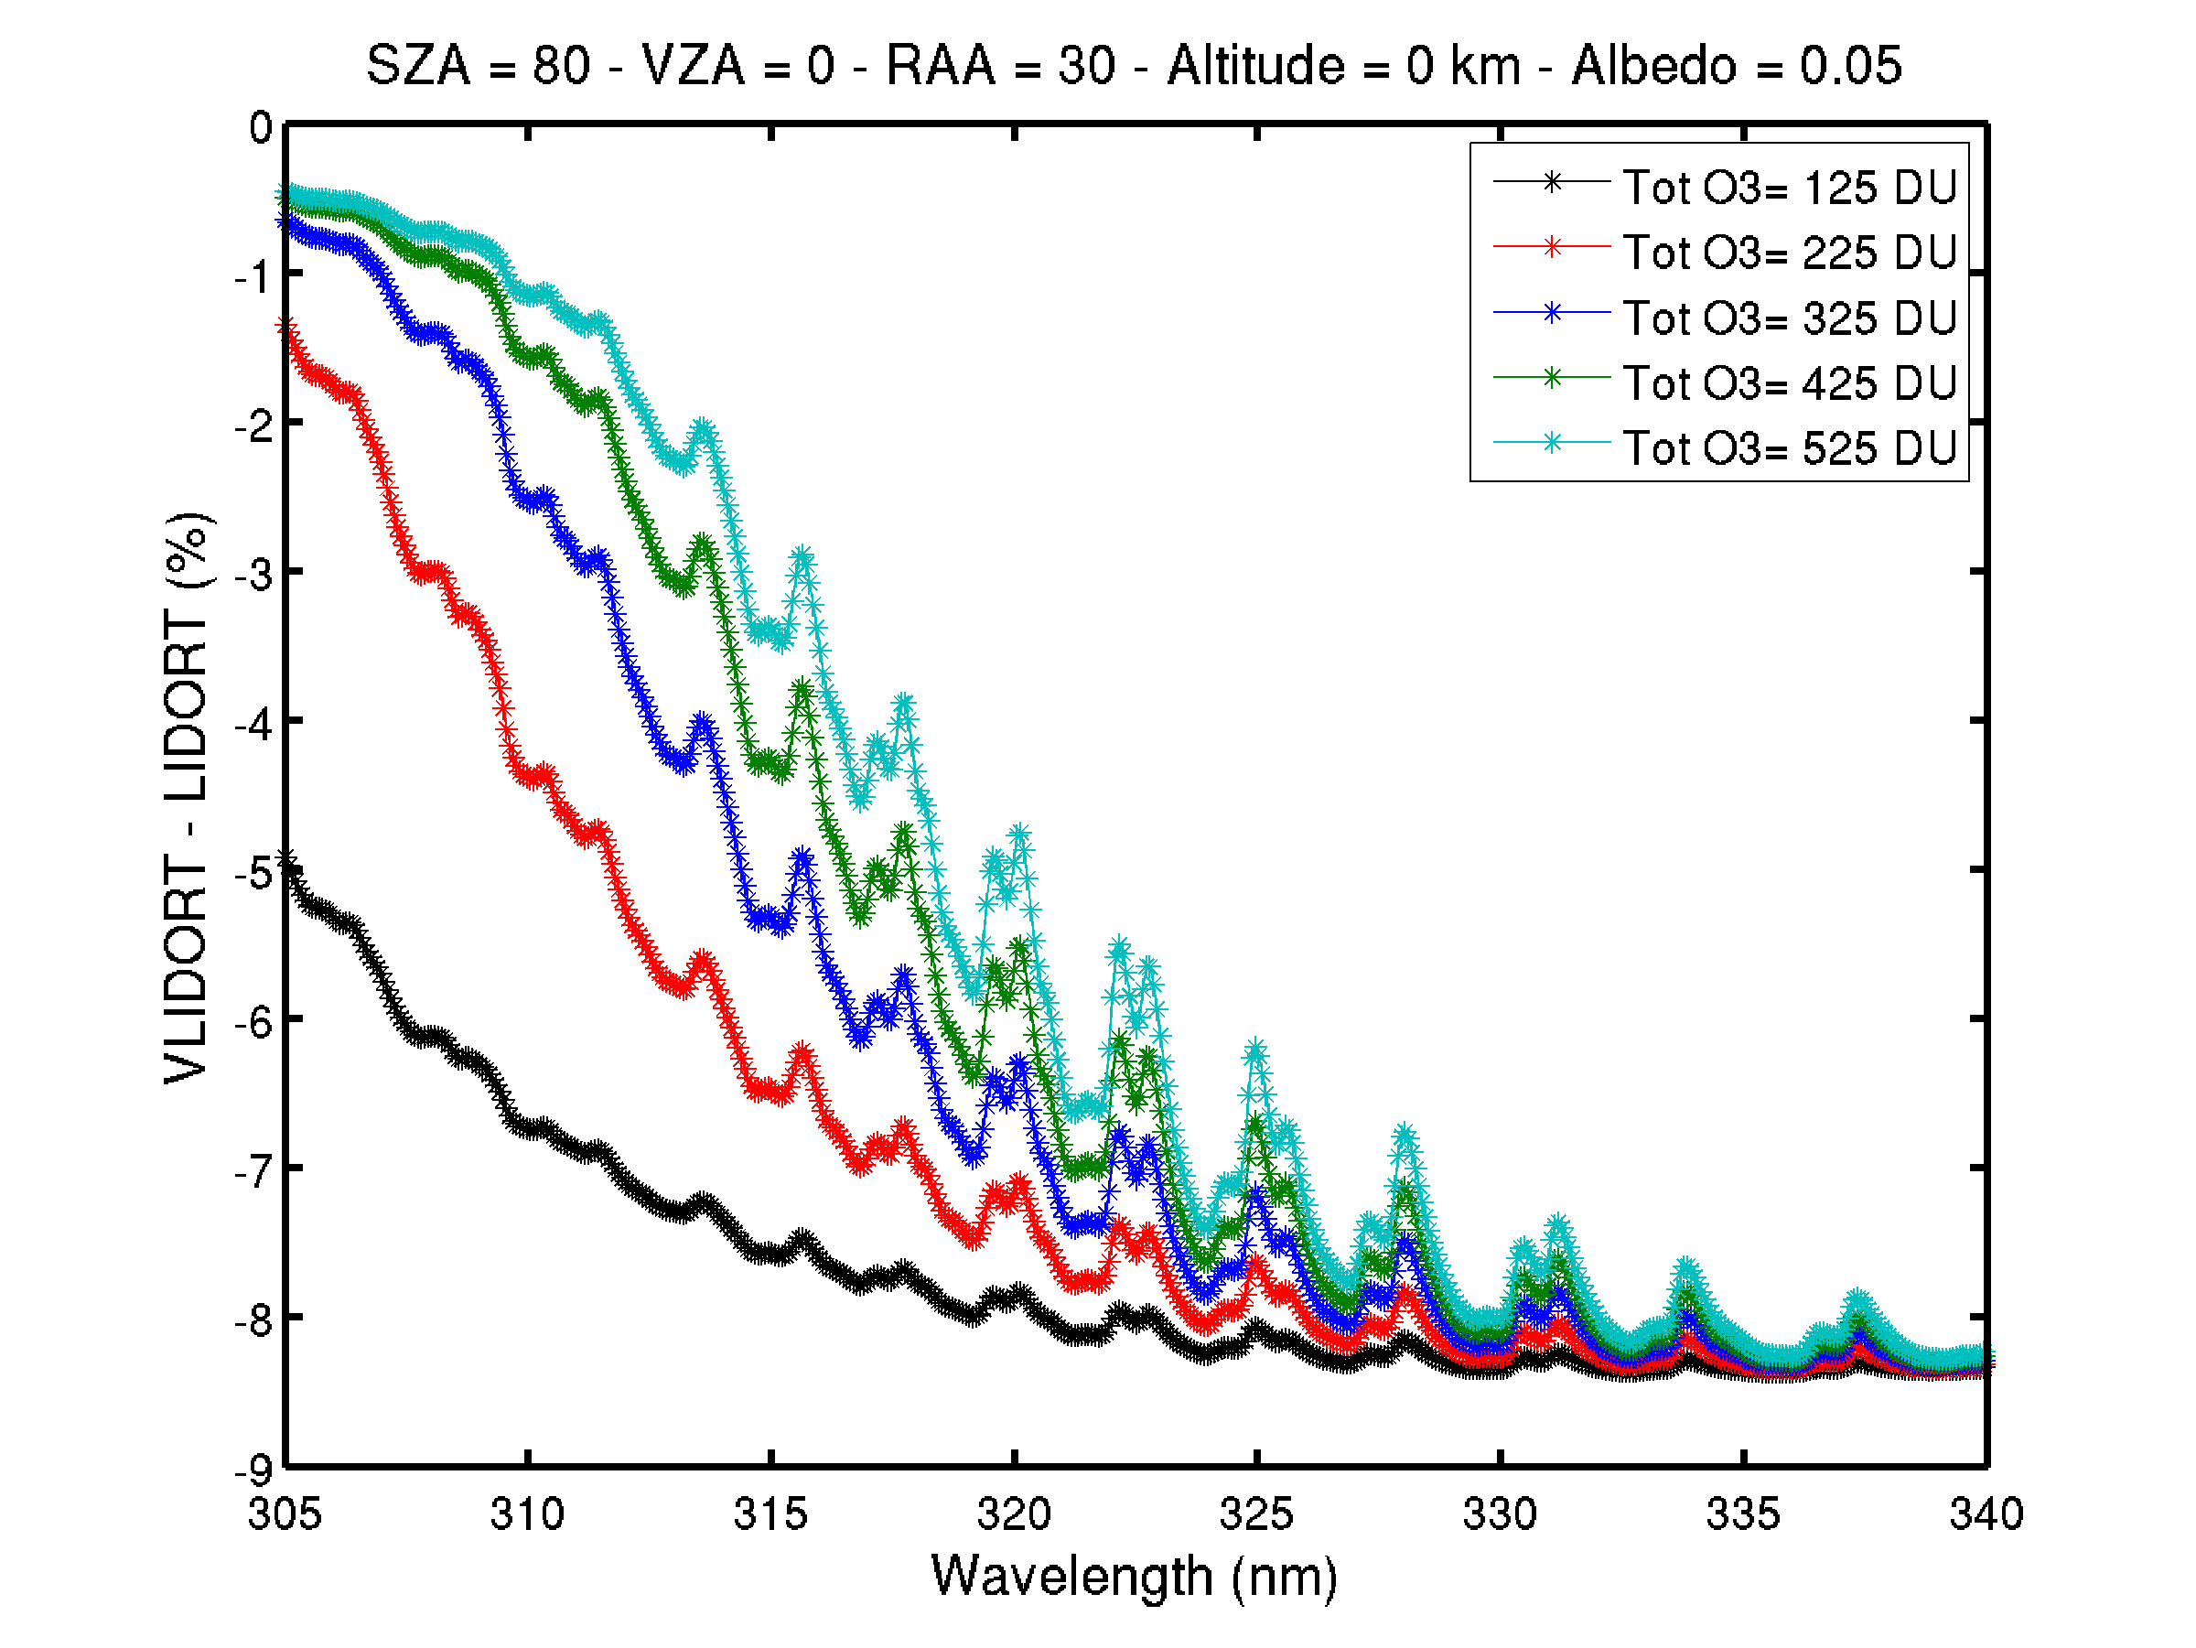
Algorithm’s key features (3)
Polarization correction → based on pre-calculated LUTs of correction factors using VLIDORT
Impact on absolute reflectance (325 nm)
Impact on ozone structures

Slide 7
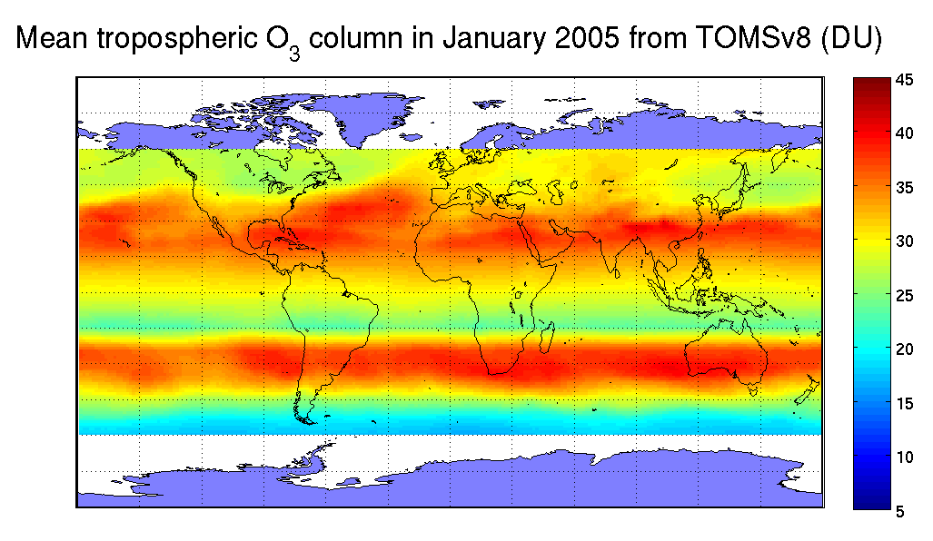
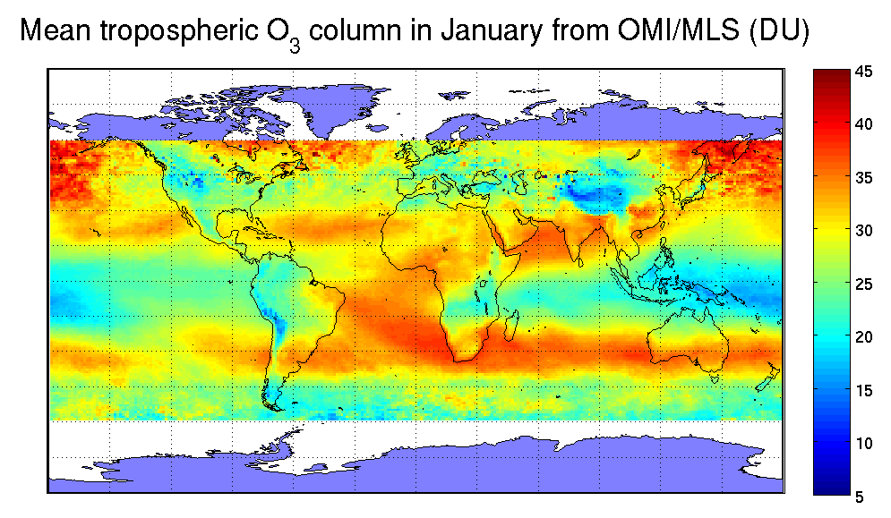
Algorithm’s key features (4)
A priori O₃ profile climatology:
  Stratosphere: Total-O₃ classified profile climatology TOMSv8.
  Troposphere: OMI/MLS climatology (longitudinally resolved – 60°N - 60°S).
A-priori tropospheric content is important for ghost column correction, especially in case of strong cloud contamination.

Slide 8
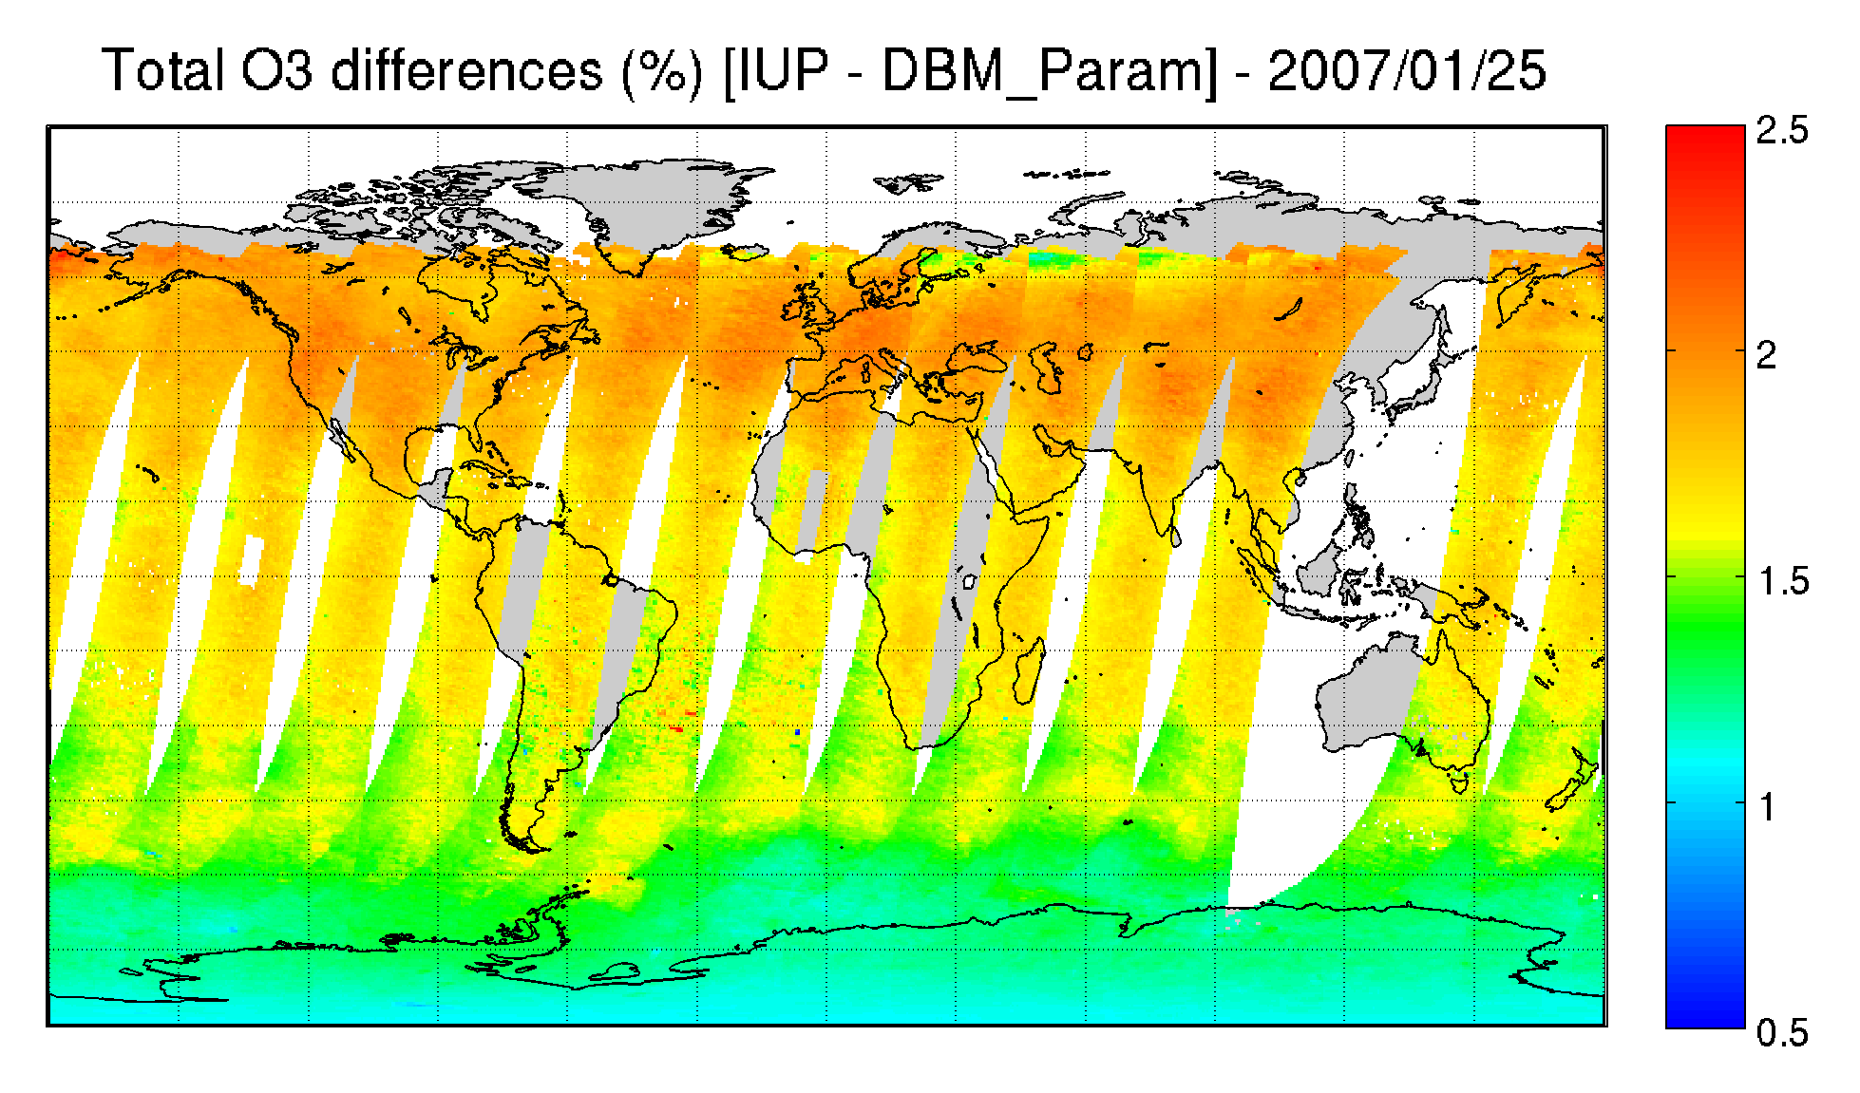
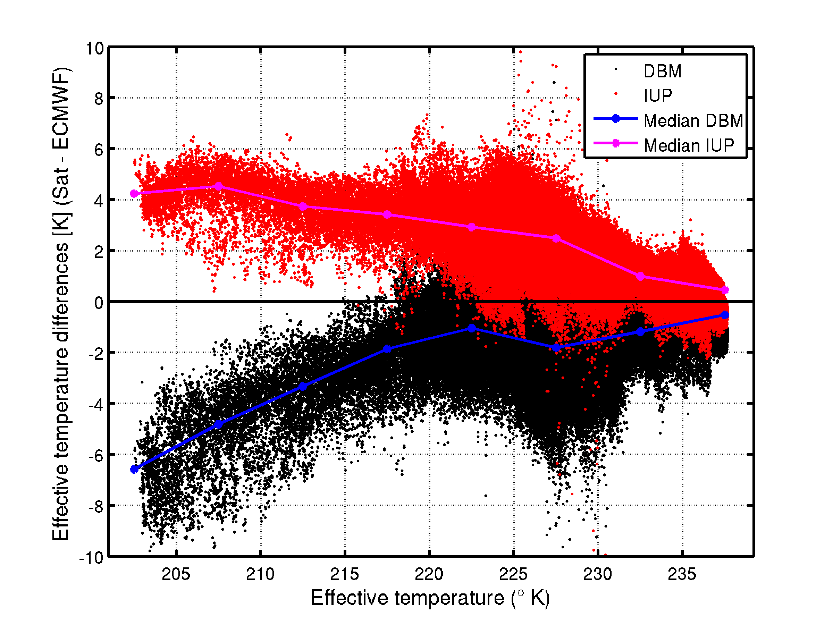
Algorithm’s key features (5)
Ozone absorption cross-sections
Current baseline: Brion, Daumont and Malicet.
The impact of a potential switch to Serdyuchenko et al. data has been assessed (ACSO contribution):
  The retrieved O₃ columns would be 1 to 2.5 % larger, depending on the effective temperature
  The fit quality is similar
→ Difficult to select one “best” data set

Slide 9
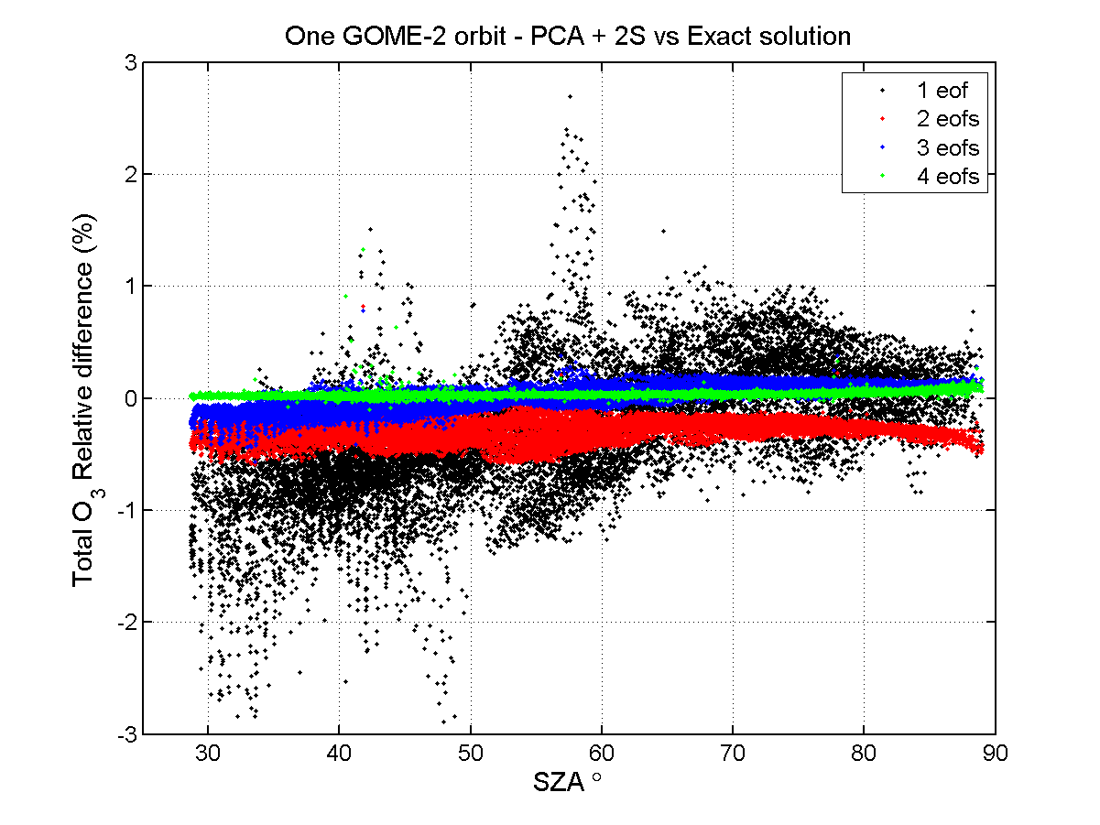
Performance enhancement using PCA
Suite of new RT tools developed by RT Solutions (Rob Spurr) → performance enhancement by approximately a factor 4-5 while maintaining good accuracy (<< 1%).
Based on principal component analysis (PCA) of optical properties, single-scattering and approximate 2-stream RT code
Paper by Spurr et al. in JQSRT.
Accuracy of the method as a function of the number of PCA eigen vectors

Slide 10
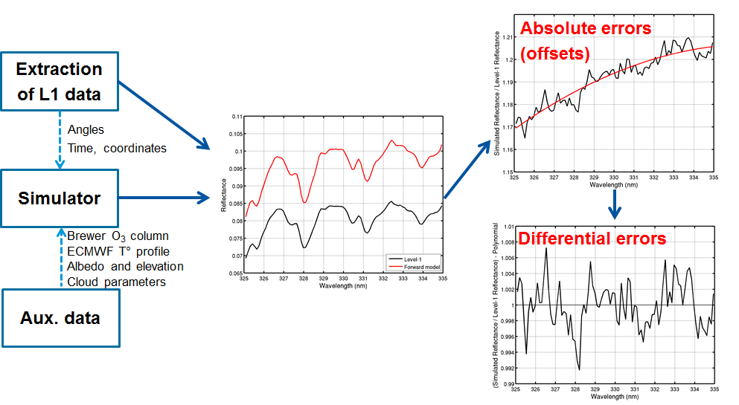
Soft-calibration of level-1
reflectances
Calibration limitations and instrumental degradation lead to inconsistencies between level-2 total O₃ data sets derived from raw level-1 data sets.
➔ Identification of artificial structures in the level-1 spectra, characterization of their main dependences (Time, SZA, VZA, …) and empirical correction.

Slide 11
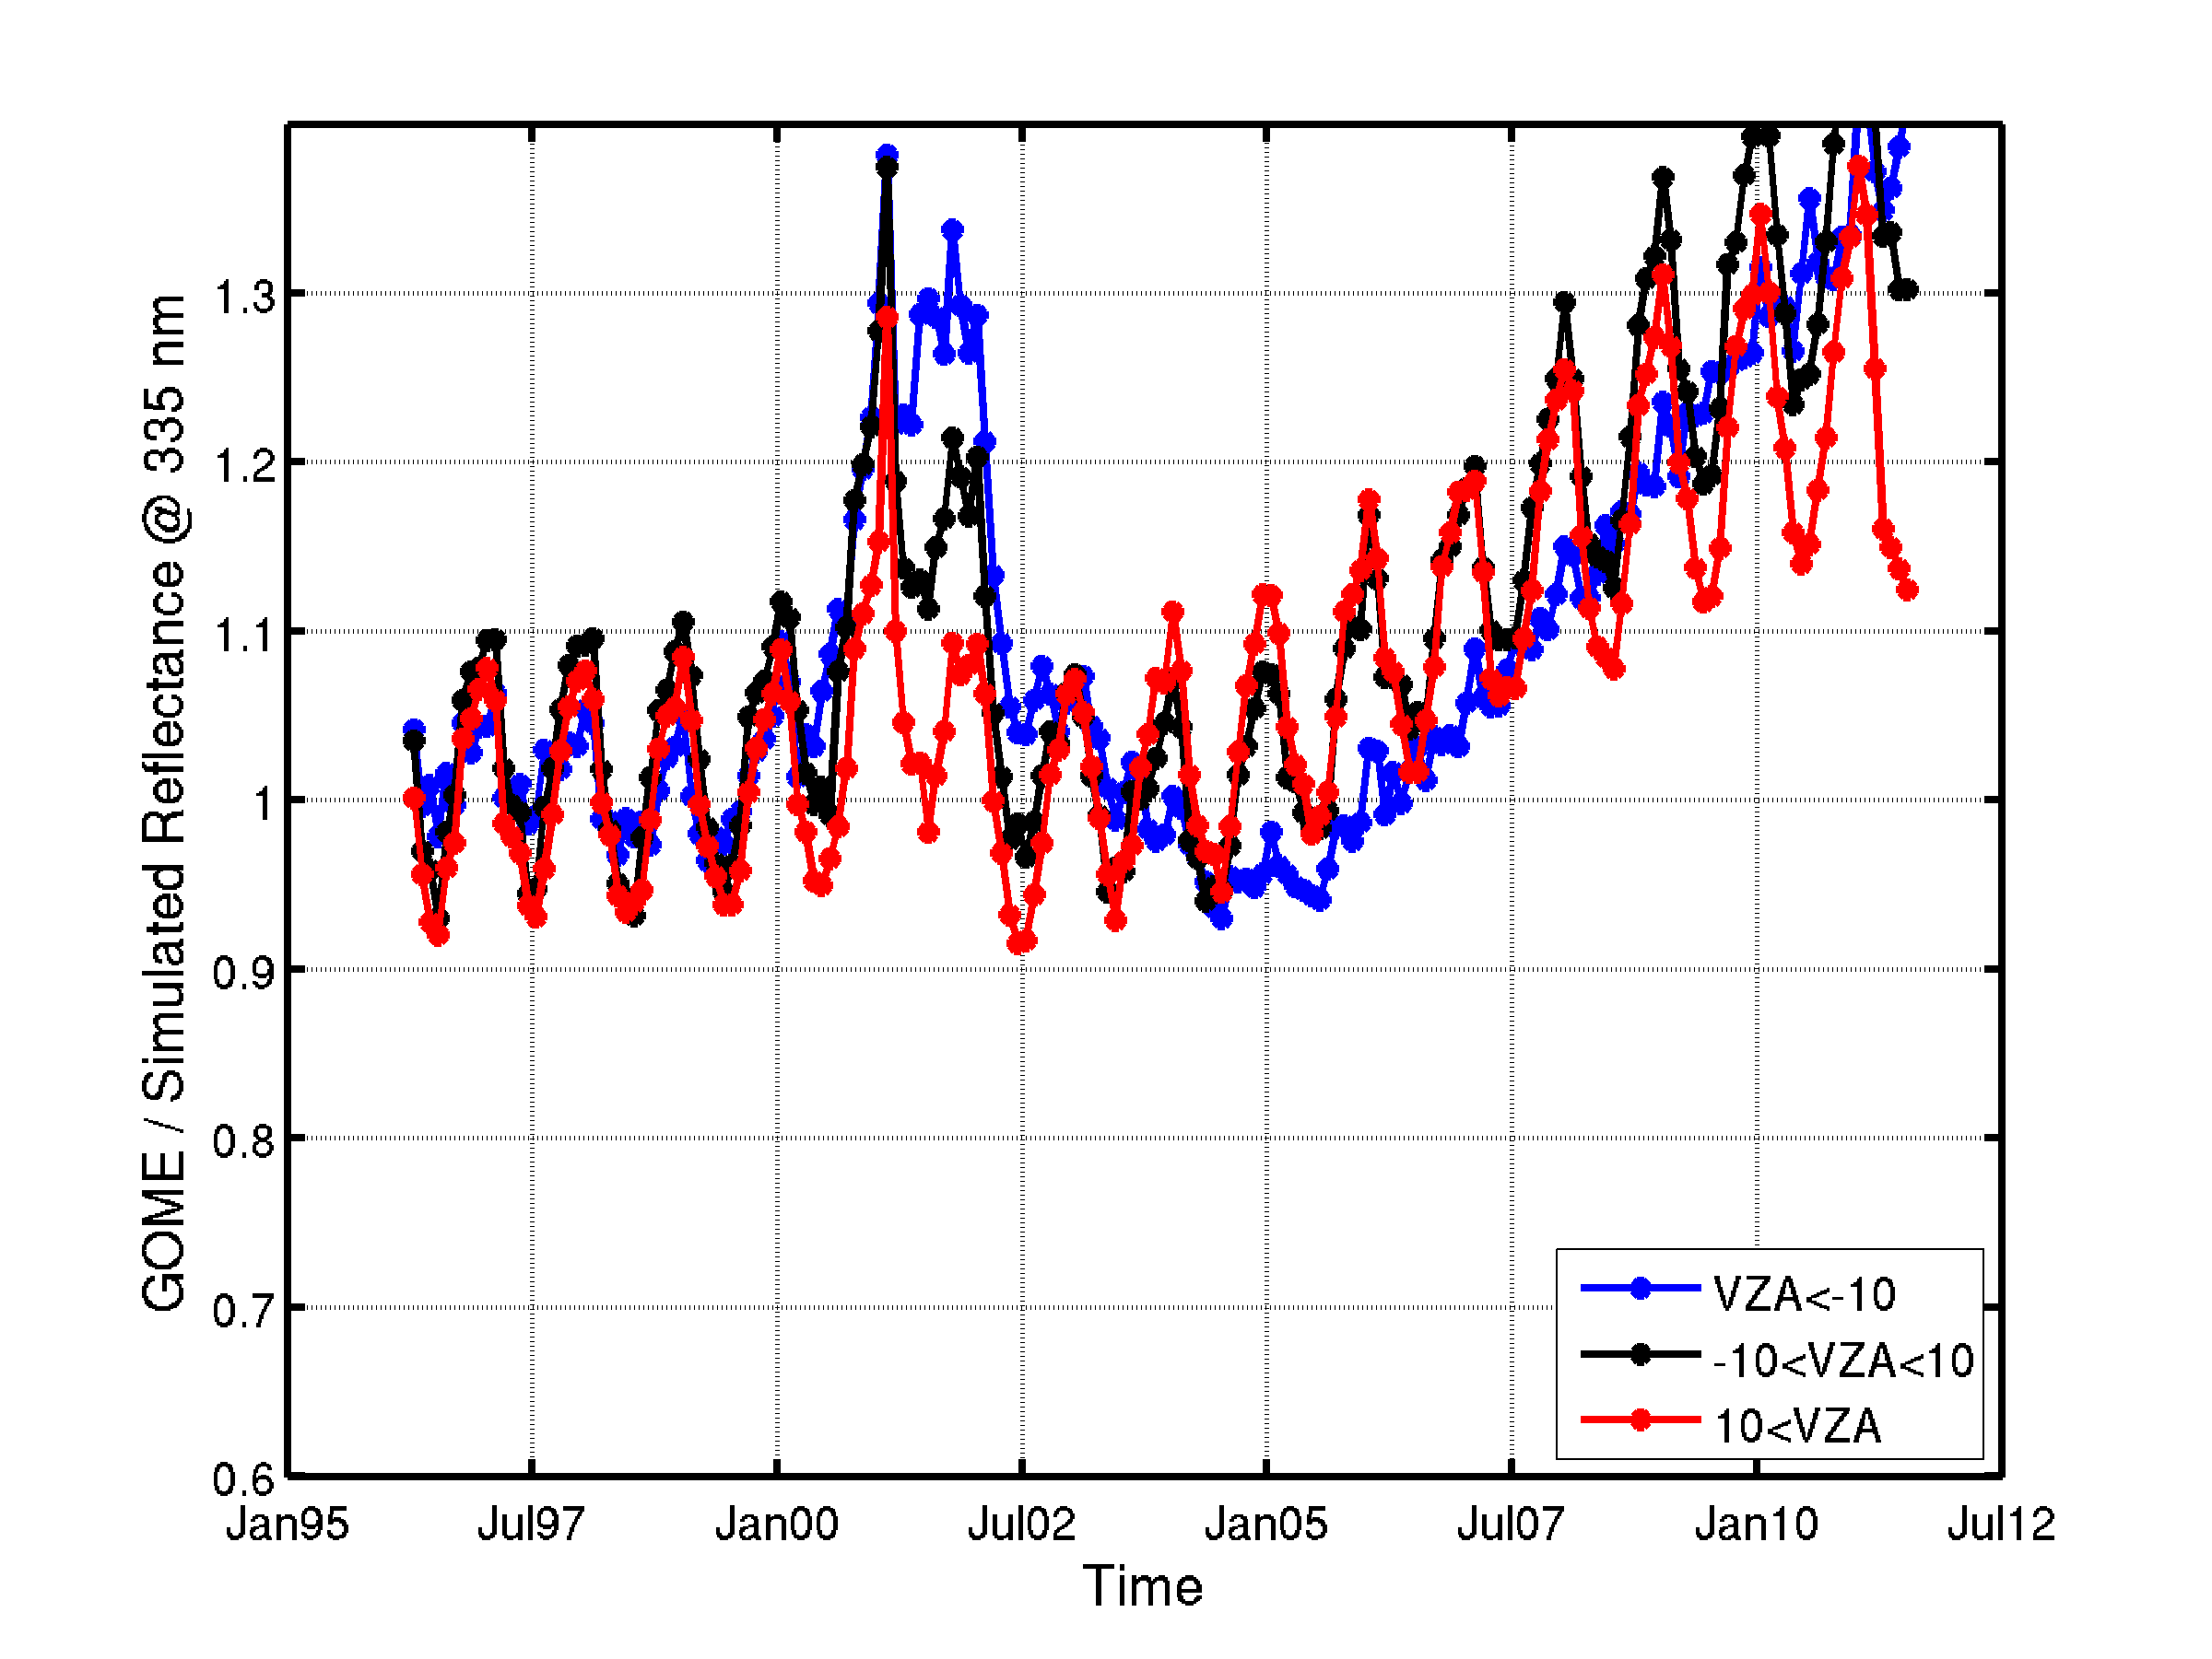
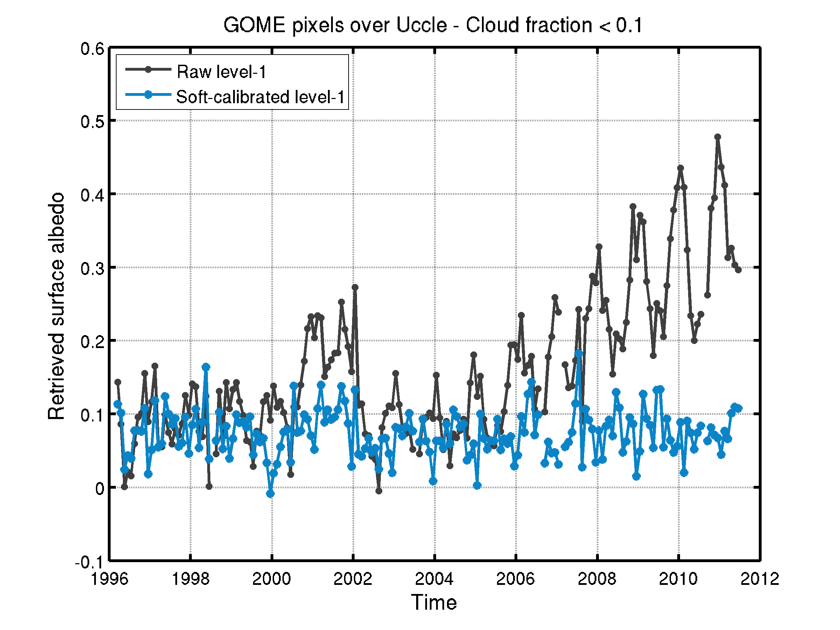
Soft-calibration of level-1
reflectances
Impact of GOME degradation on retrieved albedo
Impact on
Retrieved albedo (clear sky)
GOME degradation

Slide 12
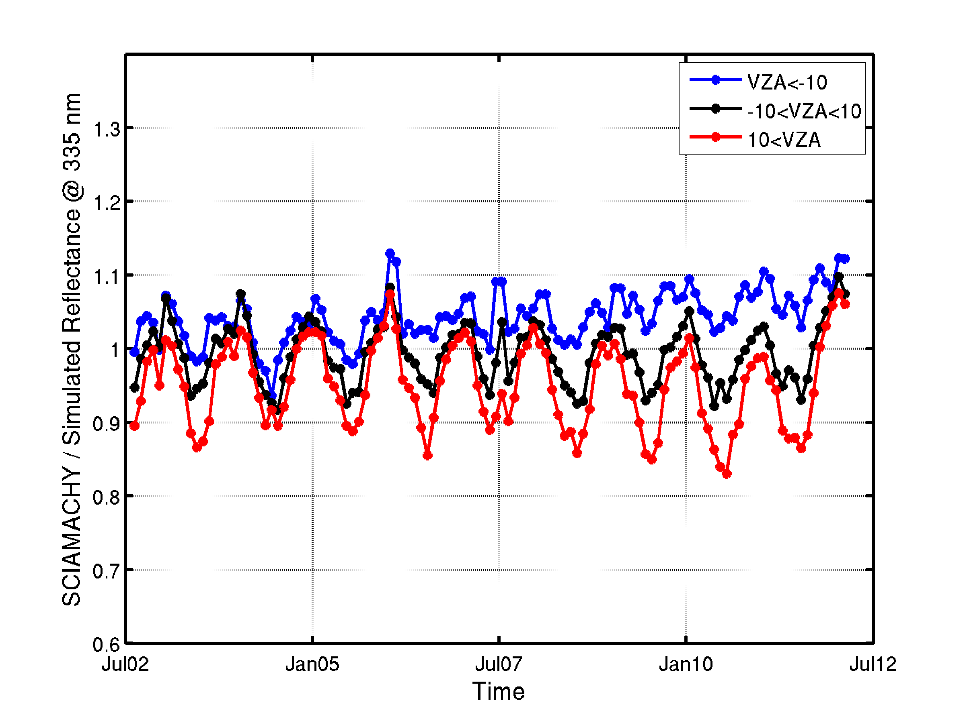
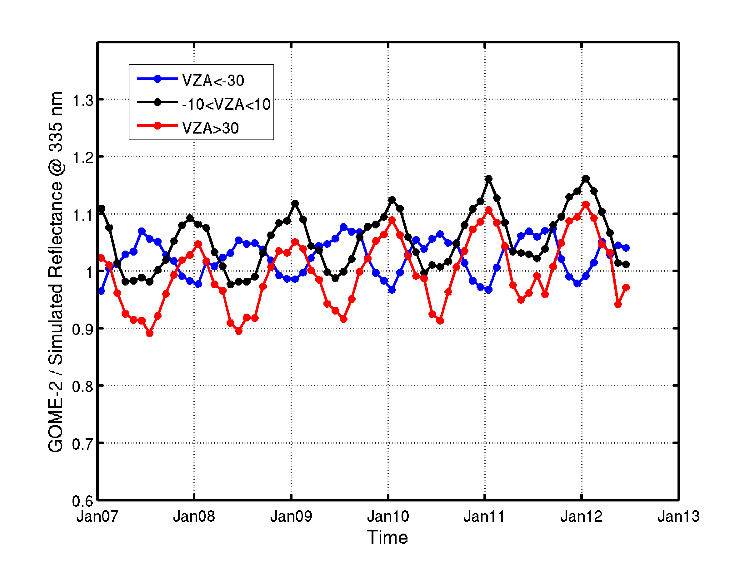
Soft-calibration of level-1
reflectances
Comparison of instrumental degradation
Ratio of measured to simulated reflectances
GOME
SCIAMACHY
GOME-2

Slide 13
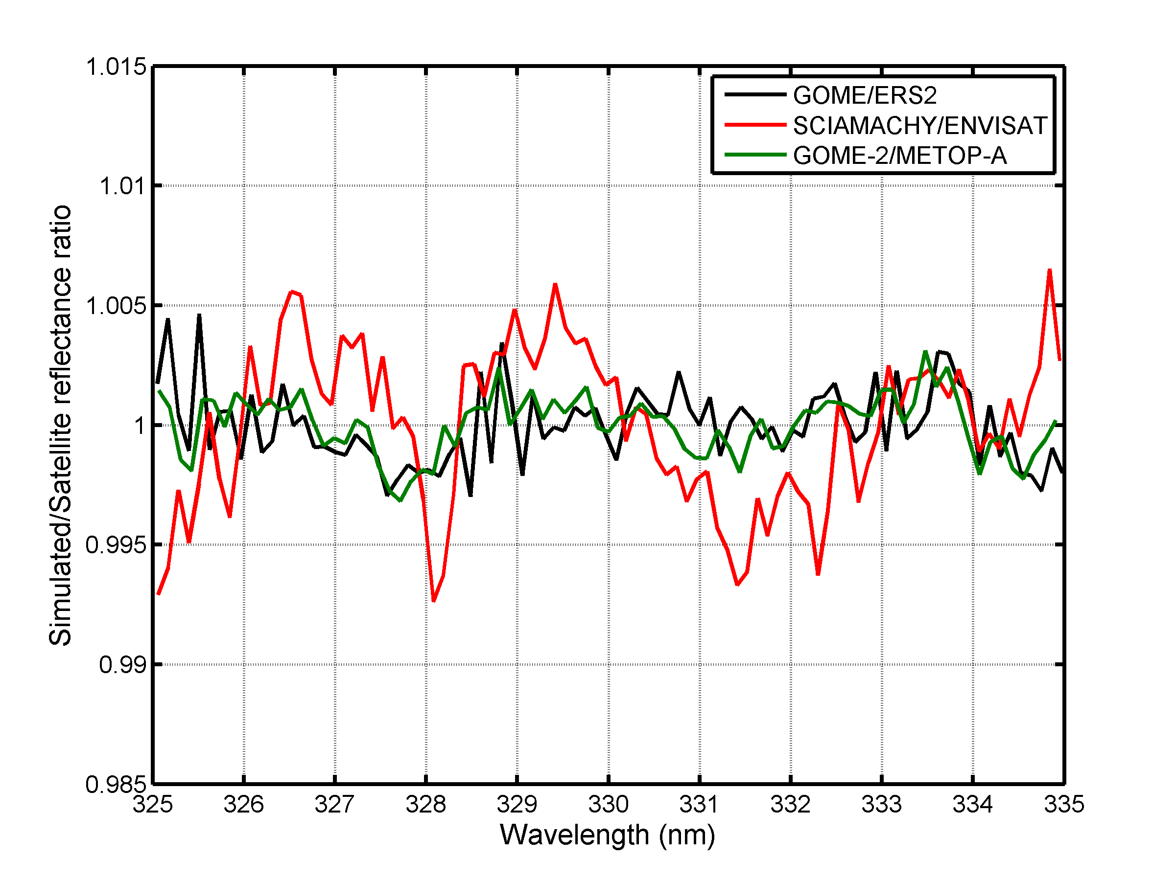
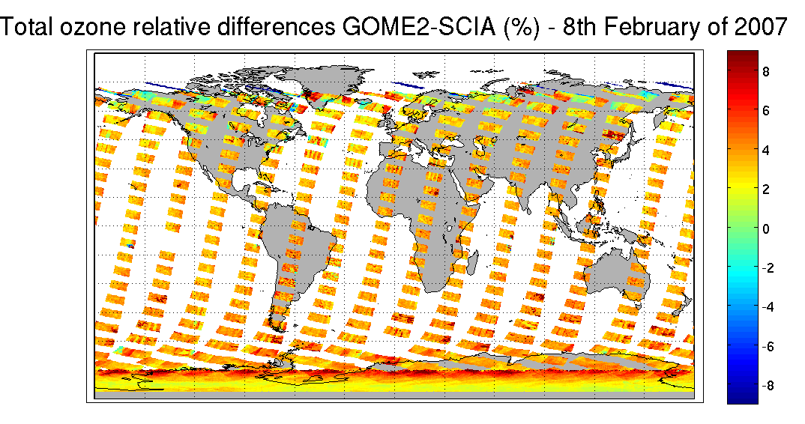
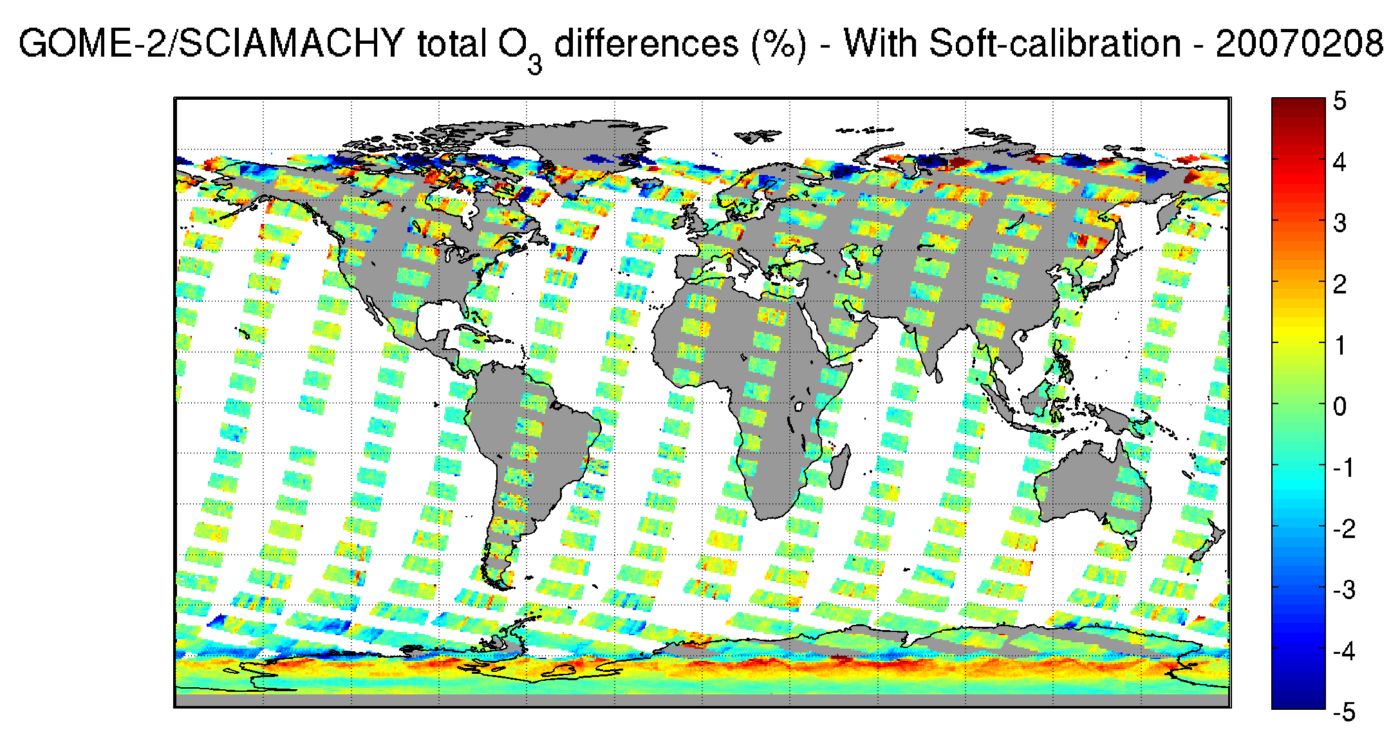
Soft-calibration of level-1
reflectances
Characterization of spectral features in reflectances
GOME2 vs SCIAMACHY (raw L1)
Simulated/Level-1 reflectance
GOME2 vs SCIAMACHY (Soft-calibrated l1)

Slide 14
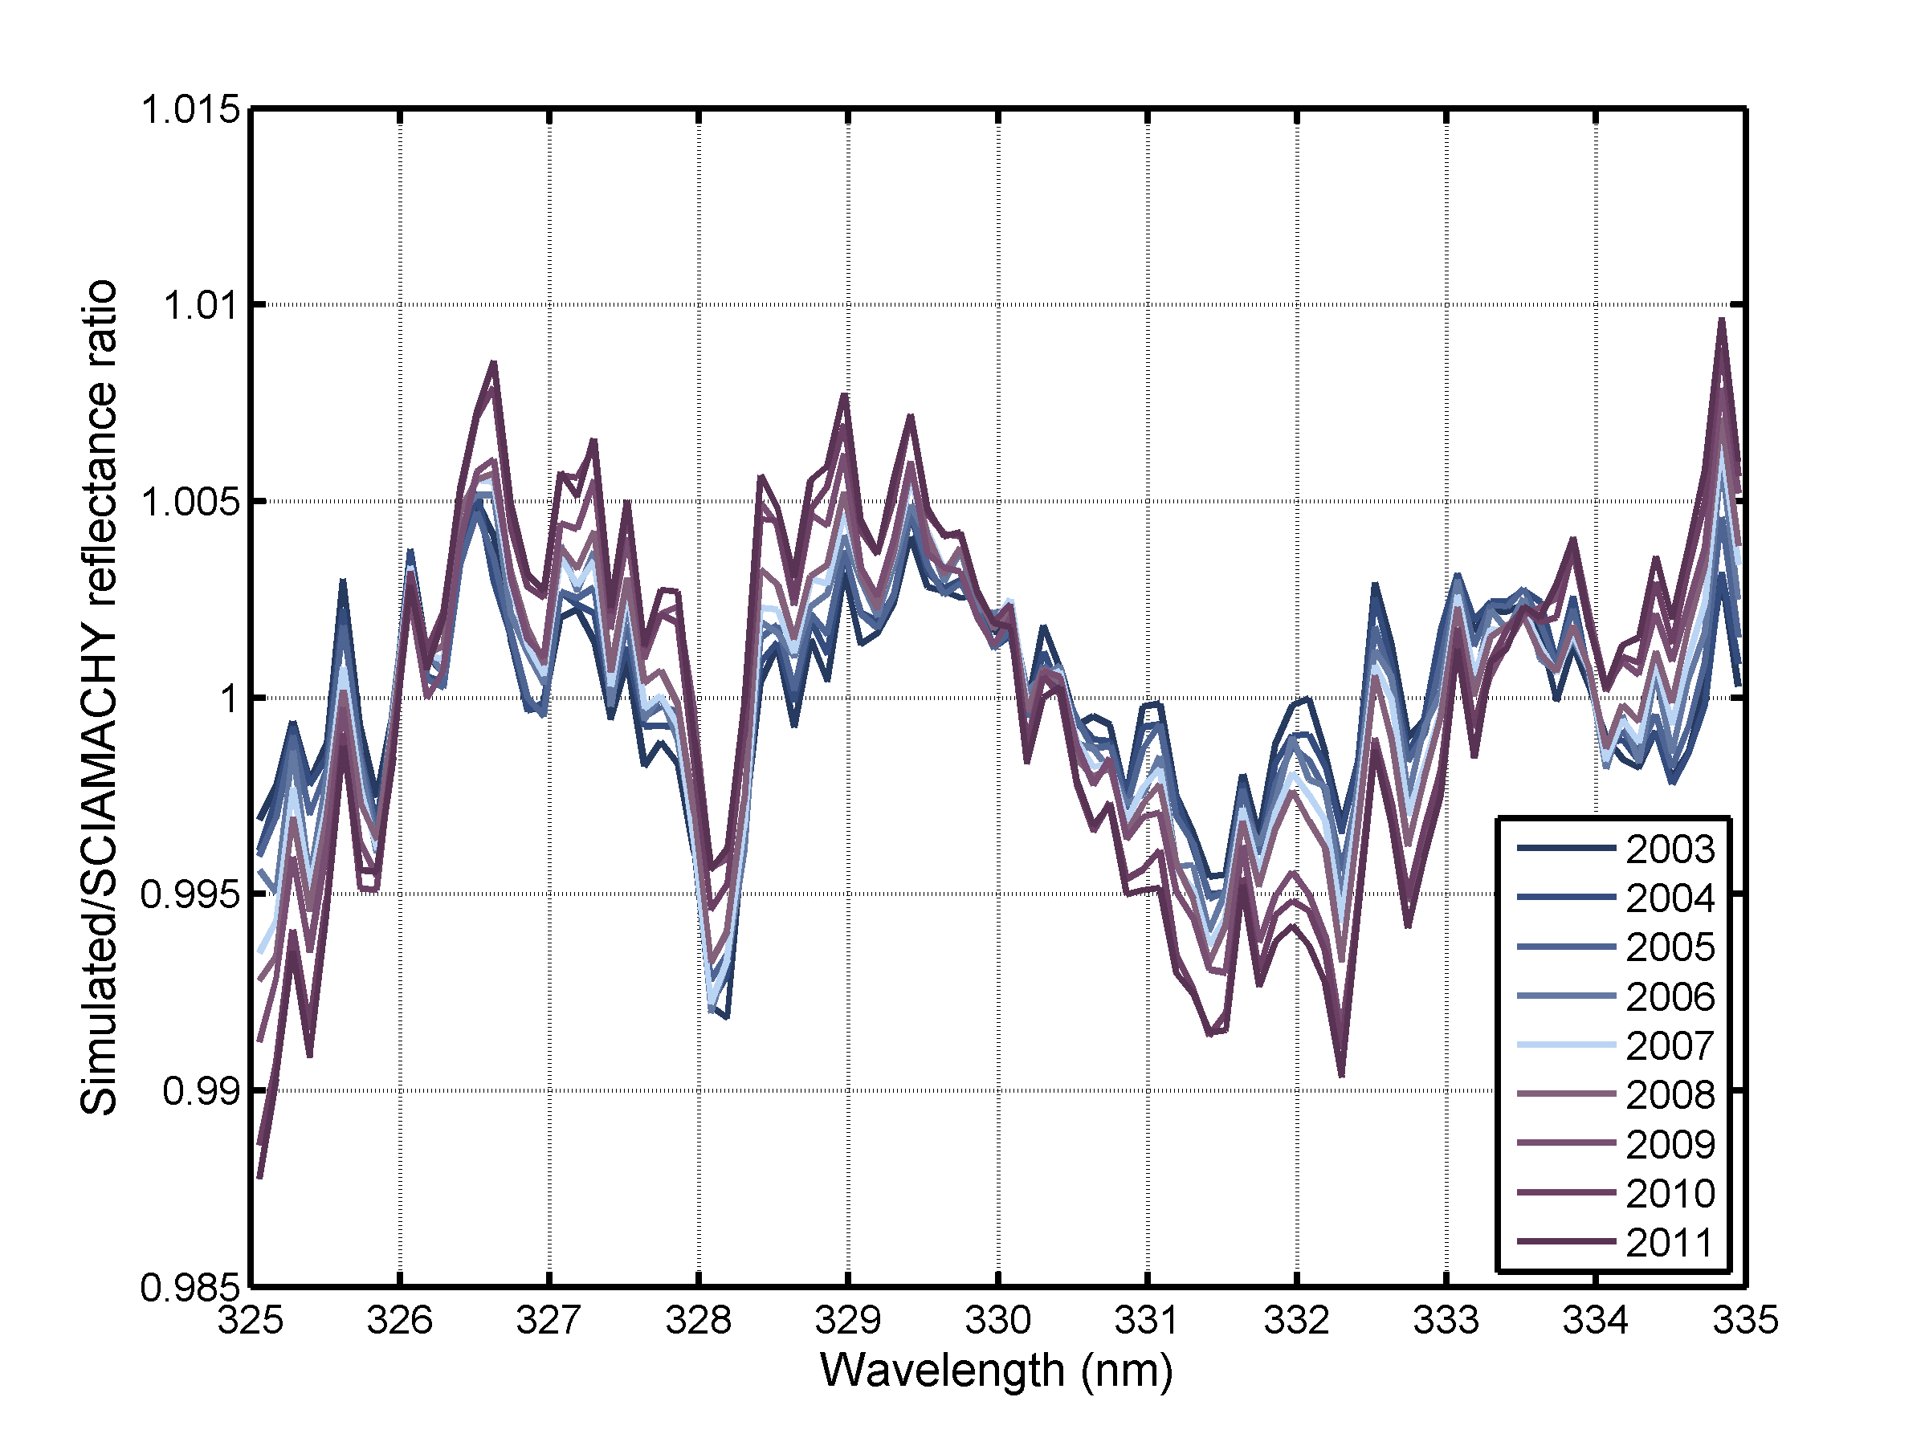
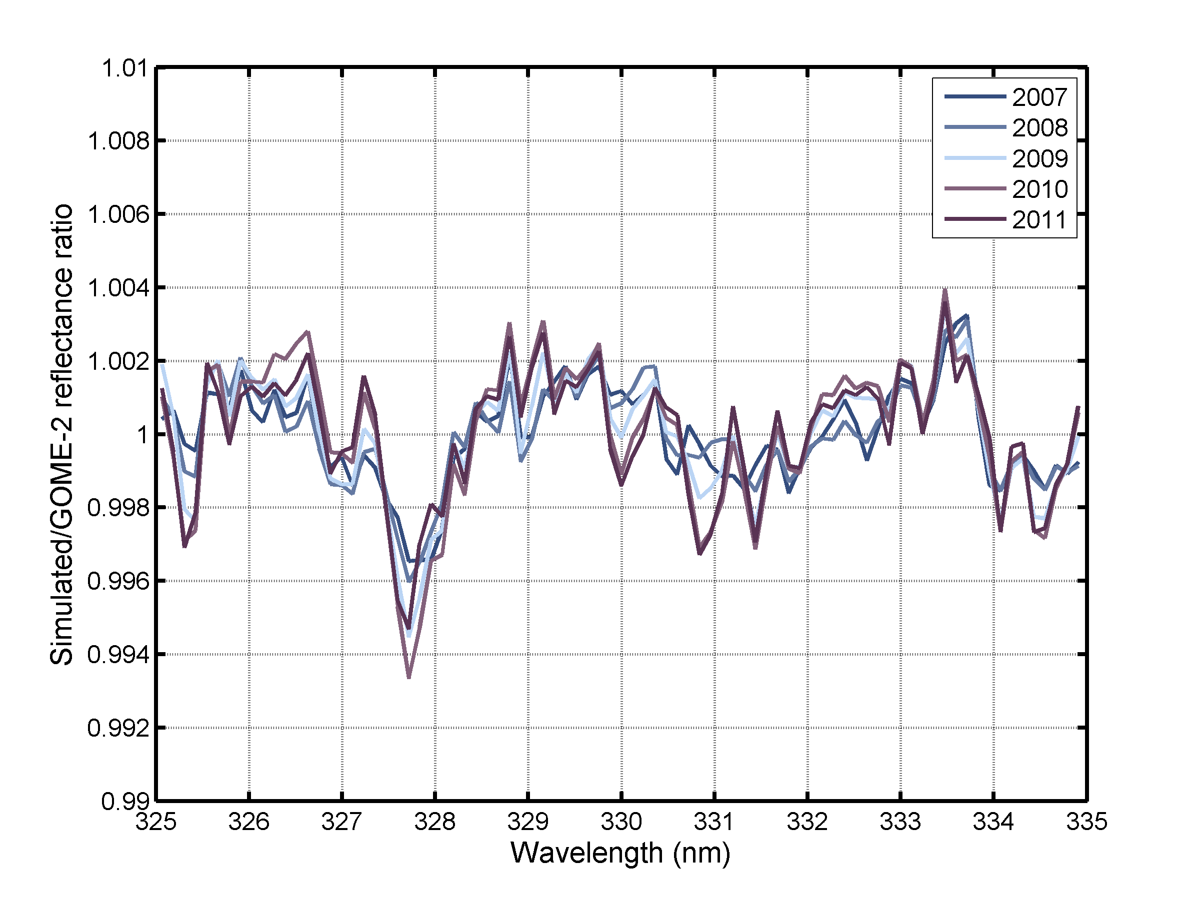
Soft-calibration of level-1
reflectances
Time dependence of spectral features
in SCIAMACHY and GOME-2 spectra
SCIAMACHY
GOME-2

Slide 15
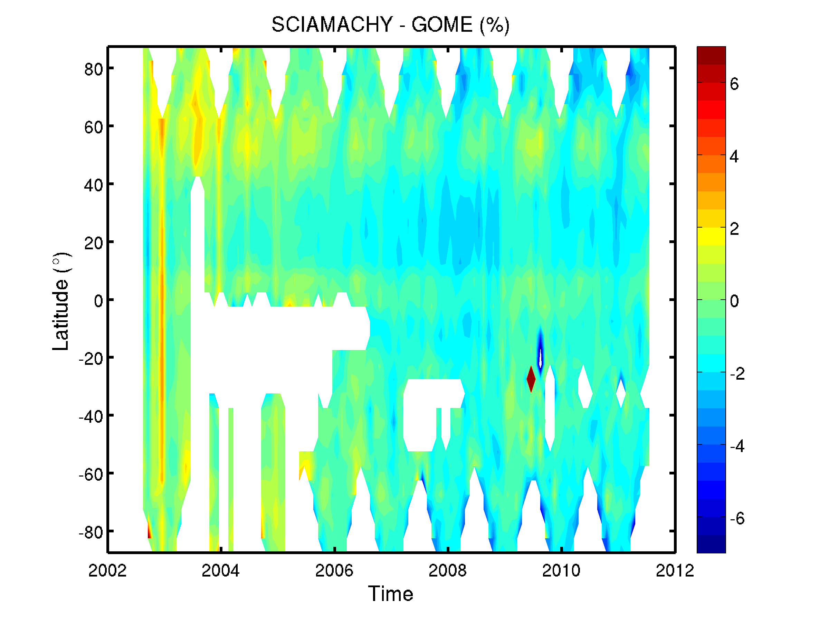
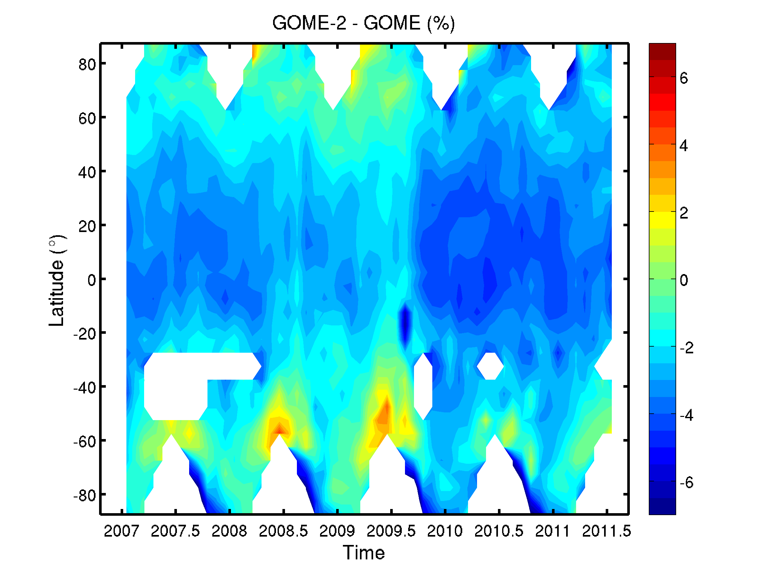
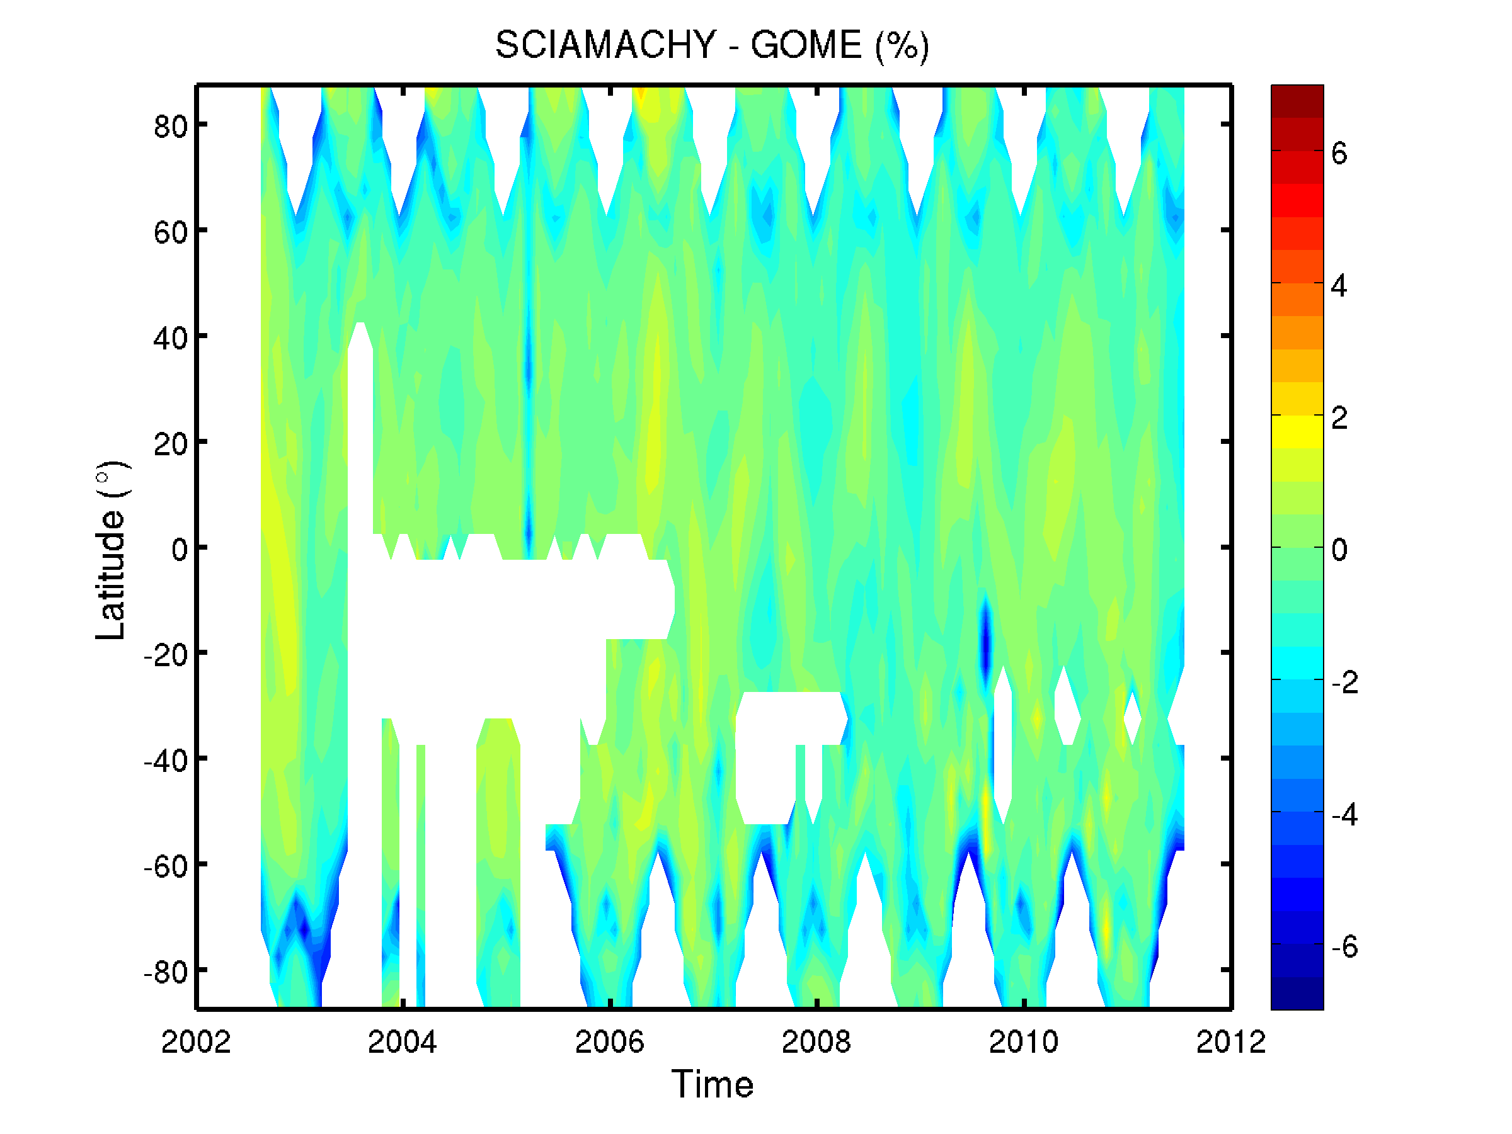
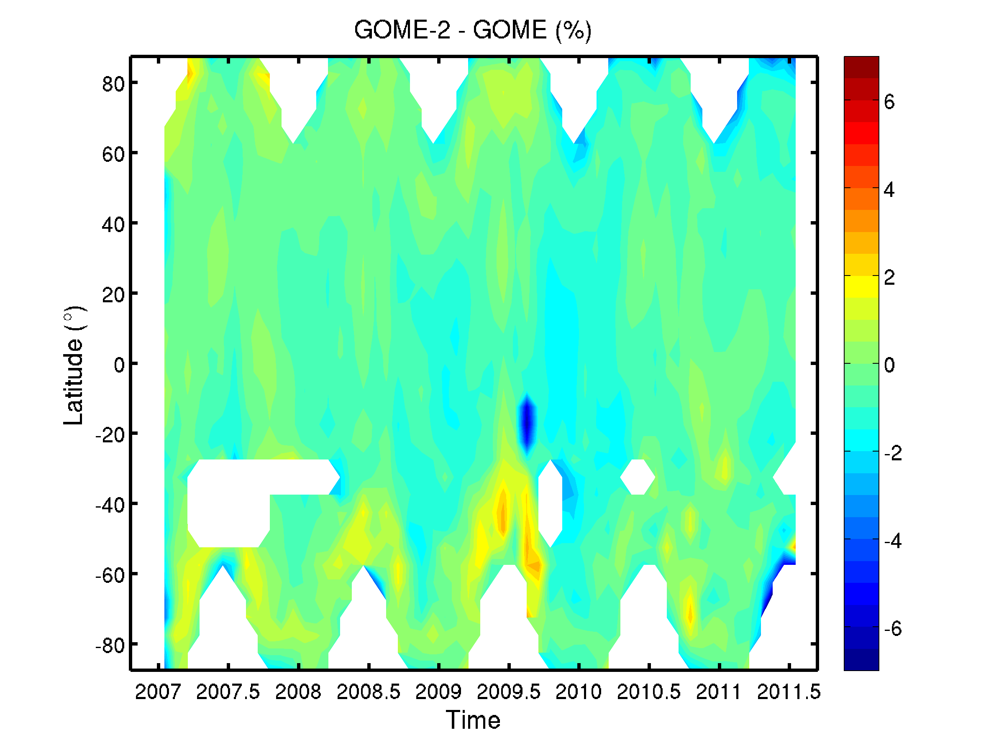
Improvement of inter-sensor consistency (1)
Current level-2 operational products
SCIAMACHY – GOME (%)
GOME-2A – GOME (%)
O₃-CCI level-2 products

Slide 16
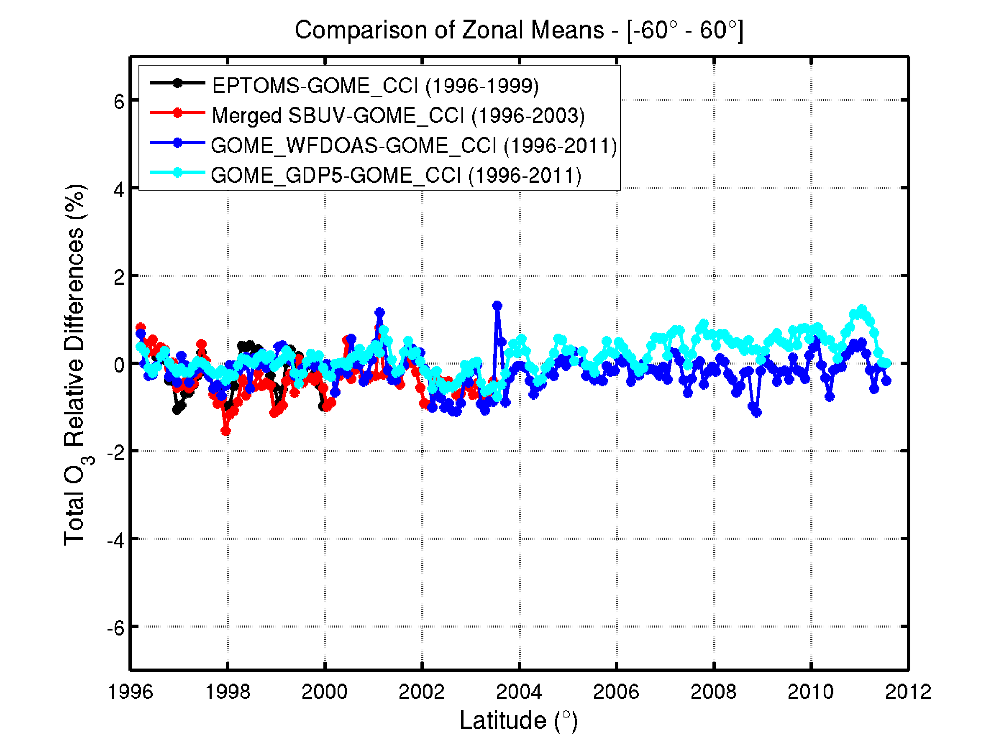
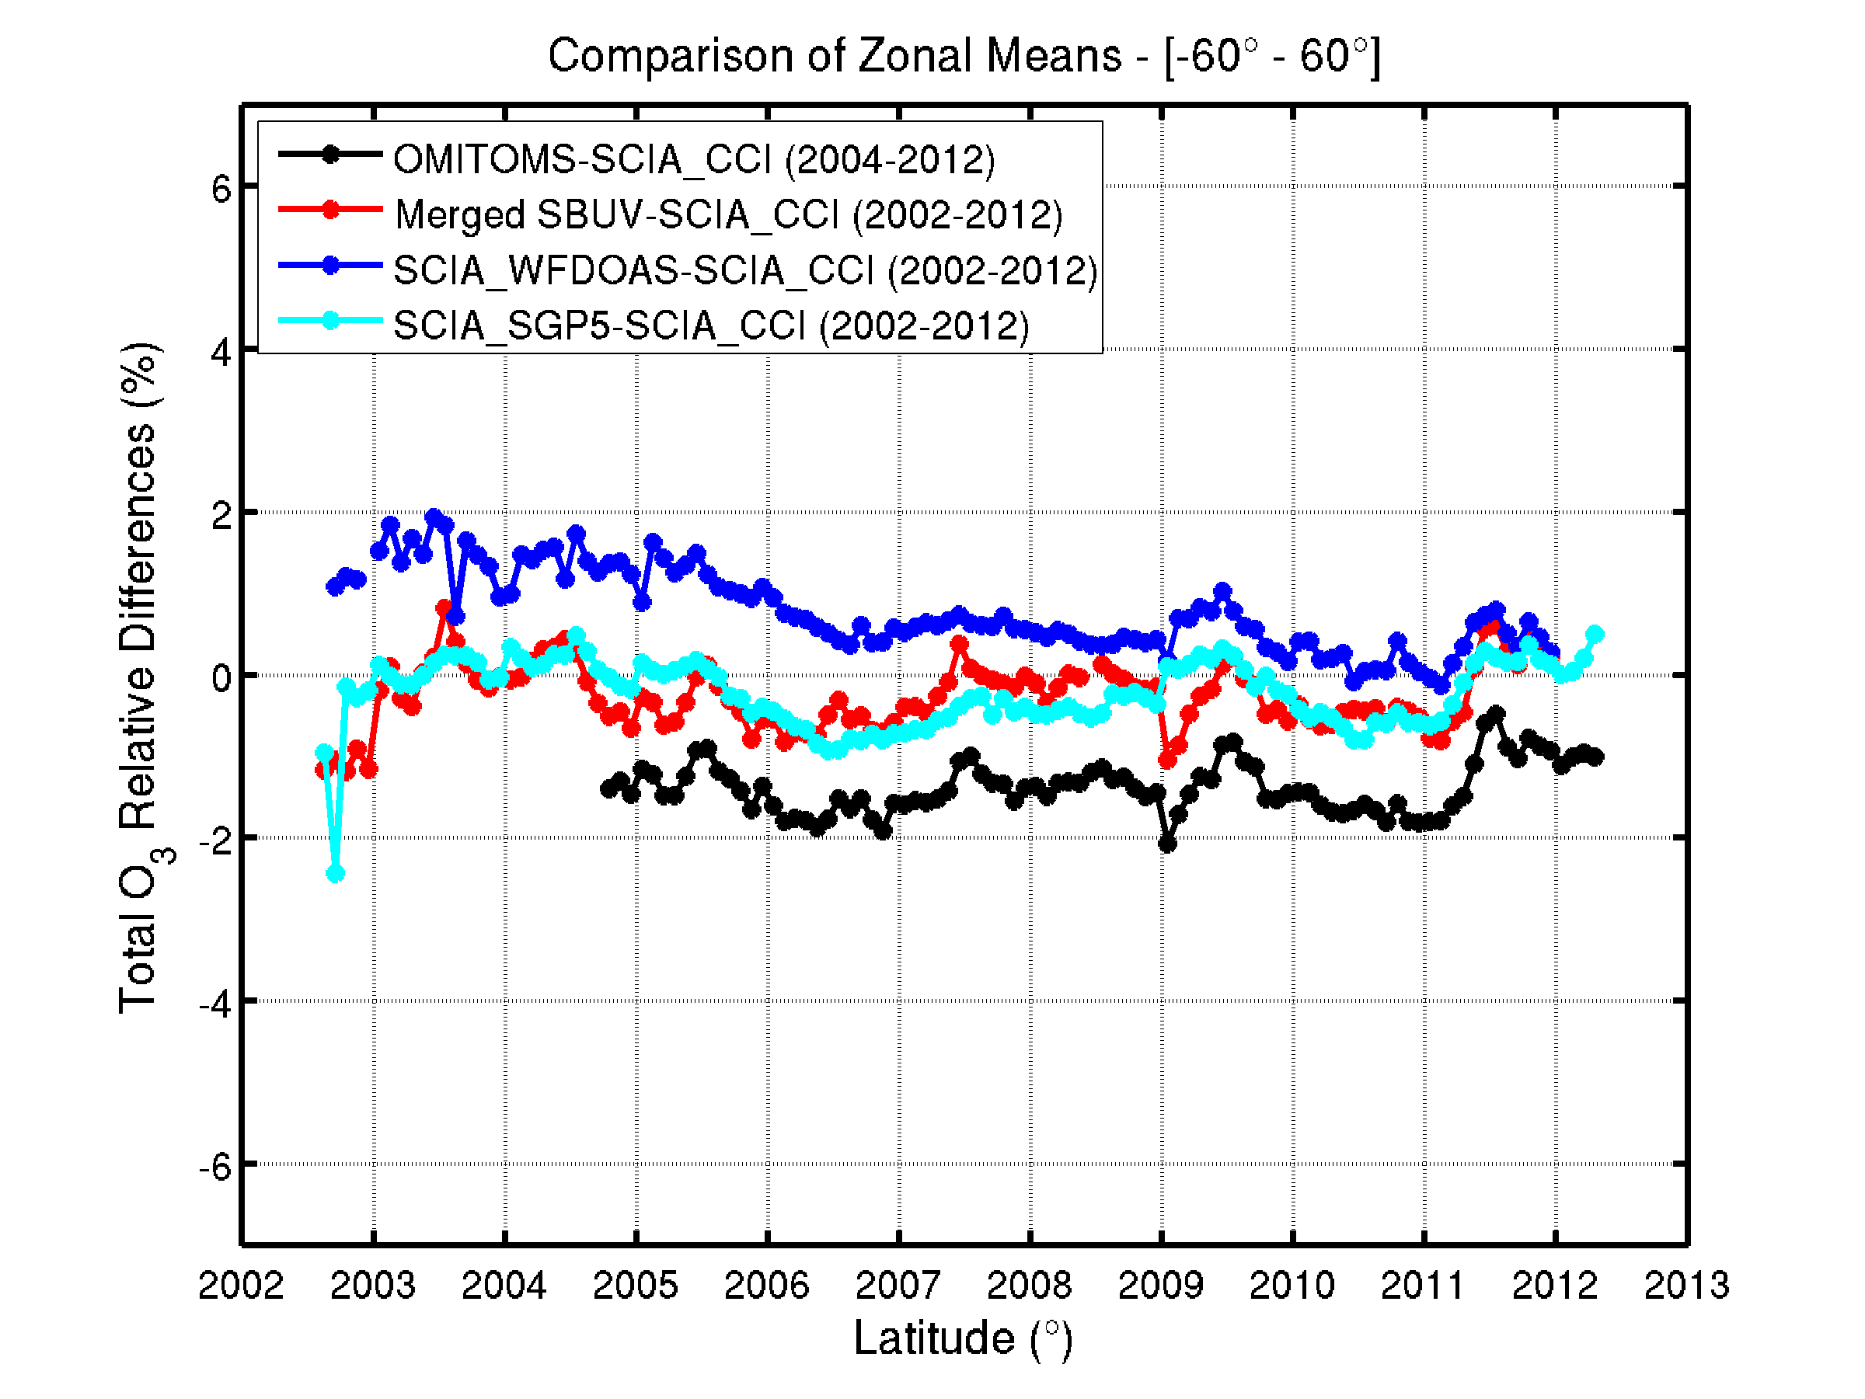
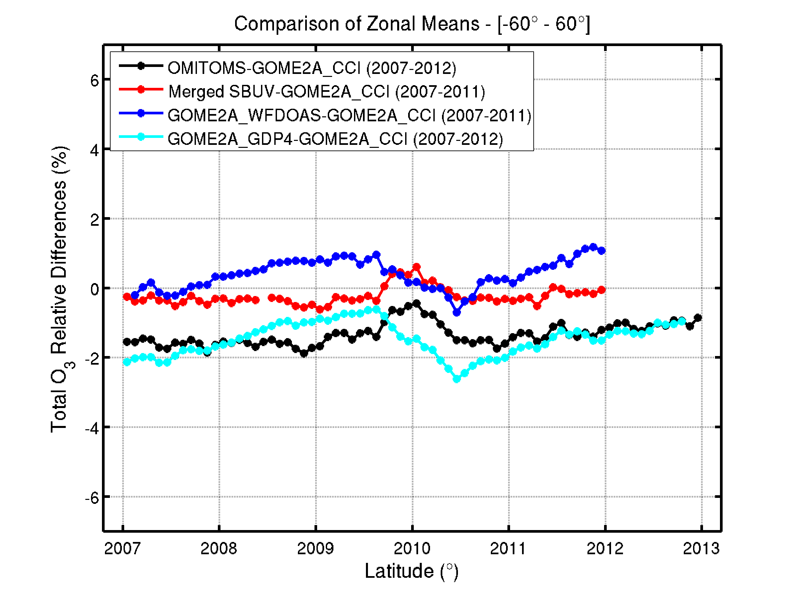
Improvement of inter-sensor consistency (2)
GOME/ERS-2
SCIAMACHY/ENVISAT
GOME-2/METOP-A
Time
Time
Time
Best overall consistency obtained with merged SBUV data set

Slide 17
Conclusion and outlook
CCI total ozone reprocessing → GOME, SCIAMACHY and GOME-2(A) instruments processed using common state-of-the-art direct-fitting (scientific) algorithm
New soft-calibrations scheme
Improved inter-sensor consistency in comparison to current level-2 data sets
Outlook
  Algorithm transfer to OMI is ongoing
  Plans for CCI Phase-2 → improvement of cloud correction, improvement of soft calibration, OMI addition, data base update (e.g. TOMS v9), work on combined column/profile algorithm

