Slide 1
SATELLITES SAOZ TOTAL OZONE COMPARISONS
J.-P. Pommereau and F. Goutail
LATMOS, CNRS and University of Versailles Saint Quentin, Guyancourt, France

Slide 2
OZONE MEASUREMENTS
SATELLITES overpasses above SAOZ stations
TOMS V8 (1995-2005), SBUV (1995-2012), GOME (1995-2003 Europe, 1995-2003 all), GOME2 (2007-2012), SCIAMACHY (2002-2012), NPP (2012), OMI-TOMS (2005-2012), OMI-DOAS (2005-2012
SAOZ
Zenith sky at twilight 86-91° SZA, Visible Chappuis bands
Version 2 retrieval following NDACC working group recommendations (daily Air Mass Factors from TOMS V8 ozone profiles climatology)
After 1995 only because of perturbation by Pinatubo volcanic aerosols

Slide 3
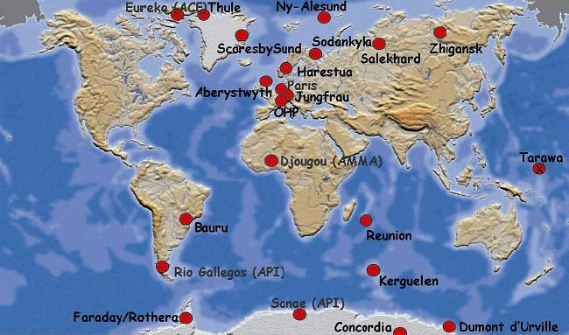
SAOZ network selected stations
Arctic
Antarctic
Mid-Lat
Tropics
Ozone CCI Darmstadt 15 April 2013

Slide 4
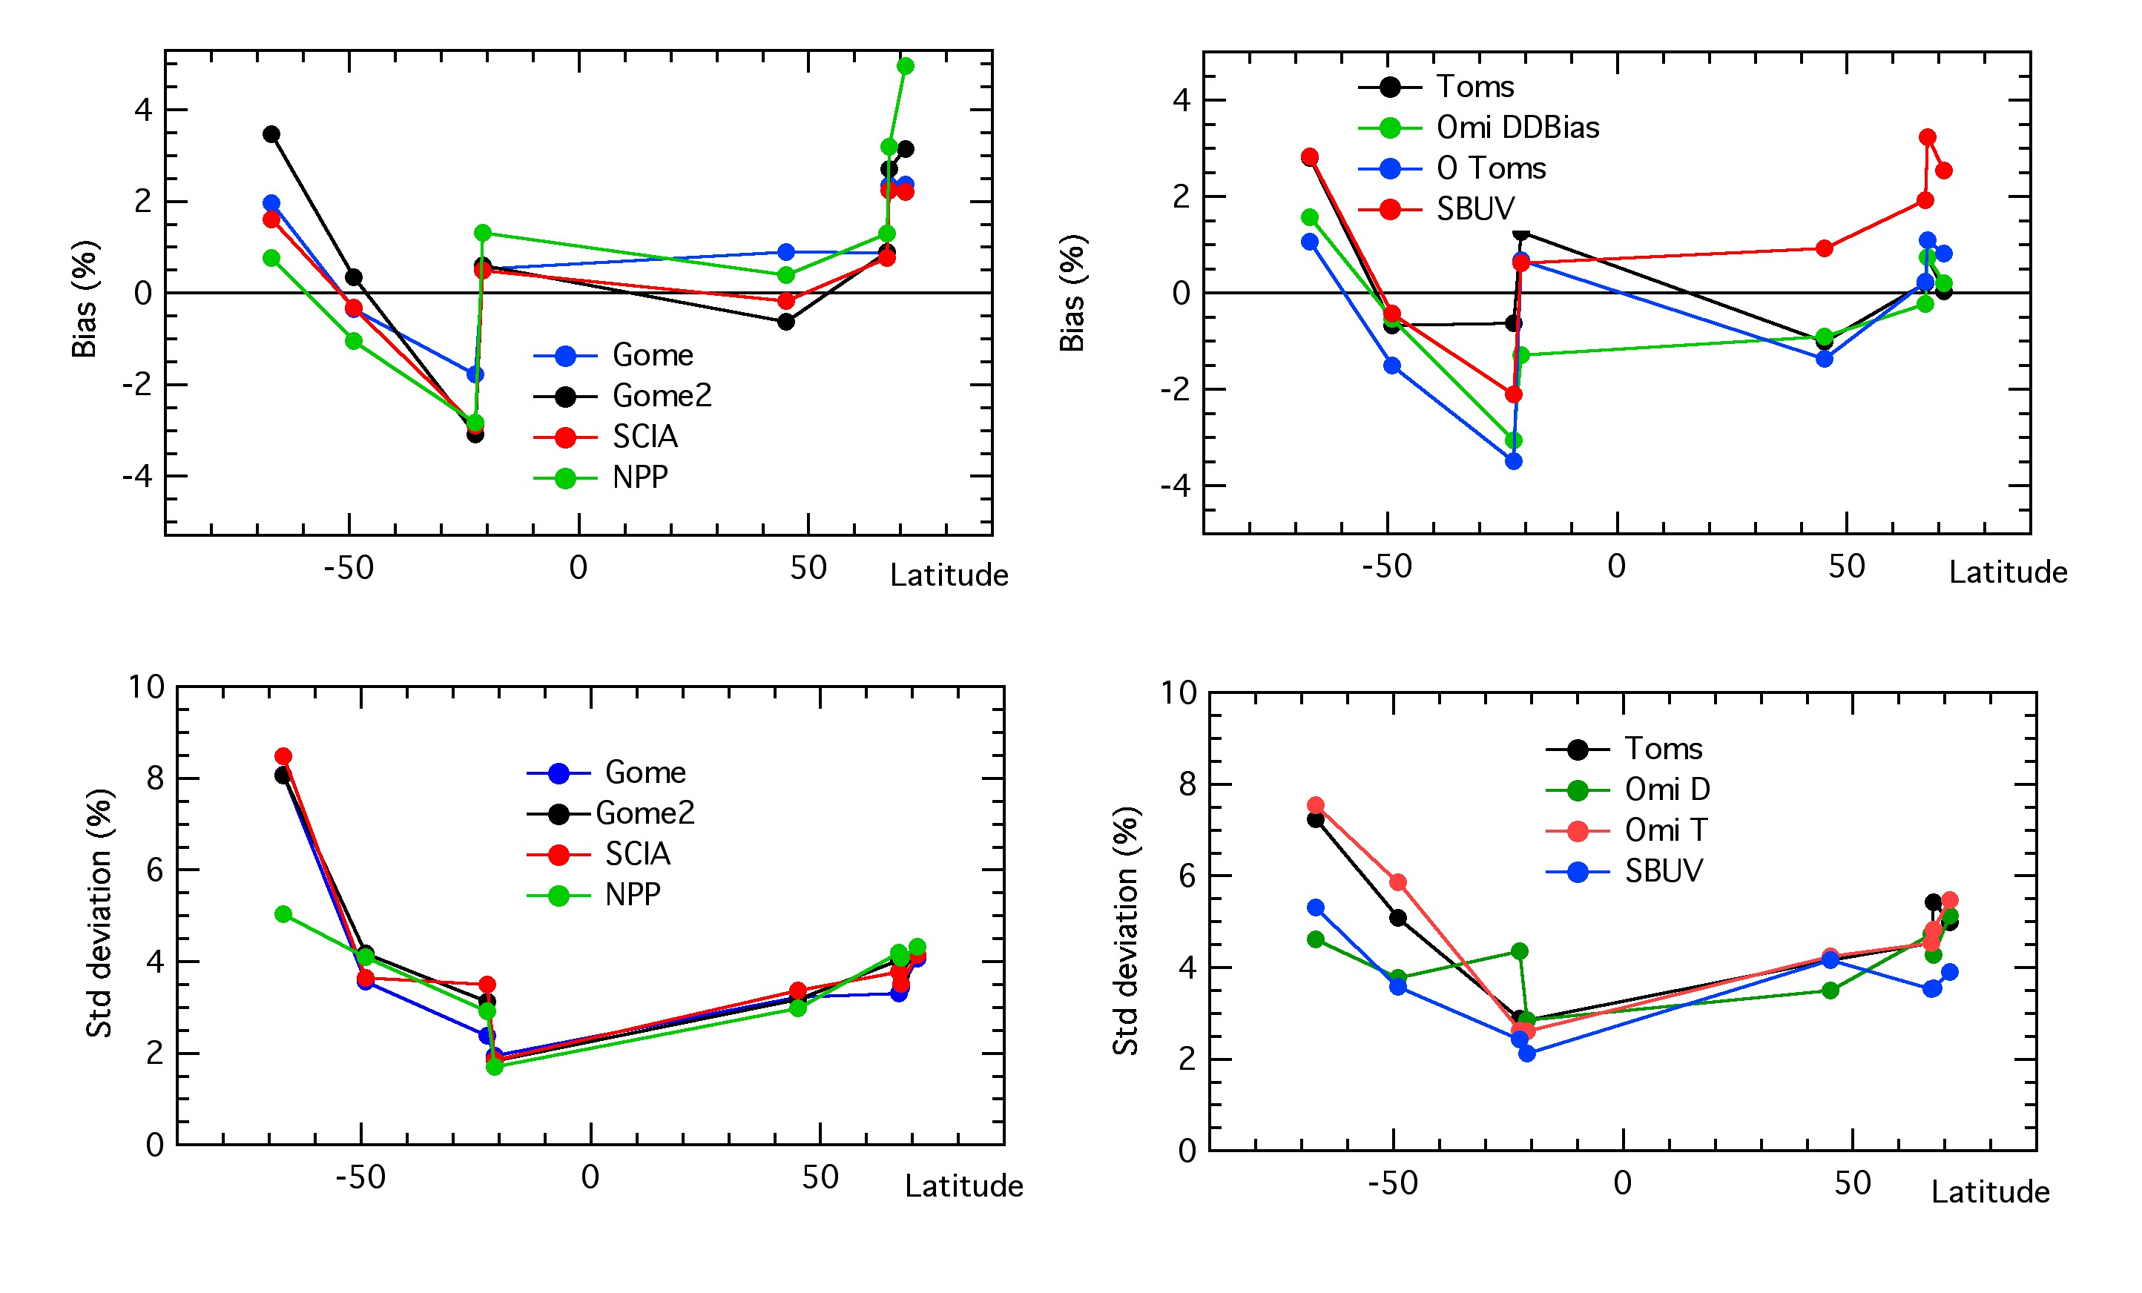
Difference Satellites-SAOZ and Standard deviations
 | SAT-SAOZ Bias | Standard deviation | Differences between satellites
TROPICS | +1%<X>-3% | ± 2% | ± 1%
MID-LAT | +1%<x>-1% | ± 3% | ± 1%
ARCTIC | 0%<X> + 4% | ± 4-5% | ± 2%
ANTARCTIC | + 1<X>4% | ± 8 % | ± 1.5%
Ozone CCI Darmstadt 15 April 2013

Slide 5
Selected SAOZ Tropical stations
Bauru
Reunion Island
Ozone CCI Darmstadt 15 April 2013

Slide 6
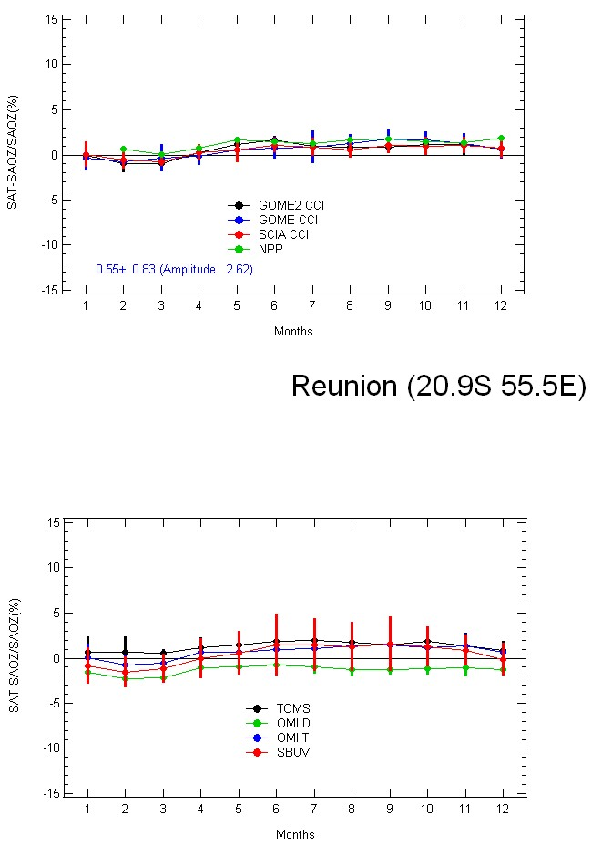
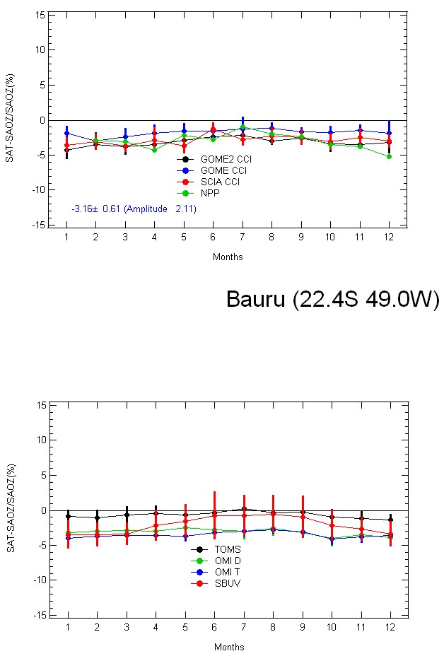
TROPICS
Summer minimum
Summer minimum
SAT-SAOZ (%)
Summer minimum
Small seasonality, except SBUV
Low bias on all satellites in Bauru compared to Reunion Island
Ozone CCI Darmstadt 15 April 2013

Slide 7
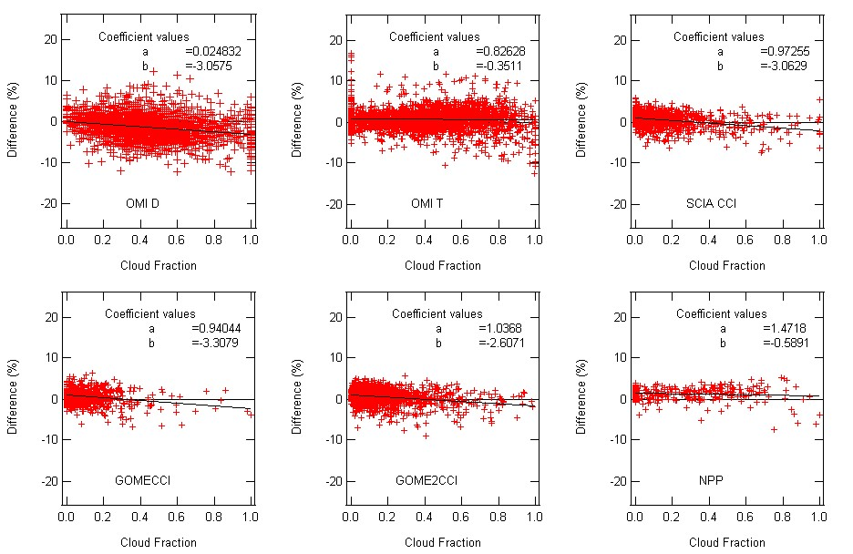
REUNION
More frequent clouds in summer Jan-Apr (ITCZ)
Clear sky in winter (trade winds)
Most influent parameter on seasonality: Cloud Fraction
3% between clear sky and overcast on OMI-D, OMI-D, SCIA, GOME and GOME 2
Ozone CCI Darmstadt 15 April 2013

Slide 8
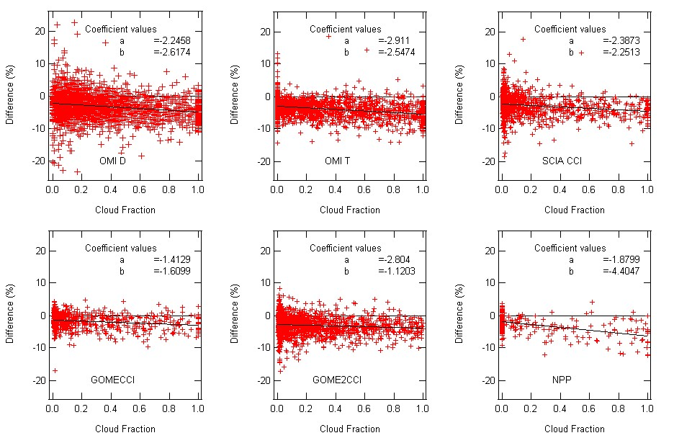
BAURU
Frequent thunderstorms in the summer (Nov-Apr), South Atlantic Convergence Zone (SACZ)
Most influent parameter on seasonality: Cloud Fraction
4% between clear sky and overcast on NPP, 2.5% on OMI-T, SCIA, OMI-D, 1.5% on GOME and GOME 2
Ozone CCI Darmstadt 15 April 2013

Slide 9
Difference between Reunion and Bauru
Larger mid-tropospheric ozone over Bauru than Reunion
O3 production by Lightning NOx in the summer
Wave # 1 zonal tropospheric ozone distribution due to biomass burning in Africa in the winter
Difference of tropospheric ozone under-estimated by satellites
Not represented by zonal mean profile
Ozone CCI Darmstadt 15 April 2013

Slide 10
SUMMARY TROPICS
Small amplitude of temperature and SZA seasonality
Most influent parameters: Tropospheric Ozone
GHOST correction at high cloud fraction
Profile longitudinal variation (impact on SAOZ AMF)
Ozone CCI Darmstadt 15 April 2013

Slide 11
SAOZ Mid-latitude selected stations
Observatoire de Haute Provence
Kerguelen Island

Slide 12
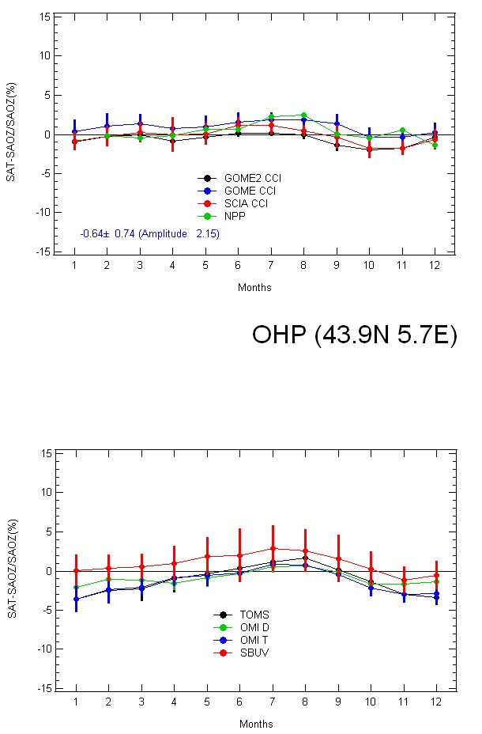
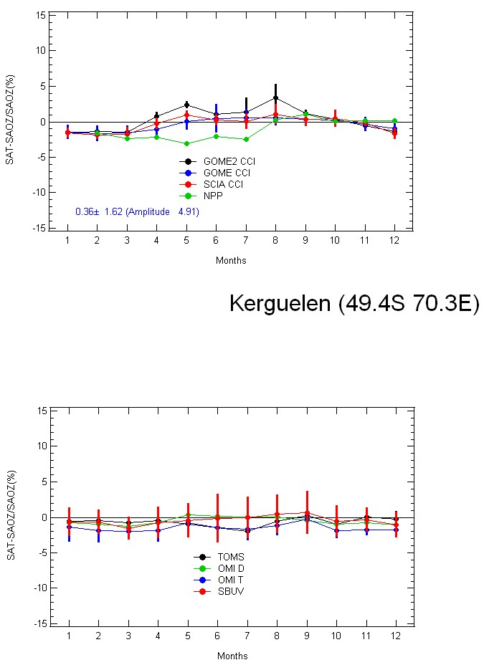
MID-LATITUDES
SAT-SAOZ (%)
Little clouds in all seasons
Max tropospheric ozone in the summer
Very high cloud fraction,
maximum in May and August
Ozone CCI Darmstadt 15 April

Slide 13
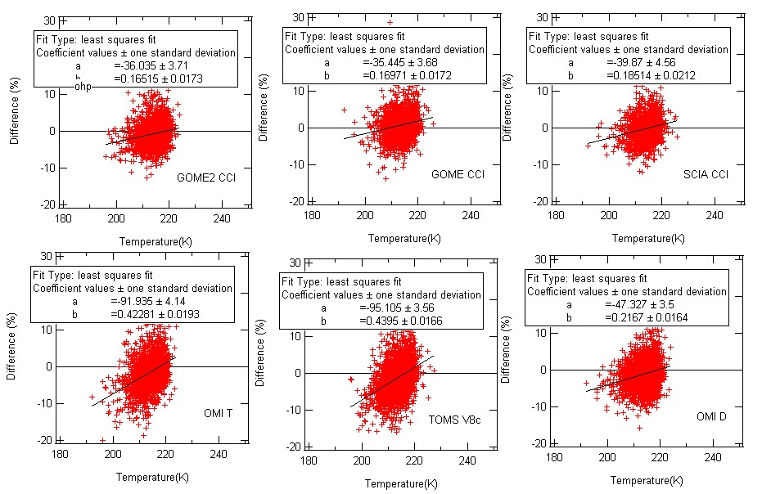
OHP. Temp dependence TOMS and OMI-T : 0.4 %/°C Others <0. 2%/°C
SAOZ not sensitive to temperature (Visible Chappuis bands)
Ozone CCI Darmstadt 15 April

Slide 14
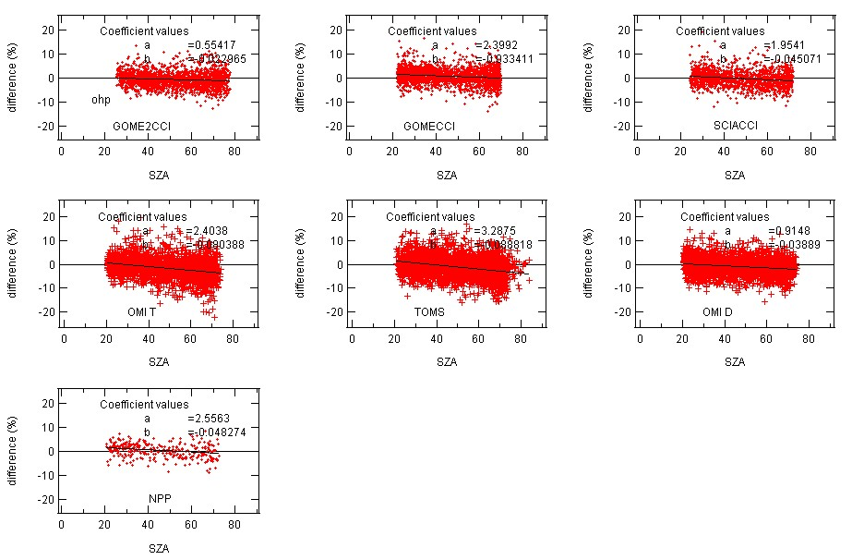
SZA dependence OHP
OMI T and TOMS:0.08%/°SZA
Others: < 0.4%/°SZA
SAOZ not sensitve (always same SZA)
Ozone CCI Darmstadt 15 April

Slide 15
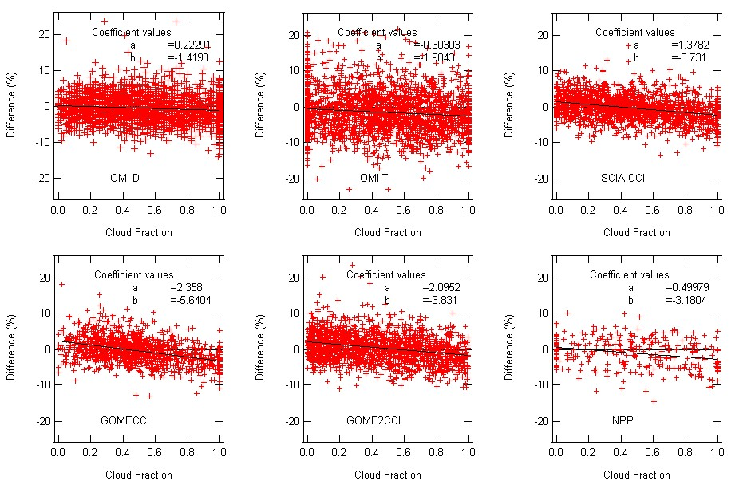
CLOUD FRACTION KERGUELEN
Cloud fraction dependence: GOME2 largest :5.6%,
GOME2, SCIA and NPP: 3-3.5%
OMI-T, OMI-D: 1.5%
Ozone CCI Darmstadt 15 April

Slide 16
SUMMARY MID-LATITUDE
MOST INLUENT PARAMETERS
Temperature and SZA dependence
TOMS largest, OMI-TOMS half, others less
Troposheric ozone above polluted areas (OHP extreme case in summer)
Influence of Ghost correction of tropospheric ozone over cloudy areas (Kerguelen winter extreme case)
Ozone CCI Darmstadt 15 April

Slide 17
SAOZ selected polar stations
Scoresbysund
Zhigansk
Sodankyla
Dumont d’Urville
Ozone CCI Darmstadt 15 April

Slide 18
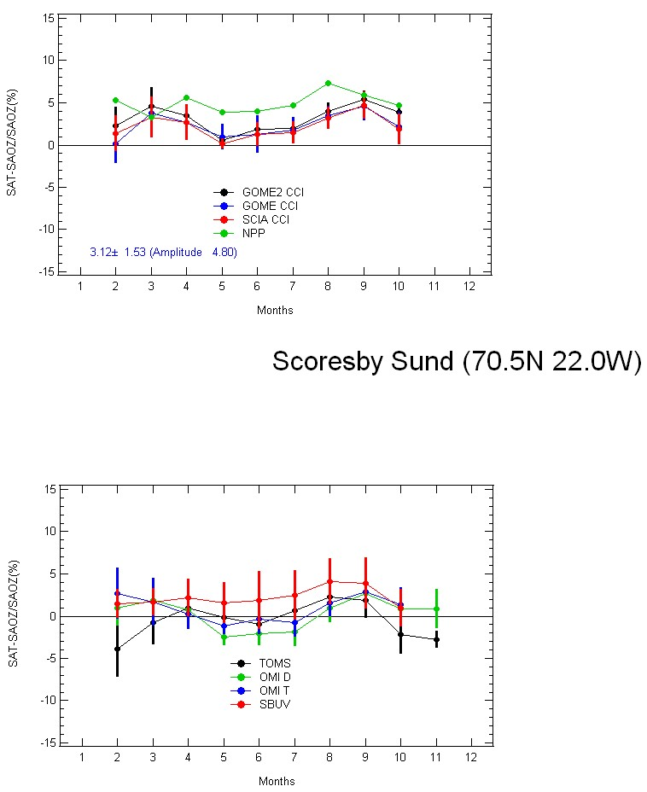
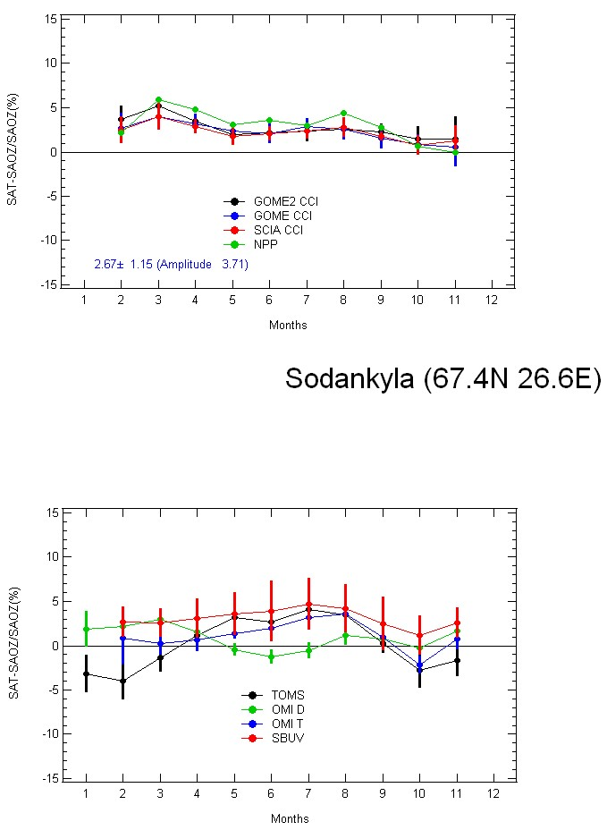
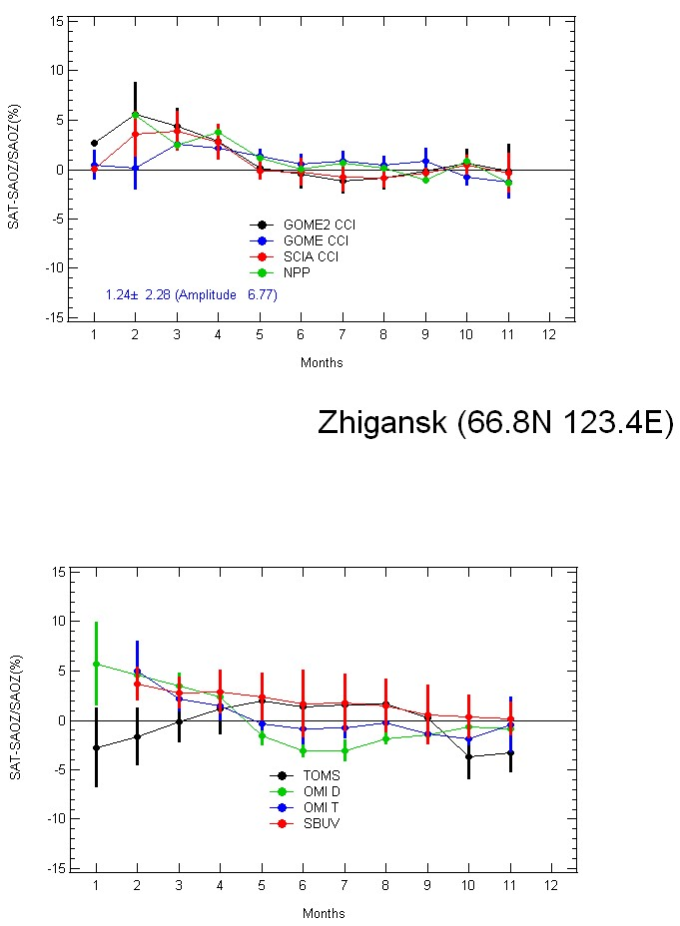
ARCTIC
SAT-SAOZ (%)
Summer maximum on some satellites (TOMS largest)
Ozone satellites larger than SAOZ in Spring over all stations,
As well as in autumn
(but in western hemisphere (not in East Siberia)
Ozone CCI Darmstadt 15 April

Slide 19
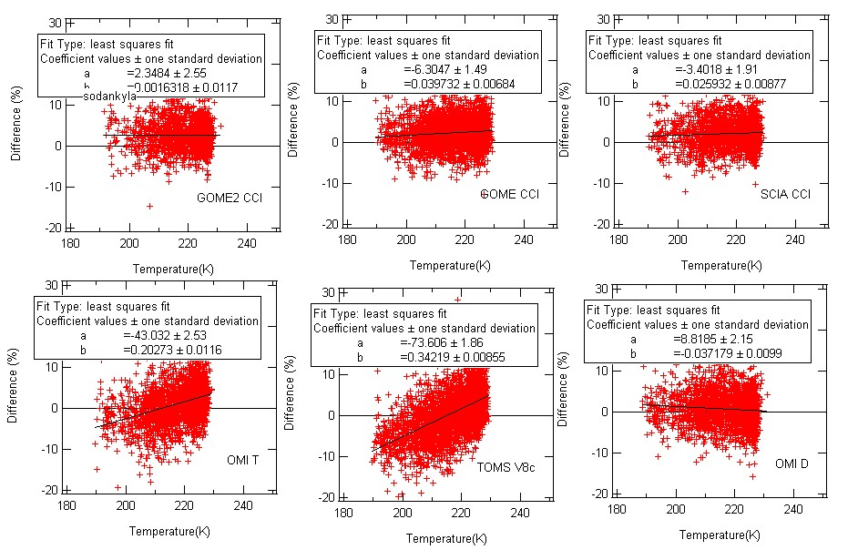
Temperature dependence Sodankyla
TOMS 0.34%/°C, OMI-TOMS 0.20%/°, NPP 0.15%/°C
OTHERS <0.04%/°C (OMI-D negative)
SAOZ not sensitive to temperature (visible cross-sections)

Slide 20
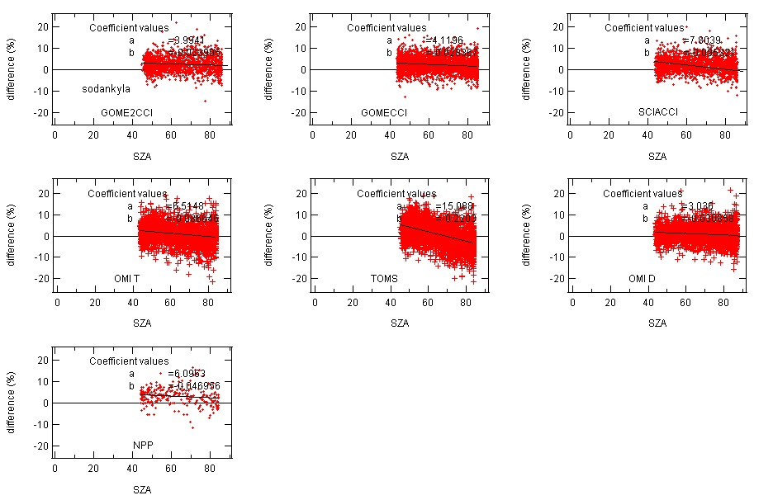
SZA dependence in Sodankyla
Max TOMS -0.22%/1°SZA OMI-TOMS -0.08 Others <0.1%/°
SAOZ not sensitive (always same SZA)
Ozone CCI Darmstadt 15 April

Slide 21
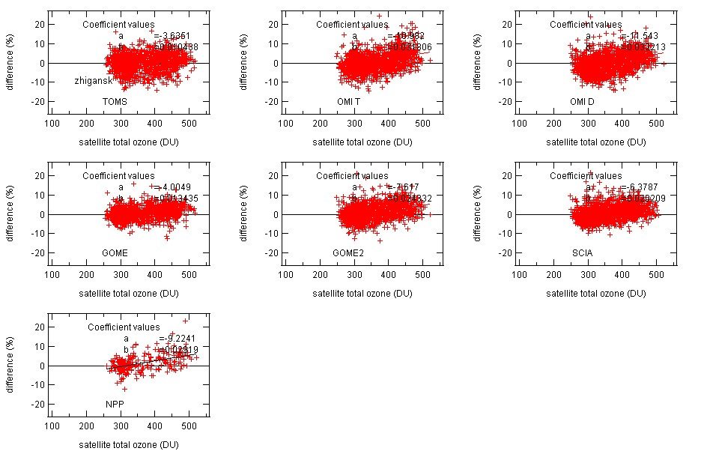
Total ozone dependence in Sodankyla:
OMI-T, OMI-D 0.03 %/DU; SCIA 0.02%/DU
Others ≤ 0.01 %/DU
Zonal mean profile not representative of stratospheric ozone profile longitudinal distribution
SAOZ AMF also affected
Ozone CCI Darmstadt 15 April

Slide 22
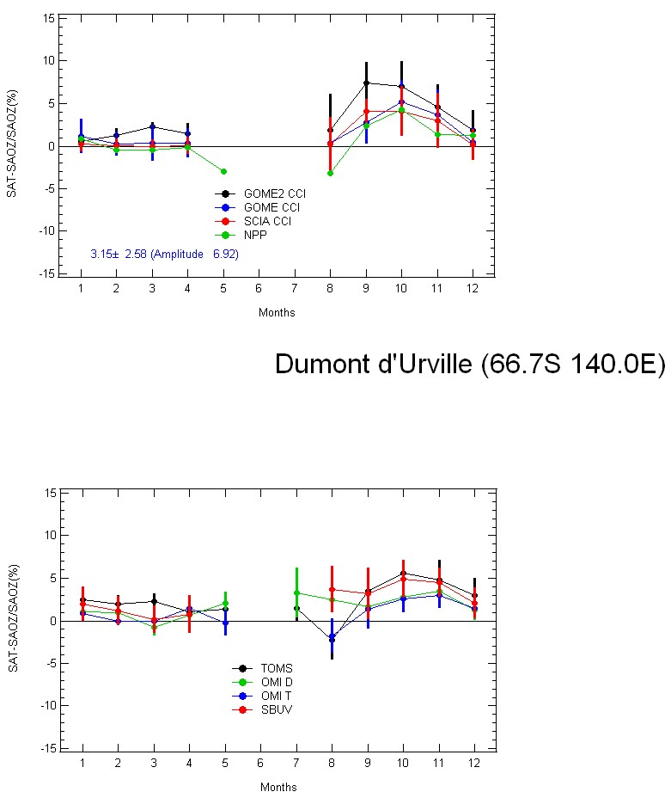
ANTARCTIC Dumont d’Urville
Maximum difference in Spring
DDU on East Antarctica almost never in ozone hole
Zonal mean stratospheric profile not representative of longitudinal distribution
Ozone CCI Darmstadt 15 April

Slide 23
SUMMARY POLAR REGIONS
TEMPERATURE AND SZA DEPENDENCES OF UV SATELLITES RETRIEVALS (Relative contributions of T and SZA difficult to separate since identical seasonality)
Most sensitive: TOMS V8, OMI-TOMS half; SBUV, NPP and all others less
OZONE PROFILE DEPENDENCE Zonal mean not representative of stratospheric ozone profile longitudinal distribution
Most sensitive OMI-T, OMI-D, SCIA half, all others less
Affects also SAOZ
Ozone CCI Darmstadt 15 April

Slide 24
CONCLUSIONS
MOST INFLUENT PARAMETERS ON DIFFERENCES BETWEEN SATELLITES AND SAOZ
TEMPERATURE AND SZA DEPENDENCES OF SATELLITES RETRIEVALS (Relative contributions difficult to separate since identical seasonality)
Most significant: TOMS V8, and OMI-TOMS half, all others SBUV, GOME, GOME2, SCIAMACHY, NPP less
STRATOSHERIC OZONE PROFILE LONGITUNAL VARIATION
Most significant in polar areas
TROPOSPHERIC OZONE LONGITUDINAL VARIATION
GHOST CORRECTION FOR CLOUD FRACTION
Most significant over intertropical convergence zones and very cloudy areas
Ozone CCI Darmstadt 15 April

Slide 25
MAJOR IMPROVEMENT OF SATELLITES AND SAOZ TOTAL OZONE RETRIEVALS ANTICIPATED FROM:
2D PROFILES CLIMATOLOGY INCLUDING TROPOSPHERIC OZONE
Ozone CCI Darmstadt 15 April

