Slide 1
GOME-Type Total Ozone (GTO)
Instrumental differences found/solved
D. Loyola, M. Coldewey-Egbers (DLR)
M. Van Roozendael, C. Lerot (BIRA)
CEOS-ACC 9, EUMETSAT, 18-APR-2013

Slide 2
Overview
GOME-type Total Ozone (GTO) data record
Merging GDP4.6 and GODFIT
Comparison with SBUV 8.6

Slide 3
GOME-type Total Ozone – ECV
Inter-Satellite Calibration: Select one data set as reference (GOME) and correct others (SCIAMACHY and GOME-2) for spatial and temporal biases and drifts
  GDP4.6: operational for SCIAMACHY and GOME-2 (Metop-A & B)
    Van Roozendael et al., JGR 2006, Loyola et al., JGR 2011
    D. Balis et al., JGR 2007, …, Koukouli et al., AMT 2012
  GODFIT: ESA CCI algorithm
    Van Roozendael et al., JGR 2012
Self-consistent and independent long-term dataset staring in 1995
Ground-based data used for geophysical validation
Merged product used for climate model evaluation

Slide 4
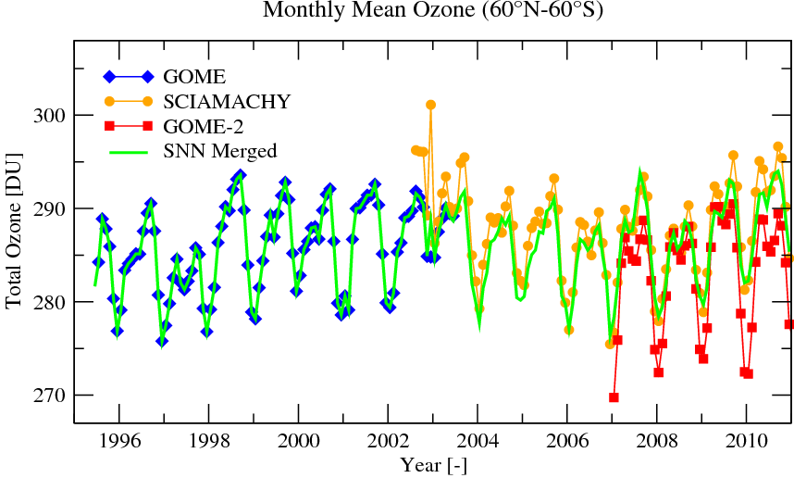

GOME-type Total Ozone – Essential Climate Variable
Fig. 5, Loyola and Coldewey-Egbers, JASP 2012

Slide 5
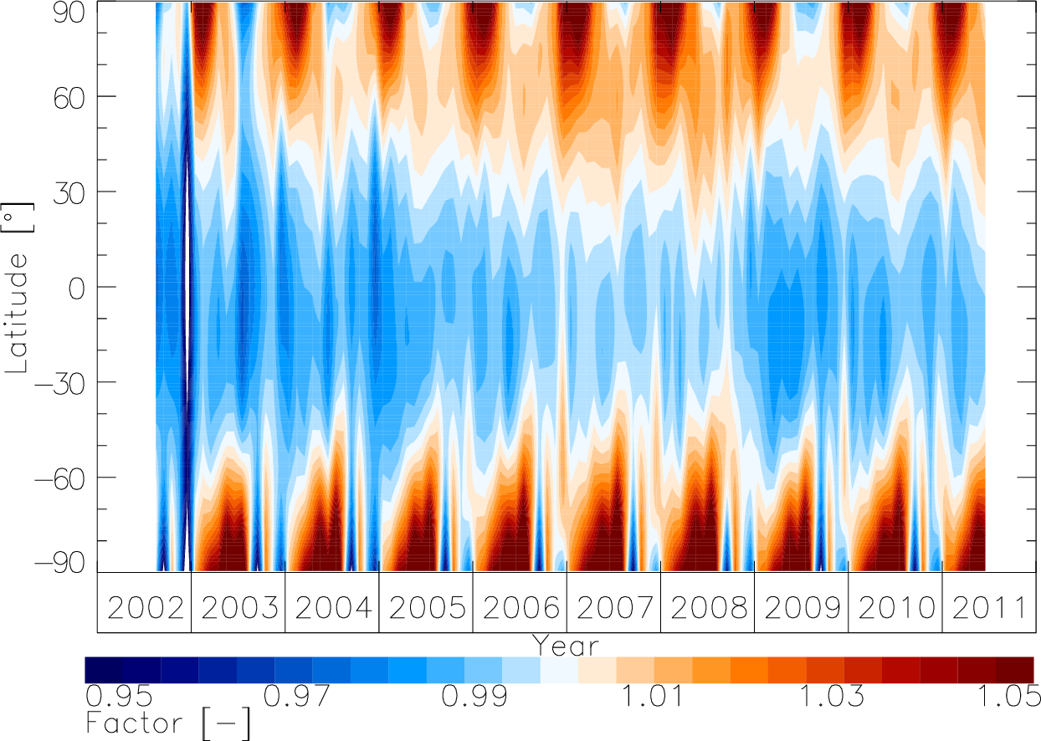
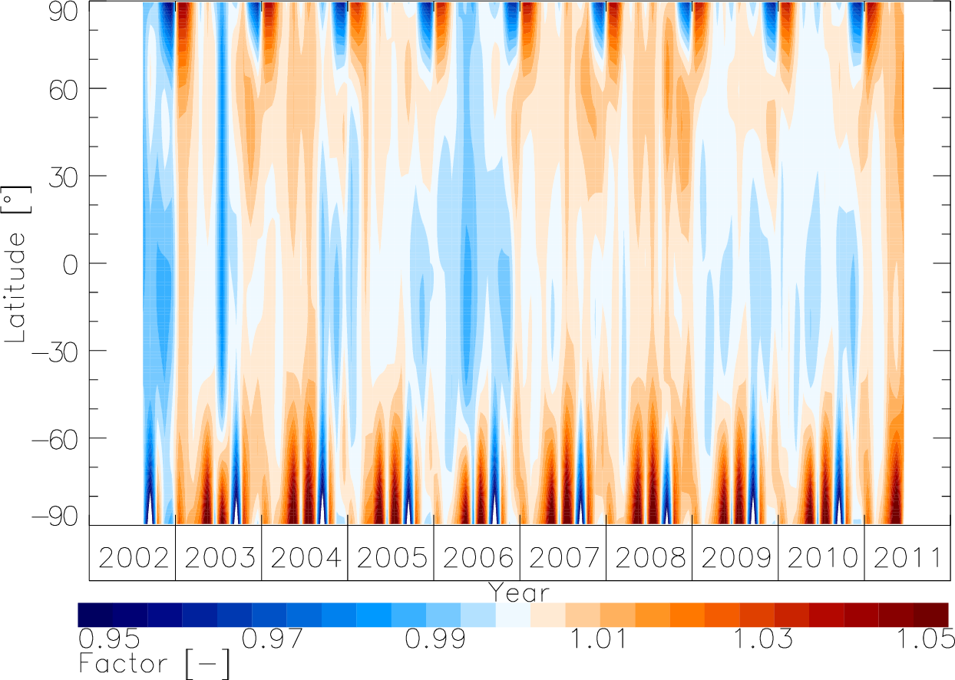
Correction factors for SCIAMACHY
GDP4.6
GODFIT

Slide 6
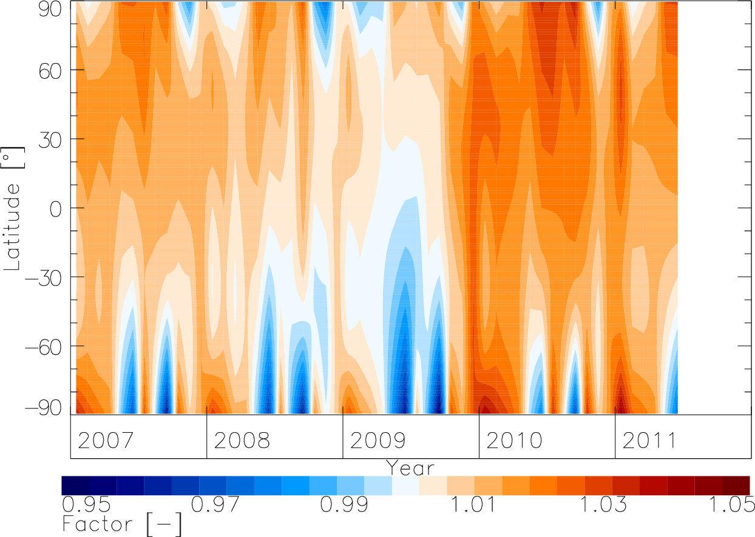
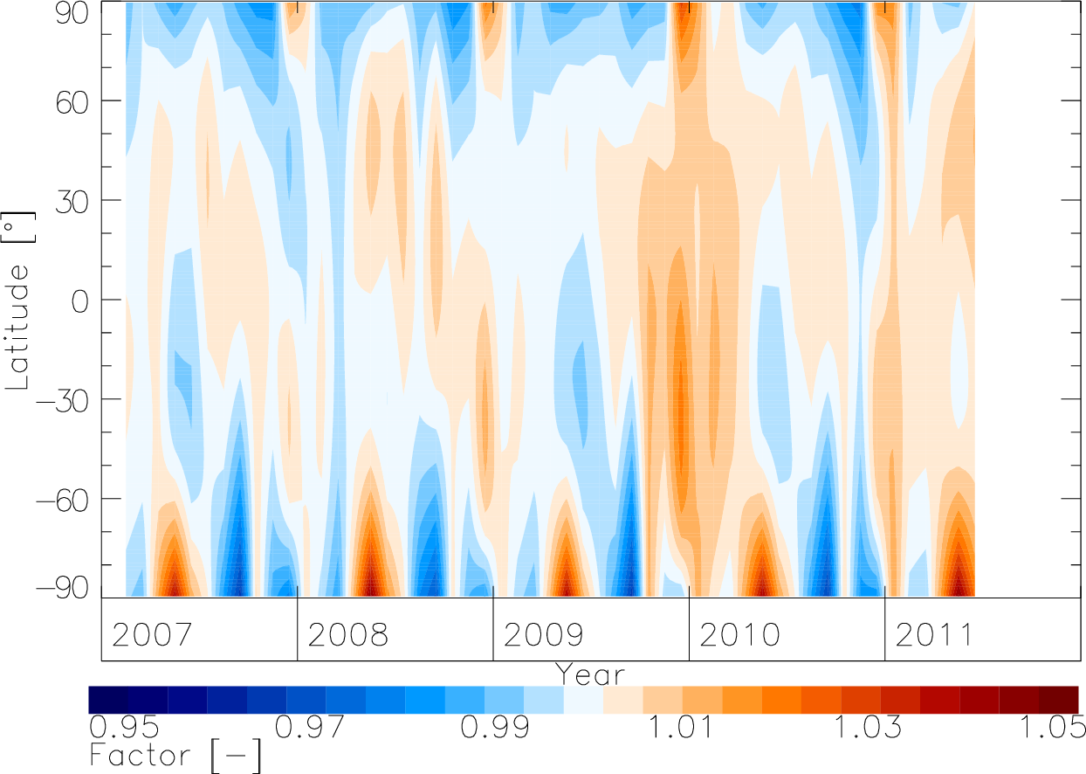
Correction factors for GOME-2/Metop-A
GDP4.6
GODFIT

Slide 7
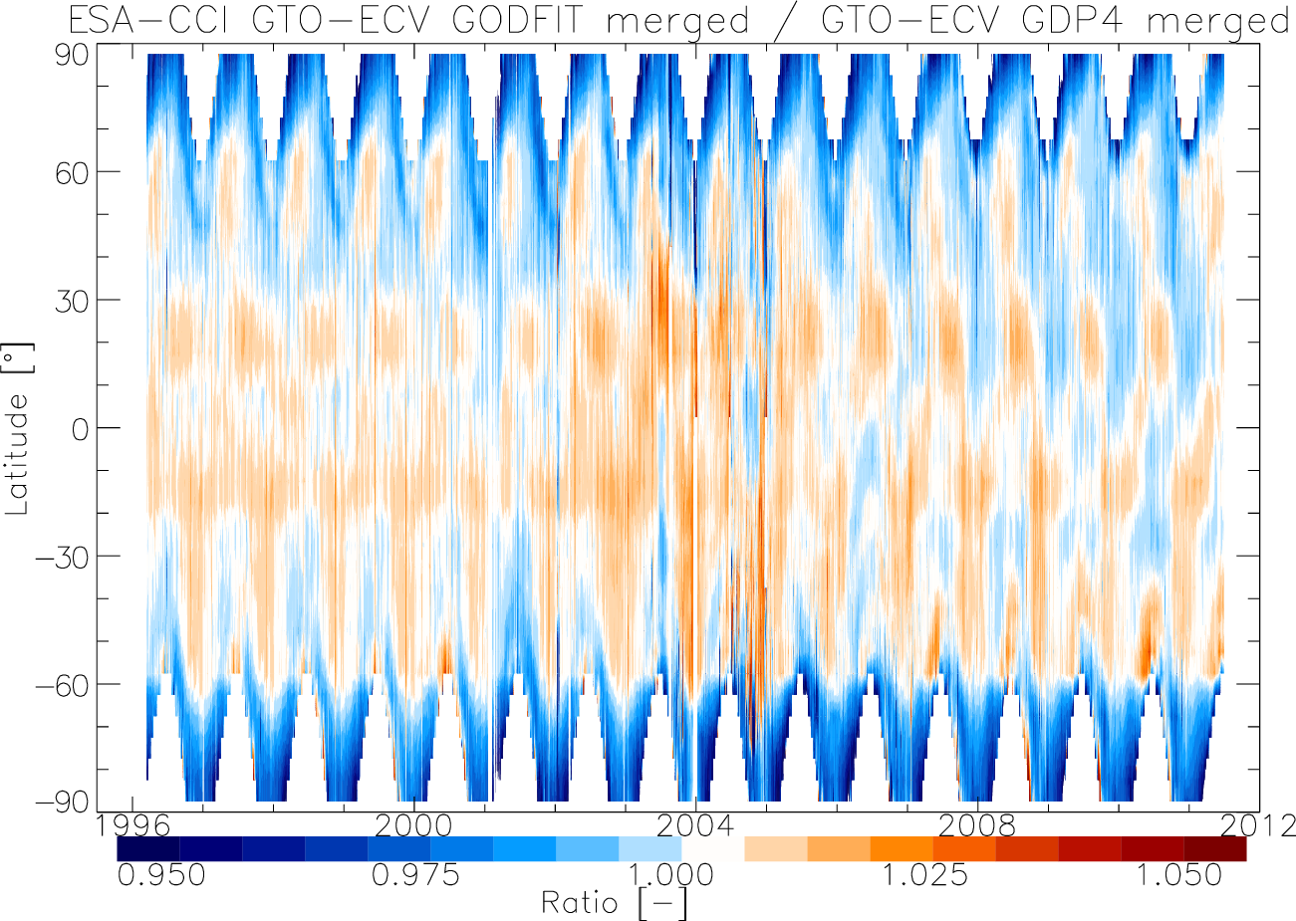
GDP4.6 versus GODFIT

Slide 8
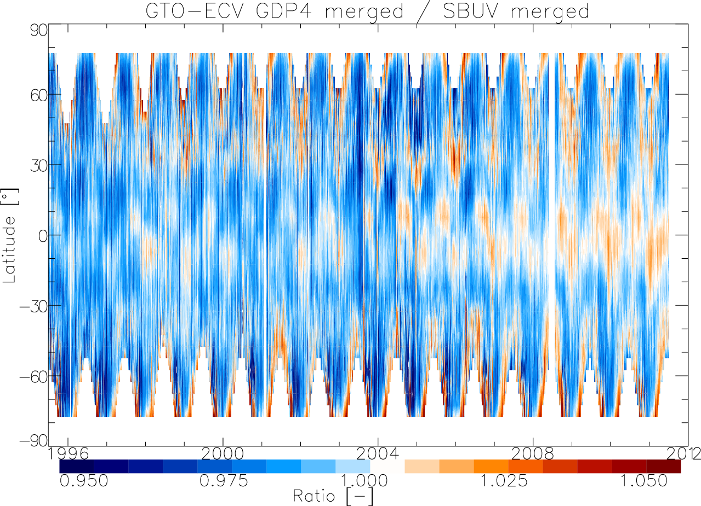
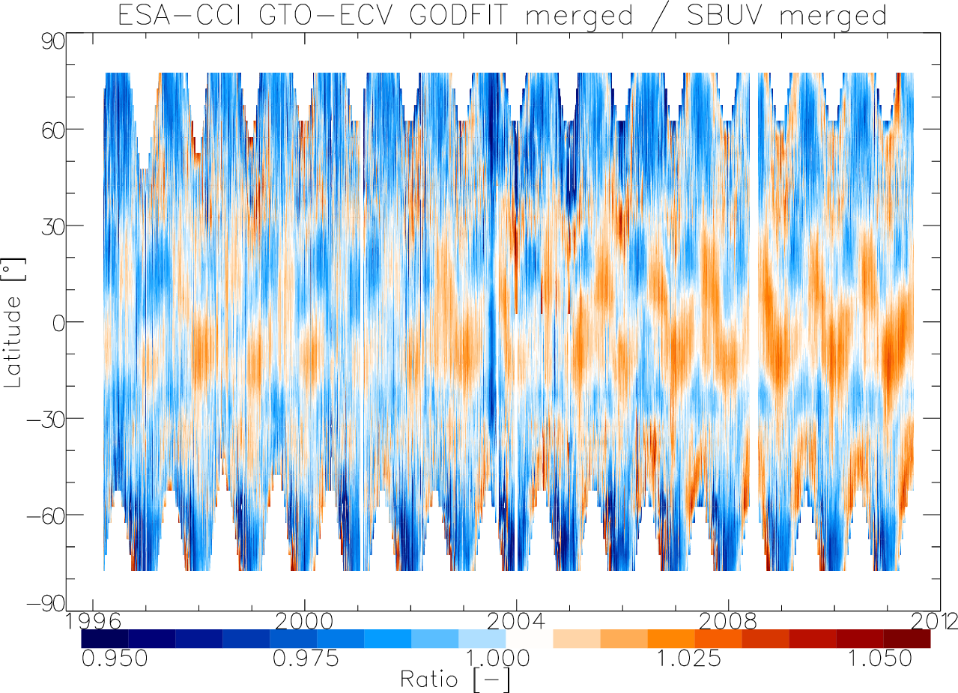
Comparison with SBUV V8.6
GDP4.6
GODFIT

