Slide 1
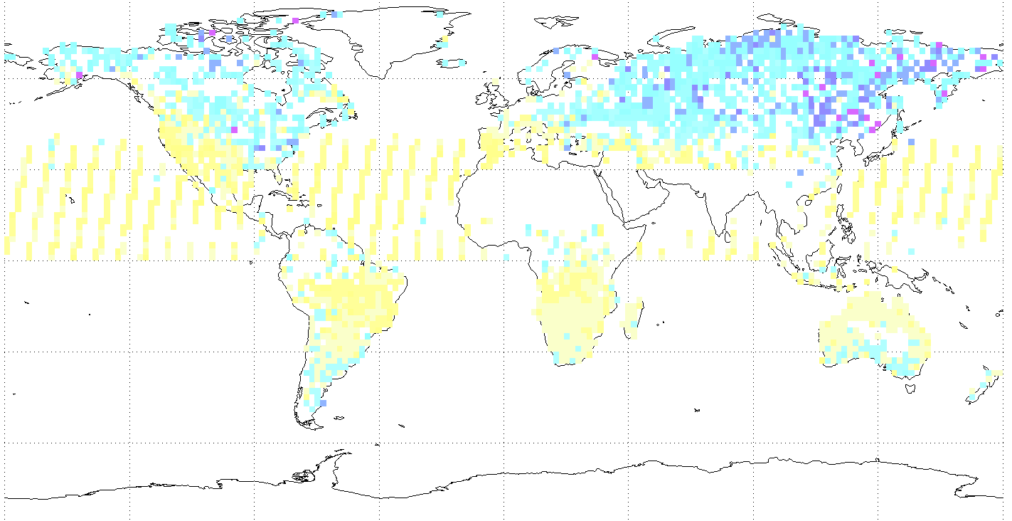
Monitoring the Atmospheric Carbon Cycle from Space
David Crisp (JPL)
Ray Nassar (Environment Canada)
March 29, 2012
Carbon Task Force Meeting
Copyright 2012 California Institute of Technology. Government sponsorship acknowledged.

Slide 2
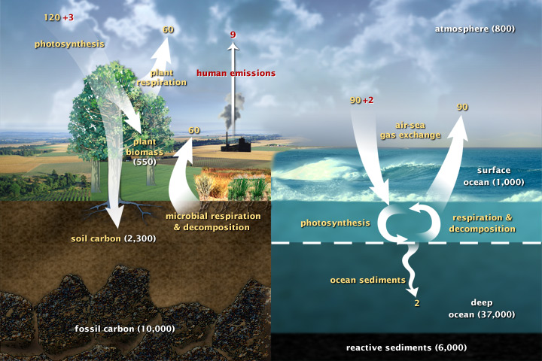
The Atmospheric Carbon Cycle
YOU ARE HERE

Slide 3
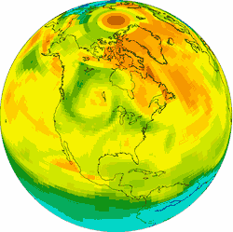

Global Measurements from Space are Essential for Monitoring Atmospheric CO₂
To limit the rate of atmospheric carbon dioxide buildup, we must
  Control emissions associated with human activities
  Understand & exploit natural processes that absorb carbon dioxide
We can only manage what we can measure
Plumes from medium-sized power plants (4 MtC/yr) elevate X_{CO2} levels by ~2 ppm for 10’s of km downwind [Yang and Fung, 2010].
These variations are superimposed on a background of “CO₂ weather”

Slide 4
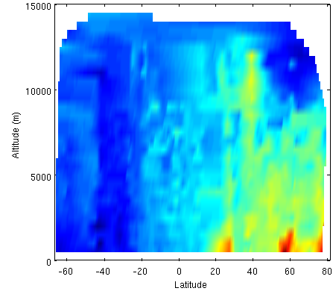
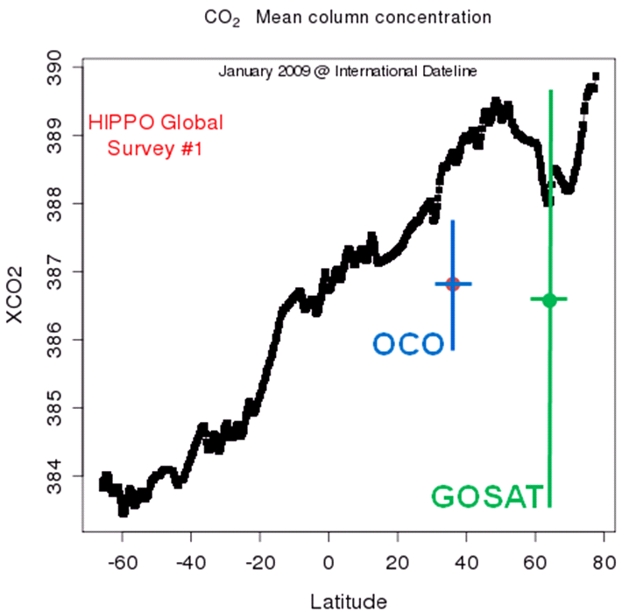
Requirement: High Precision
CO₂ sources and sinks must be inferred from small spatial variations in the (387 ±5 ppm) background CO₂ distribution
The largest CO₂ variations occur near surface
Space based NIR observations constrain column averaged CO₂, X_{CO2}
X_{CO2} must be measured with a precision of < 1 ppm on regional scales to resolve the small variations associated with sources and sinks
Small spatial gradients in X_{CO2} verified by pole-to-pole aircraft data [Wofsy et al. 2010]
372
380

Slide 5
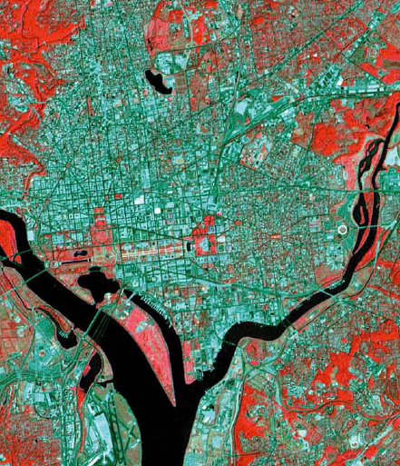
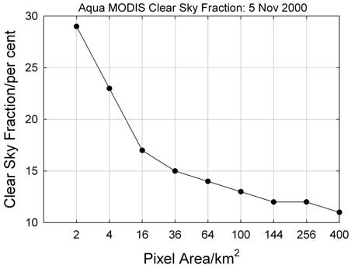
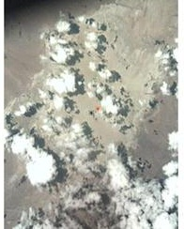
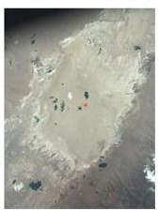
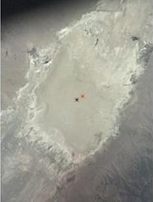
Requirement: Spatial Resolution
A Small Footprint:
Increases sensitivity to CO₂ point sources
  Minimum measureable CO₂ flux is inversely proportional to footprint size
Increases probability of recording cloud free soundings in partially cloudy regions
Reduces biases associated with optical path length uncertainties over rough topography
OCO-Nadir
OCO-Glint
2011/06/19
2011/06/22
2011/06/25
GOSAT

Slide 6
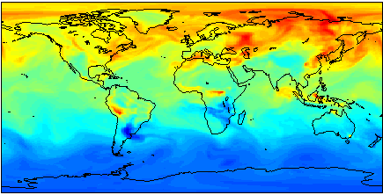
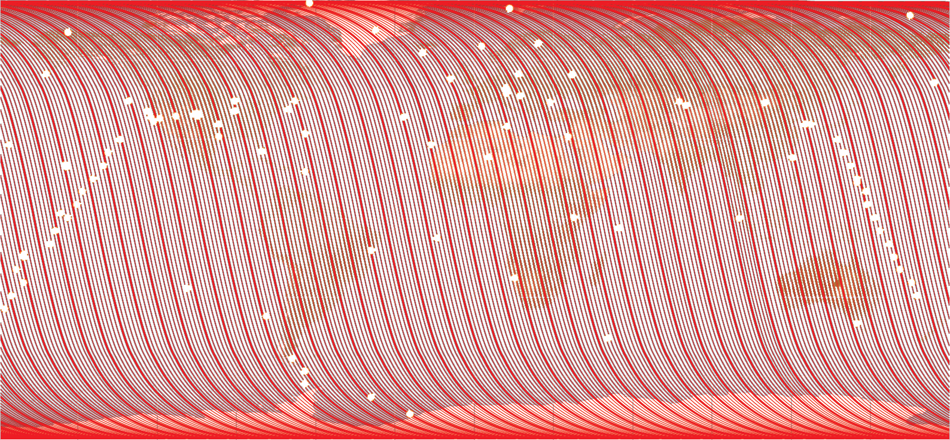
Requirement: Spatial Coverage
Ground based measurements - greater precision and sensitivity to CO₂ near the surface, where sources and sinks are located.
Space-based measurements – improve spatial coverage & resolution.
Source/Sink models - assimilate space and ground-based data to provide global insight into CO₂ sources and sinks

Slide 7
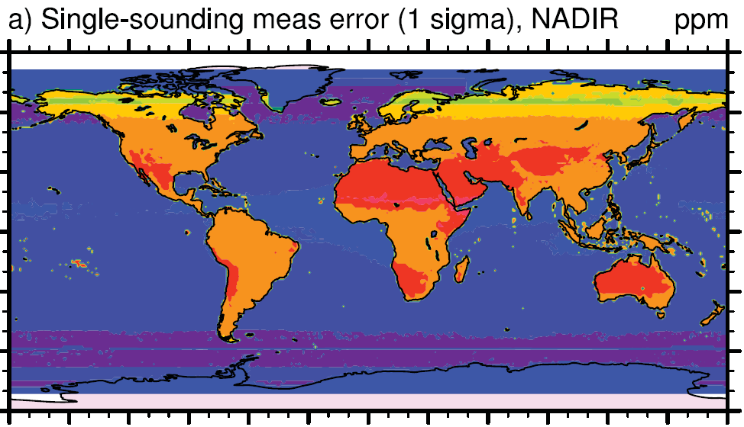

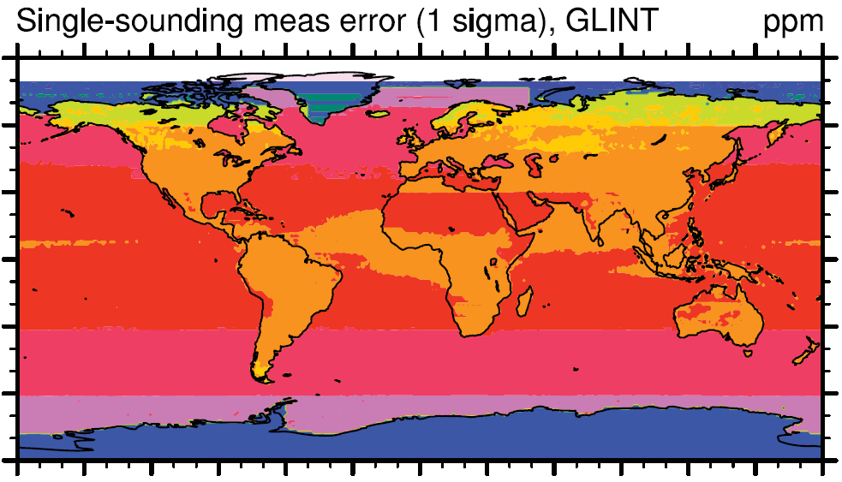

Requirement: Coverage of Oceans and Continents
  The ocean covers 70% of the Earth and absorb/emit 10 times more CO₂ than all human activities combined
  Coverage of the oceans is essential to minimize errors from CO₂ transport in and out of the observed domain
Near IR solar measurements of CO₂ over the ocean are challenging
Typical nadir reflectances: 0.5 to 1%
Most of the sunlight is reflected into a narrow range of angles, producing the familiar “glint” spot
Glint and nadir measurements can be combined to optimize sensitivity over both oceans and continents
3-5 ppm
<0.4 ppm
OCO single sounding random errors for nadir and glint [Baker et al. ACPD, 2008].

Slide 8

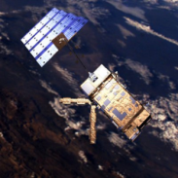
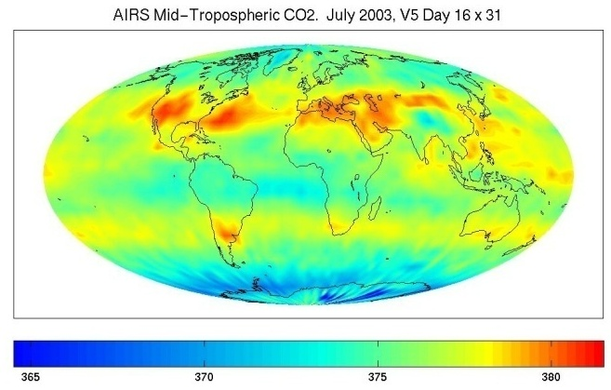
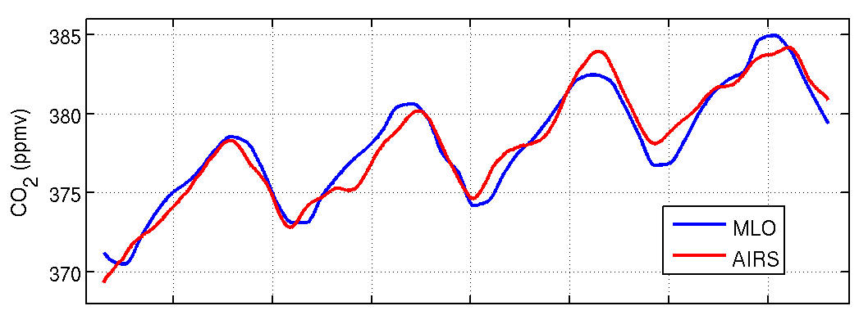
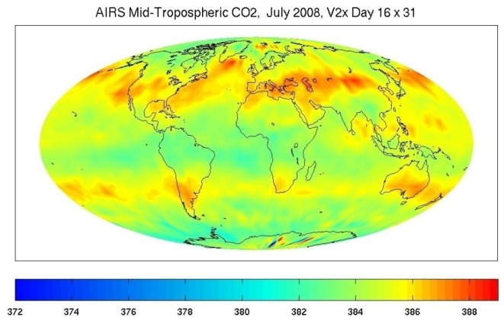
Pioneering Missions: Thermal Infrared Observations of CO₂
Aqua AIRS
Metop IASI
Thermal IR observations (AIRS, TES, IASI, CriS) measure CO₂ in the middle troposphere
  Provide global maps of CO₂ at altitudes where it is most effective as a greenhouse gas
  Provide limited information about surface sources and sinks of CO₂
AIRS July 2003 CO2
378 ppm
AIRS JULY 2008 CO2 (ppm)
388 ppm

Slide 9
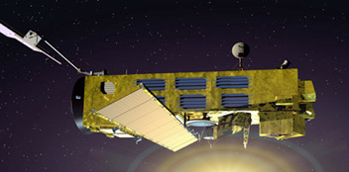
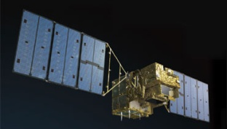
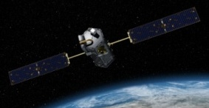
Pioneering Missions: Full-Column CO₂ Measurements using Reflected Sunlight
SCIAMACHY (2002)
  Demonstrated capability, providing regional scale maps of CO₂ and CH₄ over continents on seasonal time scales
  Limited precision (3-6 ppm), large footprint (18,00 km²), and lack of ocean coverage limited impact on carbon cycle science
GOSAT (2009) -Optimized for spectral and spatial coverage
  Collects 10,000 soundings every day over land and ocean
    10-15% are sufficiently cloud free for CO₂ and CH₄ retrievals
    Observations of the glint spot within 20°of sub-solar latitude have adequate SNR to allow X_{CO2} retrievals over the ocean at these latitudes
  Precision requirement is 1% (3-4 ppm), but typical values near 0.5%.
    Adequate to resolve regional-scale X_{CO2} variations at monthly intervals
  OCO-2 (2014) - Optimized for X_{CO2} sensitivity and spatial resolution
  Collects up to 10⁶ measurements each day over a narrow swath
    Smaller footprint ensures that >20% all soundings are cloud free
  1 ppm (0.3%) precision adequate to detect weak sources & sinks

Slide 10
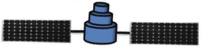
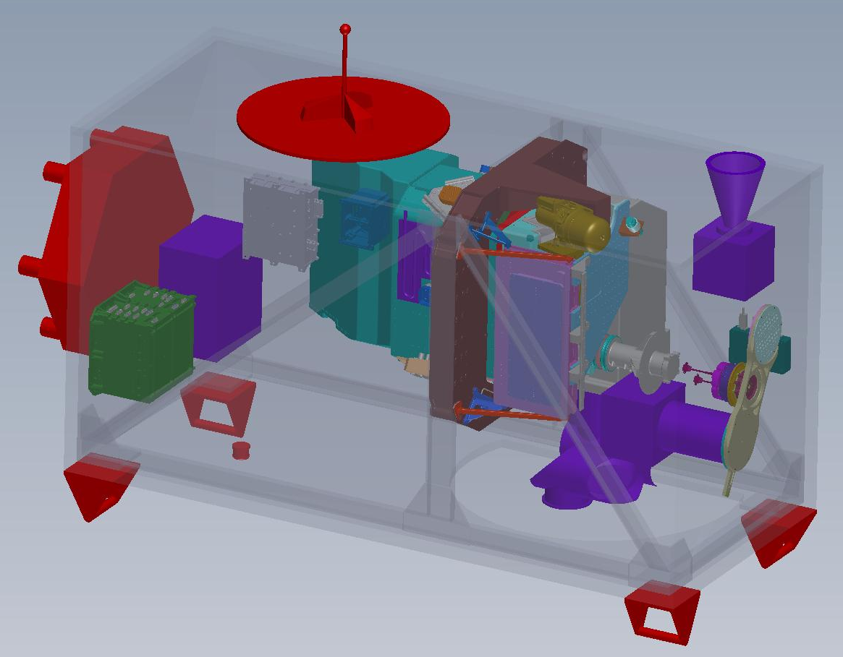
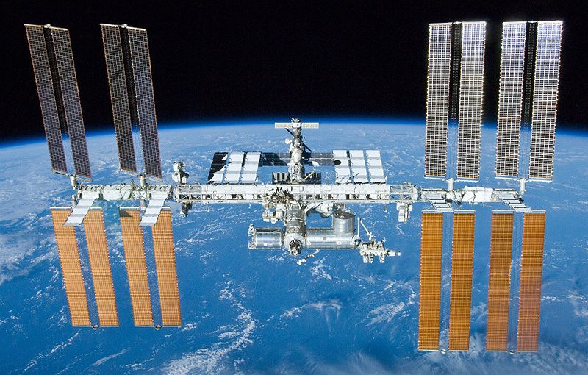
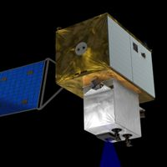
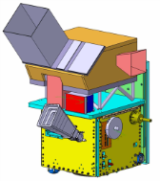
Planned Passive Solar Greenhouse Gas Missions *
TanSat (2015) - First Chinese greenhouse gas satellite
  Uses same O₂ and CO₂ bands a OCO-2
  Cloud and Aerosol Imager: 0.38, 0.67, 0.87, 1.38 and 1.61μm channels
OCO-3 (2017) - OCO-2 Spare parts instrument, flying on ISS
  First solar CO₂ instrument to fly in a low inclination, precessing orbit
GOSAT-2 (2017) – The next step, following GOSAT
  Improved resolution and expanded coverage of the ocean glint spot
  May add a channel near 2.3 µm to measure CO
ESA CarbonSat (2018) – CO₂ and CH₄ over a broad swath
  Combines high precision and resolution of OCO with a broad swath (160 to 500 km) to yield complete coverage of sunlit hemisphere weekly
CNES MicroCarb (2018) – high sensitivity at low cost
  Flies in the A-Train, providing data continuity for OCO-2
  ~1/2 to 1/3 of the size (and cost) of OCO-2, with similar sensitivity.
    Enables constellations of low-cost CO₂ monitoring satellites
*This information based on my notes from the GOSAT-2 Workshop

Slide 11
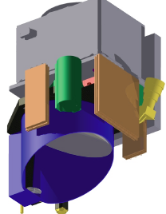
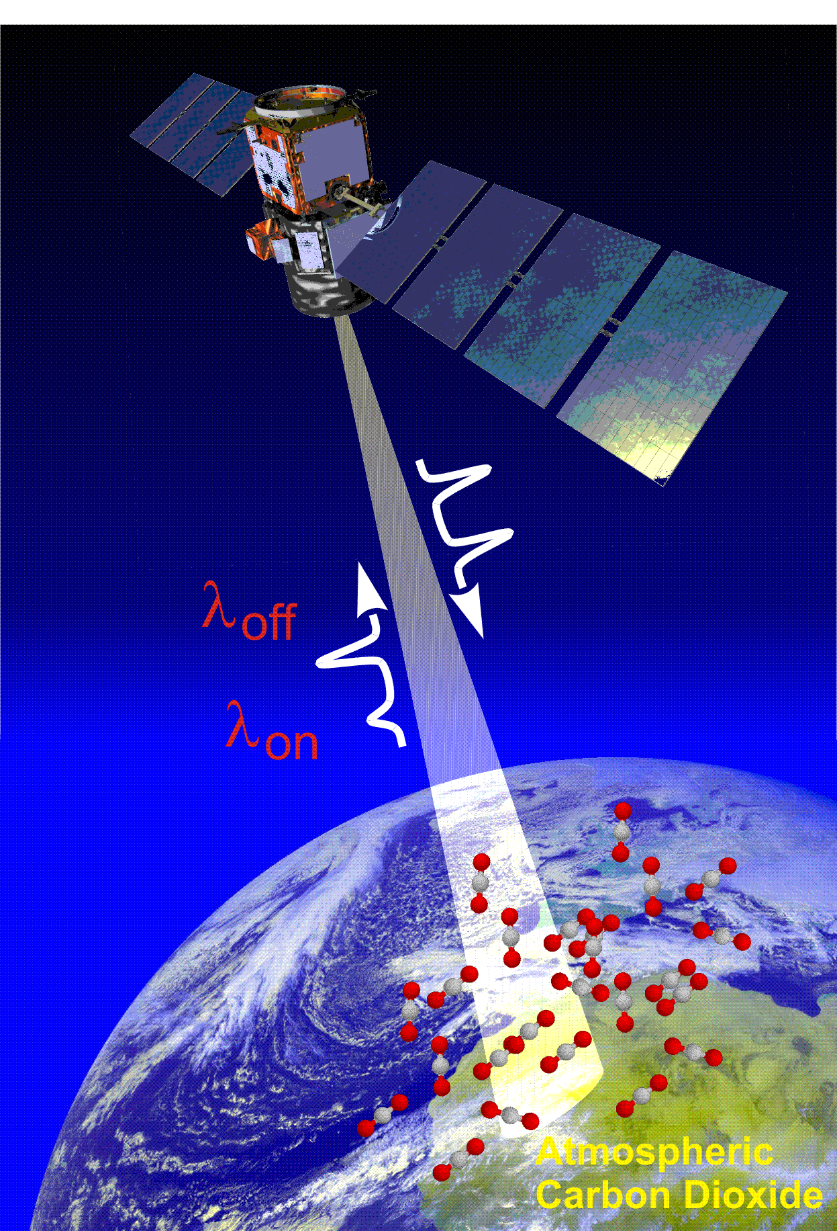
Planned Active Greenhouse Gas Missions*
Allow full-column greenhouse gas measurements day and night and at high latitudes.
MERLIN (2016): First CH₄ LIDAR (IPDA)
  Science focus: Precise (1-2%) X_{CH4} retrievals for studies of wetland emissions, inter-hemispheric gradients and continental scale annual CH₄ budgets
  Orbit: 6AM/6PM, 28-day repeat
ASCENDS (2021): First CO₂ LIDAR
  Precise (0.3%) global measurements of X_{CO2}, over days, nights, including winter high latitude regions to quantify continental and oceanic CO₂ sources and sinks
  May include a passive (2.3/4.6 µm CO channel
*Based on notes from the 5th DIAL Remote Sensing Workshop
Notes:
The first generation active CO2 sensors are still on the drawing boards.
Active LIDAR instrument concepts like those being considered for ASCENDS cannot provide the sensitivity or coverage of passive solar NIR sensors over most of the sunlit hemisphere, but can return data at night as well as during the day.
These systems are currently being tested in the laboratory and in aircraft. The first space-based deployment is still a few years off.

Slide 12

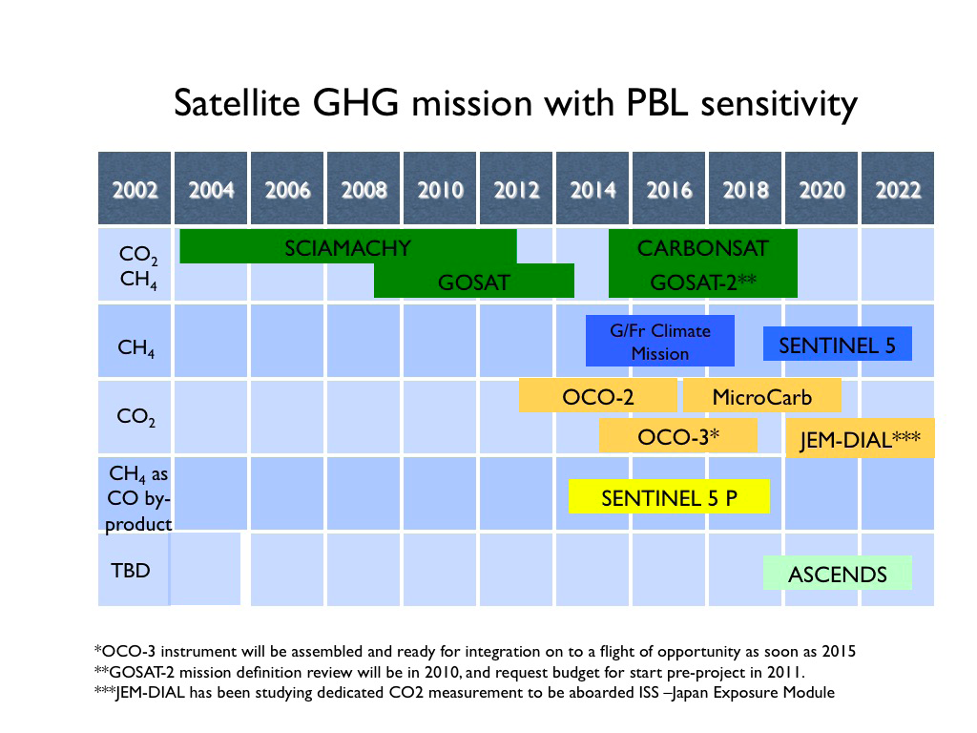
Figure 15, page 28
Incomplete and not updated with latest mission timelines!

Slide 13
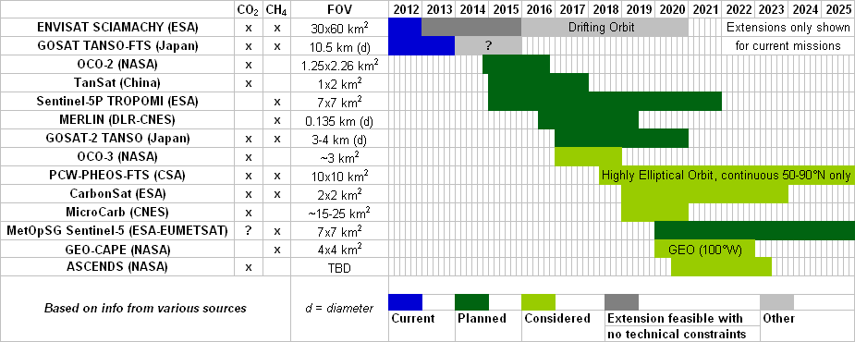
Carbon Task Force
CO₂ and CH₄ Missions with near-surface sensitivity
Near-surface sensitivity (NIR or lidar) is needed for source/sink estimation, although TIR measurements (not shown) can be combined with NIR or lidar, yielding vertical resolution.
Moving forward there are abundant TIR observations (IASI, HIRS, etc.) but potentially a NIR data gap without continuation of SCIAMACHY or GOSAT

Slide 14
GHG Constellations
Moving forward, we also need to have more than one satellite at a time for increased spatial and temporal sampling. LEO and GEO missions each have pros/cons for building a constellation.
LEO
Global coverage over many days with one satellite
Multiple satellites needed to achieve continuous observations at one location (depending on swath width)
Lower launch cost per single satellite
Lower risk of spatially-dependent biases in dataset
GEO
Temporally continuous observing over limited area
Weaker signal at large distance, but longer integration times are possible to reduce noise
3 or more satellites needed for full longitudinal coverage
Maximum latitude range of ~55°S-55°N, so must add HEO satellites for continuous coverage of latitudes poleward of ~55°S/N
There are advantages to combining LEO and GEO due to their complementary nature (as done with missions for operational weather forecasting) when designing an ideal GHG observing system.

Slide 15
Collaborative Cal/Val Activities
Development / Pre Launch:
Cross calibration of pre-launch radiometric standards
Exchange of gas absorption coefficient and solar databases
Algorithm development/intercomparison
Validation system development (TCCON + Tsukuba FTS?)
Dual/multi-Satellite OSSE’s – what do you gain with truly coordinated observations
Operations / Post Launch:
Cross calibration of solar/lunar/Earth observations
Cross validation: TCCON (possibly adding a validation campaign or two)
Algorithm implementation/intercomparison
Intercomparisons of flux inversions

Slide 16
Conclusions
Space-based remote sensing observations hold substantial promise for future long-term monitoring of CO₂ and other greenhouse gases
The principal advantages of space based measurements include:
  Spatial coverage (especially over oceans and tropical land)
  Sampling density (needed to resolve CO₂ weather)
The principal challenge is the need for high precision
To reach their full potential, space based CO₂ measurements must be validated against surface measurements to ensure their accuracy.
  The TCCON network is providing the transfer standard
Just as for weather forecasting, a coordinated global network of surface and space-based CO₂ monitoring systems as well as sophisticated models that can assimilate these data are needed to provide insight into the processes controlling atmospheric CO₂

