Slide 1

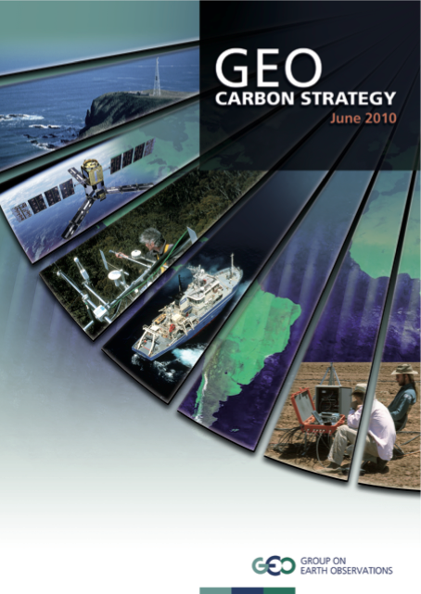
The CEOS Strategy for Carbon Observations from Space
Diane E. Wickland
Co-Chair, Carbon Task Force
19 April 2012

Slide 2
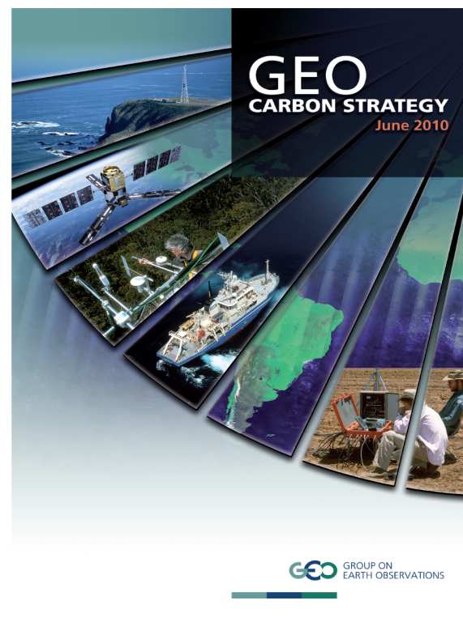
CEOS Response to the GEO Carbon
Strategy
CEOS established the Carbon Task Force (CTF) to coordinate the response from space agencies to the GEO Carbon Strategy:
CEOS Strategy for Carbon Observations from Space

Slide 3
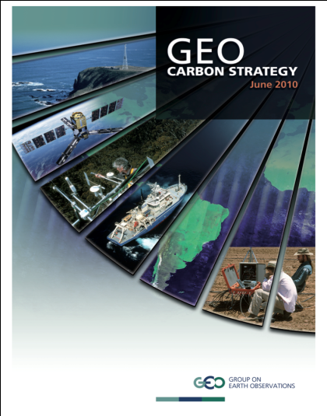
Background
Purpose of Report
  a strategy for the planning and provision of space-based observations
  of the carbon cycle and components of it;
  in support of various societal needs anticipated for carbon-related
  information.
  responds to needs expressed in the (GEO) Carbon Strategy
  (June 2010)
  and ambitions therein for global carbon observation and
  analysis system
  specific focus on the satellite observations and the efforts of
  space agencies to provide them.
Primary Audience
  CEOS and its member Agencies

Slide 4
Outline and Leads for CTF Report
CEOS Strategy for Carbon Observations from Space
Executive Summary (Moriyama, Plummer, Wickland)
Section 1: Introduction (Ward)
Section 2: Land Domain (Schmullius)
Section 3: Ocean Domain (Sathyendranath)
Section 4: Atmosphere Domain (Moore)
Section 5: Integration (Plummer)
Section 6: The Way Forward (Moriyama, Plummer, Wickland)
Appendices

Slide 5
CEOS Response to the GEO Carbon
Strategy: Key Activities
Gap analyses are being conducted
    Using existing gap analyses and updates from CEOS SEO for CO₂ and CH₄ (we are finding we need further update)
    Initial delivery of new gap analysis for ocean observations from space
    New gap analysis for land observations in early stages
Side meetings of domain chapter authors and/or CTF leads held at meetings of opportunity in past 10 months (June, October, December and February) -- in no cases were all groups represented
Initial Drafting:
    Rough drafts of introduction and four chapters (land, ocean, atmosphere, and integration) prepared and delivered December-February; Domain Leads prepared these first rough drafts
    Rough drafts iterated with Domain co-author teams in January-March
    First complete drafts of the four chapters made available for initial review and feedback by CEOS SIT representatives the week of March 19
    Way Forward chapter drafting will begin after today’s consultative meeting
    Executive Summary will wait until the chapters have matured

Slide 6
Objectives for Consultative Meeting
We are seeking consultation on the draft report and its component chapters at an early stage in its development.
CEOS agencies were invited to attend consultative meeting at SIT-27 and/or send representatives to provide feedback on the draft report.
It is important to ensure community ownership of the report, since it will set out the framework by which we progress, monitor and report our collective efforts in years to come towards an integrated observing system that meets societal needs.
Comments, suggestions, and criticisms are welcomed and will be most helpful at this early stage.
  ➔ You now have the opportunity to have a substantive influence on the report’s structure, content, and direction!

Slide 7
Backup Charts

Slide 8
Domain Chapter Authors
Atmosphere:
Berrien Moore (University of Oklahoma)
John Burrows (Universität Bremen)
David Crisp (NASA Jet Propulsion Laboratory)
Michio Kawamiya (Japan Agency for Marine-earth Science and Technology)
Martin Heimann (Max Plank Institute for Biogeochemistry, Jena)
Ray Nasser (Environment Canada)
Peter Rayner (Laboratoire des Sciences du Climat et de L'Environnement)
Land
Chris Schmullius (Friedrich-Schiller University Jena)
Shaun Quegan (The University of Sheffield)
Stephen Plummer (European Space Agency)
Sassan Saatchi (NASA Jet Propulsion Laboratory)
Masanobu Shimada (Japan Aerospace Exploration Agency)

Slide 9
Domain Chapter Authors
Ocean
Shubha Sathyendranath (Plymouth Marine Lab)
Prakash Chauhan (Indian Space Research Organization)
Watson Gregg (NASA Goddard Space Flight Center)
Nicolas Hoepffner (Joint Research Centre)
Joji Ishizaka (Nagoya University)
Johnny Johannessen (Nansen Environmental and Remote Sensing Centre)
Milton Kampel (Instituto Nacional de Pesquisas Espaciais)
Trevor Platt (Bedford Institute of Oceanography)
J-H Ryu (Korea Ocean Satellite Center)

