Slide 1
SCIAMACHY Limb Ozone
Status
Mark Weber, Christian von Savigny,
Alexei Rozanov, Nabiz Rahpoe, Claus Gebhardt,
Katja Weigel, Heinrich Bovensmann, John P. Burrows
CEOS-ACC-8 Workshop, Columbia , MD, USA, 18-19 April 2012

Slide 2
Topics
ENVISAT/SCIAMACHY mission status
SCIAMACHY ozone limb retrieval
Error characterisation
Validation results
Summary

Slide 3
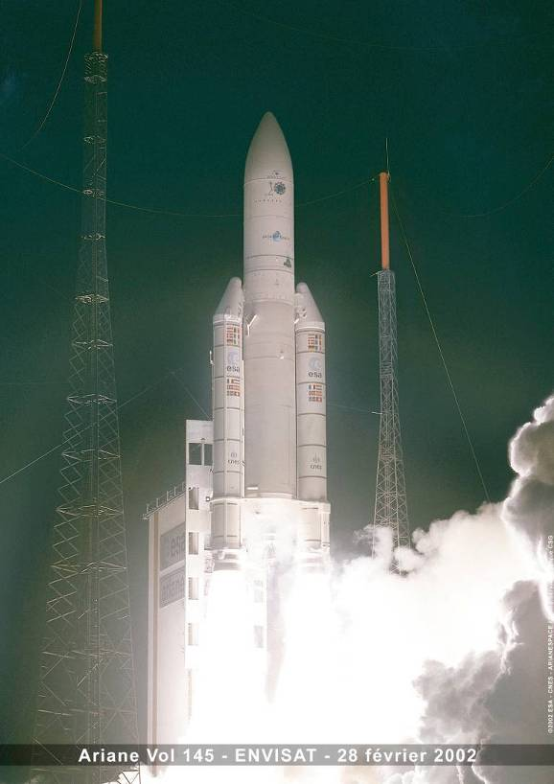
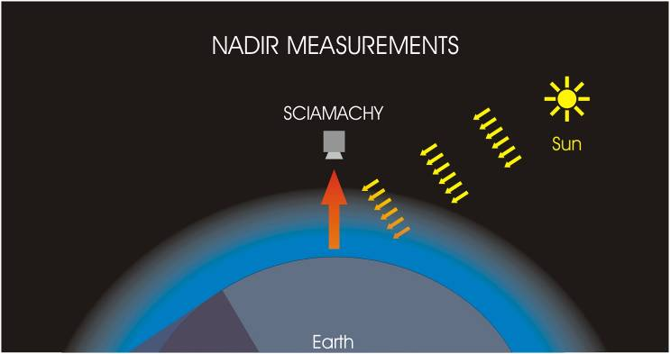
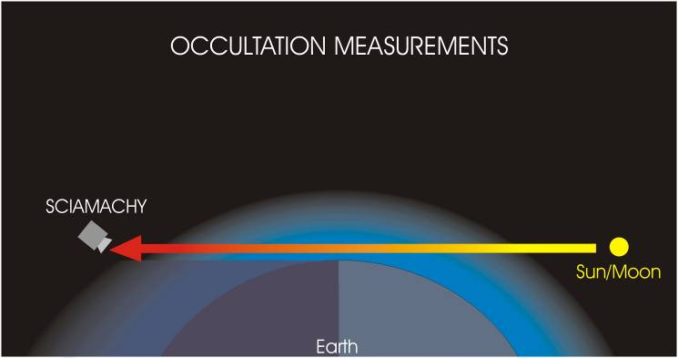
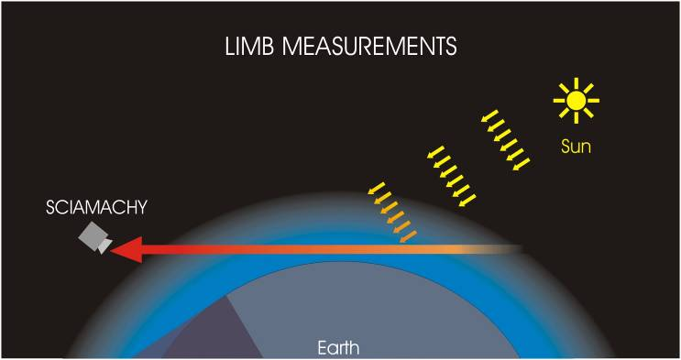
SCIAMACHY
SCIAMACHY = SCanning Imaging Absorption spectroMeter for Atmospheric CHartograpY
Features:
UV/Vis/NIR grating spectrometers:
220 - 2380 nm
Moderate spectral resolution:
0.2 – 1.5 nm
Measurement Geometries:
Launch date: February 28, 2002
Polar, sun-synchronous orbit
Descending node: 10:00 LST
Altitude: 800 (783) km

Slide 4
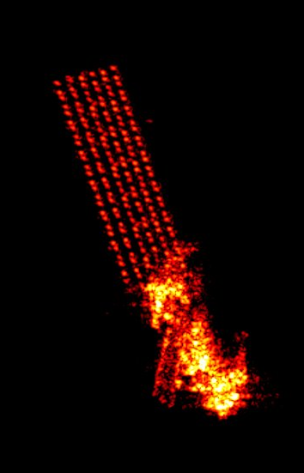
ENVISAT mission status
SCIAMACHY instrument: healthy, no large data gaps (2002-2012)
official ENVISAT mission end: Dec 2012
mission extension to Dec 2013 likely to be approved by ESA delegates/minister conference end of year
Fuel will not be used up before 2015+
BUT:
Lost complete communication with ENVISAT on Easter Sunday
Recovery attempts so far unsuccessful
TIRA radar image of ENVISAT: no damage, no orbital and orientation anomalies detectable (image courtesy Spiegel Online News, April 14, 2012)

Slide 5
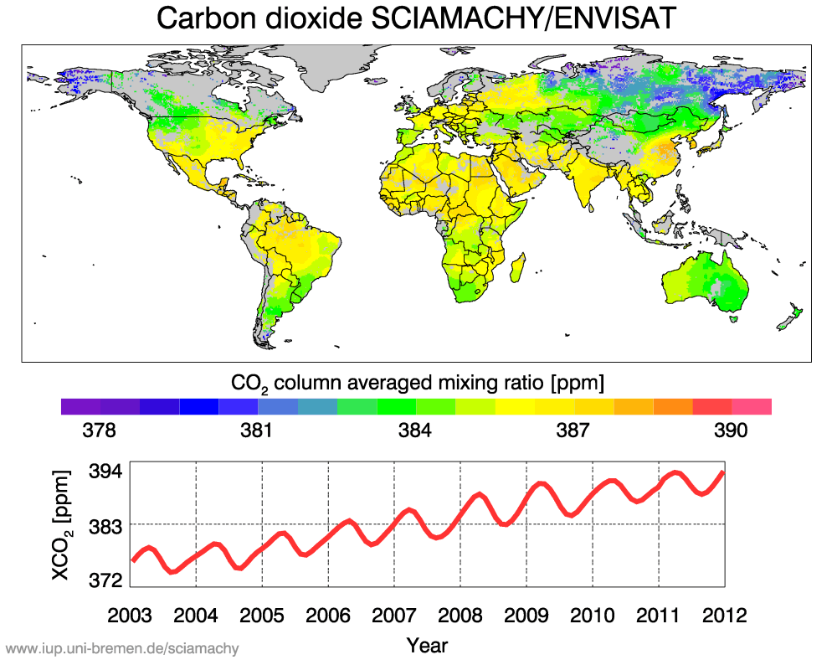
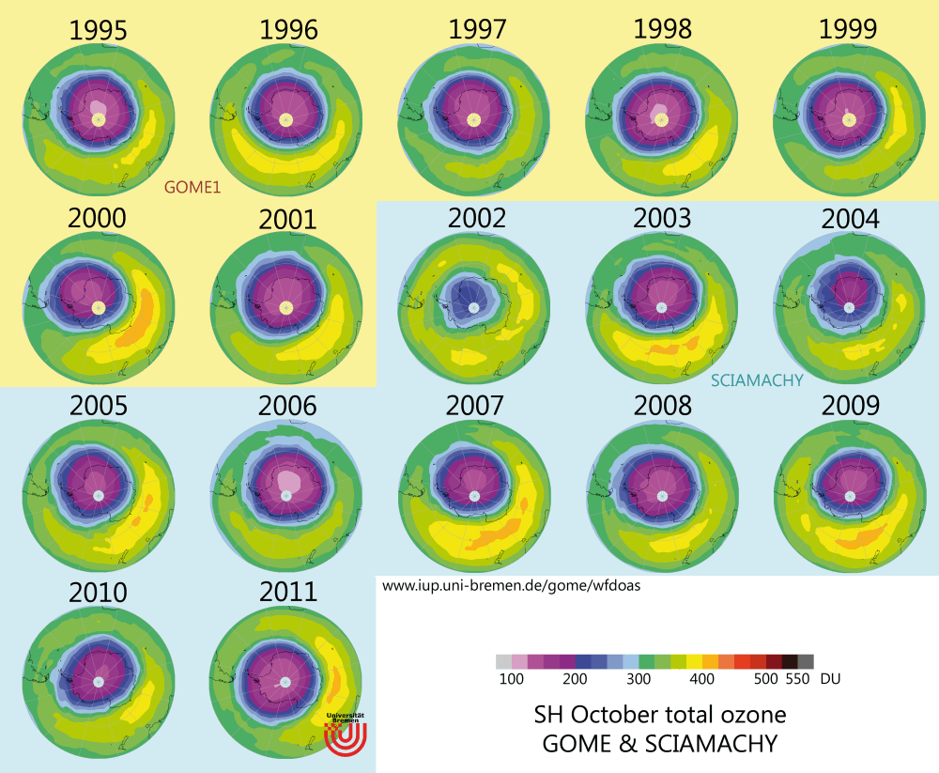
SCIAMACHY data products
  ozone chemistry (nadir/limb/occult)
    NO2, O3, OClO, BrO, H2O, aerosol
  greenhouse gases (nadir)
    CH4, CO, CO2
  air pollution/biogenic (nadir)
    NO2, O3, BrO, IO, H2CO, glyoxal, SO2, H2O
  Other:
    Limb: PSC, NLC/PMC, OH* /mesopause T, mesospheric metals
    Nadir: pytoplanctons/ocean colour, clouds, surface reflectance, mesospheric metals, thermospheric NO
    spectral solar irradiance (SSI)
Notes:
schatten:

Slide 6
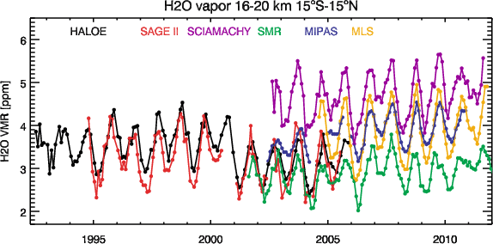
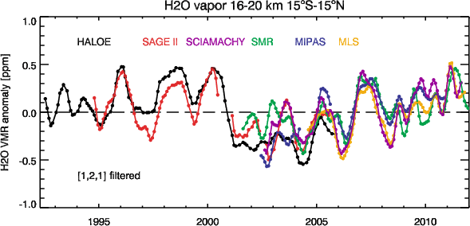
Newest SCIA limb data product: H2O
SCIAMACHY limb water vapor retrieval at 1.4µm (Rozanov et al., 2009)
  altitude range: 10-25 km
  first complete timeseries (V3)
high bias in the tropics (partially due to multiple scattered tropospheric water vapor contribution)
interannual variability well captured
Tropical LS water vapor → modulated by tropical upwelling/changes in the Brewer-Dobson circulation
  Drop after 2000, increase since then

Slide 7
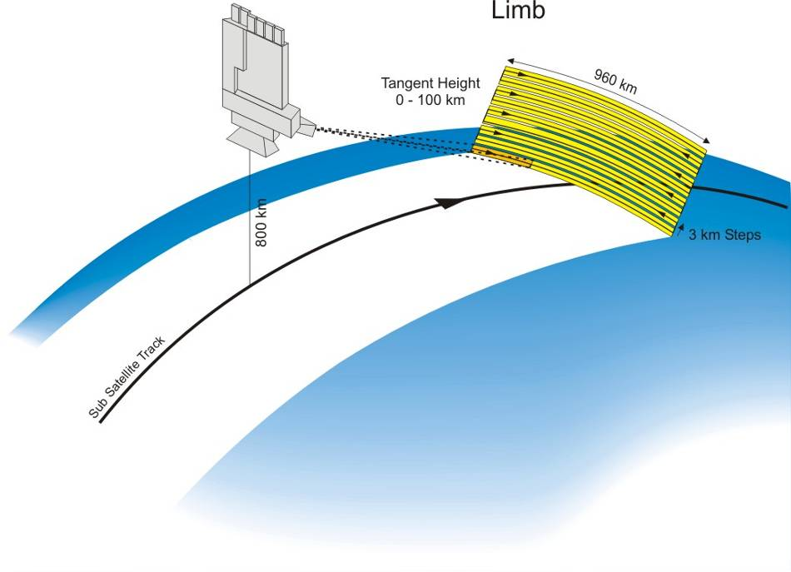
SCIAMACHY ozone limb retrievals
Tangent height range: 0 to 92 (105) km/ ozone: 10-80 km (information content up to 65 km for ozone)
Tangent height step size: 3.3 km. Vertical FOV: 2.6 km, vertical resolution (O3): 4 km
Observations optimised for limb-nadir matching (→ tropospheric ozone)
Limb ozone: ~1400 profiles per day, global coverage in 6 days
ozone retrieval: iterative Gauss-Newton inversion, weak statistical and smoothness contraints (Sonkaew et al., 2009)
Illustration of the limb-scattering geometry

Slide 8
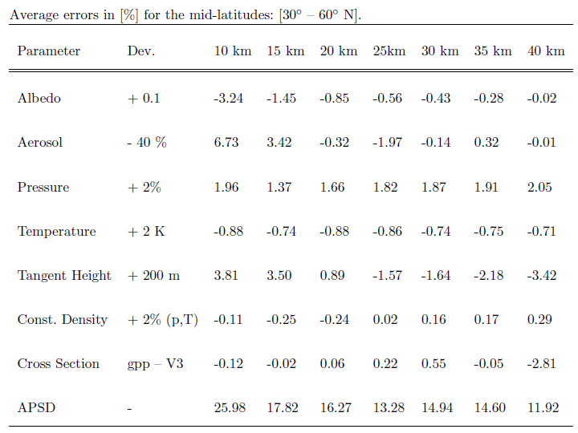
Error budget for SCIA limb O3
systematic
random
Rahpoe et al., to be submitted

Slide 9
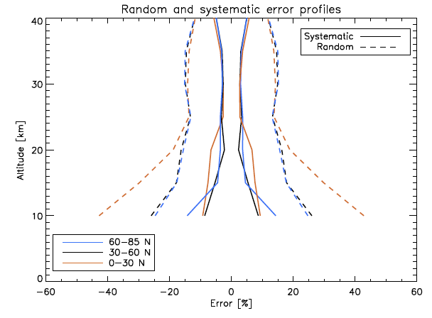
Error budget for SCIA limb O3
systematic errors: 5% above 20 km, 10% below 20 km
random error: 15% for a single profile
Rahpoe et al., to be submitted

Slide 10
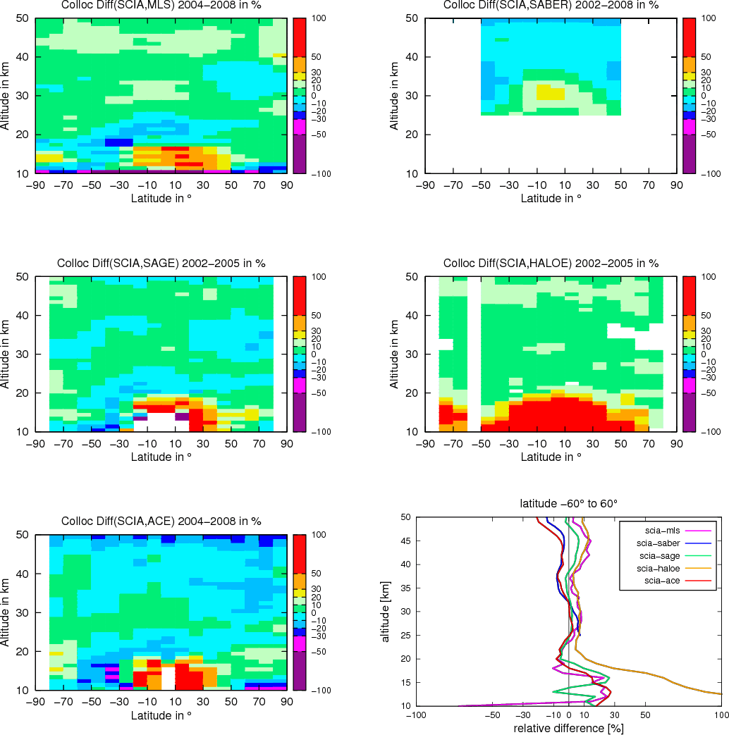
SCIAMACHY/ENVISAT validation
Mean bias between SCIA V2.1 and collocated satellite data (Mieruch et al., 2012)
  SAGE II: 0-3%,
  HALOE: 5-10%,
  MLS v2.2: 2-10%
  ACE-FTS v2U: -10 to -1%
  larger biases in the tropics below 20 km → cloud issues

Slide 11
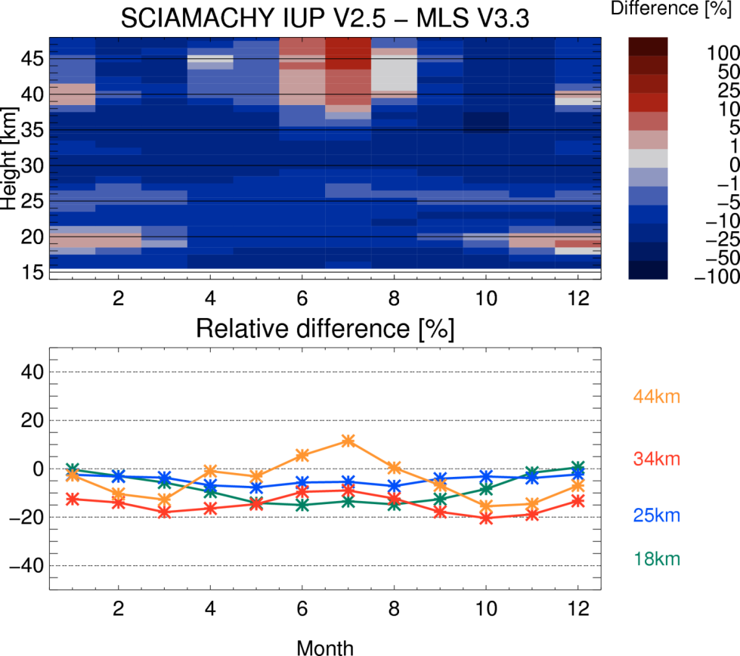
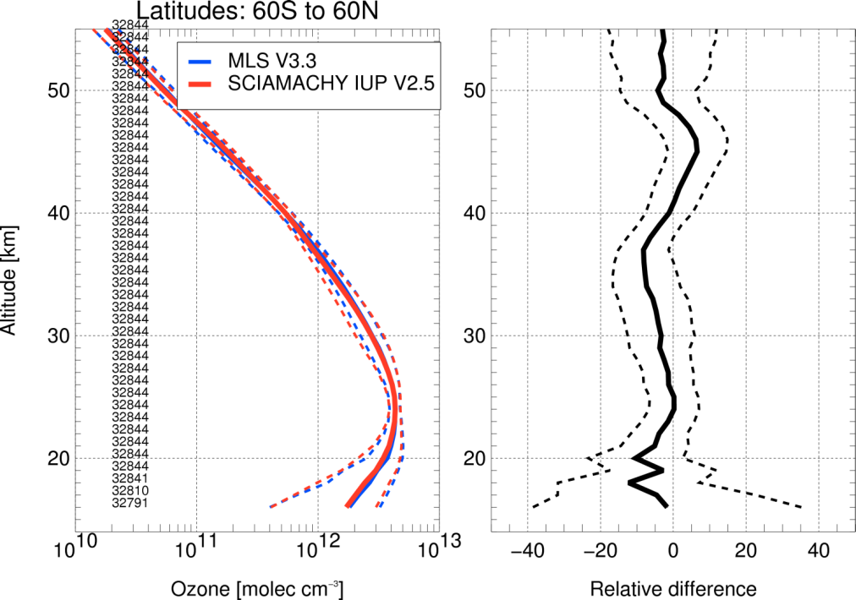
SCIAMACHY V2.5 validation: MLS V3.3
Change from SCIA V2.1 to V 2.5:
aerosol profile climatology (Fussen & Bingen 1999), albedo data base, new level 1 version (V7), 4 profiles per horizontal scan
SCIA V2.5 validation work in progress
MLS v3.3 collocations: <6h, <50 km
agreement within [-10%, +5%] (depending on altitude) in the 20-50 km range

Slide 12
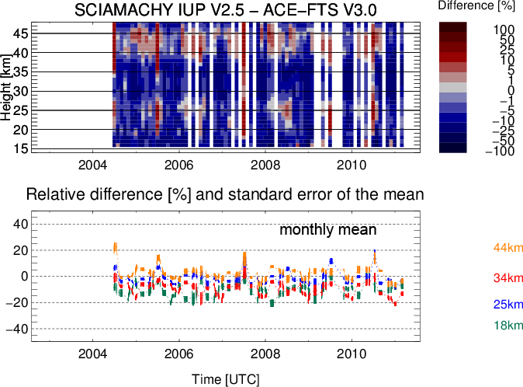
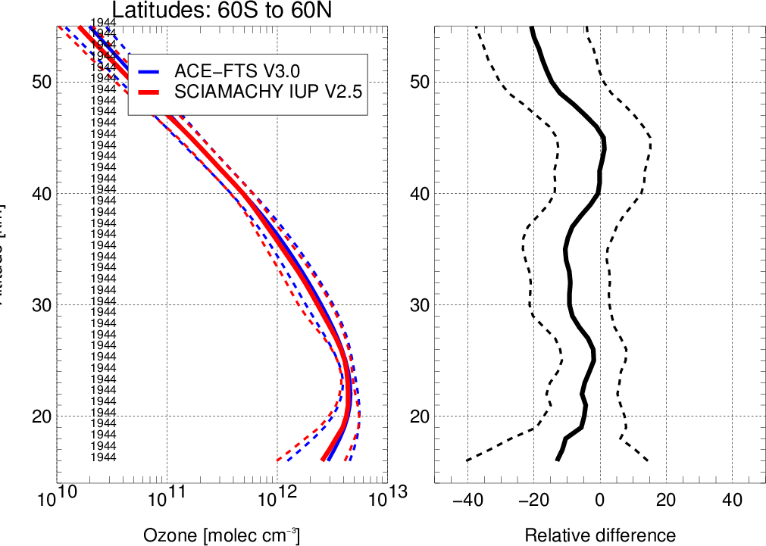
SCIAMACHY V2.5 validation: ACE-FTS V3.0
SCIA V2.5 validation work in progress
ACE FTS V3 collocations: <6h, <500 km
SCIA minus ACE-FTS -10 to -5 %, above 45 km larger neg. bias

Slide 13
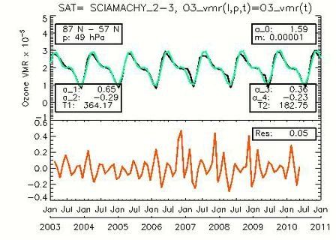
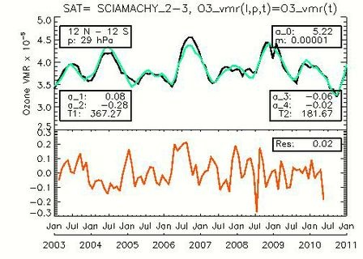
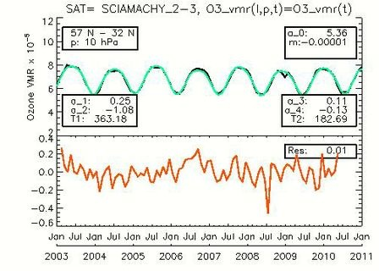
SCIAMACHY O3 timeseries
Arctic, 49hPa
tropics, 29hPa
Work in progress
Timeseries analysis
Trend model: seasonal, solar, QBO, residual linear trend
NH mid, 10hPa

Slide 14
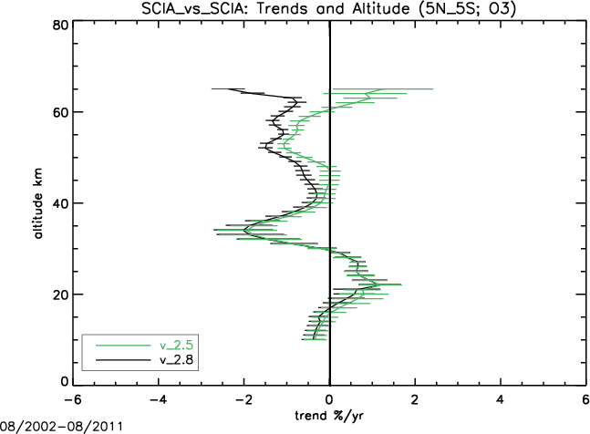
Summary
Data issues
  Tangent height offset related drift (mainly first years of SCIAMACHY)
    Corrections under investigation
    New version 2.5T?
  upper stratospheric trends are influenced by met analysis used in the retrieval (p,T profiles)
    under investigation
Ozone science
  27 day solar signature (Dikty et al., 2010
  Antarctic and Arctic chemical ozone losses (Sonkaew et al., 2011)
  Solar proton event related ozone losses (Rohen et al., 2006)
  Longterm trends (Jones et al., 2009, Steinbrecht et al., 2009)
Linear trends after
QBO & seasonal
terms removed
V2.5: ECMWF
V2.8: ERA-Interim

Slide 15
Outlook/future needs
Further improvements in level-1 data (scan angle spectral degradation)
  ESA SCIAMACHY Quality Working Group (SQWG) activity
Consolidation for use as climate data record /merging with other ESA sensor data (GOMOS/MIPAS/ESA-TPM) and historical data (SAGEs/HALOE)
  ESA ozone cci project
With (probable) loss of ENVISAT/aging of other missions
  danger of high vertical resolution ozone profile data gaps!

Slide 16
additional slides

Slide 17
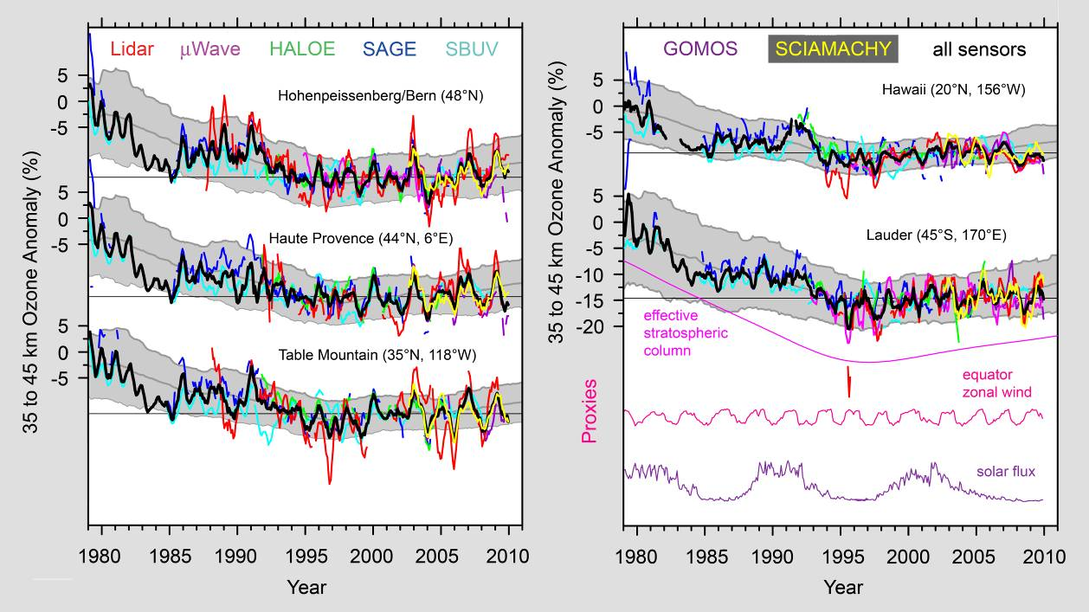
Long-term trends in stratospheric O₃
x
Adapted from Steinbrecht et al., Ozone and temperature trends in the upper stratosphere at five stations of the Network for the Detection of Atmospheric Composition Change, Int. J. Rem. Sens. [2009]

Slide 18
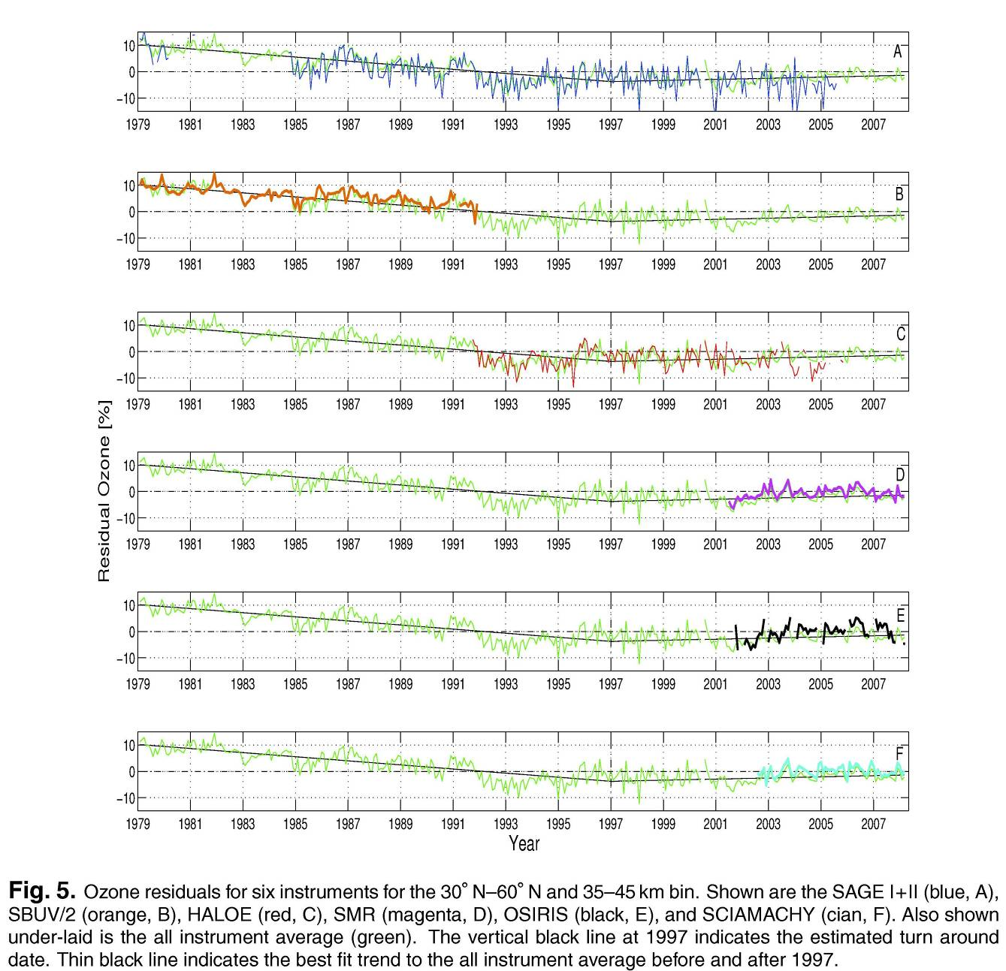
Long-term trends in stratospheric O₃
Jones et al., Evolution of stratospheric ozone and water vapour time series studied with satellite measurements, Atmos. Chem. Phys. 9, 6055 – 6075, 2009.
SAGE I + II
SBUV/2
HALOE
SMR/Odin
OSIRIS/Odin
All instrument
average
SCIAMACHY

Slide 19
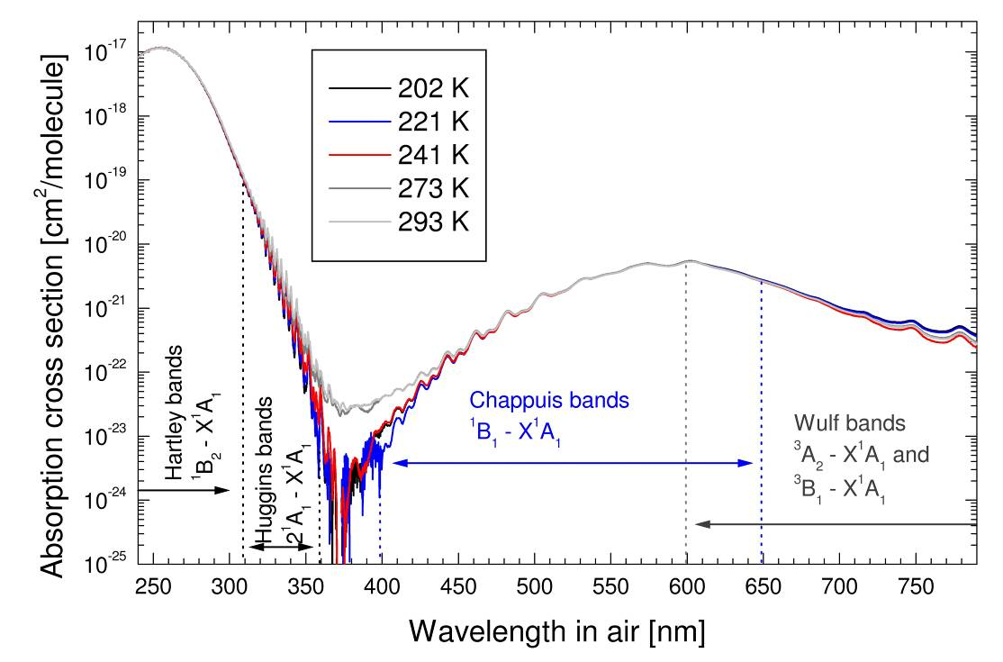
SCIAMACHY limb ozone retrieval
  Simultaneous retrieval in Hartley, Huggins and Chappuis bands (current version Stratozone 2.5)
  Wavelength triplet in Chappuis-bands: 525 nm, 600 nm 675 nm [Flittner et al., 2000; von Savigny, 2002]
  Wavelet singlets in Hartley-Huggins-bands [Rohen,2006]
(GOME FM O₃ absorption cross section Burrows et al. [1999])

Slide 20
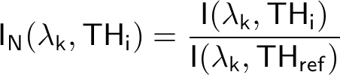
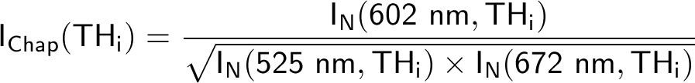
Retrieval method
Step 1: Tangent height Normalization
I: Limb radiance
TH: tangent height
TH_{ref}: reference tangent height
k: wavelength index (k ∈ [1,11])
Wavelengths (nm) | 264 | 267.5 | 273.5 | 283 | 286 | 288 | 290 | 305 | 525 | 602 | 675
TH_{low} (km) | 52 | 52 | 52 | 45 | 45 | 45 | 45 | 35 | 9 | 9 | 9
TH_{ref} (km) | 71 | 71 | 71 | 68 | 65 | 65 | 61 | 55 | 41 | 41 | 41
Step 2: Form Chappuis-triplet (Flittner, 2000; von Savigny, 2002)
Then construct retrieval vector:

Slide 21
Version 2.5 ozone limb retrieval
Feature |  | Additional remarks
Retrieved quantity | O₃ concentration
Altitude grid | Regular 1 km grid (10 – 80 km)
Inversion scheme | Iterative Gauss-Newton | Weak statistical contraint and smoothness constraint
Weighting function calculation | Analytically in single-scattering mode
Vertical resolution | About 4 km between 15 and 65 km altitude | Averaging kernels for every retrieved profiles available
Level 1 data used | Version 7.03 or higher | Including AUX_FRA platform attitude correction files as well as SCIAMACHY extra misalignment correction
Background atmosphere | 6-hourly pressure & temperature data from ECMWF analyses
Stratospheric aerosol extinction profiles | ECSTRA aerosol extinction data base [Bingen and Fussen, 2000] | Using climatological NCEP tropopause height by Randel et al. [2000]
Stratospheric aerosol phase function | Henyey-Greenstein with g ≈ 0.7
Surface albedo data | Matthews [1984] data base
O₃ X-sections | Bogumil Version 2.0 | SCIAMACHY FM X-sections
Pointing correction | No additional pointing correction applied
Cloud flagging | Tropospheric, stratospheric and mesospheric clouds are detected | Cloud flags provided in O₃ Level 2 data

