Slide 1
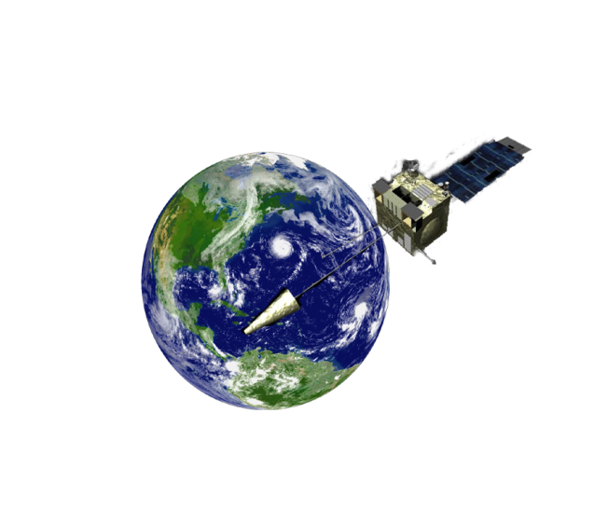

CEOS Atmospheric
Composition Portal (ACP)
Presented by Chris Lynnes
on behalf of the ACP Team
ACC-8
19 April, 2011
Columbia, Maryland

Slide 2
ACP Mission Statement
Provide access, tools, and contextual guidance to scientists and value-adding organizations in using remotely sensed atmospheric composition data, information, and services.
Help foster interoperability and application of atmospheric composition data, information and services worldwide.
Identify the unique requirements and common (shared) features of the ACC and GEOSS users to provide a value-added and complementary capability.
Work with partners in CEOS and the broader AC community in advancing the ACP
2
Notes:
2

Slide 3
ACP Technical Team
DLR
  Oleg Goussev
  Séverine Bernonville
  Michael Bittner
  Volker Mohnen
NASA
  Richard Eckman
  Ernie Hilsenrath (emeritus)
  Frank Lindsay
  Karen Moe
  GES DISC
    Chris Lynnes
    Peisheng Zhao
    Wenli Yang
    James Johnson
    Suraiya Ahmad
  Stefan Falke (Northrop Grumman)
  Rudolf Husar (Washington University)
  Erin Robinson (ESIP)

Slide 4
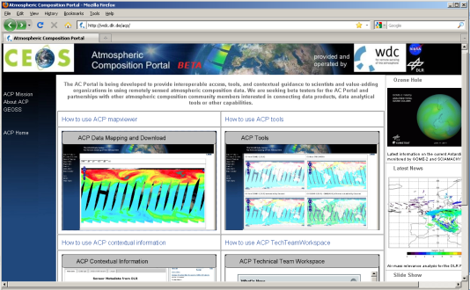
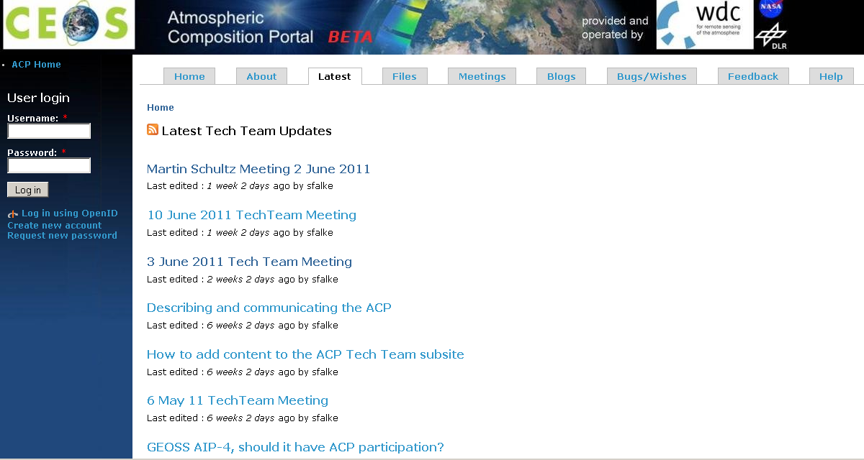
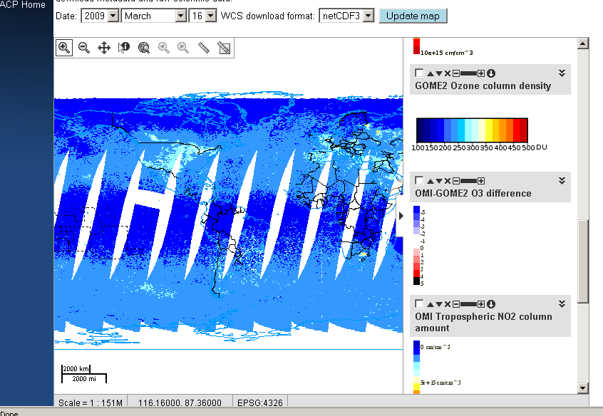
ACP at the Intersection of
Atmospheric and Information Sciences
The ACP aims to provide a community-oriented framework that applies best practices in information science and technology to atmospheric composition science.
ACP-Beta
http://wdc.dlr.de/acp/

Slide 5
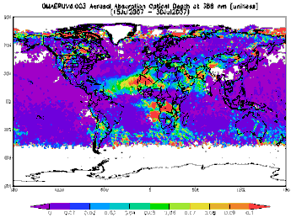
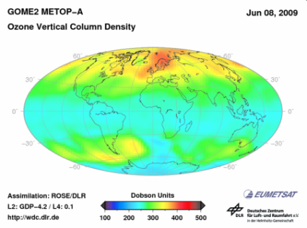
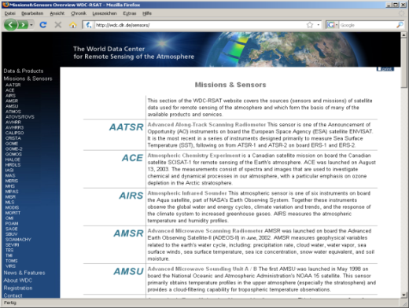
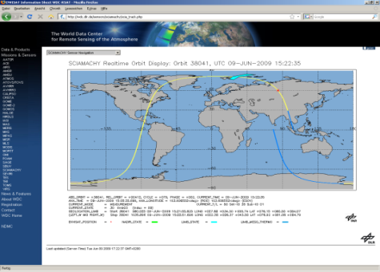
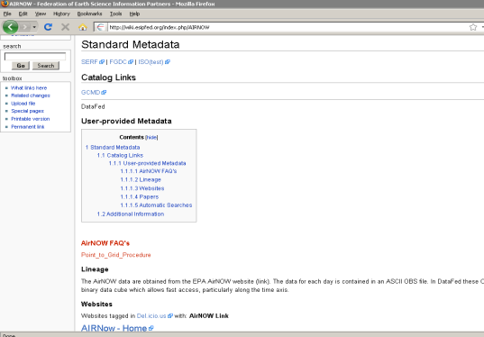
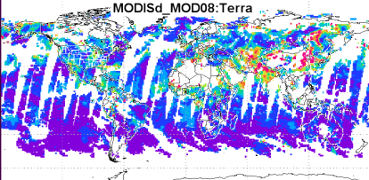
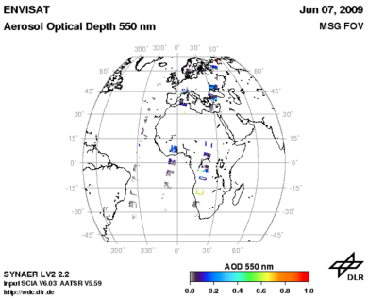
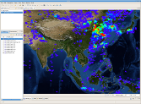
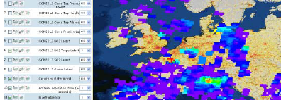
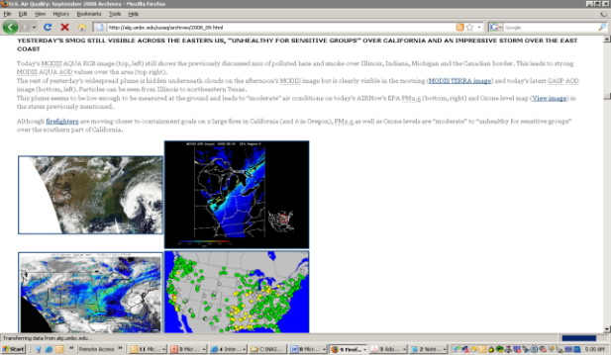
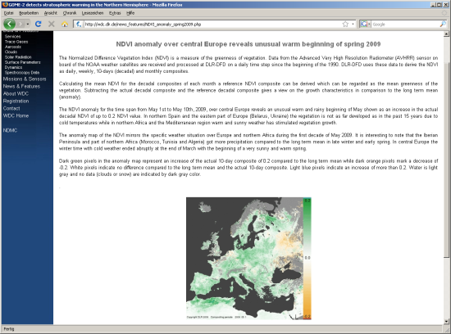
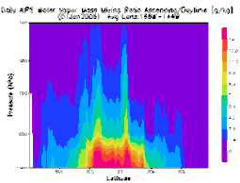
Features of the ACP Framework
5
Improved access to data
Contextual Information to help understand and use data
OMI
GOME-2
MODIS
SCIAMACHY/
AATSR
And others…
Tools for processing
and analysis
Collaboration tools for exchanging analyses and other information
5

Slide 6
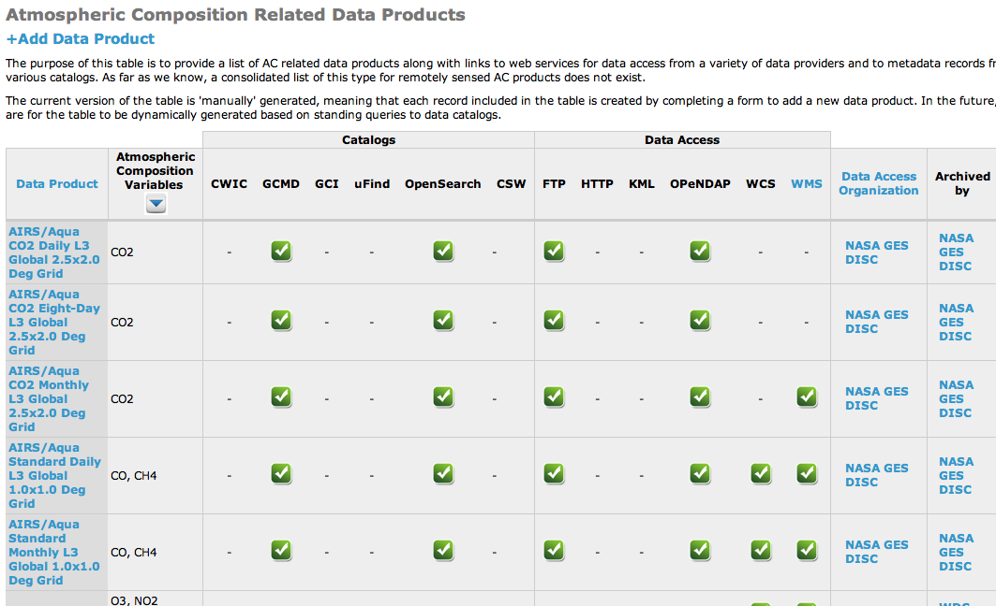
New: Data Table
Data access points for the data
Data catalog entries for the data

Slide 7
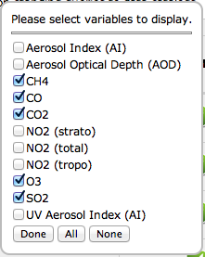
New: Data Table
Filter by variable

Slide 8
Coming this month: Simple Subset Wizard
Subsetting today:
  Locate data center
  Learn data center search tool
  Search for datasets
  Search for files
  Select files
  Add files to shopping cart
  Specify subsetting criteria
  Request Subsets
Simple Subset Wizard
  Locate data center
  Learn data center search tool
  Search for datasets
  Search for files
  Select files
  Add files to shopping cart
  Specify subsetting criteria
  Request Subsets
  Currently promoting to Operations
  Will be available from ACP home page

Slide 9
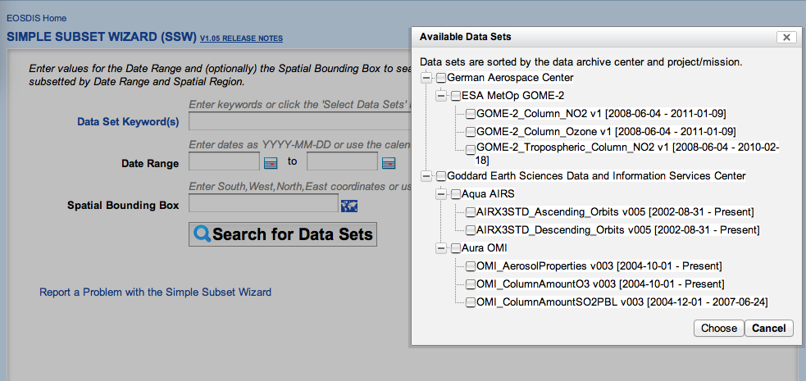
Coming this month: Simple Subset Wizard

Slide 10
Planned: Multi-sensor Data Synergy Advisor
NASA technology project to provide salient information on the key differences between data products
Initially developed for Aerosols
Can be extended for Ozone
Uses semantic web technology to store knowledge base in a machine readable / interpretable form

Slide 11
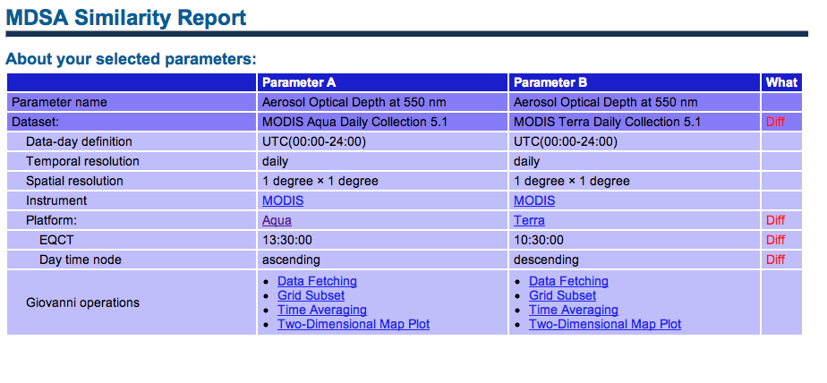
Planned: Multi-sensor Data Synergy Advisor
MDSA provides users with key info about similarities and known issues when comparing or merging datasets

Slide 12
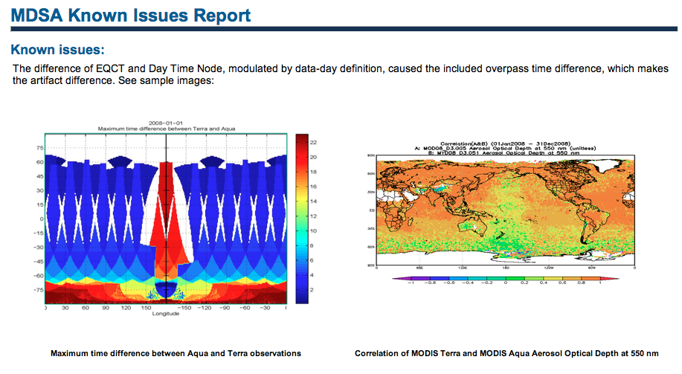
Planned: Multi-sensor Data Synergy Advisor
MDSA provides users with key info about similarities and known issues when comparing or merging datasets

Slide 13
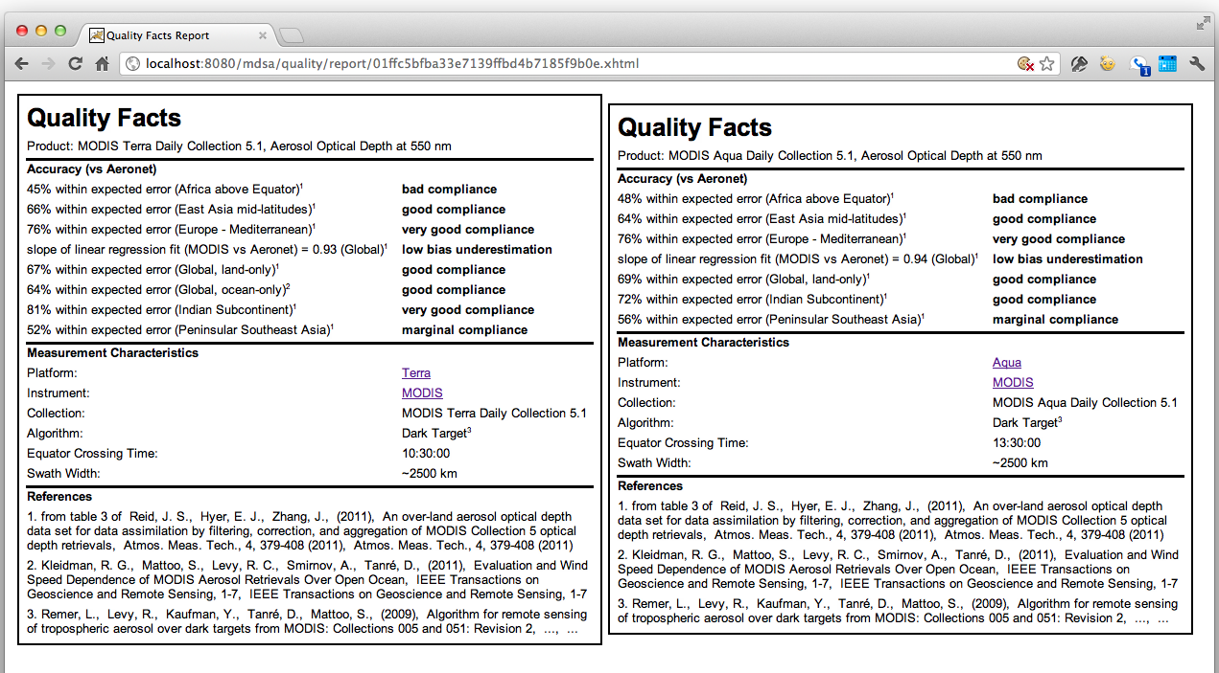
Planned: Multi-sensor Data Synergy Advisor

Slide 14
Planned: MDSA KnowledgeBase for Ozone
Basics of products
  satellite, instrument, orbital characteristics
  temporal, spatial resolution
Retrieval algorithms
  wavelengths used
  algorithm
Quality
  accuracy, uncertainty
  other quality dimensions (e.g., completeness, diurnal sampling)
Known Issues

Slide 15
Populating the Knowledge Base
Literature
Algorithm Theoretical Basis Documents
User’s Guides
Cal/Val Reports
Knowledge from Ozone Scientists(!)

Slide 16
ACP Collaborations in Progress
QA4EO
  Albrecht van Bargen, DLR and Bojon Bojkov, ESA
  Defining ACP role in providing ‘inputs’ and using ‘outputs’ of QA4EO process
AC Modelers
  Martin Schultz, Juelich Research Center
  Sharing of data via OGC Web Coverage Service, reuse of tools
AC Emissions
  Greg Frost, NOAA
  Sharing of data via OGC Web Coverage Service, reuse of tools
Myair PASODOBLE (http://www.myair-eu.org/)
  In development stages…
GEOSS Air Quality Community of Practice Information Network
  GEOSS AQ CoP meeting 23-25 August 2011 (co-organizers Rudy Husar and Martin Schultz) - http://wiki.esipfed.org/index.php/Air_Quality_Data_Network_Solta_2011
  Advancing networking and interoperability of AQ-related data systems
Earth Science Information Partners
  Air Quality, Semantic Web, Discovery, Earth Science Collaboratory Clusters

Slide 17
Need your input on:
Populating the Data Table
Populating the Ozone Comparison Knowledge Base

