Slide 1
A European modelling view on (total) ozone data set usage within climate models
P. Braesicke
University of Cambridge, UK

Slide 2
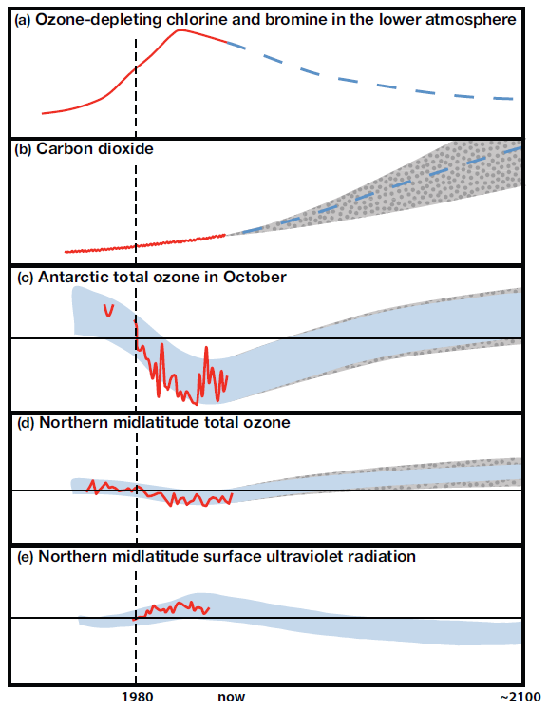
WMO/UNEP Scientific Assessment of Ozone Depletion 2010
“There is now new and stronger evidence of the effect of stratospheric ozone changes on Earth’s surface climate, and of the effects of climate change on stratospheric ozone. These results are an important part of the new assessment of the depletion of the ozone layer presented here.”
Notes:
The UNEP/WMO O3 Assessment as motivation: Link between ozone and climate change; no error bar on the observations; due to prevailing (model) biases everything is normalised

Slide 3
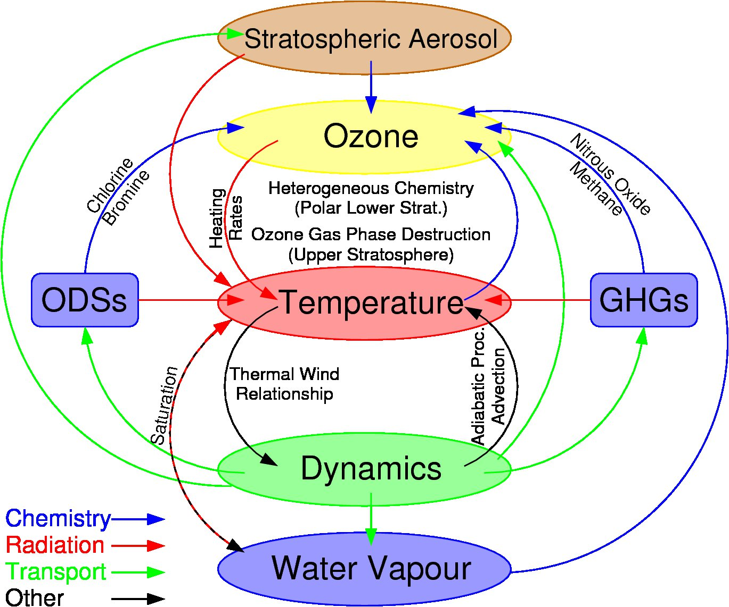
UNEP/WMO O3A 2010:
http://montreal-protocol.org/Assessment_Panels/SAP/Scientific_Assessment_2010/index.shtml
O3A: Ozone Assessment – Scientific Assessment of Ozone Depletion
Notes:
The system is highly coupled: We cannot look at ozone in isolation. We need good observations (reanalysis data) of temperature and winds (circulation) as well. Therefore the examples will try to link meteorology and ozone.

Slide 4
Ozone Challenges (Examples)
Do we capture/know the mean state?
Quantifying natural variability
Winter eddy heat flux and ozone change
Ozone loss and volume of polar stratospheric clouds (PSCs)
Attributing ozone changes
Mt Pinatubo eruption and ozone change
Determining trends
Dynamical versus chemical trends
Interdependent!

Slide 5
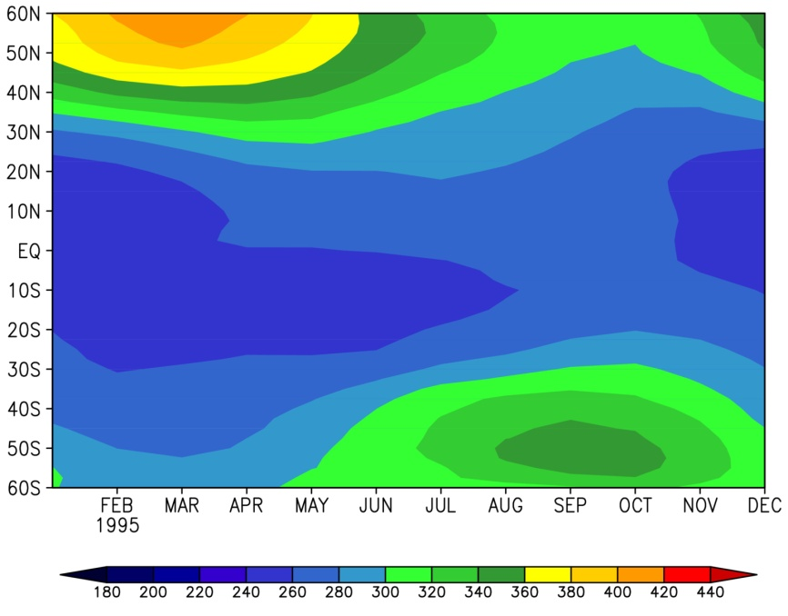
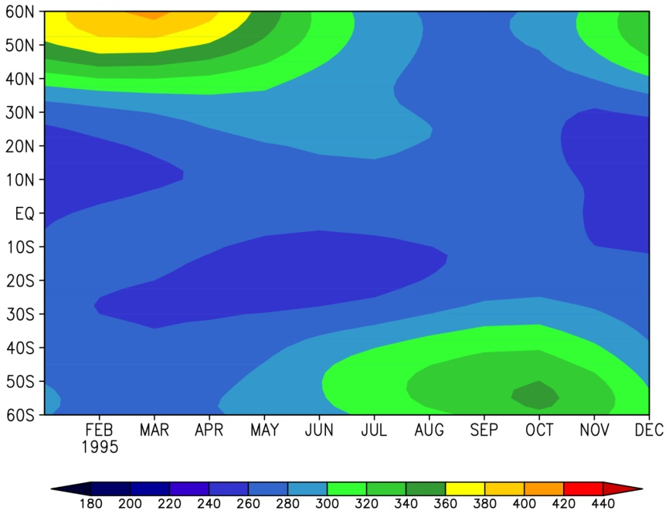
GOME Observations
UMUKCA Timeslice
Latitude
Latitude
Characterising Ozone Distributions
PDF
PDF

Slide 6
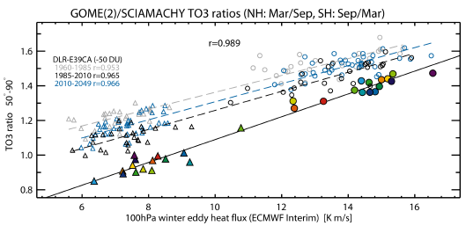
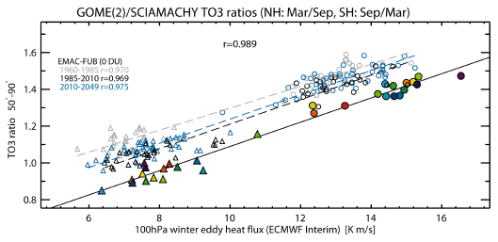
Even though models are generally able to capture the observed relationship between winter eddy heat flux and ozone change, questions about the compactness and slope of the relationship remain.
Biases, both in models and observations, are still a challenge.
A better quantitative understanding of how the mechanism works is still required.
Weber et al., ACP, 2011

Slide 7
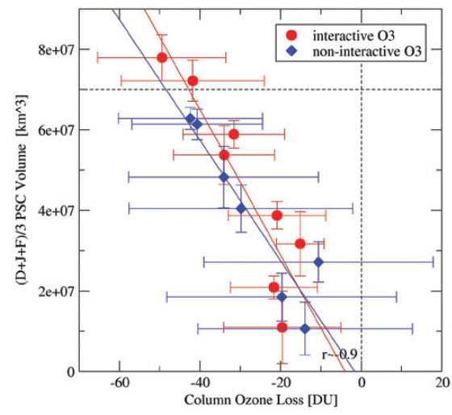
Quantifying Natural Variability
NH O3 Loss and Temp. Variability
Observations:
Rex et al., GRL, 2003
UM with parameterised stratospheric chemistry:
Pyle, Braesicke and Zeng, Faraday Discuss., 2005
All meteorological conditions are used and the data are binned; this produces the error bars – each data point represents at least four model years – accounting for variability properly requires long (expensive) model integrations and high quality measurements over many years.
Aside: This (old) model version had less ozone loss per PSC volume than observed ...
Notes:
Point: Variability and uncertainty – both are not very well quantified. We are limited by the number of observed years and by the length of our model integrations. We are currently planning longer, well specified time-slice integrations to address this in the model.

Slide 8
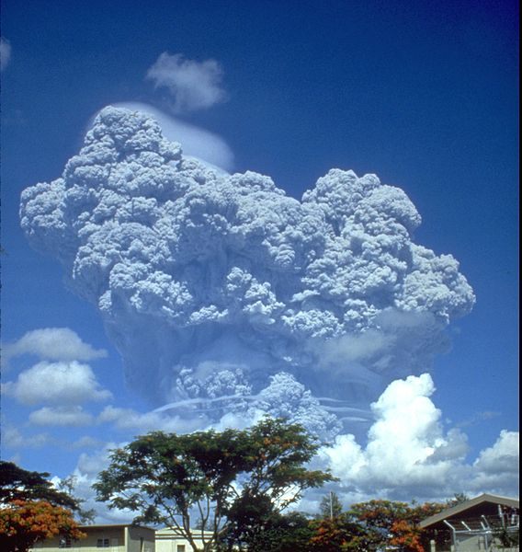
Mount Pinatubo and Strat. O3
Aerosol:
Can be modelled or prescribed!
The eruption column of Mount Pinatubo on June 12, 1991, three days before the main eruption.

Slide 9
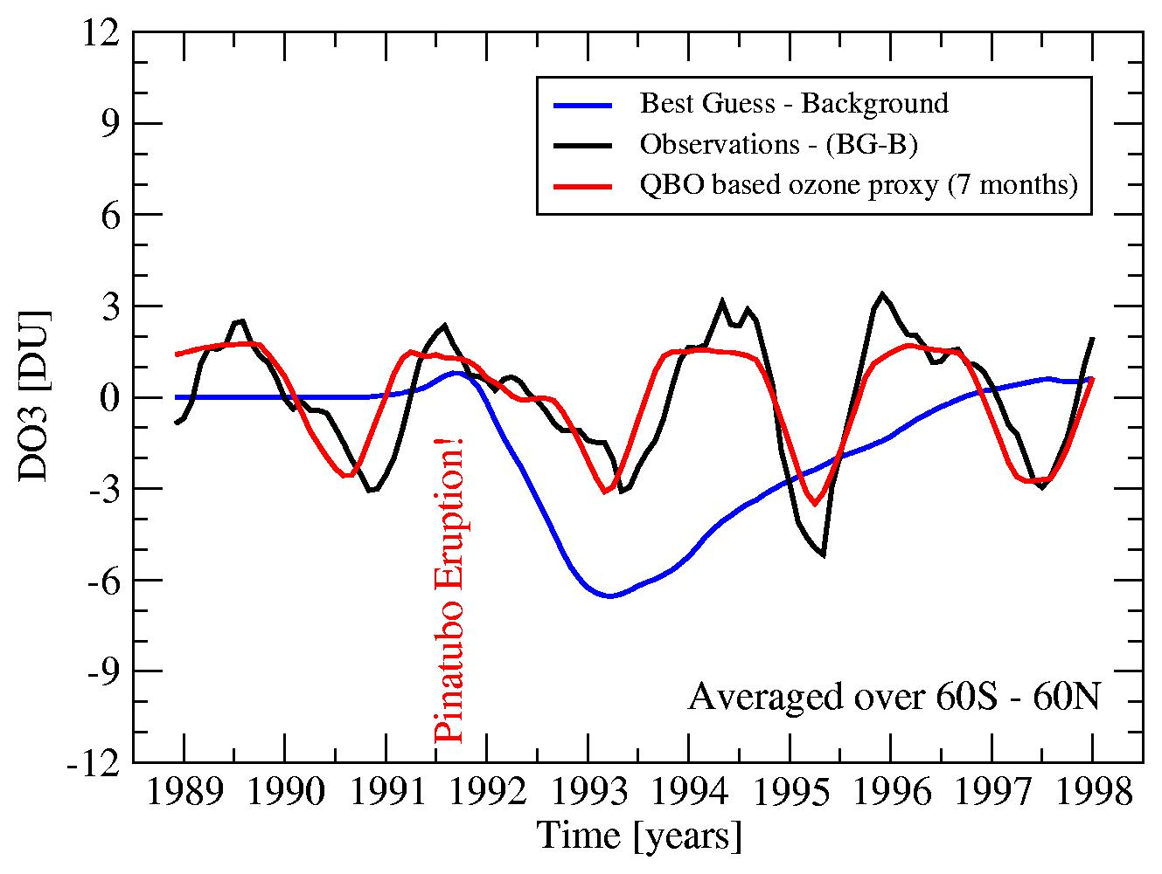
Attribution of O3 changes
“Global Ozone” (60°S-60°N)
Application of nudged UMUKCA
Nudged UMUKCA:
Relaxation assimilation of ECMWF horizontal winds and temperatures
Telford et al., ACP, 2009
Recently: Impact of the Pinatubo Eruption on Isoprene;
Sarychev eruption (Jim Haywood, Met Office)
Ozone lost due to chemistry on aerosols (model only).
Residual (dynamical) ozone variation (observation and model).
QBO proxy (can account for most of the residual).

Slide 10
A Useful Statement ...
While, the importance of dynamical influences on ozone trends has been recognised for some time, the difficulties in quantifying the impact has led to past trends being generally attributed to halogen chemistry with an implicit assumption that any uncertainties resulting from interannual changes in dynamics are adequately represented in the error bars associated with the trend estimates. This assumption holds as long as the underlying dynamical behaviour (and variability) does not change over the period under consideration. However, if changes are occurring on decadal timescales, then this no longer holds true.
Harris et al., Ann. Geophys., 2008

Slide 11
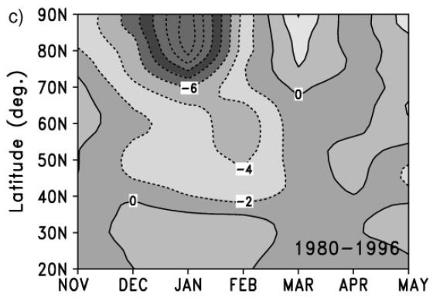
Dynamical Trends
Midwinter vortex strength and high latitude total ozone are highly correlated.
Successive years with similar dynamical conditions can induce a trend – in this example a number of subsequent strong vortex years produces a negative midwinter trend in total ozone.
Requirement: Improved high latitude coverage during winter.
Braesicke and Pyle, GRL, 2003
Braesicke and Pyle, QJRMS, 2004
Notes:
This could also be illustrated with numerous papers using CTMs – but I am coming from a CCM perspective ... ;-)

Slide 12
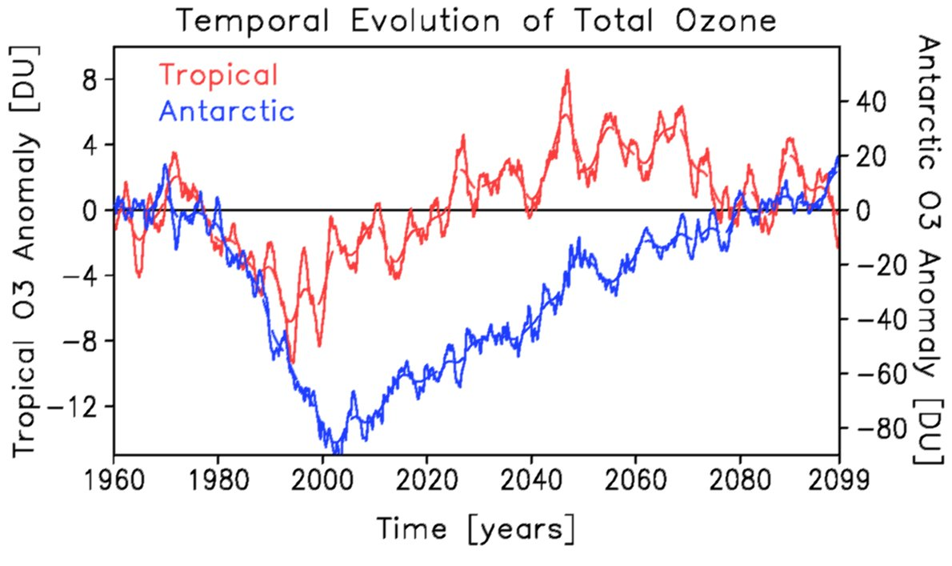
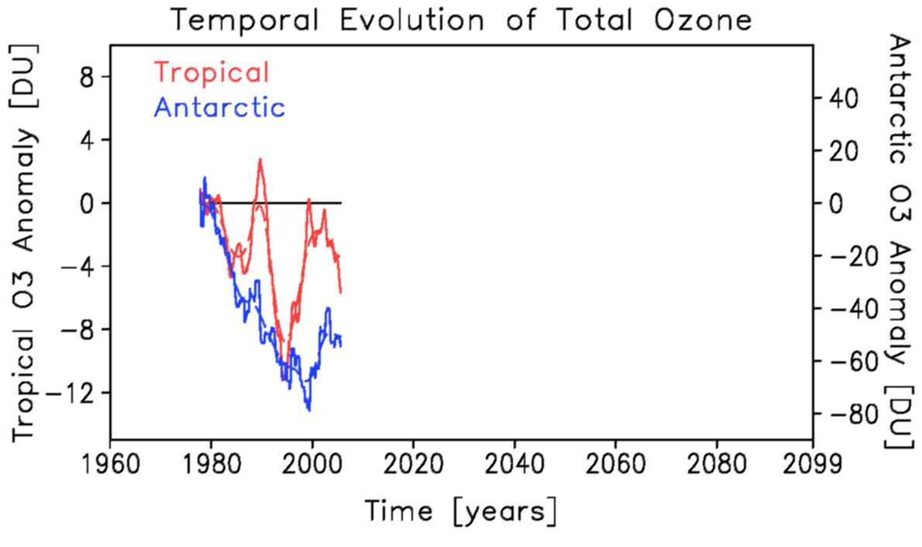
Chemical Trends/Climate Change
UKCA modelled O3
1960-2099
(with HADGEM SSTs)
TOMS observed O3
1978-2005
NIMBUS7 +
METEOR3 +
Earth Probe
Ozone values vary with the total halogen amount; but climate change modifies the recovery/return of ozone values.
Notes:
This trace is part of the summary figure in O3A.

Slide 13
Summary and Conclusion
We need continuous, precise, drift free observations of (total) ozone, with good temporal and spatial coverage, to
Quantify natural variability
Attribute ozone changes
Assess trends (dynamical/chemical)
The current efforts in merging data sets across sensors are extremely important; looking into the future it would be desirable to minimise discrepancies between future sensors (admittedly very hard to do)
The interpretation of measurements requires high quality meteorological data and long climate model integrations – close links to the operational weather centres and climate research institutions are important

Slide 14
Thank You!

Slide 15
UMUKCA Chemistry-Climate Model
UMUKCA is
based on the Met Offices Unified Model (UM)
grid point model (N48,96,216,320; L60,85), non-hydrostatic, hybrid sigma-height vertical coordinate, includes physical parameterisations for weather forecasts and climate projections (was v6.1 for CCMVal; now v7.3)
the UK’s community chemistry-climate model
the climate model can be ‘nudged’ with reanalysis data (ERA-Interim)
Chemistry: Stratospheric, Tropospheric, CheST
ASAD with Newton-Raphson solver & Fast-Jx photolysis
Aerosol: modal scheme (prescribed for CCMVal)
UKCA is part of the UM ESM setup (Ocean, Biosphere (Vegetation), Cryosphere, etc.)
Notes:
Number of gridpoints globally: N48: 2x48=96 in longitude; 1.5x48=72 in latitude

