Slide 1




Total ozone algorithms developments for GOME, SCIAMACHY and GOME-2 as part of the ESA Ozone_cci project
M. Van Roozendael, C. Lerot, J.-C. Lambert, D. Loyola, M. Coldewey-Egber, R. Spurr, D. Balis, M.L. Koukouli, C. Zehner
CEOS ACC-8, 18-19 April 2012, Columbia, MD

Slide 2
ESA Ozone_cci
Climate Change Initiative Programme
  Phase 1: 2010-2013
  Focus on 11 ECVs (Atmosphere, Land, Ocean)
  Make best use of ESA and ESA TPM sensors
Total ozone
Nadir profiles
Limb profiles
Validation
L2 algorithms
Climate Modeling
L3 merged products
L4 assimilated products
System Specifications

Slide 3
Ozone sensors
CCI focus

Slide 4













Project participants
Belgian Institute for Space Aeronomy
German Aerospace Center
Royal Netherlands Meteorological Institute
Rutherford Appleton Laboratory
University of Bremen
Karlsruhe Institute of Technology
Laboratoire Atmosphères, Milieux, Observations Spatiales
Finnish Meteorological Institute
Aristotle University of Thessaloniki
University of Athens
Royal Meteorological Institute of Belgium
Federal Office of Meteorology and Climatology MeteoSwiss
University of Cambridge

Slide 5
Data products (Phase 1, 2013)

Slide 6
Data products (Phase 2, 2016)

Slide 7
Total ozone work plan
Optimisation of GOME-type direct-fitting algorithm (GODFIT/ GDP5) and transfer to GOME, SCIAMACHY and GOME-2
Prototyping and error analysis
Demonstration → L2 reprocessing 1996-2011, based on scientific prototype (BIRA)
Data merging → L3 data set (DLR)
Validation of L2 and L3 data sets (AUTH)

Slide 8
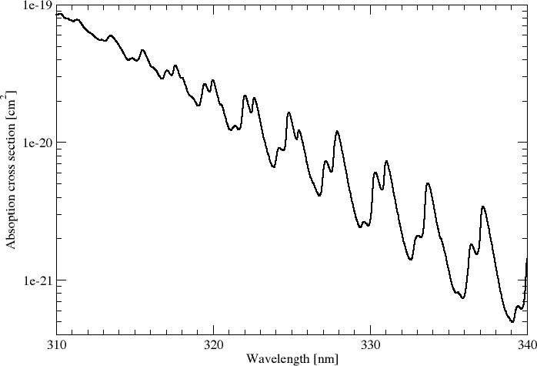
Baseline O₃ algorithm for CCI
325 – 335 nm
Full fitting of measured reflectances using LIDORT v3.3
BDM O₃ cross-sections
T°-shift fitting
Cloud correction using CRB approximation
Surface albedo closure
TOMS v8 profile climatology + OMI-MLS tropospheric ozone (Ziemke et al)
Semi-empirical Ring correction (LUTs)
Polarisation correction (LUTs)

Slide 9
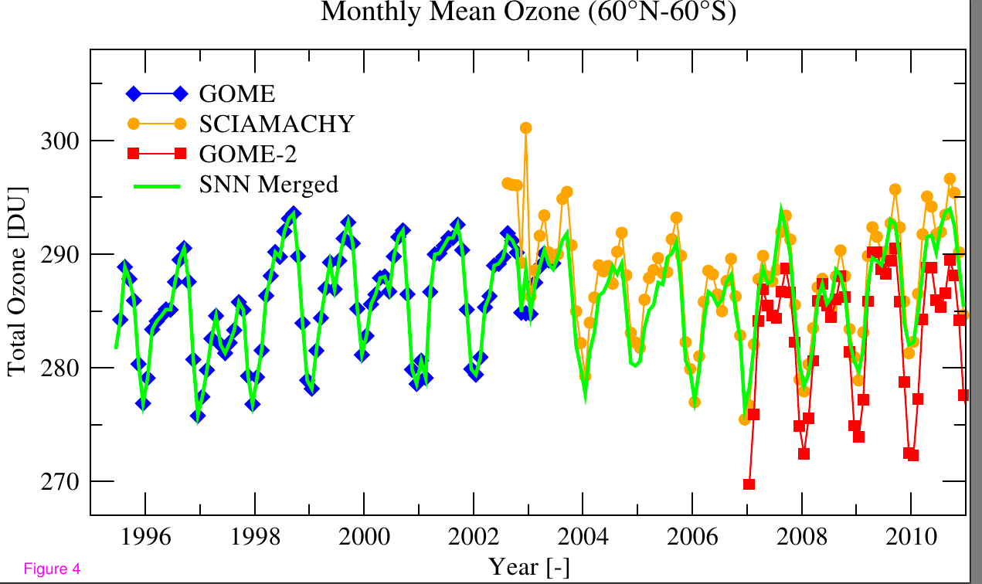
Ongoing work: reflectance correction
Motivation: consistency between sensors limited by the accuracy of the level-1, even for spectral algorithms
Systematic residual biases are found despite L2 harmonisation efforts
These biases limit the usability of multi-sensor L2 data sets, and are a source of error when building merged L3 data sets

Slide 10
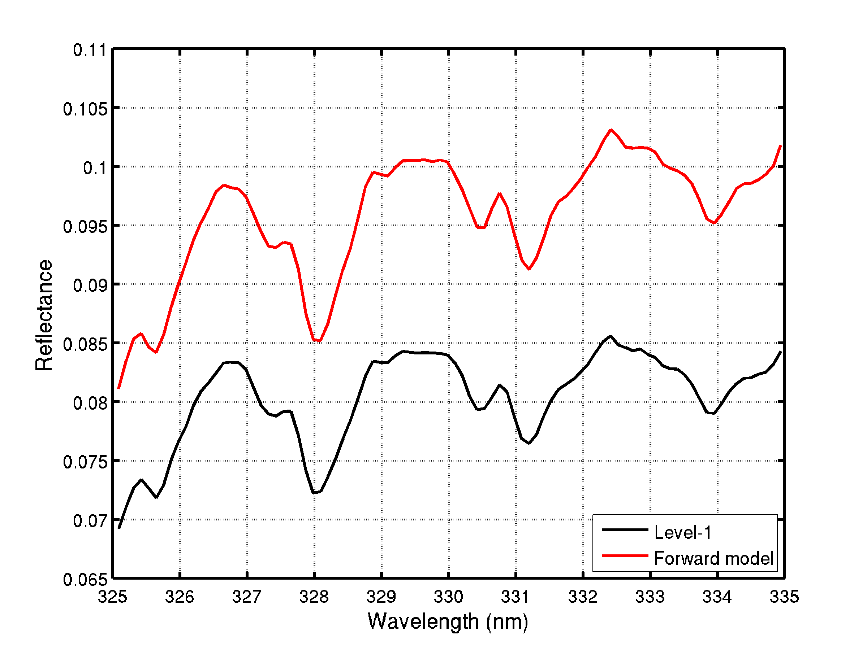
Soft-calibration of level-1
reflectances: method
Extraction of L1 data
Angles
Time, coordinates
Simulator
Sonde O₃ profile
Albedo and elevation
Cloud parameters
Aux. data

Slide 11
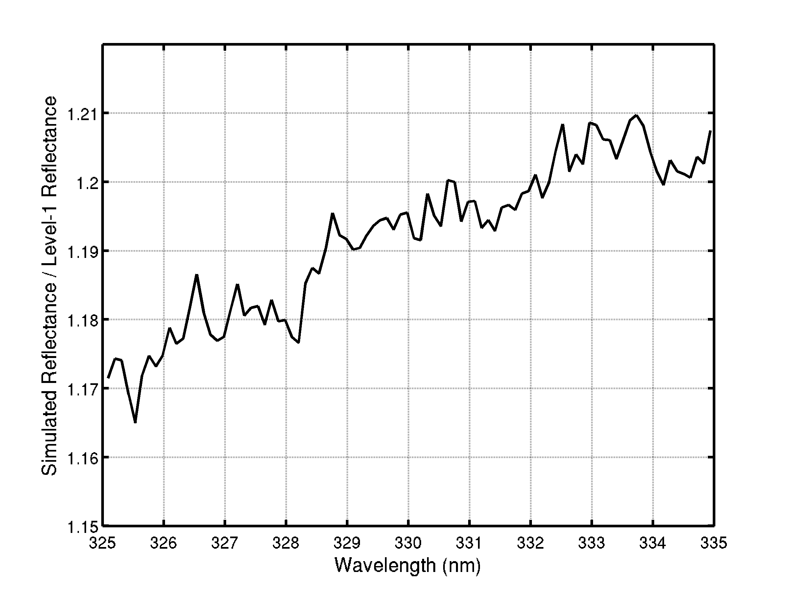
Soft-calibration of level-1
reflectances: method
Extraction of L1 data
Angles
Time, coordinates
Simulator
Sonde O₃ profile
Albedo and elevation
Cloud parameters
Aux. data

Slide 12
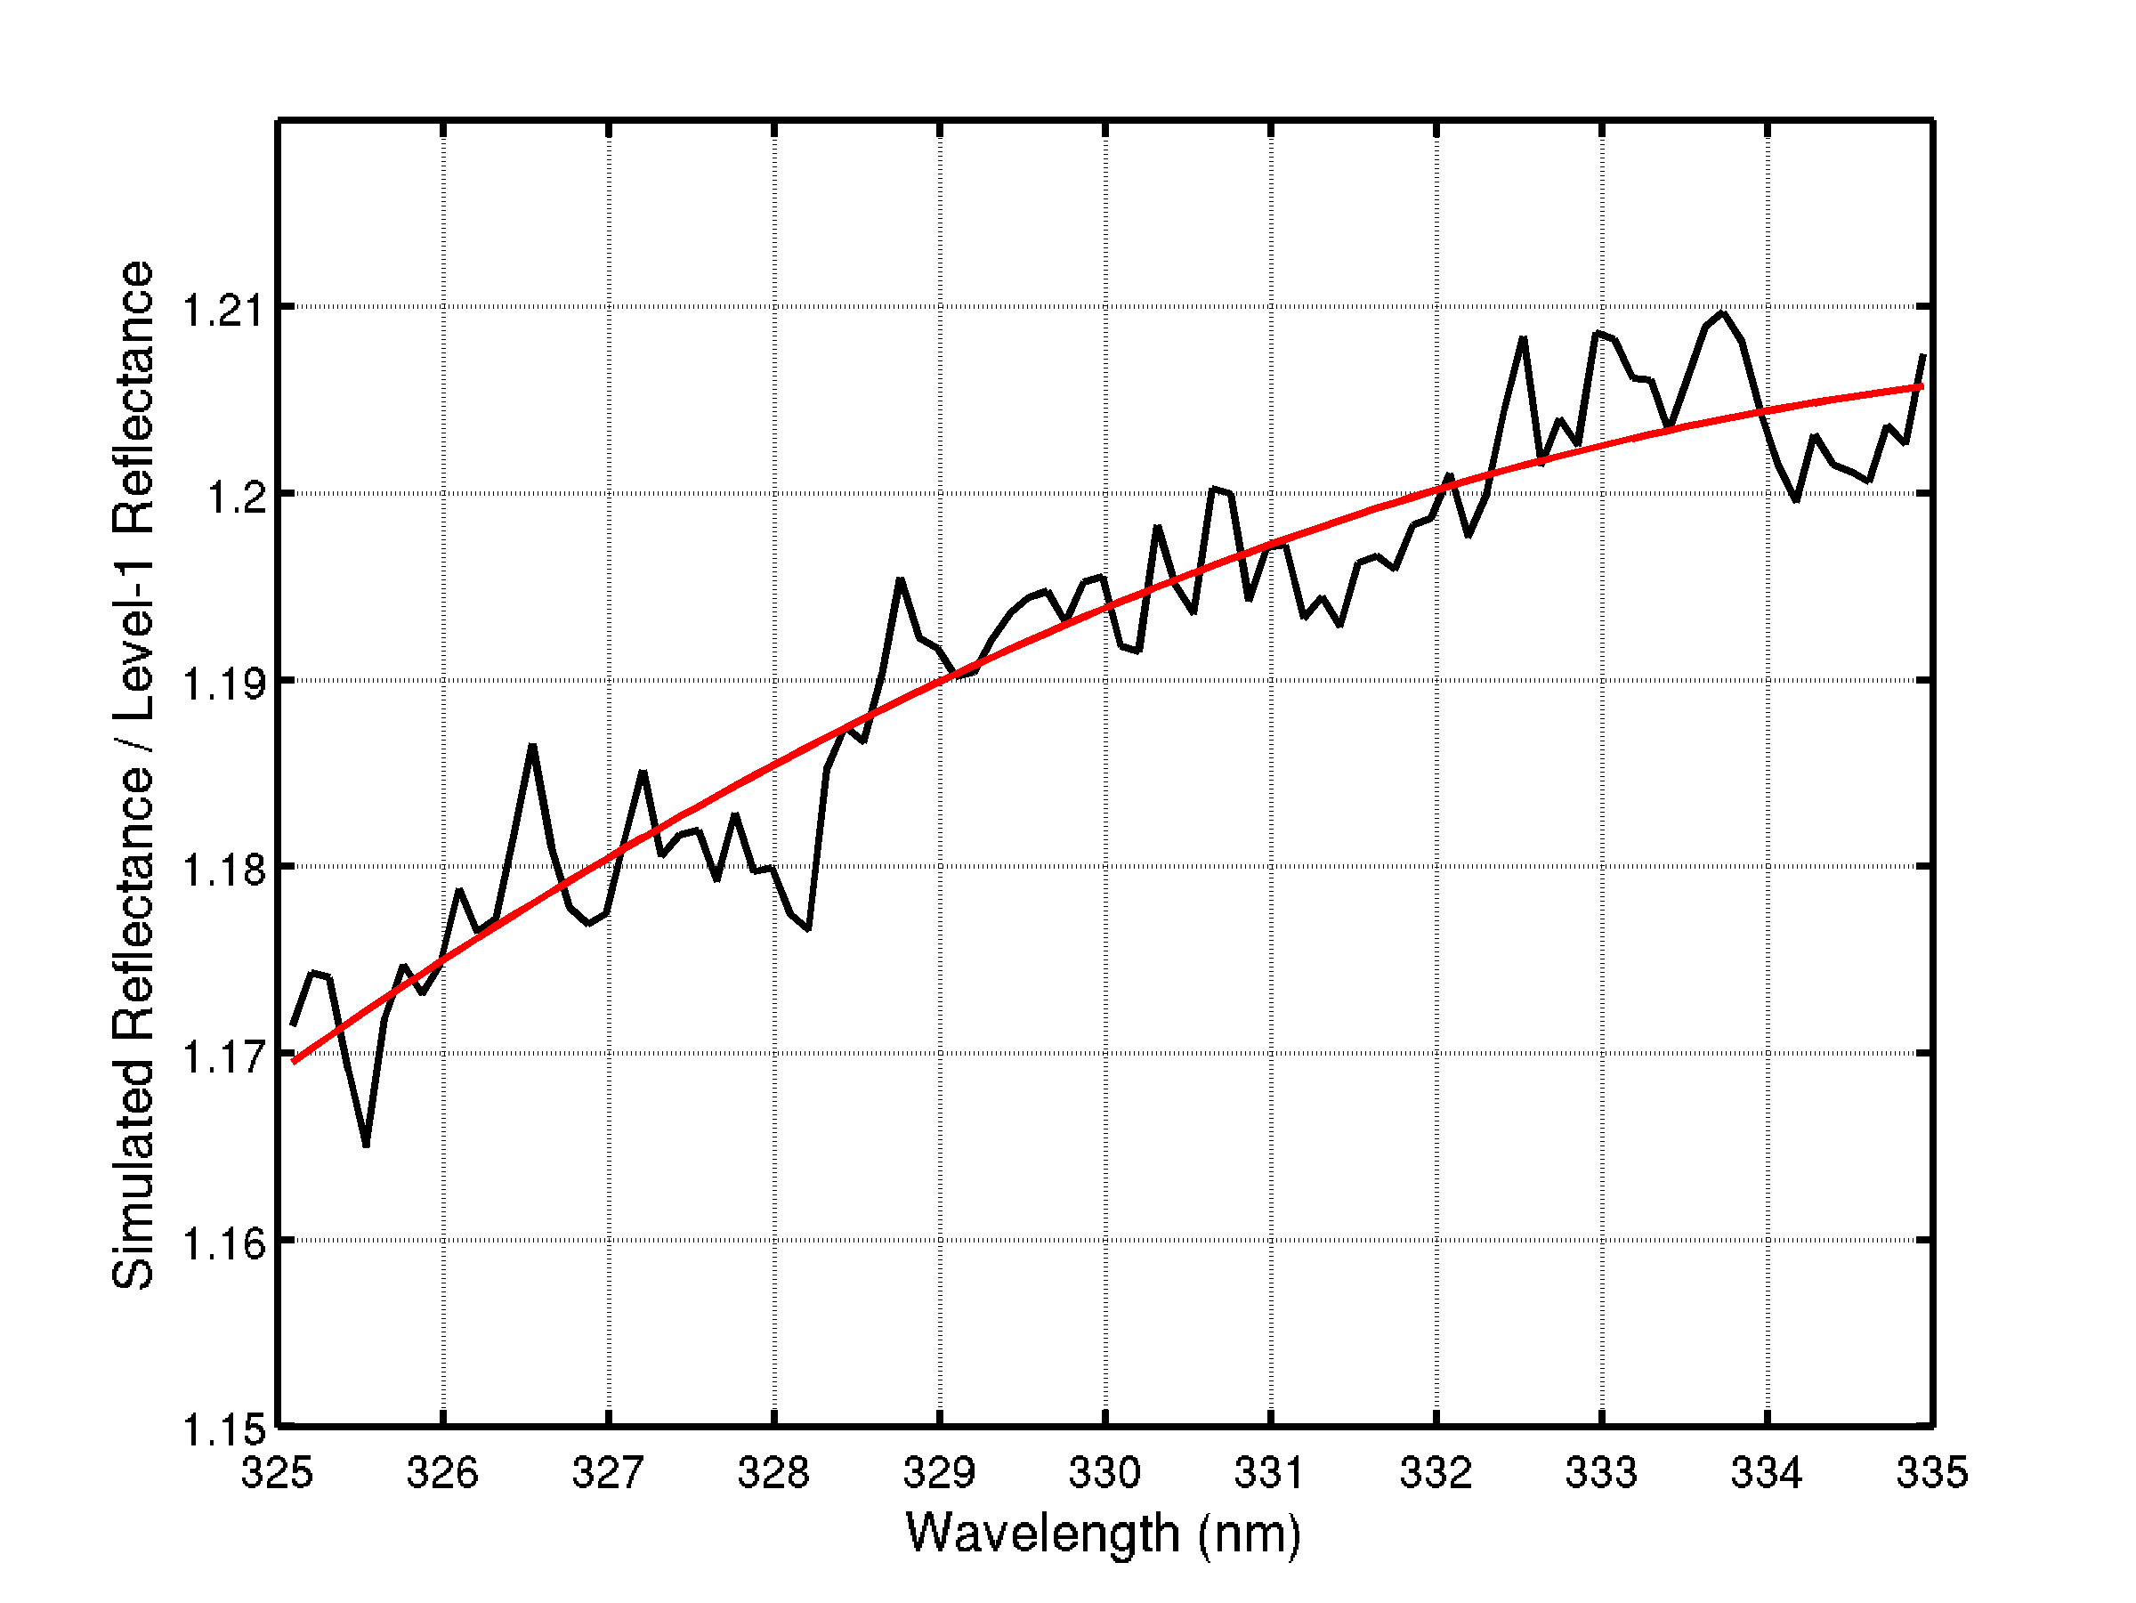
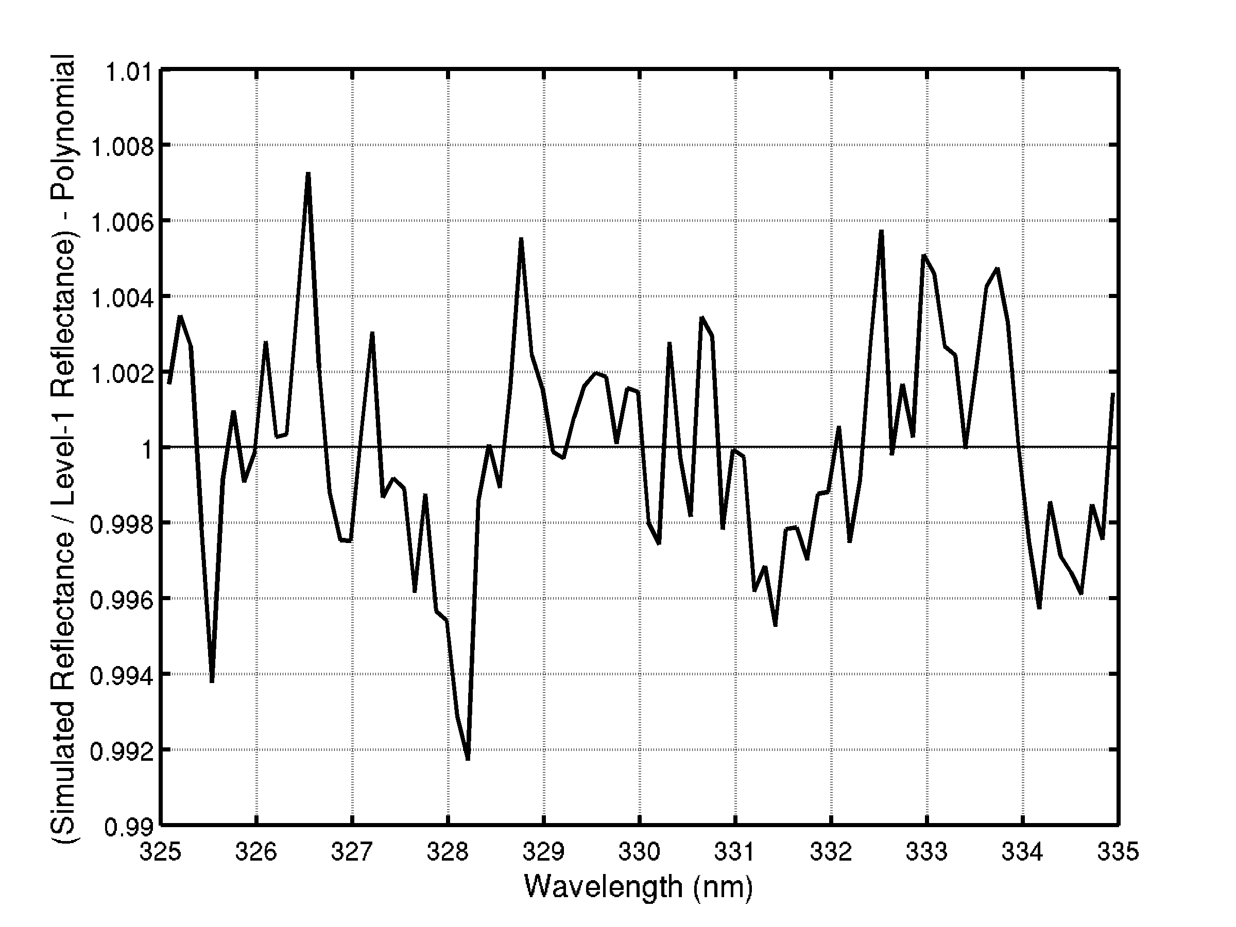
Soft-calibration of level-1
reflectances: method
Absolute errors (offsets)
Extraction of L1 data
Angles
Time, coordinates
Simulator
Sonde O₃ profile
Albedo and elevation
Cloud parameters
Differential errors
Aux. data

Slide 13
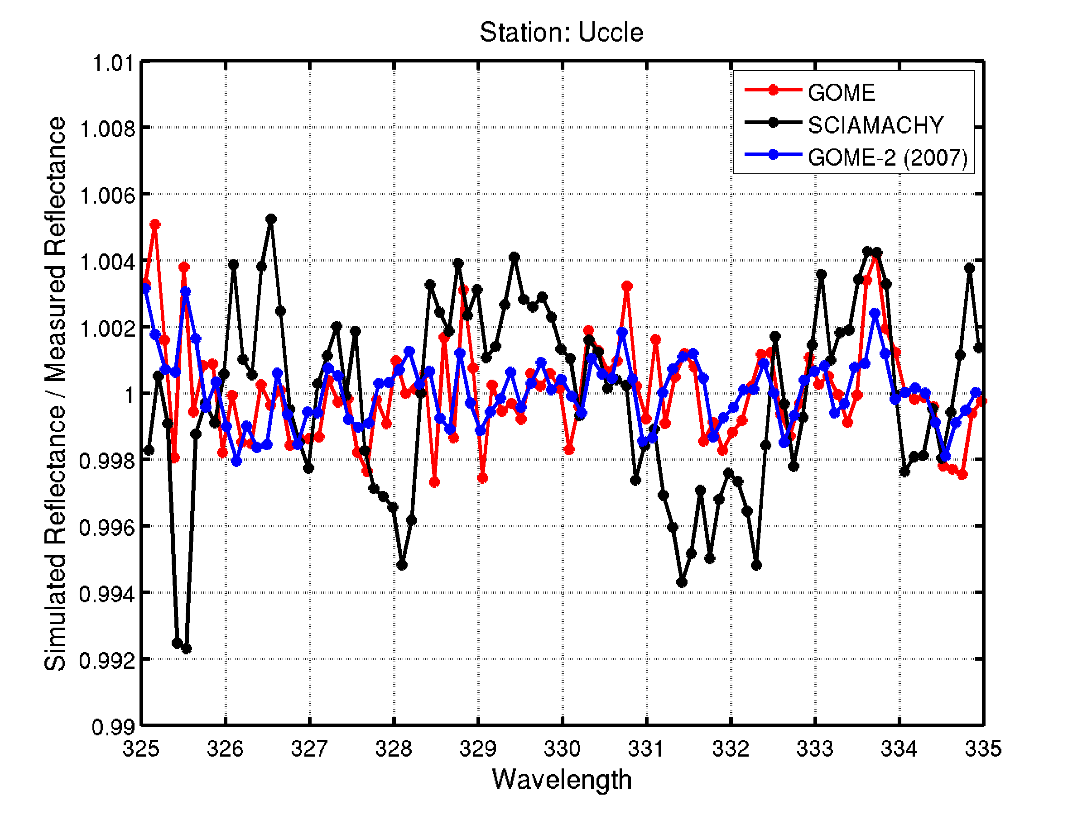
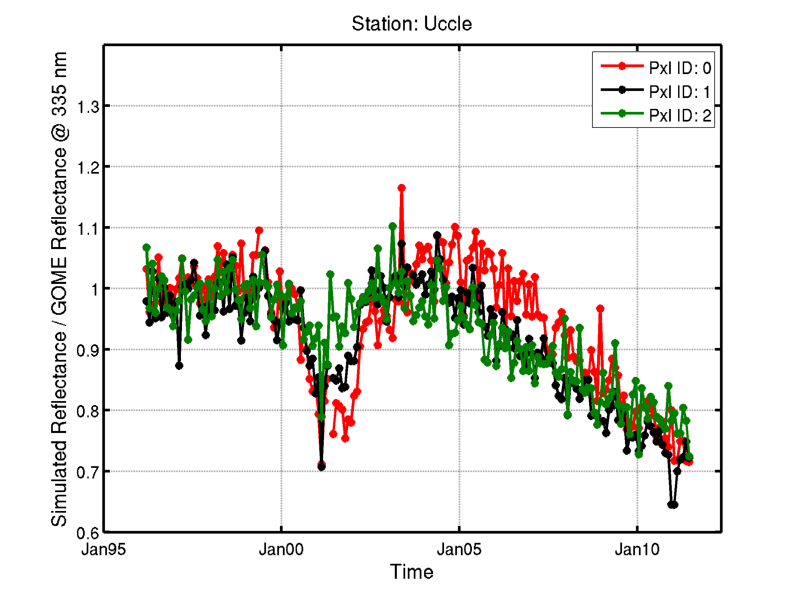
Preliminary results → Uccle
Derivation of time dependence of reflectance biases (absolute errors)
Identification of systematic spectral features
GOME
GOME degradation
SCIAMACHY spectral features

Slide 14
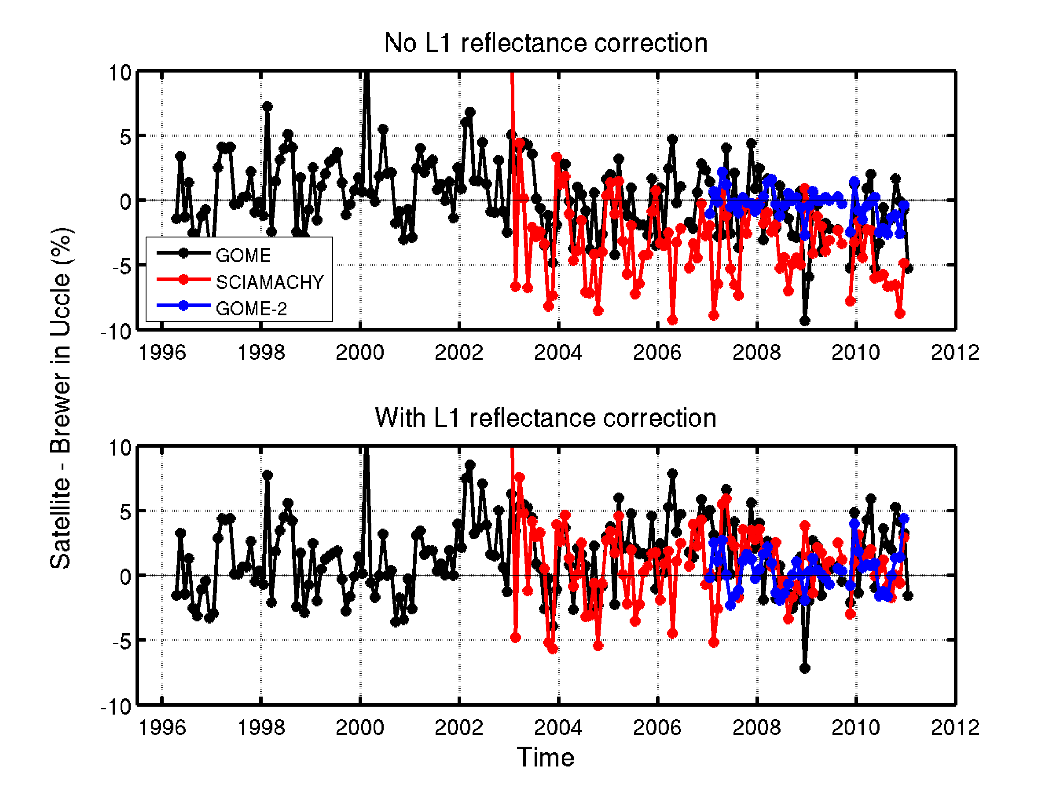
Preliminary results → impact of reflectance corrections on ozone
Average bias and spectral reflectance corrections tabulated and applied as pre-processing step in the ozone retrieval
Consistency of 3 sensors largely improved
Next step → extension at global scale

Slide 15
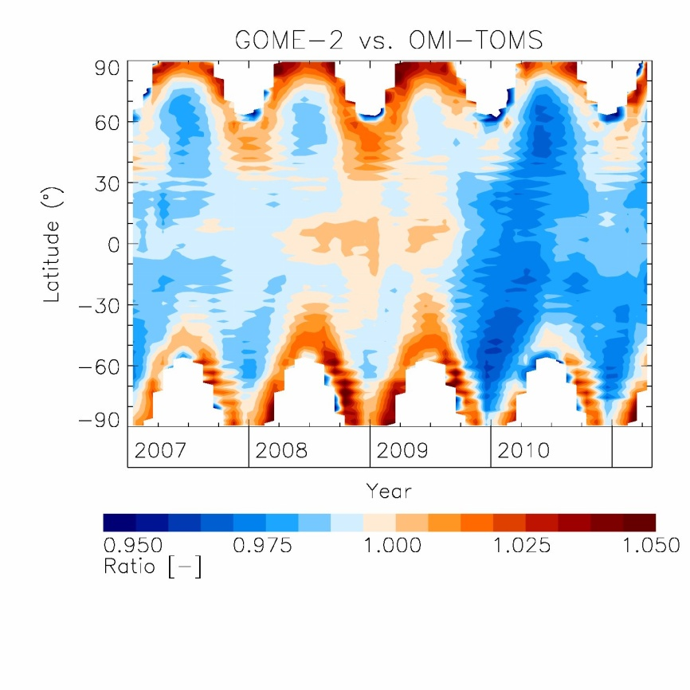
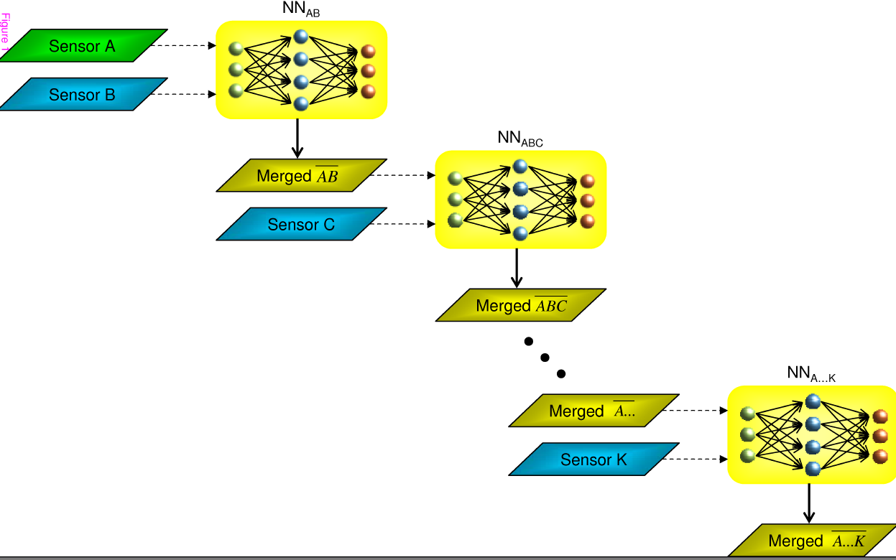
Dat a merging approach (1)
Stacked Neural Networks
NN topology: 3-6-12-1
Input: latitude, season, time
Output: ratio between two sensors

Slide 16
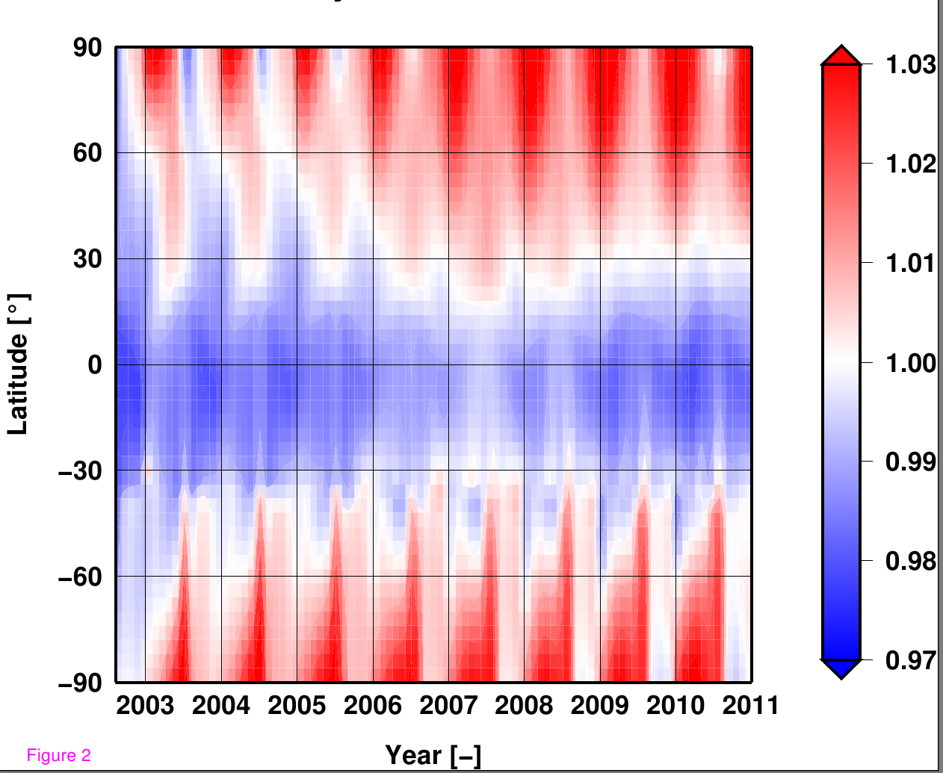
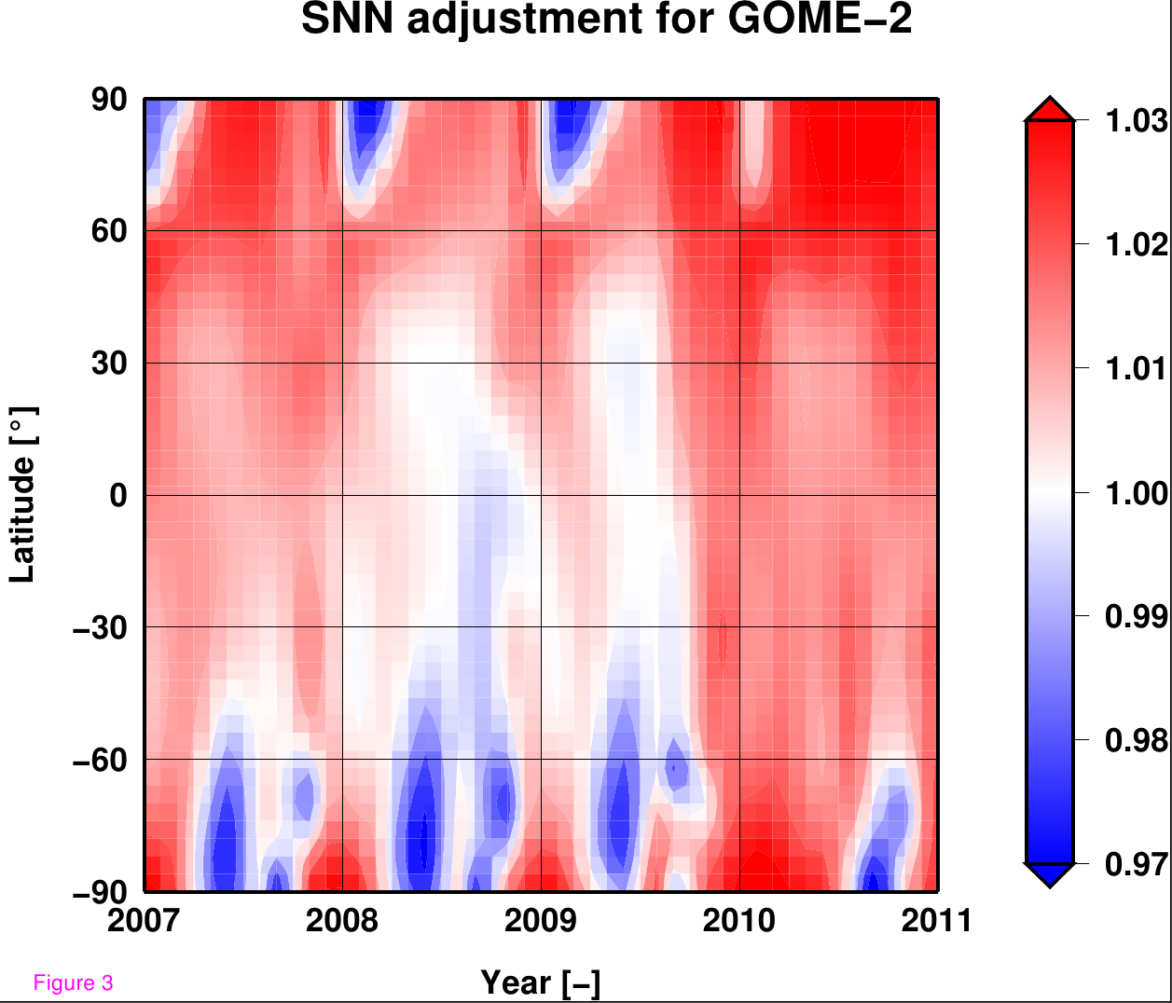
Dat a merging approach (2)
SNN adjustment for SCIAMACHY and GOME-2

Slide 17
Current merged data set
Based on existing GDP4-type data products
D. Loyola and M. Coldewey-Egbers, Multi-sensor data merging with stacked neural networks for the creation of
satellite long-term climate data records, submitted to EURASIP Journal on Advances in Signal Processing, 2012.

Slide 18
Summary and outlook
Ozone_cci ongoing 2010-2013. Will be followed by a second (operational) phase 2014-2017.
Total ozone developments focus on demonstrating improved retrieval approaches to generate more consistent L2 and L3 data products from GOME, SCIAMACHY and GOME-2.
Prototype data sets will be generated by end 2012. Reprocessing covers the 1996-2011 period.
As for other CCI data products, total ozone series will be evaluated by independent validation teams, and used as an input for intercomparisons to other existing data sets (including model data).
CCI data sets, once evaluated, will be freely available for the user community
An additional activity on OMI total ozone retrieval will be started in early 2013, with the aim to better link European and NASA/NOAA data sets (in particular better understand/characterize systematic difference)

Slide 19
Thank you for your attention

Slide 20
Planning of activities and target for data product generation
Activities | 2012
 | Feb-Mar | Apr-Jun | Jul-Sep | Oct-Dec
Soft calibration of the L1 data sets based on reference ground-based data.
Prototype finalization: Speed-up of retrievals (2-stream/PCA) Data/metadata formatting (NetCDF)
Production of limited L2 data sets (GOME-SCIA-GOME2)
Delta-validation phase
Full reprocessing of the final L2 and L3 data sets
Error budget analysis

Slide 21
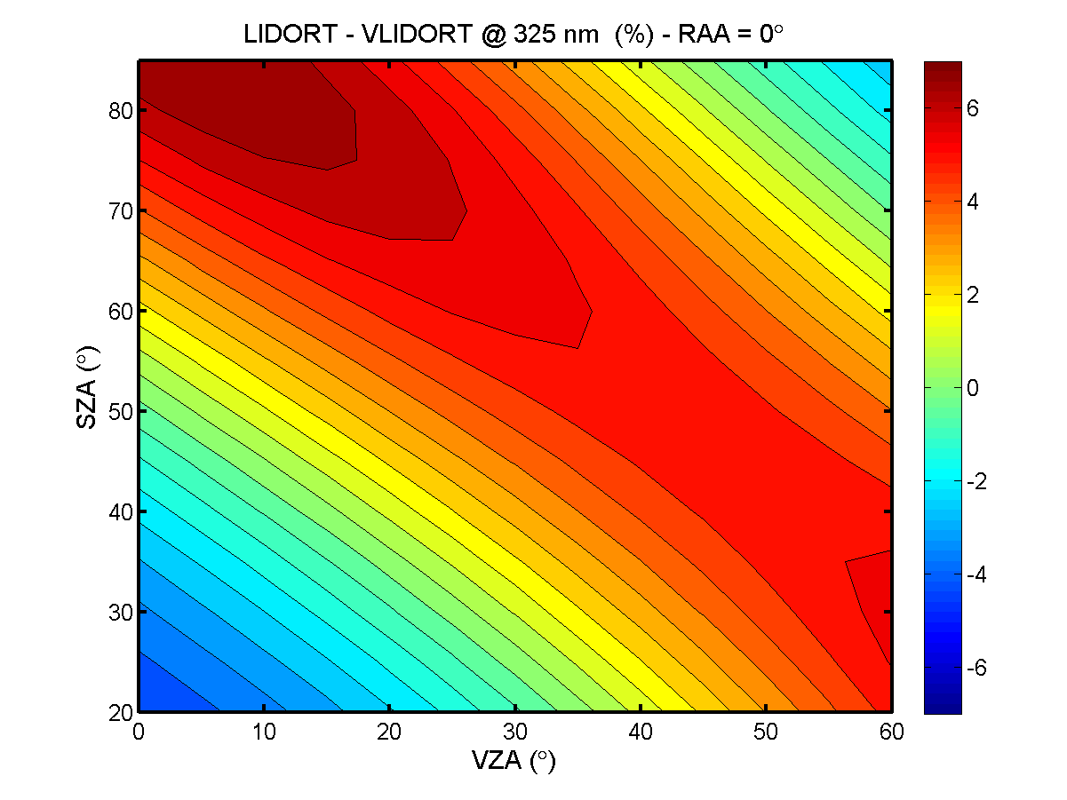
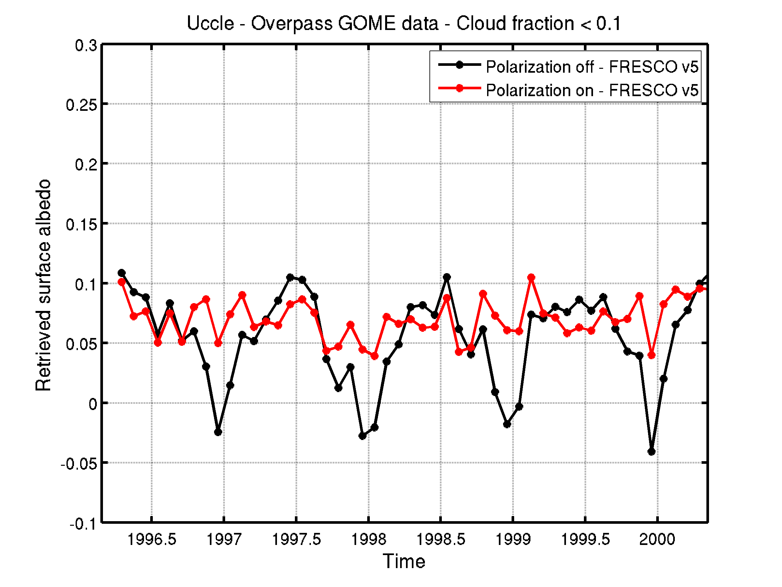
Impact of polarization on the total O₃ product
Impact on the radiance intensity
Improved albedo retrieval
Surface albedo for Uccle (cloud free pixels)
RAA = 0°
SA = 0.05
➔ If polarization is neglected:
Retrieved surface albedo biased
(internal closure mode)
⬇
Total O₃ column biased

Slide 22
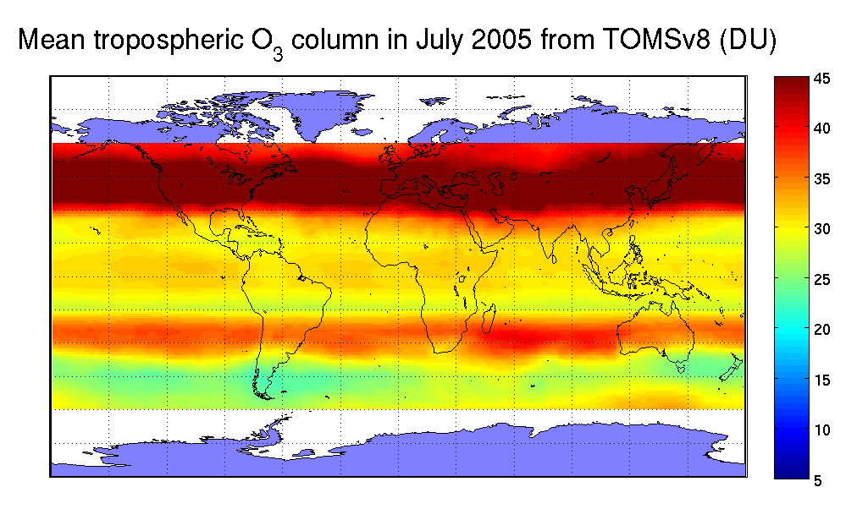
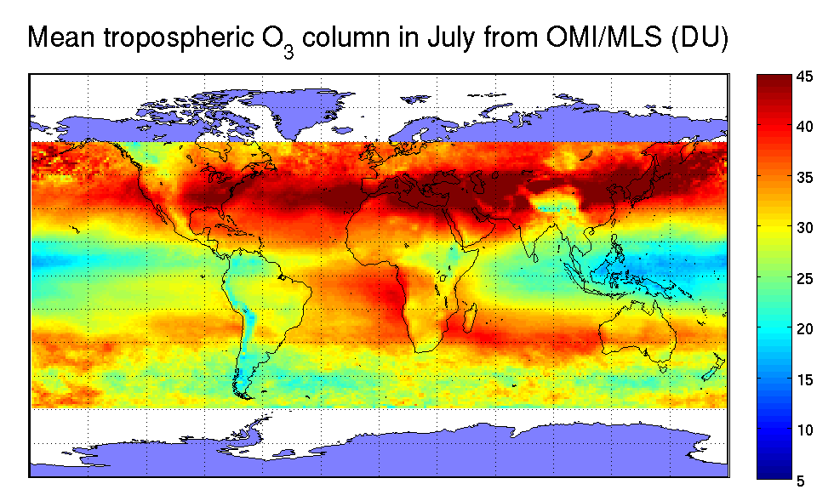
OMI-MLS tropospheric ozone
In comparison to a zonal mean climatology, the new OMI-MLS climatology
  improves the representativity of the a-priori ozone profile
  reduces cloud correction errors (ghost column), esp. in tropical regions

