Slide 1

New Directions for WGs and VCs Based on the CEOS Self Study
8th meeting of the CEOS Virtual Constellation
on Atmospheric Composition
18-19 April 2012
Timothy Stryker
CEOS Executive Officer

Slide 2
Overview
Background
  CEOS 2012 Work Plan and Priorities
  GEO 2012-2015 Work Plan and Supporting ACC Actions
SIT-27 and Initial CEOS Self-Study (CSS) Outcomes that Relate to ACC

Slide 3
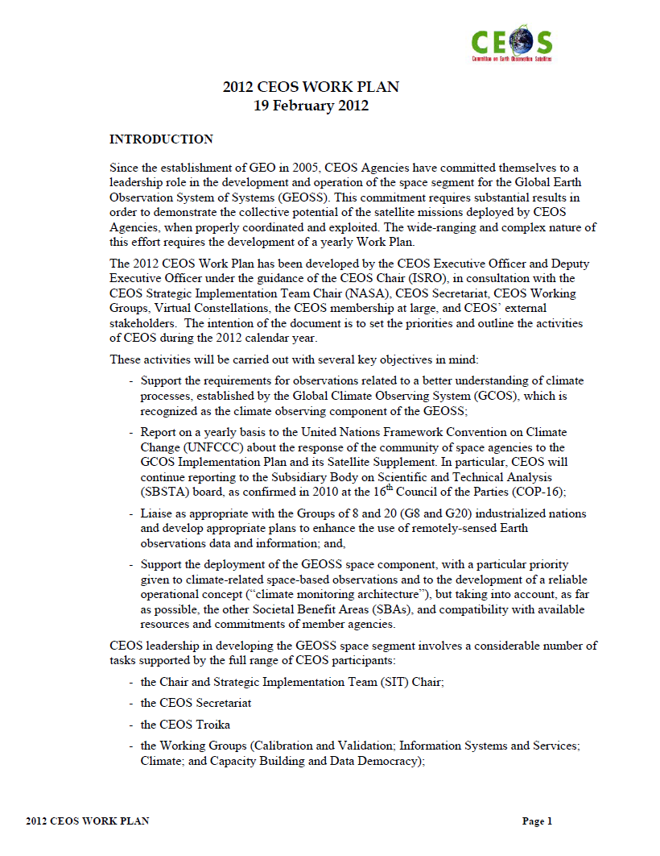
2012 CEOS Work Plan and Priorities

Slide 4
Expected CEOS 2012 Outcomes
Improved Coordination of Space Agency Activities Related to Climate
CEOS Response to 2010 GCOS IP and improvement in coordinated outputs for monitoring of ECVs
CEOS Input to Systematic Observation Requirements for GCOS Satellite Supplement
Development of FCDRs and related data sets (WG Climate)
Cooperation with GEO, WMO, and CGMS on space-based system to support climate information and adaptation
Further alignment of VCs to contribute to GCOS IP

Slide 5
Expected 2012 Outcomes (cont’d)
Progress Towards Established CEOS-GEO Priorities
CEOS leadership within and support to the GEO Global Forest Observation Task (including GFOI IP and SDCG)
Continued development of the CEOS Strategy for Carbon Observations from Space
Advancement of CEOS Data Democracy activities within the reorganized WGCBDD
Further alignment of the CEOS VC objectives/activities to GEO 2012-2015 Work Plan Tasks

Slide 6
Expected CEOS 2012 Outcomes (cont’d)
Progress Toward Established GEO-CEOS Priorities (cont’d)
Continued support to development and operationalization of the GEOSS Common Infrastructure (GCI) and its elements
The development of a more integrated approach in the areas of disaster mitigation and disaster management
Continued support to the Joint Experiments on Crop Assessment and Monitoring (JECAM) initiative
Continued CEOS leadership of/support to the QA4EO initiative

Slide 7
Expected CEOS 2012 Outcomes (cont’d)
Considering CEOS Support to Further Key GEO Priority Initiatives
Exploratory dialogue on data requirements and CEOS Agency capacities to support the G20/GEO Global Agricultural Monitoring (GLAM) initiative
Continued dialogue on potential CEOS contributions to integrated water cycle products and services
Continued dialogue on potential CEOS contributions to the GEO Biodiversity Observation Network (GEO BON)

Slide 8
Expected 2012 Outcomes (cont’d)
Continued and Enhanced CEOS Outreach to Key Stakeholders: GEO, COP, UNFCCC, SBSTA, G8/G20
Maintenance to CEOS online services such as the CEOS website and Missions, Instruments and Measurements (MIM) database
Publication of the CEOS Newsletter
CEOS inputs for Rio+20 Summit, including a print update of the CEOS Earth Observation Handbook
Further review/adoption of CSS recommendations

Slide 9
CEOS Actions in support of GEO 2012-2015 Work Plan

Slide 10
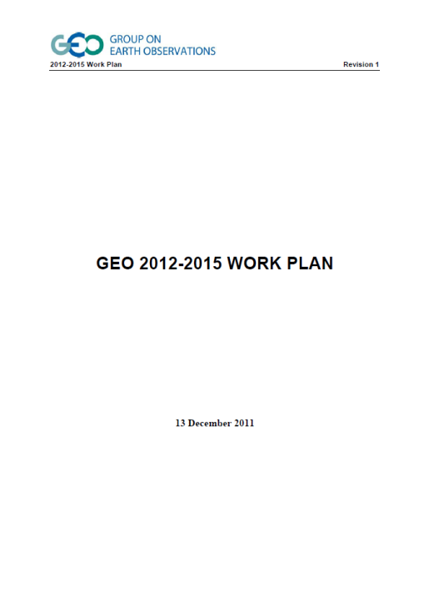
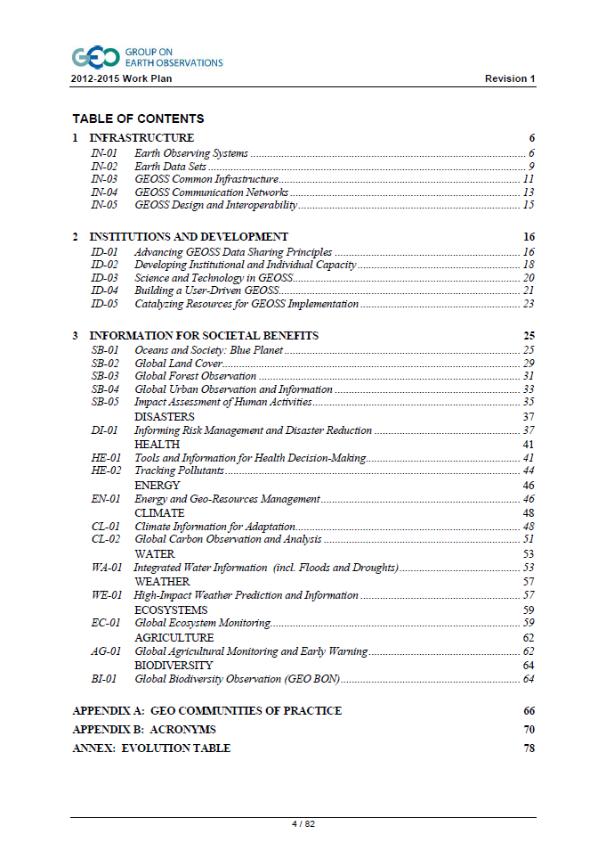
2012-2015 GEO Work Plan Statistics
Three Thematic Parts
  Infrastructure
  Institutions and Development
  Information for Societal Benefits
26 Tasks
60 Components
Notes:
The 2012-2015 GEO Work Plan is divided into three thematic parts composed of 26 Tasks and 60 Components. Each of the identified Components has a number of Priority Actions identified which, according to GEO, are “practical actions and outputs supporting the Component implementation.”

Slide 11
ACC Actions in Support of GEO Work Plan
CEOS-GEO Action Number: IN-01-C2_2
GEO Task Reference: IN-01 Earth Observing Systems
C2 Development and Coordination of Space-based Observing Systems
Action Description: Geostationary Air Quality Constellation coordination activities
Primary POC: Jay Al-Saadi, NASA
Other Participating Agencies: ESA, CSA, KARI, JAXA, NOAA
CEOS-GEO Action Number: IN-01-C2_4
GEO Task Reference: IN-01 Earth Observing Systems
C2 Development and Coordination of Space-based Observing Systems
Action Description: Long-term ozone record harmonization, enhanced intercomparison and error characterization
Primary POC: Richard Eckman, NASA
Other Participating Agencies: ESA, NASA, DLR, CSA, CNES, JAXA, NOAA

Slide 12
ACC Actions in Support of GEO Work Plan (cont’d)
CEOS-GEO Action Number: DI-01-C2_1
GEO Task Reference: DI-01 Informing Risk Management and Disaster Reduction
C2 Geohazards Monitoring, Alert, and Risk Assessment
Action Description: Volcanic Ash Monitoring from Space
Primary POC: Claus Zehner, ESA
Other Participating Agencies: to be determined
CEOS-GEO Action Number: DI-01-C2_1
GEO Task Reference: CL-01 Climate Information for Adaptation
C2 Accelerated Implementation of the Global Climate Observing System
Action Description: CEOS Response to new GCOS Implementation Plan
Primary POC: Mitch Goldberg, NOAA
Other Participating Agencies: Various CEOS VCs (incl ACC) and their members

Slide 13
ACC Actions in Support of GEO Work Plan (cont’d)
CEOS-GEO Action Number: CL-02-C1_1
GEO Task Reference: CL-02 Global Carbon Observation and Analysis
C1 Integrated Global Carbon Observation and Analysis System
Action Description: Conduct strategic gap assessments for atmospheric CO2 and atmospheric CH4. Outputs will be used for strategic planning and the "CEOS Response to the GEO Carbon Strategy" report
Primary POC: Brian Killough, NASA SEO
Other Participating Agencies: JAXA, CEOS Carbon Task Force members
View details on these and all other CEOS-GEO Actions in the “Actions” tab on
the CEOS web site:
www.ceos.org

Slide 14
SIT-27 and Initial CEOS Self-Study Outcomes that Relate to ACC

Slide 15
CEOS Self Study
Identified four top-level CEOS activities:
  Substantive space-borne coordination, scientific, and user-focused activities – actual standardised information products
  Top-level strategy development and guidance –priorities and new initiatives
  Internal CEOS coordination – among members/associates, CEOS management, and sub-organizations
  External CEOS coordination – between CEOS and outside organizations
Notes:
Disconnect between Plenary and the WGs – you can communicate the CEOS priorities to the group but it is sometimes difficult to direct the WG to address these priorities.

Slide 16
CEOS Self Study Recommendations for WGs and VCs
The need for improved interface and engagement with the SIT
The need for increased focus on physical delivery in support of current CEOS priorities
The need for increased direction to VCs and WGs in support of CEOS priorities
“Horizontal Coordination” among WGs and VCs is needed to maximize their value and impact
NASA SIT Team Follow-Up prior to SIT-27
  Discussion paper on CSS follow-up for VCs and WGs
  Individual and group teleconferences with the VCs and WGs
  VC/WG Workshop prior to SIT-27
  Further strategic discussion at SIT-27

Slide 17
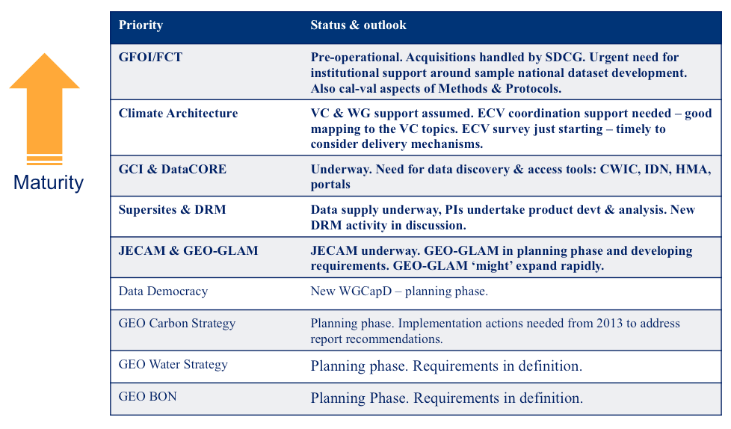
Relative Maturity of Requirements Definition
Notes:
When we speak of “physical delivery”, we mean coordinated delivery of space-based EO data/information to meet user needs
This requires an assessment of the “maturity level” of user needs/requirements, and the “maturity level” of a coordinated CEOS response
This table provides a snapshot of least developed to most developed
It is recommended that VCs focus outputs on these more “mature” activities (for ACC, climate and to lesser degrees DRM and carbon)

Slide 18
SIT-27 and Initial CEOS Self-Study Outcomes that Relate to ACC
A special half-day side meeting on CEOS WGs and VCs took place in La Jolla prior to SIT-27
  to further explore opportunities and obstacles, and look at the “sharp end” of implementation
  to support a report out to CEOS Agencies at SIT-27 on VCs’ and WGs’ perspectives and needs
  to take first steps toward identifying “top-down” priorities for VCs and WGs that match the working realities and possibilities of these groups and their participants
Notes:
Disconnect between Plenary and the WGs – you can communicate the CEOS priorities to the group but it is sometimes difficult to direct the WG to address these priorities.

Slide 19
SIT-27 Discussions that Relate to ACC
During SIT-27, a round table review was held on the membership and participation of the VCs and WGs
  strengths, weaknesses, and issues with participation
GEO must strive towards high profile achievements toward end of its 10-year plan to ensure political and financial support for its post-2015 continuation
  CEOS WGs and VCs have a role in support of delivery and must be pro-active in defining and progressing the outcomes
  Demonstration of unique and significant international coordination on subjects such as carbon, forests, food, water, and disasters

Slide 20
ACC Reporting to SIT-27
ACC needs to reach firm agreement on the path forward, recognizing the scientific utility/need (particularly from the modeling community) for a harmonized total ozone record
ACC needs a clearer understanding of how resources (financial and personnel) may be forthcoming at the CEOS Member Agency level to support total ozone harmonization activities
Other ongoing/emerging ACC activities should not be sidelined as a result of the CSS emphasis on product generation
  air quality constellation
  volcanic ash
  support to limb scattering observation coordination
Notes:
ACC reported that resources are a serious concern
Clear direction and justification are needed to advocate for alignment of existing agency resources via VC activities
Existing work is important and should not be sidetracked

Slide 21
SIT-27 Agreed Actions (draft)
27-20: SIT Chair team will work with VCs and WGs to further define opportunities and approach to implementation targets discussed at SIT-27, and ensure engagement of VCs and WGs in development of the new planning documents (due September 2012)
27-21: SIT Chair team will develop a VC/WG mission/agency participation wish-list matrix as the basis for engaging CEOS agencies and missions (April 2012)
27-22: WG Chairs and VC Leads to develop a short paper brainstorming ideas on improved communication among groups in support of more integrated CEOS objectives (June 2012)
27-23: SIT Chair team to arrange for monthly VC updates to CEOS Secretariat teleconferences (April 2012)

Slide 22
Backup Slides/
Background Information

Slide 23
CEOS in General
Established in 1984 under auspices of G-7 Economic Summit of Industrialized Nations
  Focal point for international coordination of space-related Earth Observation (EO) activities
  Optimize benefits through cooperation of members in mission planning and in development of compatible data products, formats, services, applications, and policies
Operates through best efforts of Members and Associates via voluntary contributions
30 Members (Space Agencies), 22 Associates (UN Agencies, Phase A programs or supporting ground facility programs)
As the space component of the Global Earth Observation System of Systems (GEOSS), CEOS is implementing high priority actions in support of Group on Earth Observation (GEO) Tasks
Notes:
23

Slide 24

CEOS Objectives
To optimize benefits of space-borne Earth observations through:
  Cooperation of its Members in mission planning
  Development of compatible data products, formats, services, applications, and policies;
To serve as a focal point for international coordination of space-related Earth observation activities;
To exchange policy and technical information to encourage complementarity and compatibility of observation and data exchange systems.

Slide 25



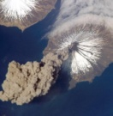



CEOS Structure 2012
Troika
Past Chair
Chair
Future Chair
(1-year terms)
ASI/Italy
ISRO/India
CSA/Canada
Troika
Strategic Implementation
Team (SIT)
Permanent Secretariat
CEOS Executive Officer (CEO)
Systems Engineering Office (SEO)
Chair: NASA Vice Chair: CNES
Chair Agency
ESA, EUMETSAT,
JAXA, NASA, NOAA, Past and Future Chairs
USGS (CEO) &
NOAA (DCEO)
NASA
(2-year terms)
(2-year terms)
WGCV
WGISS
WGCBDD
WGClimate
CEOS SBA Coordinators
Virtual Constellations for GEO
Chair
USGS
Vice Chair
CSA
Chair
JAXA
Vice Chair
CNES
Chair
INPE
Vice Chair
NOAA
Chair
EC-JRC
Vice Chair
NOAA
Atmospheric Composition
- NASA
- ESA
Precipitation
- JAXA
- NASA
Land Imaging
- USGS
- ISRO
- INPE
Ocean Surface Topography
- NASA
- EUMETSAT
Ocean Color Radiometry
- ESA
- ISRO
- NASA
Ocean Surface Vector
Wind
- NOAA
- ISRO
- EUMETSAT
Sea Surface Temperature
- ESA
- NOAA
- Agriculture
- Biodiversity
- Climate
- Disasters
- Ecosystems
- Energy
- Health
- Water
(2-year terms)
WGCV=Working Group on Calibration and Validation
WGISS=Working Group on Information Systems and Services
WGCBDD=Working Group on Capacity Building and Data Democracy
WGClimate = Working Group on Climate
SBA = Societal Benefit Area (GEO)

Slide 26
CEOS Members and Associates
MEMBERS
Agenzia Spaziale Italiana (ASI)
Canadian Space Agency (CSA)
Centre National d’Etudes Spatiales (CNES), France
Centro para Desarrollo Tecnólogico Industrial (CDTI), Spain
China Center for Resources Satellite Data and Applications (CRESDA)
Chinese Academy of Space Technology (CAST)
Comisión Nacional de Actividades Espaciales (CONAE), Argentina
Commonwealth Scientific & Industrial Research Organisation (CSIRO), Australia
Deutsches Zentrum fürLuft-und Raumfahrt (DLR), Germany
European Commission (EC)
European Organisation for the Exploitation of Meteorological Satellites (EUMETSAT)
European Space Agency (ESA)
Geo-Informatics and Space Technology Development Agency (GISTDA), Thailand
Indian Space Research Organisation (ISRO)
Instituto Nacional de Pesquisas Espaciais (INPE), Brazil
Japan Aerospace Exploration Agency/Ministry of Education, Culture, Sports, Science, and Technology (JAXA/MEXT)
Korea Aerospace Research Institute (KARI)
National Aeronautics and Space Administration (NASA), USA
National Oceanic and Atmospheric Administration (NOAA), USA
National Remote Sensing Center of China (NRSCC)
National Satellite Meteorological Center/Chinese Meteorological Administration (NSMC/CMA)
National Space Agency of Ukraine (NSAU)
National Space Research Agency of Nigeria (NASRDA)
Netherlands Space Office (NSO)
Russian Federal Space Agency (ROSKOSMOS)
Russian Federal Service for Hydrometeorology and Environmental Monitoring (ROSHYDROMET)
South African National Space Agency (SANSA)
Scientific and Technological Research Council of Turkey (TÜBITAK)
United Kingdom Space Agency (UKSA)
United States Geological Survey (USGS)
ASSOCIATES
Belgian Federal Science Policy Office (BELSPO)
Canada Centre for Remote Sensing (CCRS)
Council for Scientific and Industrial Research (CSIR)
Crown Research Institute (CRI), New Zealand
Global Climate Observing System (GCOS)
Global Geodetic Observing System (GGOS)
Global Ocean Observing System (GOOS)
Global Terrestrial Observing System (GTOS)
Intergovernmental Oceanographic Commission (IOC)
International Council for Science (ICSU)
International Geosphere-Biosphere Programme (IGBP)
International Ocean Colour Coordinating Group (IOCCG)
International Society of Photogrammetry and Remote Sensing (ISPRS)
Norwegian Space Center (NSC)
Swedish National Space Board (SNSB)
United Nations Economic and Social Commission for Asia and the Pacific (ESCAP)
United Nations Educational, Scientific and Cultural Organization (UNESCO)
United Nations Environment Programme (UNEP)
United Nations Food and Agriculture Organization (FAO)
United Nations Office for Outer Space Affairs (UNOOSA)
World Climate Research Programme (WCRP)
World Meteorological Organization (WMO)

Slide 27
CEOS Actions in Support of
GEO Priority Actions
Each of the 60 Components has a number of Priority Actions identified
  “Practical actions and outputs supporting the Component implementation”
  “Defined and implemented by Leads and Contributors”
At the February 2012 CEOS-GEO Actions Workshop, participants identified CEOS Actions that can be accomplished in support of the GEO Component Priority Actions
Notes:
We focused specifically on those Components where CEOS is already identified as a Component Lead and identified other CEOS Actions that could be accomplished for Components where CEOS is a Contributing Agency. Additional criteria included identifying synergies between CEOS and GEO, prioritizing CEOS and GEO demands, and highlighting how an identified Action could support CEOS Priorities/Expected Outcomes from the 2012 CEOS Work Plan
In February 2012, CEOS entities participated in the 2012 CEOS-GEO Actions Workshop where participants identified CEOS Actions that could be accomplished in support of the GEO 2012-2015 Work Plan Component Priority Actions.
Confirmed CEOS Support to 27 GEO Task Components
Included Confirmed CEOS Leadership of 19 GEO Task Components (and Component POC for 4)
CEOS Role in GEO WP Management Structure and Strategic Planning
Task Coordinator for 3 Tasks
Implementation Board Member for 2 Boards
Significant CEOS Participation in 2012 GEO Work Plan Symposium (30 April – 5 May)

Slide 28
CEOS Actions - GEO Priority Actions Criteria
CEOS Actions support both GEO Priority Actions and CEOS Priorities/Expected Outcomes from the 2012 CEOS Work Plan
Criteria
  Execution requires the cooperation of at least two CEOS Agencies¹
  Execution requires a “significant” level of effort and good coordination (e.g., publication of an article does not need to be followed as an action. The article might be published on www.ceos.org)
  Significant and citable benefits towards meeting societal needs
  Needs to be “Actionable” (properly described, feasible with Lead Agencies (or WG, VC), at least one Contributor, clear Milestones and Deliverables, potential support might be indicated
  ¹ WGs and VCs considered as “multi-agency’” groups
Notes:
After further refinement and discussion, a spreadsheet was prepared that captured all the proposed CEOS Actions for 2012. This list is by no means exhaustive and will continue to be updated throughout the year. The full details for each of the Actions is available on the CEOS website (www.ceos.org) via the CEOS-GEO Actions Tracking System. There are currently 47 CEOS Actions identified.

