Slide 1
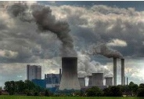
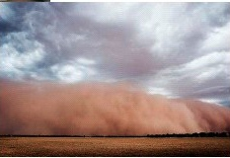
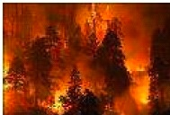


CEOS ACC-8 Meeting, April 18-19, 2012, Columbia, MD, U.S.A.
Status of
GEMS (Geostationary Environment
Monitoring Spectrometer) Mission
Onboard the Geo-KOMPSAT
Jhoon Kim
P.I., GEMS Program
Department of Atmospheric Sciences,
Yonsei University, Seoul, Korea (jkim2@yonsei.ac.kr)
C.K. Song
Officer in Charge, GEMS Program Office
D.H. Ko, J.H. Yeon, S.H. Kim, S.S. Yong, S.H. Lee
Space Payload Division, KARI
Notes:
1

Slide 2
Contributors
Hanlim Lee¹, Rokjin J. Park², Seung Hoon Lee³, Dai Ho Ko³,
Chang Keun Song⁴, Youdeog Hong⁴, Sukjo Lee⁴; H.W. Seo⁵,
Jung Hun Woo⁶, Young Joon Kim⁷, Chul Han Song⁷, Jae Hwan Kim⁸, Kwang Mog Lee⁹,
Chang Hoi Ho², Jung-Moon Yoo¹⁰, Seon Ki Park¹⁰, Yong Sang Choi¹⁰, Myeongjae Jeong¹¹,
Kelly Chance¹², P.K. Bhartia¹³, Pepijn Veefkind¹⁴, Scott Janz¹³, Yu Hwan Ahn¹⁵,
Mijin Kim¹, Sangseo Park¹, Sang Soon Yong⁴
GEMS Science Team
- Yonsei Univ., GIST, Pusan Nat’l Univ., Seoul National Univ., Konkuk Univ.,
Ewha Women’s Univ.
KARI (Korea Aerospace Research Institute)
GEMS SAG(Science Advisory Group)
- NASA, GSFC, JPL, NCAR, NRL, NOAA, Harvard Univ., UCLA,
Univ of Alabama, Univ of Iowa, Texas A&M Univ., Dalhousie Univ.,
ESA, KNMI, MPI, Univ. of Bremen, Univ. of Heidelberg,
JAXA, Univ of Tokyo, Nara Women’s Univ., JAMSTEC, …
Ministry of Environment (MoE) / NIER(National Institute of Environmental
Research), Rep. of Korea

Slide 3
Overall of GEMS Mission
One of Missions under GEO-KOMSAT 2 project
  Based on Natl. Aerospace Promotion Plan(2007) & Natl. Climate Adaptation Plan(2010)
  Succession of COMS(GEO-KOMSAT 1; 2010) project
  4 Ministries involved (MEST, ME, KMA, MLTM)
Mission Approval Process
  Proposal approved on Dec. 2010 by the Government Budget Review Committee led by the Ministry of Planning and Finance
  Main phase funding initiated as of 2012
GEMS Mission Implementation
  GEMS Program Office at NIER/ME
  Science Team : GEMS Research Center at Yonsei Univ. (P.I.: Prof. Jhoon Kim)
  GEMS Development Team : KARI GEMS team (P.I.: Dr. Seung-Hoon Lee)
RFP
  Response to RFI received in Dec. 2010
  RFP planned to be issued in May 2012
  Selection of main contractor by end of 2012
Notes:
Contingent Valuation Method(CVM)
Averting Bahavior Method(ABM)
Cost of Savings (COS)

Slide 4
Outline
GeoKOMPSAT
GEMS Requirements & Specification
Summary

Slide 5
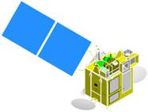




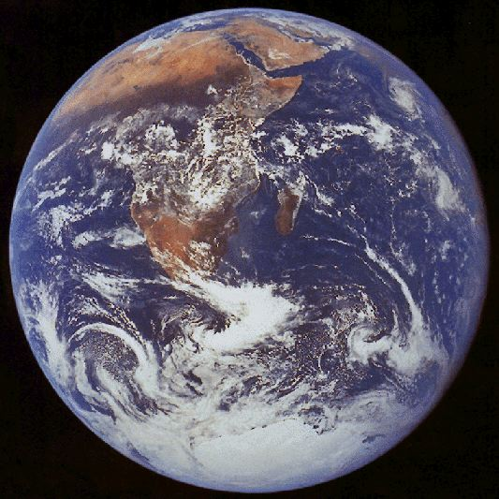




CEOS ACC: Global Environmental Monitoring
Constellation of GEO Mission to study Air Quality
GMAP Asia
(Asia Pacific)
GEO-CAPE
(America)
GEMS
GEO KOMPSAT
(Asia)
Chinese
GEO AQ Mission
(Asia)
Constellation synergy
Improving spatial and temporal coverage
to monitor globalized pollutants
Sharing basic requirements on data products and
instrument to maintain data quality
Consolidating socio-economic benefit analysis
Supporting QA and CAL/VAL
POGEQA
(Europe)
GMES S4
MTG (Europe)
Notes:
5

Slide 6
Geostationary AQ mission parameters (as of 4/2011)
 | Europe Sentinel 4 | USA GEO-CAPE | Korea GEMS | Japan GMAP-Asia
Launch | 2018 | ~2020 | 2018 | ~2018
Status | Industry Phase B1 started early 2010 | Pre Phase-A | GEO KOMPSAT funding started 2012 | Mission Definition Review 12/2009
Domain | Europe and surrounding | Contiguous US and surrounding | Asia-Pacific (5000 km x 5000 km) | Japan and East China (4000 km×4000 km)
Resolution | 8km x 8km at 40N, revisit 1hr | 4km x 4km at 35N, revisit 1hr | 7km @Seoul, A<56km² revisit 1hr | 10km (310-600 nm), revisit 1hr
Payload | UV-Vis-NIR 305-500, 750-775 nm | UV-Vis-IR (tbd) 300-500 nm SWIR 2.3 & 4.6 μm Vis &/or TIR | UV-Vis 300-500 nm | UV-Vis 280-600 nm, TIR
Species | O3, NO2, SO2, HCHO, AAI, AOD, height-resolved aerosol | O3, NO2, SO2, HCHO, AOD, CO (CO & O3 with 2 vertical DOF) | O3, NO2, SO2, HCHO, AOD | O3, NO2, (SO2, HCHO, AOD desired)
Notes | On meteo sounding platform MTG-S and in formation with meteo imager platform MTG-I. Use MTG-S TIR (expect sensitivity to large O3 and CO events); synergy with meteo. imager w.r.t. aerosol/PM | Includes ocean color mission. In orbit with GOES-R series meteo imagers. Baseline mission to include TIR and additional species: CH4, NH3, AAOD, AI, AOCH | Includes meteo and ocean color missions with meteo imager in formation. Optional accommodation for small IR instrument (CO, CO2, CH4) | Includes meteo mission. Hyperspectral TIR FTS: O3, CO, HNO3
(Courtesy, Jay Al-Saadi)
Notes:
The limitation of GEO view is the lack of a global perspective
This can be mitigated through international cooperation to form a constellation from GEO
Timing and payloads demonstrate that threshold capability is ready
N. America-Europe-Asia covers the three primary economic/population/emissions regions

Slide 7
Baseline products
Product | Import-ance | Min (cm⁻²) | Max (cm⁻²) | Nominal (cm⁻²) | Accuracy | Spectral window (nm) | Spatial Resolution (km²) | SZA (deg)
NO₂ | Ozone precursor | 3x10¹³ | 1x10¹⁷ | 1x10¹⁴ | 1x10¹⁵ | 425 - 450 | 56 < 7 km(NS) | < 70
SO₂ | Aerosol precursor | 6x10⁸ | 1x10¹⁷ | 6x10¹⁴ | 1x10¹⁶ | 310 – 330 | 56 < 7 km(NS) | < 60
HCHO | Proxy for VOCs | 1x10¹⁵ | 3x10¹⁶ | 3x10¹⁵ | 1x10¹⁶ | 327 – 357 | 56 < 7 km(NS) | < 70
O₃ | Oxidant, pollutant | 4x10¹⁷ | 2x10¹⁸ | 1x10¹⁸ | 2% or 6 DU | 300-340 Chappuis band ? | 56 < 7 km(NS) | < 70
AOD (AI, AAOD) | Air quality, Climate | 0 (AOD) | 5 (AOD) | 0.2 | 20% or 0.1@ 400nm | 300-500 (630?) | 56 < 7 km(NS) | < 70
Clouds | Data quality, climate | 0 (COD) | 50 (COD) | 17 (COD) |  | 300-500 | 56 < 7 km(NS)
Surface Property | Environ-ment | 0 | 1 | - |  | 300-500 (630?) | 56 < 7 km(NS)

Slide 8
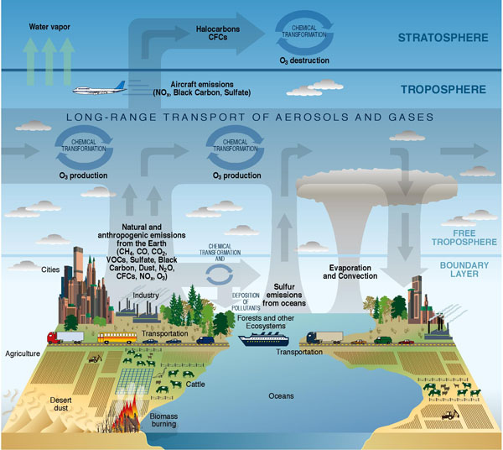
Objective: Measurement of air quality and short-lived
climate change driver in high temporal and spatial resolution
CLIMATE FORCING
LONG-RANGE TRANSPORT
METEOROLOGY
FEEDBACK
Source
Sink
AIR QUALITY
(local and
regional)
Atmospheric
Correction for
Ocean color
EMISSION
(local and urban scale)
Meteorology
Credit: CCSP Strategic Plan (illustrated by P. Rekacewicz).

Slide 9
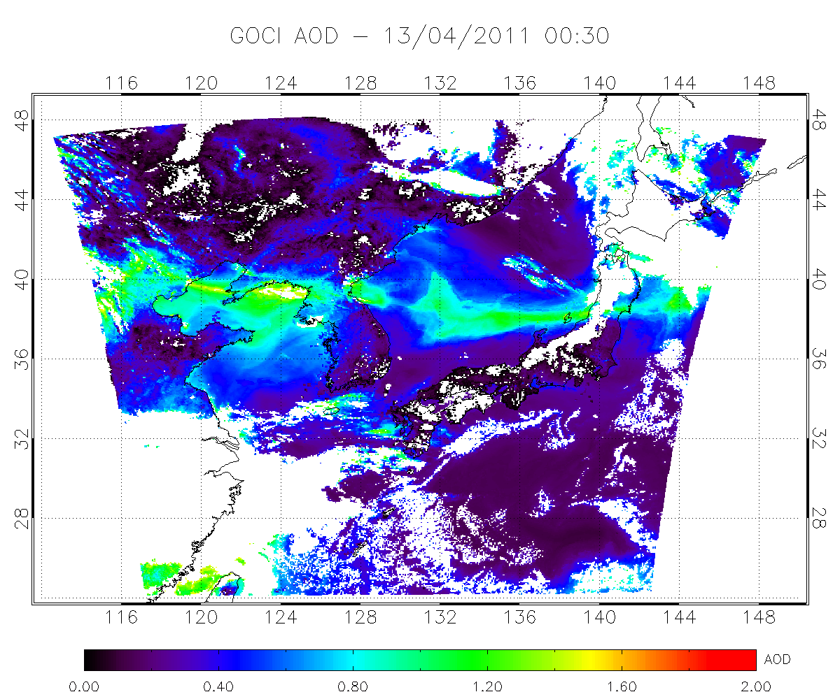
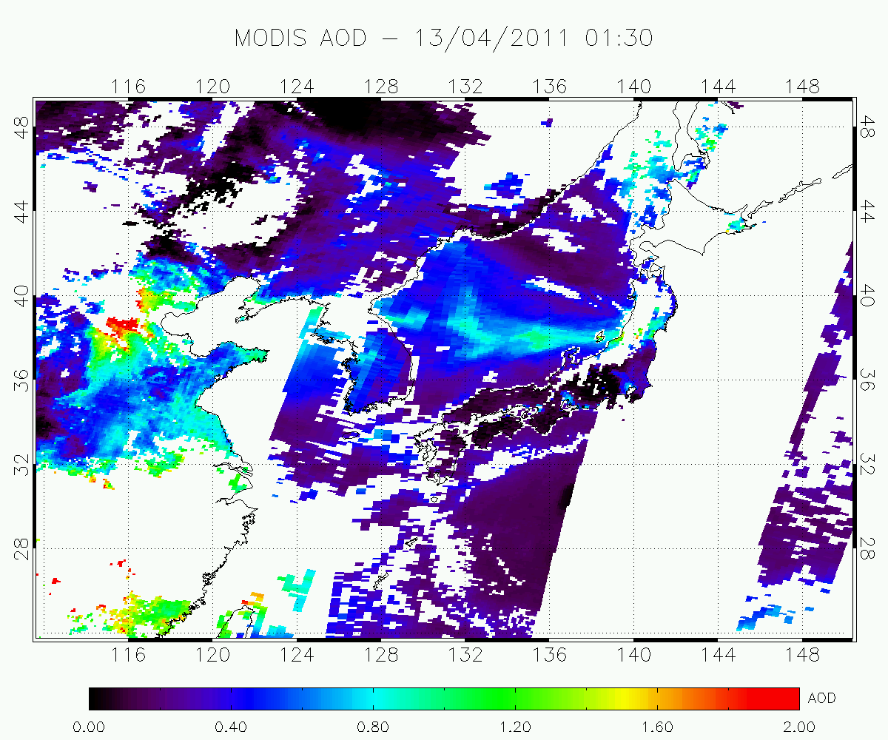
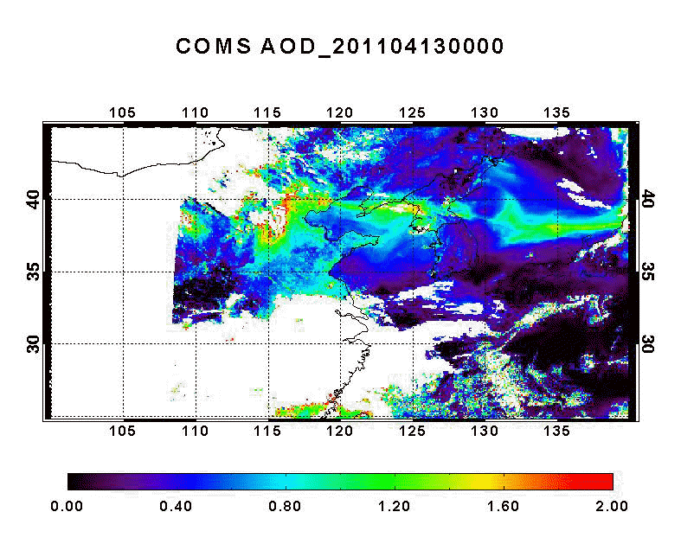
MODIS vs. COMS AOD
GOCI
An example from GOCI onboard the COMS, launched on June 26, 2010
MODIS
MI
2 LEOs
(2 x 1/day)
1 GEO (hourly)

Slide 10
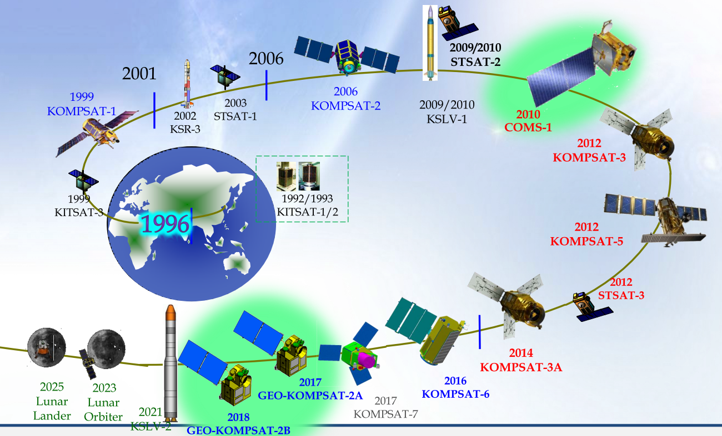
National Space Development Plan

Slide 11
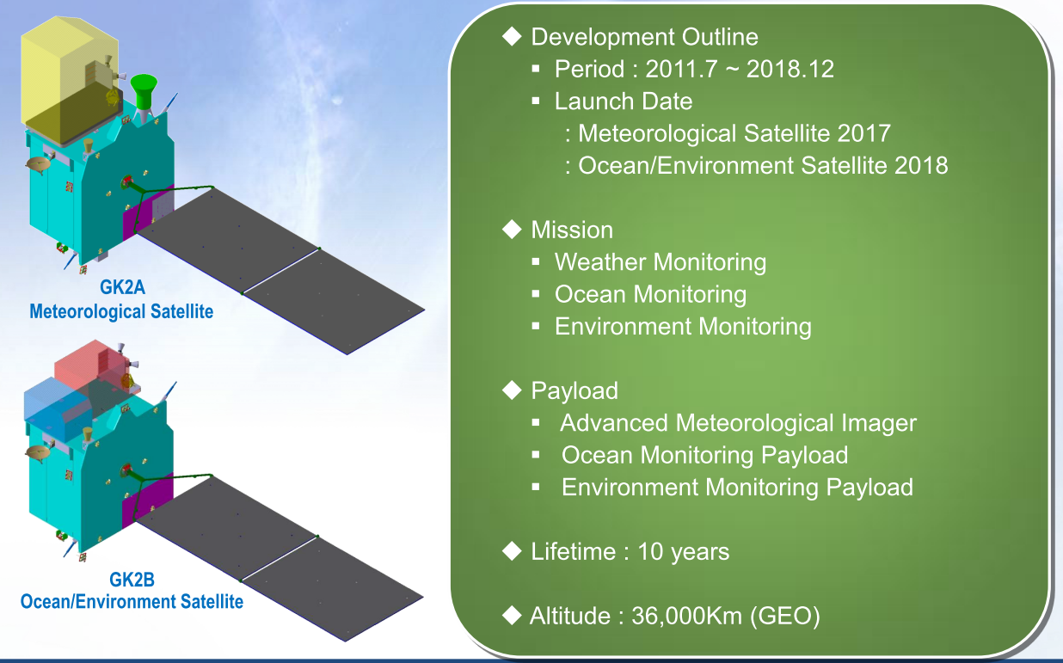
Geo-KOMPSAT-2A & 2B

Slide 12
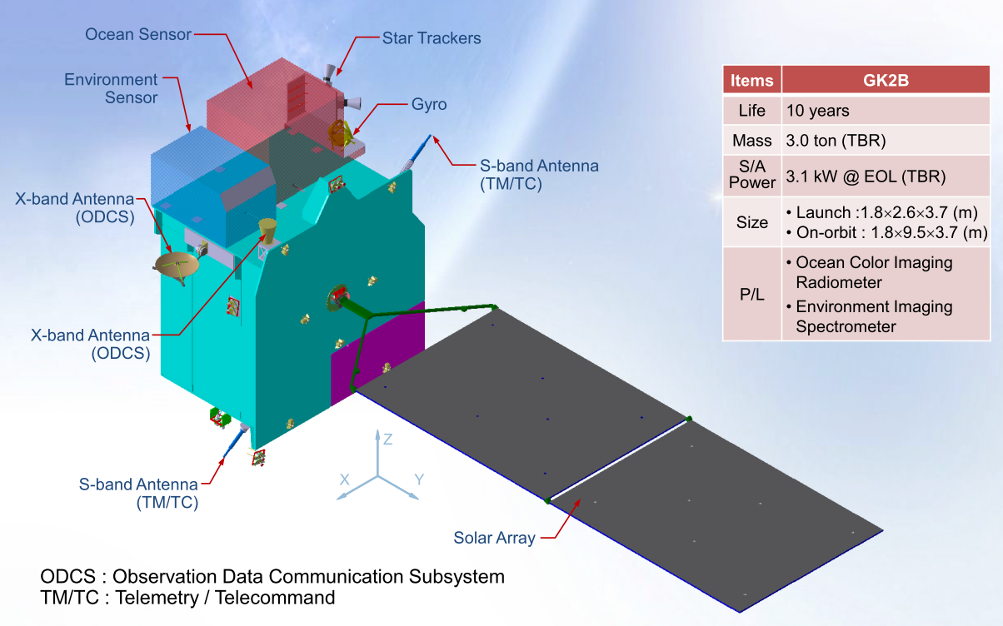
System Configuration : GK2B (1/2)

Slide 13
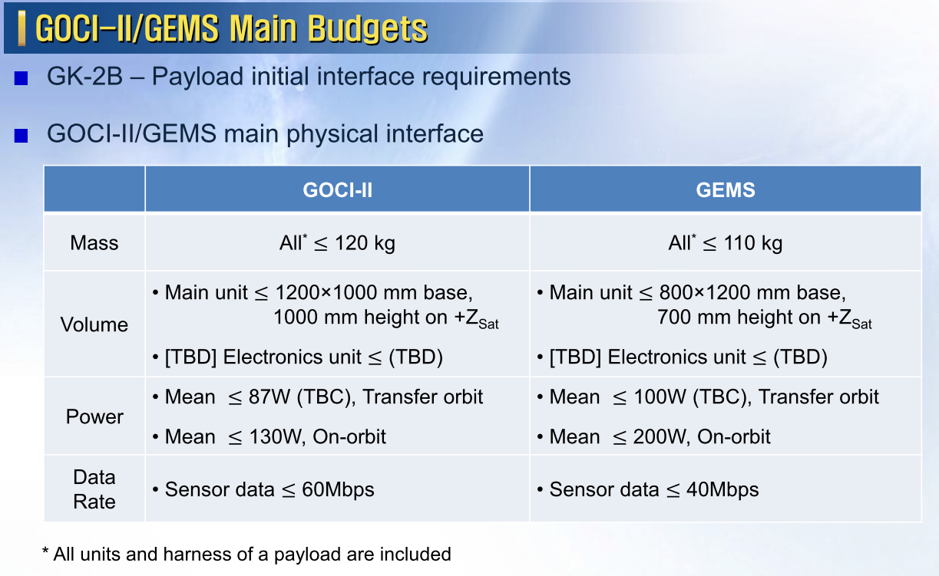
Satellite to Payloads (1/3)

Slide 14
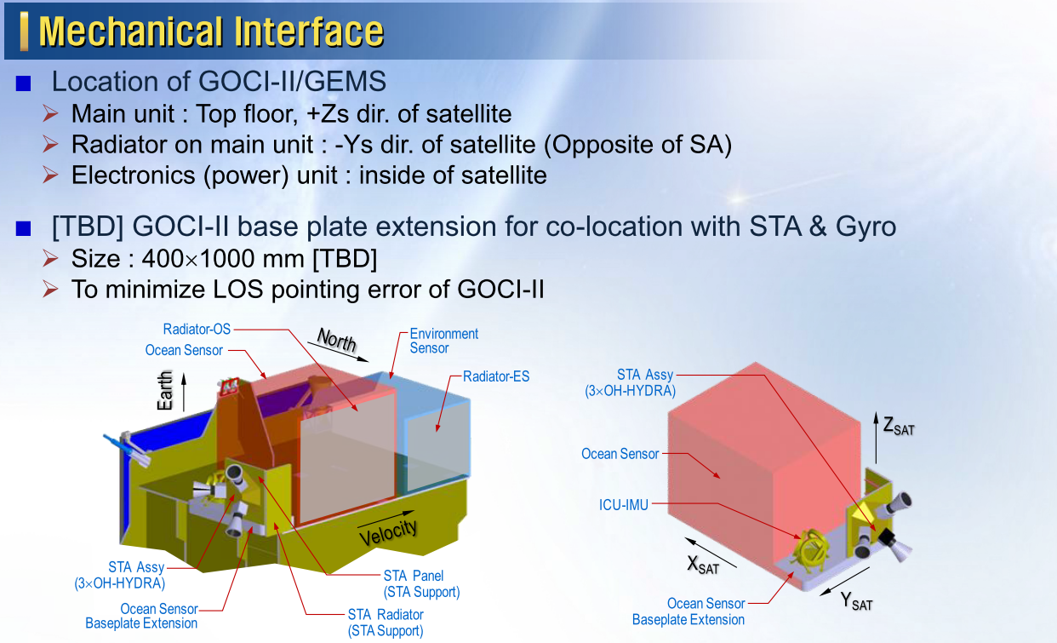
Satellite to Payloads (2/3)

Slide 15
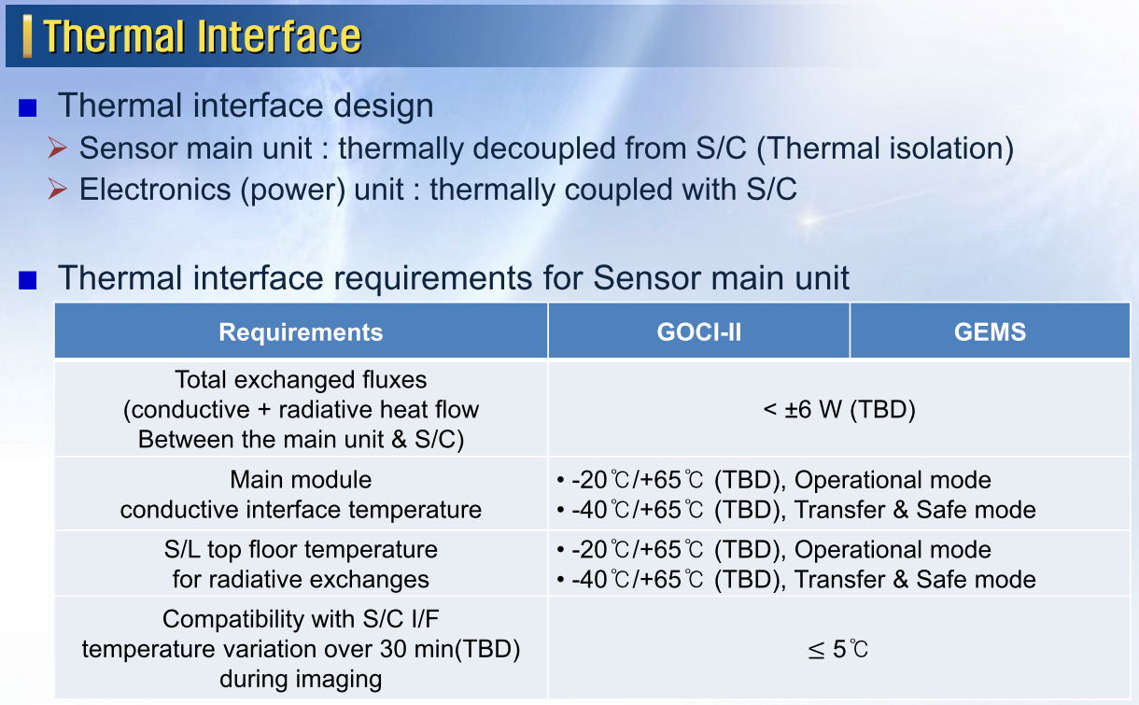
Satellite to Payloads (3/3)

Slide 16
Projected FOV & GSD simulation
Satellite longitude : 128.2E
No. of samples in NS direction : 1000
(baseline detector assumed)
EW FOV : 8.4 deg (assumed)
(depends on the scanning method & H/W)
NS GSD @ Seoul : 7km

Slide 17
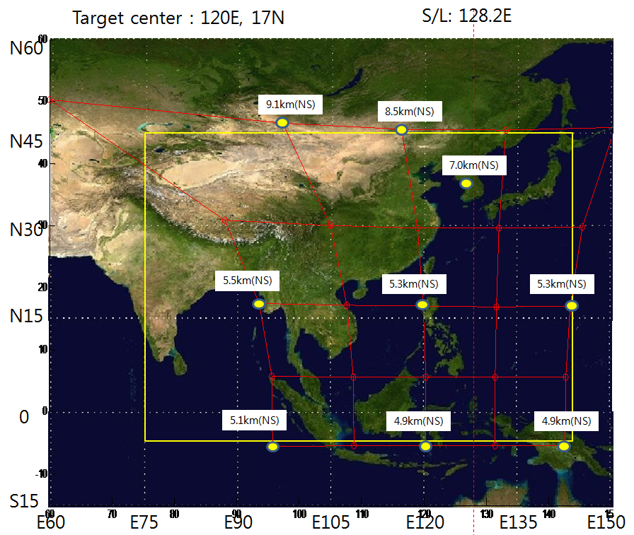
Projected FOV & GSD - NS GSD @ Seoul : 7.0km
Projected FOV
Region of interest

Slide 19
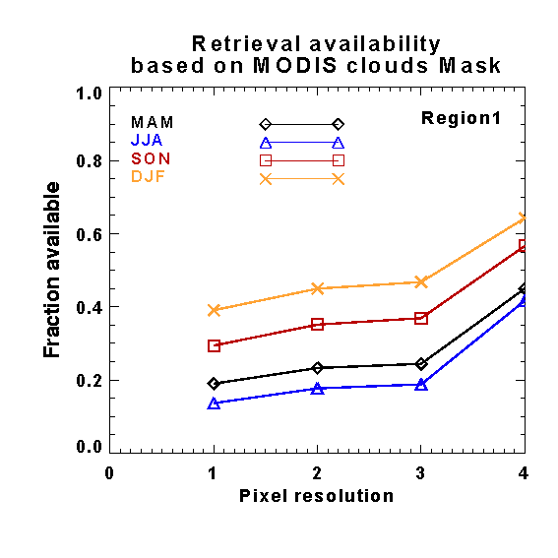
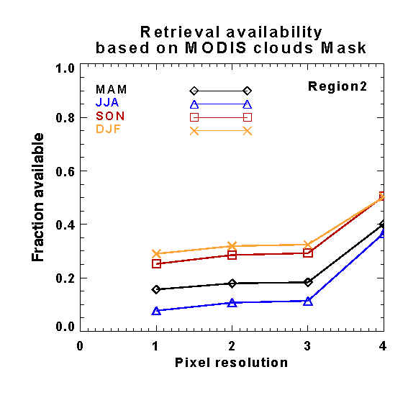
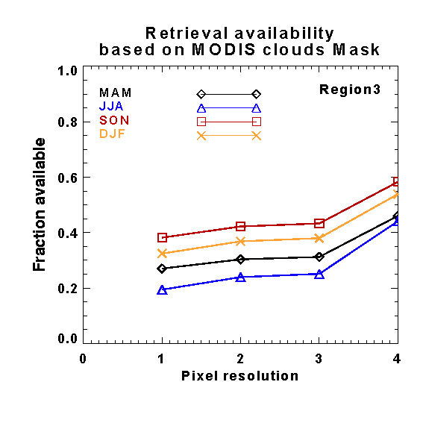
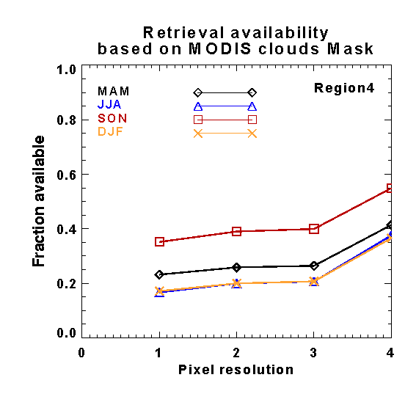
Spatial Resolution - cloud contamination
Pixel resolution
1 | 7.5 x 7.5 ㎢
2 | 5 x 5 ㎢
3 | 2.5 x 7.5 ㎢
4 | 1.25 x 3.75 ㎢

Slide 20
□ Baseline Data Products of Met-Imager (16- Channel)
Wavelength Micrometers | 0.47 | 0.64 | 0.865 | 1.378 | 1.61 | 2.25 | 3.90 | 6.185 | 6.95 | 7.34 | 8.5 | 9.61 | 10.35 | 11.2 | 12.3 | 13.3
Channel ID | 1 | 2 | 3 | 4 | 5 | 6 | 7 | 8 | 9 | 10 | 11 | 12 | 13 | 14 | 15 | 16
Aerosol Detection | X | X | X | X | X | X | X |  |  |  |  |  |  | X | X
Suspended Matter/OD | X | X | X |  | X | X
Clear Sky Masks |  | X |  | X | X |  | X |  | X | X | X |  |  | X | X
Cloud & Moisture Imagery | X | X | X | X | X | X | X | X | X | X | X | X | X | X | X | X
Cloud Optical Depth |  | X |  |  |  | X | X |  |  |  |  |  |  | X | X
Cloud Particle Size |  | X |  |  |  | X | X |  |  |  |  |  |  | X | X
Cloud Top Phase |  |  |  |  |  |  |  |  |  | X | X |  |  | X | X
Cloud Top Height |  |  |  |  |  |  |  |  |  |  |  |  |  | X | X | X
Cloud Top Pressure |  |  |  |  |  |  |  |  |  |  |  |  |  | X | X | X
Cloud Top Temperature |  |  |  |  |  |  |  |  |  |  |  |  |  | X | X | X
Hurricane Intensity |  |  |  |  |  |  |  |  |  |  |  |  | X
Rainfall Rate/QPE |  |  |  |  |  |  |  | X |  | X | X |  |  | X | X
Legacy Vertical Moisture Profile |  |  |  |  |  |  |  | X | X | X | X | X | X | X | X | X
Legacy Vertical Temp Profile |  |  |  |  |  |  |  | X | X | X | X | X | X | X | X | X
Derived Stability Indices |  |  |  |  |  |  |  | X | X | X | X | X | X | X | X | X
Total Precipitable Water |  |  |  |  |  |  |  | X | X | X | X | X | X | X | X | X
Downward Solar Insolation Surf | X | X | X |  | X | X
Reflected Solar Insolation TOA | X | X | X |  | X | X
Derived Motion Winds |  | X |  |  |  |  | X | X | X | X |  |  |  | X
Fire Hot Spot Characterization |  | X |  |  |  |  | X |  |  |  |  |  |  | X | X
Land Surface Temperature |  |  |  |  |  |  |  |  |  |  |  |  |  | X | X
Snow Cover | X | X | X |  | X | X | X |  |  |  |  |  | X
Sea Surface Temps |  |  |  |  |  |  | X |  |  |  | X |  | X | X | X

Slide 21
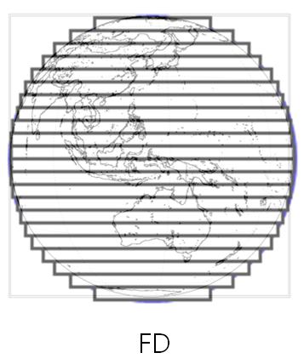
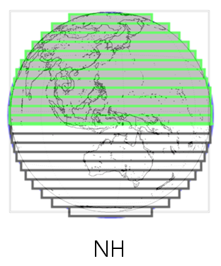
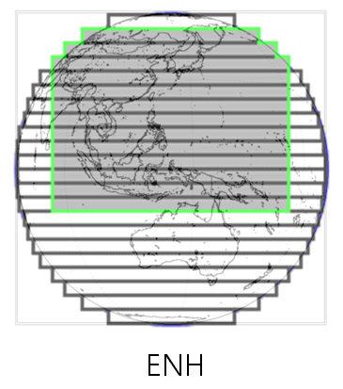
□ Hourly Operation Schedule Scenario(draft) of Met-Imager
)
(min.)
LA(Around Korea
Peninsula
2000km x 2000km)
10 min
5 min
5 min

Slide 22
GEMS Requirements
System Attributes | Requirements
Lifetime | > 7 years [option : >10 years]
Reliability | > 0.85 @EOL
Field of regard | 5000 km (N/S) × 5000 km (E/W) [Region of interest : 45°N~5°S, EW: selectable]
Duty cycle / Imaging time | 8 images during daytime or SZA < 70 deg (30 min imaging + 30 min rest) × 8 times / day
Ground sampling distance | < 7 km (N/S) at Seoul GSD area < 56 km² at Seoul
Spectral range | 300 nm to 500 nm
Spectral resolution | < 0.6 nm
Spectral sampling | < 0.2 nm (3 samples)
Signal-to-noise ratio | > 720 @nominal radiance of 320nm (TBC) > 1500 @nominal radiance of 430nm (TBC)
Data quantization | ≥ 12 bits

Slide 23
GEMS Requirements
System Attributes | Requirements
MTF (system level) | > 0.3 in N/S direction @Nyquist frequency > 0.3 in E/W direction @Nyquist frequency
Radiometric calibration accuracy | < 4% (with light source uncertainty)
Spectral calibration accuracy | < 0.02 nm (should be maintained at all times)
Polarization factor | < 2% (310-500 nm) No inflection point within 20nm for all the wavelength range
Polarization factor variance | < 1%
Stray light | < 2% and characterize after manufacture
Data rate | < 40 Mbps (TBC)
Mass | < 110 Kg
Volume | < 800 mm x 1200 mm x 700 mm

Slide 24

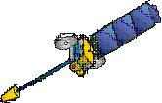
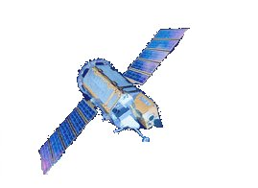

Constellation and CAL/VAL
GEO
CEOS ACC
GEOCAPE
GEMS, GMAP-Asia, Chinese Geo
Sentinel-4
TROPOMI, OMI
LEO
Airborne Hyperspectral
Imaging Spectrometer
AIRBORNE
PANDORA
AERONET
DRAGON Campaigns
GROUND-
BASED

Slide 25
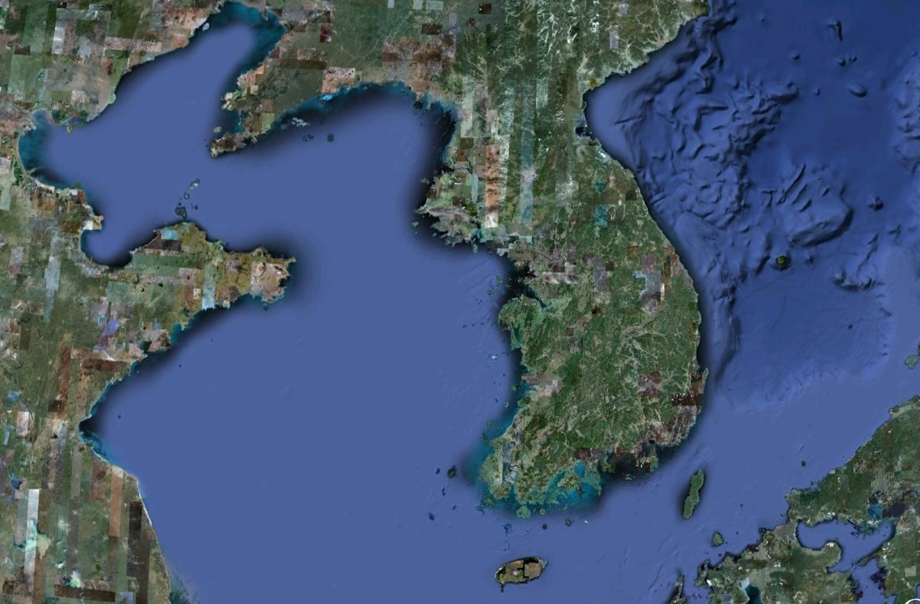
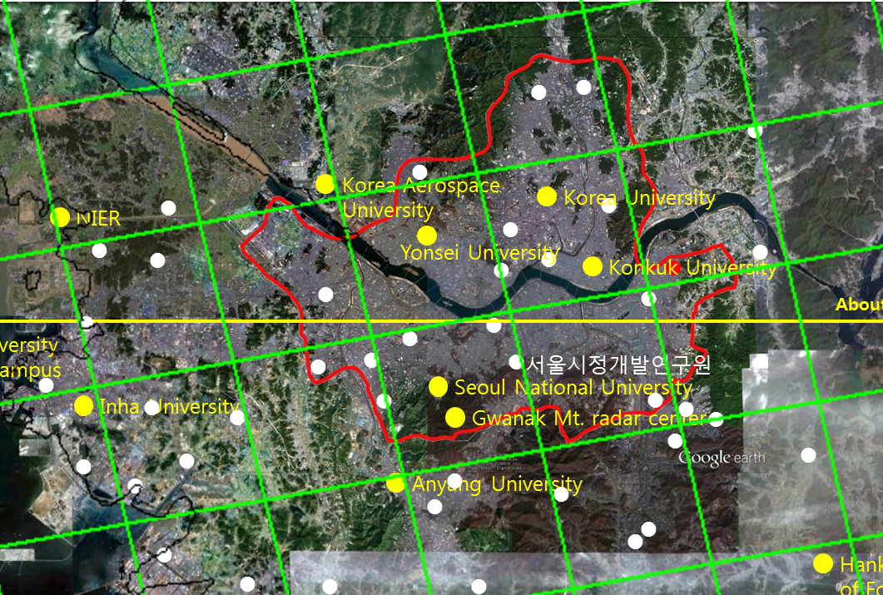
DRAGON – Korea Campaign (Mar-May, 2012)
~ 380km
Backryung do
GWNU
Songdo
Yongin
Anmyun do
Kongju
~ 530 km
Kunsan
Kyungil University
GIST
PNU
21 Sunphotometer
2 PANDORA
10 PM Sampler
3 Airborne campaign
Mokpo
Gosan
With the support from NASA/GSFC and NIER/ME

Slide 26
Summary
GEMS, a scanning UV-Visible spectrometer is going to be onboard
the Geo-KOMPSAT to be launched in 2018, together with GOCI-2 and MET Imager.
GEMS is expected to provide measurement of air quality and short-
lived climate-change drivers(SLCD) in high temporal and spatial resolution.
GEMS can contribute to understand the globalization of pollution
events, source/sink identification, and long-range transport of pollutants and SLCD.
It is very important to establish atmospheric composition constella-
tion(ACC), recommended by the CEOS, with the coordinated efforts in N. America, Europe and Asia.
To achieve such a global goal, it is crucial to collaborate internation-ally and maintain harmonized data quality.

Slide 27
  THANK YOU FOR YOUR ATTENTION !

